Slide 1


Slide 2
01.
Strategic overview
02.
Work programme
03.
Risks and priorities
CONTENT

Slide 3
01
Strategic overview

Slide 4

Strategic direction
Strategic outcomes
Vision
Mission
Improving lives through data ecosystems
To transform the production, coordination and use of statistics through optimisation, innovation and partnerships
Insightful data
Agile operating model
Interconnected statistical systems
Transformed capabilities

Slide 5




Strategic priorities
Insightful data
Agile Operating Model
Interconnected statistical system
Transformed capabilities
Sustain the quality of national indicators
Explore the use of alternative data sources
Innovate interactive dissemination platform
Reposition & strengthen the methodology function
Modernise and innovate business processes
Innovate the statistical business and geographic frames
Develop a digital business transformation strategy
Institutionalise SASQAF self-assessment
Invest in innovative technologies and ICT infrastructure
Align structure, skills and resources to strategy/redeploy staff

Slide 6
02
Work Programme

Slide 7
Economic Statistics
Business-as-usual
continues
HIGHLIGHTS
INNOVATIONS
Publish updated PPI weights
Capital expenditure survey statistical releases published quarterly
Research report to expand the coverage of Natural Capital Accounts series
Experimental Residential Property Price Indices (published monthly)
Research continues on the use of administrative data (CIPC) to supplement the Annual Financial Statistics
Test the inclusion of the TVET institutions in HEI release
230 statistical releases and reports
scheduled

Slide 8
Population and Social Statistics
Business-as-usual
continues
HIGHLIGHTS
INNOVATIONS
Main release of Census 2022 results in July 2023
Finalise data collection for the Income and Expenditure Survey in 3rd quarter
Report on documented immigrants
Thematic reports based on the Census 2022 (Education, child statistics, gender, people with disabilities, marginalized groups and household services)
Research: alternative data sources
Engagements on external data sources for Integrated Indicator Framework reporting
53 statistical releases/reports
scheduled

Slide 9
National Statistics System
Business-as-usual
continues
HIGHLIGHTS
INNOVATIONS
SDG country report
Integrated Indicator Framework (Include 88 indicators for District Development Model)
Develop a Data Source Inventory System
Institutionalisation SASQAF self-assessment portal & training
SASQAF for administrative data sources
Online metadata repository for indicators implemented
Amendment Bill ready for tabling
in Parliament

Slide 10
Statistical Operations & Support
Business-as-usual
continues
HIGHLIGHTS
INNOVATIONS
Dissemination of census results (Provincial and local)
Test Integrated Operations Model in Provinces to streamline field operations
Revamping the website (enhance further functionality of the website)
Implement enterprise architecture platform
Including a digital roadmap provides direction
Implementation of mixed-mode for household surveys continues
Dissemination of Census 2022 results
(provincial and local levels)

Slide 11
Methodology and Statistical Infrastructure
Business-as-usual
continues
HIGHLIGHTS
INNOVATIONS
Research design of the new master sample
Adopt international classification on Harmonised Systems (HS 2022)
Monitoring and evaluation practice incorporated into the quality management system
Report on additional source/s for updating the Statistical Business Register (collaborations with SARS)
Geo-portal for dissemination of statistical products
Research design for new
master sample

Slide 12
Administration
Business-as-usual
continues
HIGHLIGHTS
INNOVATIONS
Develop digital business transformation strategy
Implement the skills development strategy
Conduct impact analysis for disaster recovery
Institutionalisation of Business Process Management
Innovations in Management Information System
Assessment and review of Office Accommodation (national, provincial and district)
No additional funding
received in the ENE

Slide 13
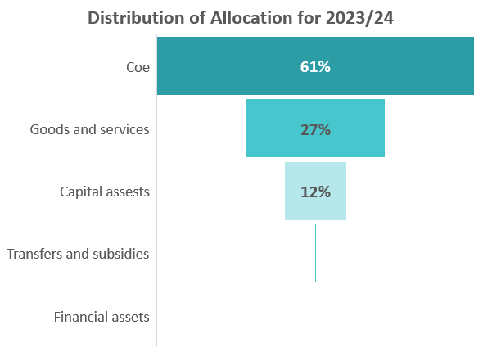
Estimates of National Expenditure
Additional funding required for negotiated salary increases
Vacancies are not fully funded
(vacancy rate: 19,6%)

Slide 14
03
Risks & Priorities

Slide 15
Strategic risks
Demand
Business Operating Model
Demand far outweighs supply
Mitigation: Census: baseline for the statistical information system in South Africa
Invest in strategic partnerships
Continues to be disrupted by factors in the external (e.g. electricity crisis) & internal environment (frame outdated)
Mitigation: Modernise the Statistical Value Chain; use of alternative data sources
Supply
Resources
Discontinued and reduced surveys
Mitigation: Poverty & Inequality – IES data collection commenced
Various thematic reports on Census 2022
Research alternative data sources
High vacancy rate (Internal churn)
Limited funding to implement strategy
Mitigation: Reprioritisation, filling of critical vacancies
Skills development strategy

Slide 16



5-year Strategic Plan Priorities
(2020/21 – 2024/25)
DRIVING LEGISLATIVE REFORM
SUSTAIN AND PROTECT THE QUALITY OF NATIONAL INDICATORS
DRIVE BUSINESS TRANSFORMATION AND CHANGE

Slide 17
Ndzi Hela Kwala

