Slide 1
PRESENTATION TO THE
Joint Standing Committee on Defence
On Office of the Military Ombud Annual Performance Plan 2023/24 and Implementation of its recommendations
Independent and Impartial
Presenter: Advocate Damane-Mkosana
Date: 04 MAY 2023

Slide 2
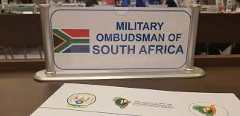
AIM
Independent
&
Impartial
The aim of the presentation is to brief Joint Standing Committee on Defence on the Military Ombud Annual Performance Plan for the FY2023/ and implementation of its recommendations

Slide 3
SCOPE
The following will be discussed as part of the presentation:
Part A – Military Ombud Mandate
Vision
Mission
Mandate
Values
Legislative Mandate
Regulatory Mandate
Revision to Legislation
Pending Court Rulings
Part B – Military Ombud Strategic Focus
Situational Analysis – PESTLE
Organisational imperatives
Minister of Defence and Military Veterans Priorities
Military Ombud Focus Areas
Organisational Environment
Reporting Lines
Organisational Structure of the Office
Independent
&
Impartial

Slide 4
SCOPE
The following will be discussed as part of the presentation:
Part C – Measuring of the Military Ombud Performance
Military Ombud Result-Based Model
Performance Information (Annual & Quarterly Targets)
Enterprise Risks with Mitigation Plans
Financial Management
Implementation of Military Ombud Recommendations
Independent
&
Impartial

Slide 5
ACCOUNTABILITY DOCUMENTS FOR THE OFFICE OF THE MILITARY OMBUD
STRATEGIC FOCUS
Vision:
A World
Leading
Independent and
Impartial
Military Ombud Institution
Mission: To provide an Independent,
Impartial and Expeditious Complaints
Resolution Process for Serving and Former
Members of the SANDF and the Public to Promote Good Governance.
Core Values. The values reflect the work ethics and culture in support of the mission of the Office of the Military Ombud:
Accountability; Confidentiality; Commitment ; Impartiality; Professionalism; Iintegrity; Courtesy and Transparency
Independent
&
Impartial

Slide 6
Office of the military ombud legislative mandate
Military Ombud Mandate. The mandate of the Office of the Military Ombud is captured in the Military Ombud Act, Act No 4 of 2012 which states that: “the Office is to investigate complaints lodged in writing by –
a member regarding his or her conditions of service;
a former member regarding his or her conditions of service;
a member of the public regarding the official conduct of a member of the Defence Force; or
a person acting on behalf of a member.”
Legislative Mandate.
Independent
&
Impartial
Legislation Mandate Description | Key Responsibilities Imposed by Legislative Mandate
Military Ombud Act, 2012 (Act 4 of 2012) | The Ombud must investigate complaints lodged with the Office. The Ombud must investigate a complaint economically, fairly and expeditiously without fear, favour or prejudice. The Ombud may resolve any dispute by means of mediation, conciliation or negotiations or in any other expedient manner. The Ombud must promote the observance of the fundamental rights of the members of the Defence Force. Establishment and maintenance of an appropriate Office Human Resource function. Establish and maintenance of an appropriate Office Financial Management function.

Slide 7
OFFICE OF THE MILITARY OMBUD REGULATORY MANDATE
Regulatory Mandate.
Legislation/Other Mandate Description | Key Responsibilities Imposed by Legislative Mandate
The Constitution of the Republic of South Africa, 1996 | Chapter 2 – Bill of Rights Chapter 3 – Co-operative Government
Public Finance Management Act, 1999 (Act No. 1) | Section 45: Responsibilities of other Officials
Defence Act, 42 of 2002 | Chapter 3 – Employment and Use of Defence Force – Section 20 Powers and duties of members while being employed. Chapter 6 - Defence Intelligence - Section 37 Determination of security classification of members and employees, Section 38 Discharge of members or employees not issued with security clearances and Section 39 Notification of security clearance or refusal thereof Chapter 8 - Limitations on Rights of Members of Defence Force – Section 49 Application and Section 50 Limitations of rights Chapter 9 - Employment in Defence Force – Section 51 Application, Section 52 Regular Force, Section 53 Reserve Force, Section 54 Commissioned officers in Defence Force, Section 55 Pay, salaries and entitlements, Section 56 Protection of members on active service, Section 57 Compensation in case of injury or disability, Section 58 Obligation to service in time of war, state of national defence or state of emergency, Section 59 Termination of service of members of Regular Force, Section 60 Legal representation for members, Section 61 Procedures for redress of grievances and Section 62 Religious observances in Defence Force Chapter 10 – Training – Section 63 Defence training institutions, Section 64 Discipline and Section 65 Designation of areas for training Chapter 13 - General Administration and Support – Section 82 Regulations, Section 84 Exemptions applicable to Defence Force, Section and 86 Right of recourse in respect of expenditure for injuries of members. Chapter 16 - Boards of Inquiry – Section 101 Convening boards of inquiry, Section 102 Attendance of persons at board of inquiry, and witnesses and Section 103 Board of inquiry in relation to absence without leave Chapter 17 - Offences and Penalties – Section 104 Offences and penalties and Section 105 Offensive behaviour
Independent
&
Impartial

Slide 8
OFFICE OF THE MILITARY OMBUD REGULATORY mandate
Regulatory Mandate.
Legislation/Other Mandate Description | Key Responsibilities Imposed by Legislative Mandate
Labour Relations Act 66 of 1995 | The purpose of the Labour Relations Act is to advance economic development, social justice, labour peace and the democratisation of the workplace by fulfilling the primary objects such as to give effect to and regulate the fundamental rights conferred by section 27 of the Constitution; to give effect to obligations incurred by the Republic as a member state of the International Labour Organisation; to provide a framework within which employees and their trade unions, employers and employers' organisations can- collectively bargain to determine wages, terms and conditions of employment and other matters of mutual interest; and formulate industrial policy; and to promote- orderly collective bargaining; collective bargaining at sectoral level; employee participation in decision-making in the workplace; and the effective resolution of labour disputes.
Promotion of Administrative Justice Act 3 of 2000 (PAJA) | The Office of the Military Ombud applies the PAJA to ensure alignment between the Military Ombud Act and PAJA and furthermore to give effect to the right to administrative action that is lawful, reasonable and procedurally fair and to the right to written reasons for administrative action as contemplated in section 33 of the Constitution of the Republic of South Africa, 1996;
Military Ombud Regulations, 2015 | The regulations gives effect to the Section 15 of the Military Ombud Act 4 of 2012 as it applies to complaints contemplated in section 4 of the Act.
Promotion of Access to Information Act 2 of 2000 (PAIA) | Part 2 - Access to Records of Public Bodies Part 3 - Access to Records of Private Bodies Part 4 - Appeals Against Decisions
Protection of Personal Information Act 4 of 2013 (POPI) | Chapter 2 – Application Provisions (Lawful processing of personal information, Rights of data subjects, Exclusions) Chapter 3 – Conditions for Lawful Processing of Personal Information Chapter 4 – Exemption from Conditions for Processing of Personal Information Chapter 10 – Enforcement Chapter 11 – Offences, Penalties and Administrative Fines
Independent
&
Impartial

Slide 9
Revision to legislation
Military Ombud Act, Act 4 0f 2012. The office started the legislative process for the amendment of the Military Ombud Act during the FY2021/22. Authority to review the Military Ombud Act was obtained from the Minister of Defence and Military Veterans (the Minister).
Further consultation was conducted with the Minister on the Miitary Ombud Amendment Bill in order to address the appropriate institutional independence model for the office. Government Technical Advisory Centre (GTAC) was appointed to conduct a further study on the most appropriate Independence Model for the office.
The outcome of the GTAC process will assist to determine the Institutional Independence Model for the Office which will have an impact on the Amendment Bill. Authority from the Minister is still pending.
Independent
&
Impartial

Slide 10
PENDING COURT RULINGS
Pending Court Rulings. Col PR Lembede// Minister of Defence and Military Veterans// Chief SANDF// Secretary for Defence// Military Ombud Matter instituted in the High Court by the Applicant to compel the Minister to implement the recommendations of the Military Ombud
The High Court found that the findings and recommendations of the Military Ombud, made in terms of section 6(8) of the Military Ombud Act 4 of 1012, in Report 08/2018 are recommendations made to the Minister and not a directive. ( Leave to appeal the judgement was applied for by the Applicant (the complainant) and the outcome is awaited.
Independent
&
Impartial

Slide 11
SITUATIONAL ANALYSIS – PESTLE and MILITARY OMBUD CONTRIBUTION
Situational Analysis. The Office’s situational Analysis for FY2023/24 provides insight into the external and internal environmental factors that affects the mandate, outcomes and outputs of the Office. The situational analysis remains aligned to the Military Ombud Strategic Plan (2020- 2025)
The matters identified in the situational analysis, is a result of the planning process that has also taken into consideration the evolving contextual environment, the 2019-2024 MTSF Foundational Pillars and Apex Priorities of Government and other relevant policy documents. The situational analysis remains aligned to the Military Ombud Strategic Plan (2020 – 2025).
External Environmental Factors.
Independent
&
Impartial
Political | Contribution to National Imperatives of Government. The matters identified in the situational analysis are derived from the annual planning process that considers the National Development Plan (NDP) Vision 2030, the Revised Medium-Term Strategic Framework (MTSF) 2019–2024, the new Sustainable Development Goals (SDGs), the 2021 and 2022 State of the Nation Address (SONA), the Minister of Defence and Military Veterans (MOD&MV) Performance Agreement and the National Security Strategy.

Slide 12
SITUATIONAL ANALYSIS – PESTLE AND MILITARY OMBUD CONTRIBUTION
Economic | The economic growth is forecast to be moderate with adverse weather and continuous power cuts dragging markedly on activity and the very high unemployment rate and inflation is denting household spending. The Office of the Military Ombud will continuously monitor this environment and prioritise the requirements to ensure that expectation and the Medium Term Budget Policy Statement (MTBPS) are aligned.
Social | Internship Programmes in Government. Every Government Department and Public Entity is required to employ interns for experiential training in support of the prevailing Government Job Creation Policy. The Office of the Military Ombud will continue to support the Governments plans by implementing the utilisation of Interns within the Office. Women, Youth and Persons with Disabilities. The Public Service Commission (PSC) equity figures, stipulate that approximately 50% of all filled Senior Management Staff (SMS) posts should be represented by women and approximately 2% of filled posts across all levels should be occupied by people with disabilities. The status currently within the Office of the Military Ombud are as follows: Total number of 59 posts are staffed. 3 out of 7 are women in senior management positions, 15 (13 women and 7 men) are youth, 0 disabled people; and 6 SASSETA Interns were appointed. One resigned in December 2022.
Independent
&
Impartial

Slide 13
SITUATIONAL ANALYSIS - PESTLE
Social | Gender Based Violence. In order to support eradication of Gender-Base Violence and the promotion of human rights the following activities were implemented within the Office: Awareness programme within the Office; and Promoting human rights during outreach programmes Strengthening Synergies. The creation of Ombudsman like institutions, demands clarity on the institutional purpose and the need for strengthening of synergies, including standardisation of approaches. The levels of confidence and popularity of the Military Ombud as an institution of choice necessitates a greater need to be accessible to Serving members of the SANDF, Former members and the Public by means of Communications, Branding and Events Management (e.g. Outreach Programme and Media Relations). Complaints Submitted. The complaints submitted reinforces the need for the Office of the Military Ombud to be widely and easily accessible, swift and impactful in its own service delivery. The future vision for the Office is to create satellite/pilot offices to be visible and easily accessible to the clients of the Office giving effect to the National Footprint requirement.
Independent
&
Impartial

Slide 14
SITUATIONAL ANALYSIS - PESTEL
Social | Stakeholder Perception Survey One of the outcomes of the Stakeholder Perception Survey conducted by the Security Institute for Governance and Leadership in Africa (SIGLA), is the need to increase visibility and raise awareness about the existence of the Office. As a result, the Communications Unit has conceptualised an Outreach Programme for the 2023/24 Financial Year which will assist the Office to enhance and improve its service standards, internal systems, public relations, public trust and confidence, and accessibility.
Technological | Information and Communications Technology Developments. Developments in information and Communications Technology (ICT) presents opportunities for improving governance while increasing operational risks, such as cyber-crime and use of technology to conceal maladministration and corruption, the office will ensure that this matter is addressed in the Office ICT Procedure Social Media. The office is present on all social media platforms to reach its stakeholders, and ensure that the public can see all activities that are taking place in the office.
Independent
&
Impartial

Slide 15
SITUATIONAL ANALYSIS - PESTLE
Technological | Information Warfare. Information is an asset that requires protection commensurate with its value. There has been an increase in cyber-attack both globally and domestically in the past year against departments. The Office will implement robust network security architecture, including appropriate segregation and segmentation between the IT and control system networks using firewalls and intrusion prevention/detection tools. The Office will furthermore perform continuous network security monitoring thus enabling the identification of abnormalities on the network. 4th Industrial Revolution. The technological revolution is a period in which one or more technologies is replaced by other technology in a short amount of time. It is an era of accelerated technological progress characterised by new innovations whose rapid application and diffusion cause an abrupt change in society. The Office will ensure that all IT procedures address the technological revolution. It will furthermore ensure that all back-up systems are in place to facilitate rapid application should the Office be affected.
Independent
&
Impartial

Slide 16
SITUATIONAL ANALYSIS - PESTLE
Legal | National Preventative Mechanism (NPM). The Office is listed as a National Preventative Mechanism in terms of the Optional Protocol to the Convention against Torture and other Cruel, Inhuman and Degrading Treatment or Punishment (OPCAT), which was ratified by SA in 2019. As a member of the NPM Steering Committee the Office must ensure that it complies with the obligations in terms of the OPCAT. In line with these obligations the Office has conducted inspections at the SANDF Military Detention Centres in collaboration with the SAHRC and submit inspection reports to the Minister which contains findings and recommendations. Non-implementation of Military Ombud Recommendations. The Military Ombud Act in Section 6 (8) prescribes that “if the Military Ombud upholds the complaint, the Ombud must recommend the appropriate relief for implementation to the Minister”. The Office has no provisions regarding the implementation of the recommendations and processes followed by the Minister when there is non-implementation. To address this concern a Military Ombud and CSANDF Liaison Forum was created, furthermore complex matters are escalated and monthly meetings are being scheduled between the Military Ombud and CSANDF to address these challenges.
Independent
&
Impartial

Slide 17
SITUATIONAL ANALYSIS - PESTLE
Legal | Ministerial Directive. The MOD&MV on 25 October 2018 signed a ministerial directive on the powers and authority of the Military Ombud. The aim of the directive was to direct the Secretary for Defence in his/her capacity as the Head of the Department (HOD) and Accounting Officer (AO) to put in place measures, structures and systems to facilitate: The autonomy of the Military Ombud in the expenditure of his appropriated budget as directed in section 10 of the Military Ombud Act; The implementation of the terms and conditions for staff of the Office of the Military Ombud without hindrance; The adaptation of the DOD financial management system, human resources system, supply chain system or any other system to give effect to directives 1 and 2 above; and In general the independence of the Office of the Military Ombud to ensure that it is not subjected to DOD policies or decisions where those are not in-line with the policies or decisions of the Military Ombud.
Independent
&
Impartial

Slide 18
SITUATIONAL ANALYSIS – PESTLE
Internal Environmental Factors.
Human Resources | The areas of Human Resource Management and Compensation of Employees (CoE) will be strengthened through action plans in order to ensure full compliance with legislation and Treasury requirements. The Office of the Military Ombud will invest in talent management in order to ensure that it has the right combination of talent and retain scarce skills. Over the 2023 MTEF the Office will continue with the following to address the challenges within the HR dimension: Implement HR measures to ensure the COE and HR costs are aligned Fill funded vacant posts in accordance with the HR plan; Provide for training and development of employees; Increase levels of administrative compliance; as well as Continue to pursue gender main-streaming. Capacity challenges throughout the organisation
Financial | Payment of legitimate supplier invoices within 30 days remains a challenge in the Office as the Office is dependent on the DOD and its legacy systems. The Office monitors payments continuously and where it is found that there are delays the matter is addressed with the relevant stakeholders.
Information Communication and Technology | The Office will strengthen its IT strategy and plans by institutionalising an IT Governance Framework, including the securing and development of IT platforms commensurate with specific requirements. The institutionalisation of the latter Framework will be achieved by monitoring and evaluating its investment in and expenditure on IT, thereby ensuring that information assets are managed effectively. The Office is in the process of procuring an Offsite backup solution to address the issue of data security the Office and is furthermore implementing Virtual Private Network (VPN) for remote access of information.
Independent
&
Impartial

Slide 19
SITUATIONAL ANALYSIS – PESTEL
Internal Environmental Factors.
Ethics & Integrity | Ethics and Integrity are of utmost importance within the Office to ensure independence and objectivity and thus are included in the Office’s Code of Conduct and the Values. Effective management of fraud and corruption risks should focus on the key areas of prevention, detection and response. The unfortunate reality is that perpetrators of fraud are constantly adapting their approach within organisations. The following activities will be implemented: Institutionalise an effective fraud prevention strategy; Effective fraud risk assessments; Optimise the use of technology in detecting fraud; Assessing employee awareness; Eliminating conflicts of interest; and Creating awareness.
Governance Risk & Compliance | The Military Ombud enterprise risks continued to be subjected to regular monitoring and scrutiny by relevant management committees and supervisory governance structures such as the Executive Committee (EXCO) and Management Committee (MANCO). A need for training has been identified and members of the Office will be trained to capacitate them fully to execute the risk management function. Risk management is substantially embedded in the strategic management process of the Office of the Military Ombud striving towards the optimal achievement of the Office's outputs.
Independent
&
Impartial

Slide 20
MINISTERIAL PRIORITIES AND MILITARY OMBUD FOCUS AREAS
MOD&MV Priorities. The evolving Ministerial Priorities for the 2020 – 2025 planning period that give impetus to the execution of the Military Ombud mandate through ministerial direction over the short-, medium- and long term within available resources are confirmed as follows: | Military Ombud Focus Areas. In support of the Revised MTSF Foundational Pillars and Apex Priorities of Government and MOD&MV’s priorities the Military Ombud identified the following seven (7) focus areas which were also presented to the Portfolio Committee on Defence and Military Veterans (PCD) in February 2021:
Strategic Direction. This priority relates to ensuring the provision of Ministerial strategic direction to the Office to ensure that the office meets predetermined expectations of Government. | Effective and Efficient Resolution of Complaints by Improving of the turn-around time for the resolution of complaints.
Organisational Renewal Direction. This priority relates to the directing the repositioning of the Office of the Military Ombud to ensure alignment to the Military Ombud Act. Structures must enhance accountability, effectiveness and efficiency within an ethical and corruption free organisation. | The Implementation of the Integrated Communication Marketing Strategy and Plan.
 | Institutional Independence by Positioning the Office to ensure effective execution of its mandate by means of a legislative review process and an amendment bill.
Strategic Resoucing Direction. This priority relates to the directing the developing of an appropriate Funding Model thereby ensuring the adequate resourcing of the function over multiple MTSF periods aligned with prevailing policy. | Operationalising the Ministerial Policy Directive on Enterprise Resource Support to Military Ombud as Signed on 25 October 2018.
 | Institutionalisation of the Governance Risk and Compliance (GRC) framework
Human Resources (HR) Renewal Direction. This priority relates to directing the renewal of the organisations human resource function to ensure that the personnel profile is able to meet both current and future obligations. | Securing Adequate Funding for the Compensation of Employees (COE)
 | Resource Management by ensuring accountable, effective and efficient resource management that is aligned to the Regulatory Framework (HR, Log, FIN and ICT)
Independent
&
Impartial

Slide 21
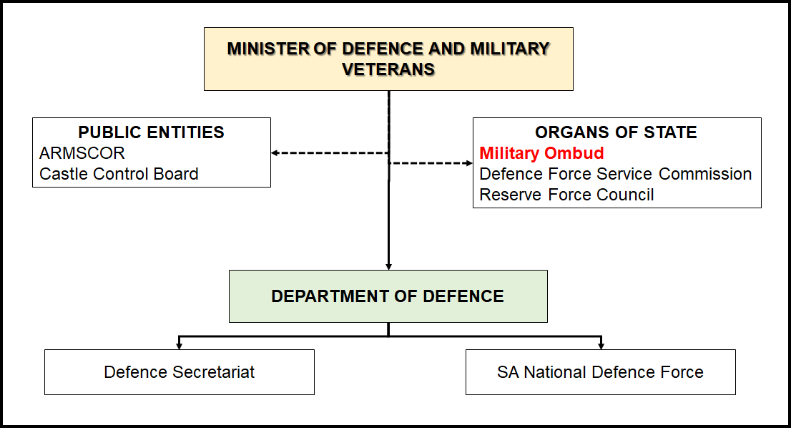
MILITARY OMBUD ORGANISATION STRUCTURE
Organisational Reporting Line.
Independent
&
Impartial

Slide 22
MILITARY OMBUD ORGANISATION STRUCTURE
Total number of posts as approved by the Minister of Defence and Military Veterans during June 2012 is 89
Office of the Military Ombud
Total number of approved posts within the Executive Office is 9
Office of the Deputy Military Ombud
Total number of approved posts within Corporate Support is 21
Total number of approved posts within Corporate Operations is 59
Independent
&
Impartial
Corporate Operations
Corporate Support
Operations
Legal Support
Communication
Policy, Strategy & Planning
Human Resources
Logistics
Finance
Intake & Analysis
Information, Communication & Technology
Facility, Security & Reception Management
Investigations
Research & Development

Slide 23
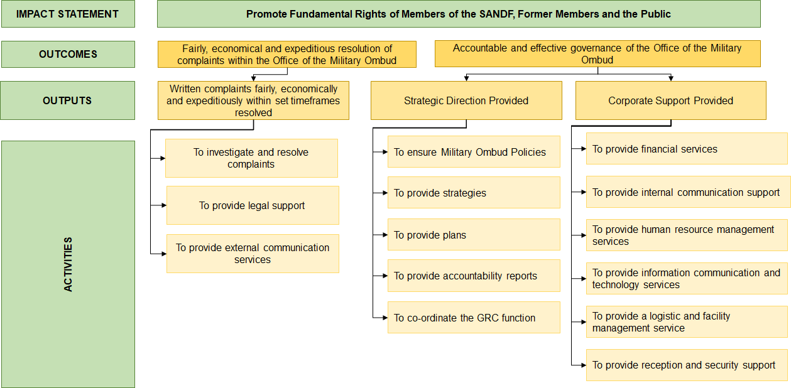
RESULT BASED MODEL (RBM)
In order for the Office to ensure alignment with the legislative mandate and the Results Based Model , The Military Ombud RBM if reflected below:
Independent
&
Impartial

Slide 24
OUTPUT INDICATORS, ANNUAL TARGETS AND QUARTELY TARGETS FOR FY2023/24
Output Indicator | Annual Target | QTR 1 | QTR2 | QTR 3 | QTR 4
Output 1: Written Complaints fairly, economically and expeditiously within set time frames resolved
Percentage of written complaints resolved fairly economically and expeditiously within the Office of the Military Ombud | 75% | 18.75 | 37.50% | 56.25% | 75%
Output 2: Strategic Direction Provided
Percentage adherence to the Military Ombud Master Record Index (MRI) for Policies / procedures | 60% | - | - | - | 60%
Percentage adherence to the Military Ombud Master Record Index (MRI) for Strategies | 80% | - | - | - | 80%
Independent
&
Impartial

Slide 25
OUTPUT INDICATORS, ANNUAL TARGETS AND QUARTELY TARGETS FOR FY2023/24
Output Indicator | Annual Target | QTR 1 | QTR2 | QTR 3 | QTR 4
Output 2: Strategic Direction Provided
Percentage adherence to the Military Ombud Master Record Index (MRI) for Plans | 100% | 12.5% | - | - | 87.5%
Number of Audit Findings | 0 | 0 | 0 | 0 | 0
Number of fruitless and wasteful expenditure within the Office of the Military Ombud | 0 | 0 | 0 | 0 | 0
Number of irregular expenditure within the Office of the Military Ombud | 0 | 0 | 0 | 0 | 0
Independent
&
Impartial

Slide 26
OUTPUT INDICATORS, ANNUAL TARGETS AND QUARTELY TARGETS FOR FY2023/24
Output Indicator | Annual Target | QTR 1 | QTR2 | QTR 3 | QTR 4
Output 2: Strategic Direction Provided
Percentage of Military Ombud Accountability documents submitted in accordance with national Prescripts | 100% | 100% | 100% | 100% | 100%
Percentage compliance of the Office of the Military Ombud to Parliamentary activities | 100% | 100% | 100% | 100% | 100%
Output 3: Corporate Support Services provided
Percentage compliance with the communication plan | 100% | 100% | 100% | 100% | 100%
Independent
&
Impartial

Slide 27
ACCOUNTABILITY DOCUMENTS FOR THE OFFICE OF THE MILITARY OMBUD MEASURING OF PERFORMANCE
Enterprise Risks with Risk Mitigation
Risk Ref No | Risk Description | Risk Response
MO02/19 | The lack of institutional independence. The Military Ombud Act, Act 4 of 2012 does not address the scope of the Military Ombud function which influences the accountability framework, resolution enforcement and powers. The Act furthermore is not aligned with higher order legislation (PFMA) wrt reporting timeframes. The credibility of the Military Ombud to deliver on the mandate is compromised due to a lack of understanding and trust by all stakeholders. | The Office will follow the Legislative amendment/review process to ensure alignment of the Military Ombud Act with the appropriate organisational form identified. Furthermore the Office will conduct outreach events, including radio interviews to promote the image of the Office, clarify its mandate and engage with stakeholders to ensure that the Office is seen to be independent wrt the finalisation of complaints.
MO01/20 | Shortfall on Compensation of Employees (CoE) Budget. Since the Office was created as a line-item, numerous requests were submitted to the DOD explaining that the allocation did not fulfil the requirement wrt the number of staffed posts. | The Military Ombud will address this matter with the Executive Authority.
MO01/22 | Slow turnaround in finalisation of investigations due to slow response by Services and Divisions. There are mainly three (3) factors that influence the slow turnaround times wrt the finalisation of complaints, namely Non receipt of timeous response from DOD (Services and Divisions); Unavailability of information from DOD archives; and Lack of cooperation of stakeholders | Enforcement of MOU with Stakeholders and Service level Agreements Monthly engagements between Mil Ombud and CSANDF as well as monthly Liaison Forums between the Office and SANDF to monitor progress.
Independent
&
Impartial

Slide 28
FINANCIAL MANAGEMENT
Sub-Programme | Audited Outcome |  |  | Vote | MTEF Estimates
 | 2019/20 | 2020/21 | 2021/221 | 2022/23 | 2023/24 |  | 2024/25 |  | 2025/26
 |  |  |  |  | Full Cost | Budgeted Amount | Full Cost | Budgeted Amount | Full Cost | Budgeted Amount
 | R’000 | R’000 | R’000 | R’000 | R’000 | R’000 | R’000 | R’000 | R’000 | R’000
Military Ombud | R53,083 | R52,150 | R50,803 | R66,730 | R75,389 | R67,163 | R79,074 | R70,179 | R82,744 | R73,407
Total | R53,083 | R52,150 | R50,803 | R66,730 | R75,389 | R67,163 | R79,074 | R70,179 | R82,744 | R73,407
Funding Deviation | - | - | - | - | -R8,226 |  | -R8,895 |  | -R9,337
Independent
&
Impartial
Economic Classification | Economic Classification 3rd Level | 2019/20 | 2020/21 | 2021/22 | 2022/23 | 2023/24 | 2024/25 | 2025/26
 |  | R’000 | R’000 | R’000 | R’000 | R’000 | R’000 | R’000
Payments | Compensation of Employees | 41,514 | 42,951 | 43,868 | 40,461 | 40,164 | 41,934 | 44,056
 | Goods and Services | 10,134 | 6,512 | 6,376 | 24,416 | 24,605 | 24,615 | 26,145
Payments Total |  | 51,647 | 49,462 | 50,243 | 64,878 | 64,769 | 66,550 | 70,201
Transfers and Subsidies | Departmental Agencies and Accounts | 1 | 1 | 1 | 1 | 1 | 1 | 1
 | Households (HH) | 728 | 8 | 36 | 140 | 102 | 109 | 433
 | Provincial and Local Government | 8 | 8 | 10 | 7 | 12 | 14 | 15
Transfers and Subsidies Total |  | 737 | 18 | 47 | 148 | 116 | 124 | 450
Purchase / Construction Capital Assets | Machinery and Equipment | 699 | 2280 | 513 | 1,494 | 778 | 1,856 | 941
 | Software and Intangible Assets | 0 | 390 | 0 | 210 | 1500 | 1,650 | 1,815
Purchase/Construction Capital Assets Total |  | 699 | 2670 | 513 | 1,704 | 2,278 | 3,506 | 2,756
Grand Total |  | 53,083 | 52,150 | 50,803 | 66,730 | 67,163 | 70,179 | 73,407

Slide 29
Implementation OF MILITARY OMBUD RECOMMENDATIONS
FINANCIAL YEAR | NO OF REPORTS SUBMITTED TO MOD&MV | NO OF REPORTS UPHELD BY MOD & MV
FY 19 / 20 | 59 | 40
FY 20 / 21 | 42 | 32
FY 21 / 22 | 44 | 28
FY 22 / 23 | 11 | 3
TOTALS | 156 | 103
Independent
&
Impartial

Slide 30
IMPLEMENTATION OF THE MILITARY OMBUD RECOMMENDATIONS
Of the 156 Reports submitted to current MOD&MV, 103 Complaints were Upheld in terms of the Military Ombud Act 4 of 2012.
The remaining reports were matters resolved through ADR and submitted to Minister for endorsement. A few of these were simply for Minister’s cognisance.
The Sec 6(11) investigation commissioned by Minister regarding the spoiled and or rotten food and drinking water provided to members deployed to Mozambique is included in the FY 21 / 22 statistics.
It remains unknown to the Military Ombud whether Minister has accepted, rejected or endorsed any of the reports submitted to her.
It also remains unknown to the Ombud whether Minister has instructed the CSANDF to implement any of the recommendations contained in reports.
Independent
&
Impartial

Slide 31
IMPLEMENTATION OF THE MILITARY OMBUD
RECOMMENDATIONS
The Military Ombud has through the MOU with Sec Def and C SANDF initiated and constituted the Military Ombud and C SANDF Liaison Forum.
In terms of the MOU, each Service and Divisional Chief shall nominate his or her Liaison Officer, mandated to represent such Chief in the Forum. The Military Ombud has mandated two of his Directors from the Operations environment to represent him. The Forum meets ten times per FY.
The Forum has a standing agenda covering :
C SANDF input to Applications to Condone late referral of complaints.
Matters under investigation awaiting responses from interested parties (C SANDF, Chiefs or members).
Matters where the Military Ombud has issued a report and made recommendations for implementation by the MOD&MV .
Matters not resolved during Liaison Forum meetings are elevated to the regular meetings scheduled between Military Ombud and C SANDF.
The Ombud also have ad hoc meetings with Chiefs of Services and Divisions regarding investigations or implementation.
Independent
&
Impartial

Slide 32
IMPLEMENTATION OF THE MILITARY OMBUD RECOMMENDATIONS
The reason for non-implementation seems to hinge on a perception that the Military Ombud does not serve as “Force Multiplier” highlighting unfair labour practices or other conduct that offend the Constitution, laws giving effect to human rights (dignity), the Defence Act or Defence policies.
The arguments of Defence in the following court cases seems to highlight Minister’s and C SANDF stance on Reports Submitted to her:
Lembede v Minister of Defence and Military Veterans and others(9642/2020) [2021] ZAGPPHC 858 (15 December 2021).
Davids v Minister of Defence and Military Veterans and Others; Miles v Minister of Defence and Military Veterans and Others (28399/2021; 13678) [2023] ZAGPPHC 160 (27 February 2023).
It should be clear that the Military Ombud does not see his recommendations as binding in law, in line with the role of an Ombudsman’s role as developed through ages (and accelerated in the 20th and 21st century).
There are currently 8 recommendations that were accepted by the previous Minister and where she instructed CSANDF to implement pending implementation.
As stated above, the level of implementation is sometimes communicated, and sometimes responded to on enquiry. Currently the Ombud has a well established relationship with C SANDF and Staff Officers mandated to attend the Liaison Forum.
Independent
&
Impartial

Slide 33
HOW TO
CONTACT US
Physical Address: Block C4, Eco Origin, 349 Witch-Hazel Ave, Highveld Centurion
Postal Address: SA Military Ombud, Private Bag X163, 0046
Tel: +27 12 676 3800
Fax: +27 12 661 2091
Toll Free: 080 726 6283 (080 SA OMBUD)
E-mail: intake@milombud.org

Slide 34
FIND US ON
SOCIAL MEDIA PLATFORMS
South African Military Ombud
South African Military Ombud
@Mil_OmbudSA
Independent and Impartial

