Slide 1
SHRA ANNUAL PERFORMANCE PLAN 2023/24
3 May 2023
SHRA is an agency of the National Department of Human Settlements
Presentation to the Portfolio Committee on Human Settlements

Slide 2
PURPOSE
For the Portfolio Committee on Human Settlements to note the SHRA 2023-24 Annual Performance Plan.

Slide 3
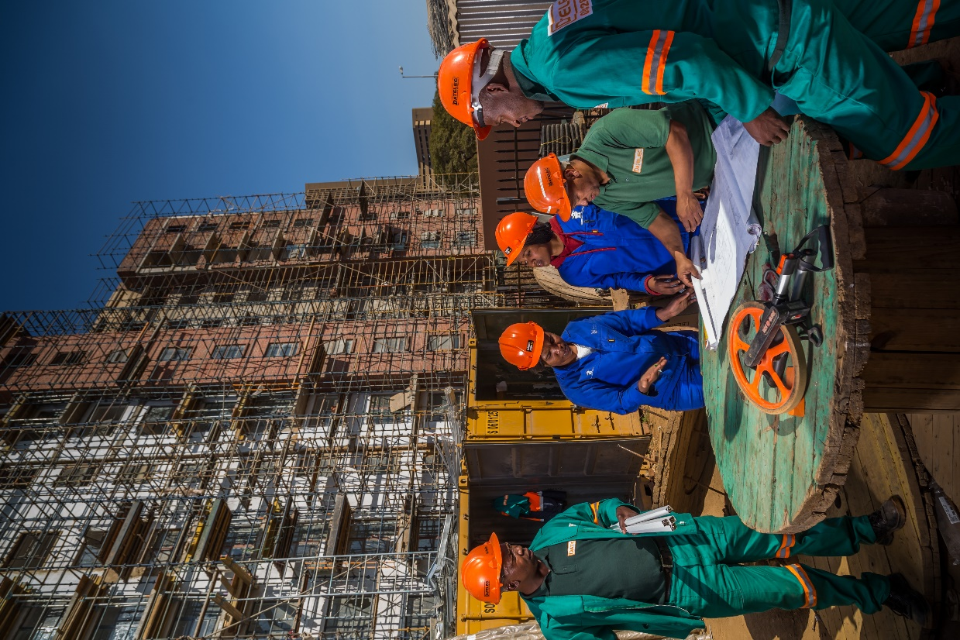
CONTENTS
A
BACKGROUND AND CONTEXT
B
STRATEGIC PLAN
C
ANNUAL PERFORMANCE PLAN
D
BUDGET

Slide 4
A.1. BACKGROUND & CONSULTATION
A SHRA Council Strategic Planning Session held between 4-5 August 2022, wherein the honourable Minister addressed Council.
The Human Settlements Indaba was held in eThekwini between 4-5 September 2022.
2nd Draft APP for 2023-24 was submitted to the National Department of Human Settlements (NDHS) on 15 October 2022.
A sector wide strategic planning session was held and attended by the honourable Minister MT Kubayi on 28 November 2022.
Feedback received from consultation process including comments received from the Minister, National Department of Human Settlements, Human Settlements Indaba and Human Settlements strategic planning Lekgotla and have been considered as part of the APP 2023/24 development.
The Final Draft APP 2023/24 has gone through the SHRA internal audit and assurance processes which was considered and approved by the SHRA Council on 26 January 2023.
Final feedback from the Department and Minister considered and incorporated in the Final APP.

Slide 5
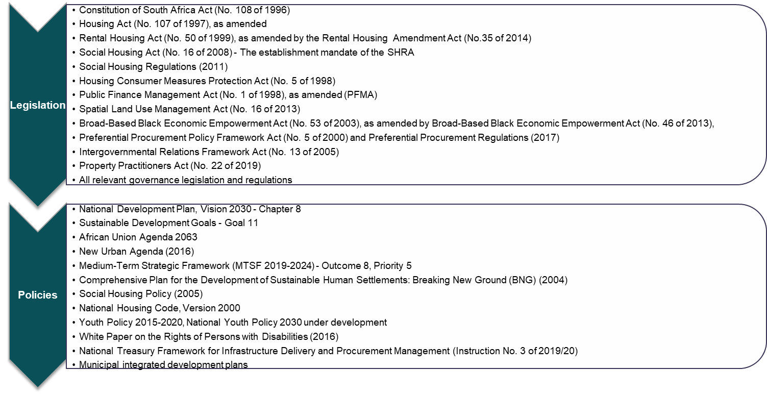
B.1. LEGISLATION AND POLICY MANDATES
Where the Constitution provides the broad context to the mandate of the Social Housing Regulatory Authority (SHRA), the specific establishment mandate of the SHRA is informed by the Social Housing Act.

Slide 6
B.2. SHRA GOVERNANCE STRUCTURES
SHRA COUNCIL
In November 2021 Cabinet approved the appointment of Council, in terms of Section 9 of the Social Housing Act, and comprises of of 12 members
5- Sub- committees
AUDIT & RISK
SOCIAL, ETHICS AND TRANSFORMATION
HUMAN RESOURCES & REMUNERATION
PROJECT DEVELOPMENT & FUNDING
COMPLIANCE, ACCREDITATION & REGULATIONS
CEO & EXECUTIVE MANAGEMENT TEAM

Slide 7
B.3. ESTABLISHMENT MANDATE: SOCIAL HOUSING ACT (2008)
Establish and promote a sustainable social housing environment;
Define the functions of national, provincial and local governments in respect of social housing;
Provide for the establishment of the SHRA in order to regulate all SHIs obtaining or having obtained public funds;
Allow for the undertaking of approved projects by SHIs and other delivery agents with the benefit of public money;
Provides for statutory recognition to SHIs.
OBJECTIVES
OF THE ACT
Provide financial assistance to SHIs through grants to enable them to develop institutional capacity, gain accreditation as SHIs and submit viable project applications;
Accredit institutions meeting accreditation criteria as SHIs and maintain a register of SHIs. In addition, conduct compliance monitoring through regular inspections and enforce compliance where necessary. In addition, intervene in the affairs of SHIs in cases of maladministration;
Approve, administer and disburse institutional investment grants and capital grants and obtain applications for such grants through engagement with provincial governments and municipalities;
Make rules and regulations in respect of the accreditation of SHIs and the disbursement of government funds to them; and
The SHRA is empowered to intervene if it is satisfied on reasonable grounds that there has been maladministration by a SHI
Promote the development and awareness of social housing, and promote an enabling environment for the growth and development of the social housing sector;
Provide advice and support to the DHS in its development of policy for the social housing sector, and facilitate national social housing programmes;
Provide best practice information and research on the status of the social housing sector;
Support provincial governments with the approval of project applications by SHIs and assist, where requested, in the process of the designation of restructuring zones;
Enter into agreements with provincial governments and the National Housing Finance Corporation to ensure that implementation by these entities is coordinated;
FUNCTIONS OF THE SHRA
INVEST
ENABLE
REGULATE

Slide 8
B.4. SHRA PLANNING FRAMEWORK: SHRA STRATEGIC PLAN 2020-2025

Slide 9
B.5. DELIVERY STATISTISCS
UNIT COMPLETIONS 2019-2023 Q4
FY | Q1 | Q2 | Q3 | Q4 | TOTAL
2019/20 | 111 | 590 | 1010 | 1299 | 3 010
2020/21 | 0 | 377 | 715 | 764 | 1 856
2021/22 | 643 | 806 | 520 | 802 | 2 771
2022/23 | 771 | 825 | 531 | 1 055 | 3 182
TOTAL |  |  |  |  | 10 819
UNIT TENANTING 2019-2023 Q4
FY | Q1 | Q2 | Q3 | Q4 | TOTAL
2019/20 | 514 | 485 | 954 | 2059 | 4012
2020/21 | - | 227 | 431 | 327 | 985
2021/22 | 479 | 387 | 258 | 933 | 2 057
2022/23 | 478 | 772 | 498 | 850 | 2 598
TOTAL |  |  |  |  | 9 652
% Tenanting in relation to completions |  |  |  |  | 89%
PERIOD | TARGET | Cum. Completions | Shortfall end 2022/23 | Target 2023/24 | Target 2024/25 | Expected end period delivery | % of Target achieved
MTSF PERIOD (2019-2024) | 18 000 | 10 819 | 7 181 (1 year remaining) | 3 200 | N/A | 14 019 | 78%
SHRA STRATEGIC PLAN (2020-2025) | 18 000 | 7 809 | 10 191 (2 years remaining) | 3 200 | 4 000 | 15 009 | 84%
The unit tenanting lags completion. Economic climate and affordability issues where new tenants are struggling with high living costs contribute to difference in take-up. A consideration to spread deposits will be discussed with SHIs.

Slide 10
C.1. UPDATES TO INSTITUTIONAL POLICIES AND STRATEGIES
KEY STRATEGIES INFORMING THE APP 2023/24
POLICY DEVELOPMENTS
Indexation of the grant quantum and Income Bands (Implemented within the 2022/23 year)
Social Housing Norms Standards (Gazetted on 20 January 2023)
National Rental Macro Policy Framework (2021/22 – developed in conjunction with NDHS)
Quantum adjustment and additional specifications (announced on 31/3/2023)
MTSF Priority 5: Spatial Integration, Human Settlements and Local Government
PART A: SECTION 2.1 – 2.3
ECONOMIC RECONSTRUCTION AND RECOVERY PROGRAMME (ERRP)
SOCIAL HOUSING GROWTH PLAN

Slide 11
C.2. A longer term approach needs to be taken in order to UPSCALE the programme
GROWTH FRAMEWORK
SCALE OF DEMAND
STRUCTURE OF THE BUDGET
INFRASTRUCTURE INVESTMENT PROGRAMME
MULTI-YEAR BUDGETING
“Double the production rate for Social Housing in the 2020/21 - 2024/25 term compared with the 2015/16 - 2019/20 term, and more than triple it in the 2025/26 – 2029/30 period thus adding a further 87,500 affordable rental housing units and growing the size of the social housing portfolio in the country to 125,000 units”
ADOPTING A SYSTEMS BASED APPROACH
POLICY REFORMS
RESTRUCTURING ZONES
LAND ASSEMBLY AND BUILDINGS
KEY FACTORS / CONSIDERATIONS NEEDED TO ACHIEVE VISION
Vertical & Horizontal overlay of accountability across the value chain & departments
UNIT SIZES
DIFFERENT TENURES, SAME BUILT FORM
DEBT AND EQUITY FUNDING
DELIVERY MODEL
LONG – TERM SUSTAINABILITY
INSTITUTIONAL ARRANGEMENTS
DEEP DOWN MARKET (CRU Bracket)
SPECIAL NEEDS & STUDENT HOUSING
BUILDING A HEALTHY PIPELINE
Source: Social Housing Programme growth plan framework for the 2020/2021 – 2024/2025 term – Approved in 2020 and reviewed October 2021.
Notes:
This slide what kind of work: do we need to do.

Slide 12
C.3. HEADLINE DELIVERABLES IN SUPPORT OF THE SHRA’S STRATEGY FOR THE 2023/24 YEAR
To upscale delivery, improve sector sustainability and drive the transformation agenda, the SHRA will prioritise the following interventions in the 2023/24 planning period
Negotiate MOAs with municipalities and provincial structures regarding the delivery of projects irrespective of the political leadership.
Partner with Accelerator(s) to provide (a) Incubation support to start up SHIs, (b) Mentorship to SHI Management and Board and (c) Leverage funding (other investors for the incubation programme).
Develop and implement a funding model that leverages public risk capital for the provision of debt and/or equity funding to grant beneficiaries by the private sector and other DFIs. Strengthen the SHRA’s social facilitation processes to minimise the occurrence of community protests. (Growth plan)
Work with the National Department of Human Settlements to motivate the inclusion of the Social Housing Programme in The Presidency’s Infrastructure Investment Programme, which is being administered by National Treasury.
Work with the National Department of Human Settlements to motivate for an increase in the proportion of the budget vote to be allocated to the Social Housing Programme Support interventions through a more focused approach going forward.
Incubation programme that provides business development support to new SHIs until they have completed their first social housing project, and achieved business sustainability
Continue to develop and implement a Municipal Support Programme to capacitate municipalities to run effective local social housing programmes, including to have approved land agreements in place and ultimately approved projects
Implement the SHRA’s Inclusive Growth Policy to support the transformation outcomes of the SHRA and the NDHS. At programme level, targets and thresholds will be set to support the Empowerment Policy of the Department.
Strengthen communication and to raise awareness, increase transparency, knowledge and understanding.

Slide 13
C.4. STRENGTHENING THE INTERNAL OPERATING ENVIRONMENT (2023/24)
Achievement of an unqualified audit outcome with no material findings.
Obtain approval and funding of the organisational structure, aimed at optimising efficiencies, capacity and capabilities, turn-around times and to address human capital gaps within the SHRA to execute on its mandate.
Strengthen SHRA performance management system and business processes.
Finalise the ICT Strategy and implementation of recommendations, prioritising the implementation of automation and digital processes to improve efficiencies, transparency, and decision-making.
Strengthen the fraud and corruption awareness drive
Establish a change management and ethical leadership programme across the organisation.
Implement the Council approved Stakeholder Management and Communications Strategy. Ensure that strategic communication is at the centre of all business processes.

Slide 14
C.5.1 HUMAN SETTLEMENTS MTSF CONTRIBUTIONS
INDICATOR | MTSF INTERVENTION / SHRA contribution
94 area-based integrated multisectoral development plans for priority development areas completed by 2024 | In collaboration with NDHS complete a multi-year development plan for social housing in line with the priority development areas: SHRA has assessed the alignment of restructuring zones (RZs) and PHSHDAs and have identified areas of opportunity. Recommendations to implement projects that are in the PHSHDAs, they would need to be gazetted as RZs in compliance with the SHA. The gazetting of PHSHDAs as RZs will ensure alignment and harmonisation of other human settlements programmes such as the Integrated Residential Development Programme (IRDP).
Long-term land development pipeline for human settlements completed | Use GIS and/or remote sensing to spatially reference the restructuring zones and social housing projects: Spatial referencing for all projects included. Applicants are required to provide the coordinates, which will be validated through GIS maps and/or SG diagrams for projects. Housing Development Agency (HDA) in conjunction with NDHS will be requested to provide support for the spatial referencing of RZs.
Revised number of 18 000 social housing units delivered (DPME, Revised MTSF 2019-2024, October 2021) | A focus is being placed on working on projects that are in planning and require collaboration with other spheres to fast-track delivery and unlock projects that require municipal statutory approvals.
 | Propose restructuring zones for development of social housing to the Minister: Continue to prioritise municipal and provincial support to proactively assist with the identification of strategically located areas that require RZ approval. This would expand social housing delivery footprint nationally.
 | Manage the delivery of 18 000 social housing units: Focus will be placed those projects that are under construction to meet delivery targets.
 | Develop a comprehensive database of all social housing developments, as well as social housing institutions: Developed and Maintained

Slide 15
C.5.2 HUMAN SETTLEMENT MTSF CONTRIBUTIONS
INDICATOR | MTSF INTERVENTION / SHRA contribution
Revised number of 18 000 social housing units delivered (DPME, Revised MTSF 2019-2024, October 2021) | In collaboration with NDHS complete a multiyear development plan for social housing in line with the priority development areas: SHRA has assessed the alignment of RZs and PDAs in terms of projects being registered on the pipeline. The SHRA has submitted the Council-approved Social Housing Growth Plan Framework (Development Plan) to the NDHS. A detailed implementation plan is currently being developed. Implementation is through the Social Housing Investment Plan (SHIP), which is the operational plan of the Project Development and Funding (PD&F) programme.
 | Regulate Social Housing Institutions, and monitor and report on status of compliance to NDHS: The SHRA Compliance Framework has been reviewed, with revised primary benchmarks and other indicators communicated to the sector – at a project and institution level (MOE, ODA, and SHI).
 | Ensure that rental agreements have a clause indicating that the status of tenants shall be re-evaluated every five years: Regulation 11(3)(j) – manage applications to amend their lease agreements. Clause could be included for means of testing purposes, further supported by annual tenant audits. SHRA has transmitted a circular to property owners / managers to implement the directive. There is concern regarding the implications pertaining to those tenants that are earning beyond the income threshold, options available and cost of regular means testing and/or regularisation without a clear policy position on what to do with those falling beyond the target market and those tenants with indefinite lease agreements.

Slide 16
C.5.3 HUMAN SETTLEMENT MTSF CONTRIBUTIONS
INDICATOR | MTSF INTERVENTION / SHRA contribution
Number of persons in the targeted market exposed to education programmes on various aspects of owning and/or renting a home | Implement a borrower, homeownership (Zenzeleni - PHP, Help Me-Buy-a-Home) and Tenant Education Programme: SHRA focus will be on tenant education in collaboration with other human settlements entities. The initiatives will form part of the SHRA’s communication strategy. The intention is for SHRA compliance officers to provide tenant education during the tenanting phase of projects. Additional regulatory capacity is being sought to increase the SHRA’s on-the-ground presence, including during tenanting. Tenant surveys have been piloted in 2021/22. The findings have informed the content of the Tenant Education Programme.
 | Monitor and report on the number of persons exposed to education programmes on owning or renting a home: The SHRA will plan, monitor, and report on tenant education for tenants allocated into SHRA funded units through the SHoRP (operational plan).
Transactional Support Programme implemented | NHBRC, NHFC, SHRA, and CSOS to establish a presence in transactional support sites: The SHRA is in the process of building capacity and capability through the MySHRA online portal, allowing for increased reach by using technology for virtual / remote transacting. The SHRA will collaborate with the Department and key sister entities, such as the HDA on initiatives aimed to establish transactional support sites.
 | Monitor and report on transaction support programmes: The SHRA reports on various transaction support programmes, including but not limited to the Incubation Programme, PSCs, Municipal Support Programme, and matters related to disputes and rental tribunals.

Slide 17
C.5.4 HUMAN SETTLEMENT MTSF CONTRIBUTIONS
INDICATOR | MTSF INTERVENTION / SHRA contribution
Transformation of the residential property market | In collaboration with NDHS, ensure the finalisation of the legislation for the residential sector transformation and develop an implementation strategy with targets for the transformation of the Residential Property Sector: The SHRA is working with the Property Sector Charter Council on developing the Transformation Charter and scorecards for the Social Housing Sector through the Department of Trade Industry and Competition which is in process of being finalised. An incubation approach at accelerating the incubation and accreditation of institutions to ensure directed spend at such entities.

Slide 18
C.5.5. SWOT
Strengths | Weaknesses
Programme has the potential to positively contribute to addressing spatial inequalities and economic recovery plan. Stable governance from an established Council. Commitment towards transformation. Consistent delivery and expenditure track record. | Structural deficiencies of the existing structure to deliver mandate. Poor communication, lack of transparency. Misalignment in performance management. Complex and lengthy application procedures. Low level of ICT maturity – manual approaches and low utilisation of existing systems. Contracting format. Policy updates and regulatory review required. Sub-optimal use of resources.
Opportunities | Threats
Expanding Restructuring Zones within identified PHSHDAs. Showcase of the programme’s potential through the partnership Infrastructure SA. Leveraging of the capital grant to drive inclusive delivery. Private sector interest and partnering in the social housing programme. Preferential local policies and rate setting for Social Housing. Energy solutions and green technologies deployed in projects. Partnerships with key within Human Settlements and sister entities (NHFC/HSDB, HDA, CSOS, NHBRC etc.) Partnerships with DFIs (DBSA, NHFC, IF, NEF) Rising demand for affordable rental options. Use of public-owned land for social housing. Expropriation of derelict or hijacked buildings. | Low economic growth, high unemployment, rising inflation and interest rates. Constrained fiscus. Affordability challenges. Construction mafias & Rental boycotts. Social instability. Loadshedding. Failing municipalities. Delays in statutory approvals, misaligned planning and delivery efforts Climate change. Political interference. Poor consumer and tenant awareness.

Slide 19
C.6. SUMMARY OF INDICATORS IN THE 2023/24 APP
SHRA has 25 indicators for the period 2023/24. Out of these 25 indicators, 9 relate to transformation
Programme 1 Administration has 9 indicators in total (8 output indicators and 1 outcome indicator). 4 Indicators linked to transformation;
Programme 2 Compliance, Accreditation and Regulation (CAR) has 6 indicators and 1 transformation indicator;
Programme 3 Sector Development & Transformation (SD&T) has 4 indicators with 1 transformation indicator; and
Programme 4 Project Development and Funding (PD&F) has 6 indicators and 3 transformation indicators.

Slide 20
C.7.1 PROGRAMME 1: ADMINISTRATION INDICATORS AND ANNUAL TARGETS
PROGRAMME ONE: ADMINISTRATION
Outcome (SP) | APP Output | Output Indicator | Unaudited Performance (2022/23) | Annual Target (2023/24) | Annual Target (2024/25) | Annual Target (2025/26)
Outcome 1: Functional, efficient and integrated government | Outcome indicator External Audit Outcome | 1.1. External audit outcome | Unqualified audit opinion with no findings | Unqualified audit opinion with no findings | Unqualified audit opinion with no findings | Unqualified audit opinion with no findings
Outcome 1: Functional, efficient and integrated government | 1.1. Internal Audit Services | 1.1.1. Percentage implementation of the Internal Audit Plan | 100% | 100% | 100% | 100%
 | 1.2. Anti-fraud and corruption | 1.2.1. Percentage implementation of the Fraud Prevention Plan | 100% | 100% | 100% | 100%
 | 1.3. Risk Management | 1.3.1. Percentage implementation of the Risk Management Plan | 100% | 100% | 100% | 100%
 | 1.4. Mitigating the sectoral risk of rental boycott’s | 1.4.1. Implementation of a Rental Boycott Strategy | Strategy developed but not approved | 80% | 85% | 90%
Outcome 6: A transformed Social Housing Sector Value chain | 6.1. Preferential procurement | 6.1.1. Percentage of SHRA procurement spend on businesses majority-owned by women | 48.5% | 40% | 40% | 40%
 |  | 6.1.2. Percentage of SHRA procurement spend on businesses majority-owned by youth | 6.4% | 16% | 16% | 16%
 |  | 6.1.3. Percentage of SHRA procurement spend on businesses majority-owned by persons living with disabilities | 0% | 5% | 5% | 5%
 |  | 6.1.4. Percentage of SHRA procurement spend on businesses majority-owned by persons living with disabilities | New Indicator | 5% | 5% | 5%

Slide 21
C.7.2 PROGRAMME 2: COMPLIANCE, ACCREDITATION AND REGULATIONS INDICATORS AND ANNUAL TARGETS
PROGRAMME TWO: COMPLIANCE, ACCREDITATION AND REGULATION
Outcome (SP) | APP Output | Output Indicator | Unaudited Performance (2022/23) | Annual Target (2023/24) | Annual Target (2024/25) | Annual Target (2025/26)
Outcome 5: An effectively regulated and sustainable social housing sector | 5.1. Performance monitoring of delivery agents | 5.1.1 Percentage of the Remedial Action plan implemented | New indicator | 70% | 75% | 80%
 | 5.2. Tenancy compliance monitoring | 5.2.1. Number of subsidised housing units' tenancy audits conducted | 3 525 | 3 750 | 4 000 | 4 250
 |  | 5.2.2 Number of Compliance Monitoring Inspections conducted | New indicator | 8 | 12 | 16
 | 5.4. Safety and security of tenants | 5.2.3. Number of Building Condition Audits conducted | New indicator | 10 | 12 | 14
 | 5.3 Improved accreditation process | 5.3.1 Number of fully accredited institutions | New Indicator Baseline: 8 fully accredited institutions | 10 | 12 | 15
Outcome 6: A transformed social housing sector value chain | 6.2. Accreditation towards empowered entities and designated groups | 6.2.1. Percentage of projects accredited from other delivery agents that are majority black-owned (new indicator) | New indicator | 75% | 75% | 75%

Slide 22
C.7.3 PROGRAMME 3: SECTOR DEVELOPMENT AND TRANSFORMATION INDICATORS AND ANNUAL TARGETS
PROGRAMME THREE: SECTOR DEVELOPMENT AND TRANSFORMATION
Outcome (SP) | APP Output | Output Indicator | Unaudited Performance (2022/23) | Annual Target (2023/24) | Annual Target (2024/25) | Annual Target (2025/26)
Outcome 3: Enhanced performance of delivery agents and projects | 3.1. Institutional Investment Grant (IIG) Programme | 3.1.1. Percentage achievement of the SHI Intervention Plan | 100% | 80% | 85% | 85%
 | 3.1.2. Percentage achievement of the Social Housing Projects’ Intervention Plan | 3.1.2. Percentage achievement of the Social Housing Projects’ Intervention Plan | 0% | 75% | 80% | 85%
Outcome 4: Increased capacity of municipalities and provinces to deliver social housing | 4.1. Municipal support programme | 4.1.1. Number of municipalities having received support | 0% | 3 | 5 | 7
Outcome 6: A transformed social housing sector value chain | 6.3. Youth internship programme | 6.3.1. Number of youth graduates placed | 11 | 15 | 20 | 25

Slide 23
C.7.4 PROGRAMME 4: PROJECT DEVELOPMENT AND FUNDING INDICATORS AND ANNUAL TARGETS
PROGRAMME FOUR: PROJECT DEVELOPMENT AND FUNDING
Outcome (SP) | APP Output | Output Indicator | Unaudited Performance (2022/23) | Annual Target (2023/24) | Annual Target (2024/25) | Annual Target (2025/26)
Outcome 2: Quality affordable social housing for rental delivered in strategically located areas | 2.1. Delivery of Social housing units | 2.1.1. Number of social housing units completed | 3 182 | 3 200 | 4 000 | 4 000
 |  | 2.2.1. Number of social housing units tenanted | 2 598 | 3 200 | 4 000 | 4 000
 | 2.2. Expenditure of the Consolidated Capital Grant (CCG) | 2.2.1. Percentage expenditure of the approved annual Consolidated Capital Grant cash flow projection | 97% | 95% | 95% | 95%
Outcome 6: A transformed social housing sector value chain | 6.4. Preferential award and spend of the Consolidated Capital Grant (CCG) | 6.5.1. Percentage of Consolidated Capital Grant (CCG) awarded to black majority owned / controlled enterprises | 100% | 75% | 80% | 80%
 |  | 6.5.2. Percentage spent by grant recipients on main contractors and professional teams that are from the designated groups | 22% | 25% | 30% | 35%
 |  | 6.5.3. Number of job opportunities created through projects implemented | 7 995 | 6 938 | 7 250 | 7 500

Slide 24
C.8.1. CROSS CUTTING STRATEGIC RISKS
Adverse business disruptions and threats to continuity
Threat to organisational reputation
Fraud & corruption
Development of a comprehensive business continuity plan
Review and update of SOPs to cater for remote working and performance delivery
Review, update, and implementation of ICT disaster recovery plan (DRP)
Development of a long-term sustainability plan (business-model, economic, social, governance and tenant affordability).
Concentration risk associated with key delivery agents
Develop and implement the rental boycott strategy
Delayed project implementation due to construction mafias
Social media management
Property sector charter (Social housing B-BBEE sector scorecard) implementation
Conduct stakeholder survey
Develop and implement a formal third-party risk management policy, framework and related processes
Develop an automated case management system for organisation-wide case and incident management
Development of an ethics management plan Fraud risk vulnerability and maturity assessment

Slide 25
C.8.2. KEY STRATEGIC RISKS PER OUTCOME
OUTCOME | KEY RISKS | Risk MitigationS
1. Functional, efficient, and integrated government | Organisational and financial model sustainability. | Development of a long-term sustainability plan. Shareholder engagements on the funding model. Leveraging of private sector participation in projects through the establishment of partnerships for debt financing and equity investment. Improved financial planning, monitoring, and reporting. Implementation of a Business Continuity Planning Programme. Implementation of the human resources management strategy and related policies.
 | Ineffective institutional governance. Inadequate resource and business process integration to enable efficiency and optimal performance | Shareholder compact monitoring and reporting. Monitoring and reporting on the implementation of Council and Committee resolutions and action items. Implementation of the Risk and Compliance Management Programme. Implementation of the Anti-fraud and corruption policy. Implementation of automated performance management system Formalisation of an integrated governance framework Business process review to accommodate changes to methods of work and management arising from remote working Innovation and agility strategy
Notes:
These have been actioned

Slide 26
C.8.3. KEY STRATEGIC RISKS PER OUTCOME
OUTCOME | KEY RISKS | Risk MitigationS
1. Functional, efficient, and integrated government | Ineffective management and safeguarding of key and sensitive information. Breach of information security and related cyber attacks | Revision and implementation of ICT policies. Digitisation of records. Implementation of the POPIA Compliance Management Programme. Ongoing re-emphasis through training on security protocols Maintain a consistent high-level standard of cybersecurity awareness Review of security protocols over information (physical and logical)
 | Complex and lengthy application procedures Low level of ICT maturity | Review of processes and with the aim of providing transparency and reducing overall timeframes. Factor the automation of processes as part of IT strategy roll-out and implementation.
2. Quality affordable social housing for rental delivered in strategically located areas | Inability to upscale the delivery of social housing. | Sector consultations with stakeholders with a view to reform delivery mechanisms to significantly increase delivery capabilities within the sector. The SHRA will participate in the spatial targeting initiative of the National Department of Human Settlements Finalisation of the implementation protocol between the SHRA and the HDA.
 | Delivery disruption due to construction mafia involvement | Adopt swift response law enforcement processes against illegal activities that risk project delivery.
3. Enhanced performance of delivery agents and projects | Ineffective project contracting and delivery. | Regular reviews and improvements to the contract management process. Improve the processes of project monitoring, support, and reporting.

Slide 27
C.8.4. KEY STRATEGIC RISKS PER OUTCOME
OUTCOME | KEY RISKS | Risk MitigationS
4. Increased capacity of municipalities and provinces to deliver social housing | Ineffective capacitation of provinces and municipalities to drive social housing programmes. | Provide technical advisory to provinces and municipalities on social housing projects. Participate at PSCs and provide advisory support, at least quarterly. Continued implementation of the municipal support and capacitation programme. Implementation of the annually approved stakeholder communication and management plan.
5. An effectively regulated and sustainable Social Housing Sector | Inadequate sector regulation. | Social Housing Policy review, update, and implementation. Stakeholder Management Plan and ongoing collaboration. Accreditation policy and standard operating procedures. Rental boycott resolution strategy. Residential Rent Relief Fund. Rental Housing Tribunal involvement in complex cases.
6. Environmental sustainability risk | Climate change | Develop SHRA’s suite of ESG and sustainability policies, frameworks and tools that outline the SHRA’s approach to environmental and social sustainability
7. A transformed Social Housing Sector value chain | Ineffective organisational impact and contribution to transformation imperatives. | Inclusion of targets in quarterly programme visits and reports. Review CCG agreements to include transformation targets. Campaign to attract designated groups which have not been reached through organisational transformation programmes. Implement the initiatives and targets of the Inclusive Growth Policy. Implement the incubation programme for delivery agents, with a focus on the designated groups. Optimise the deployment of the IIG across the value chain. Ensure Preferential Procurement is prescribed in procurement and grant funding agreements.
Progress on risk mitigation interventions to be reported quarterly

Slide 28
D.1. SUMMARY OF REVENUE
All Programmes (R’000) | Audited Outcome |  |  | Approved Budget Estimate | MTEF Budget Estimates
 | 2019/20 | 2020/21 | 2021/22 | 2022/23 | 2023/24 | 2024/25 | 2025/26
Revenue:
Operational Grant | 55 201 | 57 945 | 60 848 | 63 706 | 66 573 | 76 355 | 72 680
Consolidated Capital Grant | 723 706 | 725 747 | 713 146 | 791 144 | 825 958 | 863 051 | 901 716
Institutional Investment Grant | 21 259 | 22 428 | 22 725 | 23 534 | 23 623 | 24 684 | 25 790
Regulations | 10 560 | 11 400 | 9 400 | 9 032 | 6 500 | 6 792 | 7 096
Total revenue: | 825 752 | 810 726 | 817 520 | 857 619 | 887 416 | 922 654 | 1 007 282
The operational grant allocation has historically increased at an average of 5% between 2019/20 and 2021/22. The increasing trend has continued in the current financial year; however, the growth from 2021/2022 to 2023/24 is lower at an average of 4.74%.The growth in the operational grant is welcomed but unfortunately not sufficient to mitigate the effect of inflation, and the 14.69% increase in the 2024/25 year will be more in line with expected expenditure. The decrease in 2025/26 will place further strain given inflationary pressures.
CCG allocations fluctuated between 2019/20 to 2021/22 on an average of 3.16%. The decrease in 2021/22 related to the SHRA not receiving the full budgeted allocation. A gradual increase of 4.46% is expected from 2022/23 to 2025/26. The allocations fails to account for the geotechnical portion of projects which was formerly administered by Provincial Departments.
Regulations grant allocation has had a downward trajectory from 2019/20 to 2022/23 (14.47% reduction). From the 2023/24 expected to decrease by R3m, due to the expectation that internal capacity will increase, and the use of external service providers will be reduced. This is however a significant reduction considering the actual regulatory functions required in terms of forensic investigations, administration, associated legal fees for enforcement and the addition of the total number of units that come under regulation as projects are built. A review of this allocation is necessary.
Institutional Investment allocations are expected to continue to increase at a steady pace over the period

Slide 29
D.2. SUMMARY OF ACTUAL AND BUDGETED EXPENDITURE
Rand thousands (R’000) | 2019/2020 | 2020/21 | 2021/22 | 2022/23 | 2023/24 | 2024/25 | 2025/26
 | Audited | Audited | Audited | Approved Budget Estimate | Budget Estimate | Budget Estimate | Budget Estimate
Compensation of employees | 41 839 | 44 036 | 42 228 | 37 392 | 40 392 | 40 392 | 40 392
Salaries and wages | 39 812 | 41 282 | 39 235 | 34 409 | 37 161 | 37 161 | 37 161
Social contributions | 2 027 | 2 754 | 2 993 | 2 983 | 3 231 | 3231 | 3231
Goods and services | 41 643 | 35 016 | 38 639 | 35 346 | 32 681 | 42 755 | 39 384
Of which:
Communication | 2 283 | 1 914 | 585 | 2 185 | 2 287 | 2 544 | 2 593
Computer services | 576 | 1 120 | 2 355 | 1 542 | 1 210 | 1 452 | 1 678
Lease payments | 4 202 | 4 440 | 4 536 | 4 315 | 4 467 | 4 824 | 5 321
Legal fees | 7 738 | 3 606 | 5 911 | 5 342 | 3 587 | 4 304 | 4 303
Professional fees | 12 414 | 6 452 | 14 344 | 6 338 | 6 572 | 6 986 | 6 788
Repairs and maintenance | 102 | 157 | 71 | 196 | 201 | 241 | 246
Research and development | 0 | 0 | 0 | 2 308 | 2 587 | 3 104 | 3 128
Training and staff development | 3 778 | 1 648 | 1 141 | 2 369 | 2 698 | 2 938 | 3 101
Travel and subsistence | 3 899 | 3 685 | 1 125 | 2 976 | 3 519 | 4 223 | 5 236
Other | 6 651 | 11 994 | 8 571 | 7 775 | 5 553 | 12 138 | 6 990
Transfers and subsidies | 1 216 473 | 595 449 | 752 834 | 814 678 | 849 581 | 887 735 | 927 506
Institutional Investment Grant | 13 642 | 8 222 | 8 044 | 23 534 | 23 623 | 24 684 | 25 790
Consolidated Capital Grant | 1 202 831 | 587 227 | 744 790 | 791 144 | 825 958 | 863 051 | 901 716
Total Expenditure | 1 299 955 | 674 501 | 833 701 | 887 416 | 922 654 | 970 882 | 1 007 282
Compensation of Employees as a % of Total Expenditure | 3.2% | 6.5% | 5.1% | 4.2% | 4.4% | 4.2% | 4.0%
Goods and Services as a % of Total Expenditure | 3.2% | 5.2% | 4.6% | 4.0% | 3.5% | 4.4% | 3.9%
Grant programmes as a % of Total Expenditure | 93.6% | 88.3% | 90.3% | 91.8% | 92.1% | 91.4% | 92.1%

Slide 30
RECOMMENDATION
It is recommended that the Portfolio Committee on Human Settlements note the SHRA 2023/24 Annual Performance Plan (APP).

Slide 31
THANK YOU

