Slide 1
Department of Economic Development and Tourism
Tourism season in review
Presentation to the Standing Committee on Finance, Economic Opportunities and Tourism
3 May 2023

Slide 2
Contents
Outcomes/overview of the 2022/23 tourism season in the Western Cape.
The challenges and successes experienced during the 2022/23 tourism season.
Progress update on work in terms of the Remote Working Visas.

Slide 3
1. Season performance
Projections for the upcoming season

Slide 4
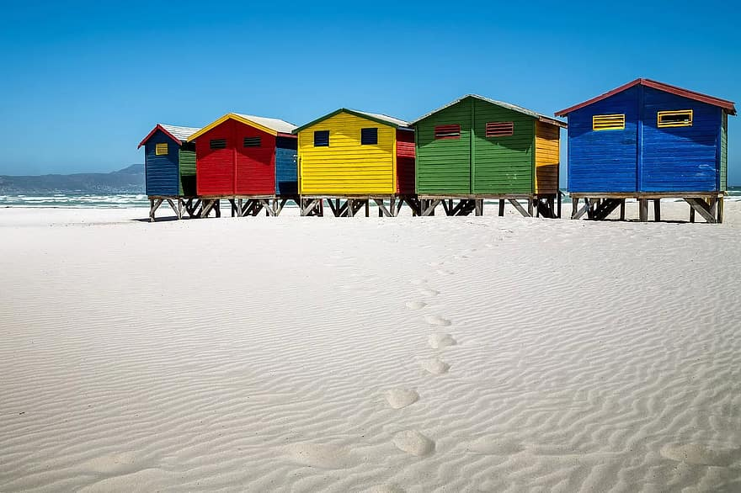
2. Season challenges and successes

Slide 5
Tourism Safety

Slide 6
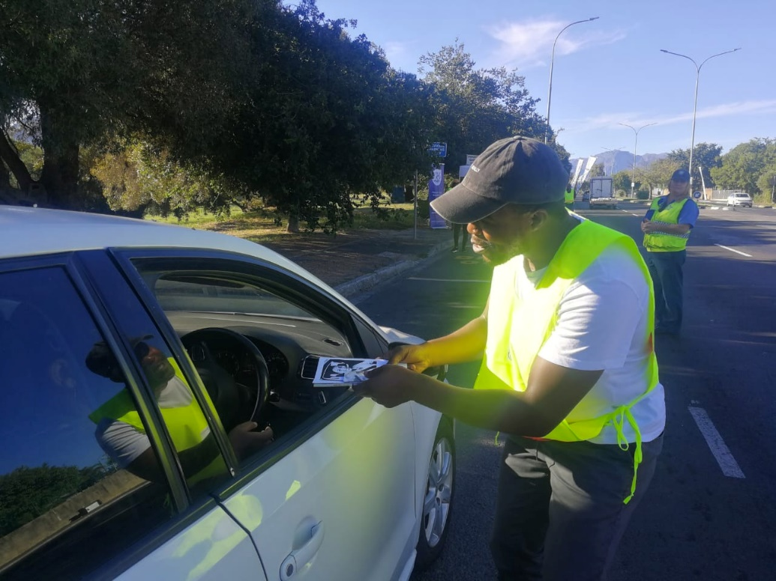
Tourism Safety: Successes and challenges
High visibility in the Cape Town CBD, Table Mountain, Signal Hill, V&A Waterfront and the Bo-Kaap of the City of Cape Town’s Tourism Safety Law Enforcement Unit supported by the Department of Community Safety’s Chrysalis Academy cadets.
The province successfully hosted major events – such as the Cape Town ePrix, ABSA Cape Epic and the Cape Town Cycle Tour - without significant incident.
Various tourism safety activations and campaigns successfully implemented.

Slide 7
Tourism Safety: Successes and challenges
The disappearance of German tourist, Nick Frischke, and other recent incidents, underscore the ongoing importance and also challenges around tourism safety.
In May, DEDAT will conduct an industry survey to assess tourism safety trends over the past season. The results will assist with planning for the 2023/2024 season.
Challenges remain with the issuing of tourist transport operator licenses by the National Public Transport Regulator. DEDAT continues to receive complaints from operators who have vehicles impounded and tourists being left stranded due to the delays experienced at the NPTR.

Slide 8
Destination Accessibility

Slide 9
Airport and cruise terminal operations: Successes and challenges
Cape Town International Airport and George Airport handled passenger volumes at close to pre-Covid levels and in general without the travel disruptions experienced in the Northern Hemisphere last year.
Despite this, there were some sporadic instances of long passenger queues as well as downtimes reported of the eGates. This requires long-term solutions to boost Department of Home Affairs staff numbers and extend the eGates beyond just domestic use. Both CTIA and George Airport also require urgent infrastructure upgrades to keep pace with rising demand.
In the case of the Cape Town Cruise Terminal, there were no significant complaints from cruise operators, however there are berthing challenges in general at the port which is exacerbated when more than 1 cruise ship needs to berth. At the start of the season, there were also some berthing challenges at the Port of Durban which then had knock on effects on Cape Town.
Frontline staff at Cape Town Cruise Terminal participated in South African Tourism’s Welcome training programme in October 2022 and DEDAT is in discussions with SAT to extend the training to Cape Town International Airport, George Airport and the Port of Mossel Bay.

Slide 10
Workforce Readiness

Slide 11
Workforce readiness: Successes and challenges
Skills shortages remain a concern for the industry. Research undertaken by DEDAT shows that 42% of surveyed businesses indicated that they have struggled to fill some vacancies over the past 6 months. Kitchen staff, foreign language guides, tour consultants and front of house managers were some of the occupations mentioned that were hard to fill.
There are concerns that the expiry of the Zimbabwe exemption permit will exacerbate industry skills shortages. 33% of surveyed businesses indicated that they would be negatively affected should SA not extend the ZEP.
Despite the above challenges, an estimated 245 learners were successfully placed with employers including at the Cape Town International Airport, through CapeNature and various members of Fedhasa in the hotel and restaurant industry.
A tourism skills forum has been established which now meets on a quarterly basis. The forum is strengthening relationships between TVET colleges and industry resulting in higher placements of learners.
33 tourist guides were trained in both culture and nature guiding at participating sites in the Cradle of Human Culture on the West Coast. The programme was sponsored by DEDAT and DCAS.

Slide 12
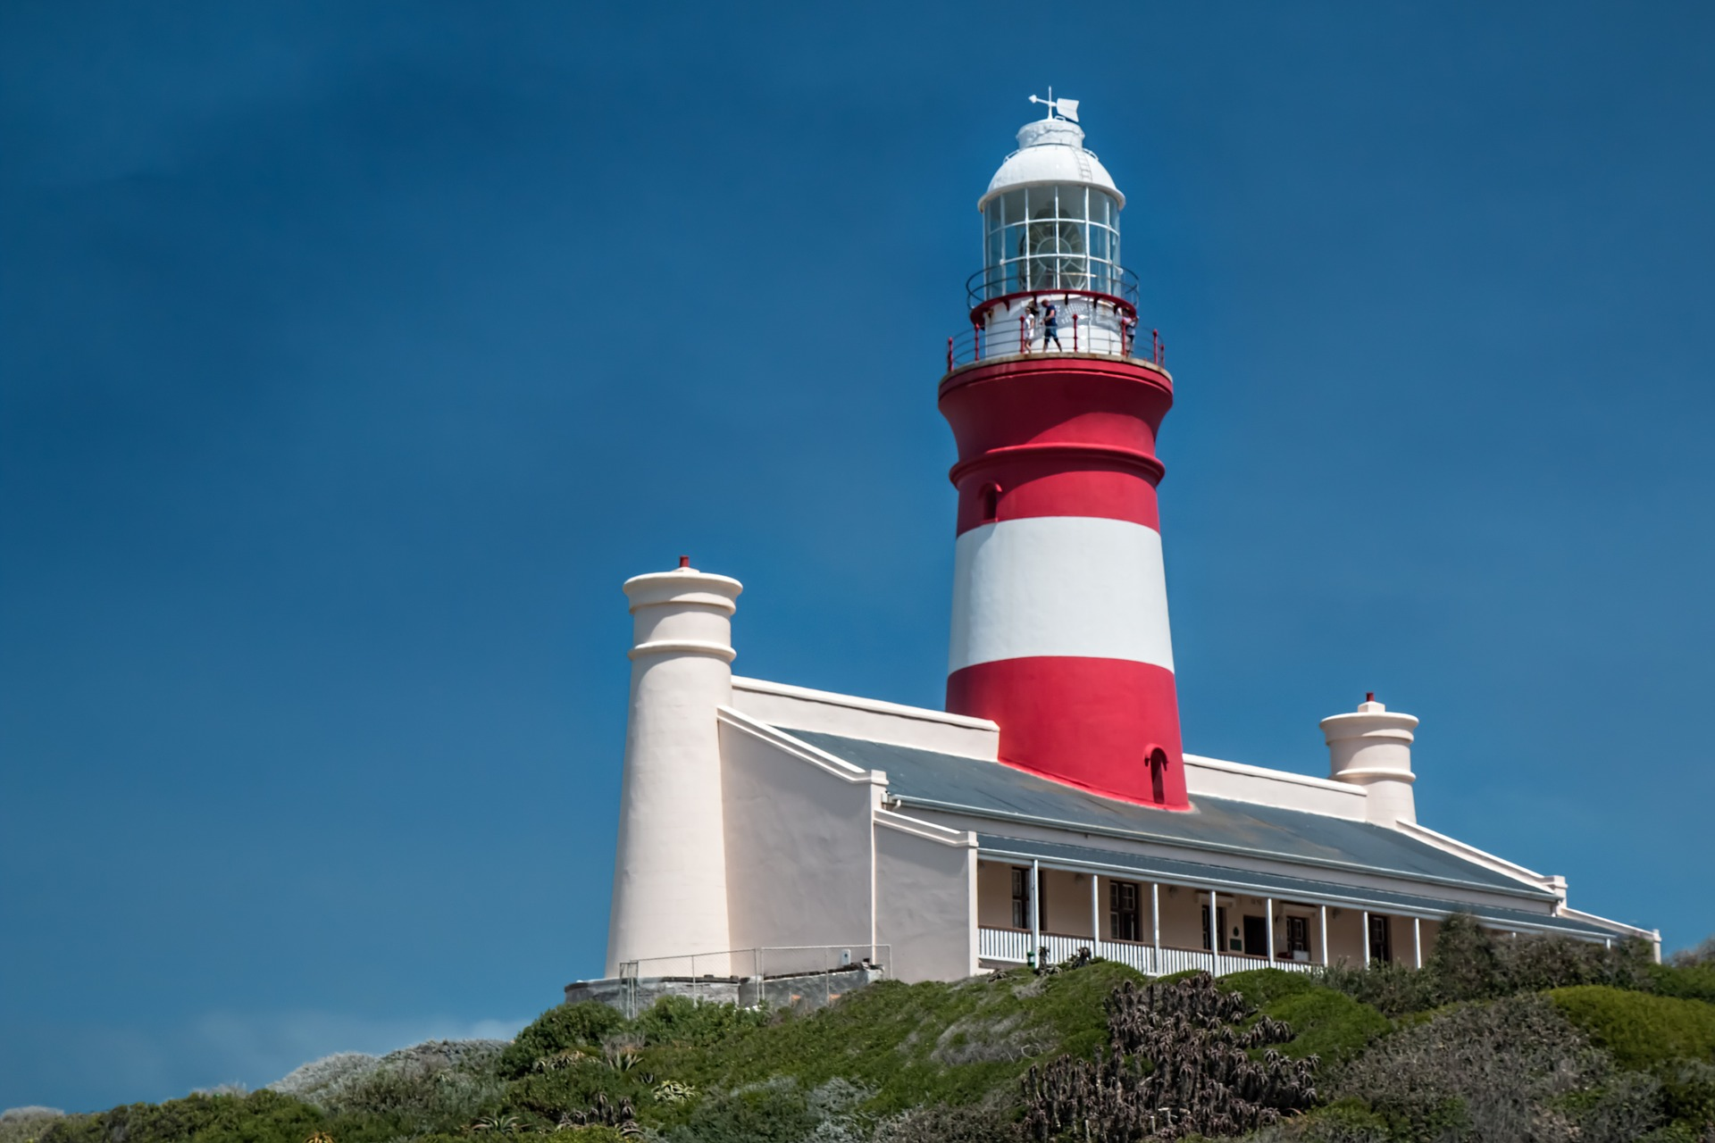
Activations and communications

Slide 13
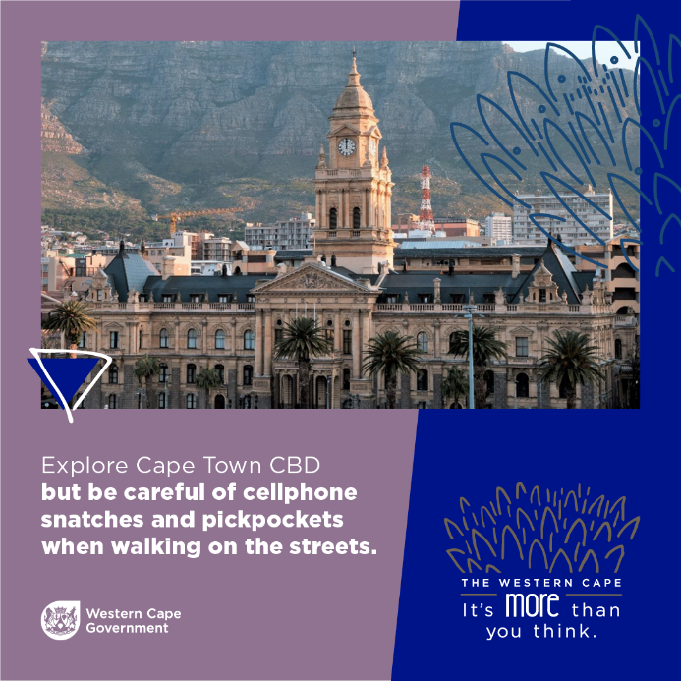
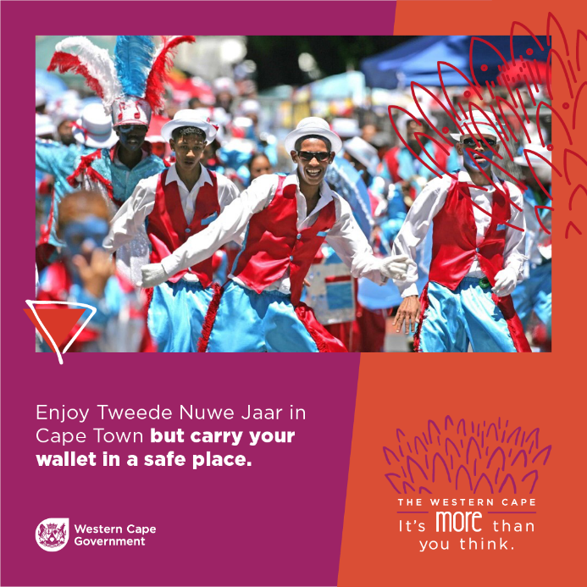
Activations & communications for summer season: Successes and challenges
DEDAT implemented a social media campaign targeting domestic tourists. The main objective of the Season Readiness campaign was to provide safety tips to South African travellers and tourists visiting the Western Cape as well as locals. The campaign ran from 13 December 2022 to 13 January 2023.
The campaign which was delivered with a R25,000 media buying budget generated nearly 4 million delivered impressions on Facebook, Instagram and Twitter.

Slide 14
3. Remote work visa advocacy efforts

Slide 15
Remote work visa & visa reform
To aid in its advocacy and lobbying activities, DEDAT is currently in the process of commissioning a study to model the economic impact of visa reform including the introduction of a digital nomad visa.
The remote work visa submission which was drafted in 2021 by DEDAT as it relates to the amended regulations will be raised at appropriate channels such as the MinMec in May 2023.
DEDAT will be launching a visa webinar series to showcase international best practice as it relates to all types of visas.
Work has commenced with DHET and a national working group regarding the critical skills visa and alignment with industry demand profiles.
The e-visa portal requires an amended approach, support will be available to DoHA on improved communication to applicants to avoid common errors as well as any red tape reduction support.

