Slide 1
Council on Higher Education
Strategic Plan 2020-2025 and 2023/24 Annual Performance Plan
Presentation to the Parliamentary Portfolio Committee on Higher Education, Science & Innovation
3 May 2023

Slide 2
Introducing the new CHE Council
Council Members 2023

Slide 3
Mandate conferred by the Higher Education Act No. 101 of 1997
Advising the Minister on HE matters, at the request of the Minister, and proactively.
Arrange and coordinate conferences.
Through the HEQC, to promote QA in HE, audit the QA mechanisms of HEIs, and accredit programmes of HE.
Publish information on HE including reports on the state of HE.
Promote access of students to higher education institutions
Perform any other functions designated to it by the HE Act, the NQF Act or by the Minister through notice in the Gazette.

Slide 4
Mandate conferred by the National Qualifications Framework Act No. 67 of 2008
Developing and managing the HEQSF.
Developing and implementing policies and criteria for advancement the HEQSF.
Sets up the CHE as the Quality Council for higher education, with responsibility for the HEQSF.
Recommending higher education qualifications to SAQA for registration on the NQF.
Maintaining a database of learners 'achievements and submitting the data for recording on the NLRD.
Take responsibility for quality assurance in relation to the HEQSF.
Conducting or commissioning and publishing research of importance for the further development of the HEQSF.
Advising the Minister on matters relating to the HEQSF.
Informing the public about the HEQSF.

Slide 5
An additional mandate: Transformation Monitoring and Oversight
The second Transformation Oversight Committee (TOC) was set up by Minister Nzimande in 2017 with the purpose of monitoring and reporting on progress on transformation in public universities; serve as an expert advisory body and provide independent and external advice to the Minister and the Department in fulfilling their oversight role; and assist in strengthening the accountability of universities in matters of transformation.
At the end of its term in 2020, the second TOC recommended to the Minister to consider transferring this responsibility to a permanent body and suggested the CHE.
In 2021, the Minister formally requested that the CHE incorporates this function into its overall mandate and Council agreed to do so.
Since then the CHE has been working to develop an approach to this, a key principle being that it would not be an add-on function, rather a strengthening of focus on this, executed through its range of mandates.
Council approved a Terms of Reference for the Transformation function at its meeting on 11 March 2023.
The CHE will take the mandate forward as described in the TORs, as resources allow.

Slide 6
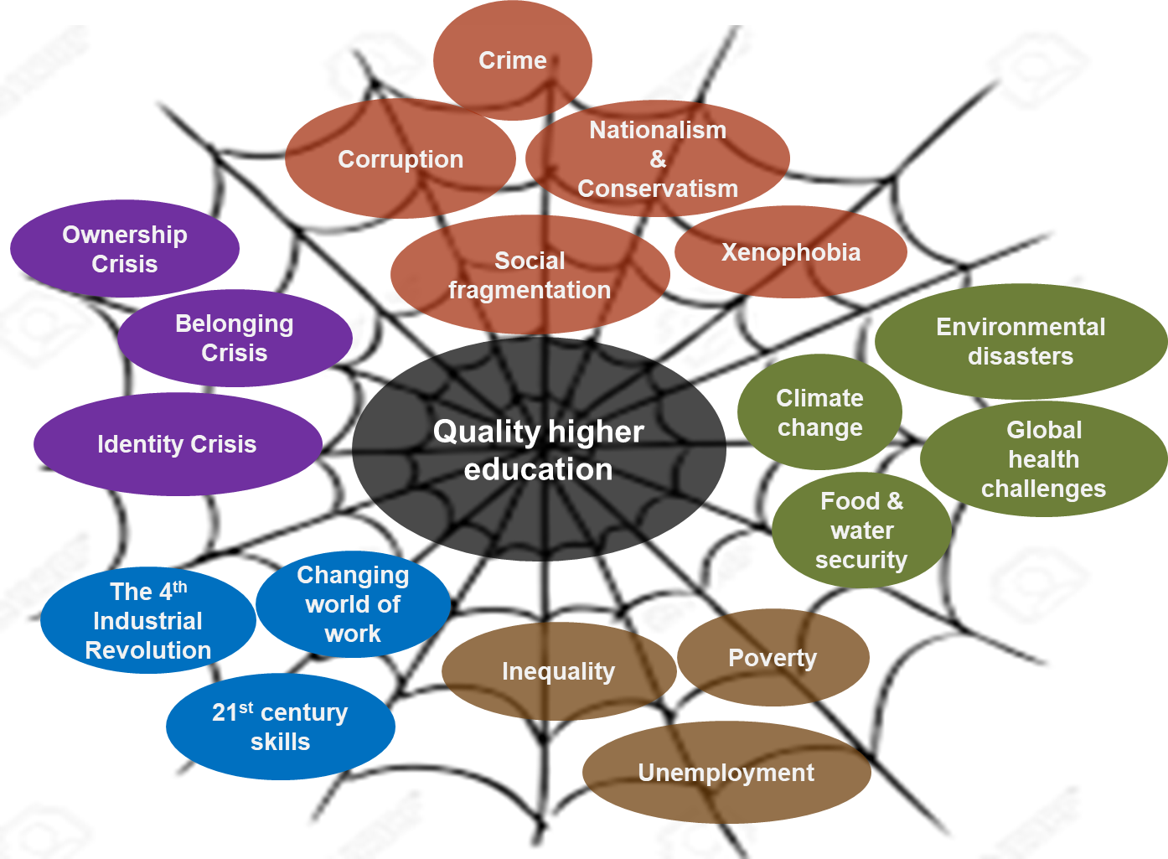
Striving towards quality Higher Education in the context of a ‘’perfect storm of wicked problems’’

Slide 7
Strategic Plan 2020-2025
Vision | Innovative, quality higher education responsive to the needs of society.
Mission | The CHE is an independent, statutory, quality assurance and advisory body for South African higher education, which transforms lives in pursuit of an equitable, prosperous, and innovative society. In fulfilment of its role, the CHE: Leads and manages external quality assurance. Regulates qualifications through the HEQSF. Is an intellectual hub for higher education research, monitoring, policy, and critical discourse. Advises the Minister on all higher education matters.
Values | In pursuit of its vision and mission the CHE is committed to, and guided by the following values: Innovation Integrity Equity Respect Accountability

Slide 8
Strategic Outcomes 2020-2025
Outcome 1 | CHE as an effective custodian of the HEQSF
To manage the development and implementation of the HEQSF policies, qualification standards and data in order to meet the goals of the NQF, NPPSET and the National Development Plan (NDP). | To manage the development and implementation of the HEQSF policies, qualification standards and data in order to meet the goals of the NQF, NPPSET and the National Development Plan (NDP).
Outcome 2 | Comprehensive and coherent quality assurance system for the higher education sector
To develop and implement a new Quality Assurance Framework for effective and efficient internal quality assurance (IQA) and external quality assurance (EQA) for the sector. | To develop and implement a new Quality Assurance Framework for effective and efficient internal quality assurance (IQA) and external quality assurance (EQA) for the sector.
Outcome 3 | A reputable centre of intellectual discourse, knowledge generation and advice on higher education
To revitalise and strengthen the research, monitoring, evaluation and advice capabilities of the CHE. | To revitalise and strengthen the research, monitoring, evaluation and advice capabilities of the CHE.
Outcome 4 | Governance, compliance and risk management
To set the broad strategic direction, policy and tone for good governance, statutory compliance and risk management of the organisation to support the discharge of the core functions of the CHE. | To set the broad strategic direction, policy and tone for good governance, statutory compliance and risk management of the organisation to support the discharge of the core functions of the CHE.
Outcome 5 | Sustainable, responsive and dynamic organisation
To design and implement an organisational architecture, business processes, capabilities and infrastructure to realise the strategy of the CHE. | To design and implement an organisational architecture, business processes, capabilities and infrastructure to realise the strategy of the CHE.

Slide 9
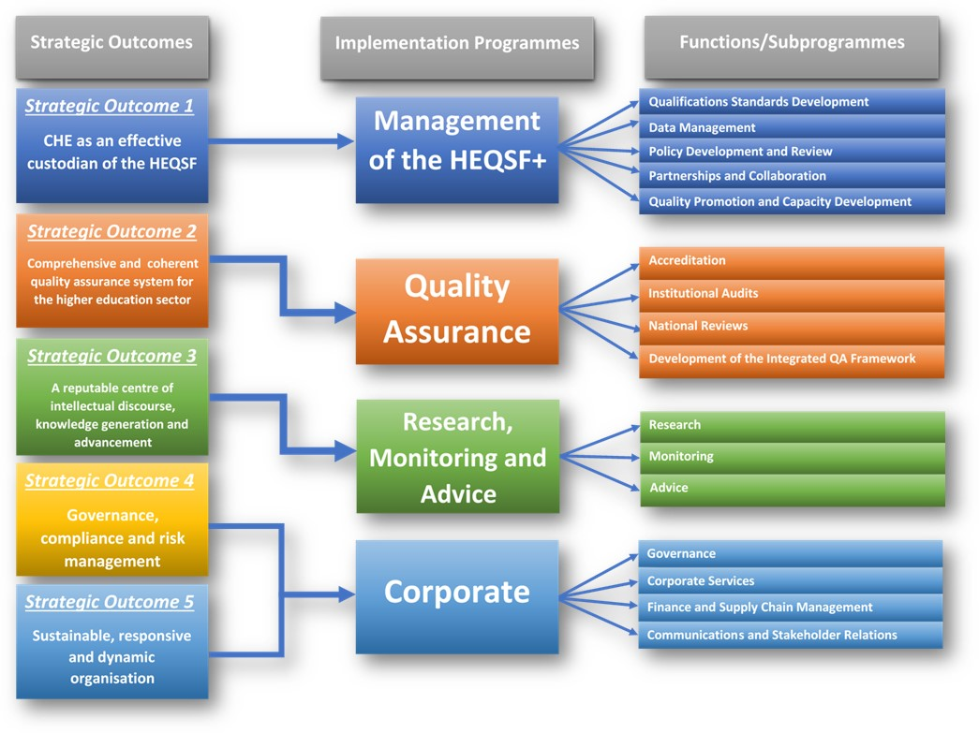

Slide 10
2023/24 Annual Performance Plan
Key:
Blue font: Name of Programme and Sub-programme
Black font: Activities and targets that continue in this 4th APP linked to the 2020-2025 Strategic Plan
Green font: New activities and/or targets that have been introduced for the 2023/24 financial year.
Strike-through: Previous year activity/target which has been changed/not applicable for this year.

Slide 11
Focus Areas for 2023/24
Preparing for the implementation of the new Quality Assurance Framework
Implementation of a national round on institutional audits
Growing the Research, Monitoring and Advice functions
Taking forward the new CHE mandate for HE Transformation Oversight
Building the image and profile of the CHE
Strengthening our regional and international networks

Slide 12
Overview of 2023/24 APP and Budget
Number of Output Indicators | 45

Slide 13
Activities | Indicators and Targets
Management of the HEQSF: Qualification Standards Development
Develop and/or review thresholds standards for qualifications to ensure relevance, comparability and currency of qualifications | 3 qualification standards fully developed or reviewed 4 qualification standards development or review processes initiated
Promote the use of the qualification standards by institutions in the design of curricula of the respective qualifications | 5 (3) events or projects for promoting the use of qualification standards undertaken
Management of the HEQSF: Data Management
Develop and maintain a comprehensive database of qualifications, learning programmes, student enrolment and achievement for all private higher education institutions | 90% (85 %) of private higher education institutions that have all required sets of data records in the database
Undertake verification and validation of data for private higher education system to ensure validity, accuracy and reliability of data | 90% (85%) percent of data sets that are verified and validated to be accurate and reliable, from all data sets submitted by private higher education institutions
Maintain HEQCIS database and submit achievement data for private higher education institutions to the NLRD | 2 data uploads onto the NLRD in a particular financial year
Development of a new CHE - MIS | 1 progress report on the development of the CHE-MIS

Slide 14
Activities | Indicators and Targets
Management of the HEQSF: Policy Development and Review
Review and undertake further development of the HEQSF | Reviewed HEQSF approved and published
Develop or review policies related to the NQF for the higher education sector | 1 policy developed or reviewed and approved
Provide support to institutions in the development and implementation of relevant institutional level policies | 8 (5) HEIs provided with support with respect to the development and implementation of relevant institutional policies
Management of the HEQSF: Partnerships and Collaboration
Undertake joint projects with SAQA, other QCs, the DHET and professional bodies | 8 (5) project reports or other submissions from the joint or collaborative projects with SAQA, other QCs, the DHET and professional bodies.
Take part in national events, initiatives and fora on NQF, quality assurance and promotion | 5 national events and/or forums on NQF, quality assurance and promotion involved in.
Take part in regional or international initiatives on qualification frameworks, quality assurance and promotion | 2 (1) regional and/or international events and/or forums on qualifications framework, quality assurance and promotion involved in

Slide 15
Activities | Indicators and Targets
Management of the HEQSF: Quality Promotion and Capacity Development
Organise and convene quality promotion and capacity building quality fora and other workshops for public and private higher education institutions, and professional bodies | 25 (20) quality promotion and capacity building quality forums and/or workshops organised, in a particular financial year
Compile and produce good practice guides on relevant themes | 1 good practice guide produced.
Quality Assurance: Accreditation
Accredit new programmes | 85% of programme accreditation applications received that go through the accreditation process and are presented to the HEQC within 8 months from the date of final submission of an application. (12 months from the date of appointment of evaluators.
Closeout open activities of existing programme reaccreditation for private higher education institutions | 85% of completed open reaccreditation applications received that go through the accreditation process and are presented to the HEQC within 12 (18) months from the date of appointment of evaluators
Organise and conduct site visits to verify the capacity of higher education institutions to offer quality programmes | 95% of site visits undertaken whose reports are presented to the HEQC within 8 (12) months from the date of receipt of reports from the site visit panels, in a particular financial year

Slide 16
Activities | Indicators and Targets
Quality Assurance: Institutional Audits
Audit the quality assurance mechanisms of higher education institutions | 10 (0) Institutional Audits initiated 10 (20) institutional site visits by CHE audit panels 10 audit reports of completed Institutional Audits finalised and approved
Quality Assurance: National Reviews
Conduct National Reviews of learning programmes in specific subject fields and qualifications | 2 National Reviews initiated
Approved reports on completed National Reviews | 100 % of completed National Reviews that have their reports finalised and approved

Slide 17
Activities | Indicators and Targets
Quality Assurance: Quality Assurance Framework
Develop the Management Information System to support the implementation of the QAF | A progress report on the development of the QAF-Management Information System approved
Facilitate the development of Higher Education Practice Standards for use in implementing the QAF | 5 Higher Education Practice Standards developed.
Research, Monitoring and Advice: Research
Undertake or commission research on selected themes or topics | 3 research reports produced
Provide platforms for fostering critical discourses on contemporary issues | 2 conferences, colloquia, seminars, or symposia organised
Disseminate research findings through scholarly publishing | 2 journals/journal articles or books/book chapters published
Synthesise and package research findings into policy briefs | 4 policy briefs or Briefly Speaking articles produced

Slide 18
Activities | Indicators and Targets
Research, Monitoring and Advice: Monitoring
Collate and analyse information on key trends and developments in higher education | 1 Higher Education Monitor/Review publication produced
Assess the performance of the public higher education sector against national targets on key indicators | 1 VitalStats publication produced
Develop and update profiles for higher education institutions | 3 institutional profiles produced or updated
Research, Monitoring and Advice: Advice
Source, analyse and package information into responsive advice | 100% of requests for advice responded to with the submission of advice
Synthesise and package research findings into proactive advice | 3 pieces of proactive advice produced and submitted
Advice provided to the Minister, on request or proactively | 5 pieces of advice

Slide 19
Activities | Indicators and Targets
Corporate: Governance
Develop or review ICT policies, frameworks, guidelines and procedures | 7 ICT policies, frameworks, guidelines and procedures developed or reviewed
Develop or review Human Resources policies, frameworks, guidelines and procedures | 7 Human Resources policies, frameworks, guidelines and procedures developed or reviewed
Develop or review financial management and supply chain management policies, frameworks, guidelines and procedures | 8 financial management and supply chain management policies, frameworks, guidelines and procedures developed or reviewed,
Organise and convene meetings of the governance structures | 28 (22) scheduled governance meetings organised and held
Corporate: Corporate Services
Develop an annual ICT Operational Plan based on the CHE’s approved Digital Transformation Framework | 1 developed and approved annual ICT Operational Plans based on the CHE’s approved Digital Transformation Framework
Conclude activities reflected in an approved annual ICT Operational Plan | 80% of activities concluded as per an approved annual ICT Operational Plan

Slide 20
Activities | Indicators and Targets
Corporate: Corporate Services (cont.)
Provide an enabling and nurturing human resources management environment through training and development, of skills and talent pipeline that addresses the CHE’s capacity priorities | 15 staff training interventions offered
Attract and retain the necessary capabilities in line with the approved posts on the organisational structure | 85% of approved posts on the organisational structure that have incumbents throughout a particular financial year
Corporate: Finance and Supply Chain
Pay eligible suppliers within 30 days from date of receipt of their invoices | 100% of eligible suppliers paid within 30 days from dates of receipt of their invoices
Monitor expenditure reports are monitored and submit consolidated reports to the relevant authorities by the compliance date on a quarterly basis | 4 approved expenditure reports submitted to DHET by the compliance date

Slide 21
Activities | Indicators and Targets
Corporate: Communications and Stakeholder Relations
Develop the Communication and Advocacy Plan | 1 developed and approved Communication and Advocacy Plan
Conclude activities reflected in the approved Communication and Advocacy Plan. | 80% of activities concluded as per the Communication and Advocacy Plan
Promote technically and operationally supported stakeholder engagement events or forums | 12 stakeholder events or forums organised in the other programmes/sub-programmes for which technical and operational support is provided

Slide 22
Budget for 2023/24

Slide 23
HIGH LEVEL SUMMARY OF THE REVENUE
REVENUE | BUDGET ALLOCATED | % OF THE ALLOCATED BUDGET
Departmental transfer | 83 140 | 86%
Projected/Estimated partial cost of recovery for Private Accreditation and Institutional Audits | 11 893 | 12%
Projected/Estimated interest income | 1 366 | 2%
TOTAL | 96 399 | 100%

Slide 24
HIGH-LEVEL SUMMARY OF THE EXPENDITURE
EXPENDITURE | BUDGET ALLOCATED | % OF THE ALLOCATED BUDGET
Compensation of employees | 36 638 | 40%
Goods & Services | 57 761 | 60%
TOTAL | 96 399 | 100%

Slide 25
BUDGET ALLOCATION ON COMPENSATION OF EMPLOYEES FOR THE FINANCIAL YEAR 2023/2024
PROGRAMMES | BUDGET ALLOCATED | % OF THE ALLOCATED BUDGET
Quality Assurance | R17 228 694.27 | 47%
Research, Monitoring and Advice | R 4 482 417.87 | 13%
Management of HEQSF | R 2 192 558.51 | 6%
Administration | R12 734 329.35 | 34%
Total | R 36 638 000.00 | 100%

Slide 26
NOTES ON COMPENSATION OF EMPLOYEE’S BUDGET
The budget allocation is based on the number of employees per Programme and the salary scales of employees.
The budget covers 50 funded posts that constitute 40% of the total baseline budget allocation.
(47 permanent & 3 fixed-term contracts) from various programmes.
Programme: Quality Assurance constitutes 47% with 22 funded posts (19 permanent & 3 fixed term contract).
Programme: Research, Monitoring and Advice constitute 13% with 5 funded permanent posts.
Programme: Management of HEQSF constitutes 6% with 2 funded posts (1 permanent & 1 fixed term contract).
Programme: Administration constitutes 34% with 21 permanent posts and includes the payment to Liberty & Allan Gray contributions for all permanent employees @ R63 00.00 per month and constitutes 5% of the total compensation of the employees.

Slide 27
BUDGET ALLOCATION ON GOODS & SERVICES FOR THE FINANCIAL YEAR 2023/2024
PROGRAMMES | BUDGET ALLOCATED | % OF THE ALLOCATED BUDGET
Quality Assurance | R27 402 786.18 | 48%
Research, Monitoring and Advice | R 5 700 000.00 | 10%
Management of HEQSF | R 6 225 000.00 | 11%
Administration | R18 433 213.82 | 31%
Total | R 57 761 000.00 | 100%

Slide 28
NOTES ON GOODS & SERVICES BUDGET
The budget allocation is based on activities that need to be undertaken to achieve the set strategic objectives of the Programmes as per the APP.
The budget methodology used is zero-based and activity-based budget.
The goods & services budget constitutes 60% of the total baseline budget allocation and includes:
Programme: Quality Assurance constitutes 48%.
Programme: Research, Monitoring and Advice constitute 10%.
Programme: Management of the HEQSF constitutes 11%.
Programme: Administration constitutes 31% of which 9% is for active 26 fixed and 10% for 15 variable contracts.

Slide 29
Some challenges that could potentially impact on the successful execution of CHE mandates going forward.
The budget allocation to the CHE is not sufficient to enable it to undertake all the work it is responsible for, and to enable a sufficient number of staff to be in place to do the work in an expanding sector, including expansion resulting from the incorporation of public colleges into higher education. Resourcing of the additional transformation oversight function is needed for it to be taken forward effectively.
The stipulated CoE to Goods and Services budget ratio is a factor that further limits the ability of the organisation to employ staff in permanent positions.
This leads to too much reliance on the use of service level contracts, of contracted staff, and on the use of peer academics for core work, and in critical support areas like IT.

Slide 30
Thank You

