Slide 1
BRIEFING TO THE SELECT COMMITTEE ON TRANSPORT, PUBLIC SERVICE AND ADMINISTRATION, PUBLIC WORKS AND INFRASTRUCTURE
PUBLIC SERVICE COMMISSION
ANNUAL PERFORMANCE PLAN
2023/24 FINANCIAL YEAR
03 MAY 2023

Slide 2
PRESENTATION OUTLINE
PSC AT A GLANCE
STRATEGIC FOCUS OF THE PSC
ADMINISTRATION PROGRAMME
LEADERSHIP AND MANAGEMENT PRACTICES
MONITORING AND EVALUATION
INTEGRITY AND ANTI-CORRUPTION
OVERVIEW OF THE BUDGET AND THE EXPENDITURE ESTIMATES
01
02
OUTLINE
03
04
05
06
07

Slide 3
PSC AT A GLANCE
Adjusted Budget
R295.5 mil
Footprint
1 National
9 Provincial Offices
Establishment
11 Commissioners
Annual vacancy rate at 7,8% below 10%
Obtained Clean Audit in 3 consecutive years
National Anti-Corruption Hotline
1420 case reports generated
10 Reports produced on Service Delivery Inspections
Total Grievances finalised 423
Total Complaints finalised 297
A

Slide 4
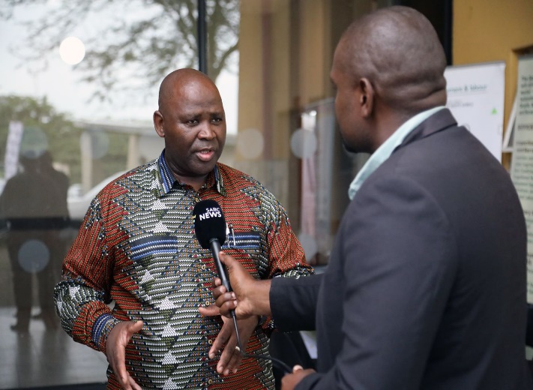
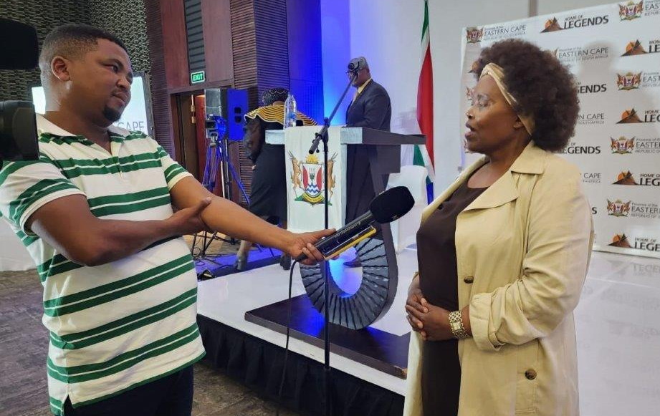
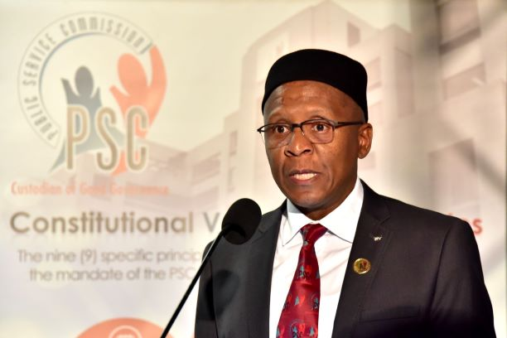
PSC AT A GLANCE - INCREASING PSC VISIBILITY & STAKEHOLDER ENGAGEMENT
23 TV Interviews and 3 Live Broadcasts
Viewership = 43m
36 Radio Interviews
Listenership = 32.8m
Coverage of provincial Citizens Forum by local media
Increase Engagement with Ministers as Executive Authorities
Live broadcast of International Anti-Corruption Day by SABC, ENCA & Newsroom Africa
Quarterly bulletin Pulse of the Public Service

Slide 5
OUR MANDATE

Slide 6
OUR MANDATE CONSTITUTIONAL MANDATE
The PSC is vested with custodial oversight responsibilities for the Public Service.
It has the power to, inter alia, monitor, evaluate and investigate public administration and personnel practices. It derives its mandate from section 196 of the Constitution, 1996.
In terms of section 196, the PSC has the power to, amongst others, issue directions regarding compliance with personnel procedures relating to recruitment, transfers, promotions and dismissals.
The PSC is required by the Constitution to exercise its powers and perform its functions without fear, favour or prejudice in the interest of maintaining an effective and efficient public administration and a high standard of professional ethics in the Public Service.
The Constitution links the PSC’s independence firmly with its impartiality and no organ of the state may interfere with the functioning of the PSC.
The PSC is further empowered in terms of the PSC Act to, inter alia, conduct inspections and enquiries

Slide 7
DEVELOPMENTS ON LEGISLATIVE MANDATE & POLICY MANDATES
Public Service Commission Bill
Significant progress on the review of the Public Service Commission Act of 1997 has been made. The primary objectives of the PSC Bill are to:
Facilitate the establishment of the PSC as a Secretariat to replace the OPSC. This is to ensure that the PSC executes its mandate fully as an independent and impartial constitutional entity.
Convert the OPSC from a government department in terms of the Public Service Act of 1994, onto a function shift to the PSC as a Secretariat established in terms of the Public Service Commission Act.
Reinforce the PSC mandate in terms of local government and public entities in line with section 196(2) of the Constitution.
It is envisaged that the current PSC Act of 1997 will be repealed and replaced by a new Act.

Slide 8
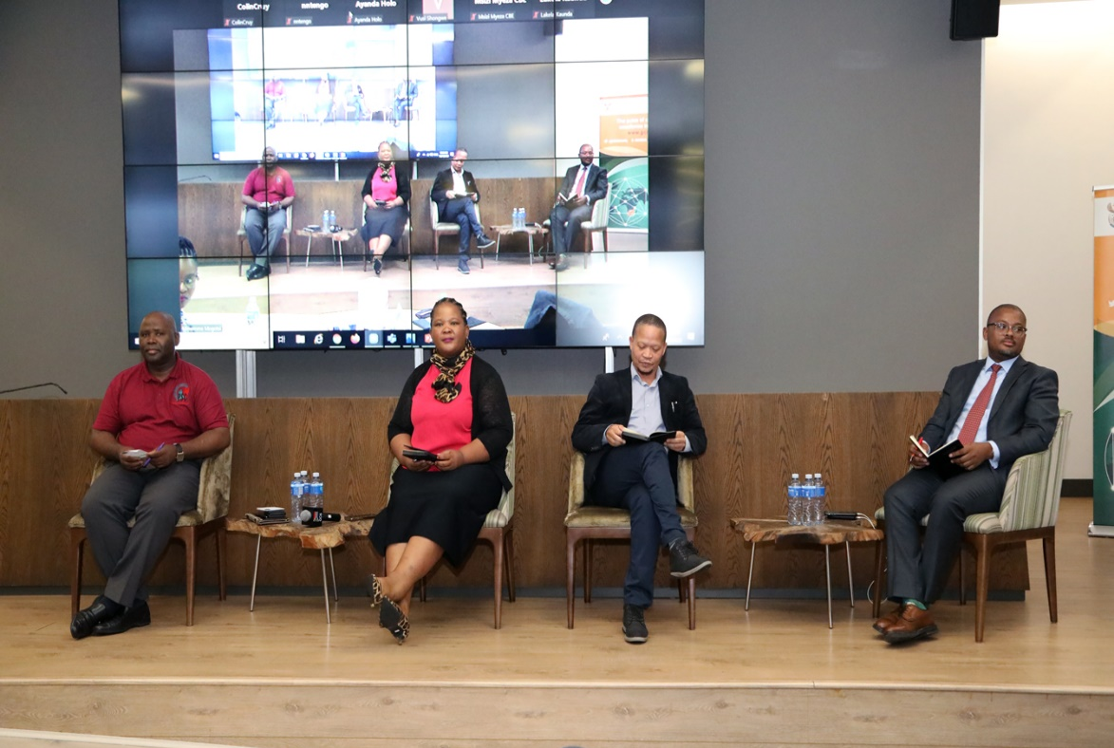
DEVELOPMENTS ON LEGISLATIVE MANDATE & POLICY MANDATES
In terms of the State of the Nation Address – the PSC is amending legislation to strengthen the role of the Public Service Commission to ensure that qualified people are appointed to senior management positions and to move towards creating a single, harmonised public service is a key priority for 2023/24
PSC is working with the NCG and DPSA to oversee the implementation of the National Framework for Professionalisation of the Public Sector

Slide 9
OUR STRATEGIC FOCUS
Vision
Mission
Values
Professionalism
Respect
Empathy
Fairness
Accountability
Integrity
Responsiveness
An impartial and innovative champion of public administration excellence in South Africa.
To actively promote the constitutional values and principles as well as service excellence in public administration practices, which result in a capable, ethical, innovative and developmental state.

Slide 10
OUR STRATEGIC FOCUS..Cont
CAPABLE STATE
A capable state has the required human capabilities, institutional capacity, service processes and technological platforms to deliver on the National Development Plan through a social contract with the people.
ETHICAL STATE
An ethical state is driven by the Constitutional Values and Principles of Public Administration and the rule of law, focused on the progressive realisation of the socio-economic rights and social justice as outlined in the Bill of Rights.
DEVELOPMENTAL STATE
A developmental state aims to meet people’s needs through interventionist, developmental; and participatory public administration. This entails building a state that is driven by the public interest and not individual or sectional interest.

Slide 11
OUR STRATEGIC FOCUS… Conti..
IMPACT
A responsive, ethical and values-driven public service that responds timeously, efficiently and effectively to the needs of the citizens.
INTERMEDIATE OUTCOME: 3
Sound leadership practices in the public service
ULTIMATE OUTCOME:4
An improved service delivery culture in the Public Service
IMMEDIATE OUTCOME:1
A strong & well-functioning PSC
IMMEDIATE OUTCOME: 2
A well-coordinated M&E System (Data Warehouse) for the PSC
The implementation of Priority 1 through the NDP 5-year Implementation Plan and the MTSF has enabled the PSC to identify 4 Outcomes that would contribute towards building “A capable, ethical and development state”.
Repositioning of the PSC to deliver on high-impact catalytic projects
OUTPUTS
Institution Building Reforms
Modernisation of the PSC processes
Review PSC Bill
Increase PSC Visibility
Unqualified audit outcome
invoices paid within 30 working days
BBBEE suppliers appointed
OUTPUTS
Grievances finalised
Labour relations improvement
Reports on leadership, HRM practices, public sector reform & professionalisation Professional Ethics workshops
Strategic engagements
Implementation of the ethics framework
NACH Referral
OUTPUTS
Report on performance of departments
OUTPUTS
CVP Promotional Engagements
Service Delivery Inspections
Position papers on public administration practices
Section 196 (4)(e) Report produced
Implementation Plan for the Professionalisation Framework

Slide 12
NUMBER OF APP TARGETS FOR THE 2023/24 FINANCIAL YEAR
The PSC has a total of 30 performance indicators for the 2023/24 financial year.
Programme 2: Leadership and Management Practice
6
Programme 1: Administration 9
Programme 3: Monitoring and Evaluation 8
Programme 4: Integrity and Anti-Corruption
7

Slide 13
PROGRAMME 1: ADMINISTRATION
Purpose of the Programme: The programme provides overall management of the PSC and centralised support services.

Slide 14
PROGRAMME 1: APP TARGETS
Programme 1 Indicators | Output Indicator | Annual Target 2023/24
1.1 | Audit opinion | Unqualified audit outcome opinion
1.2 | Percentage of valid invoices paid within 30 days of receipt | 100%
1.3 | Percentage of B-BBEE suppliers appointed | 60%
1.4 | Number of reports on stakeholder outreach programmes coordinated | 4
1.5 | Approved PSC Functional structure | PSC functional structure approved
1.6 | Number of reports on skills audit approved | 1 Report on skills audit approved
1.7 | Percentage maintenance of the vacancy rate | Vacancy rate maintained at maximum 10%
1.8 | Number of processes automated | 2
1.9 | Submission of the PSC Bill to Parliament | PSC Bill Submitted to Parliament

Slide 15
PROGRAMME 2: LEADERSHIP AND MANAGEMENT PRACTICES
Purpose of the Programme: The programme promotes sound Public Service leadership, human resource management, labour relations and labour practices.

Slide 16
PROGRAMME 2: APP TARGETS
LMP Indicators | Output Indicator | Annual Target 2023/24
2.1 | Percentage of all registered levels 2-12 grievances concluded within 30 days of receipt of all relevant information | 85%
2.2 | Percentage of all registered SMS grievances concluded within 45 days of receipt of all relevant information | 85%
2.3 | Number of reports produced on leadership and human resource management practices, public sector reform and professionalisation | 4
Four reports will be developed on:
Impact that hybrid-working arrangements had on service delivery in the Public Service
Public administration reforms and professionalization of the Public Service: A Public Service Commission perspective
Assessment of digitization of HR processes in the Public Service
The extent of utilisation of head hunting process in the Public Service.

Slide 17
PROGRAMME 2: APP TARGETS
Number of LMP Indicators | Output Indicator | Annual Target 2023/24
2.4 | Number of own accord reports as contemplated in section 196(4)(f) (iii) and (iv) of the Constitution, 1996 finalised | 3
2.5 | Number of reports on grievance management and efficiency of the grievance procedure in the Public Service produced | 3
2.6 | Number of strategic engagements on PSC recommendations with targeted departments | 10

Slide 18
PROGRAMME 3: MONITORING AND EVALUATION
Purpose of the Programme: To improve the functionality of the Public Service through institutional and service delivery evaluations.

Slide 19
PROGRAMME 3: APP TARGETS
Number of LMP Indicators | Output Indicator | Annual Target 2023/24
3.1 | Number of reports on service delivery inspections approved | 10 Reports on Service Delivery Inspections approved
3.2 | Approval of Implementation Plan for the National Framework Towards the Professionalisation of the Public Sector | Approved Implementation Plan for the National Framework Towards the Professionalisation of the Public Sector
3.3 | Number of Citizen forums conducted | 9
3.4 | Number of position papers on public administration practices | 2
Position Papers will be produced in relation to the following CVP’s:
Accountable Public Administration, and;
Efficient, effective and economic use of resources

Slide 20
PROGRAMME 3: APP TARGETS
Number of M&E Indicators | Output Indicator | Annual Target 2023/24
3.5 | Number of Section 196 (4)(e) Report produced | 1
3.6 | Number of reports produced on the National Advocacy Campaign on the CVPs | 1
3.7 | Number of reports on the performance of Departments produced | 4
3.8 | Number of studies on the effectiveness of government support for service delivery | 2
Assess the Effectiveness of Government Support for Service Delivery focusing on:
Accommodation and Property Management Services.
Information and Communication Technology services.

Slide 21
PROGRAMME 4 : INTEGRITY AND ANTI-CORRUPTION
Purpose of the Programme: The programme is responsible for undertaking public administration investigations, promoting a high standard of professional ethical conduct amongst public servants and contributing to the prevention and combating of corruption.

Slide 22
PROGRAMME 4: APP TARGETS
Number of IAC Indicators | Output Indicator | Annual Target 2023/24
4.1 | Percentage of complaints finalised within 90 working days upon receipt of a valid complaint by an Investigating Officer | 85%
4.2 | Number of own accord investigation reports as contemplated in section 196(4)(f)(i), (iii) and (iv) of the Constitution, 1996 finalised | 10
4.3 | Number of oversight report on the implementation of the ethics framework | 1
Financial Disclosure Framework
Management of Complaints, including the NACH
Financial Misconduct
The Report will have Chapters covering the following:

Slide 23
PROGRAMME 4: APP TARGETS
Number of IAC Indicators | Output Indicator | Annual Target 2022/23
4.4 | Number of articles on the promotion of professional ethics produced | 4
4.5 | Number of engagements conducted on ethics framework | 20
4.6 | Number of CVP promotional engagements held | 12
4.7 | Percentage of NACH cases referred within 7 days of receipt of case report | 90%

Slide 24
FINANCIAL PERFORMANCE REPORT

Slide 25
OVERVIEW OF 2023/24 BUDGET AND EXPENDITURE ESTIMATES

Slide 26
OVERVIEW OF 2023/24 BUDGET & EXPENDITURE ESTIMATES
The baseline allocations for the PSC for the 2023/24 financial year is R292.1 million.
Out of this budget, R220.1 million (75%) is allocated to CoE based on the fact that the PSC is primarily a knowledge–based institution and does not outsource its functions.
The Goods & Services budget is R69.8 million (24% of overall budget).
Out of this budget for Goods and Services, 82% (R57.4 million) is for mandatory costs, whilst 18% (R12.4 mil) is for the implementation of the mandate of the PSC over the MTEF period.
The budget for operational costs provides for National, Parliamentary and 9 Provincial offices, i.e. 11 offices.
The PSC has centralised its support function and as a result, the budget for Administration is high as it includes the budget for centralised support services e.g. accommodation costs, SITA services, training, internal audit, operation lease payments, Auditor General’s fees, etc.

Slide 27
OVERVIEW OF 2023/24 MTEF
Programmes | Audited Outcomes |  |  | Adjusted Appropriation | Preliminary Expenditure | Medium-term expenditure estimates
R million | 2019/20 | 2020/21 | 2021/22 | 2022/23 | 2022/23 | 2023/24 | 2024/25 | 2025/26
Administration | 125,719 | 121,637 | 121,947 | 142,316 | 127,995 | 140,541 | 146,778 | 153,276
Leadership & Management Practices | 48,991 | 47,272 | 49,728 | 49,852 | 48,634 | 49,359 | 51,529 | 53,793
Monitoring & Evaluation | 42,313 | 38,543 | 41,668 | 44,970 | 45,228 | 44,329 | 46,278 | 48,310
Integrity & Anti-Corruption | 57,506 | 53,704 | 52,428 | 58,403 | 57,136 | 57,890 | 60,436 | 63,090
TOTAL | 274,529 | 261,156 | 265 771 | 295,541 | 278,992 | 292,119 | 305,021 | 318,469
27

Slide 28
OVERVIEW OF 2023/24 MTEF
PER ECONOMIC CLASSIFICATION
Programmes | Audited Outcomes |  |  | Adjusted Appropriation | Preliminary Expenditure | Medium-term Expenditure Estimates
R million | 2019/20 | 2020/21 | 2021/22 | 2022/23 | 2022/23 | 2023/24 | 2024/25 | 2025/26
Compensation of Employees | 212,736 | 202,952 | 204,753 | 223,834 | 206,743 | 220,075 | 229,743 | 239,818
Goods & Services | 52,003 | 51,889 | 55,691 | 69,658 | 69,075 | 69,813 | 72,947 | 76,215
Transfer & subsidies | 2,690 | 1,977 | 1,933 | 611 | 1,158 | 558 | 583 | 609
Capital assets | 6,824 | 4,295 | 3,383 | 1,438 | 1,902 | 1,673 | 1,748 | 1,827
Financial assets | 271 | 43 | 1,158 | - | 115 | - | - | -
TOTAL | 274,529 | 261,156 | 265,771 | 295,541 | 278,992 | 292,119 | 305,021 | 318,469
28

Slide 29
OVERVIEW OF 2022/23 BUDGET & EXPENDITURE
PER ECONOMIC CLASSIFICATION
 | Compensation of Employees | 75% | R 220,075
 | Goods & Services | 24% | R 69,813
 | Transfer & subsidies | 0% | R 0,558
 | Capital assets | 1% | R 1,673
 | Financial assets | 0% | R -
292 119
29

