Slide 1
2023/24 Final Annual Performance Plan
Presentation by:
Ms. Phindile Mthethwa: Board Chairperson
Ms. Thembelihle Mbatha (CA)(SA : Acting Chief Ombud
Mr. Masaswivona Nhlungwana : Acting CFO
5 May 2023

Slide 2
PURPOSE
The purpose of the presentation is for the Portfolio Committee to take note of the 2023/24 Annual Performance Plan of CSOS.

Slide 3
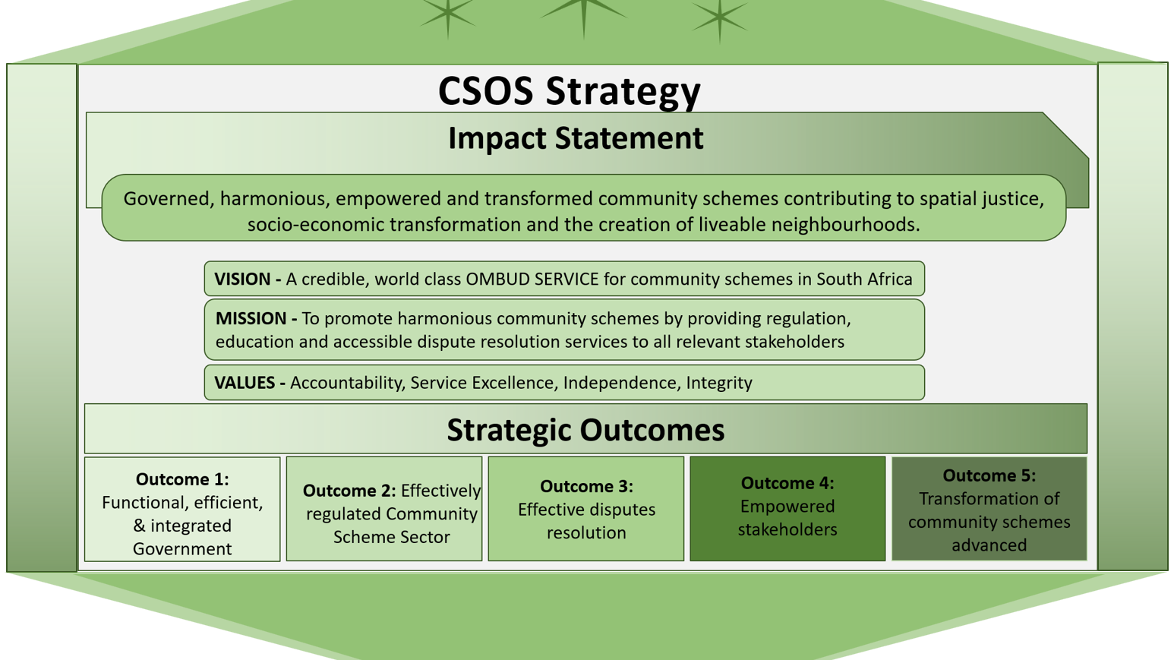

Slide 4
MTSF contributions
Priority 1: Capable, Ethical and Developmental State is the bedrock of the CSOS operations as the organisation implements a range of governance improvement measures to progress towards the achievement of an unqualified audit outcome with no material findings.
Priority 2: Economic Transformation and Job Creation through targeted procurement, as well as by implementing the preferential procurement regulations in support of the MTSF targets for designated groups, namely, 40% procurement spend to women, 20% for youth and 5% to persons with disabilities.
Priority 6: Social Cohesion and Safe Communities – CSOS will contribute towards social cohesion and safer Communities through the regulation of the conduct of community schemes and the provision of timeous dispute resolution services to ensure good governance and harmonious living within these community schemes.
Priority 5: Spatial Integration, Human Settlements and Local Government. The desired outcome is Spatial Transformation and Justice through the implementation of housing and human settlements in Priority Development Areas (PDAs).

Slide 5
MTSF INDICATOR | MTSF CONTRIBUTION BY ENTITY | CSOS RESPONSE (5-YEAR PLANNING TARGETS) | 2019-2022 ACTUAL | CORRECTIVE MEASURE
Consumer protection programmes implemented | Report the total number of community schemes registered and number of schemes paying levies as per legislation. | Number of schemes registered by CSOS: 70 000(adjusted this year) | 3 555(100%) community schemes that submitted scheme registration documents were registered. | Total Scheme Universe is 70 000, over 30 000 registered and 40 000 not registered – various initiatives to have all schemes on our database: Finalisation of data cleansing Implementation of scheme verification and validation project
 |  | Percentage of registered schemes paying levies: 75%. | 76% of registered schemes are paying levies (32 173 community Schemes registered and 24 309 community schemes are paying levies). 8 159 community schemes are not paying levies. | Various initiatives to ensure all schemes pay levies: Eradicate unallocated levies Implementation of a Billing system Charging of Interest to overdue accounts by Schemes Automation of levy paying process through CSOS Connect Implement levy study

Slide 6
MTSF INDICATOR | MTSF CONTRIBUTION BY ENTITY | CSOS RESPONSE (5-YEAR PLANNING TARGETS) | 2019-2022 ACTUAL | CORRECTIVE MEASURE
Consumer protection programmes implemented …… | Report the total number of community schemes registered and number of schemes paying levies as per legislation. | Rand value of levies collected: R 427,179,097. (adjusted this year) | R691,158,234 CSOS levy collected | Introduction of invoicing schemes will increase collection, with projection of additional R352 727 885 CSOS levy collected by 2023 to 2024
 | Number of consumer disputes submitted to CSOS and resolved within 90 days. | Percentage of disputes resolved within 90 days: 85% | 65.8% (12 262 referred and 8069 resolved) of disputes were resolved with 90 days. *An additional 8519 disputes were resolved outside the 90-days period . | Increased capacity (OD, Utilisation of Part-time Adjudicators) Discontinuation of disputes fees, improved turnaround times. Redistribution of work across the 3 Regions. There is already an overachievement of conciliation and adjudication as of Q1&2 of 2022/23

Slide 7
MTSF INDICATOR | MTSF CONTRIBUTION BY ENTITY | CSOS RESPONSE (5-YEAR PLANNING TARGETS) | 2019-2022 ACTUAL | CORRECTIVE MEASURE
Number of persons in the target market exposed to education programmes on various aspects of owning and renting a home | Implement a borrower, homeownership (Zenzeleni, help me buy a home) and tenant education programme. Monitor and report on the number of persons exposed to education programmes on owning and renting a home. | *CSOS will target the provision of training, education, and information to community scheme stakeholders, as follows: Number of training and education sessions conducted for schemes executives and owners: 300 Conduct stakeholder information sessions: 60 100% implementation of Advocacy Plan annually. | 114 training and education sessions conducted for schemes executives and owners. 31 Stakeholder information sessions conducted. 4 editions of Shared Living e-newsletters published annually (12) 100% implementation of Advocacy Plan annually. Appointed and trained 41 PDI EMA’s and coordinate placement in schemes as per applications recieved | Continue stakeholder engagements and training annually - ensure reach of the correct target audience, extended training to Cooperatives in conjunction with SHRA. Coordinate a perception survey and identify interventions to address perception shortcomings.

Slide 8
MTSF INDICATOR | MTSF CONTRIBUTION BY ENTITY | CSOS RESPONSE (5-YEAR PLANNING TARGETS) | 2019-2022 ACTUAL | CORRECTIVE MEASURE
Transactional support programme implemented | Establish a presence in transactional support sites. Monitor and report on transactional support programmes. | Regional offices will be established based on the results of feasibility studies that was conducted. Establishment will also be informed by the identified Transactional support sites by the Department of Human Settlements. A total of the 6 satellite offices will be established during the MTSF. | 3 Regional Offices (GP, KZN&WC) and 2 Satellite Offices (Bloemfontein and Gqeberha) operational and providing dispute resolution services. | For the remainder of the MTSF period 5 satellite offices will be established, with Polokwane and George being finalised in the current financial year. This improves visibility and access to services for the community schemes.

Slide 9
Contribution to Job Creation
Established a database of Executive Managing Agents (EMA) to be utilised by Community Schemes.
Appoint and train 40 previously disadvantaged individuals as Executive Managing Agents(EMA) additional to the 48 EMA’s already on the panel.
One EMA appointed by a Scheme (7 applications received - 6 rejected for not complying- guidance provided)
Shared the EMA panel with SHRA to use them as Property Managing agents for SH projects.
All the panelists on the database are HDI , advancing the sector transformation.
Partnership with YIPA (YOUTH IN PROPERTY ASSOCATION) – black owned company who are passionate about transforming the industry.
Preferential procurement from business owned by Women, Youth and People leaving with disabilities
Women 32.92%; Youth 14.78%; Disabilities 1.26% [Q3 Stats]
Appointment of 40 interns in Head office and in the Regions

Slide 10
SWOT analysis
STRENGTHS | WEAKNESSES
Promulgated legislation enabling the collection of statutory levies. Approved organisational structure. Quality assurance of schemes governance documentation. Established regional footprint. Skilled employees. Existing criminal sanctions in the CSOS Act for non-compliance. New online customer platform (CSOS Connect). Online collection mechanism. Stability in governance structures. Decentralisation of governance and compliance function. | Optimum use of revenue – CSOS is returning some funds to Treasury. Inadequate capacity vs volume of work. Poor public image. Inadequate feedback to stakeholders to avoid queries and complaints arising. Delays in implementation of risk management process. Lack of appropriate measures to enforce compliance with the CSOS Act. Slow monitoring and updating of community scheme database. Lack of proper community scheme registration processes. Slow turnaround on legislative review – impedes on CSOS implementation. Poorly phrased legislation, including lack of enforcement measures in the CSOS Act. High vacancy rate.

Slide 11
SWOT Analysis
OPPORTUNITIES | THREATS
Collaboration with other government entities to obtain community scheme database. Benchmarking with other government entities and international organisations to develop an effective strategy. Existence of new technology innovations. Availability of effective and efficient IT systems in the market. Review of levy model creates an opportunity for an increased and sustainable revenue base - revenue maximisation through efficient strategies, resulting in CSOS being able to sustain itself financially. Implementation of the approved Marketing and Communication Strategy. Amendment of the CSOS Act. Opportunity for transformation of the property sector. Appointment of advisory Ministerial Committee. Collaboration with research institutes and universities. | War for talent on the market. Be wary of undue influence from interested parties that may impact the regulatory independence on the CSOS. Perception of lack of independence. Cyber-attacks. Non-compliance by community schemes, due to CSOS inefficiencies. Deliberate non-compliance by schemes. CSOS' questionable reputation, relating to an investment made in contravention of the Treasury Regulations. Different interpretations of the Act that may result in resistance to compliance. Potential failure to meet stakeholder expectations and the imminent backlash. Negative media reports. Poor economic outlook for RSA and this will impact on payment of levies. Inability to reach procurement goals on designated groups.

Slide 12
SITUATIONAL ANALYSIS
Issue | Analysis
Scheme Registration | The entire CSOS value chain and service delivery model is underpinned on the success in creating a complete database of Community Schemes. The database is critical not only for the collection of levies but also for the provision of education and training and assuring good governance of schemes. The CSOS Connect System went live on 25 November 2022, which will enable Community Schemes (Schemes) to register online via the CSOS Connect Portal. During the 2023/24 financial year, a project to validate and verify community schemes will be implemented. A panel of service providers is appointed to conduct physical verification and registration of Schemes throughout South Africa. Total universe of community schemes is 70 000, 30 000 is registered and 40 000 not registered. Additionally in order to address the declining trend in the registrations of schemes due to the limited power that the CSOS has in terms of the CSOS Act to enforce compliance by the community schemes to register, the Service will vigorously pursue, the amendment of the legislation with the support of the DHS. During the 2021/22 financial year a total of 925 scheme registration applications were processed and registered and 982 registered year to date.
Dispute Resolution | The Dispute Resolution performance is stabilizing as a result of perfecting processes and turnaround times within assessments and compliance investigation. This has shortened the time it takes for files to mature for conciliation and adjudication. The redistribution of work from GP to KZN and the WC has a direct effect on the readiness of files to conciliated and adjudicated. With adequate capacity, it is envisaged that turnaround times will be shorten further. A total number of 8308 new applications were received within the 2021/22 financial year, 2 149 conciliated and 1 600 adjudicated. Accordingly, 5 384 disputes were finalized. The achievement continued from 21/22 financial with overachievement on Disputes target in the current financial year( 22/23) – 8032 disputes received and 7487 finalised year to date, this is 93% disputes resolved.

Slide 13
SITUATIONAL ANALYSIS
Issue | Analysis
CSOS Levy collection | The registration and payment of levies by community schemes is still a challenge for the entity, however, the entity continues to create awareness through its education and training sessions which are appreciated by stakeholders. In addition, new initiatives such as geo-mapping of existing schemes coupled with inspectorate, data cleansing, billing and proactive monitoring of new Schemes under development are being implemented to expedite Scheme enrolment. Levy collection as at 31 March 2022 was R250,518,259 million (2020: R223,569,975 million). Year to date on a target of R263 042 000, levy collection is R243 644 095, still to collect Q4 target of R85 622 787. There are 32 173 community schemes registered and 24 309 are paying levies, which accounts for 76% of the total registered schemes paying the CSOS levy. The total unallocated levies from the inception of levy collection was R226 631 429.00 (2017) currently(2023-Q3) unallocated is sitting at R142 309 397.00. Initiatives are in place to eradicate unallocated levies( Continuous engagements with FNB and Managing agents)
Compliance and Enforcement | One of the enablers of the 2020-2025 CSOS Strategic Plan is the implementation of a Compliance and Enforcement Strategy, which seeks to establish effective systems to maximise the schemes’ compliance with their obligations and to ensure non-compliance is kept to an absolute minimum, thereby ensuring that schemes comply with the CSOS Act, the Sectional Titles Schemes Management Act and other relevant legislation.

Slide 14
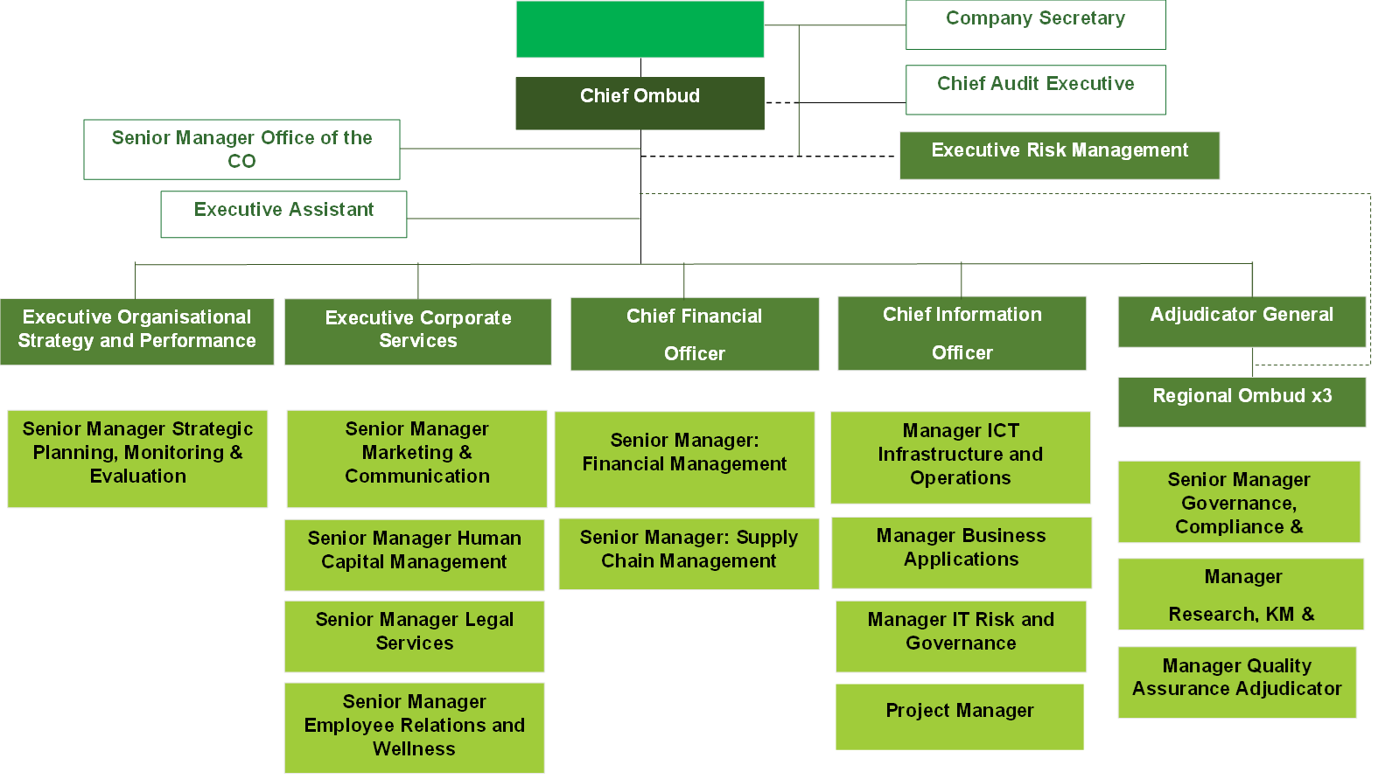
INTERNAL ENVIRONMENT ANALYSIS
The OD project was finalised during the period under review. The OD SteerCom facilitated the placement of all the permanent staff on to the new structure as per the principles outlined in the approved Placement Framework.
As at the end of Q3(2023), there were 134 permanent employees among the 251 positions on the newly revised organizational structure.
The vacancy rate was at 46 % as at the end of Q3 2022/23. The high vacancy rate is as a results of the recently approved revised organisational structure that has several new positions that still need to be filled.
A Bulk advertisement was placed in the month of December 2022.It is envisaged that the vacancy rate will decrease with the filling of vacancies in in the new financial year. 42 interviews already coordinated for the 54advertised positions.

Slide 15
OUTCOMES, OUTPUTS, PERFORMANCE INDICATORS AND TARGETS
Outcome | Outputs | Output Indicators | Estimated performance | MTEF Period (Annual Targets)
 |  |  | 2022/23 | 2023-2024 | 2024-2025 | 2025-2026
Outcome 1: Functional, Efficient and integrated Government | External audit outcome | External audit outcome | Unqualified audit opinion with limited material findings | Unqualified audit opinion with no material findings | Unqualified audit opinion with no material findings | Unqualified audit opinion with no material findings
Outcome 1: Functional, Efficient and integrated Government | Anti-Fraud and Corruption Reports | 1.1.1.Percentage of the approved Anti-Fraud and Corruption Implementation Plan implemented | 100% | 100% | 100% | 100%
 | Risk Management Report | 1.2.1.Percentage implementation of the approved risk management plan | 100% | 100% | 100% | 100%
 | Internal controls and governance | 1.3.1.Percentage implementation of Internal Audit plan | 100% | 100% | 100% | 100%
 | Transactional services offered | 1.4.1.Number of new transactional sites established (satellite office) | 2 | 3 | Satellite offices in all provinces | Satellite offices in all provinces

Slide 16
OUTCOMES, OUTPUTS, PERFORMANCE INDICATORS AND TARGETS
Outcome | Outputs | Output Indicators | Estimated performance | MTEF Period (Annual Targets)
 |  |  | 2022/23 | 2023-2024 | 2024-2025 | 2025-2026
Outcome 2: Effectively regulated Community Scheme Sector | Revenue Collected | 2.1.1.Amount of CSOS levy collected | R263 042 000 | R408,698,702 | R416,160,155 | R427,179,097
Outcome 5: Transformation of community schemes advanced | Transformation and empowerment of designated groups | 5.1.1. Percentage procurement spend on businesses owned by women | 40% | 40% | 40% | 40%
 |  | 5.1.2 Percentage procurement spend on businesses owned by Youth | 20% | 16% | 16% | 16%
 |  | 5.1.3.Percentage procurement spend on businesses owned by persons with disabilities | 5% | 5% | 5% | 5%
 |  | 5.1.4.Percentage of annual procurement spend, targeted at businesses owned by Military Veteran | No target | 5% | 5% | 5%

Slide 17
OUTCOMES, OUTPUTS, PERFORMANCE INDICATORS AND TARGETS
Outcome | Outputs | Output Indicators | Estimated performance | MTEF Period (Annual Targets)
 |  |  | 2022/23 | 2023-2024 | 2024-2025 | 2025-2026
Outcome 2: An effectively regulated community scheme sector | Community Schemes Registration | 2.2.1.Percentage of unregistered schemes registered(indicator rephrased) | 100% registration of community schemes that have submitted complete scheme registration documents | 25% | 75% | 99%
 |  | 2.2.2.Percentage of registered community schemes compliant | 60% | 65% | 70% | 80%
 | Schemes governance documentation management | 2.3.1.Percentage of quality assured schemes governance documentation | 95% | 95% | 95% | 95%
 |  | 2.3.2.Percentage of compliance certificates issued on all amended scheme documents | 100% | 100% | 100% | 100%

Slide 18
OUTCOMES, OUTPUTS, PERFORMANCE INDICATORS AND TARGETS
Outcome | Outputs | Output Indicators | Estimated performance | MTEF Period (Annual Targets)
 |  |  | 2022/23 | 2023-2024 | 2024-2025 | 2025-2026
Outcomes 3: Effective disputes resolution | Dispute resolution | 3.1.1.Percentage of disputes assessed within 30 days | 100% | 90% | 95% | 95%
 |  | 3.1.2.Percentage of disputes conciliated within 45 days | 85% | 90% | 90% | 95%
 |  | 3.1.3.Percentage of disputes adjudicated within 90 days | 85% | 90% | 90% | 95%
 |  | 3.1.4.Percentage of adjudication orders quality assured within 7 days | 100% | 95% | 95% | 95%

Slide 19
OUTCOMES, OUTPUTS, PERFORMANCE INDICATORS ANDTARGETS
Outcome | Outputs | Output Indicators | Estimated performance | MTEF Period (Annual Targets)
 |  |  | 2022/23 | 2023-2024 | 2024-2025 | 2025-2026
Outcome 4: Empowered stakeholders | Training and education | 4.1.1.Number of training and education sessions conducted for schemes executives and owners | 80 | 85 | 90 | 95
 |  | 4.1.2. Number of training sessions conducted for adjudicators and conciliators | 12 | 16 | 20 | 24
 | Stakeholder information | 4.2.1.Number of stakeholder information sessions conducted | 16 | 18 | 20 | 22

Slide 20
OUTCOMES, OUTPUTS, PERFORMANCE INDICATORS AND TARGETS
Outcome | Outputs | Output Indicators | Estimated performance | MTEF Period (Annual Targets)
 |  |  | 2022/23 | 2023-2024 | 2024-2025 | 2025-2026
Outcome 5: Transformation of community schemes advanced | Executive managing agents’ development | 5.2.1.Number of previously disadvantaged individuals trained and supported as executive managing agents | 25 | 40 | 50 | 60
 |  | 5.2.2.Percentage of community schemes’ requests for Executive Managing Agents awarded to previously disadvantaged individuals | 85% | 90% | 95% | 95%

Slide 21
RESOURCE CONSIDERATIONS
  BUDGET INFORMATION

Slide 22
DETAILED BUDGET
 | 2021/22 Revised total | 2022/23 | 2023/24 | 2024/25 | 2025/26
INCOME | Estimated Budget | Estimated Budget | Estimated Budget | Estimated Budget | Estimated Budget
 | (R') | (R') | (R') | (R') | (R')
Government Grant | 24,022,000 | 24,817,000 | 24,912,000 | 26,031,000 | 27,197,189
Community Scheme Levy Income | 239,398,000 | 263,513,923 | 408,698,702 | 416,160,155 | 427,179,097
Interest Received | 9,110,761 | 9,511,634 | 10,462,798 | 11,509,078 | 12,659,985
Other Income | - | 69,554 | 83,465 | 100,158 | 120,190
Surplus retention | 27,799,575 | 133,971,365 | 0 | 0 | 0
TOTAL INCOME | 300,777,326 | 431,883,476 | 444,156,965 | 453,800,391 | 467,156,461

Slide 23
2023/24 MTEF BUDGET AND ESTIMATES PER PROGRAMME AND QUARTERLY BREAKDOWN

Slide 24
STATEMENT OF FINANCIAL PERFORMANCE – MTEF BUDGET 2023/24 TO 2025/26

Slide 25
INCOME BUDGET
A. Grant Income
Government Grant that is received by the CSOS from 2021/22 to 2024/25 increase on Rand at the average rate of 3% over this period. With the steady increase in the levy collections, the CSOS is able to maintain its operations with limited reliance on the Grant.
B. LEVY INCOME AND OTHER INCOME
The successful implementation of Revenue enhancement and Scheme registration strategies will improve on the registration of community schemes, which will positively impact the collection of levies. The proper accounting of levy income will also be addressed in the 2023-24 financial year. Currently the CSOS does not have enforcement powers for the collection of levies, however, it is working on the amendment of its Act to address this shortcoming as well as reviewing the current levy model.
The projections for the 2023/24 financial year have been based on the MTEF guidelines. It is expected that as more stakeholders become aware of the CSOS, the CSOS levy income will increase and so will the demand of services offered by the CSOS thereby informing the sharp increase in levy projectons going forward.

Slide 26

EXPENDITURE BUDGET
Staff Costs
The existing headcount complement is 132 permanent and 37 interns and 16 temporary staff.
There are critical positions identified which are to be prioritised and are accounted for in the Staff Costs, including employees to be recruited for the expansion of additional points of presence for the CSOS. The OD process has also been finalised and National Treasury has approved retention of surpluses to start in filling the critical posts
Cost-of-living increases budgeted in line with 2022 MTEF COE Guidelines in relation to inflation for Costing and Budgeting for Compensation of Employees and provision for performance-related remuneration.
Operational Expenses
Operational expenses for core functions of Dispute Resolution, Community Schemes Database Management and related activities, as well as the storage, management, and retrieval of community schemes’ governance documents. These activities should naturally consume the second largest expenditure after staff costs.
In the cashflow statement, the cash and cash equivalents increased by R144 million from 2022/23 to 2023/24 due to the envisaged accelerated increase in revenue and increase in spending and expenditure to be undertaken in the new financial year

Slide 27

Narration of the Budget and Financial Statements (continued)
Marketing and Communications
Marketing and communication functions continues to be earmarked as an important function of the CSOS, due to the lack of awareness on what CSOS does. The PR exercise will entail the public consultation campaigns, brand promotion, media monitoring, media presence and management costs Furthermore, the production of the mandatory annual report and annual performance reports are part this cost category.
Stakeholder Training and Consumer Education
Education of stakeholders, including reaching the affordable and subsidy housing market community schemes, is a core function of the CSOS and a key contribution to the current MTEF for the Department. The CSOS intends to roll out extensive programmes in this area during the coming planning period including provision for Public Schemes which have suffered neglect.

Slide 28
Narration of the Budget and Financial Statements (continued)
Facilities and Infrastructure Expenses
Rental office space; fittings and furniture, lease of assets [office equipment]; annual licenses, ICT support services, Disaster Recovery and Business Continuity – costs to also include expansion of Satellite Offices in other Provinces for greater access
Capital Goods
Core System [BAS – CSOS Connect] under development to be supported by an ERP system yet to be procured. Records Management System to be procured to assist with remnants of physical records and ease of access to digitized records. Fleet Management costs also catered under this Item. Capital projects will be funded in the main from approved roll over amounts from National Treasury. The capital expenditure budget for software decreased by R33 million from 2022/23 to 2023/24 and is mainly attributable to the progress in implementation of the BAS project as well as the records managements systems with the upgrade of the SAGE ERP System.

Slide 29

Narration of the Budget and Financial Statements (continued)
Travelling and Accommodation
Measures introduced to limit travelling and accommodation costs ie. Virtual Platforms except in unavoidable inter-regional travel.
Board Expenses
Board expenses in line with National Treasury guidelines. Include Board fees, capacitation of Directors and yet to be established Advisory Council by the Minister.
General and Administration Costs
Costs to maintain a functional and habitable office, achieve compliance, and maintain an effective operation.

Slide 30
RECOMMENDATION
It is recommended that the Portfolio Committee on Human Settlements take note of the 2023/24 Annual Performance Plan of CSOS.

Slide 31
Thank you

