Slide 1
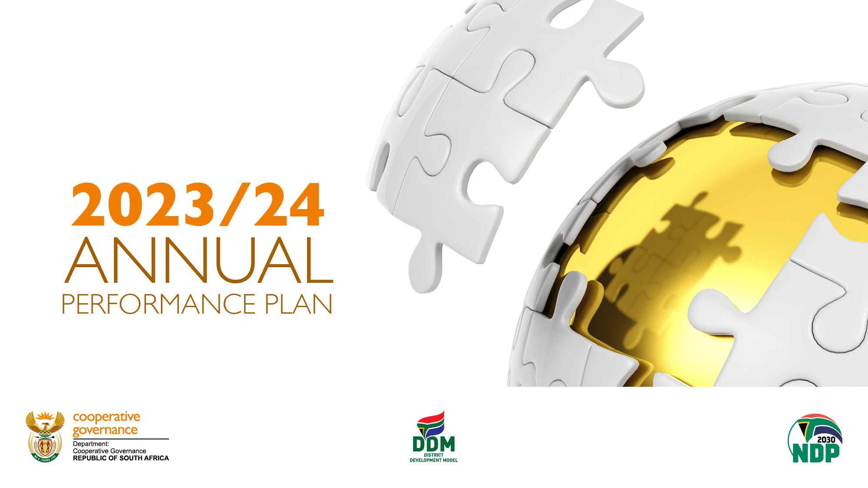
SELECT COMMITTEE ON COOPERATIVE GOVERNANCE AND TRADITIONAL AFFAIRS
& REVISED STRATEGIC PLAN 2020-25
Director-General: 2 May 2023

Slide 2
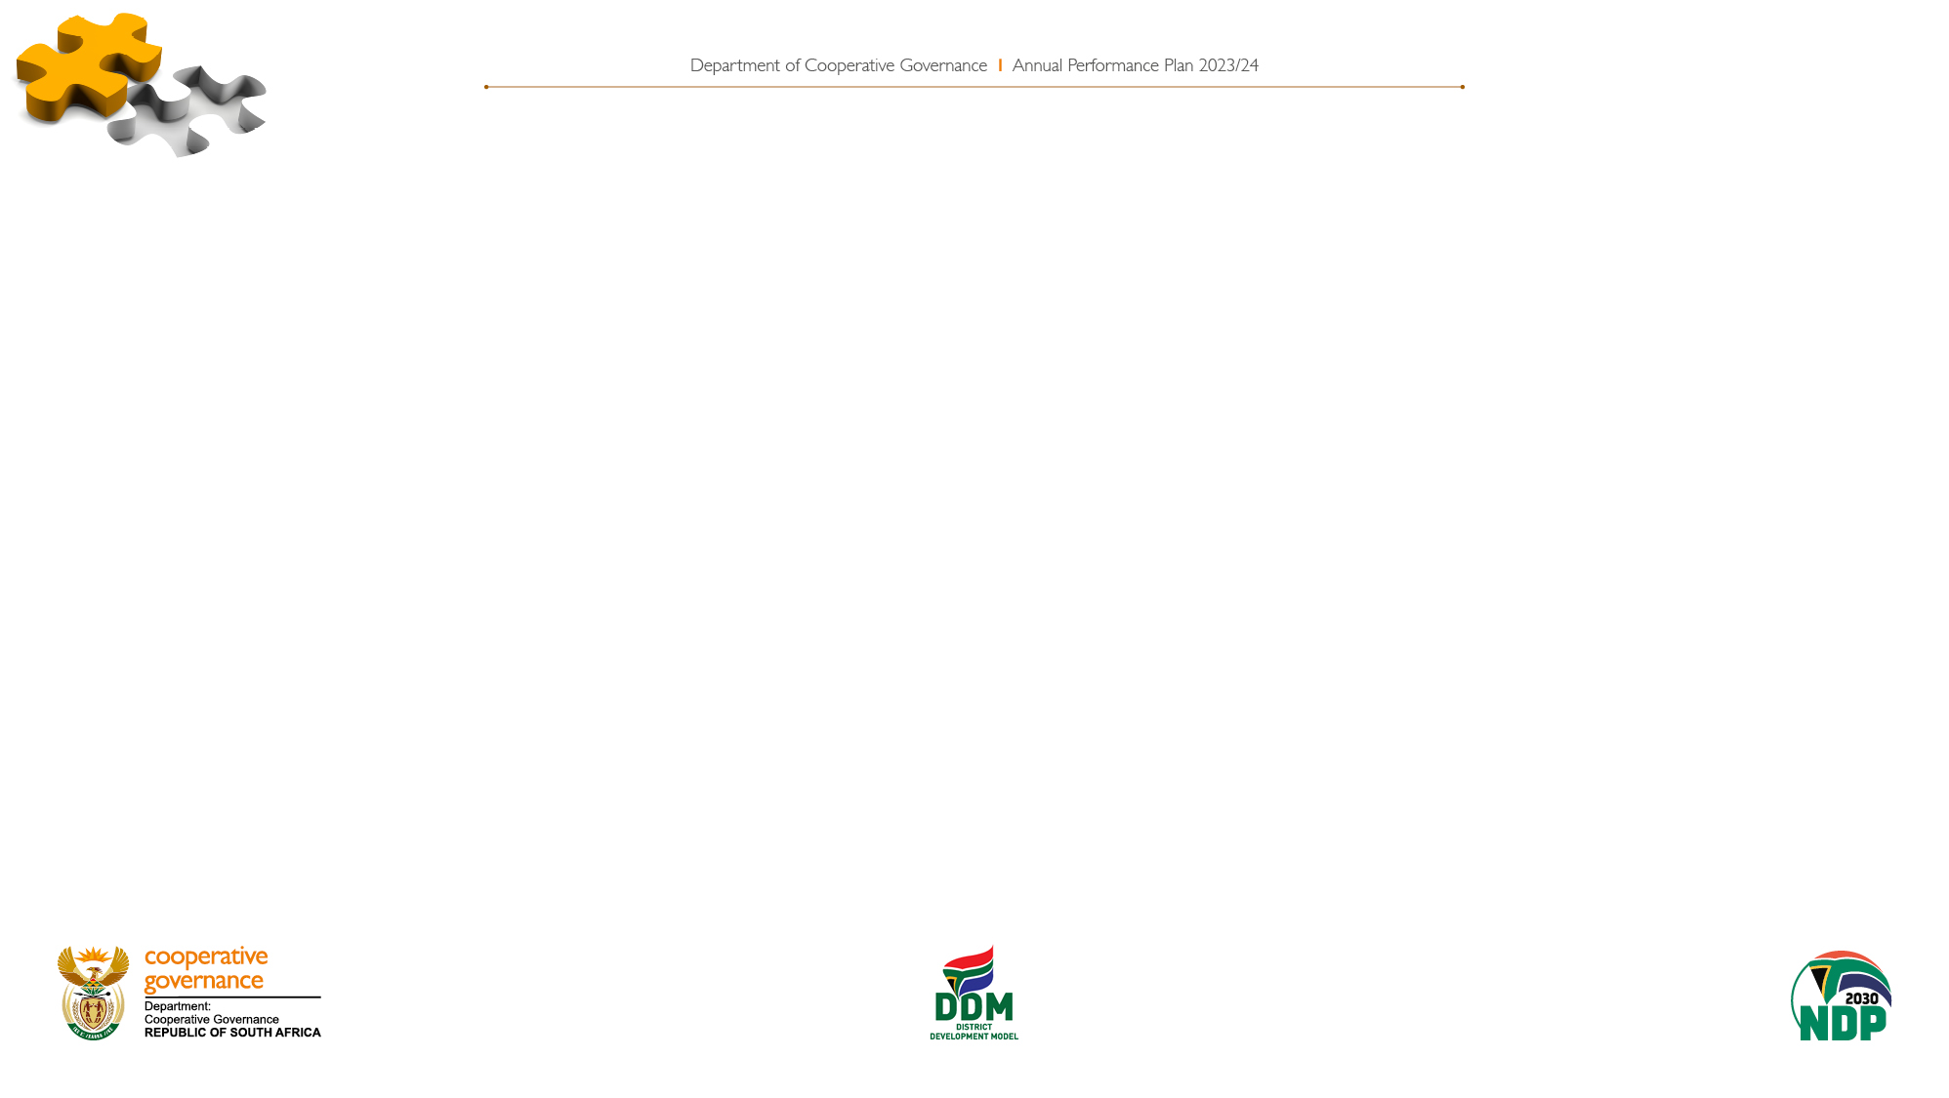
PRESENTATION OUTLINE
Introduction
Part 1 – Revised Strategic Plan 2020-2025
Part 2- Annual Performance Plan 2023/24; and
Part 3 – DCoG MTEF Budget Allocation.
Recommendations

Slide 3
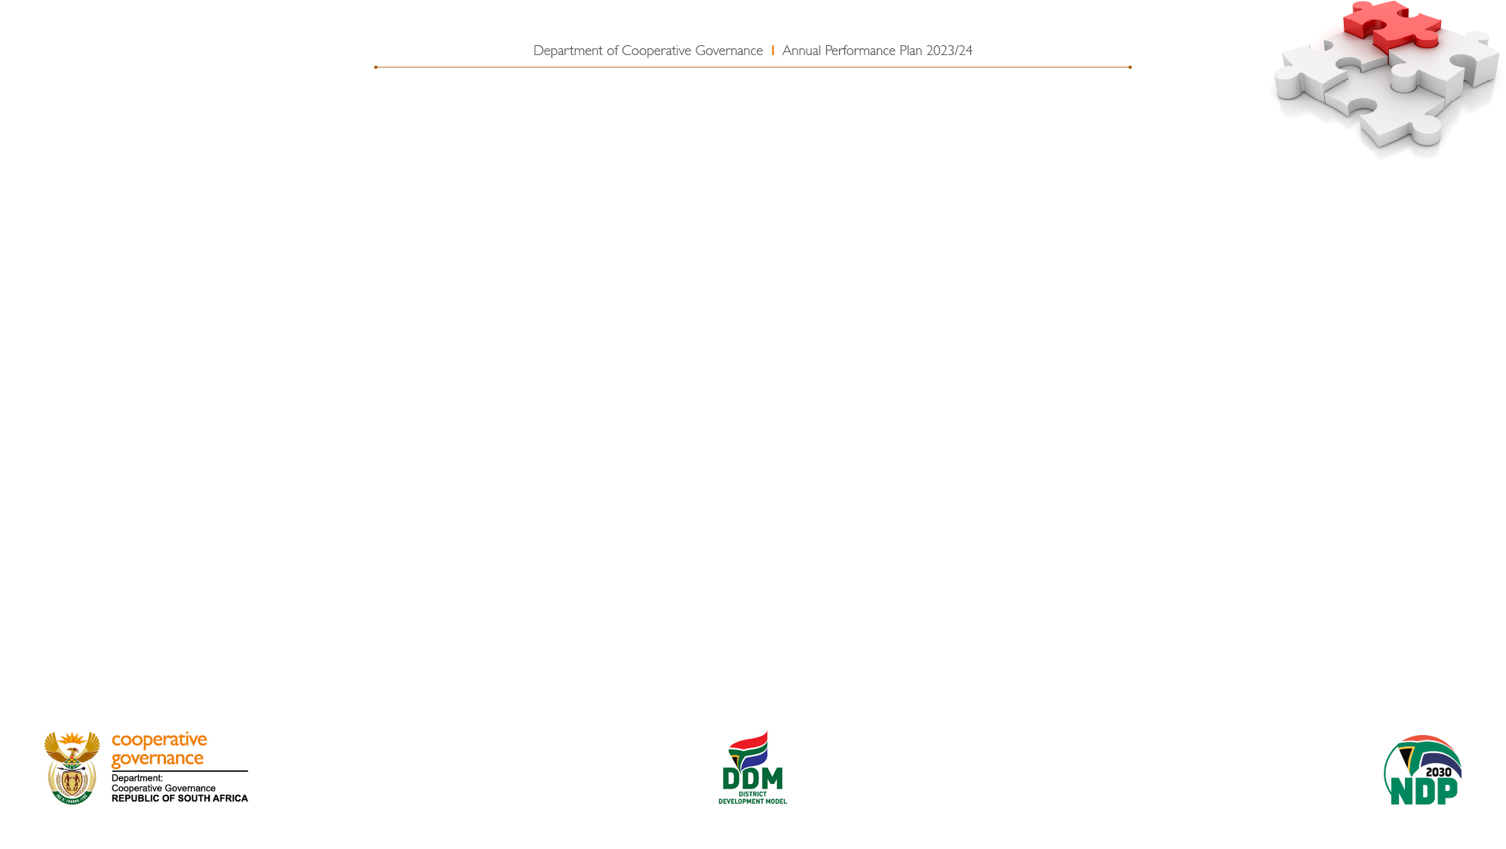
PURPOSE
To Present to the Select Committee on Cooperative Governance and Traditional Affairs the DCOG Revised Strategic Plan 2020/25, Annual Performance Plan 2023/24 and MTEF Budget Allocation

Slide 4
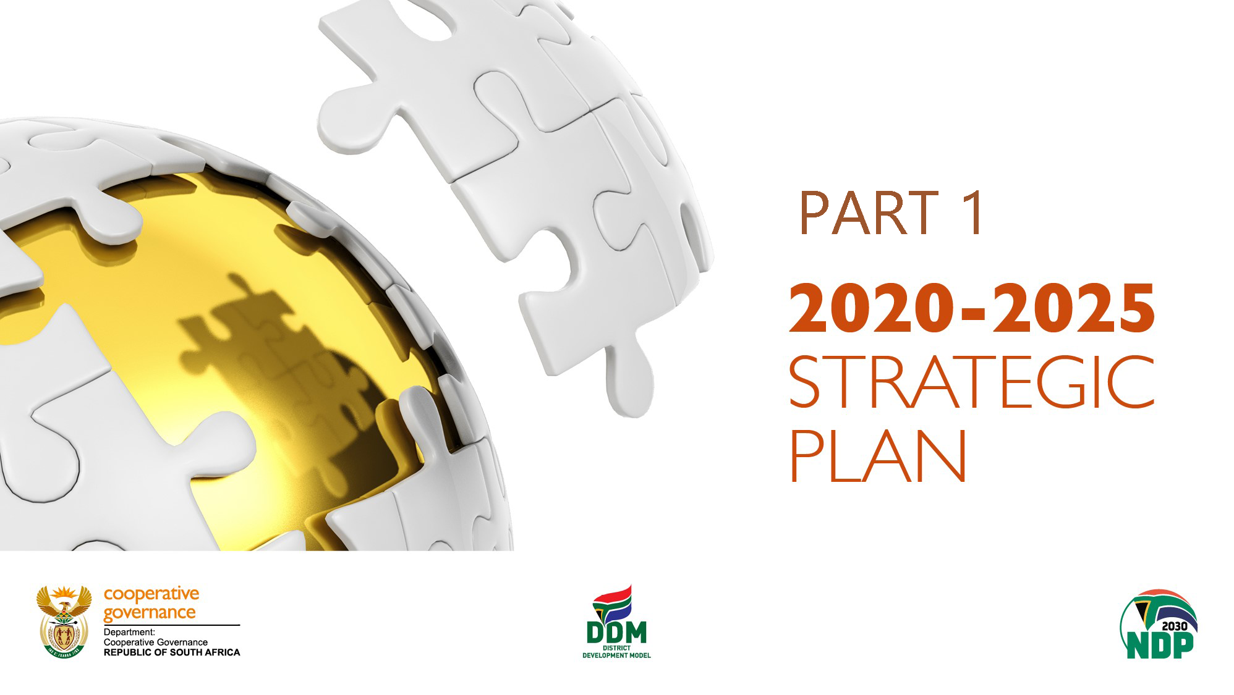

Slide 5
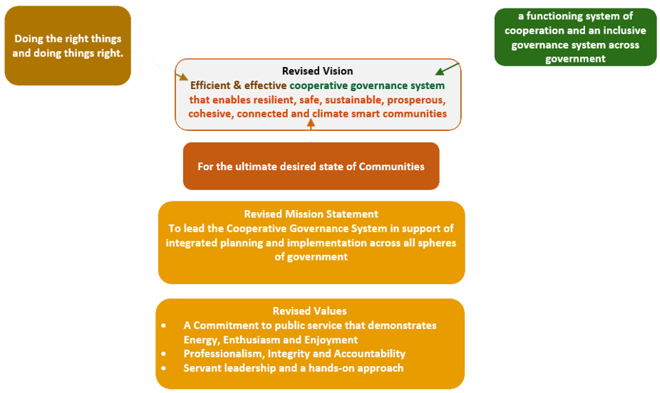
REVISED VISION, MISSION AND VALUE

Slide 6
REVISED PRIORITIES, FOCUS AREAS AND OUTCOME
Vision / Impact: Efficient & effective cooperative governance system that enables resilient, safe, sustainable, prosperous, cohesive, connected and climate smart communities
Mission: Lead the Cooperative Governance System in support of integrated planning and implementation across all spheres of government
Outcomes
Functional inter-governmental governance systems
Citizens engaged and participating in Government
Basic services delivered to all citizens in an effective and efficient manner
Financially viable municipalities
Sustained Good Municipal Governance
Direct
Cooperate
Coordinate
Support/ Intervene
Enable
Focus
Legislation and Policy
Cooperative and Participatory government
Integrated planning and implementation
Institutional capacity, governance and accountability
Integrated knowledge management
Priorities
Policy Review
Policy Compliance
Policy triggers
IGR– horizontal + vertical integration
Social Compacts
Citizen participation
District profiles
District One-Plans
All plans, budgets aligned to One-Plans
Governance
Financial viability
Capacity
Support / Intervention
Integrated Knowledge
Integrated Monitoring
The revised SP prioritizes the right policy universe that enables IGR to jointly plan, monitor, support, and intervene. The achievement of the intended Outcomes is an enabler to realise our Impact = resilient, safe, sustainable, prosperous, cohesive, connected and climate smart communities

Slide 7
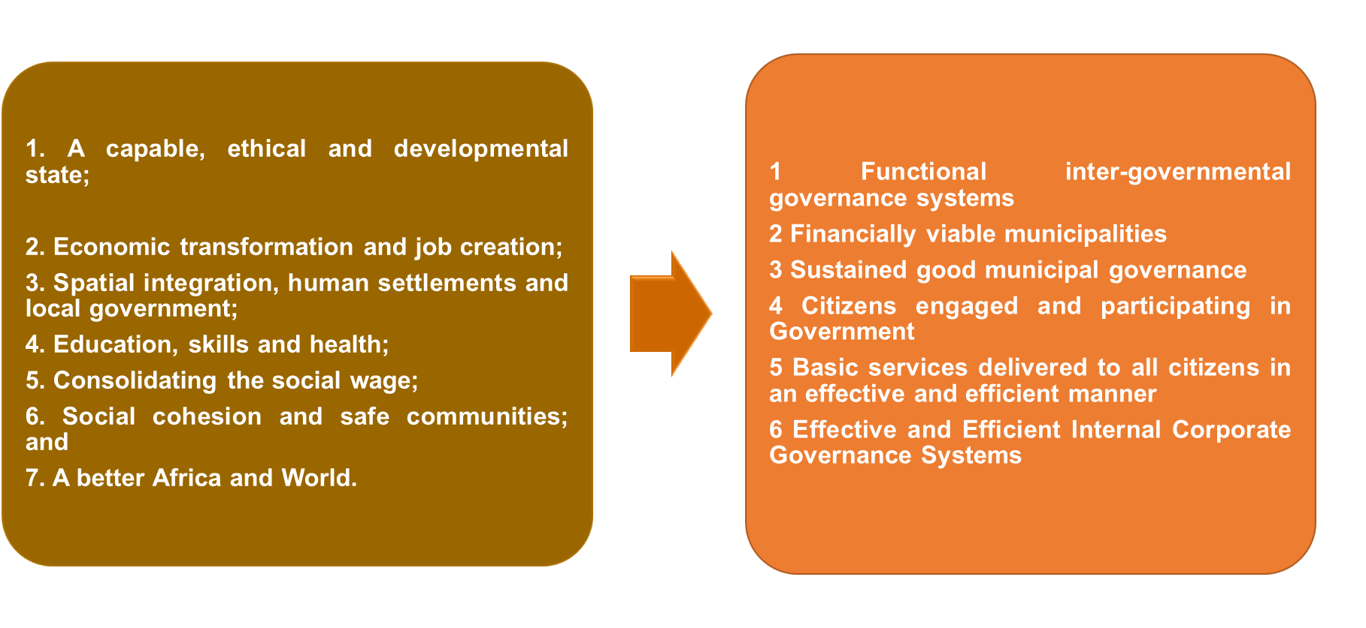
DEPARTMENTAL PRIORITIES
SIX DCoG Strategic Outcomes
Government Priorities

Slide 8
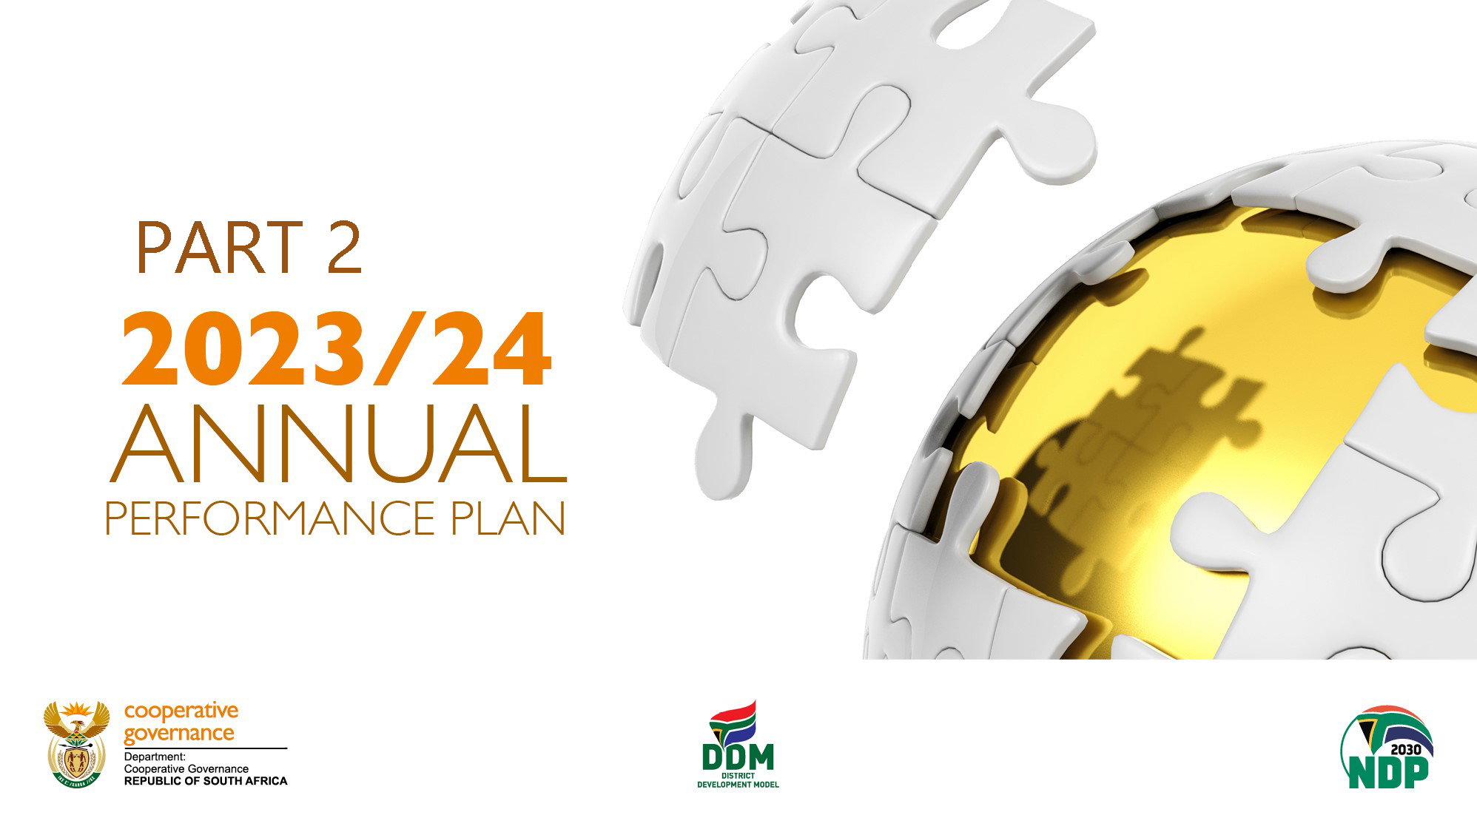

Slide 9
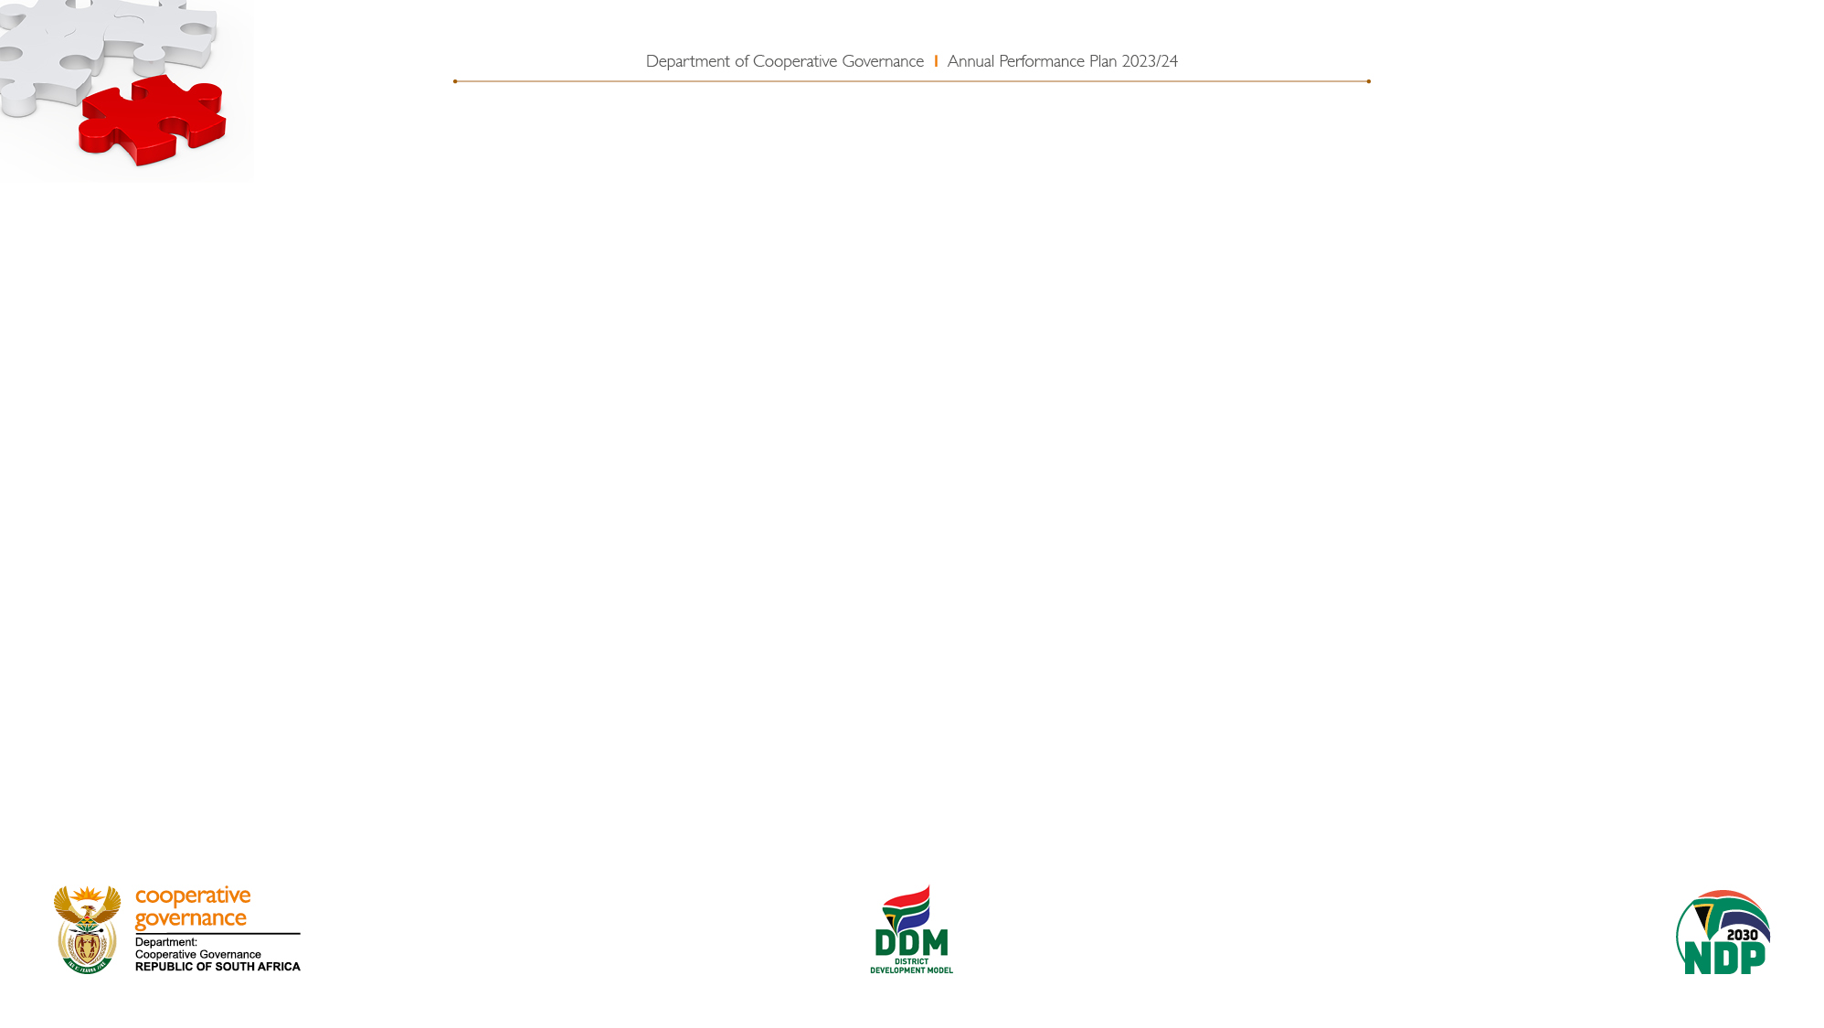
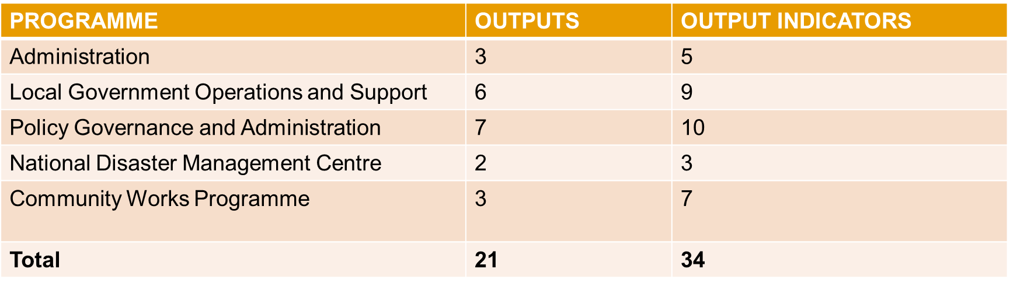
SUMMARY NUMBER OF PROJECT PER PROGRAM
The DCOG APP 2023/24 consists of the following number of outputs and output indicators:
The total number of Key Performance Indicators is 34

Slide 10

PROGRAMME 1: ADMINISTRATION
Outputs | Output Indicators | Annual Targets 2023/24
Corporate Services Improvement Plan (CSIP) implemented | 1.1 Percentage implementation of approved CSIP | 90% implementation of approved CSIP by 31 March 2024
Financial Services Improvement Plan (FMIP) implemented | 1.2 Percentage implementation of approved FMIP | 90% implementation of approved FMIP by 31 March 2024
Procurement spend on entities owned by women, youth and persons with disabilities | 1.3a Percentage procurement spend on entities owned by women | 40% procurement spend on entities owned by women by 31 March 2024
 | 1.3b Percentage procurement spend on entities owned by youth | 30% procurement spend on entities owned by youth by 31 March 2024
 | 1.3c Percentage procurement spend on entities owned by persons with disabilities | 7% procurement spend on entities owned by persons with disabilities by 31 March 2024

Slide 11
PROGRAMME 2: LOCAL GOVERNMENT OPERATIONS AND SUPPORT
Outputs | Output Indicators | Annual Targets 2023/24
DDM Institutionalised across all spheres of government | 2.1 Regulations in terms of the Intergovernmental Relations Framework Act (IGRFA) gazetted | Regulations in terms of the Intergovernmental Relations Framework Act (IGRFA) gazetted by 30 September 2023
 | 2.2 IGRFA amendment bill submitted to Parliament | IGRFA amendment bill submitted to Parliament by 31 March 2024
 | 2.3 Number of districts/metros that implemented at least one DDM catalytic project | One catalytic project implemented in 15 Districts/metros by 31 March 2024
Long standing disputes on water and electricity resolved | 2.4 Number of dysfunctional municipalities in which long-standing disputes on water and electricity are resolved through DDM | Long-standing disputes on water and electricity resolved in 22 dysfunctional municipalities by 31 March 2024
Implemented Municipal Support and Intervention Plans (MSIPs) | 2.5 Number of dysfunctional municipalities with MSIPs developed and implemented. | 22 dysfunctional municipalities with MSIPs developed and implemented by 31 March 2024

Slide 12
PROGRAMME 2: LOCAL GOVERNMENT OPERATIONS AND SUPPORT, cont.
Outputs | Output Indicators | Annual Targets 2023/24
Functional municipalities | 2.6 Percentage of Municipalities that are dysfunctional or at High Risk | 60% of Municipalities are dysfunctional or at High Risk by 31 March 2024
Functional ward committees | 2.7 Percentage of dysfunctional ward committees for which intervention plans are implemented | Intervention plans implemented for 50% of dysfunctional ward committees by 31 March 2024
Municipal Infrastructure | 2.8 Percentage of MIG receiving municipalities spending at least 85% of MIG allocations by the end of the municipal financial year | 50% of MIG receiving municipalities spending at least 85% of 2022/23 MIG allocations by 30 June 2023
 | 2.9 Number of MIG receiving dysfunctional municipalities spending at least 10% of MIG allocations on infrastructure repairs and refurbishment by the end of the municipal financial year | 5 MIG receiving dysfunctional municipalities spending at least 10% of 2022/23 MIG allocations on infrastructure repairs and refurbishment by 30 June 2023

Slide 13
PROGRAMME 3: POLICY, GOVERNANCE AND ADMINISTRATION
Outputs | Output Indicators | Annual Targets 2023/24
Local Government Legislative Review report and Local Government General Laws Amendment Bill | 3.1 Local Government General Laws Amendment Bill submitted to Cabinet and Parliament | Draft Local Government: General Laws Amendment Bill submitted to Cabinet by 31 March 2024
Improved Revenue management in dysfunctional municipalities | 3.2 Number of dysfunctional municipalities with increased revenue | 22 dysfunctional municipalities with increased revenue by 31 March 2024
 | 3.3 Percentage decrease in debt owed to dysfunctional municipalities | 10% decrease in debt owed to dysfunctional municipalities by 31 March 2024
Competent senior managers appointed in municipalities | 3.4 Number of municipalities where all senior managers meet the prescribed competency requirements | 66 municipalities where all senior managers meet the prescribed competency requirements by 31 March 2024
Concluded disciplinary cases | 3.5 Percentage of reported cases of allegations of financial misconduct, fraud and corruption by municipal staff members where disciplinary proceedings were concluded | 50% of reported cases of allegations of financial misconduct, fraud and corruption by municipal staff members where disciplinary proceedings were concluded by 31 March 2024

Slide 14
PROGRAMME 3: POLICY, GOVERNANCE AND ADMINISTRATION cont.
Outputs | Output Indicators | Annual Targets 2023/24
Consequences for breach of codes of conduct | 3.6 Percentage of cases of breach of the code of conduct for councillors where appropriate sanctions were applied | Appropriate sanctions applied in 50% of cases of breach of the code of conduct for councillors by 31 March 2024
 | 3.7 Percentage of cases of breach of the code of conduct for senior management where appropriate sanctions were applied | Appropriate sanctions applied in 50% of cases of breach of the code of conduct for senior management by 31 March 2024
Improved citizen satisfaction in service delivery | 3.8 Percentage of municipalities with improved citizen satisfaction with service delivery | 10% of municipalities with improved citizen satisfaction with service delivery by 31 March 2024
Spatially just and transformed national space economy | 3.9 Number of municipalities with SPLUMA compliant SDFs | 30 municipalities with SPLUMA compliant SDFs by 31 March 2024.
 | 3.10 Number of intermediate city municipalities with capital expenditure frameworks aligned to the Integrated Urban Development Framework | 5 intermediate city municipalities with capital expenditure frameworks aligned to the Integrated Urban Development Framework by 31 March 2024.

Slide 15
PROGRAMME 4: NATIONAL DISASTER MANAGEMENT CENTRE
Outputs | Output Indicators | Annual Targets 2023/24
National Disaster Management Framework | 4.1 Number of sector departments implementing disaster funding arrangements in terms of the Disaster Management Act | 4 sector departments implementing disaster funding arrangements in terms of the Disaster Management Act by 31 March 2024.
 | 4.2 Number of municipalities in priority disaster areas implementing a disaster management strategy to prevent, prepare for and mitigate disaster risks in terms of the Disaster Management Act | 14 municipalities in priority disaster areas implementing a disaster management strategy to prevent, prepare for and mitigate disaster risks in terms of the Disaster Management Act by 31 March 2024.
Improved functionality of Municipalities through implementation of the National Fire Safety and Prevention Strategy. | 4.3 Number of municipalities implementing the National Fire Safety and Prevention Strategy | 10 municipalities implementing the National Fire Safety and Prevention Strategy by 31 March 2024.

Slide 16
PROGRAMME 5: COMMUNITY WORK PROGRAMME
Outputs | Output Indicators | Annual Targets 2023/24
CWP participants enrolled in programme | 5.1 Number of people participating in the CWP sustained income model | 230 000 people participating in the CWP sustained income model by 31 March 2024
 | 5.2 Number of people participating in the new CWP sustainable exit strategies model | 20 000 people participating in the new CWP sustainable exit strategies model by 31 March 2024
 | 5.3 Percentage of women, youth and persons with disabilities participating in the Programme | 55% Women, 30% Youth and 2% persons with disabilities participating in the programme by 31 March 2024
Procurement spend on entities owned by women, youth and persons with disabilities | 5.4a Percentage procurement spend on entities owned by women | 40% procurement spend on entities owned by women by 31 March 2024
 | 5.4b Percentage procurement spend on entities owned by youth | 30% procurement spend on entities owned by youth by 31 March 2024
 | 5.4c Percentage procurement spend on entities owned by persons with disabilities | 7% procurement spend on entities owned by persons with disabilities by 31 March 2024

Slide 17
PROGRAMME 5: COMMUNITY WORK PROGRAMME cont.
Outputs | Output Indicators | Annual Targets 2023/24
Unqualified audit outcome | 5.5 Percentage of material irregularities and qualification paragraphs from previous financial years resolved | 100% of material irregularities and qualification paragraphs from previous financial years resolved by 31 March 2024

Slide 18
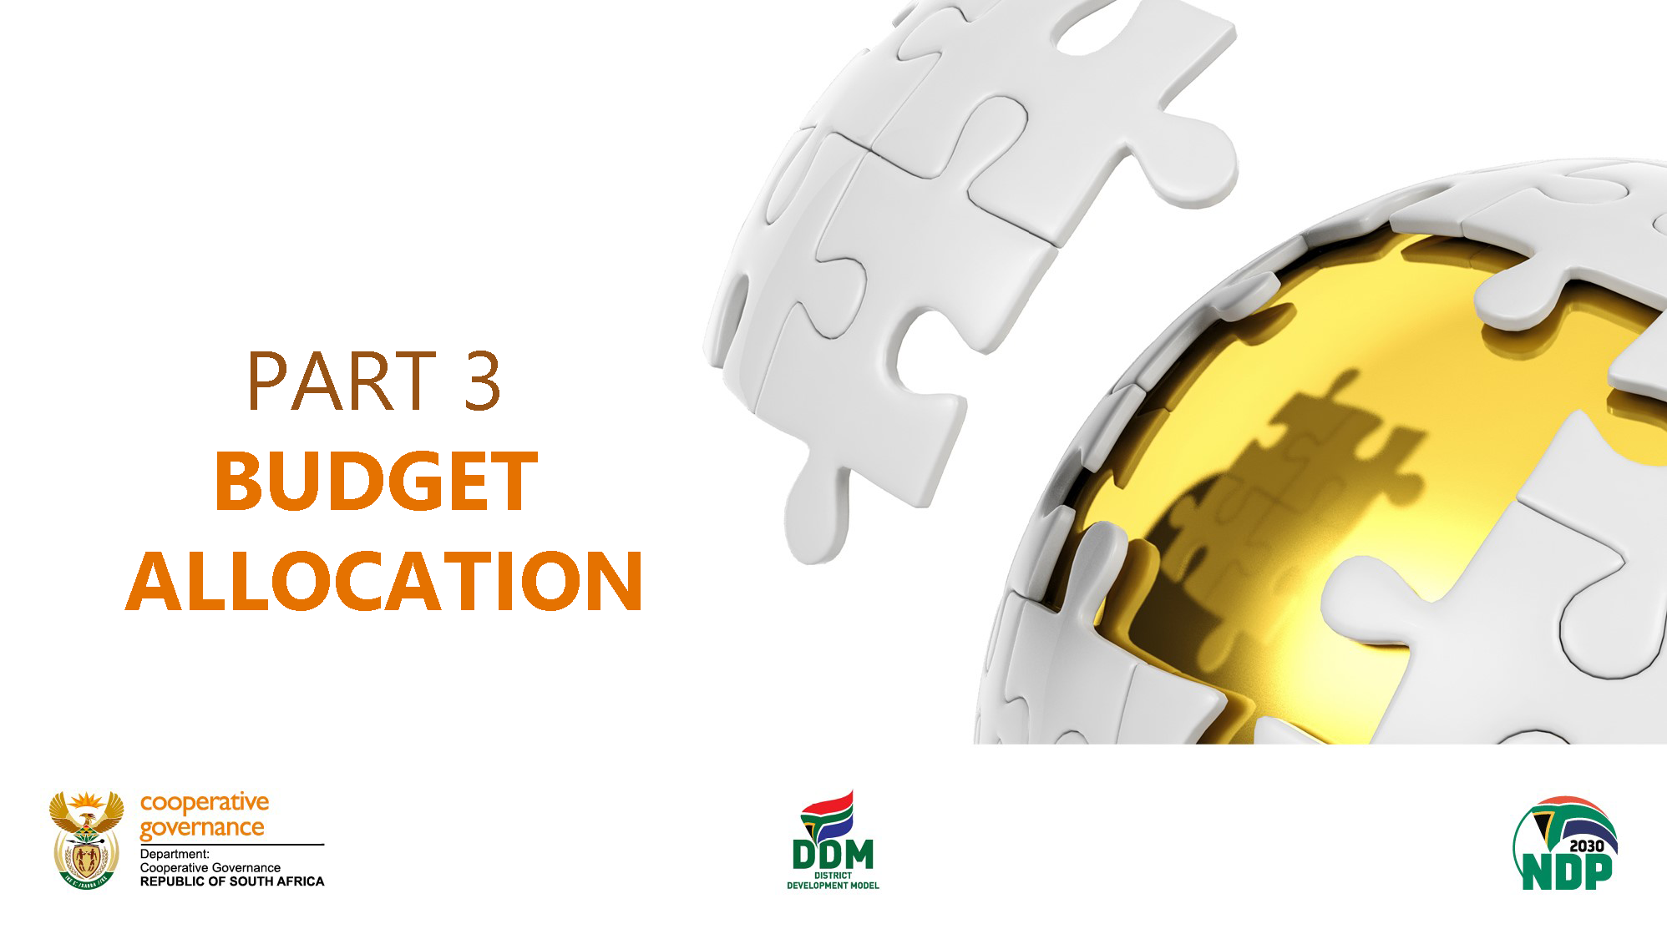

Slide 19
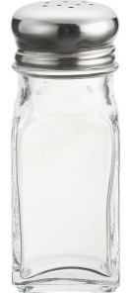

2023 MTEF KEY VALUE DRIVERS
Programme 1: Administration
R351.3 million
Programme 2: Intergovernmental Support
R9.2 billion
Programme 3: Intergovernmental Policy and Governance
R96.9 billion
Programme 4: National Disaster Management Centre
R932.2 million
Programme:5 Community Work Programme
R4.3 billion
2023/24 BUDGET ALLOCATION R 121 698 251.00
Compensation of employees
R346.7 million
Goods and services
R4.7 billion
Transfers and Subsidies
R116.6 billion
Capital
R23.4 million
Annual Performance Plan & Operational Plan
Procurement Plan
Service delivery

Slide 20
2023 ESTIMATE OF NATIONAL EXPENDITURE (ene) Allocation
The total expenditure of the Department is expected to increase at an average annual rate of 5.9 per cent, from R121.7 billion in 2023/24 to R136.5 billion in 2025/26.
Transfers to provinces and municipalities account for an estimated 95.4 per cent (R371.8 billion) of the department’s total budget over the MTEF period, of which the Local Government Equitable Share and the Municipal Infrastructure Grant accounts for 92.6%.
Expenditure on compensation of employees is expected to increase at an average annual rate of 4.4 per cent, from R346.7 million in 2023/24 to R377.7 million in 2025/26. This low increase reflects the anticipated decrease in the number of personnel from 585 in 2022/23 to 511 in 2025/26 due to mandatory reductions.
Goods & services will grow by 5.6%, but this growth is only on CWP and NDMC earmarked funding while the departmental operational budget will only grow by 1.5 per cent.
Payments for Capital assets is expected to decrease by 23.4 per cent.

Slide 21
COMPENSATION OF EMPLOYEES
GOODS AND SERVICES
2023/24: The Department goods and services allocation is encompassing indirect grant (MSIG), earmarked funds (CWP & NDMC assessment) and operational.
The MSIG support various projects that most must be implemented within the local sphere which are:
The District Development Model (DDM).
Roll-out of the Prototype Staff Establishment, Staffing Regulations and Competency Framework Projects.
Cost of Supply Study on Water.
Improvement of Records and Data Management Projects.
NDMC Assessment is earmarked to evaluate and assess damages to infrastructure that would relate to disaster as a result of floods, fire, drought, etc.
CWP allocation is to support government employment initiatives by creating income security in areas of unemployment.
Operational allocation is to support all administrative and operational activities to ensure that the Department achieve its strategic goals as set out in our mandate.
2023/24: The Department may experience overspending due to previous mandatory reductions and anticipated wage settlement for salary increase at an average of 7.5 per cent in the 2023/24 FY, which may lead to unauthorized expenditure, as COE is classified as specifically and exclusively appropriated. As proposed by NT, the Department is expected to be reprioritize funding as follows:
Programme 2: LGOS reprioritize R4 million under Travel and Subsistence, due to its recurring underspending as a results of meeting that are held virtually.
Programme 3: PGA reprioritize R3 million under Travel and Subsistence, due to its recurring underspending as a results of meeting that are held virtually.
Programme 4: NDMC reprioritize R5 million under Consultants and Travel and Subsistence, due to its recurring underspending as a results of cost containment measures and meeting that are held virtually.
Programme 5: CWP reprioritizes R31 million of Programme Management under Catering, Consultants and Travel and Subsistence due to support that Programme 1 and core function is giving to the programme and recurring underspending.

Slide 22
Payments for Capital Assets
Payments for Capital assets:
It is anticipated that the payments designated for capital assets will experience a reduction of 23.4% during the 2023/24 fiscal period.
These funds are intended to facilitate the acquisition of various machinery and equipment that will serve as essential instruments for the departmental officials, including office furniture, computer software, licenses, as well as other intangible assets such as vehicles, cellular phones, signal coverage devices, bags, containers, and domestic equipment.
A significant portion of these funds is expected to be allocated towards the development of infrastructure within the new office building.

Slide 23
2023 LG ALLOCATIONS AS PER DORA BILL
CHANGES TO LOCAL GOVERNMENT ALLOCATIONS
Additions to the local government equitable share
R8,3 billion is added to the LGES to increase coverage of the provision of free basic services
R2.5 billion in 2023/24, R2.3 billion in 2024/25 and R3.3 billion in 2025/26 to fully fund the provision of free basic services
Allocated through a formula to ensure fairness for all 257 municipalities.
Formula has updated data for:
- Household growth: 2,7% growth in Stats SA’s 2021 GHS
- Bulk water: 8.9% average water board bulk price increases
Bulk electricity: 20.7% based on previously approved Multi-Year Price Determination (MYPD)
Projected CPI for other costs
The formula is fully funded to account for House Hold growth and cost increases over the MTEF

Slide 24
PER HOUSEHOLD ALLOCATION TO MUNICIPALITIES 23/24

Slide 25
MTEF ALLOCATIONS PER PROVINCE (LGES)

Slide 26
MTEF ALLOCATIONS PER PROVINCE (MIG)

Slide 27
Recommendations
It is recommended that the Select Committee note the Annual Performance Plan and allocated budget FY 2023/24

Slide 28


