Slide 1
DSAC 2023/24 (APP) annual performance plan
Portfolio committeE
Presented by Acting Director-General:
02 May 2023

Slide 2

What Guides our Planning?
2020-2025 Strategic Plan
2023-2024 Annual Performance Plan
Core Outputs in 2023/24 APP
Our National Footprint – the DDM Model
Budget Allocation
Presentation
Structure

Slide 3
What Guides Our Planning?

Slide 4
STRATEGIC ALIGNMENT
SONA 2023
MTSF 2024/25
Constitution
NDP 2030
DSAC Strategic Plan
International Commitments
SDGs 2030
Entities Mandate
Acts
Policy & Legislation
White Papers
AU Agenda 2063
CCI Masterplan
National Sport and Recreation Plan
UNESCO
NASP 2023
BPF 2023
Public Entities APP
Public Entities Strategic Plan
DSAC APP
Operational Plan
Operational Plan
Annual Priority Interventions

Slide 5

Mandate
The Department is mandated amongst others to:
Provide leadership to the sport, arts, culture, and heritage sector to accelerate its transformation.
Provide an enabling policy, legislative and institutional framework to the SACH sector.
Promote participation in sport and recreation, arts and culture, and heritage.
Lead nation-building and social cohesion through social transformation.
Preserve, develop, protect, and promote the cultural, heritage, linguistic diversity, and legacy of South Africa.
Oversee the development and management of sport, arts, culture & heritage in South Africa in consultation with provinces.
Support the development of talented athletes and creatives by providing them with opportunities to excel.
Support high performance athletes and creatives to achieve success at an international level.
Promote access to information through enhancement of key structures and systems.

Slide 6
Mandate
Vision: “An active, creative, winning and socially cohesive nation”
Mission: “To provide an enabling environment for the Sport, Arts and Culture (SAC) Sector to foster an active, creative, winning and socially cohesive nation”

Slide 7
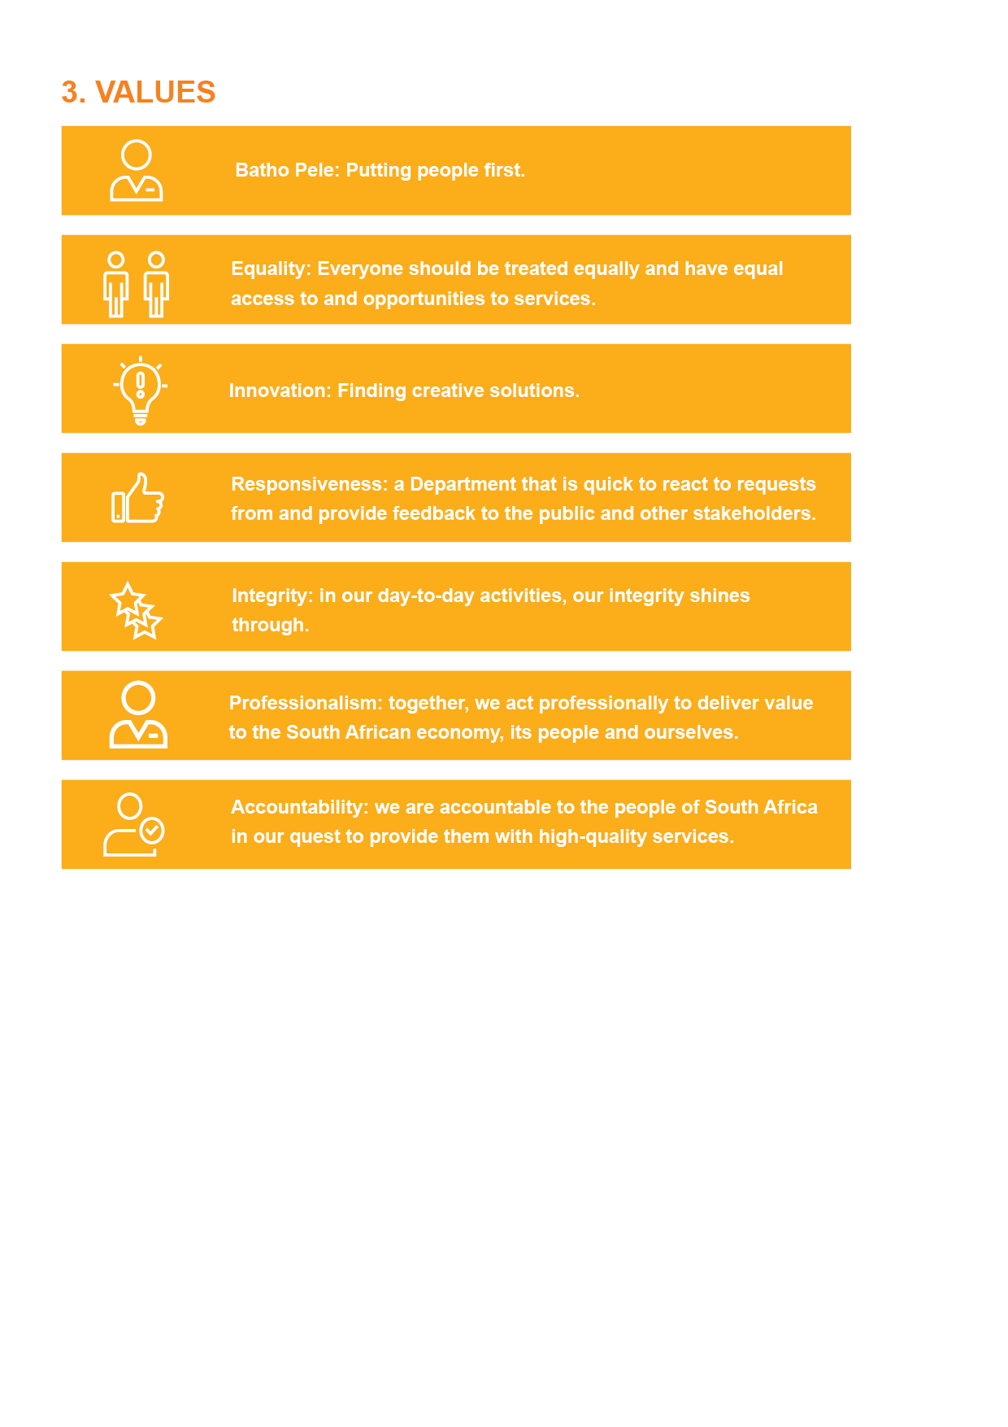
Values

Slide 8
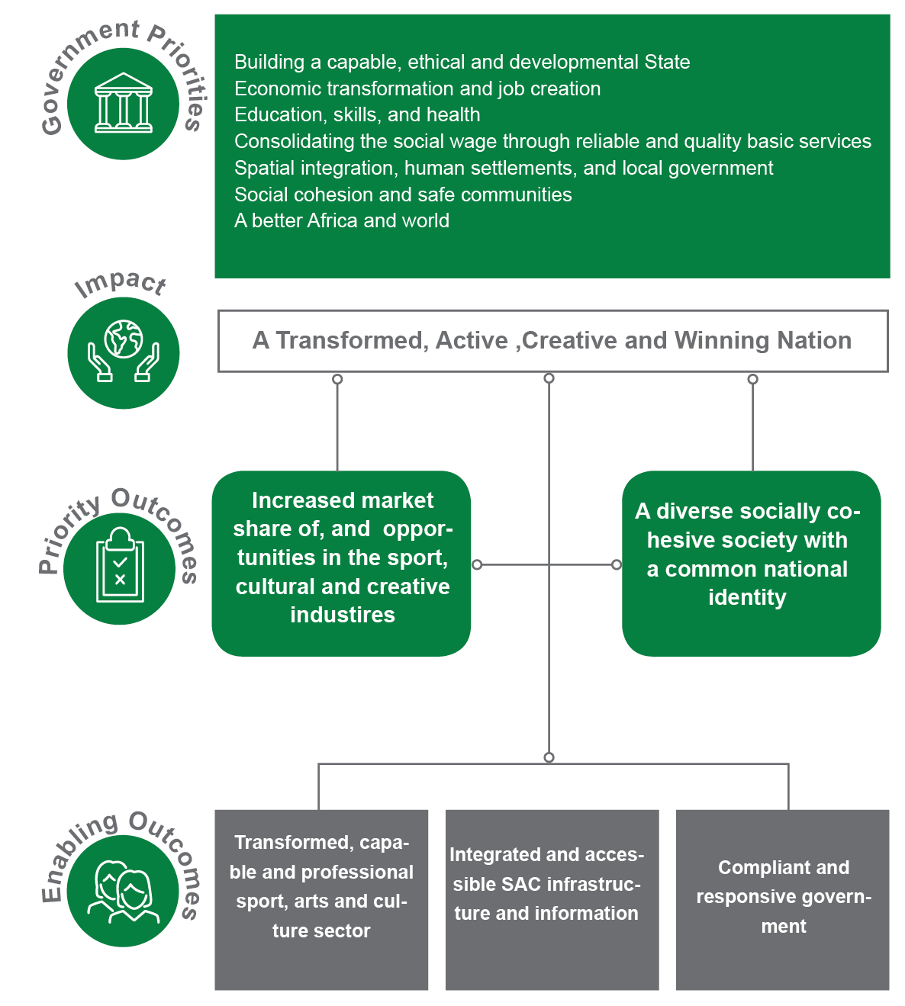
Government Priorities – DSAC Outcomes

Slide 9
Measuring Outcomes –
Increased market share of, and job opportunities created in sport, cultural and creative industries.
OUTCOME INDICATOR | BASELINE | FIVE-YEAR TARGET | SOURCE OF INFORMATION
CCI growth index | 4.9% | 5% | SACO; StatsSA – Annual Financial Statistics; Updated Social Accounting Matrix
Exports of cultural goods and services as a percentage of all exports. | -0.45% | 0.6% | SACO; SARS Customs and Excise Database
Percentage of Gross Domestic Product attributable to private and formal cultural production. | 1.7% | 2% | SACO; StatsSA
Number of people employed in the cultural and creative sectors and cultural occupations as a percentage of overall employment for the latest year. | 2.52% | 4% | SACO; Employment Survey - StatsSA
% of Broad-Based Economic Empowerment (BBBEE) procurement spend | 78% | 70% | DSAC Annual Report
% employment equity These targets are the minimum expected – a higher percentage equity is more favourable | 45% woman at senior management service (SMS) level; 2.1% people with disabilities | 50% woman at senior management service (SMS) level; 2% people with disabilities | DSAC Annual Report
13

Slide 10
Measuring Outcomes –
A diverse socially cohesive society with a common identity
OUTCOME INDICATOR | BASELINE | FIVE-YEAR TARGET | SOURCE OF INFORMATION
Pride in being South African | 83% | 90% | GCIS National Tracker Survey
Public opinion on race relations | 42% (2018/19) | 60% | GCIS based on Ipsos data
Social Cohesion Index | 61.4% | 70% | BrandSA Annual National Omnibus Survey
% of citizens who show a strong devotion to their country | 82% | 95% | STATSSA: Governance, Public Safety and Justice Survey Institute of Justice and Reconciliation SA Reconciliation Barometer
14

Slide 11
Measuring Outcomes –
Enablers
OUTCOME | OUTCOME INDICATOR | BASELINE | FIVE-YEAR TARGET | SOURCE
Transformed, capable and professional SAC Sector | Arts and Culture Sector organised into councils affiliated under the CCIFSA | Councils not affiliated under the CCIFSA | Councils for sector genres established | DSAC
 | Improvement in Olympic and Paralympic medal status | Total number of 2020 Olympic and Paralympic medals | An increase of 10 medals | DSAC
Integrated and accessible SAC infrastructure and information | Number of sport and recreation facilities compliant with norms and standards | 137 | 175 | DSAC
Compliant and responsive governance | Audit outcome | Unqualified | Clean | DSAC Annual Report

Slide 13
Slide Title
Begin Planning
Documentation
13 CD Sessions
6 June 2022
An Environmental Analysis Working Document Template, with guidelines, was developed.
Sessions facilitated with 10 Chief Directorates
Analysis
Mandate
Outcomes
Performance
New MTSF
August Workshop
Strategic Planning
CDs Presentation
Identify
Outcomes
CDs present to SMS
17-19 August
Assess presentations & provide feedback
Results of environmental analysis (SWOT)
1. DSAC SWOT
2. 2023/24 Draft Plans
Planning Process Map
3. Challenges
Public Entities
4. Admin support plan
Consolidation
Strategic Alignment
Progs update presentations and develop responses to new challenges raised
APP enriched with research findings & Government Priorities for 2023/24.
Public Entities assisted upon request
DPME
Draft 1 submitted October
DPME
2023/24 ENE
Quality Assurance
Draft 1 Self Assessment conducted Nov
> 80%
Share Draft 1 APP with M&E; Risk; Internal Audit
Align ENE commitments to Draft APP

Slide 14
Steps towards finalisation & tabling
Dec 2022
Respond to NT queries on APP
Integrate feedback from M&E and Internal Audit
7 Feb 2023
Update expenditure analysis (ENE)
Receive feedback from DPME (15 Dec)
Minister’s workshop
March 2023
Respond to feedback from M&E; Internal Audit & DPME
Share APP
Table APP from 9 March 2023
Update Draft 1 APP
Confirm strategic priorities
Print and distribute APP
Way forward
Update APP with Ministry inputs
Update Strategic Risk Plan
Submit to AGSA 13 Jan
Review 2023 SONA commitments 9 Feb
Draft responses to DPME feedback
Respond to DPME queries & resubmit 17 Feb
Address AGSA queries
Present APP to Audit Committee 27 Feb
Design and finalize APP
Include ENE budget tables
Feb 2023
Source outstanding prog. information
Jan 2023
www.free-powerpoint-templates-design.com

Slide 15
Structure of APP

Slide 16
PART A: OUR MANDATE
1. Mandate
1.1 Acts
1.2 Bills
1.3 Regulations
1.4 Other prescripts governing the Department
1.4.1 Sector specific
1.4.2 Generic
1.5 International treaties
2. Updates to institutional policies and strategies governing the five-year planning period
3. Updates to relevant court findings

Slide 17
  1. Cultural Institutions Act, 1998 (Act No. 119 of 1998)
  2. Culture Promotion Act, 1983 (Act No. 35 of 1983)
  3. Heraldry Act (Act No. 18 of 1962)
  4. Legal Deposit Act, 1997 (Act No. 54 of 1997)
  5. National Archives and Record Service of South Africa Act, 1996 (Act No. 43 of 1996)
  6. National Arts Council Act, 1997 (Act No. 56 of 1997)
  7. National Council for Library and Information Services Act, 2001 (Act No. 6 of 2001)
  8. National Film and Video Foundation Act, 1997 (Act No. 73 of 1997)
  9. National Heritage Council Act, 1999 (Act No. 11 of 1999)
  10. National Heritage Resources Act, 1999 (Act No. 25 of 1999)
  11. National Library of South Africa Act, 1998 (Act No. 92 of 1998)
  12. National Sport and Recreation Act, 1998 (Act No. 110 of 1998)
  13. Pan South African Language Board Act, 1995 (Act No. 59 of 1995)
  14. Safety at Sports and Recreational Events Act, 2010 (Act No. 2 of 2010)
  15. South African Boxing Act, 2001 (Act No. 11 of 2001)
  16. South African Geographical Names Council Act, 1998 (Act No. 118 of 1998)
  17. South African Institute for Drug-free Sport Act, 1997 (Act No. 14 of 1997)
  18. South African Language Practitioners' Council Act, 2014 (Act No. 8 of 2014)
  19. South African Library for the Blind Act, 1998 (Act No. 91 of 1998)
  20. Use of Official Languages Act, 2012 (Act No.12 of 2012)
Acts

Slide 18
BILLS
National Sport and Recreation Amendment Bill, 2021 – approved by Cabinet for submission to Parliament.
South African Geographical Names Council Amendment Bill 2021 – to be submitted to the South African Geographical Names Council for consideration.
Heraldry Bill, 2023 – to be submitted to the Office of the Chief State Law Advisor.
REGULATIONS
These regulations will be reviewed after the National Sport and Recreation Act, 1998, has been amended–
Bidding and Hosting of International Sport and Recreational Events Regulations, 2010
Recognition of Sport and Recreation Bodies Regulations, 2011
Funding of Sport or Recreational Bodies Regulations, 2015
Safety at Sport and Recreational Events Regulations, 2017.
Bills and Regulations

Slide 19
Policy development 2023/24
Programme 2
Athlete Support Policy
South African Sport Academies Strategic Framework and Policy Guideline
The Prioritisation of Sport and Recreation Bodies Policy
Recognition of Excellence Policy
Infrastructure Management Policy:
Safeguarding in Sport Policy
National Plan and Recreation Plan
Programme 3
National terminology policy guidelines
Translation administration policy guidelines
DSAC language policy.
National Book Policy
Visual Arts Policy
Theatre & Dance Policy
Events Technical and Production services industry B-BBEE Sector Code
DSAC Transfers and Funding Policy
Craft Strategy
Music policy
Design policy
International Relations Strategy and Policy
Programme 4
National Heritage Legacy Projects policy

Slide 20
Court Rulings
Case | Ruling | Implications
The National Department of Arts and Culture (DAC) and The South African Roadies Association (SARA) Case number: 63756/17 | 3-year obligation for the funding of SARA’s Operational & Programming costs. The current ruling on the SARA matter is that of the Public Protector of South (PPSA) Africa dated June 2017. In this ruling, the PPSA outlined several remedial actions to be implemented by the Department. These were further made into an order of court by the High Court of South Africa on 22nd August 2018, which instructed the Department to implement the Settlement Agreement of April 2014 between the Department and SARA which obligated the Department to fund SARA’s proposals for renovations, operational and programming costs. | Creates limitations to programme planning & available budget. Creates legal precedence risk.

Slide 21
PART B: OUR STRATEGIC FOCUS
Updated Situational Analysis
- External Environmental Analysis
- Internal Environmental Analysis
Overview of Human Resources
Core Projects of DSAC – 2023/24

Slide 22

SITUATIONAL ANALYSIS - external
SWOT ANALYSIS
ECONOMY AND JOB OPPORTUNITIES
2023 Budget Prioritization Framework
Economic Reconstruction and Recovery Plan
Presidential Employment Stimulus Programme
SACO CCI Mapping Study 2022
Cultural Creative Industries Masterplan
Mzansi Golden Economy (MGE)
SOCIAL COHESION AND NATION BUILDING
GENDER-BASED VIOLENCE AND FEMICIDE
TRANSFORMATION AND CAPACITY BUILDING
INFORMATION AND INFRASTRUCTURE
GOVERNANCE
TARGET GROUPS
Youth
Women
People with a disability

Slide 23

SITUATIONAL ANALYSIS - internal
Organisational Review
Human Resources
Preferential procurement
ICT Strategy
Budget

Slide 24
Human Resources
SALARY LEVEL | DISABILITY | COLOURED MALE | COLOURED FEMALE | INDIAN MALE | INDIAN FEMALE | AFRICAN MALE | AFRICAN FEMALE | WHITE MALE | WHITE FEMALE | TOTAL FILLED | FUNDED VACANT POSITIONS | POSTS ADDITIONAL TO ESTABLISHMENT | TOTAL POSTS
Interns |  |  |  |  |  | 13 | 36 |  |  | 49 |  | 49 | 49
Level 1 |  |  |  |  |  |  |  |  |  | 0 |  |  | 0
Level 2 |  |  |  |  |  | 7 | 12 | 1 |  | 20 |  | 13 | 20
Level 3 |  |  |  |  |  | 5 | 11 |  |  | 16 | 1 | 1 | 17
Level 4 | 2 |  |  |  |  | 8 | 4 |  |  | 12 | 5 |  | 17
Level 5 |  |  |  |  |  | 12 | 18 |  | 1 | 31 | 15 | 5 | 46
Level 6 | 1 |  | 1 |  |  | 8 | 11 |  | 2 | 22 | 1 |  | 23
Level 7 | 4 | 1 | 1 |  | 1 | 26 | 62 | 1 | 5 | 97 | 44 |  | 141
Level 8 |  |  |  |  |  | 9 | 21 | 4 | 1 | 35 | 8 |  | 43
Level 9 | 3 |  |  |  |  | 31 | 41 | 2 | 4 | 78 | 33 |  | 111
Level 10 |  |  | 1 |  |  | 8 | 18 |  | 1 | 28 | 4 |  | 32
Level 11 | 3 | 1 |  |  | 1 | 34 | 27 |  | 3 | 66 | 21 | 3 | 87
Level 12 |  | 2 | 2 |  |  | 21 | 16 | 4 | 3 | 48 | 4 |  | 52
Level 13 | 2 |  | 1 |  | 2 | 20 | 20 | 1 |  | 44 | 4 |  | 48
Level 14 |  | 1 | 1 |  |  | 9 | 4 |  |  | 15 | 1 | 1 | 16
Level 15 |  |  |  |  | 1 | 1 | 2 |  |  | 4 | 1 |  | 5
Level 16 |  |  |  |  |  | 2 | 1 |  |  | 3 | 1 |  | 4
TOTAL | 15 | 5 | 7 | 0 | 5 | 214 | 304 | 13 | 20 | 568 | 143 | 72 | 711
Vacancy rate: 20.11
Disability: 2.64
SMS Women: 48.48
SMS Vacancy Rate: 11.86
Youth %: 22.54%

Slide 25

Core Projects of DSAC – 2023/24
The five tables below provide a snapshot of the core projects of DSAC that have been planned for 2023/24.
The projects are grouped according to the 5 Outcomes they predominately contribute towards.

Slide 26
Government Priority | ECONOMIC TRANSFORMATION AND JOB CREATION A BETTER AFRICA AND WORLD
DSAC Outcome | INCREASED MARKET SHARE OF AND JOB OPPORTUNITIES CREATED IN SPORT, CULTURAL AND CREATIVE INDUSTRIES
Intervention | Enabling framework/well researched, regulated and funded SAC sector | Support a range of cultural and creative sector initiatives to promote the diverse creative industries | Expansion in new and traditional creative industry markets, cultural diversity and heritage | Increased economic participation by historically disadvantaged groups
Outputs | Research (incl. SACO) Intellectual property development Integrated funding model Cultural & Creative Industries Master plan (CCI) Economic Reconstruction & Recovery Plan (ERRP) | Mzansi Golden Economy programme (MGE) Films and documentaries Flagship & cultural events Sport events Emerging creatives programme Visual artists - Art Bank acquisitions Public Art Publishing House | Market access programmes (incl film festivals; book fairs) International engagements Touring ventures Cultural diplomacy | Job creation Targeted procurement spends Presidential Employment Stimulus Programme (PESP)

Slide 27
Economic contribution
Design and creative services contributed 32% of the Cultural and Creative Industries (CCI), followed by audio-visual and interactive media at 30% and the visual arts and crafts at 15% of the CCI’s contribution to the GDP.
For the first time in 20 years, South Africa had a positive cultural goods trade balance for some quarters in 2020 and 2021
The creative economy accounts for 6% of all employment in South Africa (an estimated 1 million jobs)

Slide 28
Job opportunities provided
The SACH seen as “new gold” which has the potential to increase economic growth and create jobs in South Africa. Response - MGE
MGE | SOURCE OF JOB OPPORTUNITIES | 2022/23 JOB OPPORTUNITIES PROVIDED | 2023/24 JOB OPPORTUNITIES PROJECTED
The MGE seeks to create economic and job opportunities in the arts, culture, and heritage sector by supporting programmes designed to develop audiences, stimulate demand, increase market access, and develop skills. | Programme 1 | Does not create jobs, support is provided to line functions. Projects are implemented through service providers.
Programme 2 | Programme 2
Sport and recreation bodies | Sport and recreation bodies |  | 685
Conditional Grant | Conditional Grant | 256 | 470
Legacy Projects | Legacy Projects | 35 (only for Dr. JL Dube project) | 44
Public Entities (Infrastructure) | Public Entities (Infrastructure) | 1311 | 400
MIG | MIG | 440 | 560
Outdoor gyms | Outdoor gyms | 50 | 50
Programme 3 | Programme 3
MGE | MGE | 12 534 | 12 000
PESP | PESP | 29 930 | 36 000
Programme 4 | Programme 4
Heritage bursary graduates | Heritage bursary graduates |  | 15
PESP | PESP |  | 4 000
Heritage institutions (estimated) | Heritage institutions (estimated) |  | 220

Slide 29
Government Priority | SOCIAL COHESION AND SAFE COMMUNITIES
DSAC Outcome | A DIVERSE, SOCIALLY COHESIVE SOCIETY WITH A COMMON NATIONAL IDENTITY
Intervention | INCREASE AWARENESS OF CHARTER OF POSITIVE VALUES AND NATIONAL SYMBOLS | EQUALISING OPPORTUNITIES, INCLUSION AND REDRESS | INCREASE INTERACTION ACROSS SPACE, RACE AND CLASS (BY FACILITATING OPPORTUNITIES FOR PEOPLE TO SHARE SPACE AND EXPERIENCE)
Output | Moral Regeneration Movement projects National symbols Heraldry Services | Target groups’ programmes Social compact Initiatives against Gender-Based Violence Living Human Treasures publications Transformed and standardised geographical names. | National days’ celebrations. Participation in sport and recreation Advocacy platforms on social cohesion Community conversations Provincial Community Arts Development Programmes Youth-focused arts development programmes Sport and recreation promotion campaigns and events International Cultural Seasons Africa Month Arts and Social Development Programmes Community and school SAC programmes

Slide 30
Social Cohesion
________
DSAC with its various partners and stakeholders are reviewing the Social Cohesion Strategy to refocus efforts and improve the response to what the NDP calls for.
- worrying trust-deficit trends
In terms of the determinants for social cohesion, South African society is negatively driven by all the determinants required for social cohesion:
Racial diversity: The racial segregation caused by apartheid is well-documented.
Gender Inequality persists and is one of the inequalities that cut across racial and income inequality most likely contributing to the high levels of GBV in South Africa.
Economic inequality: The World Bank has found South Africa to be the most unequal in terms of income inequality.
Education: The school drop-out rate is between 37 and 42 percent (Business Tech, 2020).
Historical events: Once again, the history of apartheid and colonialism and its devastating impact on South African society, is well-documented.
GDP: The South African economy has been stagnating for a prolonged period, and fails to deliver jobs (RSA, N.d.).
Subjective well-being: There is a stark contrast in the subjective well-being of the minority communities, especially the White and Indian communities, versus the Black majority (Neff, 2005).
Health: There is disparity in health cover between the various race groups.

Slide 31
The Social Cohesion and Nation Building Compact
Even though numerous consultations have taken place including a Sector Consultation (January-December 2019); the Social Compact Convention (February 2020); a social compact consultation workshop (February 2021); and the 2022 Presidential social sector summit of 4-5 August 2022, the compact has not yet been signed.
All sectors have been mobilised and the aforesaid, are some of the consultation efforts made, with the intention that the outcome would be the signing of the compact by all relevant parties. With engagements of relevant parties at the National Economic Development and Labour Council (NEDLAC) not having borne fruits, clear direction must be provided to the Department as to the future need for a social cohesion and nation building compact, and whether it would not assist the process, for a more central and authoritative coordinating structure/organisation rather than the DSAC, to be leading the processes towards signing this compact or incorporating it into other compacts.
At this stage, without the signing of the compact by relevant parties, or provision of direction for the future as highlighted above, the project remains stuck (despite DSAC having led the development of a draft).
The Department will provide the necessary feedback to the Social Protection and Community Development Cluster in this regard.

Slide 32
2019-2024 MTSF
2024 – 2029 MTSF PROPOSED CONTRIBUTIONS FROM DSAC
Number of community conversations/dialogues implemented to foster social interaction.
Number of advocacy platforms on social cohesion implemented by social cohesion advocates.
Number of athletes supported by scientific support.
Number of sport and recreation promotion campaigns and events implemented.
Number of schools, hubs and clubs provided with equipment and attire.
Number of Provincial Community Arts Development Programmes implemented.
Number of projects in the creative industry supported through the Mzansi Golden Economy programme.
Number of Films and/or Documentaries supported telling stories of the History of Liberation, Cultural and Heritage importance.
Number of bursaries awarded for the development of qualified language practitioners
Number of Job Opportunities for language practitioners.
Percentage of documents received that are translated and edited.
Number of multi-year human language technology projects supported.
Number of initiatives implemented to raise awareness on the national symbols.
Number of organised sport and recreation community activities supported.
Number of heritage bursaries awarded to deserving students

Slide 33

Government Priority | EDUCATION, SKILLS, AND HEALTH
DSAC Outcome | TRANSFORMED, CAPABLE AND PROFESSIONAL SPORT, ARTS AND CULTURE SECTOR
Intervention | Increase awareness of SAC offerings and opportunities | Capacity building in SAC sector | SAC practitioners achieve success at international events | Capacitate, organise and professionalise the SAC sector
Output | SAC promotional campaigns | Artists placed in schools Bursaries Capacity building projects Practitioners supported through the SAC academies, COEs and incubators Induction of newly appointed public entity council members | High performance athletes supported Talented athletes developed Scientific support services Government support to anti-doping agencies Recognising achievements in SAC. | Transformation in sport and recreation Provision of sports equipment and attire National federations supported Sector support Presidential Employment Stimulus Programme (PESP)

Slide 34
Capacity building
In supporting education, skills, and health, DSAC is committed to upskilling and transforming the sector. Bursaries, placements, incubators, and other capacity building initiatives are central to this. This area was stagnant during COVID but is recovering well as the programmes are implemented at full capacity again.
Cultural occupations are contributing to transformation objectives in South Africa.
Younger creative economy workers also tend to be more representative of the demographics of the country, which is further evidence of ongoing transformation.
Given the Creative Industry’s changing skills requirements as the sector pivots to digital platforms in the 4IR, education and skills development must remain a priority.
The Department allocates a budget each year towards Incubator and Training Programmes where artists are provided with practical skills that enable them to grow their businesses. This programme aims to support the development, availability, and the retention of skilled human capital in the country’s heritage sector.

Slide 35
Government Priority | SPATIAL INTEGRATION, HUMAN SETTLEMENTS AND LOCAL GOVERNMENT
DSAC Outcome | INTEGRATED AND ACCESSIBLE SAC INFRASTRUCTURE AND INFORMATION
Intervention | Access to information | SAC infrastructure programme | Multipurpose SAC hubs and/or precincts
Output | Official languages promoted and developed Records digitised SACO Research Reports Human Language Technologies Records management Terminology Development Language planning & development Archives Awareness Week Indigenous Knowledge Systems National Archives International Decade of Indigenous Languages (IDIL) Archival Services – incl film, video & sound. Library Services | National heritage legacy facilities Resistance and Liberation Heritage Route sites Sports infrastructure projects Outdoor gyms and playparks Libraries Statues, monuments & museums Theatres Refurbishment of Community Arts Centres (especially in rural areas) | Multipurpose SAC hubs

Slide 36
Infrastructure
Infrastructure development is critical to attaining South Africa’s long-term economic and social goals.
The construction of infrastructure generates employment and broad-based black economic empowerment opportunities, further contributing to the goals of the National Development Plan (NDP).
Economic Reconstruction and Recovery Plan (ERRP) highlights infrastructure investment as one of the key initiatives that are intended to ensure employment opportunities, skills transfer and development, and much-needed economic growth
However, infrastructure service delivery in various sectors face similar problems of internal control deficiencies that led to money being wasted and value not being derived because of inefficient and ineffective infrastructure delivery
DSAC response: prioritise the resuscitation of the internal Infrastructure Committee to monitor projects and finalise implementation of the norms and standards framework, pending the availability of funding.

Slide 37
Government Priority | A CAPABLE, ETHICAL AND DEVELOPMENTAL STATE
DSAC Outcome | COMPLIANT AND RESPONSIVE GOVERNANCE
Intervention | Performance and financial oversight | Capacitated human resources | Integrated stakeholder management | Strengthen public entity oversight mechanisms | Service delivery
Output | Planning: Strategic Plan, Annual Performance Plan, MTEF, ENE Reporting: monthly, quarterly and annual In-Year Monitoring Reports Irregular, unauthorised and fruitless and wasteful expenditure Audit outcome Audit Charters Audit Plans Asset Management Annual Strategic Risk Assessment DSAC Project Risk Assessments Enterprise Risk Management Policies Financial disclosures | Internship programme Workplace Skills Plan Human Resource Planning Recruitment and Selection Conditions of service Vacancy rate Employment equity Consequence management Diversity and transformation strategy Employee Wellness Programme Health and Productivity Programme Performance assessments Employee training programmes | Cluster coordination Intergovernmental forums: MINMEC; TIC; CEOs MOU between three spheres of government Integrated policy framework Litigation reports SCM contract commitment registers Portfolio and Select Committees liaison G20 participation UNESCO; BRICS; PPEM; AU Sports Council Region 5. CATHSSETA National Lotteries Commission (NLC) SEDA | Fully constituted councils/boards of public entities Shareholders compacts Oversight visits to public entities Amalgamation of entities Assistance to public entities – SP; APP; AR; ENE; procurement plans | Valid Invoices paid within 30 days Systems modernised Service Delivery Improvement Plan Citizen’s satisfaction index Call centre system SAGN system Security policy Preferential Procurement plan. Institutional Disaster Management Plan Izimbizo

Slide 38
PART C: MEASURING OUR PERFORMANCE
INSTITUTIONAL PROGRAMME PERFORMANCE INFORMATION
PROGRAMMES 1-4
Purpose
Outcomes, Outputs, Performance Indicators and Targets
Explanation of planned performance over the medium-term period
Target groups
PUBLIC ENTITIES AND NON-PROFIT ORGANISATIONS

Slide 39
Programme One
Administration

Slide 40
PROGRAMME 1: ADMINISTRATION
The purpose of this programme is to provide strategic leadership, management, and support services to the Department. It consists of the following sub-programmes.
Ministry includes the Minister’s and Deputy Minister’s salaries, direct office support costs, travel costs and that of their staff, salaries of all advisory staff as well as residential and car allowances.
Management includes the costs of the Director-General, the programme manager of the Administration programme and Internal Audit.
Strategic Management and Planning includes research and policy, monitoring and evaluation and strategic planning.
Corporate Services includes human resources, information technology; marketing and communication; risk management and legal services.
Office of the Chief Financial Officer includes management of the financial administration.
Office Accommodation includes activities and costs relating to office accommodation functions provided by the Administration programme.

Slide 41
Key Programmes
Entity Reporting System.
Sport Information Management System.
Archivematica System for the National Archives.
DSAC Awareness Campaigns
Legislative drafting
Community/sectoral engagements - izimbizo
Highlights
Finalisation of the merger of the two former departments (SRSA&DAC) and met compliance requirements i.e. Tabling of the APPs and ARs within the same period of the merger (2020/21).
Received unqualified audit opinion for 2020/21 & 2021/22 financial years.
Organisational review process underway- Macro-structure in draft form.
10.19% of interns on the staff complement at 30th December 2022 – also in the 2023/24 APP
100% payment of invoices paid within 30 days as at 30th December 2022 - also in the 2023/24 APP

Slide 42
Governance and Oversight Fully constituted councils/ boards of public entities | The appointment of Councils/Boards of Public Entities is to ensure that there is Accounting Authority responsible for affairs of each institution as per enabling legislations. It is also to ensure that public entities comply with the principles of good governance. Selection is regulated by the applicable legislations and regulations per public entity. Call for nominations are publicised publicly in the print and electronic media. Selection is made based on qualifications and experience serving in a governance structure. Some of the challenges experienced are that it becomes difficult to attract more experienced candidates to serve in these Councils/Boards due to the amount of remuneration paid to members. This situation is constantly monitored to deal with as it arises. Deliverables for 2023/24 Monitoring of public entities performance in terms of non-financial and financial performance. This is to ensure that entities contribute to the implementation of their mandate and by extension that of the Department. Unit also ensures that there is optimal and prudent use of financial resources allocated and that entities are properly managed. Functional Boards/Councils.
Key programme

Slide 43




Key programme
CAMPAIGN | DELIVERABLE | OUTPUT
 | To Educate & Remind South Africans about the history and need to preserve the history of our country in the journey travelled to overcoming past unlawful adversities & winning whilst building a cohesive nation! | My National Day ATL (Above The Line) Advertising
 | To Raise Awareness about the role men and boy-children CAN and MUST play in PREVENTING GBVF by protecting, caring and looking after women and girl-children. | Golekane Active Citizenry ATL Awareness Drive
 | To drive awareness, usage and observance of the patriotic pride towards SA’s national flag and national symbols | I Am The Flag Campaign
 | To get 27m South Africans exercising regularly by 2030 | Virtual Gyms Weekly Drive

Slide 44
Outcome | Outputs | Output Indicators | Annual Targets
 |  |  | Audited Performance |  |  | Estimated Performance | MTEF targets
 |  |  | 2019/20 | 2020/21 | 2021/22 | 2022/23 | 2023/24 | Q1 | Q2 | Q3 | Q4 | 2024/25 | 2025/26
CORPORATE SERVICES
Compliant and responsive governance | Internship programme. | ADMIN 1.1 Percentage of interns enrolled against funded posts | - | 5,8% | 5,6% | 5% | 5% | - | - | - | 5% | 5% | 5%
Compliant and responsive governance | Services modernized | ADMIN 1.2 Number of prioritised manual services modernised | 2 | 0 | 1 | 2 | 2 | - | - | - | 2 | 2 | 2
Transformed, capable and professional sport, arts and culture sector | SAC awareness campaigns | ADMIN 1.3 Number of SAC awareness campaigns activated to profile the work of the Department | 7 | 4 | 9 | 4 | 4 | - | - | - | 4 | 4 | 4
Compliant and responsive governance | Izimbizo hosted | ADMIN 1.4 Number of Izimbizo held | 20 | - | - | 9 | 9 | 3 | 3 | 2 | 1 | 9 | 9
OFFICE OF THE CHIEF FINANCIAL OFFICER
Compliant and responsive governance | Valid invoices paid within 30 days | ADMIN 1.5 Percentage of valid invoices paid within 30 days | 99,5% | 99,92% | 100% | 100% | 100% | 100% | 100% | 100% | 100% | 100% | 100%
Compliant and responsive governance | Fully constituted councils/boards of public entities | ADMIN 1.6 Percentage of councils/boards that are fully constituted | NPI | 100% | 100% | 100% | 100% | 100% | 100% | 100% | 100% | 100% | 100%
1
Performance Information Tables

Slide 45
Programme Two
Recreation Development and Sport Promotion

Slide 46
Purpose: Support the provision of mass-participation opportunities, the development of elite athletes, and the regulation and maintenance of facilities.
SUB-PROGRAMMES
Winning Nation supports the development of elite athletes.
Active Nation supports the provision of mass participation opportunities in sport and recreation.
Infrastructure Support regulates and manages the provision of sport and recreation, and arts and culture facilities. This subprogramme also provides technical support during the construction, repair and renovation of buildings belonging to public entities and other institutions in the sport, arts, and culture sector.
2

Slide 47
Key programmes/projects /focus areas | Short description – Rationale & justification – Deliverables for 2023/24
National School Sport Championships | This is the premier competition of School Sport, which is intended to ensure the Identification of Talent, Provide competitive opportunities to learners, showcase the talents of learners. It is scheduled for Autumn, Winter and Summer. It involves 15 Sporting Codes and 4 Indigenous Games. Annually we target 5000 learners in various age categories, gender, racial groups. It helps to build a pipeline for our high-performance sport and transformation.
Provision of Sport Equipment and Attire to Schools | The provision of sport equipment and attire is meant to enable participation of learners in sport. Previously disadvantaged schools have been limited from participation in sport due unavailability of sport equipment and attire. Annually 2500 schools are provided sport equipment and attire to encourage them to participate in sport.
Indigenous Games Festival | The annual festival celebrates South Africa’s varied indigenous games, with approximately 2 800 participants from all provinces embracing the African Renaissance and popular cultural activities. The festival sees nine provincial teams competing for four days, in nine codes, including kgati, morabaraba, ncuva, khokho, dibeke, Iintonga, diketo, jukskei and drie stokkies.
Programme
Two

Slide 48
Key programmes/ projects/focus areas | Short description – Rationale & justification – Deliverables for 2023/24
Athletes supported through the scientific support programme | Athlete Support Programme seeks to assist, through direct funding; those junior semi elite athletes who can compete for senior Provincial and National teams. The aim was to bridge the gap between OPEX and the Programmes for development athletes such as sport academies. This output has been pursued since 2016 when the policy was first approved. 80 athletes will be supported through this programme.
EPG Report on Transformation in Sport | This output has been pursued since 2012 after a National Sport and Recreation Indaba in November 2011 took a resolution that: ‘If the objectives of the Transformation Charter are to be achieved there will be a need to monitor and evaluate the implementation thereof’. The main objective of Transformation is to ensure equitable access to sport participation opportunity to all South Africans, recognising the constitutional right to sport and harnessing the socio - economic benefits of sport based on a system embracing the values of respect for each other, fair and just behaviour, good governance and innovation embedded in the principle of: equitable resource distribution, elimination of inequalities, access to participation opportunity, skill and capability development at all level and all areas, empowerment of the individual and increased community involvement. Monitor and evaluate progress made in terms of transformation in sport
Programme Two

Slide 49
Key programmes/ projects/focus areas | Short description – Rationale & justification – Deliverables for 2023/24
District and Provincial Championships/ Tournament | These activities are largely meant to nurture and identify the best talent within the districts and province. They are used by provinces to select a provincial team that will participate at the National Championships. We target over 75 000 learners annually to participate at the district tournaments.
Integration of Sport, Arts and Culture Plans | The MoU is ready for sign-off, the integrated framework has brought all programmes being delivered by DSAC in partnership with the Department of Basic Education into one formal agreement. There are a number of programmes, that includes, Artist in Schools, School Sport, National Youth Camp, Spelling Bee, Choral Eisteddfod, Indigenous Games etc.
Sport Ambassador’s Programme | Former professional players in Athletics, Football, Rugby, Netball including Boxing (Communities) will bring the necessary expertise and skills to help with the after-school programme for school sport. They have recruited to provide coaching, mentorship, administrative support and motivation within the school sport programme. Currently 21 Sport Ambassadors have been appointed by the Minister. They will also help set-up the School Sport Structures at a community level.
Programme Two

Slide 50
Key programmes/ projects/focus areas | Short description – Rationale & justification – Deliverables for 2023/24
Move for Health Commemoration Day | The 10th May is commemorated internationally as an annual global initiative to promote physical activity and healthy lifestyles. The World Health Organization (WHO) recognized the importance of this day which formally got underway on Saturday May 10, 2003, with broad links to communities around the world. The initiative was called for by WHO Member States and since then member States have been urged to celebrate a Move for Health Day each year to promote physical activity as essential for health and well-being. The main objectives of the “Move for Health” campaign are to: Facilitate the development of sustained national and local physical activity initiatives, policies and programmes.. Increase population-wide participation in physical activity Increase participation in physical activity through sport organisations, events and other socio-cultural forums. The event will be held on 10 May or a day close to it depending on circumstances ( e.g. clashes with other matters of priority)
Nelson Mandela Sport, Arts and Culture Day | The event is meant to use the combined power of sport and arts to carry forward Madiba’s legacy of building a true rainbow nation, at peace with itself and the world. It plays an important role in promoting reconciliation, nation building and social cohesion.
Programme Two

Slide 51
Key programmes/ projects/focus areas | Short description – Rationale & justification – Deliverables for 2023/24
Big Walk | TAFISA declared the first Sunday of October, as the World Walking Day. This has provided a simple and fun way to be physically active and celebrate Sport for All against the global crisis of physical inactivity. Over three decades, millions of people hailing from over a hundred and sixty countries have made a habit of walking together on the first Sunday of October, turning it into “World Walking Day”. Annually Big Walk attracts over 25 000 who participate in the event.
National Youth Camp | NYC is the Department's legacy project. This programme is designed to respond to the National priorities and to the plight of the youth in the country. It is also intended to promote activism, patriotism and social cohesion ,nation building and national identity among South African youth using sport and recreation as a catalyst. It also seeks to Address challenges of eliminating poverty, unemployment , illiteracy and other symptoms of under development. The objective is to eliminate racism , xenophobia , sexism and other aspects of intolerance, empower youth to make an active contribution towards sustainable economic environment through community projects. Each province brings a total of 120 learners from all of background to a week-long camp. A stratification criteria is prescribed.
Programme Two

Slide 52
Key programmes/ projects/focus areas | Short description – Rationale & justification – Deliverables for 2023/24
Andrew Mlangeni Golf Development Day | The annual programme, hosted by the National Department of Sport Arts and Culture in partnership with the June & Andrew Mlangeni Foundation. The day aims to expose amateur golfers to a professional tournament and to give them the opportunity to play alongside professional golfers. The funds generated from this golf development day are channelled into programmes to honour the life of Andrew Mlangeni as a national hero of our people and a true embodiment of the philosophy of life-long participation in sport and recreation.
Ministerial Outreach Programme | The Programme is meant to provide a direct and targeted need in communities as the Ministry may deem necessary. Through these interventions, Community Clubs and Hubs, including sport organizations receive the ministerial support and intervention to advance sport and recreation in their communities. Each Province receives an allocation for the purpose of responding to the Ministry needs in their respective provinces. The outreach programme is linked to the handover of sports facilities to communities. Th number of events is dependent on amongst other, facilities completed to be handed over, and activities within the District Development Programme.
Programme Two

Slide 53
Key programmes/ projects/focus areas | Short description – Rationale & justification – Deliverables for 2023/24
Athletes supported by Provincial Sports and District Academies | The programme focuses on supporting athletes with potential talent from various provincial sport structures. 3700 athletes will be supported.
Financial and Non-Financial Support Sport and Recreation Bodies | Ensure that sport and recreation bodies remain viable organizations and deliver programmes as per their mandate, achieve NSRP targets and transformation targets. Approximately 60 Sports Bodies will be beneficiaries
Major Sport Events and Inter-Governmental Support | Support is provided to Sports Bodies bidding for and Hosting International Sporting Events, like Management of Bidding and Hosting Applications Major Sport Event Support NATCCOM assistance Development/ finalisation of Sport Tourism Strategy (Bidding and Hosting Plan)
Programme Two

Slide 54
Key programmes/projects /focus areas | Short description – Rationale & justification – Deliverables for 2023/24
MIG Funding, Provision of Technical and Management Support to Municipalities | Allocation of funding from the ring-fenced Municipal Infrastructure Grant (MIG) to municipalities for construction and upgrading of sport and recreation facilities Provision of support and monitoring sport of infrastructure projects to ensure compliance with applicable Norms and Standards of DSAC on sport facilities, and value-earn for funding allocated Provision of sport facilities, especially in previously disadvantage areas, is an indispensable enabler for promotion, development and transformation of sport and recreation sector
Construction of Outdoor Gyms and Children Playparks | The programme involve construction of at least 10 outdoor gyms of children play parks annually It seeks to actualize a National Development Plan (NDP) directive that all settlements of the country must be provided with these facilities to promote physical activity and healthy lifestyles in communities. Upon completion, these facilities are managed and maintained by the municipalities as per MoU signed between municipalities and DSAC. 73 Outdoor gyms were installed since 2013 and 30 Outdoor gyms to be installed in the next 3 financial years, starting this current financial year.
Programme Two

Slide 55
Key programmes/ projects /focus areas | Short description – Rationale & justification – Deliverables for 2023/24
Implementation of Capital Works Projects for Promotion, Preservation and Transformation of Heritage Landscape | Construction/ Development of sites recognized to be of cultural and heritage significance under the Resistance and Liberation Heritage Routes, and Legacy programmes. The Sub-programmes works in collaboration with HPP as the sub-programme that is responsible for identification of such sites. Some of the current major projects include construction of Dr. J.L. Dube Amphitheatre in Inanda, KZN, Sarah Baartman Centre of Remembrance in Hankey, Eastern Cape.
Capital Funding, Provision of Support and Monitoring (Public Entities) | Implementation of DSAC mandate is also pursued through its Entities (28) Provision and maintenance of required infrastructure is critical to respective mandates of these Entities, including their accommodation. Funding is allocated through a process prescribed in DSAC infrastructure Policy and database of projects is provided through the User Asset Management Plan which is mandatory in term of Government Immovable Asset Management Act (GIAMA). Beyond funding DSAC provides both technical and project management support. Construction of new facility for National Archives and upgrading of the current is also a concurrent function between this sub-programme and Archives in HPP. The sub-programme also support capital works project for Community Arts Centres implemented by ACPD.
Programme Two

Slide 56
Outcome | Outputs | Output Indicators |  | Annual Targets
 |  |  |  | Audited Performance |  |  | Estimated Performance | MTEF targets
 |  |  |  | 2019/20 | 2020/21 | 2021/22 | 2022/23 | 2023/24 | Q1 | Q2 | Q3 | Q4 | 2024/25 | 2025/26
WINNING NATION
Transformed, capable and professional sport, arts and culture sector | High-performance athletes supported. | RDSP 2.1 Number of athletes supported through the scientific support programme per year (MTSF: 80 + 40 + 80 + 80 + 80 = 360) (ENE: 80) | RDSP 2.1 Number of athletes supported through the scientific support programme per year (MTSF: 80 + 40 + 80 + 80 + 80 = 360) (ENE: 80) | 175 | 40 | 342 | 80 | 80 | - | 40 | 40 | - | 80 | 80
Transformed, capable and professional sport, arts and culture sector | Talented athletes developed. | RDSP 2.2 Number of athletes supported by sports academies (MTSF:3 700 + 1 850 + 3 700 + 3 700 + 3 700 = 16 650) (ENE: 3 700) Standardised | RDSP 2.2 Number of athletes supported by sports academies (MTSF:3 700 + 1 850 + 3 700 + 3 700 + 3 700 = 16 650) (ENE: 3 700) Standardised | 4174 | 2 249 | 8 859 | 3 700 | 3 700 | 500 | 1000 | 1200 | 1000 | 3 700 | 3 700
2
Performance Information Tables

Slide 57
Outcome | Outputs | Output Indicators | Annual Targets
 |  |  | Audited Performance |  |  | Estimated Performance | MTEF targets
 |  |  | 2019/20 | 2020/21 | 2021/22 | 2022/23 | 2023/24 | Q1 | Q2 | Q3 | Q4 | 2024/25 | 2025/26
ACTIVE NATION
A diverse, socially cohesive society with a common national identity | Participation in sport and recreation. | RDSP 2.3 Number of people actively participating in organised sport and active recreation events (MTSF: 350 000 + 5 000 + 330 000 + 315 000 + 295 000 = 1 295 000) (ENE: 295 000) | 462 592 | 58 439 | 332 053 | 315 000 | 295 000 |  |  |  |  | 296 561 | 300 000
A diverse, socially cohesive society with a common national identity | Sport and recreation promotion campaigns and events. | RDSP 2.4 Number of sport and recreation promotion campaigns and events implemented. (MTSF: 8 + 2 + 8 + 8 + 8 = 34) (ENE: 8) | 8 | 3 | 8 | 8 | 8 | 1 | 2 | 3 | 2 | 8 | 8
70 000
75 000
75 000
75 000
2
Performance Information Tables

Slide 58
ACTIVE NATION
Transformed, capable and professional sport, arts, and culture sector | Provision of sports equipment and attire. | RDSP 2.5 Number of schools, hubs and clubs provided with equipment and/or attire as per the established norms and standards. (MTSF: 2 500 x 5 = 12 500) (ENE: 2 500) Standardised | 3 762 | 3 936 | 4 732 | 2 500 | 2 500 | - | 500 |  |  | 2 500 | 2 500
Transformed, capable and professional sport, arts, and culture sector | Talented athletes developed | RDSP 2.6 Number of learners in the National School Sport Championship per year. (MTSF: 5 000 x 4 = 20 000) (ENE: 5 000) | 5 408 | 0 | 2 309 | 5 000 | 5 000 | - |  |  | -
Transformed, capable and professional sport, arts and culture sector | Talented athletes developed | RDSP 2.7 Number of learners participating in the district school sport tournaments. (MTSF: 50 000 + 0 + 75 000 + 75 000 + 75 000 = 275 000) (ENE: 75 000) Standardised | 164 413 | - |  | 75 000 | 75 000
1 000
1 000
2 500
2 500
5 000
5 000
101 740
30 000
75 000
75 000
10 000
30 000
5 000
2
Performance Information Tables

Slide 59
INFRASTRUCTURE SUPPORT
Integrated and accessible SAC infrastructure and information | Sports infrastructure projects | RDSP 2.8 Number of municipalities provided with technical and / or management support during construction. (MTSF: 40 + 35 + 50 + 50 + 50 = 225) (ENE: 50) | 43 | 35 | 106 | 50 | 50 | 50 | 50 | 50 | 50 | 50 | 50
Integrated and accessible SAC infrastructure and information | Outdoor gyms and playparks. | RDSP 2.9 Number of community outdoor gyms and children’s play parks constructed (MTSF: 10 X 5 = 50) (ENE: 10) | 10 | 10 | 6 | 10 | 10 | - | - | - | 10 | 10 | 10
Integrated and accessible SAC infrastructure and information | National heritage legacy facilities. | RDSP 2.10 Number of heritage legacy facilities (including the Resistance and Liberation Heritage Route [RLHR] sites) developed and/or maintained to transform the national heritage landscape. (MTSF: 1 + 1 + 3 = 5) (ENE = 3) | 1 | 2 | 0 | 3 | 3 | - | - | - | 3 | 3 | 3
2
Performance Information Tables

Slide 60
Programme Three
Arts and Culture Promotion and Development

Slide 61
Purpose: to promote and develop arts, culture, and languages, and implement the national social cohesion strategy.
It is comprised of the following sub-programmes:
National Language Services promotes the use and equal status of all official languages. This entails the development of language terminologies and human language technology, translation and editing services in all official languages, and the awarding of bursaries.
Cultural and Creative Industries Development supports cultural and creative industries by developing strategies, implementing sector development programmes, supporting sector organisations’ programmes, and providing training support to arts and culture practitioners.
International Cooperation assists in building continental and international relations for the promotion and development of South African sport, arts, culture, and heritage by actively participating and influencing decision-making in identified multilateral organisations and bilateral fora.
Social Cohesion and Nation Building implements the national social cohesion strategy and brings targeted groups in arts, culture, and heritage, including arts and culture in schools, into the mainstream. This sub-programme is also responsible for the coordination of Priority 6 (social cohesion and safer communities) of the government’s 2019-2024 medium-term strategic framework.
Mzansi Golden Economy seeks to create economic and job opportunities in the arts, culture, and heritage sector by supporting programmes designed to develop audiences, stimulate demand, increase market access, and develop skills.
The Department transfers funds to the National Film and Video Foundation in support of the development of skills, and local content and marketing South Africa’s film, audio-visual and digital media industry.
3

Slide 62
Key programmes/ projects/focus areas | Short description – Rationale & justification – Deliverables for 2023/24
Social Cohesion Advocates | The Social Cohesion Advocates are a group of distinguished persons from different sectors of society (e.g. Media, Business, Academia, Religion, Youth, etc.) who play a prominent role in promoting social cohesion in our country. Rationale & justification. The SCAs taking forward the commitments made at the 2012 National Social Cohesion Summit and guiding our nation toward the noble vision of an integrated and inclusive South African society set forth in the National Development Plan. Deliverables At least 20 Social Cohesion Advocates Platforms for 2023/2024 (As per the MTSF). Social Cohesion Advocates will continue to focus on: Promoting non-racialism, non-sexism, equality and human solidarity, and Promoting peaceful coexistence in communities.
Community Conversations/ Dialogues | The Community conversations provide a dialogic platform for people from diverse backgrounds to come together in a conversation about how to bridge persistent socio-historical divisions, mainly entrenched along racial, cultural and ethnic identities. The main assumption, which is part of the methodological approach, is the idea that levers for cohesion are located within the communities themselves instead of noble ideas from outside. In this regard, communities should engage in open and inclusive conversations that result in long-term solutions to their challenges. Deliverables At least 20 Community Conversations/ Dialogues for 2023/2024 (As per the MTSF). Diverse audience (in terms of race, social standings, – contribute to creating a diverse society that acknowledges transformation.
Programme Three

Slide 63
Key programmes/ projects/focus areas | Short description – Rationale & justification – Deliverables for 2023/24
Moral Regeneration Movement | The Moral Regeneration Movement (MRM) is a national networking body that was launched in April 2002 to coordinate and stimulate the vision and activities of all sectors of society aimed at countering anti-social attitudes and practices and regenerate the fundamental moral and spiritual principles enshrined in the South African Constitution. The Moral Regeneration Movement is a networking forum that facilitates, and coordinates initiatives aimed at moral/ethical renewal and transformation. Working with and through local structures in communities, the MRM seeks to promote local action and commitment from within the various communities and institutions. Five Moral Regeneration Movement projects for 2023/2024 ( as per MTSF) increase to 8 as per Minister’s delivery agreement.
Africa Month | Africa Month Programme is an initiative sponsored by South Africa for the African Union and officially adopted by the 5th Pan African Cultural Congress (PACC). The initiative is meant to achieve solidarity and unity in the African Continent within the context and framework of Pan Africanisms and African Cultural Renaissance. The programme is aimed to advance the idea of decolonization and regeneration of the African continent and to promote AU Institution, its vision and its programmes towards the attainment of “Africa we Want”. Key deliverable – Schedule of events and activities developed and implemented in consultation with DSAC line function, the South African Missions Abroad and Strategic African Countries.
Programme Three

Slide 64
Key programmes/ projects/focus areas | Short description – Rationale & justification – Deliverables for 2023/24
Cultural Seasons | Cultural Seasons are means or mechanisms through which the country use to advance and implement cultural diplomacy. Cultural seasons promotes global, continental and regional integration. DSAC use Cultural Seasons to show case South Africa’s sport, arts, culture and heritage and to promote and expend global and intra Africa trade of cultural goods and services. DSAC use Africa Cultural Seasons to the implement the African Union Charter for African Cultural Renaissance and African Union Agenda 2063, which both elaborate on the importance of Africa’s total emancipation and development and call for Africa to unite in cultural diversity and African Renaissance through creative and cultural industries. Key deliverable Host Cultural Season with Egypt and Zambia.
Programme Three

Slide 65
Key programmes/ projects/focus areas | Short description – Rationale & justification – Deliverables for 2023/24
Terminology Coordination (TC) | Terminology Coordination facilitates the development of terminology in all the official languages in various subject fields. The objective is to generate specialised terminologies in previously marginalised languages and coordinate terminology projects nationally to avoid duplication and ensure ease of access to the terminology lists by all South African citizens. National Terminology Register is under development which will form the basis of a National Term Bank and Languages Archive. 4 Terminology projects Indigenous Plants and Animals Road Safety Information and Communication Technology Engineering and Construction.
Human Language Technologies (HLT) | HLT facilitates the bridging of digital divides amongst South Africans by ensuring that language technologies assist them to access information and government services in their respective languages or language of choice. 6 multi-year HLT projects supported: 1.Applying voice computing technology to language literacy: March 2022 – June 2025 2.Python and Neural NLP resources for South African languages: March 2022 – April 2025 3.Extending the multilingual corpus of code-switched South African speech: Sep 2022 – 30 Oct 2025 4.Digitalising the South African Sign language: April 2022 – June 2025 5.Advancing South African Sign language for 4IR Technological development using place names: April 2022 – 30 June 2025 6.Online platform for the immersive learning of isiZulu: April 2022 – June 2025
Programme Three

Slide 66
Key programmes/ projects/focus areas | Short description – Rationale & justification – Deliverables for 2023/24
Cultural & Creative Industries Development (CCID) | The CCID develops policies, strategies and interventions through the following programmes: Capacity building International and Local Market Access Support to sector organisations Arts education and Training Youth Development Community Arts Development Literary Arts Development GBVF Intervention/Awareness
Mzansi Golden Economy | Impact: Through these interventions the Department has managed to invest in the creative economy, create an enabling environment for productivity and for the sector’s economic competitiveness • Job creation and opportunities: 12 534 • Access to Markets and Audiences – (Annual participation in Provincial and National Flagships and International platforms, E.g. Venice Biennale, Edinburgh Festival, Gothenburg Book Fair, collaborating with practitioners around the world) • Research and development – current and live statistics of the performance of the CCID in the broader economy. (SACO Reports) • Strategic investments – Artbank, NAC, BASA, NFVF, Venture Capital.
Programme Three

Slide 67
Key programmes/ projects/focus areas | Short description – Rationale & justification – Deliverables for 2023/24
Local and International Market Access platforms supported. | The target is informed by the need to improve the production, dissemination of local content exposure to relevant markets, as this is our cultural capital which helps to define our identity and our vantage point in the world, thus also contributing to social cohesion, nation-building and national pride. The need is further informed by ongoing and expanding markets.
Capacity Building projects supported. | The target is strategic because it is geared towards providing training and requisite skills in the arts, to ensure that the sector is competitive and able to respond to the increasing demands, including those of the 4IR. This can not be an exhaustive target to due skills deficiencies in the sector, it is therefore retained. This is through Incubator Programs, Academy support programs, amongst others.
Youth -focused Arts Development programmes | Given the crisis of ever-increasing triple challenges still facing many young people in South Africa, the target attempts to address them. It is also informed by the need to support youth development imperatives (access, skills, education, participation, opportunities, second chances) and set-asides programmes. Given the ongoing and increasing demands, the programs have been re-designed and re-focused.
Gender-based violence and Femicide Awareness projects support | In response to the increasing pandemic of Gender-Based violence and Femicide in South Africa, the DSAC developed and supports awareness programme and strategies to change this social ill. Additionally, the DSAC has a Wellness Programme for Artists and Athletes.
Programme Three

Slide 68
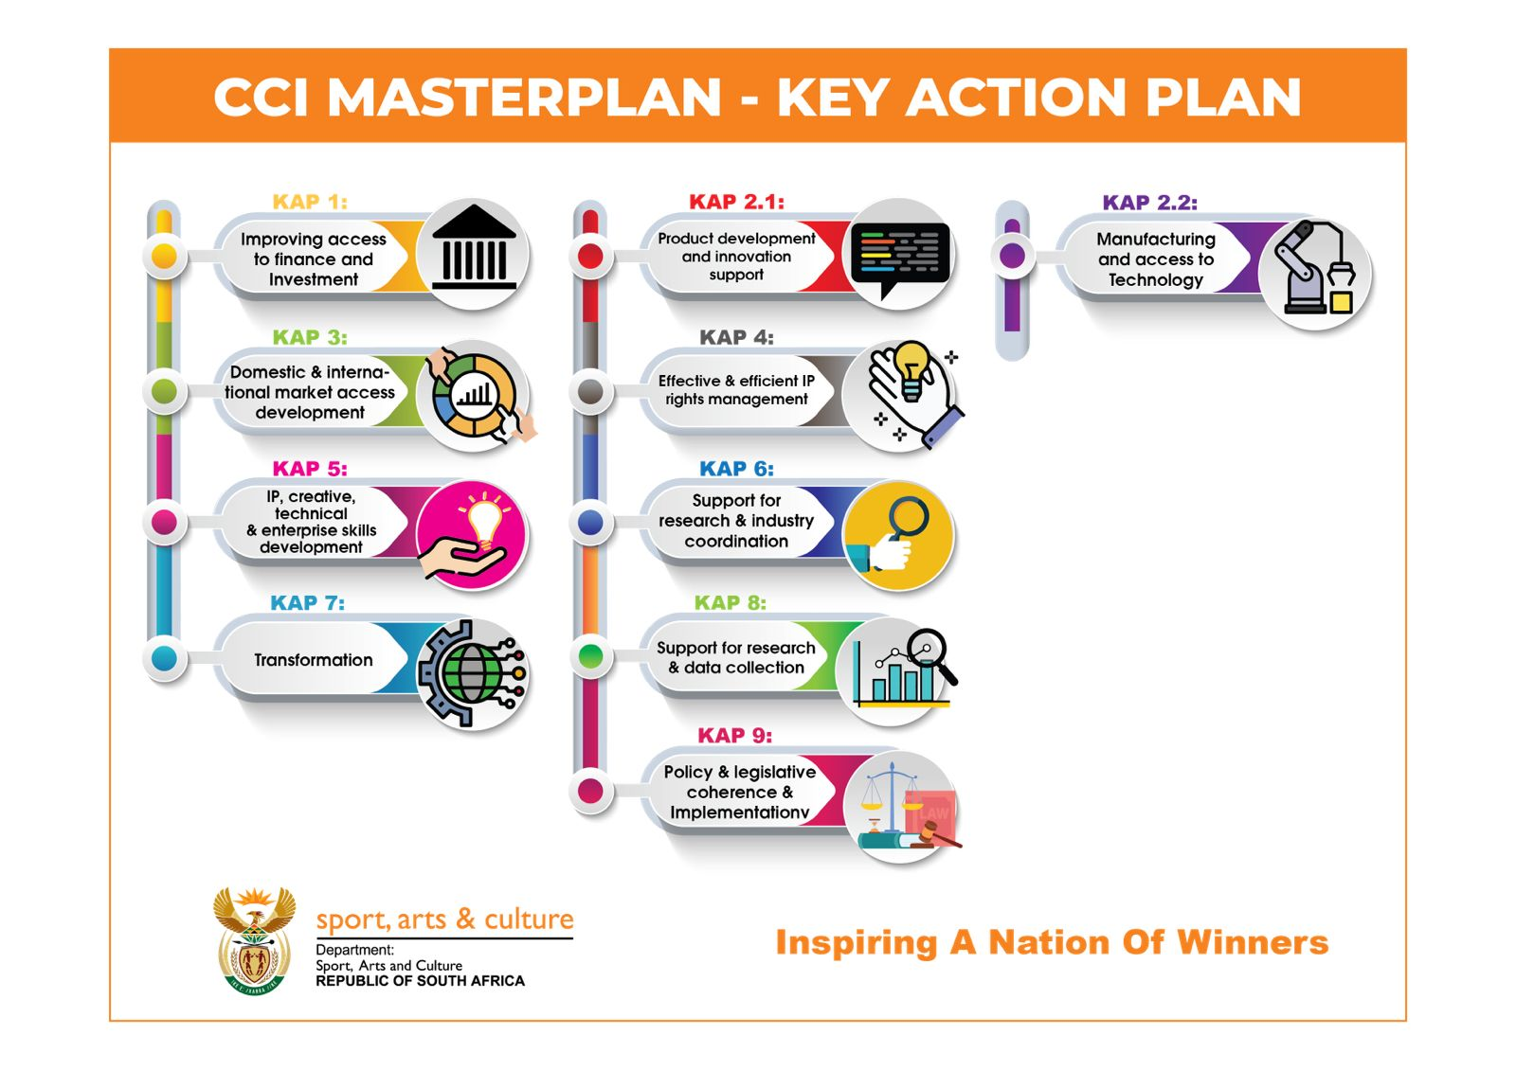

Slide 69
Outcome | Outputs | Output Indicators | Annual Targets
 |  |  | Audited Performance |  |  | Estimated Performance | MTEF targets
 |  |  | 2019/20 | 2020/21 | 2021/22 | 2022/23 | 2023/24 | Q1 | Q2 | Q3 | Q4 | 2024/25 | 2025/26
NATIONAL LANGUAGE SERVICES
Integrated and accessible SAC infrastructure and information | Human Language Technology projects | ACPD 3.1 Number of multi-year human language technology projects supported. MTSF: 6 + 6 + 4 + 4 + 4 = 24) (ENE: 6) | 6 | 6 | 6 | 6 | 6 | - | 2 | 3 | 1 | 6 | 6
Integrated and accessible SAC infrastructure and information | Official languages promoted and developed | ACPD 3.2 Percentage of official documents received that are translated and / or edited. (MTSF: 100%) | 100% | 100% | 100% | 100% | 100% | 100% | 100% | 100% | 100% | 100% | 100%
Transformed, capable and professional sport, arts and culture sector | Bursaries | ACPD 3.3 Number of bursaries awarded for the development of qualified language practitioners per year. (MTSF: 300 + 300 + 250 + 250 + 250 = 1350) (ENE: 250) | 458 | 486 | 301 | 250 | 250 | - | - | 250 | - | 250 | 250
3
Performance Information Tables

Slide 70
CULTURAL AND CREATIVE INDUSTRIES DEVELOPMENT
Increased market share of, and job opportunities in the sport, cultural and creative industries | Market access programmes. | ACPD 3.4 Number of local and international market access platforms supported. (ENE: 15) | 12 | 6 | 12 | 15 | 15 | - | 7 | 8 | - | 15 | 15
Transformed, capable and professional sport, arts and culture sector | Capacity building projects. | ACPD 3.5 Number of capacity building projects supported. (ENE: 22) | 12 | 10 | 20 | 22 | 22 | - | - | - | 22 | 22 | 22
A diverse socially cohesive society with a common national identity | Provincial Community Arts Development Programmes. | ACPD 3.6 Number of Provincial Community Arts Development Programmes implemented per year (MTSF: 9 x 5 = 45) (ENE: 9) | 0 | 8 | 7 | 9 | 9 | - | - | - | 9 | 9 | 9
3
Performance Information Tables

Slide 71
A diverse socially cohesive society with a common national identity | Youth-focused arts development programmes. | ACPD 3.7 Number of youth focused arts development programmes financially supported. (ENE: 4) | 1 | 2 | 4 | 4 | 4 | - | 1 | 1 | 2 | 4 | 4
A diverse socially cohesive society with a common national identity | Gender Based Violence and Femicide projects. | ACPD 3.8 Number of initiatives against gender-based violence and femicide financially supported. | NPI | 1 programme | 1 programme | 3 | 3 | - | - | - | 3 | 3 | 3
INTERNATIONAL COOPERATION
Increased market share of, and job opportunities in the sport, cultural and creative industries | International Relations Strategy. | ACPD 3.9 Number of International Relations Strategies developed. | NPI | NPI | NPI | NPI | 1 | - | - | - | 1 | 4 Progress reports on the implementation of the IR Strategy | 4 Progress reports on the implementation of the IR Strategy
3
Performance Information Tables

Slide 72
SOCIAL COHESION AND NATION BUILDING
A diverse socially cohesive society with a common national identity | Moral Regeneration Movement projects. | ACPD 3.10 Number of moral regeneration projects supported by Government (MTSF: 5 projects pa) | 1 Programme | 5 | 0 | 5 | 5 | - | - | - | 5 | 5 | 5
A diverse socially cohesive society with a common national identity | Community conversations. | ACPD 3.11 Number of community conversations / dialogues implemented to foster social interaction per year. (MTSF: 9 + 10 + 20 + 20 + 20 = 79) (ENE = 20) Standardised | 9 | 10 | 20 | 20 | 20 | 5 | 5 | 5 | 5 | 20 | 20
A diverse socially cohesive society with a common national identity | Advocacy platforms on social cohesion. | ACPD 3.12 Number of advocacy platforms on social cohesion implemented by social cohesion advocates. (MTSF: 20 + 15 + 20 + 20 + 20 = 95) (ENE: 20) | 20 | 20 | 47 | 20 | 20 | 5 | 5 | 5 | 5 | 20 | 20
A diverse socially cohesive society with a common national identity | Target Groups programmes. | ACPD 3.13 Number of projects through which target groups are supported | NPI * *Previous indicator was structured differently | NPI * | NPI * | 8 | 8 | - | - | - | 8 | 8 | 8
A diverse socially cohesive society with a common national identity | National days’ celebrations. | ACPD 3.14 Number of National Days’ celebrations held. (ENE = 6) | 7 | - | - | 6 | 6 | 2 | 2 | 1 | 1 | 6 | 6
3
Performance Information Tables

Slide 73
MZANSI GOLDEN ECONOMY
Increased market share of, and job opportunities in the sport, cultural and creative industries | Mzansi Golden Economy programme. | ACPD 3.15 Number of projects in the creative industry supported through the Mzansi Golden Economy programme (MTSF: 70 + 12 + 67 + 67 + 67 = 283) (ENE: 90) | 71 | 13 | 68 | 67 | 90 | 9 | 11 | 18 | 52 | 90 | 90
Transformed, capable and professional sport, arts and culture sector. | Artists placed in schools. | ACPD 3.16 Number of artists placed in schools per year. (ENE: 340) | 382 | 0 | 325 | 300 | 340 | - | - | - | 340 | 340 | 340
Integrated and accessible SAC infrastructure and information. | SACO research reports. | ACPD 3.17 Number of reports produced by SACO. (ENE: 16) | 37 | 13 | 21 | 16 | 16 | - | - | - | 16 | 16 | 16
NATIONAL FILM AND VIDEO FOUNDATION
Increased market share of, and job opportunities in the sport, cultural and creative industries | Films and documentaries. | ACPD 3.18 Number of films and documentaries supported telling stories of the history of liberation, and heritage importance. (MTSF: 30) | NPI | NPI | 10 | 10 | 10 | - | - | - | 10 | 10 | 10
3
Performance Information Tables

Slide 74
Programme Four
Heritage Promotion and Preservation

Slide 75
The purpose of this Programme is to preserve and promote South African heritage, including archival and heraldic heritage; oversee and transfer funds to libraries. It is comprised of the following sub-programmes:
Heritage Promotion supports a range of heritage initiatives and projects, such as the transformation of the heritage landscape through the conceptualisation, equipping and operationalisation of legacy projects ; the Funding of Heritage Institutions ( Museums, National Heritage Council and South African Heritage Resources Agency); the documentation of South Africa’s indigenous knowledge through the writing of books on living human treasures and the compilation of a national register of South Africa’s indigenous knowledge systems assisted by the Indigenous Knowledge Authentication Panel; leading the transformation of the heritage landscape through resistance and liberation heritage route and the relocation of statues; the Bureau of Heraldry, which registers symbols, popularises national symbols through public awareness campaigns, coordinates the National Orders Awards Ceremony; develops and reviews heritage policies and legislation for the preservation, conservation and management of South African heritage.
National Archive Services acquires, preserves, manages, and makes accessible records with enduring value.
Public Library Services transfers funds to provincial Departments for conditional allocations to community library services for constructing and upgrading libraries, hiring personnel, and purchasing library materials.
The Department provides secretarial services to the South African Geographical Names Council, an advisory body that facilitates name changes by consulting with communities to advise the Minister of Sport, Arts and Culture.
Purpose
4

Slide 76
Programme Four
Key programmes/projects/focus areas | Short description – Rationale & justification – Deliverables for 2023/24
National symbols | Promote national symbols towards fostering unity in diversity, social cohesion, national identity, nation building and patriotism. Deliverables for 2023/24 20 Public awareness activations on the “I am the Flag” Campaign to promote the national flag, 100 flags provided to schools (new requests and replenishing) to compliment the learning area associated with national symbols, 10 workshops to advance knowledge among citizens on National Symbols, including the Flag.
Geographical Names | Publishing in the Government Gazette a list of geographical names approved by the Minister to promote transformation of the heritage landscape through geographical names standardization. Reclaiming removed geographical names, renaming spaces to names of anticolonial anti-apartheid heroes, moments and events, correcting founding myths and decolonizing the geographical names landscape. Deliverables for 2023/24 3 gazettes published.

Slide 77
Programme Four
Key programmes/projects/focus areas | Short description – Rationale & justification – Deliverables for 2023/24
Conceptualize, equip and operationalize legacy projects to transform the heritage landscape | Conceptualize, design, research, collect, install and present objects, exhibitions and information in various forms in newly created museums. Equip these museums with operational tools such as furniture, information technology, etc. whilst they are either under construction or where construction has been finalized. Install monuments, statues, memorials in public spaces formerly exclusive to some population groups . Correct founding myths and decolonize iconography in public spaces Deliverables for 2023/24 Conceptualise, design, develop and install OR Tambo Garden of Remembrance statue and bust, Charlotte Maxeke Statue, Archie Gumede Statue Winnie Mandela Clinic exhibition and, Sarah Baartman Exhibition. Operationalise Liliesleaf Museum.
Monitoring Implementation of the Resistance and Liberation Heritage Route | The Resistance and Liberation Heritage Route recognizes communities, icons, places/sites, and record epoch-making stories which had a significant impact on the South Africa’s struggle against colonialism and for liberation. The Programme is part of the UNESCO and AU Programme of the African Liberation Heritage Programme “Roads to Independence”. DSAC with the Provinces and the National Heritage Council (NHC) as implementing agency develop RLHR sites and alternative forms of memorialization to preserve, protect and promote our resistance and liberation heritage. DSAC monitors the implementation progress on the RLHR through progress reports against implementation plans from the NHC and reports to cabinet bi-annually. Deliverables for 2023/24 4 reports

Slide 78
Programme Four
Key programmes/projects/focus areas | Short description – Rationale & justification – Deliverables for 2023/24
Records digitised / Provide access to information | More than 90% of archival records are not digitised. This delays online access to record. Digitisation is an ongoing process based on the extent of archival records preserved at the National Archives. Online access to records will be enhanced in line with 4IR if archival records are digitised. There is a need to allocate resources in order to fulfil the mandate of the Constitution and that of the NARSSA Act with regards to access to information. This output has been pursued for a period of 4 years. NARSSA has to date digitised the Rivonia Trial Dictabelts, CODESA and Multiparty Negotiating Forum Collections, and these are available online. Currently the Treason Trial and TRC collections (dictabelts and paper records) are being digitised and will soon be uploaded on the NARSSA website. 300 Records are to be digitised as per APP. 30 000 Paper records digitised as per the Operation Plan.
Newly built and/or modular libraries supported financially / Provide access to information and infrastructure | Transfer funds to provincial departments for conditional grant allocations to community library services for constructing and upgrading libraries, purchasing of library materials in all formats including material for the blind and visually impaired, ICT etc. The funding has been made available since 2007 to transform urban and rural community library infrastructure, facilities and services at provincial level. To date 238 new libraries have been built and 670 existing facilities have been upgraded. However, there is still a need to provide more services in order to close the gaps and address the inequalities of the past. The provision of access to information enables the society to gain access to knowledge that will improve their socio-economic status. Libraries promote literacy and support lifelong learning, creates a culture of reading and improves the quality education. 32 libraries financially supported.
Heritage bursaries | DSAC awards heritage bursaries to deserving students in order to bridge the skills gap within the heritage sector. From 2023/2024 financial year, the DSAC will be placing qualified unemployed heritage graduates at the DSAC institutions to equip them with work or practical experience.

Slide 79
Outcome | Outputs | Output Indicators | Annual Targets
 |  |  | Audited/Actual Performance |  |  | Estimated Performance | MTEF Targets
 |  |  | 2019/20 | 2020/21 | 2021/22 | 2022/23 | 2023/24 | Q1 | Q2 | Q3 |  | Q4 |  | 2024/25 |  | 2025/26
HERITAGE PROMOTION
Transformed, capable and professional sport, arts and culture sector | Bursaries. | HPP 4.1 Number of students awarded with heritage bursaries per year. (ENE: 45) | 66 | 70 | 61 | 45 | 45 | - | 45 | - | - | - | - | 45 | 45 | 45
A diverse socially cohesive society with a common national identity. | Books documenting Living Human Treasures. | HPP 4.2 Number of books documenting Living Human Treasures published. (ENE: 5) | 2 | 2 | 6 | 5 | 5 | - | - | - | - | 5 | 5 | 5 | 5 | 5
A diverse socially cohesive society with a common national identity | “I am the Flag” Campaign. | HPP 4.3 Number of public awareness activations on the “I am the Flag” Campaign (MTSF: 0 + 0 + 20 + 20 + 20 = 60) (ENE = 20) Standardised | NPI | NPI | 37 | 20 | 20 | 6 | 6 | 4 | 4 | 4 | 4 | 20 | 20 | 20
4
Performance Information Tables

Slide 80
A diverse socially cohesive society with a common national identity | Flags provided to schools. | HPP 4.4 Number of flags provided to schools. (MTSF:1 300) | 1 004 | 0 | 125 | 100 | 100 | 30 | 30 | 20 | 20 | 100 | 100
A diverse socially cohesive society with a common national identity | National symbols workshops. | HPP 4.5 Number of workshops hosted to advance knowledge of National Symbols. (ENE = 10) | NPI | 0 | 23 | 10 | 10 | 2 | 3 | 3 | 2 | 10 | 10
Integrated and accessible SAC infrastructure and information | Heritage legacy projects | HPP 4.6 Number of heritage legacy projects where exhibition content is developed. (ENE: 2) | NPI | 0 | 1 | 3 | 2 | - | - | - | 2 | 3 | 3
Integrated and accessible SAC infrastructure and information | Resistance and Liberation Heritage Route sites | HPP 4.7 Number of progress reports on resistance and liberation heritage route sites received and analysed. | NPI | NPI | 1 | 2 | 4 | 1 | 1 | 1 | 1 | 4 | 4
4
Performance Information Tables

Slide 81
NATIONAL ARCHIVES SERVICES
Integrated and accessible SAC infrastructure and information | Records digitised. | HPP 4.8 Number of records digitised | 463 Dictabelts 314 audio tapes | 60 treason trial dictabelts _ | 476 | 240 | 300 | 75 | 75 | 75 | 75 | 360 | 400
PUBLIC LIBRARY SERVICES
Integrated and accessible SAC infrastructure and information | Libraries. | HPP 4.9 Number of libraries financially supported per year. (ENE: 32) Standardised | 36 | 33 | 34 | 29 | 32 | 32 | 32 | 32 | 32 | 35 | 38
SOUTH AFRICAN GEOGRAPHICAL NAMES COUNCIL
A diverse socially cohesive society with a common national identity | Transformed and standardised geographical names. | HPP 4.10 Number of Gazette notices on standardised geographical names published. (ENE: 3) | 3 | 0 | 4 | 3 | 3 | - | 1 | 1 | 1 | 3 | 3
4
Performance Information Tables

Slide 82


Targeted groups

Slide 83
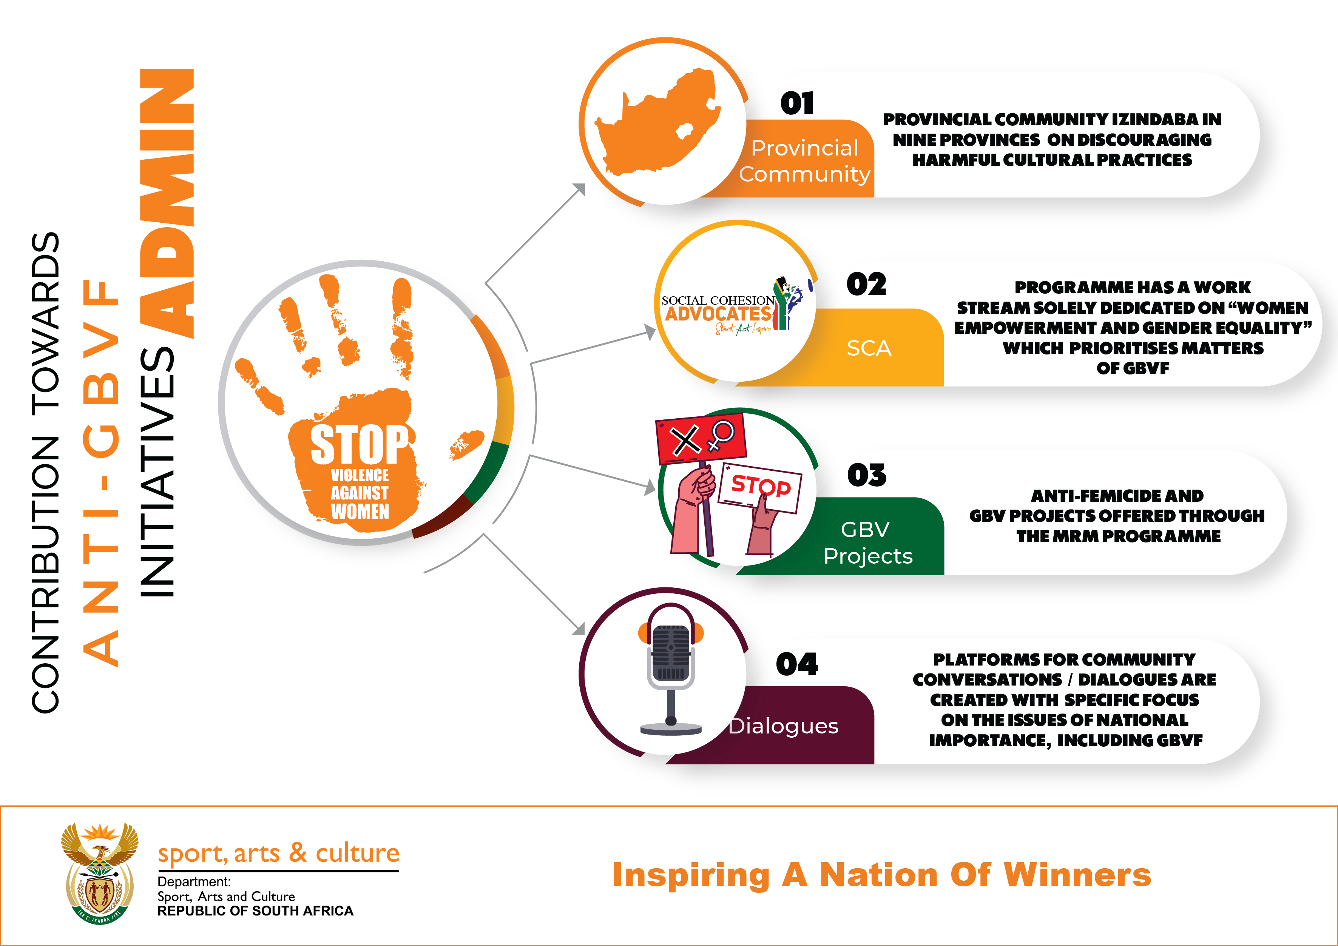

Slide 84
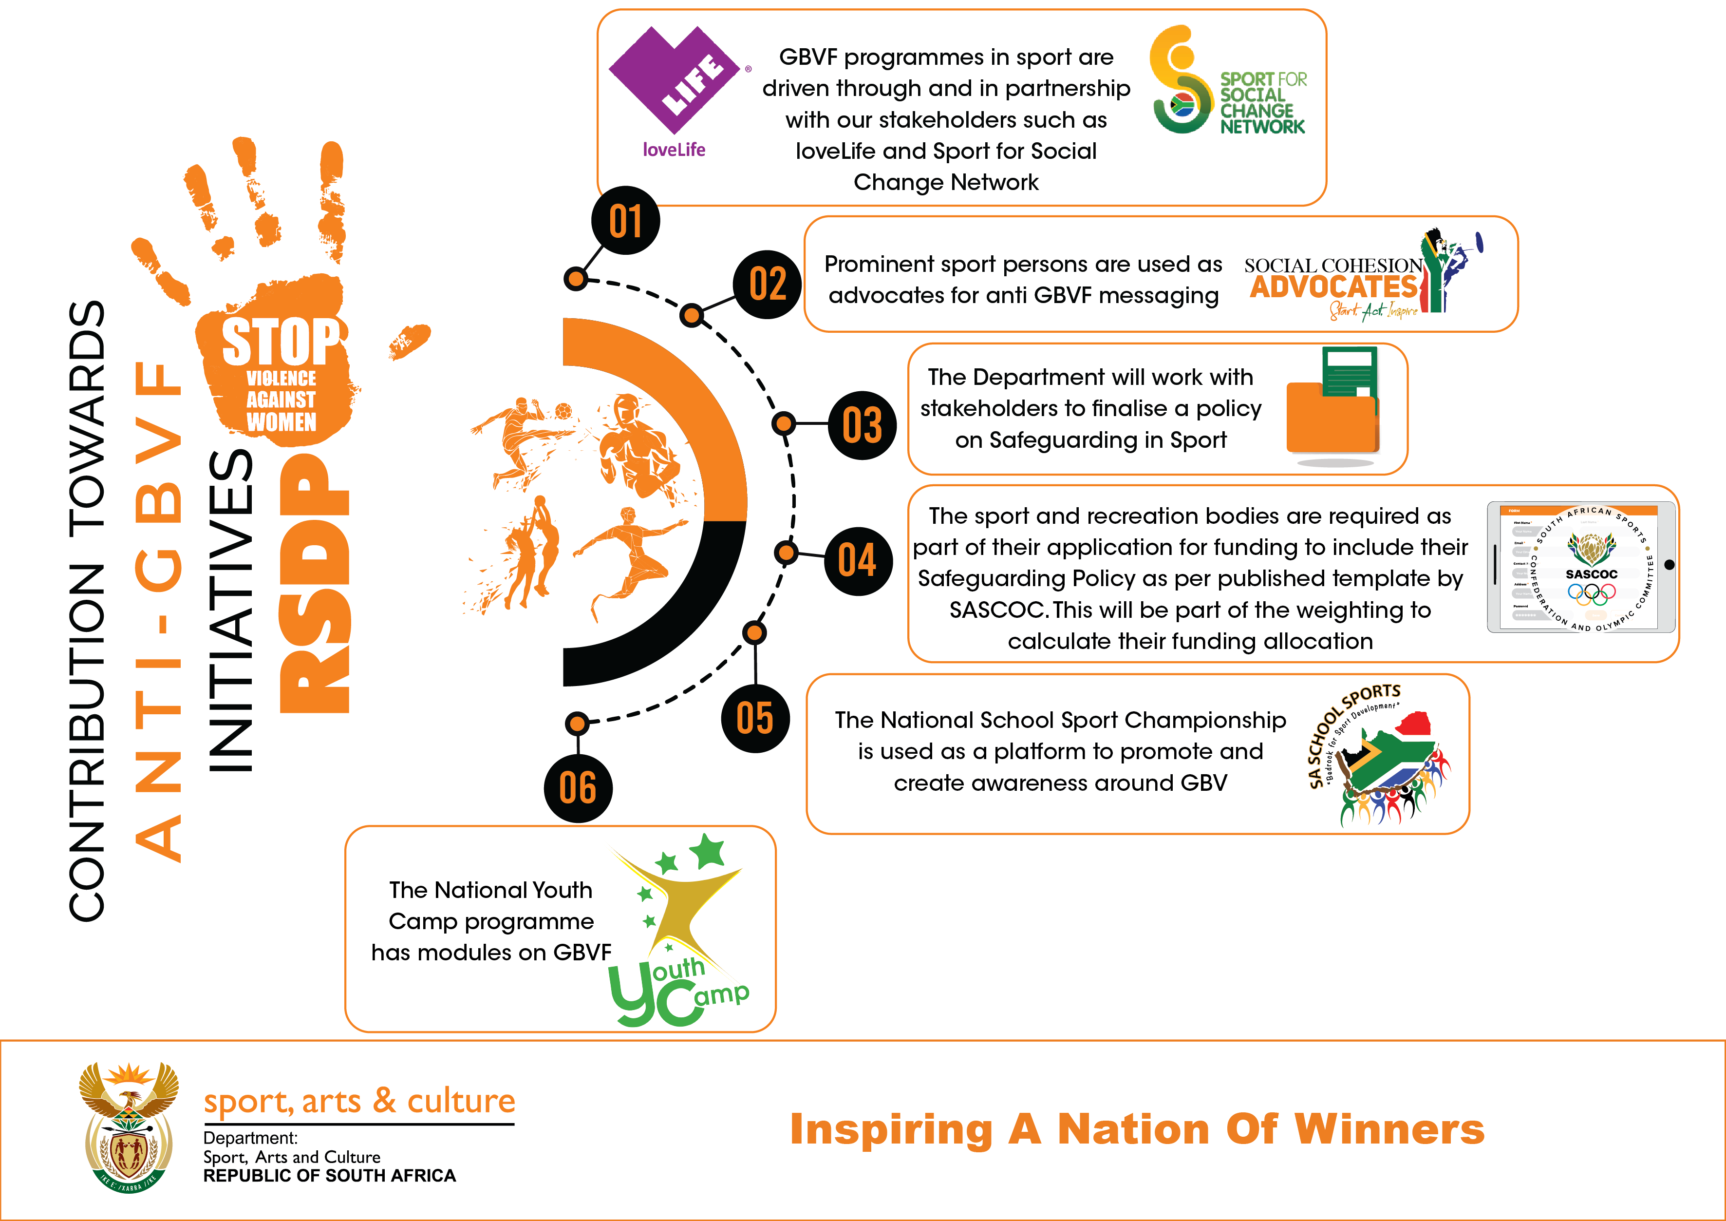

Slide 85
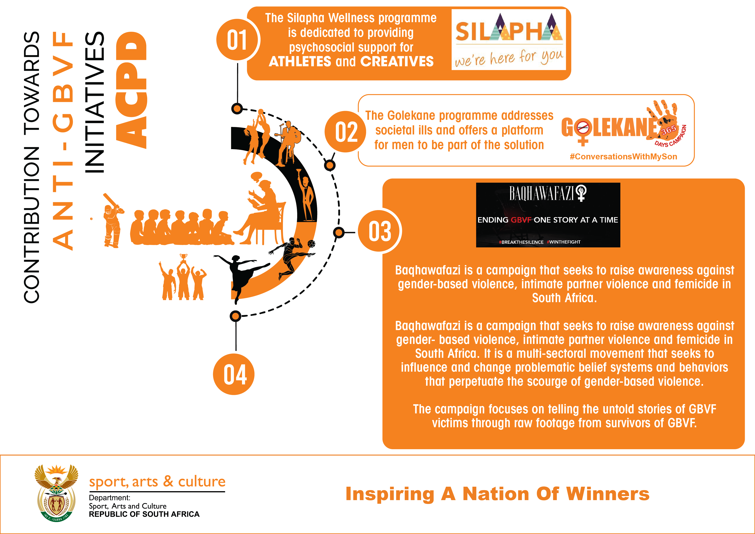

Slide 86
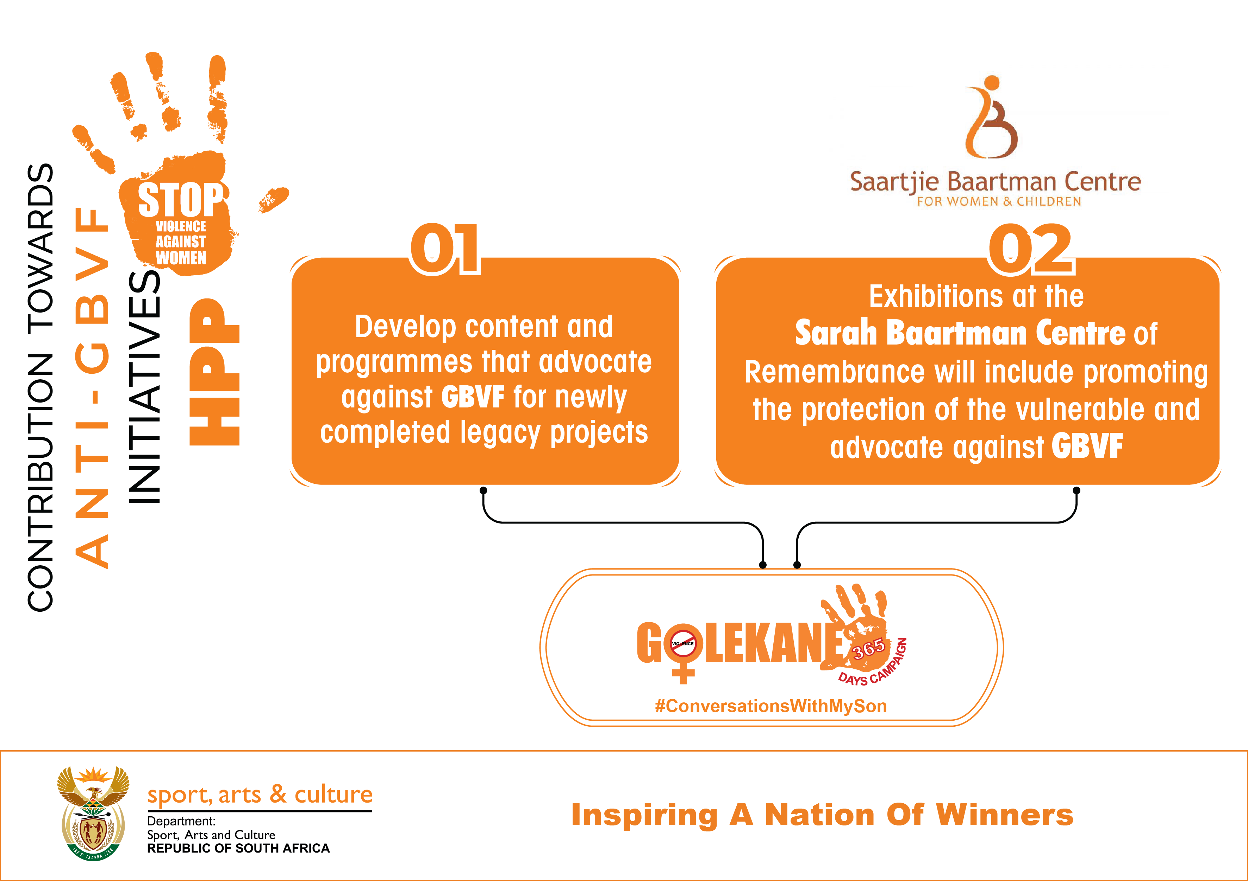

Slide 87
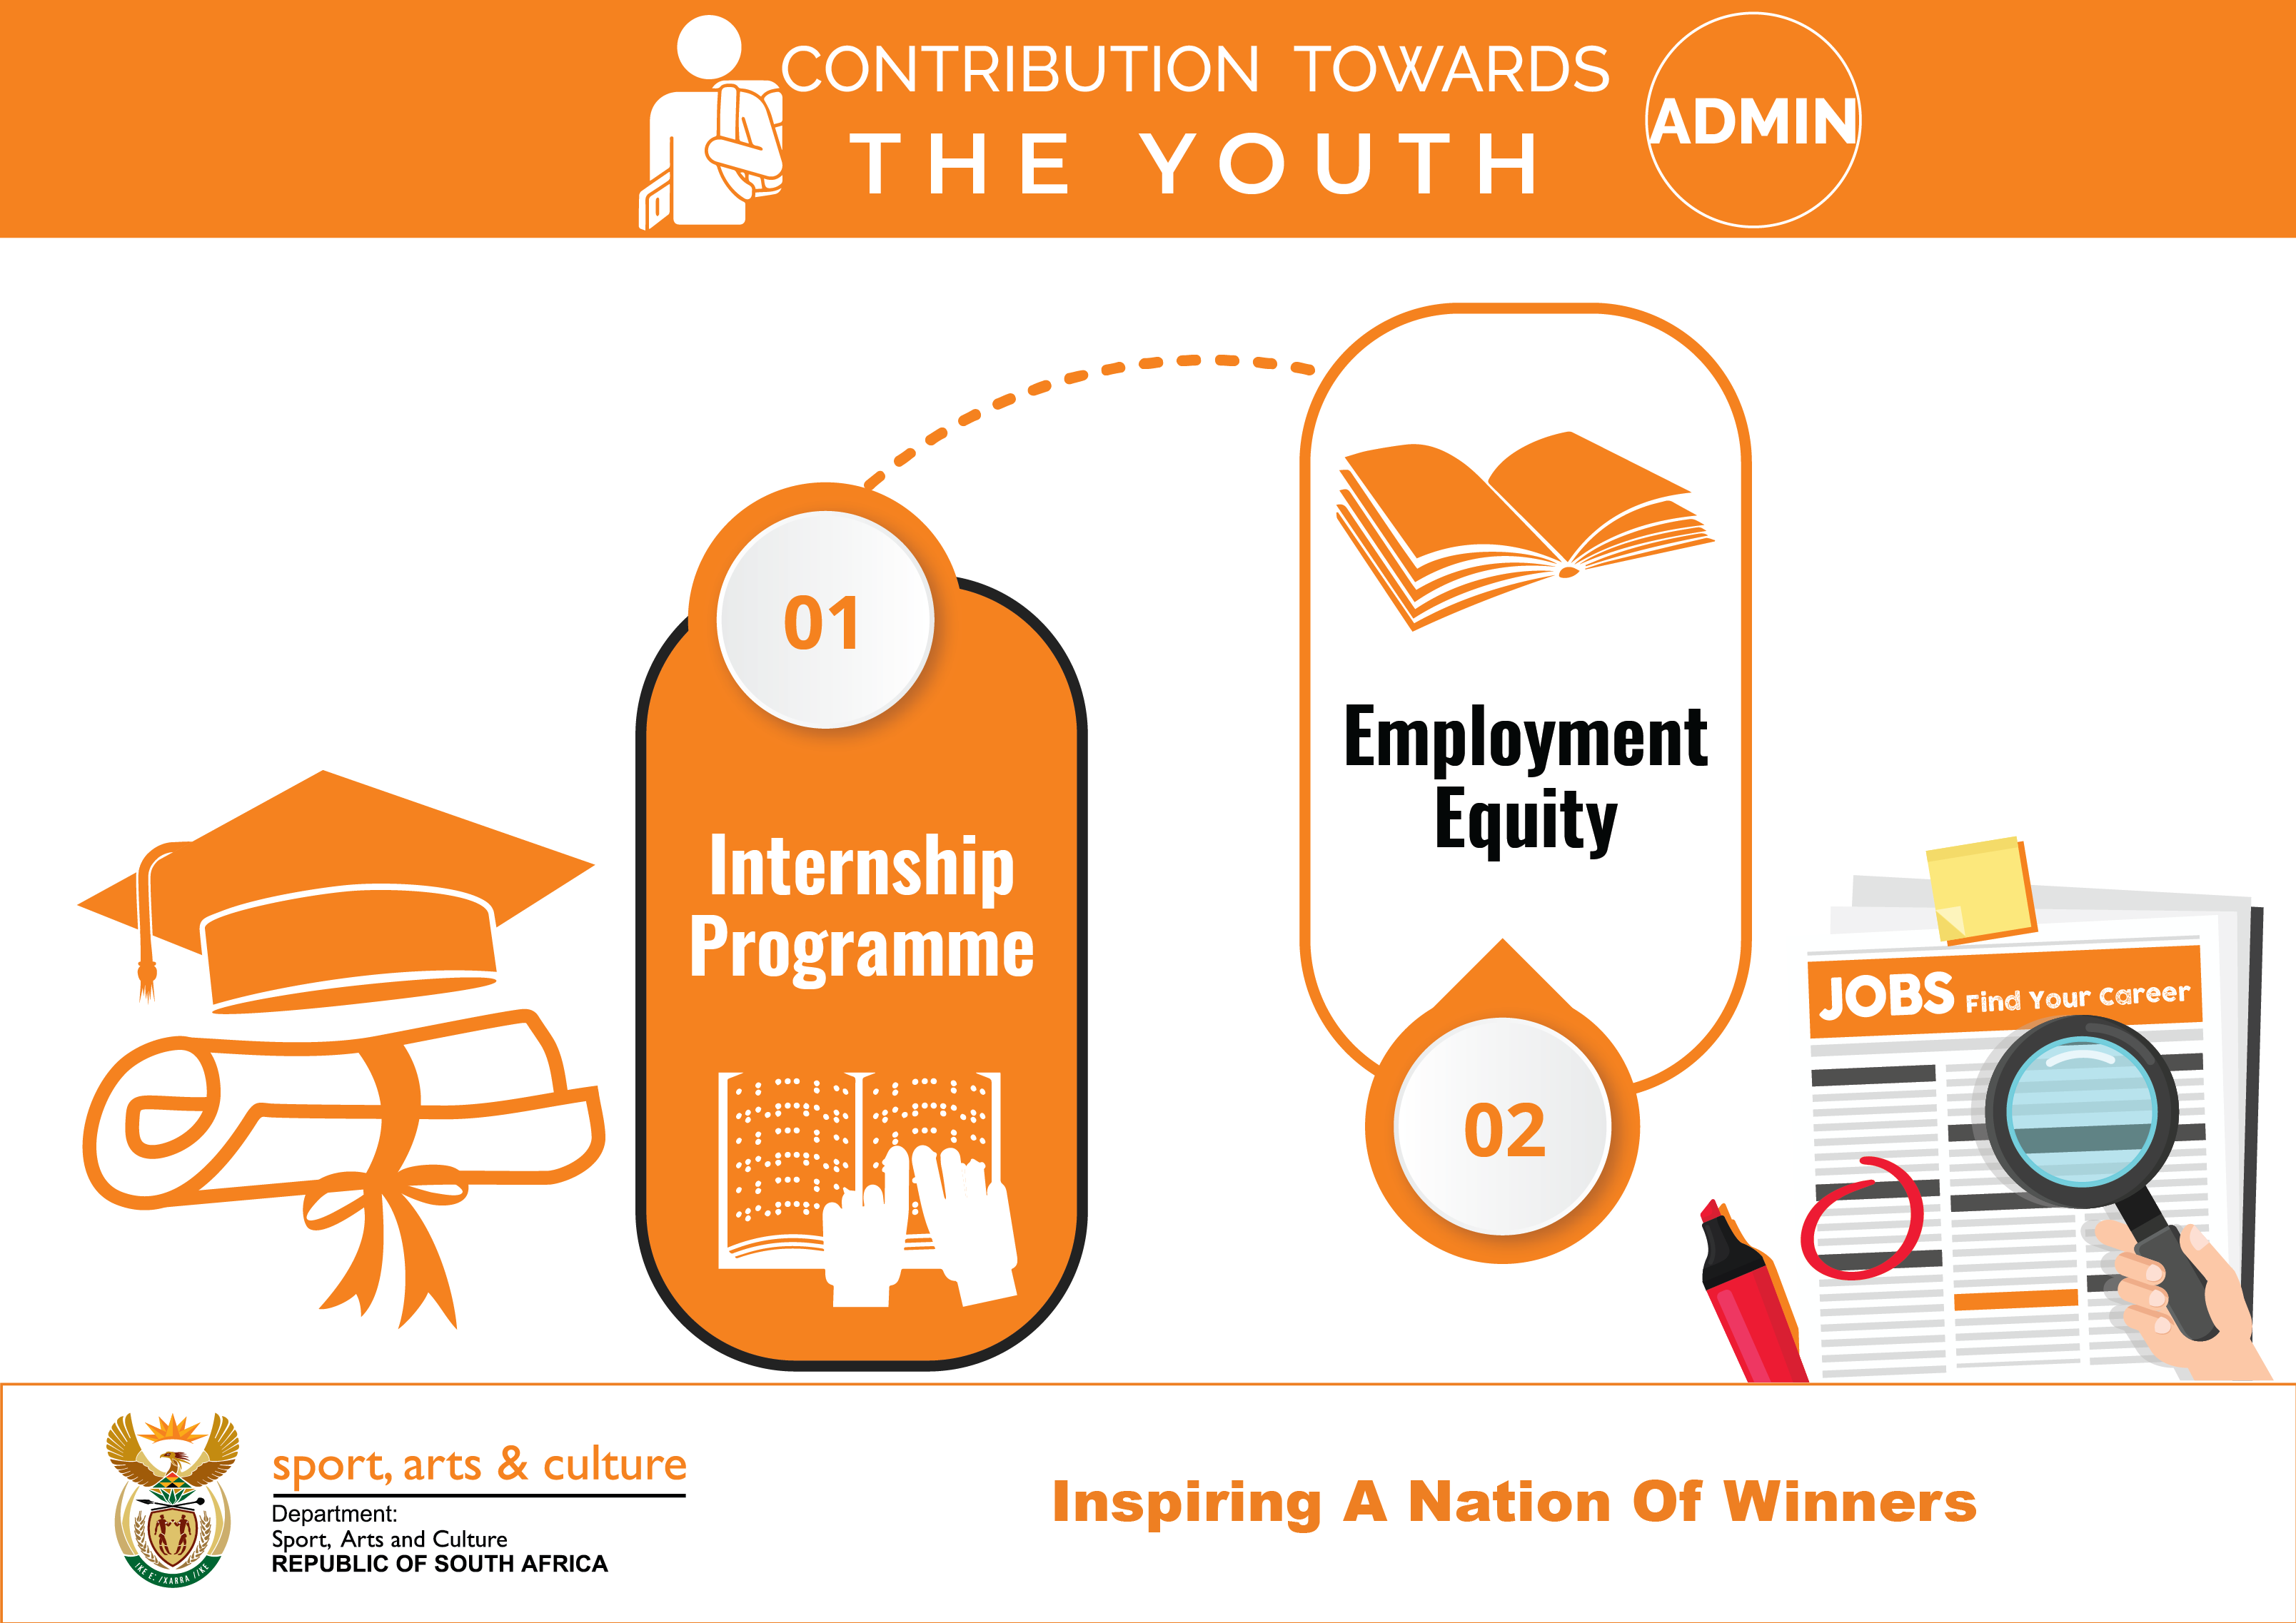

Slide 88
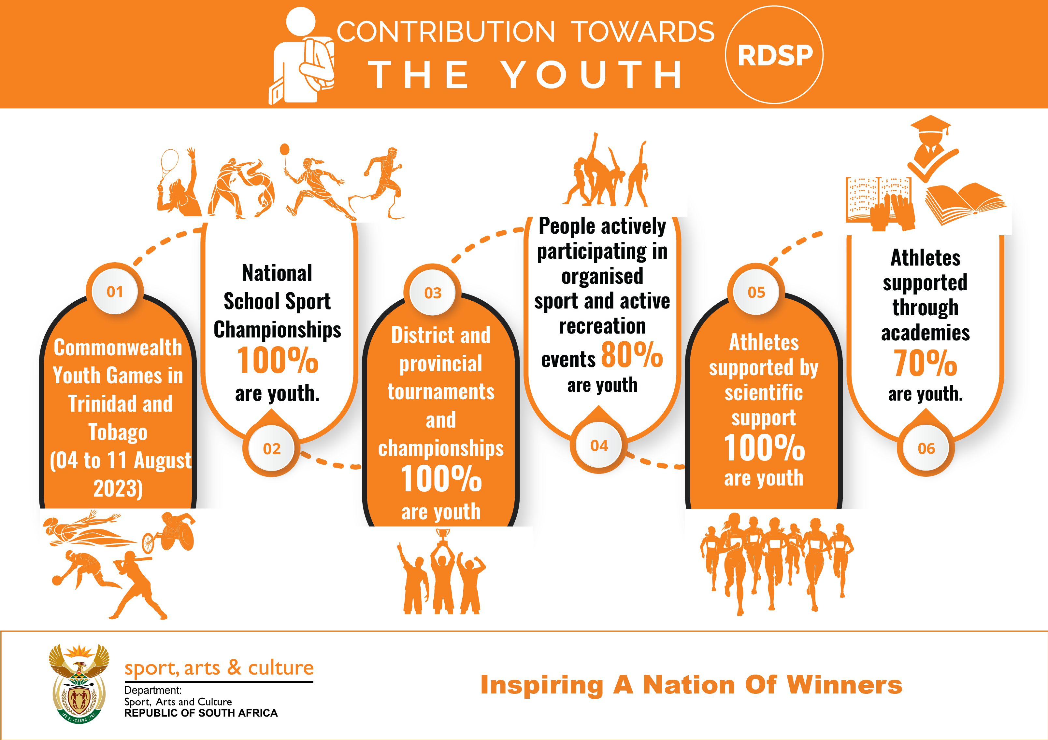

Slide 89
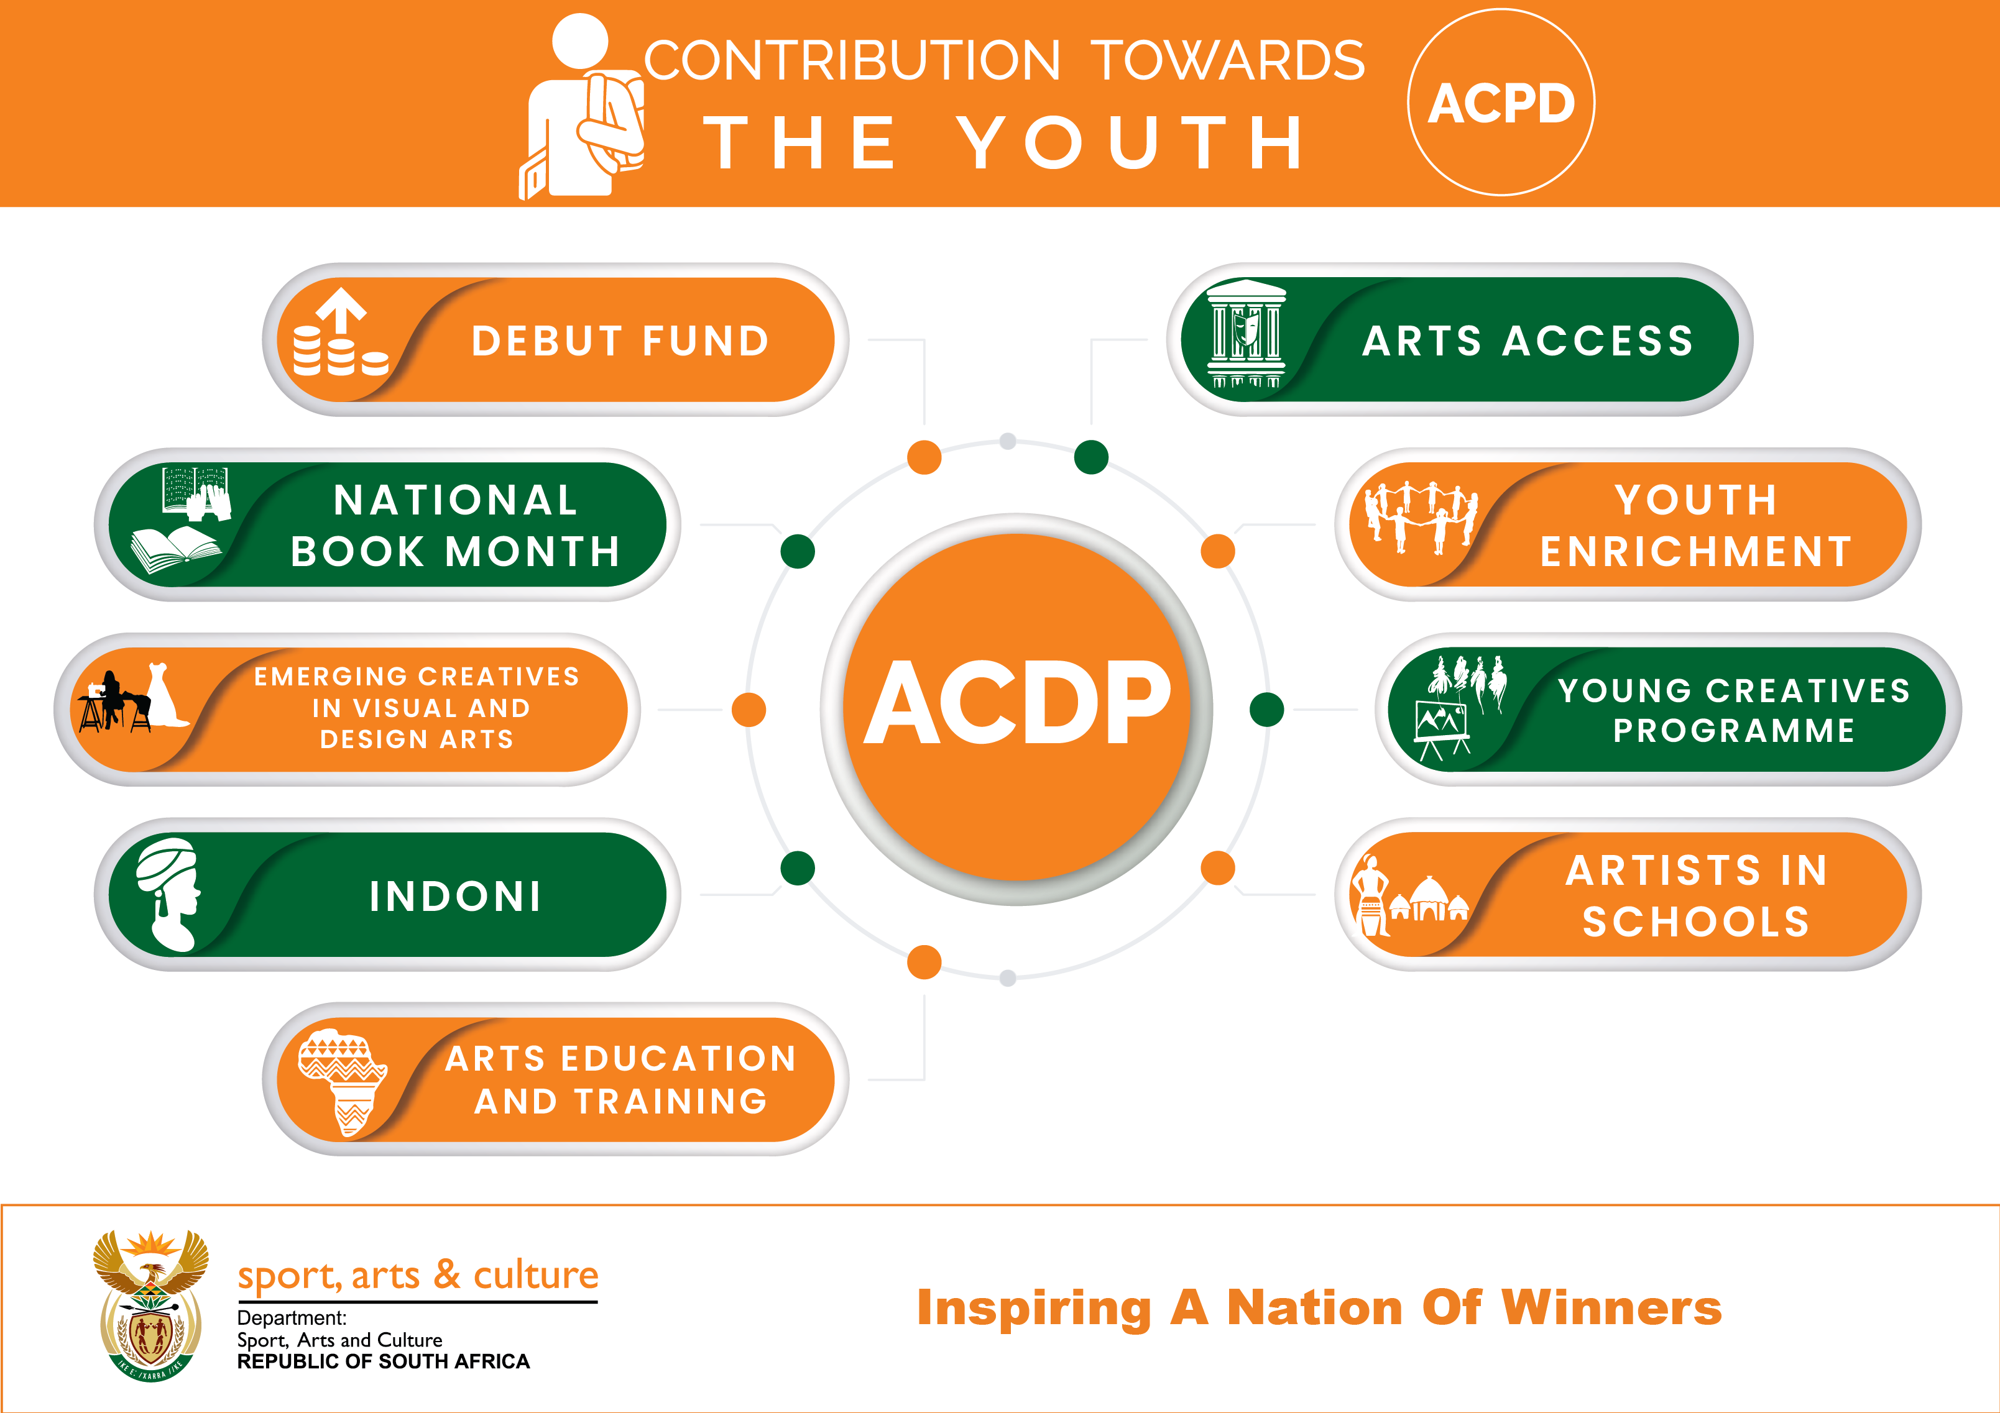

Slide 90
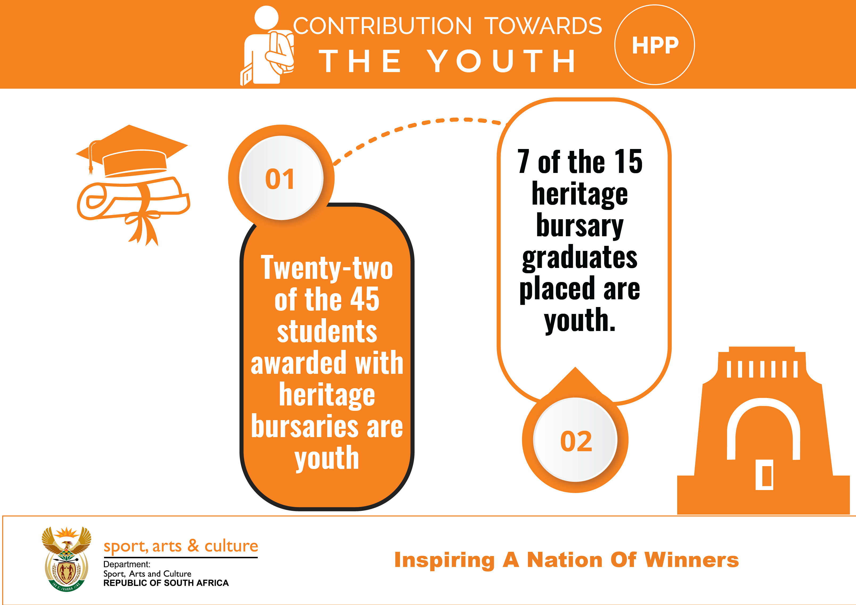

Slide 91
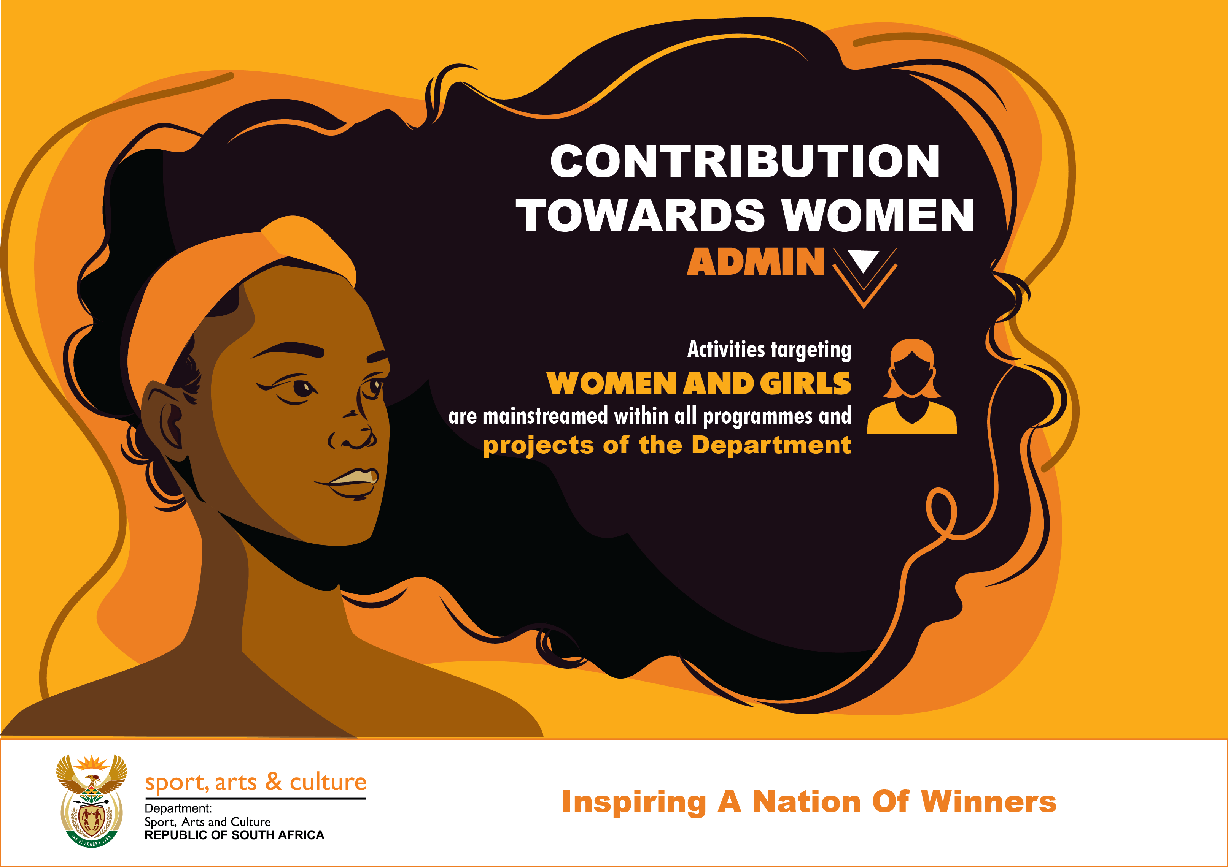

Slide 92


Slide 93


Slide 94


Slide 95
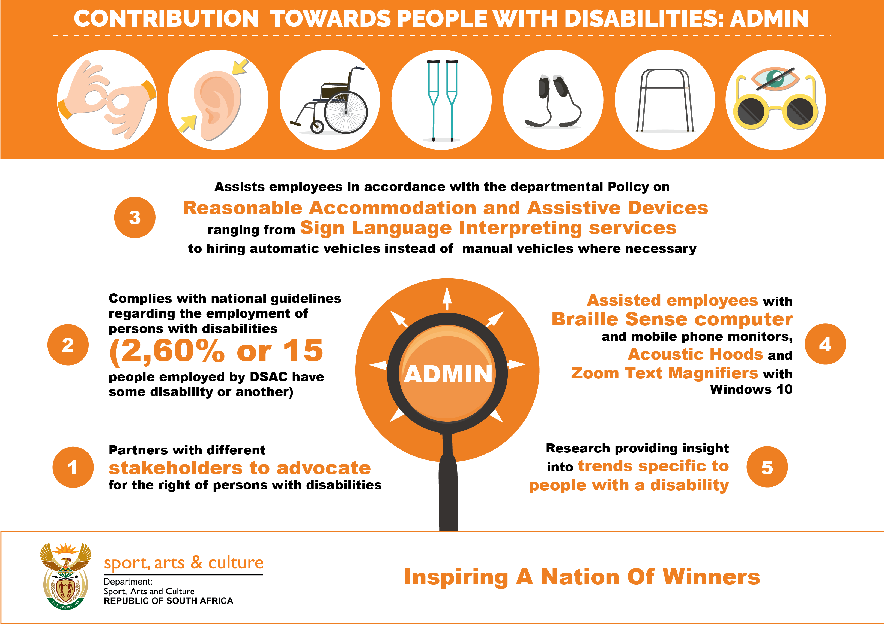

Slide 96
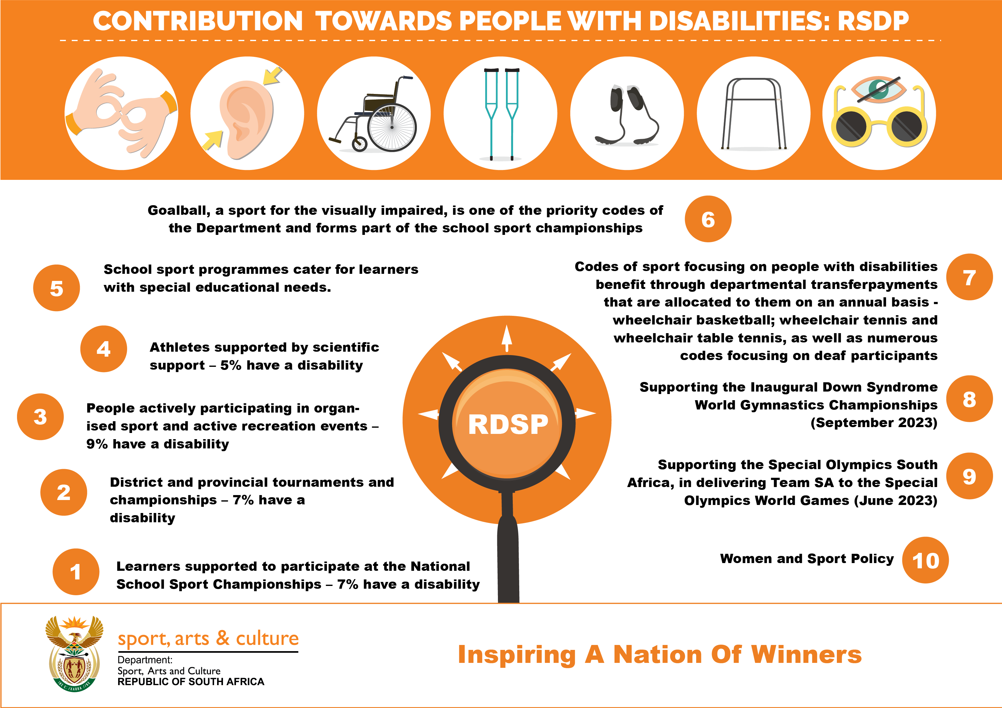

Slide 97
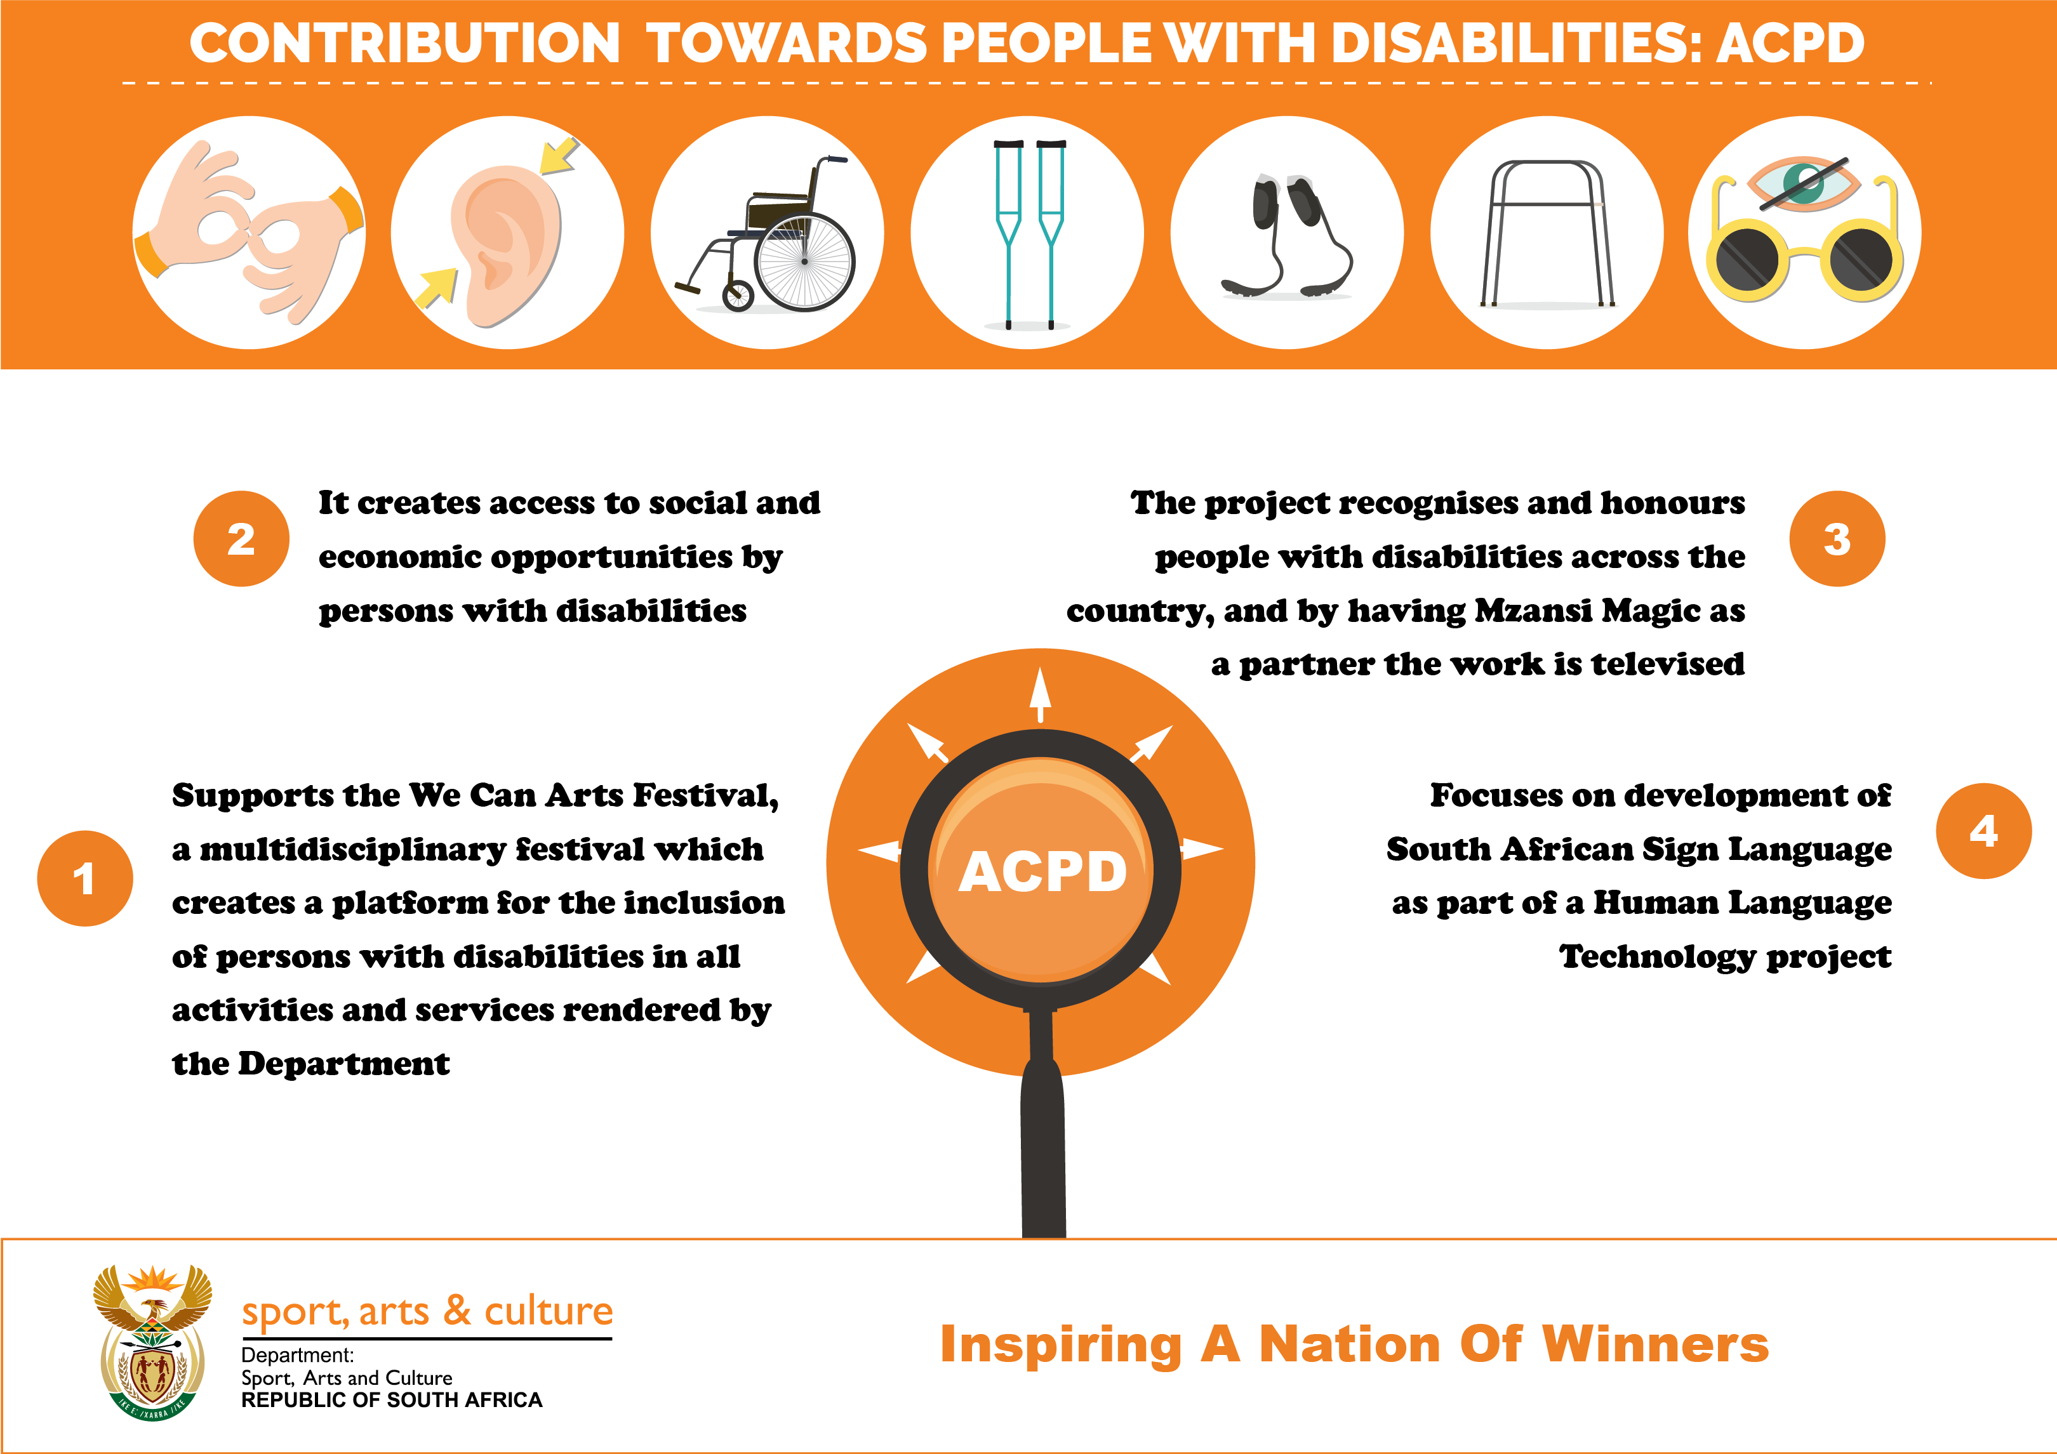

Slide 98
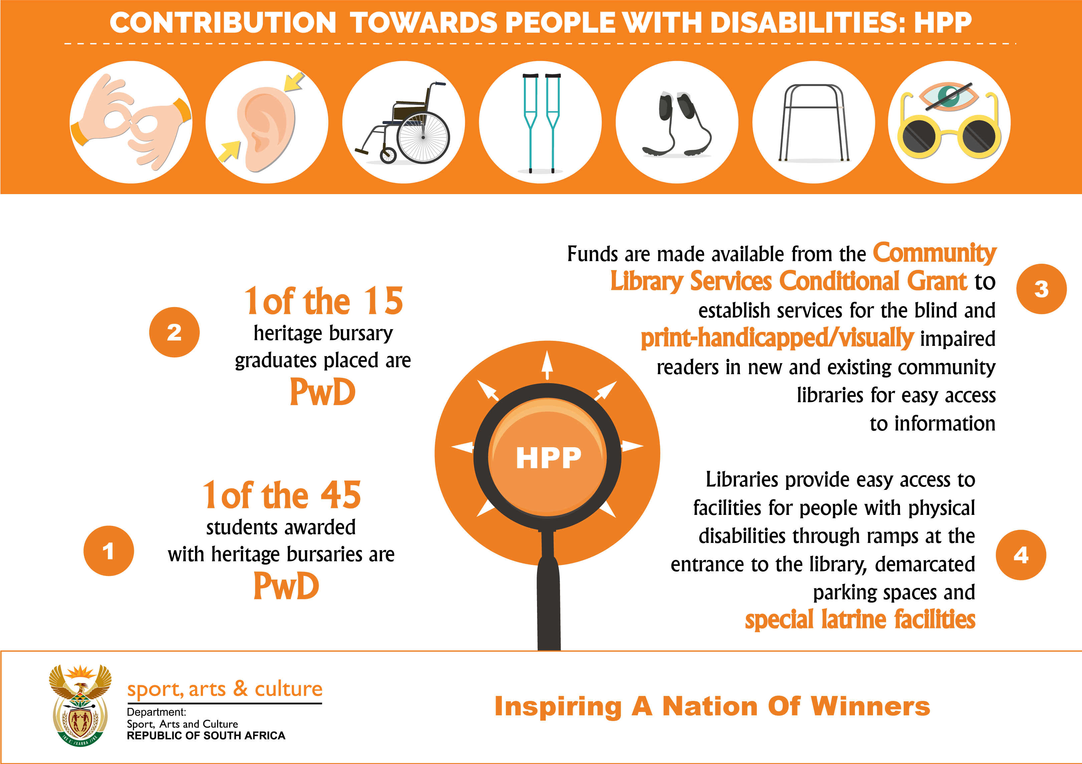

Slide 99
ANNEXURE D:District Development Model
Public entities reporting to the Minister

Slide 100
Public entities reporting to the Minister

Slide 101
Public entities reporting to the Minister

Slide 102
Public entities reporting to the Minister

Slide 103
Public entities reporting to the Minister

Slide 104
NPOs

Slide 105

Part D:
TECHNICAL INDICATORS DESCRIPTIONS

Slide 106
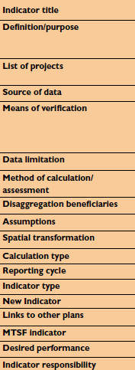
Prog 1
Prog 2
10 Indicators
Prog 3
18 Indicators
(6 managed in Prog1)
Prog 4
10 Indicators
6
Indicators

Slide 107
PART E: ANNEXURES TO THE ANNUAL PERFORMANCE PLAN
ANNEXURE A: Amendments to the Strategic Plan
ANNEXURE B: Conditional Grants - CFO
ANNEXURE C: Consolidated Indicators
ANNEXURE D: District Development Model

Slide 108
ANNEXURE A: Amendments to the Strategic Plan
Twelve standardised indicators were published in the 2020-2025 Strategic Plan (pg. 106). In 2021 a revised list, of seven indicators was submitted to DPME for implementation from 2022/23.
Number of community conversations/dialogues implemented to foster social interaction per year.
2. Number of public awareness activations on the "I am the Flag" campaign.
3. Number of libraries established per year.
4. Number of public awareness programmes conducted in archives.
5. Number of schools, hubs and clubs provided with equipment and/or attire as per the established
norms and standards.
6. Number of athletes supported by the sports academies.
7. Number of learners participating at the district school sport tournaments.

Slide 109
ANNEXURE C: CONSOLIDATED INDICATORS
Institution | Output Indicator | Annual Target | Data source
PROVINCIAL DEPARTMENTS OF SPORT, ARTS AND CULTURE | P2: Cultural Affairs |  | PROVINCIAL DEPARTMENTS OF SPORT, ARTS AND CULTURE
 | Number of community conversations/dialogues implemented to foster social interaction per year. (DSAC APP 3.11) | 56
 | Number of public awareness activations on the "I am the Flag" campaign. (DSAC APP 4.3) | 20
 | P3: Library and Archives Services
 | Number of libraries established per year. (DSAC APP 4.9) | 32
 | Number of public awareness programmes conducted in archives. (DSAC National Archives) | 44
 | P4: Sport and Recreation
 | Number of schools, hubs and clubs provided with equipment and/or attire as per the established norms and standards. (DSAC APP 2.5) | 2 500
 | Number of athletes supported by the sports academies. (DSAC APP 2.2) | 3 700
 | Number of learners participating at the district school sport tournaments. (DSAC APP 2.7) | 75 000
Provincial institutions within the sport, arts and culture sector: These are a core set of indicators that have been developed and agreed to, by all provincial institutions within the sport, arts and culture sector together with DSAC. The standardised indicators are relevant to achieving our sector-specific priorities and have been approved by the provincial Accounting Officers. They have been incorporated into the provincial institutions’ APPs and form the basis of the quarterly and annual performance reporting process.

Slide 110
INSTITUTION | OUTPUT INDICATOR | DATA SOURCE
DEPARTMENT OF SPORT, ARTS AND CULTURE PUBLIC ENTITIES | HERITAGE | DEPARTMENT OF SPORT, ARTS AND CULTURE PUBLIC ENTITIES
 | Total number of collections (heritage) items
 | Number of new acquisitions
 | Number of accessioned/archived materials (heritage items)
 | Number of total collection items digitized
 | Number of exhibitions curated
 | DEVELOPMENT AGENCIES
 | Number of projects funded
 | Number of projects funded targeting women, youth people with disabilities and marginalized communities
 | Number of content scripts developed per year (NFVF)
 | PERFORMING ARTS
 | Number of productions staged
 | Number of community-based productions
 | Number of festivals staged
 | Proportion of local content staged
ANNEXURE C: CONSOLIDATED INDICATORS
Public Entities within the sport, arts and culture sector: The following indicators are also relevant to achieving our sector-specific priorities and are implemented through arts, culture and heritage public entities:

Slide 111
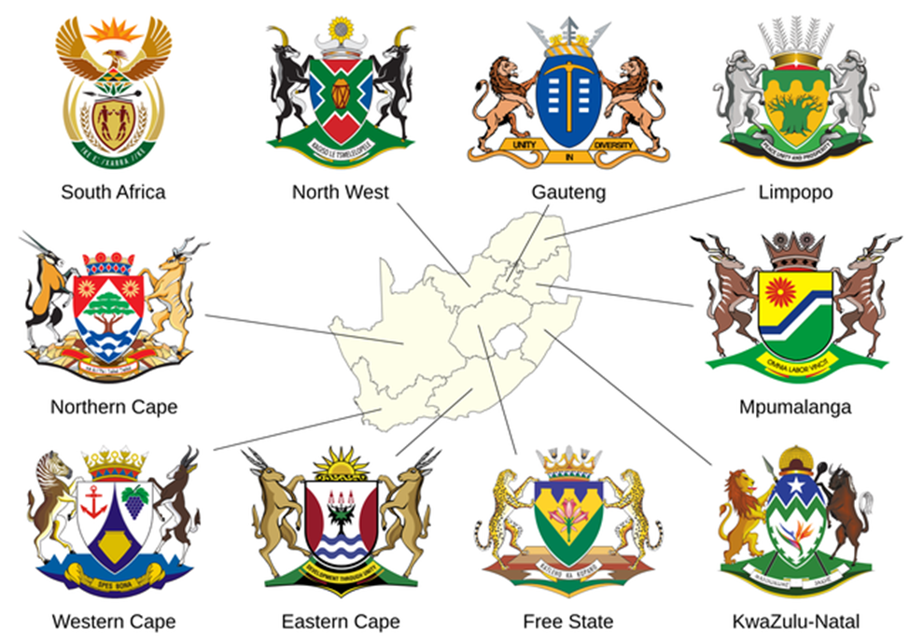
ANNEXURE D: District Development Model

Slide 112
ANNEXURE D: District Development Model
The DDM is anchored on the development of the “One Plan”.
2. The One Plan is an intergovernmental plan setting out a long-term strategic framework to guide investment and delivery in the 52 district and metropolitan space.
3. This plan is meant to be jointly developed and agreed to, by all spheres of government.
4. The development and approval of the One Plan involves a series of collaborative intergovernmental planning sessions reflecting on research, evidence and solution for 52 district and metro spaces.

Slide 113
ANNEXURE D: District Development Model
Province | No. of Projects
KZN | 39
Gau | 30
EC | 27
NC | 18
NW | 16
WC | 15
LIM | 14
FS | 14
MPU | 12
National | 14

Slide 114
FINANCIAL RESOURCES
2023 MTEF APPROPRIATION
2023 MTEF Budget Allocations VOTE 37: Sport, Arts and Culture 2023/24 Allocation Summary of Total Budget per Economic Classification 2023 MTEF Earmarked Funds 2023 MTEF Specifically and Exclusively Appropriated Funds Conditional Grants

Slide 115
2023 MTEF APPROPRIATION

Slide 116
SUMMARY OF BUDGET PER PROGRAMME 2023/24
PROGRAMME | Adjusted Appropriation 2022/23 | 2023/24 | 2024/25 | 2025/26
Administration | 545,224 | 454,859 | 474,831 | 496,108
Arts and Culture Promotion and Development | 1,343,380 | 1,778,221 | 1,375,462 | 1,437,084
Heritage Promotion and Preservation | 1,756,653 | 2,631,457 | 2,749,766 | 2,872,953
Recreation Development and Sport Promotion | 2,660,196 | 1,482,667 | 1,549,445 | 1,618,861
TOTAL MTEF ALLOCATIONS | 6,305,453 | 6,347,204 | 6,149,504 | 6,425,006

Slide 117

SUMMARY OF BUDGET PER ECONOMIC CLASSIFICATION

Slide 118
Summary of Budget per Economic Classification
Economic Classification | Adjusted Appropriation 2022/23 | 2023/24 | 2024/25 | 2025/26
Current payments
Compensation of employees | 385,766 | 376,422 | 393,325 | 410,947
Goods and services | 701,537 | 640,415 | 655,086 | 684,028
Total Current payments | 1,087,303 | 1,016,837 | 1,048,411 | 1,094,975

Slide 119
Summary of Budget per Economic Classification
Economic Classification | Adjusted Appropriation 2022/23 | 2023/24 | 2024/25 | 2025/26
Transfers and subsidies
Departmental agencies and accounts | 2,375,720 | 2,398,805 | 2,089,334 | 2,181,906
Foreign governments and international organisations | 10,840 | 5,569 | 5,885 | 6,105
Higher education institutions | 9,453 | 7,403 | 6,978 | 8,103
Households | 40,793 | 26,479 | 27,447 | 28,676
Non-profit institutions | 429,823 | 391,151 | 404,805 | 422,125
Provinces and municipalities | 2,176,061 | 2,174,760 | 2,272,428 | 2,374,233
Public corporations and private enterprises | 92,175 | 94,460 | 100,266 | 110,984
Total Transfers and subsidies | 5,134,865 | 5,098,627 | 4,907,143 | 5,132,132

Slide 120
Summary of Budget per Economic Classification
Economic Classification | Adjusted Appropriation 2022/23 | 2023/24 | 2024/25 | 2025/26
Payments for capital assets
Buildings and other fixed structures | - | 34,926 | 59,073 | 72,181
Heritage assets | 68,291 | 183,401 | 120,862 | 111,075
Machinery and equipment | 14,995 | 8,413 | 8,015 | 8,643
Software and other intangible assets | - | 5,000 | 6,000 | 6,000
Total Payments for capital assets | 6,305,453 | 231,740 | 193,950 | 197,899
TOTAL MTEF ALLOCATIONS | 6,305,453 | 6,347,204 | 6,149,504 | 6,425,006

Slide 121
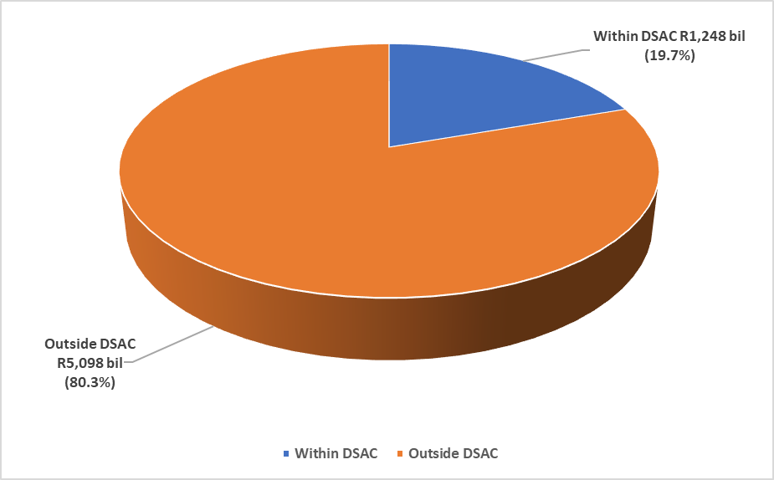
2023/24: WHERE FUNDS WILL BE SPENT
TOTAL ALLOCATION R6,347 BIL

Slide 122
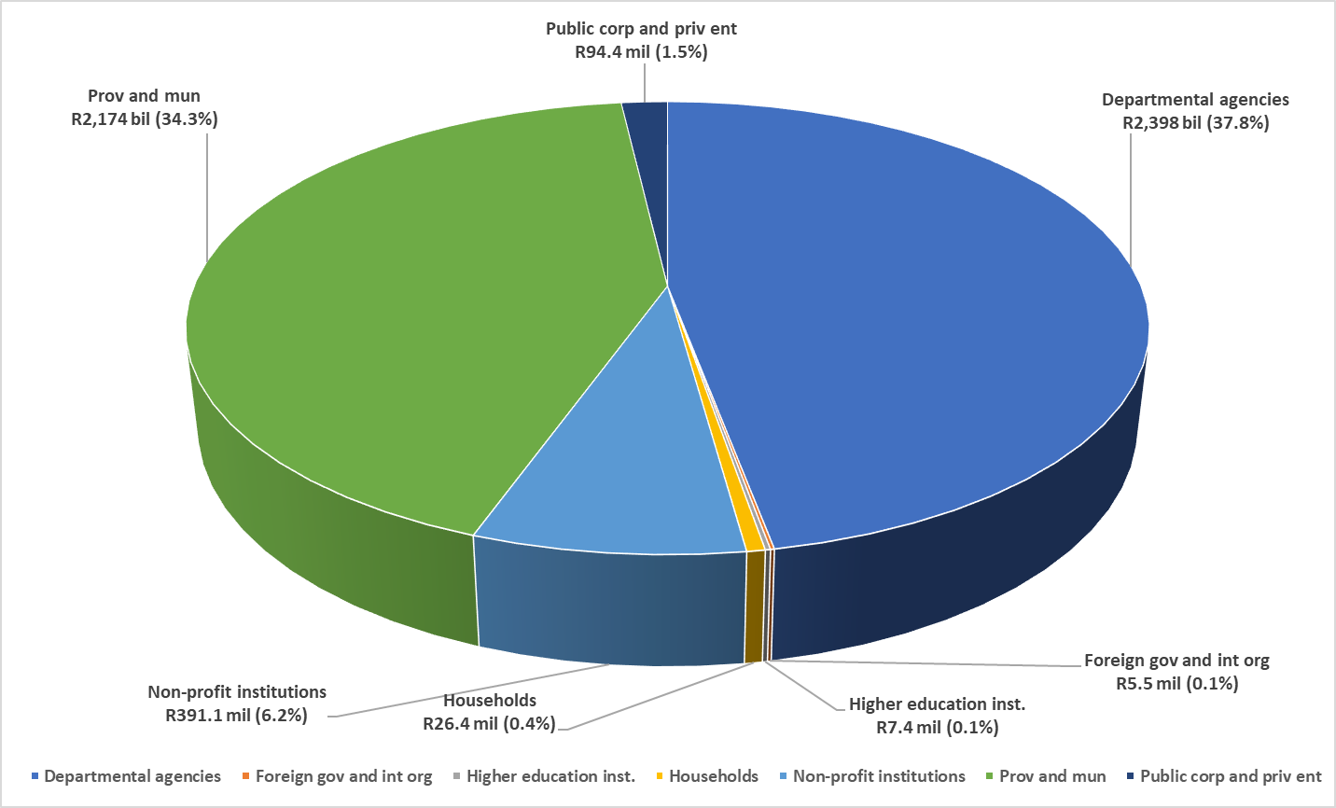
2023/24: HOW FUNDS WILL BE SPENT
OUTSIDE DSAC R5,098 BIL (80.3%)

Slide 123
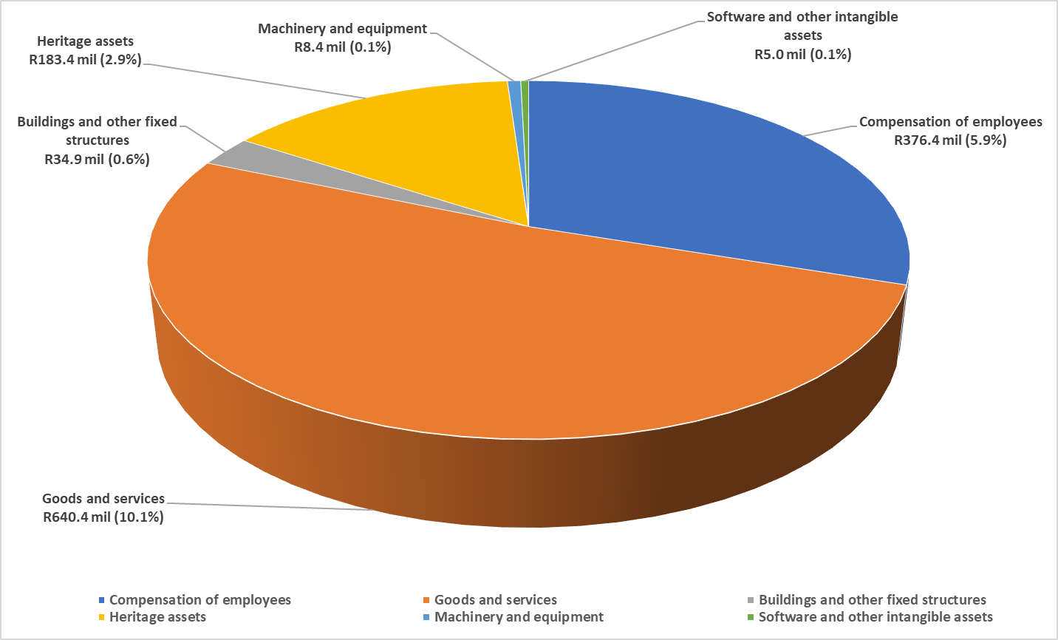
2023/24: HOW FUNDS WILL BE SPENT
WITHIN DSAC R1,248 BIL (19.7%)

Slide 124

2023 MTEF Earmarked Funds

Slide 125
2023 MTEF Earmarked Funds
Earmarked Funds | APPROPRIATION 2023/24
Sport Federations | 117,568
The Sports Trust | 25,807
LoveLife | 40,030
Oversight and support for sport infrastructure projects in municipalities | 7,397
Capital works: Legacy projects - heritage assets ( G&S, Cap Assets and Transfers) | 243,022
Capital works: Infrastructure for public entities | 151,049
Capital works: Legacy Projects -RLHR | 15,635
Pan South African Language Board | 123,566

Slide 126
2023 MTEF Earmarked Funds
Earmarked Funds | Appropriation 2023/24
Mzansi Golden Economy | 298,202
MGE (PESP): Expansion of creatives industry stimulus | 462,000
National Film and Video Foundation | 149,783
Community Library Services (National) | 28,682
Capital works: Infrastructure for public entities | 144,049
Capital works: Upgrading of public spaces & community arts centres, and incubators programme | 31,773
Total | 1,838,563

Slide 127
CONDITIONAL GRANTS ALLOCATION FOR 2023/24
SPECIFICALLY AND EXCLUSIVELY APPROPRIATED | APPROPRIATION 2023/24
Mass participation and sport development grant | 603,960
Community library services grant: Current | 1,331,097
Community library services grant: Capital | 239,703
Compensation of employees ceiling | 385,269
Total | 2,560,029

Slide 128
Conditional Grant: Community library services grant 2023/24
PROVINCE | CURRENT ALLOCATION PER PROVINCE | CAPITAL ALLOCATION PER PROVINCE | TOTAL ALLOCATION PER PROVINCE
Eastern Cape | 149,397 | 28,692 | 178,089
Free State | 170,275 | 8,197 | 178,472
Gauteng | 171,522 | 5,000 | 176,522
Kwazulu-Natal | 120,043 | 69,007 | 189,050
Limpopo | 121,123 | 32,474 | 153,597
Mpumalanga | 137,226 | 33,500 | 170,726
North West | 108,005 | 44,446 | 152,451
Northern Cape | 162,375 | 16,187 | 178,562
Western Cape | 191,131 | 2,200 | 193,331
Total | 1,331,097 | 239,703 | 1,602,801
Current allocation of community library conditional grants are the allocation provided for funds to be directly spent by a province on goods and services such as library materials, contract library staff, newly staff appointed, capacity building programmes and procurement of sanitizers.
Capital allocation of community library conditional grants are the allocation provided for capital assets including all kinds of property, movable or immovable, tangible or intangible such as follows:
Library ICT systems.
New community libraries
Upgrade library structures

Slide 129
Conditional Grant: Mass Participation and Sport Development Grant 2023/24
Province | Allocation per province
Eastern Cape | 74,267
Free State | 43,318
Gauteng | 108,727
Kwa Zulu Natal | 103,488
Limpopo | 68,331
Mpumalanga | 54,765
North West | 50,101
Northern Cape | 36,447
Western Cape | 64,516
Total | 603,960

Slide 130
Thank you

Slide 131

DISCUSSION

