Slide 1
Small-Scale Fishery Co-Management & the Role of Women in the Fisheries Sector Building Resilience in Small-Scale Fishing Communities in South Africa: 3rd Roundtable Discussion Date: May 2nd, 2023 Time: 12pm – 1:30pm (SAST/Cape Town) Venue: Zoom Meeting
Prof. Moenieba Isaacs,
Institute for Poverty, Land and Agrarian Studies (PLAAS), School of Government, Faculty of Economic and Management Sciences, University of the Western Cape

Slide 2
Key pointers for my talk
What is co-management?
Rationale for co-management.
Lessons, experiences and challenges for co-management in the region and in South Africa.
What is needed in South Africa?
Nothing stays behind - the role of women in fisheries?

Slide 3
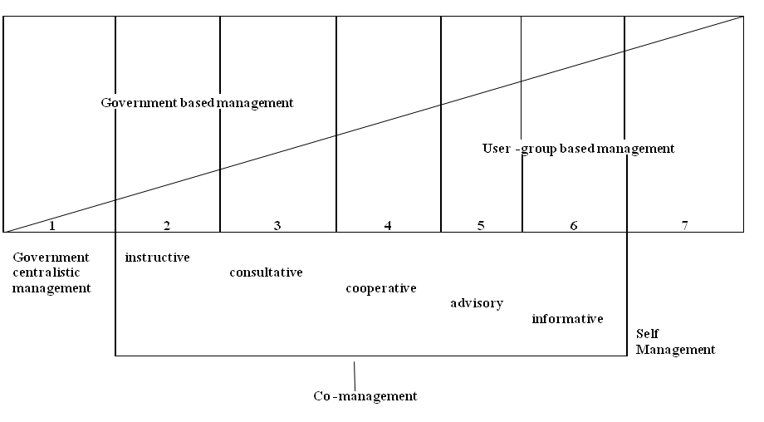
What is co-management?

Slide 4
Why focus on women?
Most marginalized group within already marginalized small-scale fishing communities
Carried with them layers and layers of hardship, resistance, protest and resilience, becoming change-makers within communities
The social reproductive roles of women
Roles as mothers of fishing families
Roles as caretakers of communities
Roles as activists
Roles as business-women and entrepreneurs

Slide 5
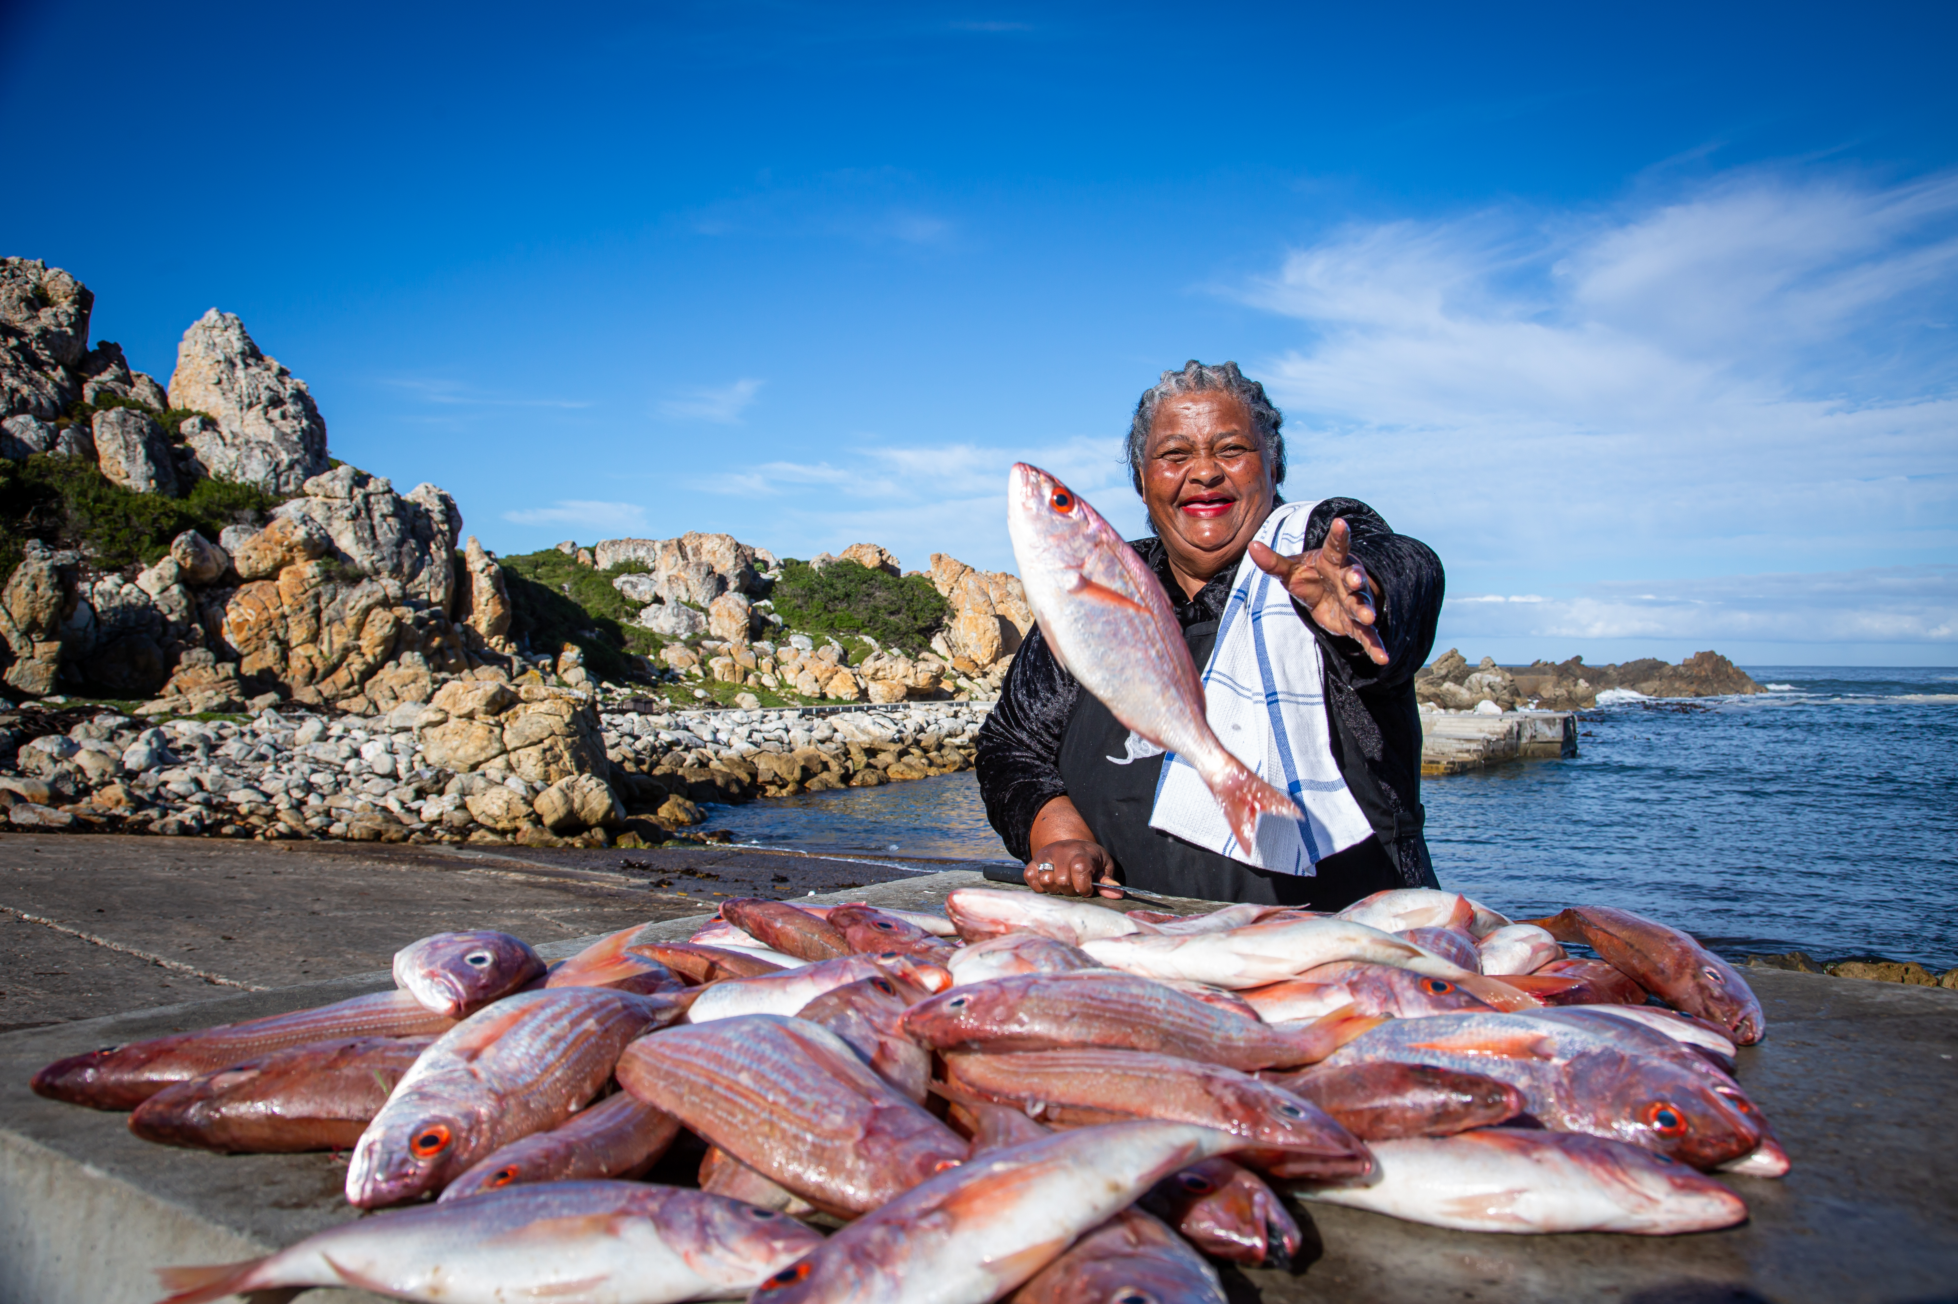
The experience of women (2022)
Of the sea
Of fish
Of their new-found freedom in Democracy and Interim Measures
Their identity as fisherwomen (in the context of fishing families)
Their community
Activism
Transformation
Fishing regulations and the government

Slide 6
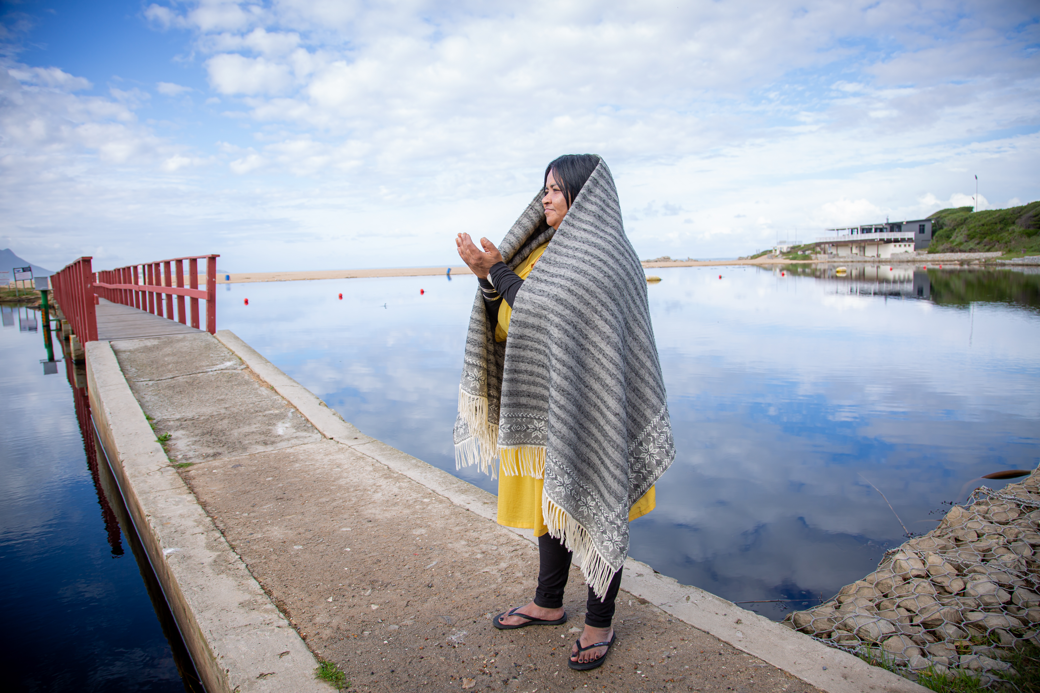
Women and the sea
A place of joy, freedom, self-realization
A place known intimately (wind, weather, tides, sound, feeling)
A source of life; a source of death
A force to respect
A place where our loved ones have died
A place where our loved ones have been buried, never to be found
The sea is much more than merely a resource
Notes:
We have that indigenous knowledge of the sea / My grandfather knew the water; he respected the water / You learn your water
We know the fish and their patterns
We know what can go wrong (foreign/endogenous fish escaping into the sea from aquaculture enclosures)
We know the water, to benefit from it and to protect it

Slide 7
Women and fish
Fishing is a birthright; Fish is life
Fish is food, and nourishment for the family
Income to afford schooling for children, homes, fishing equipment
A source of joy, inspiration and love
Every women enthusiastically talked about her favourite fish, part of a fish, recipe, preparation, sharing of the dish
We see fish is getting fewer; the fish changes
Fishing becoming more and more expensive with rising costs
Fish is much more than a mere commodity
Notes:
We are the owners of fishing grounds; its ours
We see fish is getting fewer; the pattern of the fish changes
Fish quality is dropping (warmer water?)

Slide 8
Women and their new-found freedom
Utter excitement (release of Mandela; dawn of Democracy)
We discovered that we had rights, and could exercise them
Feelings of empowerment and power
New opportunities opening up
Disillusion when men in the fishing industry excluded them, exploited them, actively opposed and undermined them as fisherwomen
Women felt left alone to fend for themselves

Slide 9
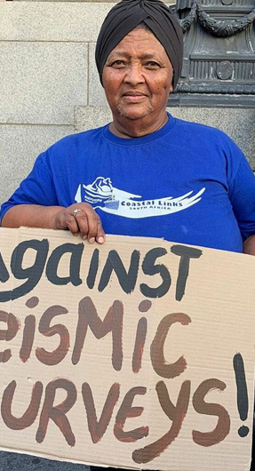
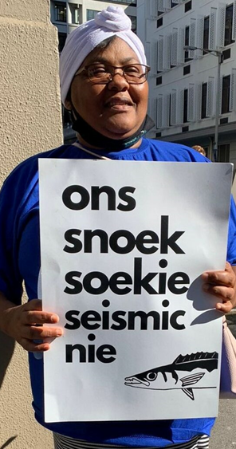
And yet, the struggle continues
Against tourism and recreational activities interfering with fishing
Against Karpowership that will park floating electricity generators near harbours, with seismic effects on fish
Against seismic exploration for oil and gas; east and west coast
Against Blue economy initiatives based on poor knowledge of sea
Again: litigation (in the name of Blue Justice) on the basis of
Recognition
Right to livelihoods
Right to food
From 2002 to 2022 the circle closes, as if nothing changed

Slide 10
In reflection, what is missing?
Women’s role is disappearing, nothing stays behind.
Local organization is weak
Charismatic leaders (mainly men, and few women)
Litigation cannot be the first resort
Strengthening the base at local level to engage with local authorities is crucial

Slide 11
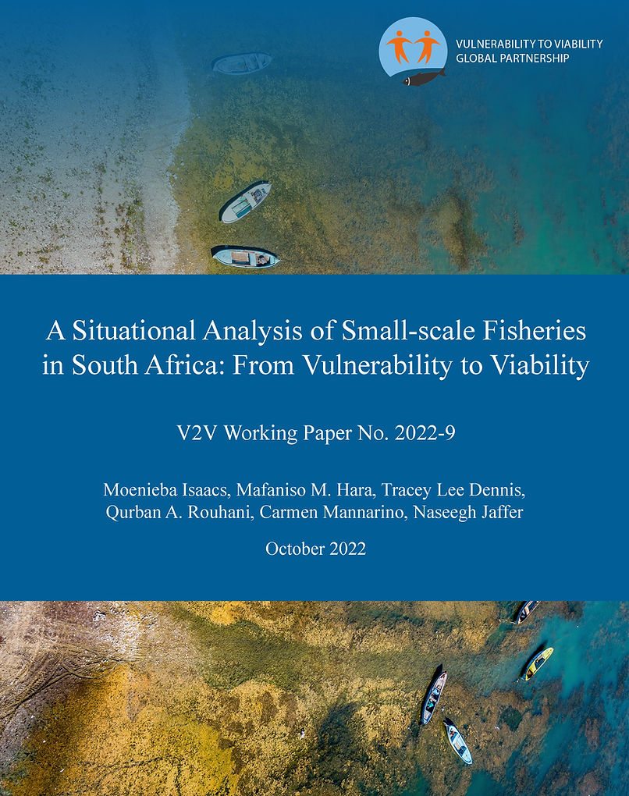
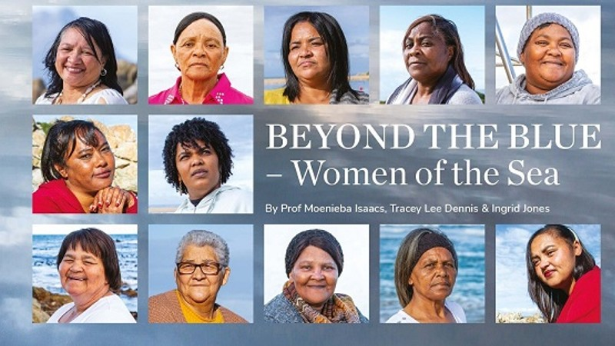
Resources used for this presentation

