Slide 1

Western cape energy strategy and approach
Ad Hoc Committee on Energy Crisis
Premier Winde
28 April 2023

Slide 2
Introductory Remarks: WC Energy Strategy
Premier Winde

Slide 3



Our approach to Energy in Context
  Given the extent of the energy crisis, the Western Cape Government established an Energy Resilience Programme that aims to:
    Reduce the impacts of load shedding on businesses and citizens in the Western Cape
    Facilitate a lower level of reliance on Eskom in the Western Cape.
  R1.1 billion has been set aside to:
    Reduce the impact of loadshedding
    Boost the green economy and to set up a strong pipeline of green energy projects
    Scale up support to municipalities to help them get more power into the grid
    Identify critical transmission infrastructure upgrades.
  An Energy Council has been established for the purpose of identifying and actioning solutions to the energy crisis – an enabling governance arrangement

Slide 4
R1.1 billion towards our Energy Response (1)
Department | Categorisation | Project | Budget
 |  |  | 2023/24 R'000 | 2024/25 R'000 | 2025/26 R'000 | MTEF R'000
DoTP | Loadshedding impact reduction | Demand side management programme | 9,700 | 700 | 700 | 11,100
DEDAT |  | Alternative energy support: SMMEs | 18,500 | 18,500 | 18,500 | 55,500
DoTP |  | Emergency load shedding packs | 60,000 | 0 | 0 | 60,000
DEDAT | Green Economy Ecosystem Support | Green Economy Ecosystem Support | 7,100 | 9,300 | 9,500 | 25,900
DoTP | Project preparation support | Municial Pooled Buying | 3,300 | 4,000 | 6,000 | 13,300
DoI |  | Municipal IPP procurement Stellenbosch | 9,800 | 6,500 | 900 | 17,200
DoI |  | Project preparation facility | 40,000 | 40,000 | 40,000 | 120,000
DLG |  | Pilot renewable energy solutions in municipalities | 5,000 | 10,000 | 15,000 | 30,000
DLG |  | Specialist service providers | 2,000 | 3,000 | 0 | 5,000
DoI |  | Explore gas power | 1,000 | 0 | 0 | 1,000
DEDAT (WESGRO & Freeport Saldanha) |  | Green hydrogen development: PMO | 5,000 | 27,500 | 27,500 | 60,000

Slide 5
R1.1 billion towards our Energy Response (2)
Department | Categorisation | Project | Budget
 |  |  | 2023/24 R'000 | 2024/25 R'000 | 2025/26 R'000 | MTEF R'000
DoI | Grid, generation & financing planning | Grid & transmission infrastructure upgrade planning | 3,000 | 3,500 | 4,000 | 10,500
DLG |  | Municipal EMPs | 1, 740 | 1,760 | 1,840 | 5,340
DoTP |  | WC Integrated Resource Plan (IRP) | 7,500 | 2,000 | 2,000 | 11,500
DEDAT |  | Western Cape Just Energy Transition Investment Plan | Budget Previously Allocated
DoTP | Capacity to implement | Core energy team internal resourcing | 5,150 | 5,150 | 5,150 | 15,450
DLG |  | Additional capacity - DLG (water & wastewater load shedding impacts) | 5,750 | 5,750 | 5,750 | 17,250
DoI |  | Additional capacity to support implementation | 8,100 | 8,473 | 8,862 | 25,435
WCED | Operational | LED lighting | 40,000 | 44,000 | 30,000 | 114,000
WCED |  | Solar PV | Budget Previously Allocated
Total Energy Allocation |  |  | 232, 640 | 190, 133 | 175, 702 | 598, 475
Energy Reserve |  |  |  |  |  | 501, 525
Total |  |  |  |  |  | 1, 100, 000

Slide 6
…complimented by an investment of R3.9 billion over the MTREF by the City of Cape Town…
2023/24 Energy Infrastructure Allocations per Metro/District
Largest Energy Infrastructure Budget Allocations (City of Cape Town) | 2023/24 Budget Allocations | Total MTREF (2023-2025) allocations
COCT: Triangle 132kV Upgrade | R131.5 million | R173.2 million
COCT: System Equip Repl: North Area N FY24 | R60 million | R60 million
COCT: Vehicles: Replacement FY24 | R45 million | R45 million
COCT: Bellville South Main Substation Upgrade | R42.9 million | R45 million
COCT: System Equip Repl: South Area S FY24 | R40 million | R40 million
COCT: MV Sys Infra: South Area S FY24 | R40 million | R40 million
COCT: Revenue Protection Meter Replacement FY24 | R33 million | R33 million
COCT: Prepayment Meter Replacement FY24 | R32 million | R32 million
Province-Wide
R1,847 billion
Total population
7,328,044
West Coast District
R132 million
7,1% of total municipal capex
Total population: 480,424
Cape Winelands District
R174.6 million
9.5% of total municipal capex
Total population: 984,921
Central Karoo District
R726 000
0,04% of total municipal capex
Total population: 76,035
Cape Town Metro
R1,147 billion
62,1% of total municipal capex
Total population: 4,837,094
Garden Route District
R332,9 million
18,0% of total municipal capex
Total population: 635,624
Overberg District
R59,3 million
3,2% of total municipal capex
Total population: 313,945
  Energy Infrastructure Projects comprises 12.6 per cent of total municipal capital expenditure for 2023/24
Notes:
CKD, 9 mil for 2024/25.

Slide 7
…and a further investment of R1.9 billion over the MTREF by the remaining municipalities
2023/24 Energy Infrastructure Allocations per Metro/District
Ten Largest Energy Infrastructure Budget Allocations (excl. City of Cape Town) | 2023/24 Budget Allocations | Total MTREF (2023-2025) allocations
George - Renewable Energy Project | R65 million | R166 million
Knysna - Electrification Of Informal Areas | R38 million | R38 million
Overstrand - Electrification of Low-Cost Housing Areas | R27.3 million | R60.4 million
George - New 20mva Transformers | R25 million | R30 million
Stellenbosch Electrical Infrastructure: HV Substations | R25 million | R75 million
Swartland MV Networks | R23.7 million | R83.7 million
Stellenbosch - Electrical Infrastructure: MV Substations | R 23.1 million | R23.3 million
Saldanha Bay -New 66KV Substation Marais Industry | R20.9 Million | R36.8 million
Stellenbosch - Electrical infrastructure: MV Networks | R18.5 Million | R49.5 million
Overstrand - New 66 11kv Substation | R18.4 million | R18.4 million
Province-Wide
R1,847 billion
Total population
7,328,044
West Coast District
R132 million
7,1% of total municipal capex
Total population: 480,424
Cape Winelands District
R174.6 million
9.5% of total municipal capex
Total population: 984,921
Central Karoo District
R726 000
0,04% of total municipal capex
Total population: 76,035
Cape Town Metro
R1,147 billion
62,1% of total municipal capex
Total population: 4,837,094
Garden Route District
R332,9 million
18,0% of total municipal capex
Total population: 635,624
Overberg District
R59,3 million
3,2% of total municipal capex
Total population: 313,945
  Energy Infrastructure Projects comprises 12.6 per cent of total municipal capital expenditure for 2023/24
Notes:
CKD, 9 mil for 2024/25.

Slide 8
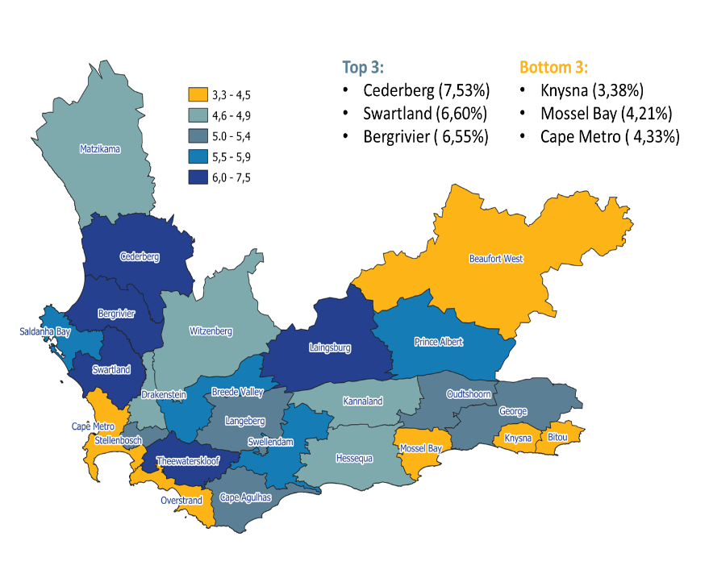
R88,815 million to assist municipalities (emergency funding)
  An immediate response to the prolonged load-shedding, thereby mitigating the impact on the provision of basic services and potential health risks:
    Towards the purchase and installation of back-up energy supply
    Which may include generators, renewable power sources, batteries and all ancillary costs associated with the installation i.e.: switch gear, safe keeping, caging etc. for water and wastewater infrastructure
  The funding will enable 24 local municipalities and the five district municipalities to keep providing basic services such as potable water and hygienic and environmentally safe sewage
  Required governance and oversight arrangements are in place: Transfer Payment Agreement with municipalities

Slide 9
The Energy Crisis
A. Lester

Slide 10
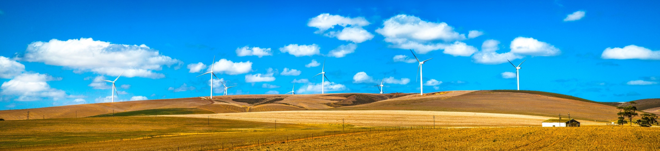
Energy continues to be an escalating crisis in SA
  The decline of Eskom is a critical factor that has led us to this crisis
  This is not a simple crisis to address & it won’t be resolved quickly
  The solutions lie in a complete overhaul of the power sector, which is underway – incl. unbundling of Eskom & increasing diversification & decentralization
  The regulatory, process & other changes needed are radical & are happening at an unprecedented rate
  WCG & metro & local municipalities have a critical role to play in the new landscape & in providing &/or enabling solutions

Slide 11
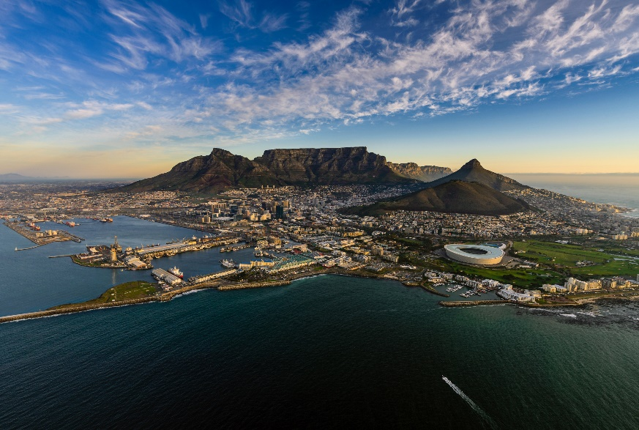
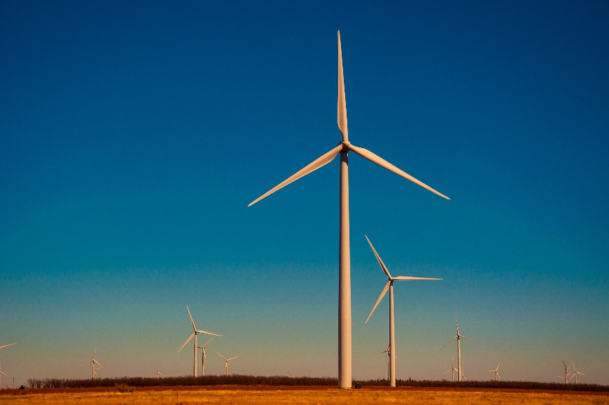
The Western Cape in context
    The Western Cape:
  Stable and resilient economy yet exposed
    is the 3rd largest economy in SA & has the 3rd largest load energy demand in SA
    provides 55% of SA agricultural exports
    has the highest numbers of local & international tourist visiting each year
    Inequality in the WC remains relatively high at 0.60, but lower than the SA average of 0.68
  Leading Good Governance through accountability, transparency and performance
    achieved unqualified audits for all Provincial Government Departments
    is the only Province where 90% of the local municipalities have received clean audits
    has the lowest electricity debt level compared to other provinces
  Established Energy strategy and well positioned transmission base with strong engineering skills but opportunity to further strengthen
    has the most diversified energy mix of any province incl.: nuclear, hydro, wind, solar, gas/diesel
    has the lowest frequency of network incidents nationally
    has the lowest duration of network incidents nationally
    has 49 000 kms of line (all voltage levels) in the province
    holds more than 8 Main Transmission substations and 100 Distribution substations in the province

Slide 12
However, power supply shortages impacts negatively on the economic outlook
  By 2021, the Western Cape is estimated to have lost between R48.6 to R61.2 billion in real GDP since loadshedding commenced in late 2007.
  The real GDP lost in 2022 was estimated at R8.2 billion
  The volume of electricity delivered to the Western Cape in 2022 was significantly lower than in 2008 (-17.0 per cent), but also lower than in 2020 (-5.1 per cent) and 2021 (-3.0 per cent).
  The cost of loadshedding on the Provincial economy is estimated to be R12.8 billion in 2023

Slide 13
Lower electricity usage at WCG facilities due to increased loadshedding

Slide 14
Fuel, oil and grease - increase mainly due to costs for running generators
Report drawn as of 30 March 2023 – expenditure numbers for March not final

Slide 15
Implementing our Strategy
A. Lester

Slide 16
Energy governance structures
Directing and overseeing the implementation of the Western Cape Government’s urgent action to relieve both the immediate impacts of load shedding and its medium to long term energy strategy. Chaired by the Premier
Energy Council
Energy Council Steercom
Energy Resource Team
Core Energy
Team
Unblocking any departmental issues & facilitating capacity where needed, and as a ‘caucus’ so that all HODs are aligned as best possible before a WC EC mtg. Chaired by the Director General
Officials working on the various energy workstreams – whether part or full-time. Group chaired by the Core Energy Team.

Slide 17
WCG programmes have positioned the province as the hub for energy resilience
REIPPPP | Municipal IPP procurement | Wheeling | SSEG | Business support
1 008 MW total installed REIPPPP projects in WC in commercial operation | Pre-feasibility analyses for 5 WC municipal IPP procurement pioneering projects – initial TA support for 50 MW project in Stellenbosch Municipality | 3 major private sector wheeling projects supported: 470 MW | 24 municipalities supported on SSEG, with 21 providing compensation for feedback of electricity | 5 082 businesses directly assisted with Green Economy support
785 MW of REIPPPP BW5 projects located in WC | City of Cape Town 200 MW tender in progress & dispatchable 500 MW tender soon to be released. | 7 municipalities provided with wheeling framework & tariff support & wheeling pilots in George Municipality & City of CT | 197MW SSEG registered by municipalities (excl. recent spike of 1040 applications made in CT) | 10 804 downloads of the 2022 market intelligence reports for energy, water & EVs
REIPPPP BW5 – 16 / 25 won by CT-based energy developers & further 5 have HQ in WC |  | Wheeling Use of Systems Agreements developed to enable wheeling across municipal grids |  | 24 industry briefs & case studies developed & distributed
BW6: 4 791MW (24 projects) in WC submitted to REIPPPP |  | 1 820 MW of Eskom transmission capacity in WC taken up by private sector projects |  | R12.9bn worth of investment facilitated in green economy
 | R9.9m of funding provided to 8 municipalities for 13 foundational energy studies to enable RE penetration at scale |  | R9.9m of funding provided to 8 municipalities for 13 foundational energy studies

Slide 18
WC recognizes the need to scale & speed up delivery
Western Cape Energy Resilience Programme strategic objectives:
To reduce the impacts of load shedding on businesses & citizens in the Western Cape
To facilitate a lower level of reliance on Eskom in the Western Cape
Reduce off take between 500MW – 750MW by 2025 (Short Term)
Reduce off take between 750MW - 1 800MW by 2027 (Medium Term)
Reduce off take between 1 800MW - 5 700MW by 2035 (Long Term)
      *** Note substantial change from previous targets given state of Eskom & WC Growth for Jobs Strategy
Whole of government approach to achieve these objectives
There are five things we need to focus on to achieve our objective
Load Shedding Relief Programme (LSRP)
Provincial Integrated Resource Plan (PIRP - Long Term Energy Plan)
Demand Side Management Programme (DSMP)
New Energy Generation Programme (NEGP)
Network Development Programme (NDP)

Slide 19
Delivering on our Strategy over the short-, medium- and long-term
Short term | Medium term | Long term
Development, coordination & implementation of BCPs – municipalities, WCG, residential & private sector
Communications
Alternative energy supply for critical municipal & WCG services & SMMEs
Lower LSM households emergency load shedding packs
Protect energy infrastructure from vandalism and theft
Disaster mitigation & management
Strategic planning, development & management
WC Integrated Resource Plan
Planning based on IRP modelling
Partnerships with energy stakeholders
Established, capacitated & resourced economic IQ centre for energy
National negotiations re load shedding buffering
Develop WC energy efficiency / DSM programme
Implementation:
  Public sector: ramp up of energy efficiency in facilities & operations
  Private & residential sectors: baselines, M&V system, & communications & implementation mechanisms
Public sector: Further scaled energy efficiency
Private & residential sectors : Implementation at scale incl demand side aggregation
Demand side management
Generation, procurement & trading of low-carbon energy
Maintenance & expansion of required energy infrastructure

Slide 20
Delivering on our Strategy over the short-, medium- and long-term
Short term | Medium term | Long term
Green economy ecosystem support incl.:
  Streamlining processes for SSEG registration, develop & implement standardised wheeling framework & agreements & optimise SSEG feed-in tariffs & wheeling tariffs – focus on key municipal areas
  Address business issues re SSEG, wheeling & utility scale projects
Municipal IPP procurement:
  Selection of preferred bidders for STM
  CCT IPP procurement advanced
  Assisting municipalities with more efficient procurement process
  Project Prep Facility: Assisting municipalities contract management capacity for PPAs / PPPs incl to take projects to bankability *
  Pooled buying / energy trading mechanism developed
Explore gas power options
Pilot RE solutions in municipalities for own use
Planning & financing partnerships established for GH2 production at scale
Schools PV and LED Lighting
Demand side management
Generation, procurement & trading of low-carbon energy
Process & implementation mechanisms incl. access to & unlocking of land -> continuous improvement for scaled projects
Public, private & residential sectors: implementation at scale
Energy storage for solar & wind (MT) & newer techs (LT)
Green Hydrogen projects implemented in WC
Maintenance & expansion of required energy infrastructure
* Assisting municipalities contract management capacity for PPAs or PPPs - general capacity building for all municipalities & hands-on contract management support for ‘key’ municipalities in ST – MT

Slide 21
Delivering on our Strategy over the short-, medium- and long-term
Short term | Medium term | Long term
Transmission and distribution infrastructure
Plan, cost & access financing & use of public sector land for the rollout of the strengthening & expansion of municipal distribution infrastructure within key municipalities
Map out Eskom transmission & distribution capacity
System for regular updating of capacity allocations by Eskom
Advocacy for an amended Eskom capacity allocation system
Scaling up support to municipalities for EMP updates
Strengthening & expansion of municipal distribution infrastructure within key municipalities
Demand side management
Strengthening & expansion of municipal distribution infrastructure within further WC municipalities
Generation, procurement & trading of low-carbon energy
Partnerships for co-financing Eskom Tx & Dx infrastructure
Maintenance & expansion of required energy infrastructure
Scaling up support to municipalities for EMP updates
Develop & implement initiative/ proposal funnel to ID viable solution options for the province(WCG, municipalities, pvt sector)
WC Just Energy Transition (JET) Investment Plan
Develop / identify financing & other mechanisms for implementation at scale
Remove of regulatory constraints to investment in low carbon energy in the WC
Unlock local content requirements with National for renewable energy components and/or systems
Increased investment in energy sector
Implement financing mechanisms to deliver at scale
Identify & secure climate / green finance investment opportunities
Attract investment in & facilitate local production of key renewable energy components and/or systems
Develop key skills in low carbon energy

Slide 22
Western Cape Government commits R1.1 billion towards Energy…
Load Shedding Relief Programme (LSRP):
Disaster mitigation & management
Well co-ordinated & managed disaster mitigation & management system incl. public & private sector & households
R115.5 million
Provincial Integrated Resource Plan (PIRP - Long Term Energy Plan):
Strategic planning, development & management
Evidence-based & cost optimal plan of energy options to enable planning & investment
R11.5 million
Informs
Demand Side Management Programme (DSMP):
Demand side management
Enables right-sizing & reduced investment in alternative energy systems & negotiations with National re load shedding buffering for WC
R11.1 million
New Energy Generation Programme (NEGP):
Generation, procurement & trading of low-carbon energy
Enables new energy – on & off grid
R381.4 million
Network Development Programme (NDP):
Maintenance & expansion of required energy infrastructure
Enables movement of energy using the grid
R15.84 million
Financing implementation
Attract financing for implementation, enable financing mechanisms for incentivization & implementation & attract local production
Increased investment in energy sector
R63.135 million for Capacity and resourcing
Total Energy Allocation | 598 475
Energy Reserve | 501 525
TOTAL | 1 100 000

Slide 23
…complimented by an investment of R3.9 billion by the City of Cape Town…
2023/24 Energy Infrastructure Allocations per Metro/District
Largest Energy Infrastructure Budget Allocations (City of Cape Town) | 2023/24 Budget Allocations | Total MTREF (2023-2025) allocations
COCT: Triangle 132kV Upgrade | R131.5 million | R173.2 million
COCT: System Equip Repl: North Area N FY24 | R60 million | R60 million
COCT: Vehicles: Replacement FY24 | R45 million | R45 million
COCT: Bellville South Main Substation Upgrade | R42.9 million | R45 million
COCT: System Equip Repl: South Area S FY24 | R40 million | R40 million
COCT: MV Sys Infra: South Area S FY24 | R40 million | R40 million
COCT: Revenue Protection Meter Replacement FY24 | R33 million | R33 million
COCT: Prepayment Meter Replacement FY24 | R32 million | R32 million
Province-Wide
R1,847 billion
Total population
7,328,044
West Coast District
R132 million
7,1% of total municipal capex
Total population: 480,424
Cape Winelands District
R174.6 million
9.5% of total municipal capex
Total population: 984,921
Central Karoo District
R726 000
0,04% of total municipal capex
Total population: 76,035
Cape Town Metro
R1,147 billion
62,1% of total municipal capex
Total population: 4,837,094
Garden Route District
R332,9 million
18,0% of total municipal capex
Total population: 635,624
Overberg District
R59,3 million
3,2% of total municipal capex
Total population: 313,945
  Energy Infrastructure Projects comprises 12.6 per cent of total municipal capital expenditure for 2023/24
Notes:
CKD, 9 mil for 2024/25.

Slide 24
…and a further investment of R1.9 billion by the remaining municipalities
2023/24 Energy Infrastructure Allocations per Metro/District
Ten Largest Energy Infrastructure Budget Allocations (excl. City of Cape Town) | 2023/24 Budget Allocations | Total MTREF (2023-2025) allocations
George - Renewable Energy Project | R65 million | R166 million
Knysna - Electrification Of Informal Areas | R38 million | R38 million
Overstrand - Electrification of Low-Cost Housing Areas | R27.3 million | R60.4 million
George - New 20mva Transformers | R25 million | R30 million
Stellenbosch Electrical Infrastructure: HV Substations | R25 million | R75 million
Swartland MV Networks | R23.7 million | R83.7 million
Stellenbosch - Electrical Infrastructure: MV Substations | R 23.1 million | R23.3 million
Saldanha Bay -New 66KV Substation Marais Industry | R20.9 Million | R36.8 million
Stellenbosch - Electrical infrastructure: MV Networks | R18.5 Million | R49.5 million
Overstrand - New 66 11kv Substation | R18.4 million | R18.4 million
Province-Wide
R1,847 billion
Total population
7,328,044
West Coast District
R132 million
7,1% of total municipal capex
Total population: 480,424
Cape Winelands District
R174.6 million
9.5% of total municipal capex
Total population: 984,921
Central Karoo District
R726 000
0,04% of total municipal capex
Total population: 76,035
Cape Town Metro
R1,147 billion
62,1% of total municipal capex
Total population: 4,837,094
Garden Route District
R332,9 million
18,0% of total municipal capex
Total population: 635,624
Overberg District
R59,3 million
3,2% of total municipal capex
Total population: 313,945
  Energy Infrastructure Projects comprises 12.6 per cent of total municipal capital expenditure for 2023/24
Notes:
CKD, 9 mil for 2024/25.

Slide 25
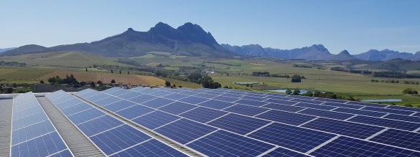
Proposed areas for strategic partnerships
Technical advisory & capacity support – on multiple projects / areas of work including:
  WC IRP
  Transaction advisory support for:
    Municipalities’ IPP procurement, own generation projects etc
    Schools and Clinics PV Projects
  Mapping out & planning for energy infrastructure strengthening and expansion – assess and review
    Transmission distribution infrastructure
  Green hydrogen development
Potential co- financing of interventions such as:
  Schools and Clinics PV
  Load shedding packs to lower LSM households
  Piloting and scaling renewable energy solutions in municipalities
  SMME alternative energy support
  Demand side management
*Financing investment requirements mainly within municipal Energy infrastructure

Slide 26


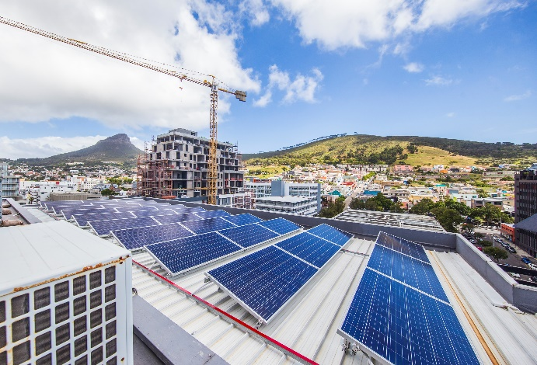
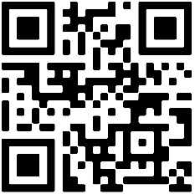
Partnering for greater impact in the Western Cape
  The Western Cape is a reliable partner and well-positioned to drive Energy security in South Africa - evident through our resilient economy and good governance track record
  Significant progress to date, a clear Energy strategy is being delivered on and investments have been made– the WC is ready for greater impact through exploring strategic partnerships in the energy space
  There is a need to establish partnerships to crowd in the necessary strategic network and technical advisory & capacity support to drive energy security
  Our approach should ensure that ALL residents of the Western Cape benefit – inspiring hope in the WC by driving delivery with urgency
Premier Alan Winde’s Energy Digicon
(2 March 2023)
SCAN ME

Slide 27
Parliamentary Questions

Slide 28
Parliamentary Questions
    Which municipalities will be prioritised in terms of the energy crisis with the allocated Emergency fund?
    Which municipalities will be benefitting and getting electricity from the Independent Power Producers (IPPs) with funding provided from the Premiers budget. In addition:
    2.1. What is the service level agreement with these municipalities in terms of continuity and availability including the term for purchasing electricity from the IPPs;
    2.2. Whether electricity costs will be affordable for the poor and indigent households across the Province;
    2.3. What is the BBBEE status of the Independent Power Producers?
    What is the model being used in this instance, is it a model that looks at the site/facility being built by the IPP/service provider and run by the service provider and how does municipalities buy from them? Or is this going to be built and handed over to the municipality for management?
    The wastewater treatment facilities in the Province, will this be included in the oversight because of the high-faecal content of tap water, among others and which municipalities will benefit from this?
    A status update on the progress in procuring and distributing the Emergency Energy packs as mentioned by the Department during the Appropriations deliberations in March in 2023.

Slide 29
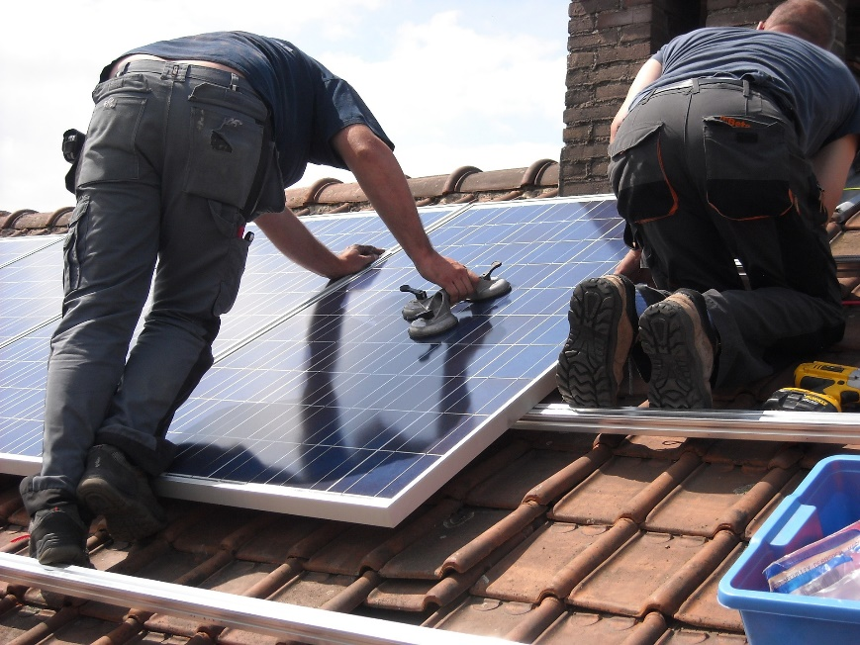
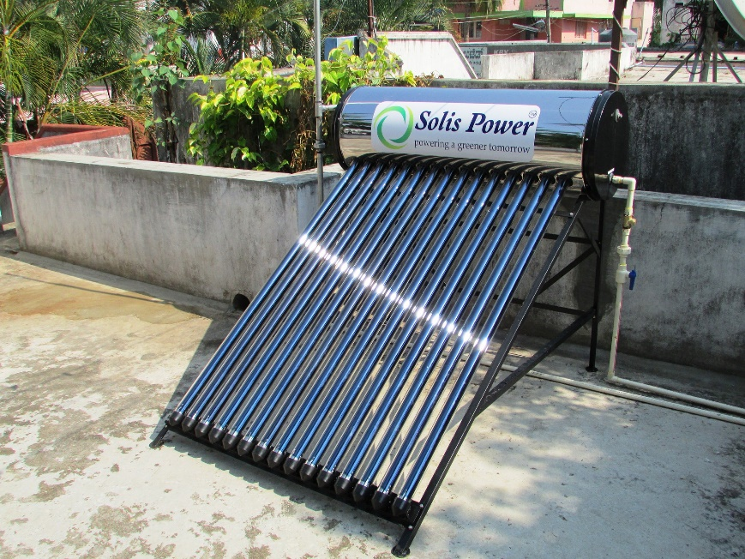
Which municipalities will be prioritised in terms of the energy crisis
with the allocated Emergency fund? (HoD Paulse)
    This grant is a contribution towards the municipalities’ fiscus to procure back-up generators for their critical water and sanitation infrastructure.
  All the municipalities were prioritised except the City of Cape Town, given the magnitude of their energy back-up programme.
  Prioritisation was done based on an assessment undertaken by the Department of Local Government.
  Each Municipality will be responsible for operation and maintenance of the procured generators.

Slide 30
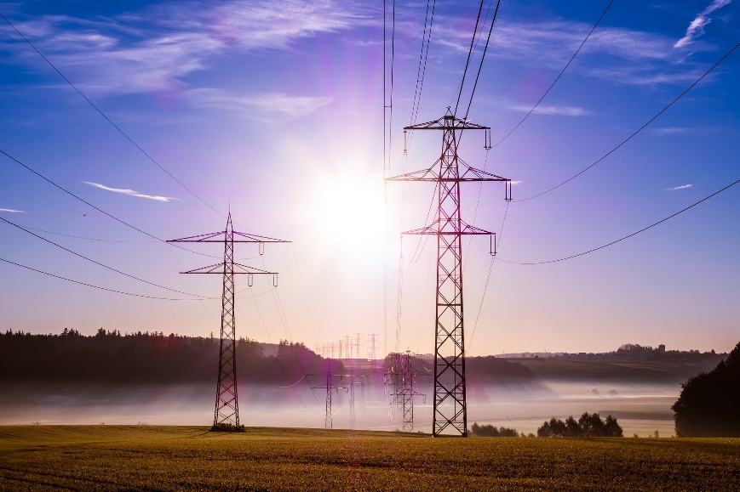
Which municipalities will be benefitting and getting electricity from the
Independent Power Producers (IPPs) with funding provided from the Premiers budget?
  A thorough municipal project selection process (including factors such as municipal readiness, energy policy, council support, internal capacity, financial standing and others) was undertaken.
  Pre-feasibility studies for municipal IPP procurement were undertaken for four municipalities (Drakenstein, Mossel Bay, Saldanha Bay and Stellenbosch).
  We are working to secure transaction advisory services and project officer capacity support for the implementation of Stellenbosch Municipality’s pioneering project (an up to 50 MW embedded solar PV plant).
  We are investigating the viability of a municipal pooled buying mechanism (initially focused on Drakenstein, Stellenbosch, Saldanha Bay and Mossel Bay municipalities as well as the City of Cape Town).
  A Project Preparation Facility is being established.

Slide 31
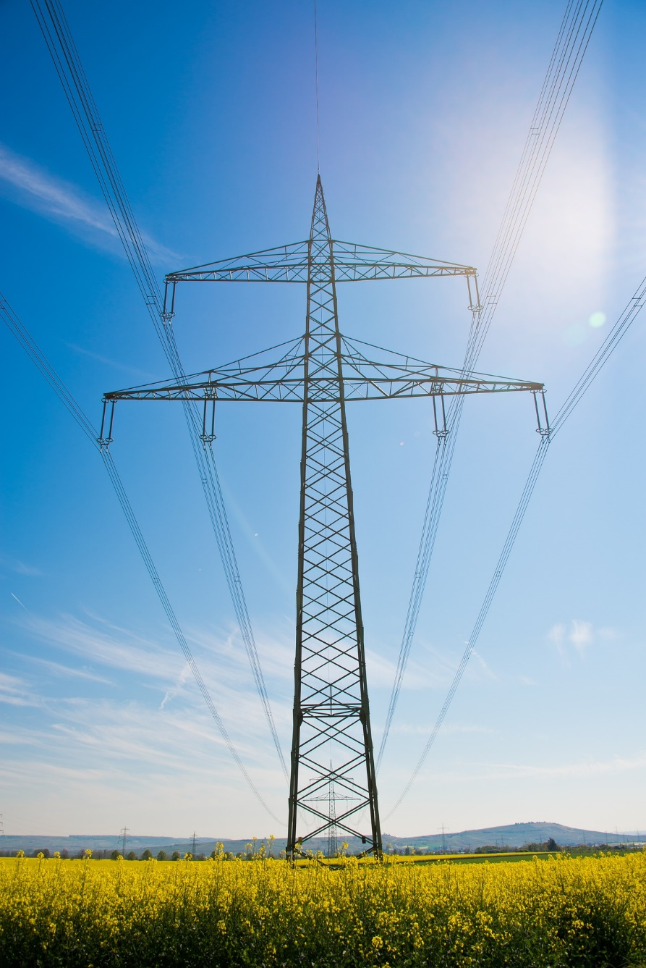
What is the service level agreement with these municipalities in terms of continuity and
availability including the term for purchasing electricity from the IPPs?
  The agreement between an IPP and Stellenbosch Municipality in the form of a Power Purchase Agreement (PPA) is part of the procurement process that Stellenbosch Municipality is about to embark on.
  PPA term is expected at between 15 and 20 years.
  All potential risks to the contract are defined in the PPA, together with the agreed mitigation measures and/or penalties.
  We expect that the standard SCM rules of the municipality and prevailing legislation would apply in terms of BBBEE.
  All indications and research show that the price of electricity from renewable energy IPPs should be cheaper than the current Eskom tariffs.
  The prices are usually allowed to escalate annually only by CPI, which is agreed to upfront in the final signed PPA for the entire term, providing better price increase certainty for the municipality and customers.

Slide 32
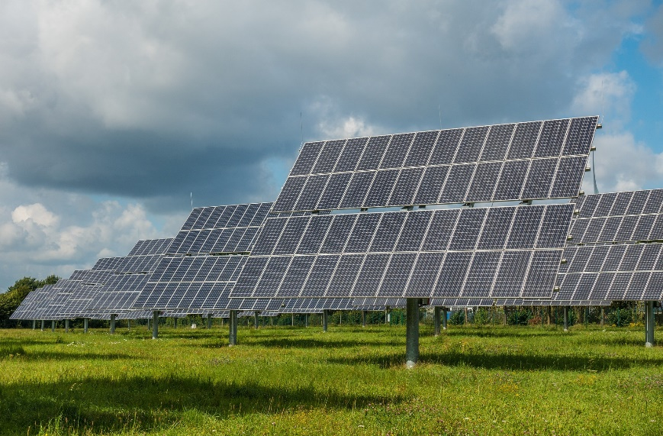
Which IPP Model will be utilised?
  The IPP will build and run the facility, selling energy to the municipality, similar to how it does its bulk purchases from Eskom at present.
  The IPP takes on all the risks, to secure land, all authorizations, design, finance, build, maintain and operate the power plant.
  The municipality shall purchase from the IPP based on the agreed tariff in the PPA for the term of the PPA at an agreed annual escalation.

Slide 33
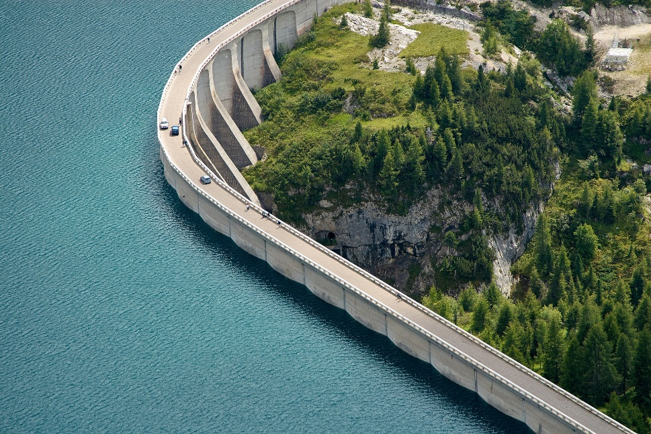
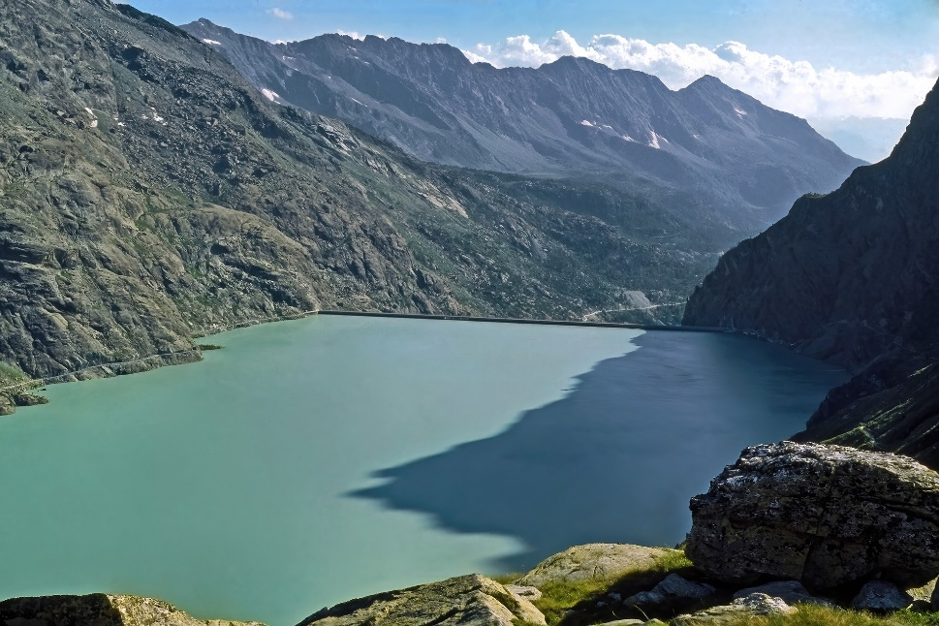
Wastewater treatment facilities in the Province (HoD Paulse)
  Several critical wastewater treatment plants which pose public and environmental health risks have been identified.
  The upgrading of municipal water and wastewater infrastructure is receiving the highest priority in terms of the current catalytic projects identified for funding through the SIDAFF programme.
  Various IGR platforms assist municipalities to develop risk abatement plans with the aim to improve the operations of WWTPs and therefore reducing the risk of polluting rivers.
  Municipalities are encouraged to prioritise water and wastewater infrastructure projects on their MIG, Water Services Infrastructure and Region Bulk Infrastructure Grants to develop contingency plans.
  Pre-directives and Directives issued by DEA&DP and DWS are also used to prioritise the upgrading of water and wastewater infrastructure.

Slide 34

Status update on the progress in procuring and distributing the Emergency Energy packs
  The beneficiary selection criteria and approach to rolling out the project are still under discussion and require consultation with various stakeholders.
  Co-funding of the programme is also being sought from the City, some municipalities, and the private sector to enable packs to be distributed to more homes

