Slide 1

whew
^{2023/24} ^{ANNUAL} ^{PERFORMANCE PLAN AND BUDGETS}
^{26 APRIL 2023}
^{SELECT COMMITTEE}
^{ON}
EDUCATION AND TECHNOLOGY, SPORTS, AND CULTURE

Slide 2
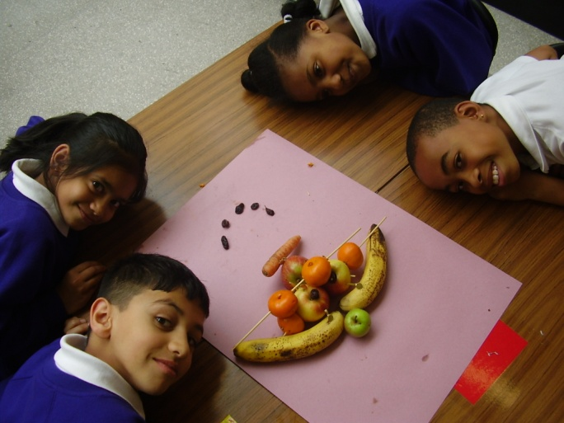
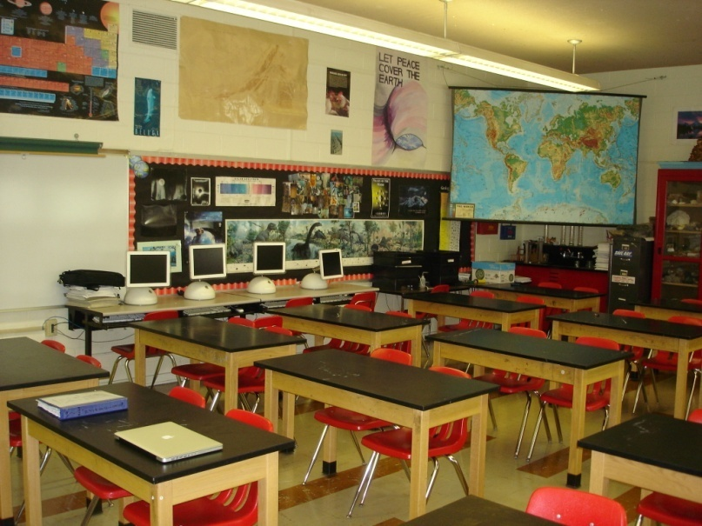
PRESENTATION OUTLINE
Purpose
Mandate
Policy Context
2023/24 Priorities
Partnerships (Collaborations)
Recommendations

Slide 3
PURPOSE OF THE PRESENTATION
The purpose of the presentation is to give an overview of the 2023/24 Annual Performance Plan and budgets with specific focus to priorities with specifics to basic education and skilling of out of school youth in response to the 6th Administration Priorities.

Slide 4
MANDATE
SUB-OUTCOME | 2024 MTSF (NDP Implementation Framework towards vision 2030
Improved school-readiness (Access/Quality for ECD) | Implementation of Migration of ECD Strategy (from DSD to MDoE)
 | Finalise the two years of compulsory pre-school education
 | Ensure each learner attends Grade R and has access to Grade R LTSM
 | Professional development of ECD practitioners
 | Auditing and registration of ECD centres
 | ECD Institute fully functional, conducting training & material development
Every 10-year old able to read for meaning (Reading standard in Systemic Evaluation and PIRLs) | Expand the Early Grade Reading Strategy
 | Building capacity of teachers in content knowledge and methodology
 | Implementation of new assessment for Gr. 3, 6 & 9
 | Provision of reading materials and workbooks (incl. digitisation of the workbooks and textbooks)
Youth better prepared for further learning and world of work (TIMMS performance and Gr 3, 6, 9 systemic evaluation) | Increased accountability for performance in schools
 | Strengthen monitoring system and capacity of districts
 | Promote more effective approaches to teacher development, such as professional communities of learning (PLCs) and technology-enhanced in-service training
 | Recruiting of young teachers to enter the system through Funza Lushaka bursaries
 | Improve monitoring and evaluation of the schooling system through whole school evaluation
School-leavers prepared to contribute to prosperous and equitable South Africa | Establish effective schools accountability linked to learner performance
 | Improve teachers’ subject content knowledge
 | Establish functioning district offices, that are able to support schools
Every learner enrolled in schools that support learning and decency | Infrastructure complying with minimum norms and standards
 | Connectivity of all schools

Slide 5
POLICY LINKAGE: MTSF IMPACT INDICATORS
Outcome: Improved education, training and innovation
Indicator | NDP Target | Mpumalanga V2030 Target
Pre -school education | All children should have at least 2 years of pre-school education by 2030 | All children should have at least 2 years of pre-school education by 2030
Annual assessment average mark (Mathematics and Languages) | 90% of learners in grades 3, 6 &9 must achieve 50% or more in Annual assessment by 2030 (Mathematics and Languages) | 90% of learners in grades 3, 6 &9 must achieve 50% or more in Annual assessment by 2030 (Mathematics and Languages)
Throughput rate | Between 80% & 90% of learners should complete 12 years of schooling or vocational training by 2030 | Improve throughput rate of learners to at least 80% by 2030
Matric pass rate | 80% of abovementioned learners should pass exit exams | 80% of abovementioned learners should pass exit exams
Innovation | Expand science, technology & innovation outputs by increasing spending by government & encouraging industry to do so | Gross expenditure of research & development (GERD) in MP as a percentage of provincial GDP to increase to at least 2%

Slide 6
POLICY CONTEXT
Mandate
The Department derives its Core mandate from the Constitution.
Sections of the Constitution that are particularly applicable to education:
Equality
Rights of the child:
A child’s best interests are of paramount importance in every matter concerning a child
Access
Equity
Redress
No unfair discrimination on any grounds
The right to education
Right to fairness
Correct previous wrongs
Core Business
To provide an education of progressively high quality for all learners and so doing lay a strong foundation for the development of all our people talents and capabilities and advance the democratic transformation of society.

Slide 7
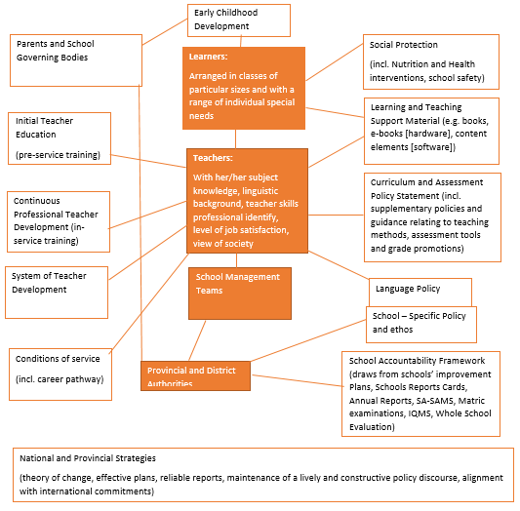
THEORY OF CHANGE FOR QUALITY BASIC EDUCATION

Slide 8


Priorities for 2019-2024
1
2
3
4
5
6
7
Consolidating the Social Wage through Reliable and Quality Basic Services
Economic Transformation and Job Creation
Spatial Integration, Human Settlements and Local Government
Education, Skills and Health
Social Cohesion and Safe Communities
A Better Africa and World
A Capable, Ethical and Developmental State
Building a capable state that serves all the people
Building a united and cohesive society
Investment, jobs and inclusive growth
An effective land reform programme
Eradicating poverty and improving people’s lives
Education and skills for a changing world
Better Africa, better world
MTSF 2019-2024
January 8th Statement
MTSF 2020/21 IMPLEMENTATION PLAN
SONA

Slide 9
BASIC EDUCATION: PRIORITIES
1. Reading for Meaning
2. Skills for a Changing World
3. Teacher Development (for teaching Learning & Numeracy)
4. Assessment and Accountability
5. Digital (School) Connectivity
6. Early Childhood Development
7. Decolonization of Basic Education
8. School Safety, Health and Social Cohesion
9. Integrated Infrastructure Development
10. School Nutrition (and other pro-poor policy initiatives)
11. Integrated Governance, IGR and Labour Peace

Slide 10
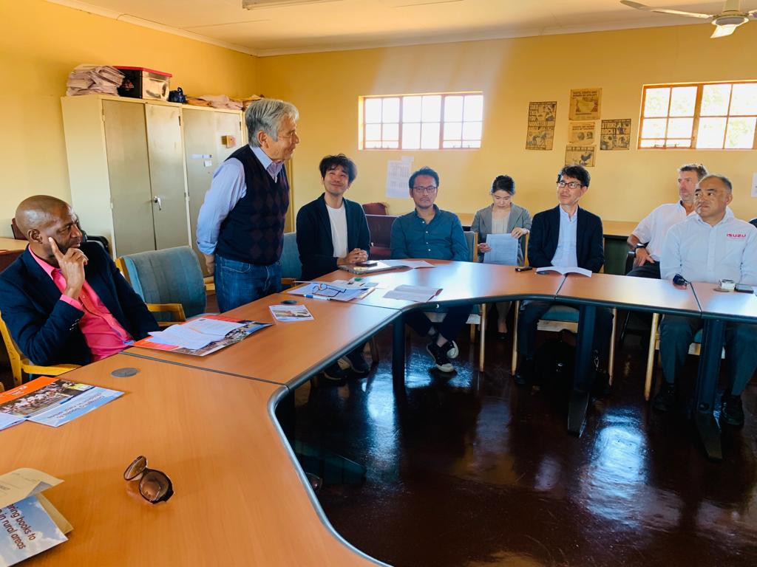
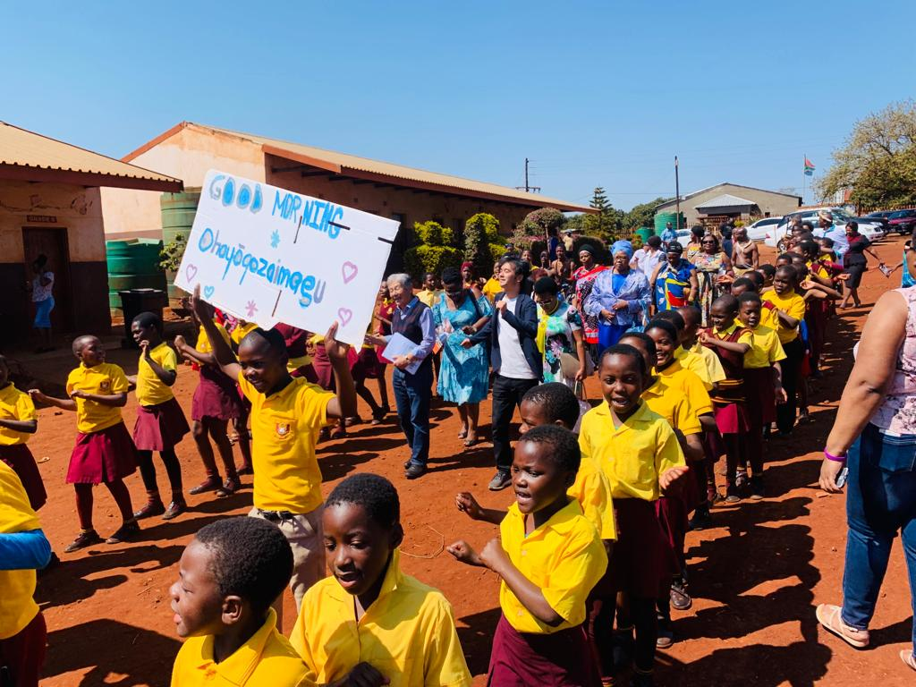
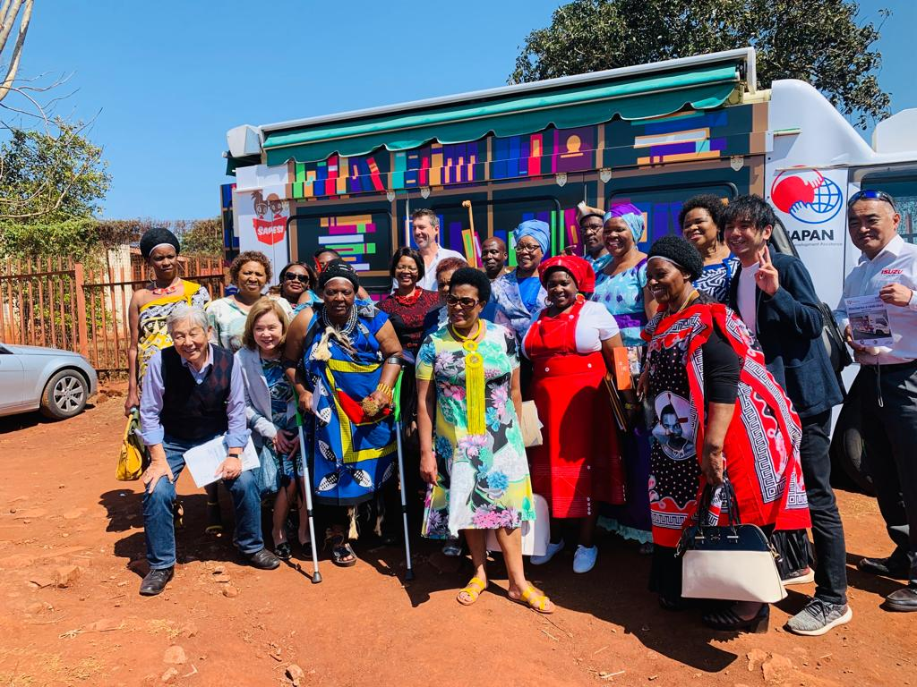
READING

Slide 11


2023/24 ANNUAL PERFORMANCE PLAN FOCUSED ON PRIORITIES

Slide 12
Priorities for 2023/24 financial year – education, skills and health
MTSF OUTCOME: EARLY CHILHOOD DEVELOPMENT: IMPROVED SCHOOL-READINESS (ACCESS/QUALITY)
Increased access to ECD service for 0-4 cohort to 60%
Increased access to ECD education and 100% learners supplied with workbooks in all schools offering grade R
Construction of 36 ECD specialised classrooms in public ordinary schools
249 ECD practitioners capacitated
Roll out of the caregiver parental training for 0-4 cohort,
  Transfer made to qualifying centres and Registration of schools, Development of norms and standards, Implementation of ECD migration to DBE,
  Develop and monitor the DATA base of the ECD Centers on quarterly .
  Increase number of fully registered ECD centres to 1495, Confirmation of existences and quality assurances of NPIs, Train 200 practitioners on ECD NQF L4 qualification through the ECDI, Refurbishment of 29 ECD centres and construction of 1 new ECD centre
Supply and Delivery of workbook 1 & 2 to 1067 public primary schools, Transfers to 1067 schools and compensation of 2068 practitioners, Capacitate 400 ECD practitioners on National Curriculum Framework implementation,Conduct school readiness assessment for Gr. R learners in 1067 schools, Capacitate 42 Foundation Phase Subject Advisors on Mathematics, Languages and Life Skills subject content
Completed construction of 36 ECD specialised classrooms
Train 261 ECD practitioners NQF level 6 (Diploma qualification) in their 3rd year of study (those that met the academic requirement).

Slide 13

Priorities for 2023/24 financial year – education, skills and health
MTSF OUTOCME: EVERY 10-YEAR OLD ABLE TO READ FOR MEANING: (READING PROGRAMME)
30% of Grade 4 learners reading with understanding
84% of learners in grades 3 achieving at the required level (50% and above) in the national assessment in literacy and numeracy:
84% of grade 6 learners achieving at the required level (50% and above) in the national assessment in first additional language and home language and mathematics
66% of grade 9 learners achieving at the required level (50% and above) in the national assessments in Home and first additional language and mathematics
Building the capacity of Foundation Phase (FP) and Intermediate Phase (IP) SAs, DHs and coaches in early identification of barriers to reading in EFAL and African Languages in all districts (using face to face and virtual models),
Implement Baseline Assessment of Learners reading levels in 880 primary schools, 75% of FP & IP teachers trained on Primary Schools Reading Improvement Project (PSRIP) and EFAL programme capacitation of 23 SAs and DHs to train and support FP teachers in 320 primary schools on EGRA ,
Implement the Read to Lead campaign in 75% of the primary schools to mobilise parents to support reading at home and Learners supported through reading camps and school competition programmes, 75 % of schools have access to lesson plans in all African languages (print and digital format).
Supply and Delivery of workbook 1 & 2 to 1067 public primary schools, Transfers to 1067 schools and compensation of 2068 practitioners, Capacitate 400 ECD practitioners on National Curriculum Framework implementation,Conduct school readiness assessment for Gr. R learners in 1067 schools, Conduct parents' advocacy campaign in order to create awareness on the importance of ECD, Capacitate 42 Foundation Phase Subject Advisors on Mathematics, Languages and Life Skills subject content

Slide 14


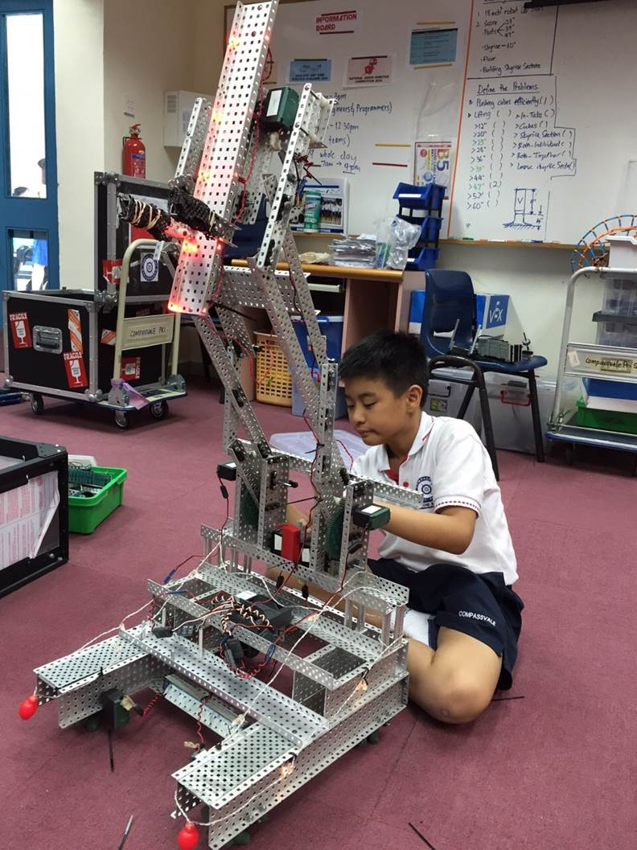
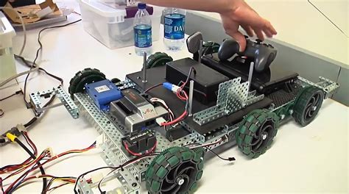
CURRICULUM SKILLS & COMPETENCIES FOR THE CHANGING WORLD

Slide 15
Priorities for 2023/24 financial year – education, skills and health
MTSF OUTCOME: SCHOOL LEAVERS PREPARED TO CONTRIBUTE TO PROSPEROUS AND EQUITABLE SOUTH AFRICA: IMPROVE GR. 12 LEARNER PERFORMANCE
80% of learners passing National Senior Certificate (NSC)
46% of Grade 12 learners passing at bachelor level
23% of Grade 12 achieving 60% or more in Mathematics
28% of Grade 12 achieving 60% or more in Physical Science
Set aside sufficient budget for the implementation of the Learner Performance Improvement Plan (LPIP) as a strategic plan to improve the performance of results across all Grades and Phases of the schooling system. The Department has put in place systems and controls to Manage and Administer incident free NSC Examination across the educations programs.
Targets set for all grades and phases of learning and subjects to achieve the MTSF set targets for the education sector. Conduct multi-disciplinary oversight visits to sampled schools across all districts to monitor implementation of the LPIP, Provide schools with supplementary material, Offer second chance opportunity for youth to finish their NSC, Conduct district quarterly review meetings to track learner performance and evaluate the impact of curriculum support.
55,9% of learners having access to information through connectivity and broadband
Implementation of coding curriculum for Gr. R-3 and GET and FET in 238 schools (128 primary schools and 110 secondary schools), Provide resources for the coding and robotics pilot 110 Secondary schools, Provide resources for the vocationally oriented pilot , Provide online resources through the curriculum and MSTA websites
Connect 150 schools in partnership with DCDT

Slide 16
Priorities for 2023/24 financial year – education, skills and health
MTSF OUTCOME: SCHOOL LEAVERS PREPARED TO CONTRIBUTE TO PROSPEROUS AND EQUITABLE SOUTH AFRICA: IMPROVE GR. 12 LEARNER PERFORMANCE
School safety
Through put rate increased to 75%
Capacity building of 400 school safety committees on their roles and responsibility, In partnership with (Lead Department is DCSSL) Social Crime prevention programes implement namely: Crime and drug awareness campaigns, Prison visits, Symposium/debates, Scholar patrol JPCC, child in traffic CIT,
In partnership with (SAPS will lead the programme) Crime prevention activities to the Identified schools in the province: Adopt a Cop, Search and Seizure, Awareness campaigns, Junior cop programme, Linking of schools, Implementation of the integrated school safety plan in line with the school safety framework
Conduct effective Screening Identification and Assessment Support, Tracking of learners through SA-SAMS, Promote and monitor home schooling programme, Provision of NSNP to 1550 schools for 196 feeding days,
Provision of scholar transport to 60 000 learners, Implementation of no fee policy and school fee exemption policy benefiting 907 124 learners

Slide 17
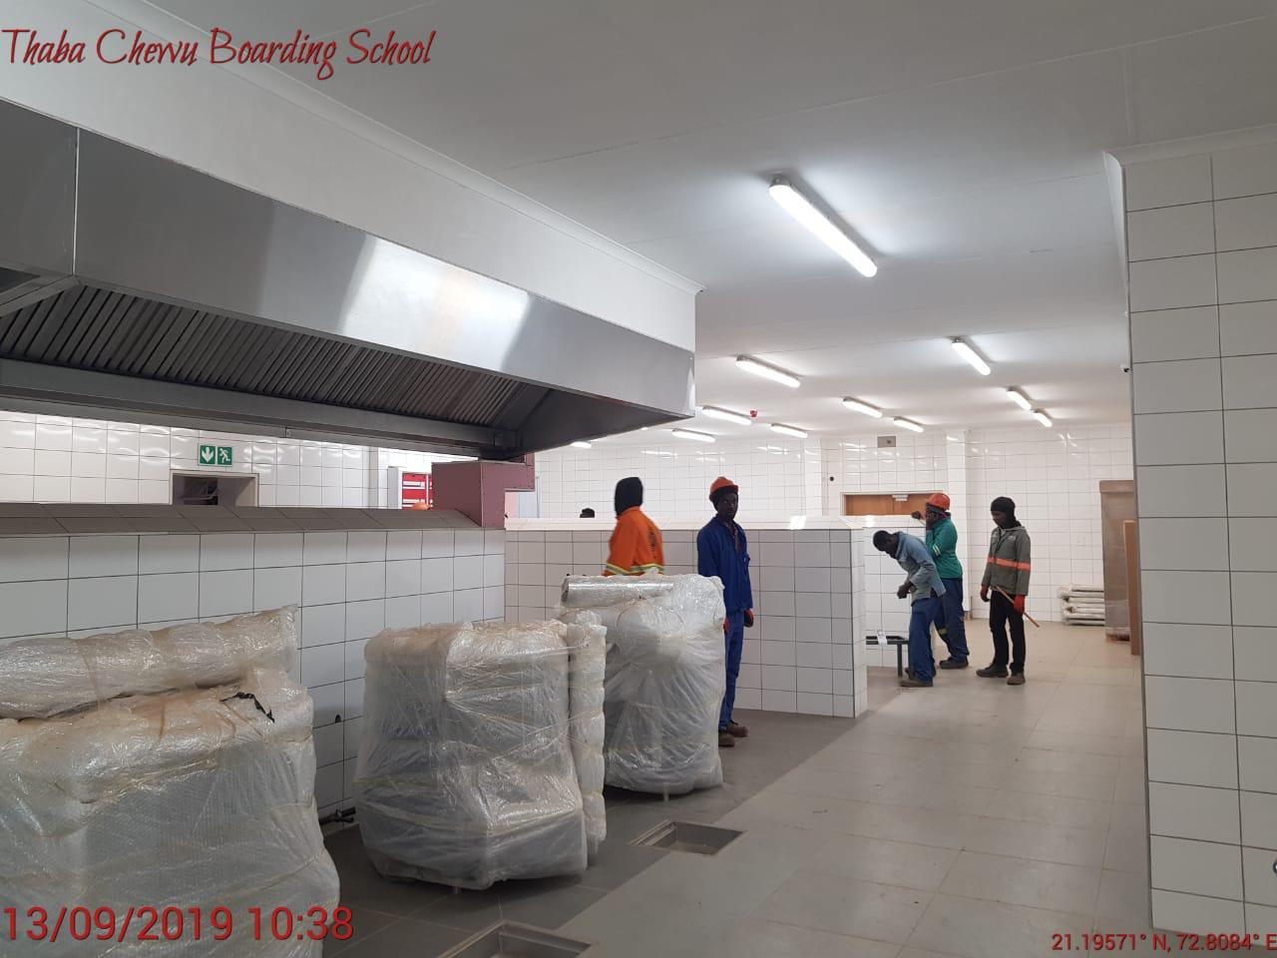
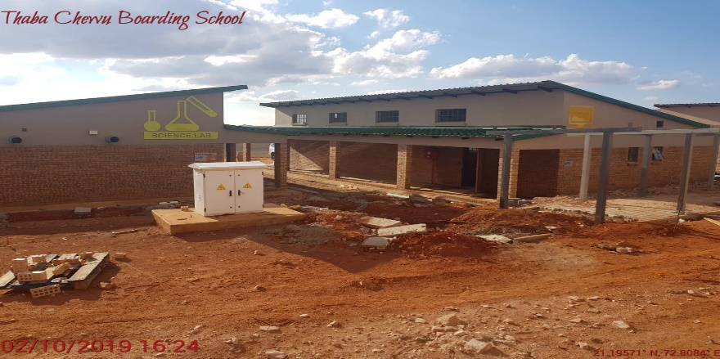
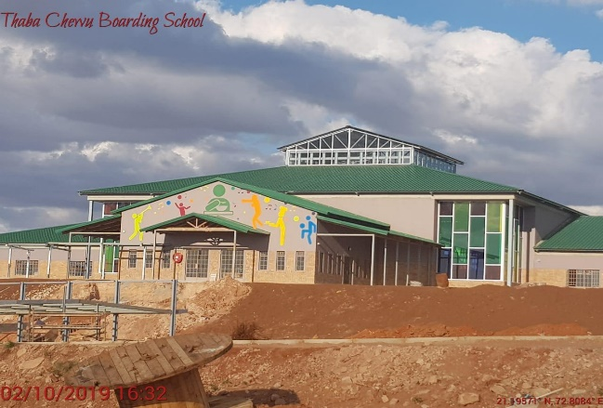
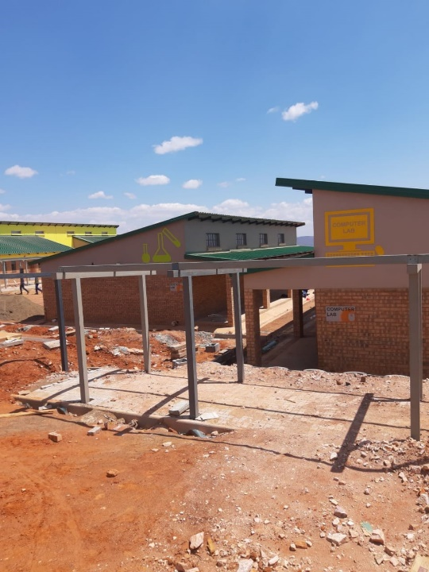
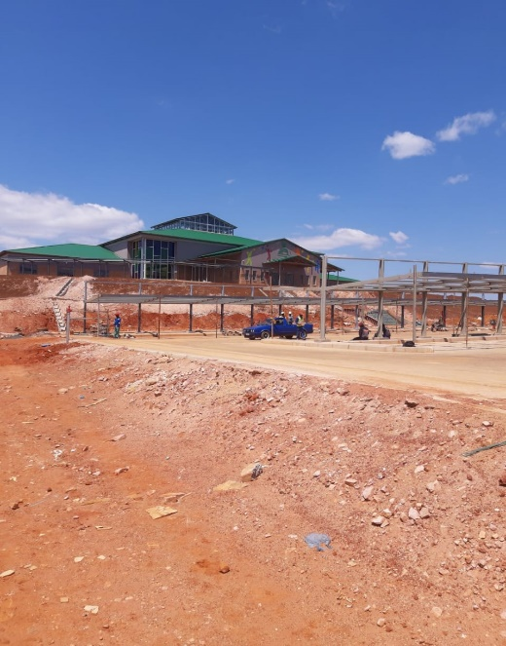
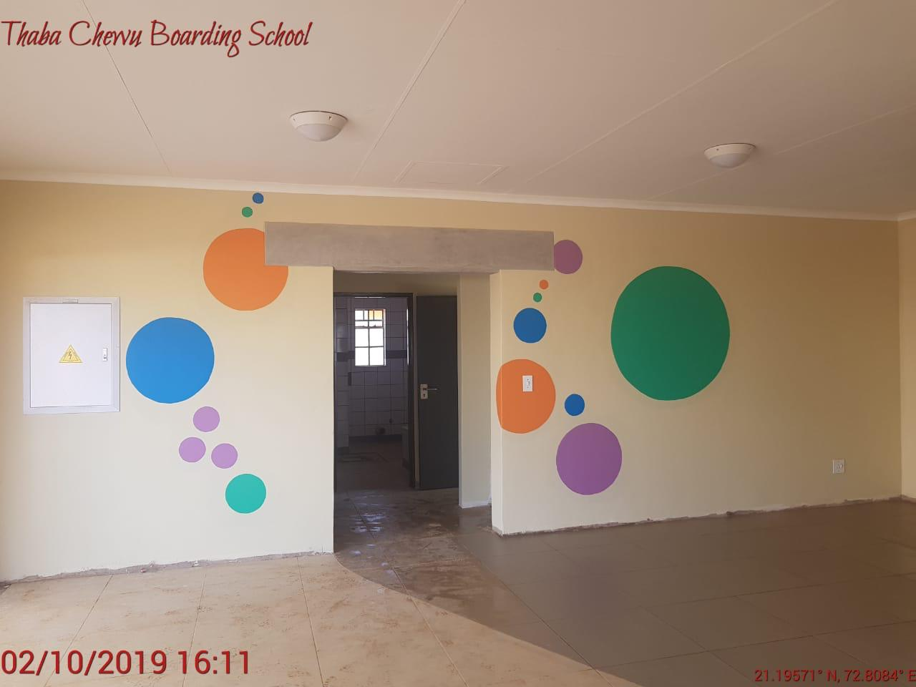
INFRASTRUCTURE PROJECTS

Slide 18
Priorities for 2023/24 financial year – education, skills and health
MTSF OUTCOME: SCHOOL PHYSICAL INFRASTRUCTURE AND ENVIRONMENT THAT INSPIRES LEARNERS TO LEARN AND TEACHERS TO TEACH
Complete 3 projects started prior year
175 schools undergoing scheduled maintenance
420 classrooms completed
18 schools provided secure fencing facilities
Monitor and complete 3 projects carried forward (Yihle lentfo, New Ermelo, Mpisi-Jamela) Complete planning and design and Tendering process and Complete construction of Mkhondo Boarding School
Monitor school maintenance projects in 175 schools in the three districts
Hand over projects for construction and commencement and Complete construction of 420 classrooms
Complete planning and design and Tendering process and Monitor and Complete installation of fence

Slide 19
Priorities for 2023/24 financial year – education, skills and health
MTSF OUTCOME: IMPROVE ACCESS TO HIGHER EDUCATION AND TRAINING THROUGH POST SCHOOL FUNDING, AND DEVELOPMENT OF SKILLS NEEDED IN THE WORKPLACE
Implementation of the skills master plan
Maintain 1781 bursars and 600 learnerships and 600 interns
Operationalising and implementing the Skills Hub functionalities
580 out of school youth trained on skills development programmes
Implement the Provincial Skills Development Master Plan to respond to economic needs of the province.
Consultation with stake holders on the Provincial Skills Master plan
Administer 1781 bursars and 600 learnerships and 600 interns
Implement and manage Skills Hub (built project) infrastructure development according to the project management phases, Implement and maintain the corporate governance and management processes of the skills hub, Introduce first phase functional programme and Continuation of the Digital Training at the MRTT House and Stakeholder engagement and strategic partnership agreements signed
Recruitment, registration and training of 580 students: 60 candidates registered for RPL and trade testing, 50 students trained on SAQA registered training for culinary and hospitality studies, and customised training, 200 students trained on technical learnerships and Apprenticeships towards 21st Century Artisan Development, 200 students to receive accredited or customised institutional training and 70 students coached and mentored in the workplace

Slide 20
Collaborations with other partners

Slide 21
Collaborations with other partners
The department in partnership with US Peace Corps the United State Corporative Agency that has partnered with the Department of Education
  It provided educational support to strengthens interventions to learners in improving reading with children in rural areas .
  To promote reading of children at an early age in the Primary schools.
USAID
Barberton mines: Kaapvallei relocation – at R29 million .Phase 2: 95% completion (Ehlanzeni District)
Phase II :Building classroom & amenities at Bonginhlanhla primary in Kriel (Nkangala District) - Phase 2 with amount of R20 million is 100% complete, hand over planned for 27th of February 2023
Trans Alloys:
  Construction of a additional 12 classrooms at Clewer Primary school (Nkangala District) at R15 million – progress at Planning and Design Stage
  Construction of Vosman clinic (Nkangala District) at the tune of R9 million complete. In addition Steenbok, Clinic, (Ehlanzeni District) at the amount of R3,8 million was completed and handed over.
Glencoe and Msimbithi Mine: Morelig combined school relocation at amount of R39 million at a new site in Wonderfontein (Nkangala District). - project at 65% completion
Thungela Goedehoop Mine: Provision of mobile boardroom, staffroom and kitchen at KwaZamokuhle Secondary School (Nkangala District) with amount of R800 thousand - Project is 65% complete
SOCIAL
INFRASTRACTURE

Slide 22
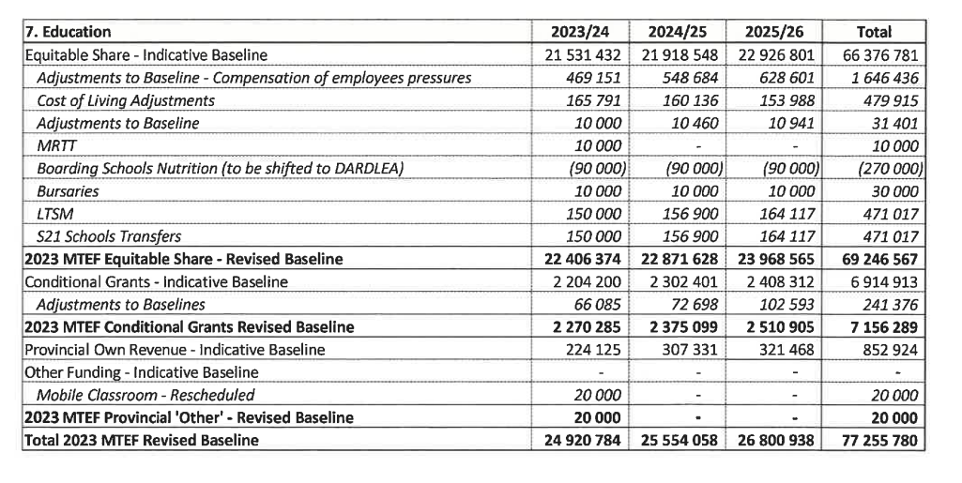

2023/24 FINAL ALLOCATION
The Department adjusted budget is R24 526 billion of which R1.897 billion is conditional Grants R19.154 billion is COE and R3.475 billion for other priorities. The final allocation letter for 2023/24 financial year reallocate R300 million from the cost of living adjustment to fund LTSM and Transfers to schools.
The increase in the baseline of R934 942 was allocated for COE,( R469 151 for the COE Pressures and R465 791 for the cost of living adjustment). Excluding the COE allocation, the Departmental budget was decreased by R520 million compared to the previous financial.

Slide 23
ITEM | ALLOCATION | BUDGET SHORTFALL | COMMENTS
Norms and Standards for School Funding (Section 21 Schools) | 981 000 | 150 000 | Additional funding is required to fund schools in line with the national norms and standards for school funding.
Compensation of Employees | 19 678 000 | 300 000 | Only R165 million was allocated for the cost of living adjustment , which raises a shortfall of R300 million in the COE budget.
Boarding Schools (contractual obligations) | 13 000 | 40 000 | An amount of R90 million for Boarding school’s allocation was shifted to the Department of Agriculture, however part of this allocation is meant for the boarding school’s contractual obligations (Electricity, DSTV; Medication; Cleaning detergents etc).
Bursaries | 50 000 | 40 000 | The budget pressure of R40 Million is for the payment of local university fees and the payment of International universities.
MRTT | 64 549 | 43 000 | Only R10 million additional allocation was received for MRTT. The Entity is therefore having an overall budget deficit of R43 million, the Department is unable to assist due to the current financial constraints.
LTSM (E-Learning) | 150 000 | 573 000 | The Department will require an additional amount of R573 million to ensure the sustainability of the E-Learning project.
School Furniture | 0 | 93 000 | The Department is currently having 717 schools experiencing shortages in school furniture. A total number of 325 421 learners are without school furniture. This furniture backlog amounts to R93 million.

Slide 24
ITEM | ALLOCATION | BUDGET SHORTFALL | COMMENTS
Mkhondo Boarding School operationalization | 0 | 68 000 | The Department requires an additional allocation of R68 million for the operationalization of the Boarding School. This includes the procurement of dormitory, laundry, kitchen and dining hall equipment and furniture to name but a few.
Leave Gratuity | 100 000 | 20 000 | The allocated budget for leave gratuity in 2023/24 financial year is R100 million, however taking into consideration the spending trends in the previous financial years, the Department will require an additional allocation of R20 million under this item
Skills Levy | 10 000 | 198 000 | The Department could not fully fund the training programmes in line with the mandatory 1% funding due to budgetary constraints this has a direct bearing on the development of personnel in order to deliver on service delivery
ETDP SETA | 5 000 | 58 000 | The current funding is not in line with the 30% of the skills levy that is due to the SETA’s for the implementation of Educator training programmes. This has been reported as non-compliance by the SETA
Monitoring and support | 90 087 | 70 000 | The department will not have sufficient operational budget which indirectly affects the support to schools for effective curriculum delivery.
Infrastructure | 0 | 50 000 | To cater for the pressure of new schools in fast growing towns, the Department requires an additional allocation of R50 million under Equitable Share.
Monitoring and support to schools | 15 000 | 10 000 | Support to under performing schools will not be adequately provided due to the budget shortfall.
TOTAL | 21 327 456 | 1 813 000

Slide 25
ANNEXURE A DETAILED 2023/24 APP

Slide 26
PRIORITY 2: EDUCATION, SKILLS AND HEALTH
EARLY CHILHOOD DEVELOPMENT: Improved school-readiness (Access/Quality)
2023/24 Annual Targets | Planned Activities | MTEF |  |  |  | Location
 |  | 2020/21 R’000 | 2021/22 R’000 | 2022/23 R’000 | 2023/24 R’000 | Local Municipality (DDM Projects)
92% of Grade 1 learners who have attended grade R | Conduct ECD awareness campaigns on access, registration requirements, parental capacitation sessions and breastfeeding partnering with Municipalities, DOH and DSD | 12 600 | 13 230 | 13 892 | 14 000 | Beneficiaries are spread across all municipalities
learners supplied with workbooks in all schools offering grade R | Submission of needs for workbook 1 & 2 and Delivery of workbook 1 & 2
 | Provision of outdoor play equipment apparatus to 300 schools and 200 ECD Centre
Construction of 35 ECD specialised classrooms in public ordinary schools | Monitor and complete projects started in the previous financial year | 70 000 | 73 500 | 77 175 | 77 300
 | Analysis of the schools needs, complete Assessments, Planning & Design
 | Budget confirmations and appoint contractors for new projects
 | Hand over project to contractors for construction
 | Construction complete (Practical completion)
683 ECD practitioners capacitated | Monitor and support 200 Grade R practitioners on 2nd year NQF Level 6 | 9 500 | 9 975 | 10 473 | 10 600
 | Monitor and support 283 practitioners on 3rd year NQF Level 6
 | Enroll and train 200 practitioners on NQF level 4

Slide 27
PRIORITY 2: EDUCATION, SKILLS AND HEALTH
EARLY CHILHOOD DEVELOPMENT: Improved school-readiness (Access/Quality)
2023/24 Annual Targets | Planned Activities | MTEF |  |  |  | Location
 |  | 2020/21 R’000 | 2021/22 R’000 | 2022/23 R’000 | 2023/24 R’000 | Local Municipality (DDM Projects)
Increased access to ECD service for 0-4 cohort to 60% | Participate in the policy finalisation at DBE | 30 206 | 31 716 | 33 302 | 33 604 | All municipalities
 | Assessing learners for learning barriers
 | Profiling of practitioners and centres
 | Conduct information sharing session on the approved policy on ECD
 | Registration of schools, Development of norms and standards Quality assurance and Capacity development Nutrition and Funding Curriculum implementation and Professional development Establishment of 1 Sub-Hub per District and functional ECD centres of Excellence in the Province

Slide 28
PRIORITY 2: EDUCATION, SKILLS AND HEALTH
Every 10-year old able to read for meaning: (Reading Programme)
2023/24 Annual Targets | Planned Activities | MTEF |  |  |  | Location
 |  | 2020/21 R’000 | 2021/22 R’000 | 2022/23 R’000 | 2023/24 R’000 | Local Municipality (DDM Projects)
30% of Grade 4 learners reading with understanding | Coordinate grade 1-3 practical reading assessment | 4 200 | 4 410 | 4 630 | 5 000 | All municipalities
 | Drawing from the lessons of the Early Grade Reading Study, and other research, roll out best practices, such as lesson plans, graded reading books, individualised coaching of teachers, and other innovations.
 | Professional teacher development provided for teaching reading.
 | Provision of Foundation Phase Readers to all primary schools
 | Support reading clubs in established all primary schools
 | Learners supported through reading camps and school competition programmes (reading festival, Spelling Bee, etc.)
 | Incremental Introduction to African Language implementation
 | Implement innovative assessment approaches such as the Early Grade Reading Assessment (EGRA), so that teaching is facilitated.
 | Partner with University to Develop Distance Learning material for teachers on teaching reading

Slide 29
PRIORITY 2: EDUCATION, SKILLS AND HEALTH
Youth better prepared for further learning and world of work (Gr. 3, 6 & 9 Systemic Evaluation)
2023/24 Annual Targets | Planned Activities | MTEF |  |  |  | Location
 |  | 2020/21 R’000 | 2021/22 R’000 | 2022/23 R’000 | 2023/24 R’000 | Local Municipality (DDM Projects)
84% of learners in grades 3 achieving at the required level (50% and above) in the national assessment in literacy and numeracy | Schools monitored to have completed the curriculum in Literacy and Numeracy in Gr. 3,6 and 9 Schools utilising Language and Maths results for improving teaching and learning Providing targeted teacher training focusing on pedagogical practice in the classroom and theories of learning Support learners through extra academic tuition, mentoring, blended learning support through the use of ICT Writing of Provincial Common Assessments (Maths and Languages) Moderation of Provincial Common Assessment Expand early grade reading programme to 300 more schools Annual school district report including diagnostic information for parents on Language and Maths produced per districts and presented to parents and parents formations Provide schools with supplementary material (Atlas, wall charts, maths and sciences kits, subject content dictionaries). Conducting learner camps and competition in languages and mathematics Developed curriculum to introduce Digital Skills curriculum and a Coding and Robotics curriculum within the subject Technology | 6 200 | 6 510 | 6 836 | 9 000 | All municipalities
84% of grade 6 learners achieving at the required level (50% and above) in the national assessment in first additional language and home language and mathematics
66% of grade 9 learners achieving at the required level (50% and above) in the national assessments in Home and first additional language and mathematics

Slide 30
PRIORITY 2: EDUCATION, SKILLS AND HEALTH
School leavers prepared to contribute to prosperous and equitable South Africa: Improve Gr. 12 Learner Performance
2023/24 Annual Targets | Planned Activities | MTEF |  |  |  | Location
 |  | 2020/21 R’000 | 2021/22 R’000 | 2022/23 R’000 | 2023/24 R’000 | Local Municipality (DDM Projects)
80% of learners who passed National Senior Certificate (NSC) | Implementation of the Learner Improvement Plan in all schools Train teachers, HODs and Subject Advisors on setting and moderating quality assessment tasks Conduct winter and spring classes for all learners from schools that performed below 70% Conduct revision lessons for all FET subjects and monitor the Grade 12 NSC Examination Actualise exchange the learning programmes with other countries. Leadership support for curriculum management through training and coaching (in partnership with NGOs and business) Provide targeted teacher training focusing on pedagogical practice in the classroom and theories of learning Support learners through extra academic tuition, mentoring, blended learning support through the use of ICT Provide schools with supplementary material Offer second chance opportunity for youth to finish their NSC Build on past successes in improving learner access to textbooks and workbooks with a view to ensuring that no learner is without the books he or she needs. Supply schools with Content Access Points and Nano PCs Explore the dual language teaching methodology ( infuse LoLT and mother tongue) | 12 743 | 13 880 | 15 074 | 16 020 | All municipalities
46% of Grade 12 learners passing at bachelor level
23% of Grade 12 achieving 50% or more in Mathematics
28% of Grade 12 achieving 50% or more in Physical Science
Through put rate improved to 75%

Slide 31
PRIORITY 2: EDUCATION, SKILLS AND HEALTH
Every learner enrolled in schools that support learning decency
2023/24 Annual Targets | Planned Activities | MTEF |  |  |  | Location
 |  | 2020/21 R’000 | 2021/22 R’000 | 2022/23 R’000 | 2023/24 R’000 | Local Municipality (DDM Projects)
55.9% of learners having access to information through connectivity and broadband | Connectivity of schools and maintenance of existing infrastructure | 5 425 | 5 696 | 5 981 | 6 200 | All municipalities
 | Developed curriculum to introduce Digital Skills curriculum from Grades R to 6 and a Coding and Robotics curriculum within the subject Technology in Grades 7 to 9.
 | 300 teachers from pilot schools trained on robotics and coding
 | Technology driven learning and teaching strategy in line with the 4IR developed
 | 100 schools identified to pilot the coding & robotics curriculum
Establishment of focus schools | 10 focus schools established in line with industrial economic zones (agriculture, sport, arts, aviation etc.) | Operational | Operational | Operational | Operational | Mbombela LM eMalahleni LM Chief Albert Luthuli LM Dr. JS Moroka LM
 | 4 schools identified to introduce technical subjects from Gr. 10
100% of learners having access to the required textbooks in all grades and in all subjects | Provide learners with access to required textbooks | 299 315 | 314 079 | 329 783 | 412 007 | All municipalities
 | Provision of e-books to targeted primary schools
Percentage of learners with access to required workbooks | Procurement and delivery of workbooks in schools

Slide 32
PRIORITY 2: EDUCATION, SKILLS AND HEALTH
Every learner enrolled in schools that support learning decency: Improved the quality of teaching and learning through provision of Infrastructure and learning materials
2023/24 Annual Targets | Planned Activities | MTEF |  |  |  | Location
 |  | 2020/21 R’000 | 2021/22 R’000 | 2022/23 R’000 | 2023/24 | Local Municipality (DDM Projects)
Provided 3 schools with adequate infrastructure | Monitor the construction of schools Complete construction of 3 schools (new and replacement schools [Mkhulu Primary, Mkhondo B/S, New Klarinet]) |  |  |  |  | Mkhondo LM Steve Tshwete LM eMalahleni LM
 | Budget confirmations and appoint contractors for new projects Hand over project to contractors for construction and Commence with construction of schools in 5 fast growing towns completed (2 in Mbombela, 1 in Secunda, 1 in eMalahleni and 1 in Lydenburg) | 62 692 | 168 001 | 10 292 | 10 640 | Goven Mbeki LM Mbombela LM eMalahleni LM Thabo Chweu LM
 | Complete Assessments, Planning & Design for school of the deaf Budget confirmations and appoint contractors for new projects Hand over project to contractors for construction and commencement thereof | 86 600 | 191 000 | 104 400 | 106 400 | Mbombela LM

Slide 33
PRIORITY 2: EDUCATION, SKILLS AND HEALTH
Every learner enrolled in schools that support learning decency: Improved the quality of teaching and learning through provision of Infrastructure and learning materials)
2023/24 Annual Targets | Planned Activities | MTEF |  |  |  | Location
 |  | 2020/21 R’000 | 2021/22 R’000 | 2022/23 R’000 | 2023/24 R’000 | Local Municipality (DDM Projects)
80 schools provided with basic services standards (Water and Sanitation) | Monitor and complete projects started in the previous financial year Analysis of the schools needs, complete Assessments, Planning & Design Budget confirmations and appoint contractors Hand over project to contractors for construction Practical completion of projects | 364 950 | 308 455 | 164 277 | 165 000 | All Municipalities
175 schools undergoing scheduled maintenance | Analysis of the schools needs, complete Assessments, Planning & Design Budget confirmations and appoint contractors Hand over project to contractors for construction Practical completion of 60 projects | 268 230 | 281 641 | 295 723 | 305 000

Slide 34
EARLY CHILHOOD DEVELOPMENT
Improved school-readiness (Access/Quality)
2020/21 Annual Targets | Planned Activities | MTEF |  |  |  | Location
 |  | 2020/21 R’000 | 2021/22 R’000 | 2022/23 R’000 | 2023/24 R’000 | Local Municipality (DDM Projects)
Implementation of the Mpumalanga Skills Master Plan | Finalised the Mpumalanga Skills Master Plan Strengthen the capacity of the education system in Mpumalanga and MRTT Develop targeted interventions to respond to the skills needs of the province Partner with various sectors to respond to the skills set of the future and provide access to work experience | 200 | 250 | 270 | 283 | All municipalities
Maintain 1781 bursars and 600 learnerships and 600 interns | Recruit youth for enrolment in HEIs (studying for scarce and critical skills) Monitor and support youth in completing their studies | 180 000 | 150 000 | 160 000 | 150 000
Recruit candidates on registered for RPL and Trade Testing | Recruit and register learners apprenticeship (artisan development programme) Form partnership training authorities and industry for placement of learners | 5 000 | 5 500 | 6 000 | 5 000

Slide 35
EARLY CHILHOOD DEVELOPMENT
Improved school-readiness (Access/Quality)
2023/24 Annual Targets | Planned Activities | MTEF |  |  |  | Location
 |  | 2020/21 R’000 | 2021/22 R’000 | 2022/23 R’000 | 2023/24 R’000 | Local Municipality (DDM Projects)
Implementation of Mpumalanga Skills Master Plan | Develop targeted programmes to respond to the provincial government support needs | 2 000 | 2 500 | 3 000 | 3 800 | All municipalities
 | Develop key management competencies, knowledge and skills in targeted departments and entities
 | Develop strategies to absorb graduates and trained people
 | Partner with SETAs to respond to the skills needs of the province
 | Work closely with TVET colleges and Universities to offer curriculum/qualifications that respond to the scarce and critical skills
 | Establish partnerships with private sector, NGOs, trade and professional bodies in addressing the scarce and critical skills of the future.

Slide 36
Conclusion
That the Committee note and make inputs to the presented reports

Slide 37
ANNEXURE A
COLLABORATIONS

Slide 38
PRIORITY 2: EDUCATION, SKILLS AND HEALTH
Improved the quality of teaching and learning through provision of Infrastructure
2023/24 ANNUAL TARGET | KEY ACTIVITIES | STAKEHOLDERS (PARTNERS) | LOCATION
Building of school hall at Elukhanyisweni Secondary in Witbank | complete Assessments, Planning & Design Budget confirmations and appoint contractors Hand over project to contractors for construction Practical completion of projects | AMRO Carries | eMalahleni
Building of classroom blocks at Sibongile Primary School in Matsulu | complete Assessments, Planning & Design Budget confirmations and appoint contractors Hand over project to contractors for construction Practical completion of projects | General Electrical Company | Mbombela
Building classroom blocks and toilets at Dunbar Secondary school in Witbank | complete Assessments, Planning & Design Budget confirmations and appoint contractors Hand over project to contractors for construction Practical completion of projects | General Electrical Company | eMalahleni
Building Morelig Primary school at Emakhazeni Municipality | complete Assessments, Planning & Design Budget confirmations and appoint contractors Hand over project to contractors for construction Practical completion of projects | Glencor Mining | eMakhazeni

Slide 39

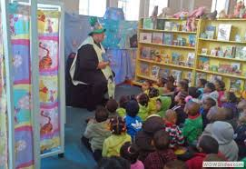
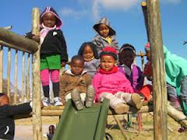
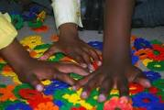
EARLY CHILDHOOD DEVELOPMENT

Slide 40
PRIORITY 2: EDUCATION, SKILLS AND HEALTH
Improved Grade R and planning for extension of ECD
2023/24 ANNUAL TARGET | KEY ACTIVITIES | STAKEHOLDERS (PARTNERS) | LOCATION
4 00 childminders trained | child minders trained on specific age categories within Pre-Grade R cohort on educational stimulation and care giving /parental support (NQF level 4 and 5) | MDoE to develop curriculum and train DSD to identify trainees DoH to assist on curriculum | All municipalities
Conduct awareness campaigns in the | Conducting ECD awareness campaigns on access, registration requirements, parental capacitation sessions and breastfeeding | DSD to lead DoE DoH ORC Municipalities
1 060 Schools | Provisioning of LTSM (ECD readers and play equipment) to community based centres & public schools | DoE DSD
300 centres | Provision of Play equipment to community base centres
80% of children attending Gr. R immunised | Children under 1 year of age fully immunized against vaccine preventable diseases quarterly Immunize and do catchups of all eligible learners in 0-4 and grade R | DoH DoE

Slide 41
PRIORITY 2: EDUCATION, SKILLS AND HEALTH
Improved Grade R and planning for extension of ECD
2023/24 ANNIUAL TARGET | KEY ACTIVITIES | STAKEHOLDERS (PARTNERS) | LOCATION
168 000 children accessing ECD services | Provide care & support to learners | DSD ECD private providers Municipalities Parents DHA DOE | All municipalities
1069 schools and 300 centres | Provide educations stimulation programmes (playing with learners, reading to learners, creative writing)
 | Registration of learners for grants, birth certificates etc.
30 250 children assessed | Assessing of children for learning barriers
1069 schools and 500 ECD centres | Monitor and support NCF implementation in registered ECD centres

Slide 42




SCHOOL SAFETY

Slide 43
PRIORITY 2: EDUCATION, SKILLS AND HEALTH
School Safety
INDICATORS (OUTPUT LEVEL) | 2023/24 TARGET | KEY ACTIVITIES | STAKEHOLDERS (PARTNERS) | LOCATION
Number of schools provided with safety resources | 10 schools | Procure, install and maintain alarm systems | DoE, SGBs, Schools safety committees | All municipalities
 | 200 schools | Procure drug-testing devices and metal detectors | DoE, SGBs
 | 300 schools | Conduct searches and seizures in schools | DoE, DSD, DCSSL, SAPS
 | 100 schools | Conduct environmental health assessments to schools | DoH, DOE
Number of schools capacitated on schools safety programmes | 3 262 committee members | Capacitate school safety committees members on positive discipline and management of bullying | DoE, DSD, SAPS
 | 600 schools | Conduct social crime prevention campaign programmes that focus on substance abuse, bullying, violence prevention, sexual offences and cyber-related matters. | DoE, DSD, SAPS
 | 1500 schools | Conduct anti-crime campaigns – school debates & prison visits, | DCSSL, DOE, SAPS Municipalities
 | 500 schools | Conduct an audit of service providers in the area.
 | Biannually | Evaluate and assess progress periodically as determined by the School Safety Committees and cluster structures | DoE, SGB
 | 11 schools | Erect clear vu fencing facilities in identified hot spot schools | DoE, DPWRT

Slide 44
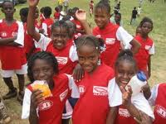

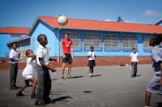
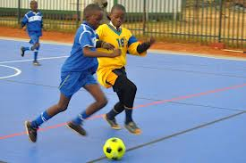
IN-SCHOOL SPORT

Slide 45
PRIORITY 2: EDUCATION, SKILLS AND HEALTH
Mass Participation in Sport
INDICATORS (OUTPUT LEVEL) | 2020/21 TARGET | KEY ACTIVITIES | STAKEHOLDERS (PARTNERS) | LOCATION
Increase number of learners taking part in physical activities | Coordinate sporting 12 sporting code competitions from circuit up to national level | Conduct School League events from Circuit to National levels for public ordinary & special schools: Basketball Netball Athletics Chess Cricket Football Gymnastics Volleyball Table-tennis Tennis Hockey Jukskei Morabaraba and Rugby including LSEN | DOE DCSR DBE Sport Codes & Sport Federations | All municipalities

Slide 46
Gallery

Slide 47
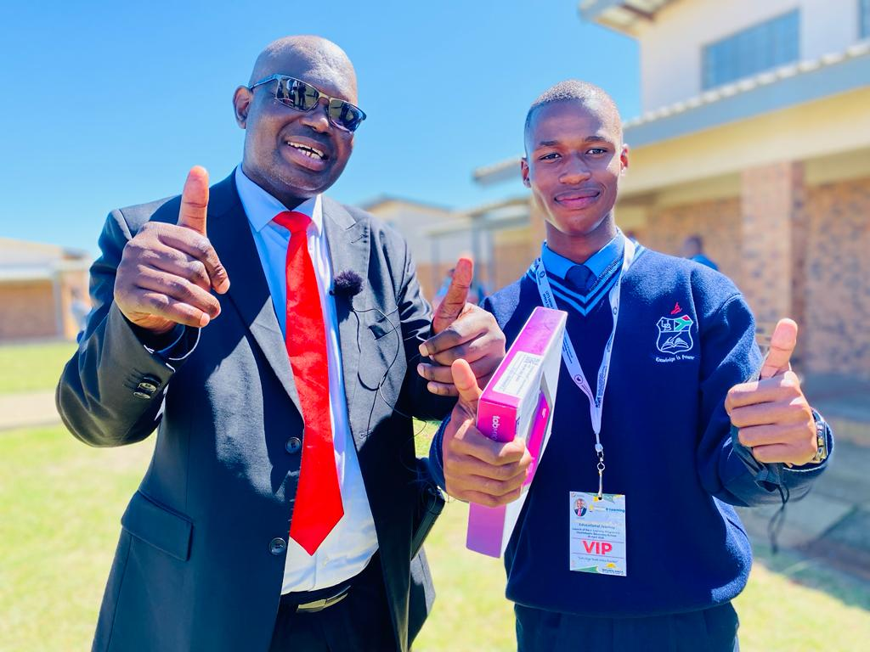
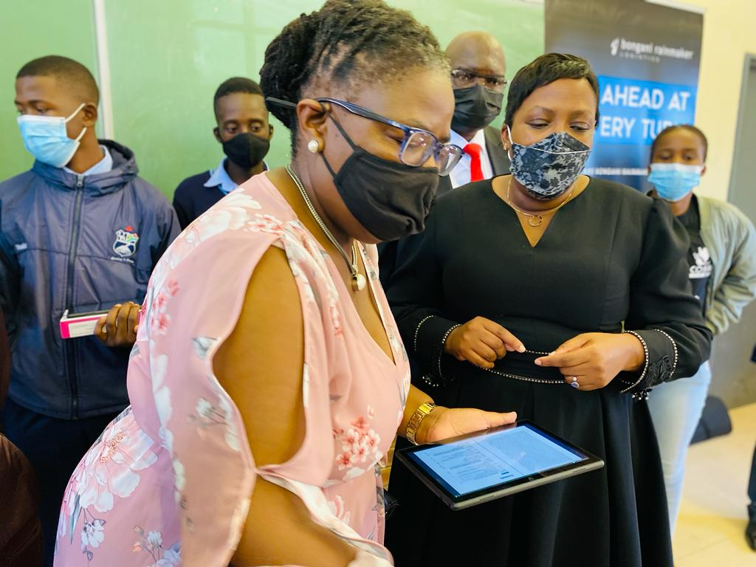
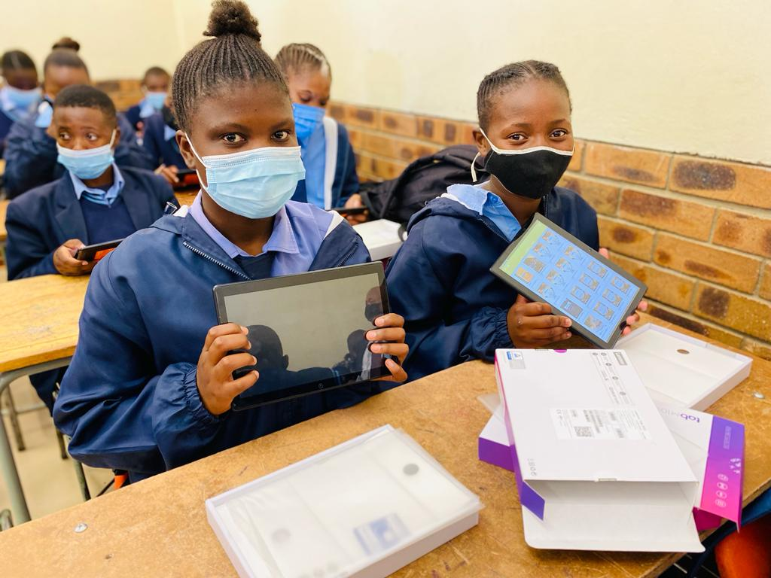
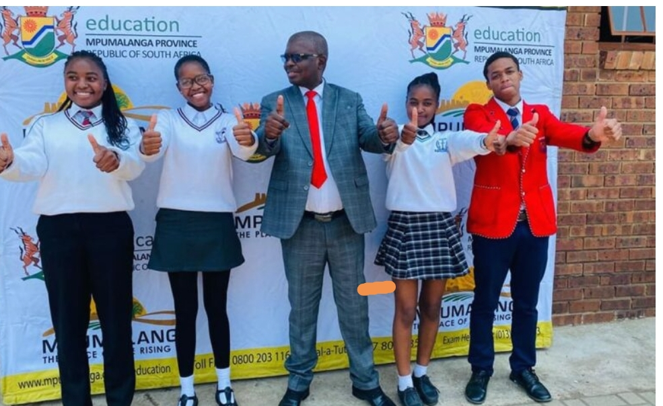
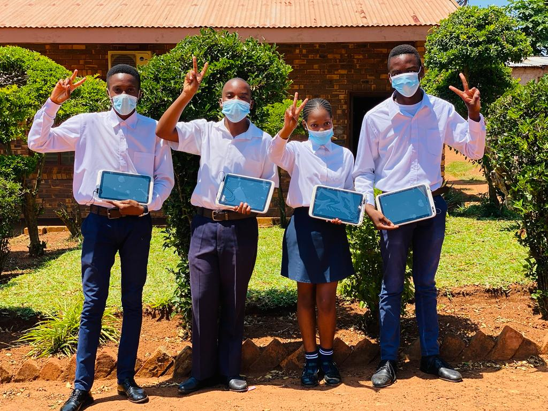
9. Recommendations

Slide 48


Slide 49


^{when the sun rises}
^{we work hard to deliver}

