Slide 1
Department of Local Government
STANDING COMMITTEE ON LOCAL GOVERNMENT
Indigent Policies in Municipalities in Western Cape
Mr G Paulse
25 April 2023

Slide 2
Indigent Policy: Legal Framework and Requirement

Slide 3

Legislative Framework – Indigent Policies (1)
  Constitutional Framework
  Section 156 of the Constitution of the Republic of South Africa, 1996 (“The Constitution”) provides amongst other for the following:
    A municipality has Executive Authority in respect of, and has the right to administer—
    Local government responsibilities are defined in part B of Schedule 4 and part B of Schedule 5.
    These functional areas include water, electricity, sanitation and refuse removal.
  In terms of Section 227 of the Constitution, Local Government is entitled to an equitable share of nationally raised revenue to enable it to provide basic services and perform the functions allocated to it.
    The Local Government equitable share is an unconditional transfer that supplements the revenue which municipalities can raise themselves (including revenue raised through property rates and service charges).

Slide 4
Legislative Framework (2)
  COGTA guidelines issued
  Section 96 of the Local Government: Municipal Systems Act, 32 of 2000 (“The Act”) requires a municipality to adopt, maintain and implement a credit control and debt review policy which is consistent with its rates and tariff policies and complies with the provision of the Act.
    And whereas Section 97 (c) of the Act further requires that such policy must provide for “Provision of indigent debtors” that is consistent with its rates and tariff policies and any national policies on indigents – Purpose of the Indigent Policy
  Section 62 of the Municipal Finance Management Act, 2003 states that the accounting officer of a municipality is responsible for managing the financial administration of the municipality. This officer must, for this purpose, take all reasonable steps to ensure that the municipality has and implements an indigent policy.
  The municipalities therefore needs to pass a by-law that indicates that financial assistance may be granted by the municipality to persons that meet the criteria as laid down in the indigent policy.
    The MFMA, Section 17(3) states that when an annual budget is tabled in terms of Section 16(2), it mut be accompanied by the following documents: …, Section E & J. (budget related policies and grant allocations)
    This policy and by-law must therefore be revised on annual basis as part of the annual budgeting & IDP process.

Slide 5
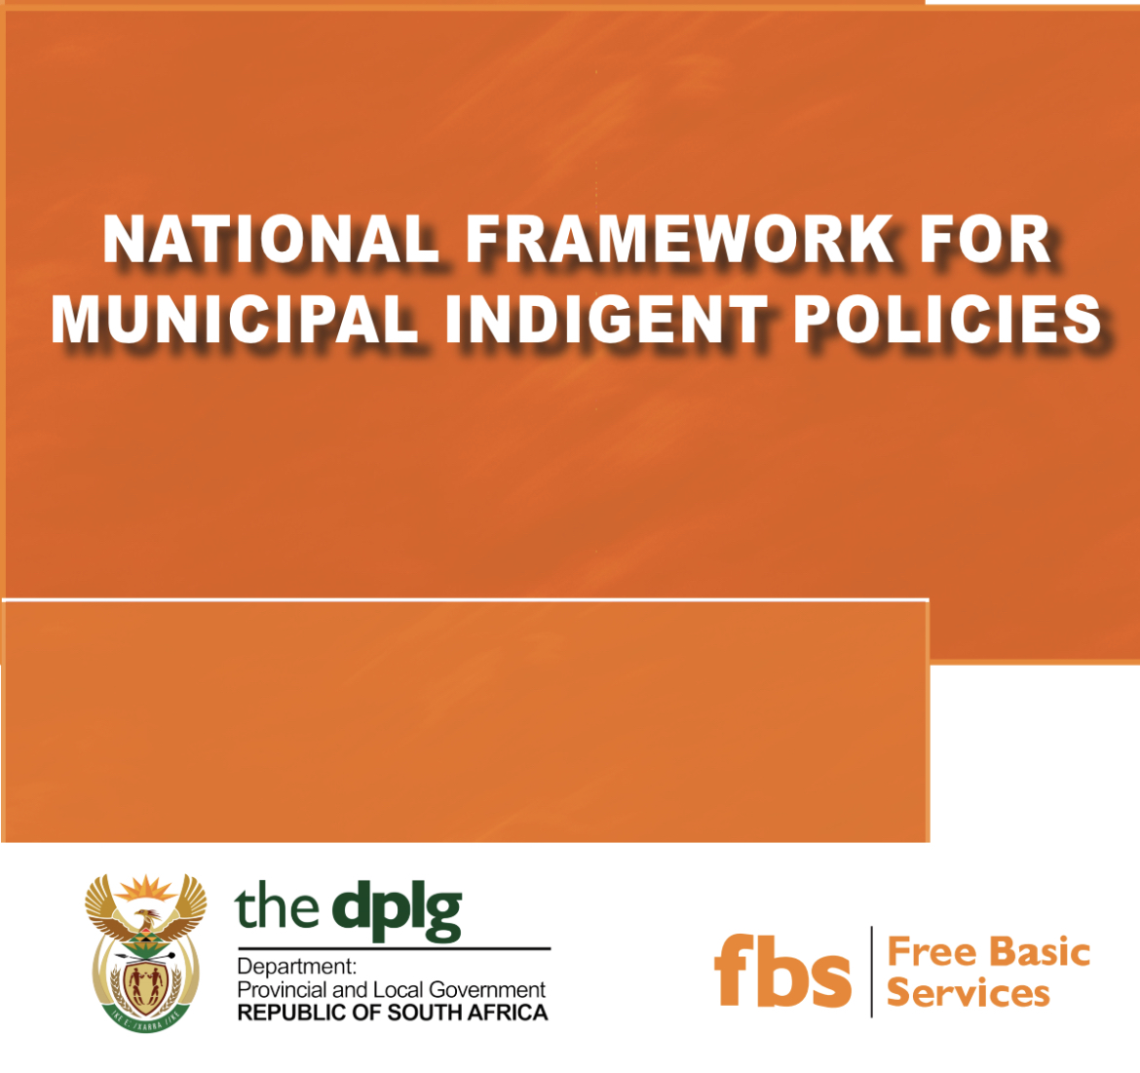
COGTA Guidelines: 2005 (currently under review by COGTA)
The COGTA Guidelines highlights the following:
  The Municipal Indigent Policy is intended to guide the national initiative to improve the lives of indigents and to improve access to Free Basic services.
  The policy recognizes the need for intergovernmental co-operation in the process of dealing with indigents but places a specific emphasis on the municipal sphere – therefore requires a local understanding.
  The Municipal Indigent Policy Framework was approved by the Cabinet Social Sector Cluster as part of the social wage package in 2005 and approved by MinMec in 2006.
  The Indigent Policy Framework provides a basis for the provision of Free Basic Services to the indigent, and as such, enhances current indigent policies applied by municipalities.
    The guidelines for implementation of the indigent policy provide municipalities with options for the development of their indigent policies.
    The guidelines apply specifically to Free Basic Services programme within municipalities i.e., Free Basic Water, Free Basic Sanitation, Free Basic Energy/Electricity and Free Basic Refuse Removal.
    Municipalities are expected to customize the guidelines to suit their specific situations

Slide 6
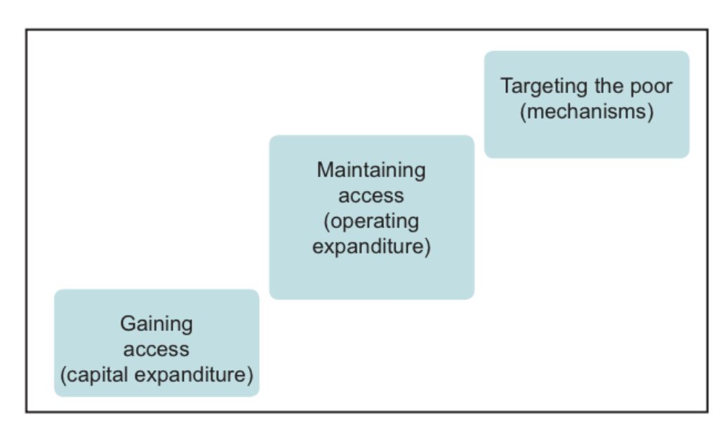


Matters to be Covered in the Policy
  Legislative Framework
  Policy Principles and Background
  Objective and Scope
  Targeting Approach
  Qualifying criteria
  Application Process
  Penalties and Disqualification
  Exit Mechanisms
  Monitoring and Evaluation
  Verification
  Communication
  Contact Officer
  Council Approval
  Three Parts to an Indigent Policy as per National Framework:

Slide 7
Status of Free Basic Service Provision in the Western Cape

Slide 8
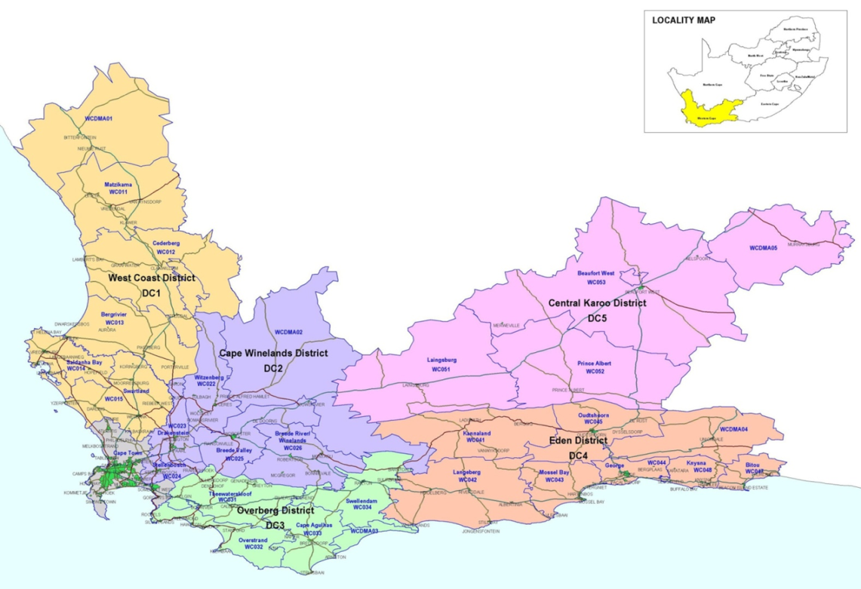
Free Basic Service Provision in the Western Cape Province
  Compliance to National Indigent Framework adopted by Cabinet in 2005:
      As per the National Indigent Framework, the standard set of free basic services includes:
      All municipalities in the WC comply with this standard.
Water | Electricity | Sanitation | Refuse
6kl | 50KwH | Free | Free

Slide 9
Free Basic Services – Quantum provided by WC Municipalities
Source: Municipal Annual Reports
LEVEL OF FREE BASIC SERVICES PROVIDED BY MUNICIPALITIES IN THE WC: 2021/22
MUNICIPALITY | WATER (kl) | ELECTRICITY (kwh) | SANITATION | REFUSE REMOVAL
NATIONAL STANDARD | 6 | 50 | Free | Free
WESTERN CAPE
City Of Cape Town | 15kl | 60kwh | Free | Free
Witzenberg | 6kl | 50kwh | Free | Free
Drakenstein | 6kl | 50kwh | Free | Free
Stellenbosch | 10kl | 100kwh | Free | Free
Langeberg | 6kl | 50kwh | Free | Free
Breede Valley | 10kl | 50kwh | Free | Free
Hessequa | 6kl | 50kwh | Free | Free
Oudtshoorn | 6kl | 50kwh | Free | Free
Knysna | 6kl | 50kwh | Free | Free
George | 6kl | 70kwh | Free | Free
Bitou | 6kl | 50kwh | Free | Free
Kannaland | 6kl | 50kwh | Free | Free
Mossel Bay | 6kl | 50kwh | Free | Free
Matzikama | 10kl | 50kwh | Free | Free
Bergrivier | 6kl | 50kwh | Free | Free
Cederberg | 6kl | 50kwh | Free | Free
Saldanha Bay | 6kl | 50kwh | Free | Free
Swartland | 6kl | 50kwh | Free | Free
Theewaterskloof | 6kl | 70kwh | Free | Free
Overstrand | 6kl | 50kwh | Free | Free
Cape Agulhas | 6kl | 50kwh | Free | Free
Swellendam | 6kl | 50kwh | Free | Free
Laingsburg | 6kl | 50kwh | Free | Free
Prince Albert | 6kl | 50kwh | Free | Free
Beaufort West | 6kl | 50kwH | Free | Free

Slide 10
Qualifying Thresholds: Qualification Baseline
MUNICIPALITY | Qualifying Thresholds: Combined Households Income 2021/2022
City Of Cape Town | Not exceeding R4 500
Witzenberg | May not exceed R3 000. However, two individual government pension (old age or disability) that exceeds the threshold (R3 000) may qualify if it is the only household income.
Drakenstein | Income based on combined government pension grant
Stellenbosch | Not exceeding R6 500
Langeberg | R3 500
Breede Valley | Total monthly income of not more than two (2) times the monthly Government old age pension
Hessequa | Equaling two state pension grants per indigent household
Oudtshoorn | Total monthly income of not more than two (2) times the monthly Government old age pension
Knysna | Total monthly income of not more than two (2) times the monthly Government old age pension
George | Total household income may not exceed, two times state pension (SASSA) per month
Bitou | A combined gross income equivalent to or less than two times of Old age pension
Kannaland | Not exceeding R6 000
Mossel Bay | Total monthly household income must not be more than twice (2x) the monthly State old age pension
Matzikama | Not exceed an amount equal to the 2x monthly government pension grant
Bergrivier | Total HH income of R5 000
Cederberg | Does not exceed an amount equal to twice the monthly government pension grant
Saldanha Bay | R4 600
Swartland | R4 515
Theewaterskloof | Less than twice the monthly pension grant
Overstrand | Indigent household with income less than four times the Government State Old Age Pension and electricity consumption less than 400 kWh
Swellendam | Not exceed 2x All Pay Pension
Cape Agulhas | The value of 2 x state social grants
Laingsburg | R3 500
Prince Albert | R4 000
Beaufort West | The household income may not exceed the total of 2x All Pay Pension
Thresholds are not prescribed – the decisions rests with Councils, however the definition of an Indigent Household should be guided by definitions provided in the Constitution
Source: Municipal Indigent Policies

Slide 11
Registered Indigent Households in Western Cape
Note: Universal approach to indigent support in some areas
In some areas, a blanket approach is used whereby all households receive FBS by virtue of their geographical location (e.g The City of Cape Town)
COVID-19 and ensuing lock-down also impacted on the registration and verification of Indigent Households.
Re-registration hampered by restricted movement of people
Trend: Municipalities retaining previously registered numbers on their registers
Source: Municipal Annual Reports

Slide 12
Registration and Maintenance of Indigent Registers:
In Practice…

Slide 13
Registration and maintenance of Indigent Registers
  Households must apply annually to be considered for the indigent subsidy as provided for in the Indigent Policy. (Part of the budget & IDP process)
    Some systems are designed to automatically refresh registers at the beginning of each year which necessitates re- registration/application
    The applications are registered and considered in line with policy and then captured on the Indigent Register
    Indigent registers, together with the applications and required documentation (proof of income or unemployment, etc.) are maintained with due consideration of the Protection of Personal Information Act, 4 of 2013.
    Municipalities may conduct audits to verify the authenticity of the information furnished or possible changes in the status of applicants.
    DLG’s CDW’s plays a critical part in the door-to-door campaigns to assist with the identification and registration of qualifying households

Slide 14
Mr G Paulse
DEPARTMENT OF LOCAL GOVERNMENT
Tel: +27 21 438 4997
Graham.Paulse@westerncape.gov.za
www.westerncape.gov.za

