Slide 1
Presentation to the Parliamentary Portfolio Committee on Higher Education, Science and Innovation
21 April 2023

Slide 2
OVERVIEW

Slide 3

TIA Act
TIA established as an Agency to promote the development and exploitation, in the public interest, of discoveries, inventions, innovations and improvements.
TIA’s objective is to support the state in stimulating and intensifying technological innovation to improve economic growth and quality of life for all South Africans by developing and exploiting technological innovations.
3

Slide 4
Who We Are
VISION
Be a leading technology innovation agency that stimulates and supports technological innovation to improve the quality of life for all South Africans.
VALUES
Integrity
Innovation
Transparency
Excellence
Professionalism
Teamwork
MISSION
Facilitate the translation of South Africa’s knowledge resources into sustainable socio-economic opportunities.
4

Slide 5

Policy Environment
National Development Plan
STI the driver of equitable economic growth and development, job creation and socio-economic reform
STI key to improving health systems, education and infrastructure
2020/21-2024/25 Medium-Term Strategic Framework goals
Priority 2 (Economic transformation and job creation)
Priority 3 (Education, skills and health)
Economic Reconstruction and Recovery Plan
Aims to restore SA’s economy through stimulating equitable and inclusive growth post-COVID-19
District Development Model
Synchronises government planning within 44 districts and 8 metropolitan municipalities to improve development & service delivery

Slide 6
Policy Environment (cont.)
White Paper on Science, Technology and Innovation
Support inclusive economic growth through technological innovation
Improve competitiveness of businesses (especially SMMEs)
Empower youth, women and people with disabilities
Decadal Plan
Principles of transformation and economic inclusivity
Revitalising and modernising agriculture,
manufacturing and mining
New sources of growth: circular economy
& digital economy
Societal Grand Challenges: Climate change & environmental
sustainability; Future-proofing education & skills; Future of society
Bio-economy Strategy
Use SA’s bio-based resources to significantly contribute to the economy through biotech-based industries
Energy sector innovation (decarbonisation)
Health innovation
STI in support of a capable state
Innovation for inclusive development

Slide 7
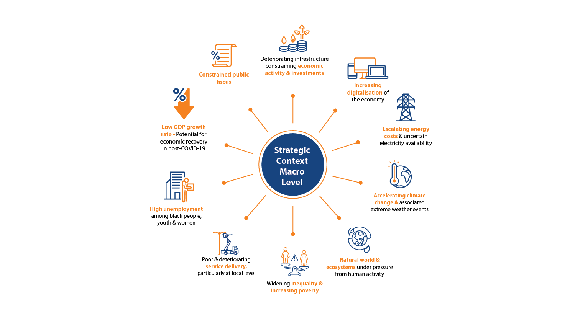

Slide 8
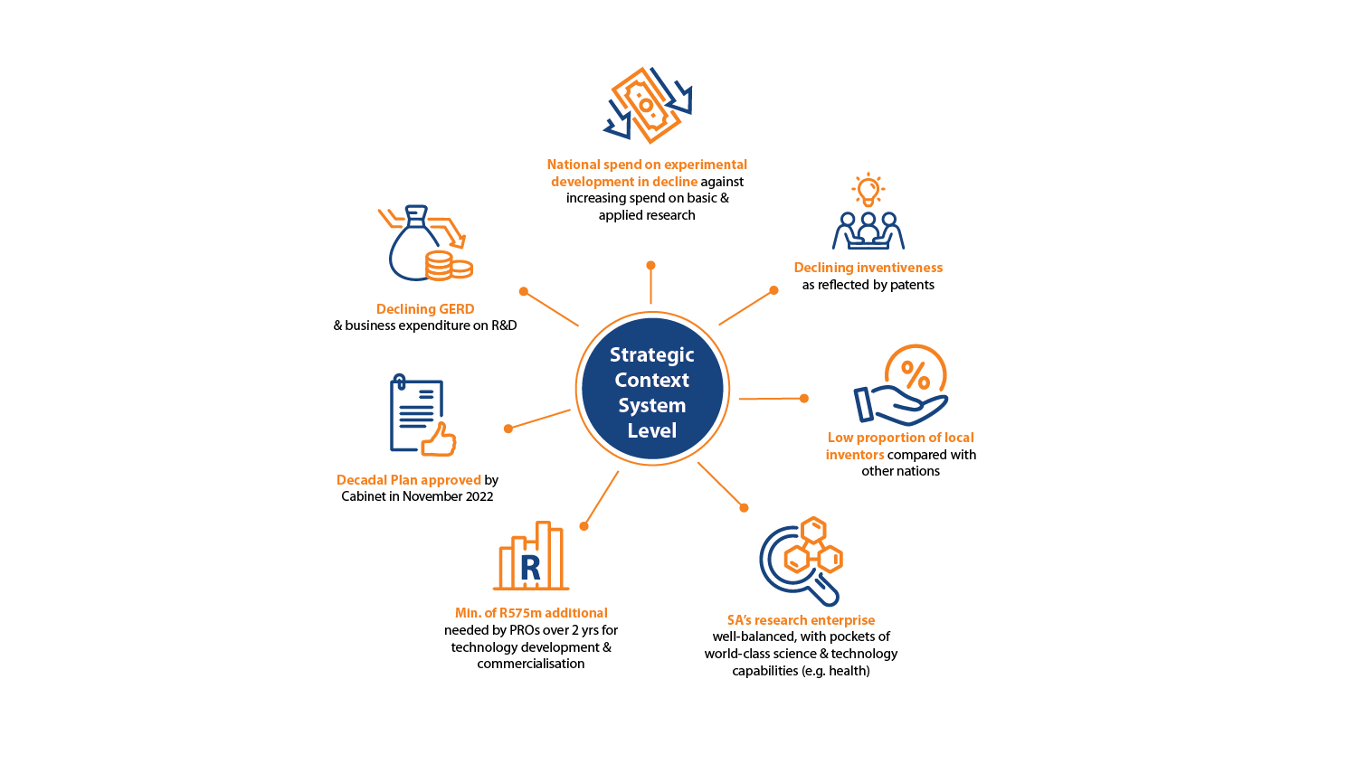

Slide 9
Strategic Context – Institutional
TIA Performance
2018/19: 91%
2019/20: 90%
2020/21: 90%
2021/22: 86%
Financial
Budget: R611,7m (R406,1m MTEF; R151,6m other)
2021/22 97% income disbursed
2021/22 efficiency ratio of 28% (target: 30%)
R746,5m funding leveraged in 2021/22 (target: R239m)
Stakeholder/Customer
Stakeholder survey result: 71%
2021/22 performance: 86%
Commercialisation performance
  2021/22: 59 achieved against a target of 40
  2022/23 (YTD): 30 achieved against a target of 35
74,5% of 2021/22 budget disbursed to HEIs & SCs
Internal Business
Unqualified audit for 11th yr, clean audit for 2nd yr
ISO 9001 certification maintained since 2018
Investment approval turnaround time
Poor internal integration (portfolios, systems)
Work/life balance through hybrid/remote working
Staffing constraints due to limited MTEF allocations
Learning & Growth
Institutionalised evaluation and learning (impact assessment and programme-specific evaluations)
Usage of external experts to mitigate internal skills gaps
601 interns hosted (over the period 2011/12-2022/23)

Slide 10
Institutional Review of TIA
Mandate to address market failure challenge (innovation chasm) remains relevant.
‘TIA 2.0’ model with functionalities & capabilities for successful commercialisation of research.
TIA correctly positioned in ‘highest risk location’ in innovation ecosystem.
Retain 3A Scheduling for 5 years & reconsider.
TIA needs a significantly strengthened functionality (curatorship along entire innovation chain).
Capacity deficits in core areas (due diligence & commercial deal-making).
Implementation record fair; COVID-19 response commendable.
Need a clearly-articulated transformation agenda & significant additional capital.
Operational efficiencies to be addressed.
Produce a new business case with bold new initiatives supported by DSI for expansion & capital scale-up over next 10 years.
10

Slide 11
Organisational
Performance

Slide 12
Transformation (2021/22 Performance)
Women (6/8 targets met)
Youth (3/8 targets met)
PWD (1/8 targets met)
12

Slide 13
Maturing Technologies in TIA’s Portfolio
Of ~500 projects managed by TIA, 80 of these have good prospects for commercialisation, particularly the 67 at TRL6 or higher.
These need at least R715m over 2-4 yrs for further technology development and pre-commercialisation.
30
3
TRL 9
TRL 8
TRL 7
TRL 6
TRL 5
TRL 4
1
25
8
2
20
15
8
1
10
2
2
19
7
3
5
6
1
3
5
3
0
Bio-economy Commercialsation Seed Fund Innov. Incl. Dev.

Slide 14
Near-market or Market-ready Technologies in the Innovation Fund
3
TIA has utilised R182,2m from DSI to further de-risk prior investments, investing in 30 projects under the Innovation Fund.
28 were previously public-funded or stem from a PRO; 21 have utilised IP originating from public-funded research.
Results of IF funding have been encouraging
(see pie chart).
As of Sept. 2022 TIA recorded R283,4m in leveraged funds (R1,42 leveraged for every R1 from TIA), with R192,4m from the private sector.
11
9
7
Fully de-risked (ready for the market or already in the market)
Will be fully de-risked after Innovation Fund investment
Will require further financing to be fully de-risked
Project being exited, dormant or distressed

Slide 15
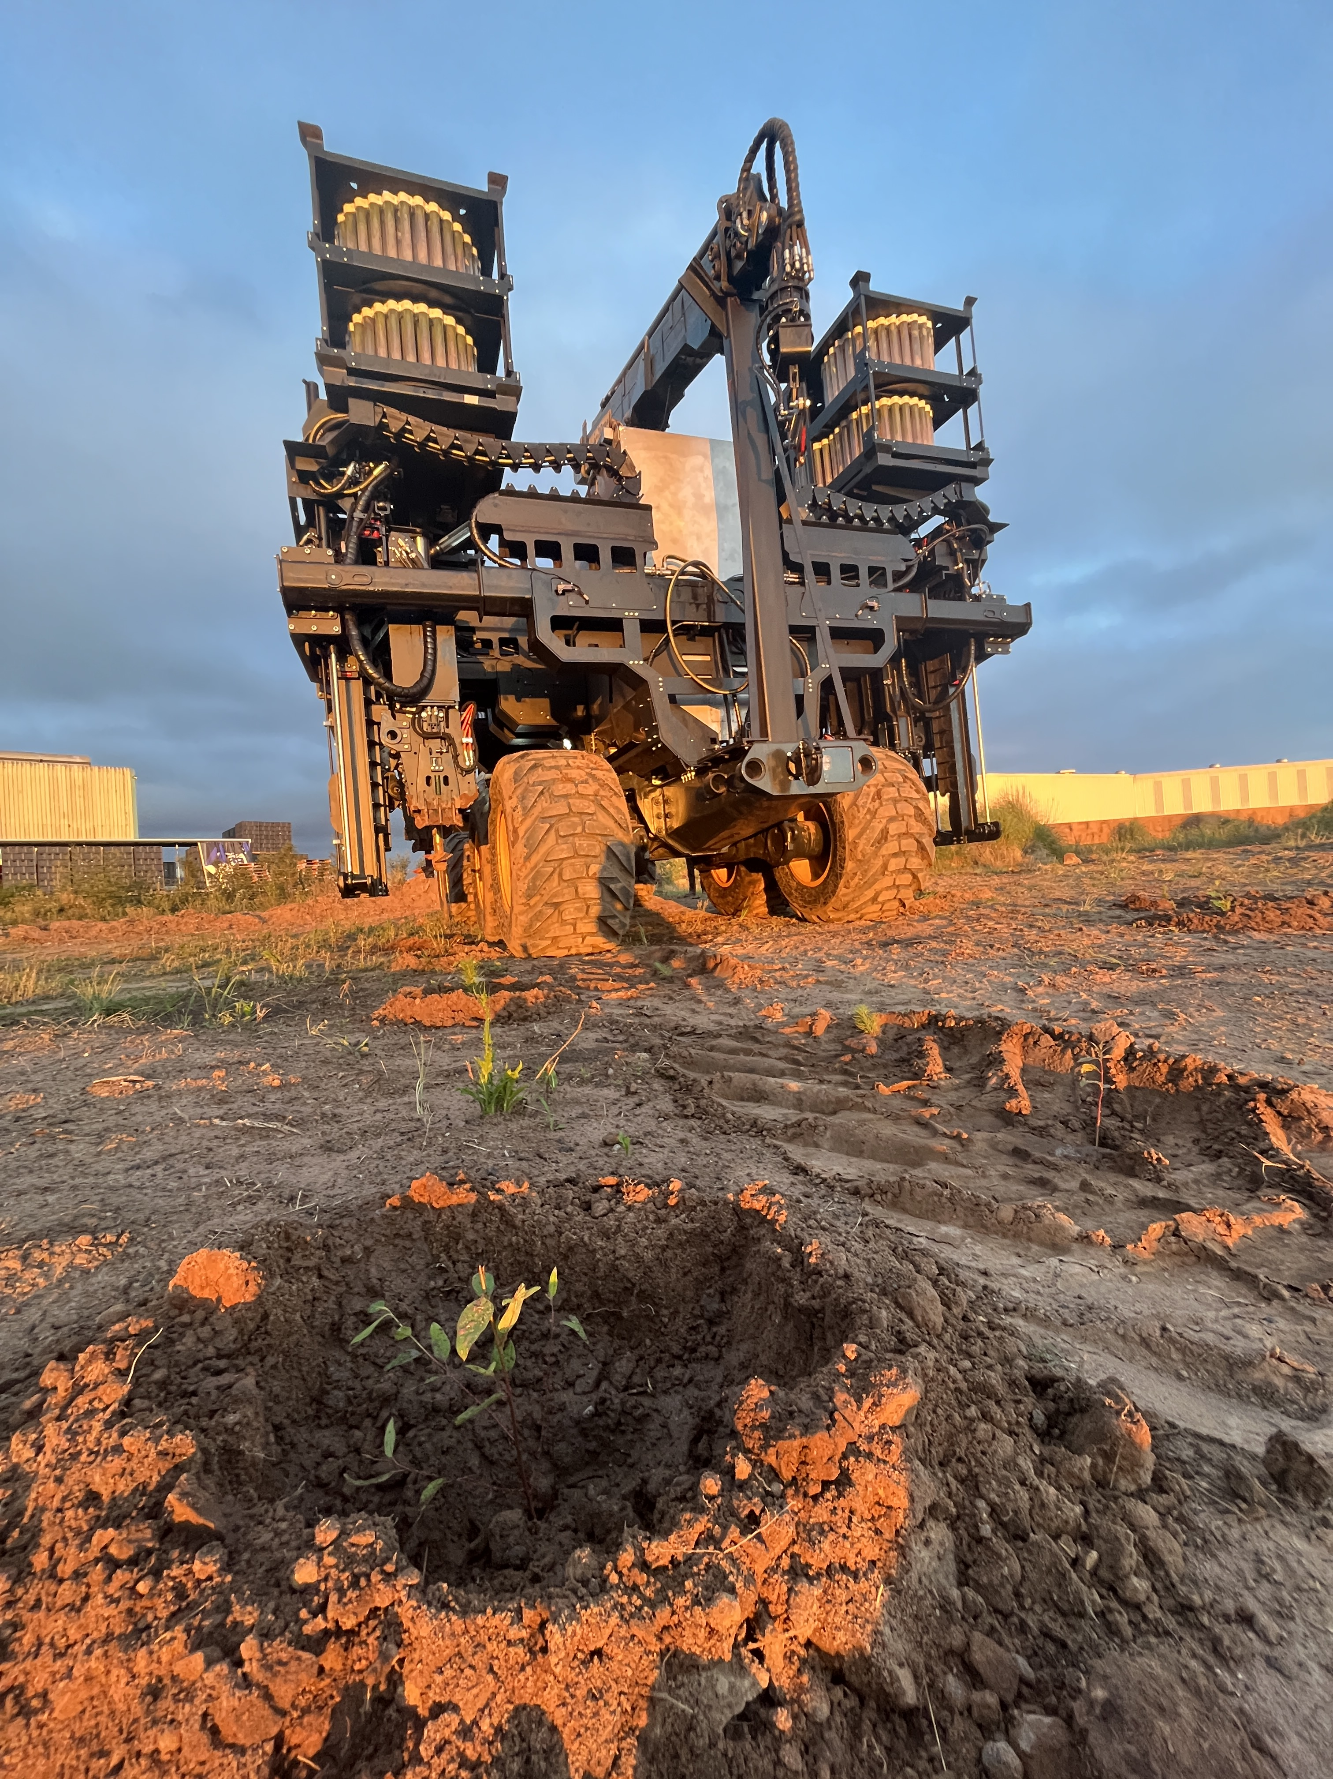
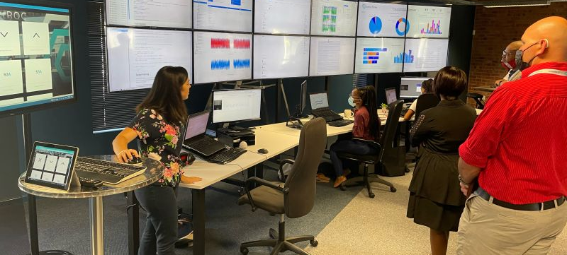
Decadal Plan Alignment
NovelQuip Forestry Mechanised Planting Technology project
A fully automated seedling planter for commercial forestry.
Promotes sustainable forestry, forest
regeneration and regreening
(modernising agriculture).
Stone Three Smart Sensor Process Advisory Dashboard
Aims to increase the productivity of crushing, grinding & flotation in mineral processing, thereby raising competitiveness.
Supports modernising the mining sector through digitalisation; helps to extend life of mining equipment.

Slide 16
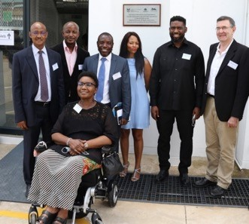


Decadal Plan Alignment (cont.)
Khepri Innovations Insect Protein
A waste stream/landfill alternative to the food value chain, producing high-value animal feed protein.
Contributes towards pollution reduction & regenerative systems (reduced fertilisers
and antibiotics in farming).
Will contribute towards the circular economy priority and the national Waste RDI Roadmap
Active Pharmaceutical Ingredients Cluster
Aims to develop & produce APIs locally to combat the priority diseases in SA and the continent (health innovation).
Will reduce reliance on
imported APIs & stimulate local pharmaceutical value
chains & related innovations
through localisation of techs & demonstration of capabilities for the manufacture of scarce/costly drugs & APIs.

Slide 17
Opportunities
Transformation, inclusivity & economic revival (MTSF & STI White Paper)
Increased transformation through focused initiatives (historically disadvantaged HEIs, PDIs, women, youth & PWD)
Many TIA focus areas aligned with 4IR, AI-driven health trends & other national priority areas.
Increased demand for innovation/technology-based investments – new funds, programmes & partnerships
Partnership opportunities with SETAs & other DHET initiatives
Exploring external income generation to reduce reliance on the fiscus.
Climate change & just energy transitions partnerships & initiatives
Expand Technology Stations network, Technology Platforms and Technology Clusters
17

Slide 18
Outcome 1: Commercialised innovations
Challenge
Poor translation of public-funded technologies & IP for socio-economic growth & development
Objective
Direct more of TIA’s resources to support the translation of locally developed technologies & IP from HEIs & science councils into commercialised innovations
Decadal Plan
Rejuvenate manufacturing and mining through competitiveness and efficiency improvements and application of new technologies
Improve energy supply security and decarbonise the economy through greener energy technologies
Sustainably utilise its natural resources (waste and water) and transitioning to a circular economy
Digital transformation of key industries and sectors, including cybersecurity
Bridge digital divide for access and inclusion of PDIs and marginalised groups
Support access to IP from public-funded R&D to black, women and youth-owned high-tech start-ups
18

Slide 19
Planned Performance: Outcome 1
Output | Indicator | Annual Targets
 |  | MTEF Period
 |  | 2023/24 | 2024/25 | 2025/26
Technologies licensed/assigned | No. of licensed/assigned technologies | 20 | 25 | 30
PRO/industry collaborations | No. of projects involving industry | 50 | 52 | 56
Technologies diffused | No. of diffused technologies | 20 | 24 | 28
Products launched | No. of products launched | 40 | 44 | 48
Revenue from commercialised innovations | Rand value of royalties, sales & exits | R10m | R15m | R20m

Slide 20
Outcome 1: Explanation of Planned Performance
Increasing collaboration between research sector and industry
New (mid 2020) indicators embraced
  IP transactions (licenses, assignments etc)
  Industry joint collaborations
  Industry co-funding (leveraged funds)
Direct correlation between tracking products launched vs income generation
Revenues from commercialized innovations
  Tail end of full investment life cycle
    Exits and disposals
    Revenue collection (e.g. royalties)
20

Slide 21
Outcome 2: Delivering on the Bio-economy
Challenge
Unrealised potential for new bio-based products and processes and the creation of new enterprises and new markets
Objective
Support the translation of bio-based knowledge resources into sustainable bio-based solutions through implementing the Bio-economy Strategy (agriculture, health, industrial biotechnology and IKS)
Decadal Plan
Revitalising and modernising the agriculture sector through improving economic competitiveness and productivity
Leveraging off the circular economy
Innovation in support of health (optimisation of health systems, improving quality of healthcare, digitisation of healthcare systems)
Ecosystem-based climate change adaptation and mitigation through technology development and dissemination in key sectors
21

Slide 22
Planned Performance: Outcome 2
Output | Indicator | Annual targets
 |  | MTEF period
 |  | 2023/24 | 2024/25 | 2025/26
Bio-based technologies developed | No. of bio-based technologies demonstrated | 30 | 37 | 40
Technology Platforms managed & supported | No. of Technology Platforms | 9 | 10 | 10
Technology Innovation Clusters managed & supported | No. of Technology Innovation Clusters | 9 | 10 | 11

Slide 23
Outcome 2: Explanation of Planned Performance
B-E Division will harvest demonstrated technologies from clusters (API Cluster and MeDDIC), & will support SMME development & commercialisation.
Continued support to Technology Platforms to reach sustainable income generation capacity, followed by TIA exiting (replaced by industry) or play a minimal role.
New nanotech platform proposed by DSI. Establishment subject to securing funding.
Expansion of bioprocessing platform nationally will be pursued, subject to securing funding.
National Bioentrepreneurship programme (possible partnership opportunity for TIA in CSIR-Gates Foundation programme).
Consider supporting RDI elements of NRF call for Vaccine Preparedness Institute.
Continued support for existing programmes in cannabis innovation for greater impact.
23

Slide 24
Outcome 3: SMMEs Supported through Technology Stations
Challenges
Structurally high unemployment, especially women and youth; poor SMME startup and survival rates; fragmented and poorly coordinated NSI
Objective
Promote the growth of SMMEs and cooperatives, contribute towards innovation-led industrialisation processes, creation of decent jobs, technology start-up enterprises and the support of SMMEs
Decadal Plan
Foster inclusive development through SET and enterprise development support to grassroots innovators, cooperatives, entrepreneurs and businesses
Foster transformation through increased spatial footprint to underserved provinces and priority districts
24

Slide 25
Planned Performance: Outcome 3
Output | Indicator | Annual Targets
 |  | MTEF Period
 |  | 2023/24 | 2024/25 | 2025/26
New centres | No. new technology & innov. support centres | 8 | 9 | 10
Support to SMMEs & co-operatives | No. SMMEs & co-operatives getting SET & enterprise dev. support | 3 000 | 3 100 | 3 200
High-level HCD | No. of high-level students & post-docs | 130 | 150 | 175
Innovation products produced | No. of IP- & knowledge-based innov. products | 200 | 220 | 250
Leveraged funds | Rand value leveraged | R300m | R310m | R320m

Slide 26
Outcome 3: Explanation of Planned Performance
Systemic interventions, particularly where there are system failures and gaps.
launching dedicated women, youth & people with disabilities-focused innovation support programmes to ensure inclusive innovation beyond university boundaries.
Secure industry partnerships, thereby leveraging TIA’s resources.
Focus on internal collaboration within TIA to improve the positioning of the TSP, particularly with regards to the Grassroots Innovation Programme.
Build on the solid foundation of the Seed Fund Programme model.
Exploit strategic partnerships with several African countries to enable capacity building, peer-to-peer learning and market access opportunities.
Embedding skills development within TIA’s programmes and interventions aligned with the country’s draft Master Skills Plan.
Work-integrated learning & graduate internship programme for university & TVET graduates in Centres for Occupational Excellence.
26

Slide 27
Planned Performance: Administration
Output | Indicator | Annual Targets
 |  | MTEF Period
 |  | 2023/24 | 2024/25 | 2025/26
Good financial governance | Audit opinion | Clean external audit opinion | Clean external audit opinion | Clean external audit opinion
Improved investment decision turnaround time | Turnaround time (<R1m) | 4 weeks | 4 weeks | 4 weeks
 | Turnaround time (R1m-R15m) | 15 weeks | 15 weeks | 15 weeks
 | Turnaround time (>R15m) | 26 weeks | 26 weeks | 26 weeks
Support underserved provinces | Funding to underserved provinces | Min. 30% available funds allocated | Min. 30% available funds allocated | Min. 30% available funds allocated
Transform TIA’s investment portfolio | Funding to transformed recipients | Min. 40% available funds allocated | Min. 50% available funds allocated | Min. 50% available funds allocated

Slide 28
Strategic Initiatives
Develop and implement a TIA Commercialisation Strategy
Secure PFMA sections 54 Exemptions
Implement Initiatives to support the Just Energy Transition
Support implementation of the Hydrogen Society Roadmap
Establish a focused Bio-entrepreneurship Programme
Implement a Cannabis Industry Builder programme
Launch specific transformation Funds for Women, Youth and Persons with Disabilities
Implement the Strategic Stakeholder Engagement Framework
Fund raising through a Fund of Fund approach
28

Slide 29
Budget

Slide 30
3-Year
Budget

Slide 31
Thank you

