Slide 1
Annual Performance Plan for FY2023/24
PRESENTATION TO THE PORTFOLIO COMMITTEE ON HIGHER EDUCATION, SCIENCE AND INNOVATION
APRIL 21, 2023

Slide 2

Contents
Five Year Strategic Objectives
Vision, Mission & Values
DSI Funded Projects
Who we are
Finance
Progress on Minister’s Directives
Key Highlights and Challenges
FY 2023/24 Performance Plan
2
Notes:
2

Slide 3
Who we are
The South African Council for Natural Scientific Professions (SACNASP) is the registration and regulatory body for natural science professionals in South Africa.
SACNASP was established in terms of the Natural Scientific Professions Act (27 of 2003) (the NSP Act) as amended by the Science and Technology Laws Amendment Act (7 of 2014).
3
Notes:
3

Slide 4
Our Mandate
Register
Registration of Natural Scientists
Enable
To enable registered scientists through life-long learning
Regulate
To protect the Public, the Profession & the Environment
Advise
To advise government for policy & decision making
Integrity in Science
4
Notes:
4

Slide 5
Vision, Mission and Values
Vision
Leading the development and advancement of the Natural Science Professions in South Africa.
Mission
To provide an efficient statutory Council for the recruitment, registration, regulation, and advancement of the Natural Scientific Professionals to ensure high-quality services for economic growth and societal benefit.
Values
SACNASP will be guided by the values of independence, non- discrimination, diversity, inclusiveness, honesty, integrity, respect, non-partisanship, innovation, diligence, responsiveness and collaboration.
“ A robust and productive science knowledge economy”
5

Slide 6
5-year Strategic Objectives
To proactively advise Government and relevant stakeholders on the contributions and role of the Natural Scientific Professions in South Africa.
To enforce high professional and ethical standards for the natural scientific workforce.
To promote the natural science professions and science engagement in South Africa.
To promote the professional development and transformation of the natural science sector in South Africa.
To foster a culture of good corporate governance
1
2
3
4
5
6
Notes:
6

Slide 7
Alignment to National Priorities
SACNASP's strategic plan aligns to five of the seven national priorities
A capable, Ethical and Developmental State.
Economic Transformation and Job Creation.
Education, Skills and Health.
A better Africa and a Better World
Social Cohesion, Safer Communities; and
7
Notes:
7

Slide 8
Contributions to National Development Plan
NDP
New report on “The skills and competencies required for the future natural scientist amid grand societal challenges’.
ERRP
Decadal Plan
Collaboration with government entities to decrease application times and reduce financial burden on young graduates to improve access to employment opportunities.
Skilling, upskilling and reskilling programmes (CMP and CPD)
Promote 4IR early Q1 2023 collaboration with University of Johannesburg.
Development of programmes to give people living in rural areas access to SACNASP iniatives.
Continuing Professional Development contributes to an enabling environment on innovation.
8
Notes:
8

Slide 9

Performance Plan FY2023/24
2021/22
Performance
9
Notes:
9

Slide 10
STRATEGIC OBJECTIVE 1: To proactively advise government and relevant stakeholders on the contributions and role of the natural scientific professions in South Africa.
Our Mandate:
Register
Registration of Natural Scientists
Enable
To enable registered scientists through life-long learning
Regulate
To protect the Public, the Profession and the Environment
Advise
To advise government for policy and decision making
10
Notes:
10

Slide 11
Strategic advice for national development
Reports to government to inform policy and decision making.
Taking science to society through science engagement and communication activities – a science engaged citizenry.
Responding to ministerial directives.
11

Slide 12
Report on Pathways into the labour market & self-employment for natural science graduates
Closer stakeholder collaboration for skills planning
Identify and mainstream emerging skills and fields of study
Public and private employers to provide more opportunities for work experience
Support the development of relevant skills towards self-employment
The report emphasizes the need for inclusivity - gender and youth responsiveness
12

Slide 13
Performance Plan Indicators and Targets
STRATEGIC OBJECTIVE 1: To proactively advise government and relevant stakeholders on the contributions and role of the natural scientific professions in South Africa.
Outcome | Output Indicator | Actual Performance |  | Estimated Performance | MTEF Targets
 |  | 2020/21 | 2021/22 | 2022/23 | 2023/24 | 2024/25 | 2025/26
Outcome 1 Provide reports on relevant government policy matters. | Number of reports developed to inform government policy and legislation every two years. | One report on unemployed natural science graduates was completed on 31 August 2021. | Drafting the RFQ for the brief titled “The skills and competencies required for the future natural scientist amid societal grand challenges in South Africa.” | Establishment of a reference group to guide the development of ToRs for report 2: “The skills and competencies required for the future natural scientist amid societal grand challenges in South Africa.” | First draft of report 2 finalised and submitted to Council. | Drafting the Concept note/brief for report 3 as guided by Council. | Publication of report 3 and approval by Council.
Notes:
13

Slide 14
STRATEGIC OBJECTIVE 2: To enforce high professional and ethical standards for the natural scientific workforce.
Our Mandate:
Register
Registration of Natural Scientists
Enable
To enable registered scientists through life-long learning
Regulate
To protect the Public, the Profession and the Environment
Advise
To advise government for policy and decision making
14
Notes:
14

Slide 15
Registration categories & fields of practice
Registering scientists in three categories:
  Professional Natural Scientist
  Certificated Natural Scientist
  Candidate Natural Scientist
Agricultural Science | Including Forestry and Wood Science
Animal Science
Aquatic Science | Includes Marine Science
Atmospheric Science | Includes Climatology and Meteorology
Biological Science
Botanical Science
Chemical Science | Includes Industrial Science
Conservation Science
Earth Science
Ecological Science
Environmental Science
Extension Science
Food Science
Geological Science
Geospatial Science
Materials Science | Includes Metallurgical Science
Mathematical Science
Microbiological Science
Physical Science | Includes Radiation Science
Soil Science
Specified Science | Fire Origin and Cause Investigation
Statistical Science
Toxicological Science
Water Resources Science | Includes Hydrological Science and Water Science
Zoological Science
15

Slide 16
Registration trends
The number of registered scientists on the database in FY2022/23 was 17 140 with 2 448 new scientists registered during the year, while the total number of applications received was 2 635 which includes applications for additional fields of practice and upgrades. SACNASP is anticipating high application volumes in 2023/24.
2019/20 | 2020/21 | 2021/22
15
Notes:
16

Slide 17
Registered Scientists/FoP

Slide 18
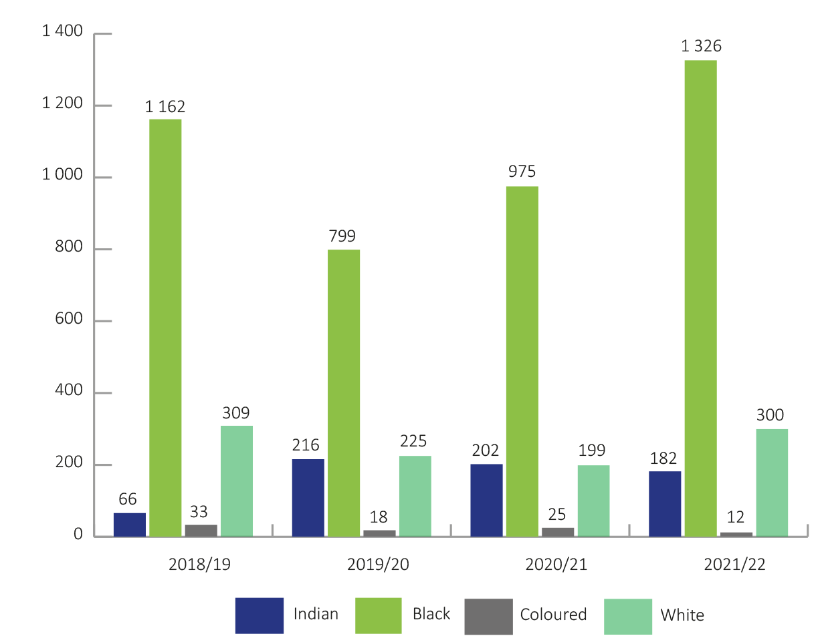
Registration by race
17
Notes:
18

Slide 19
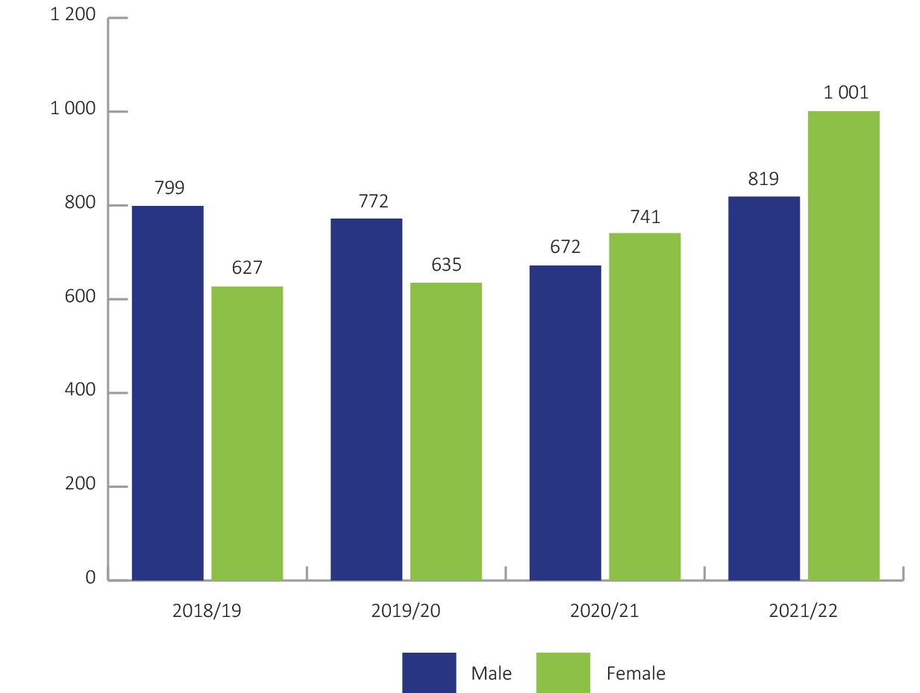
Registration by gender
18
Notes:
19

Slide 20
Registration by age
19
Notes:
20

Slide 21
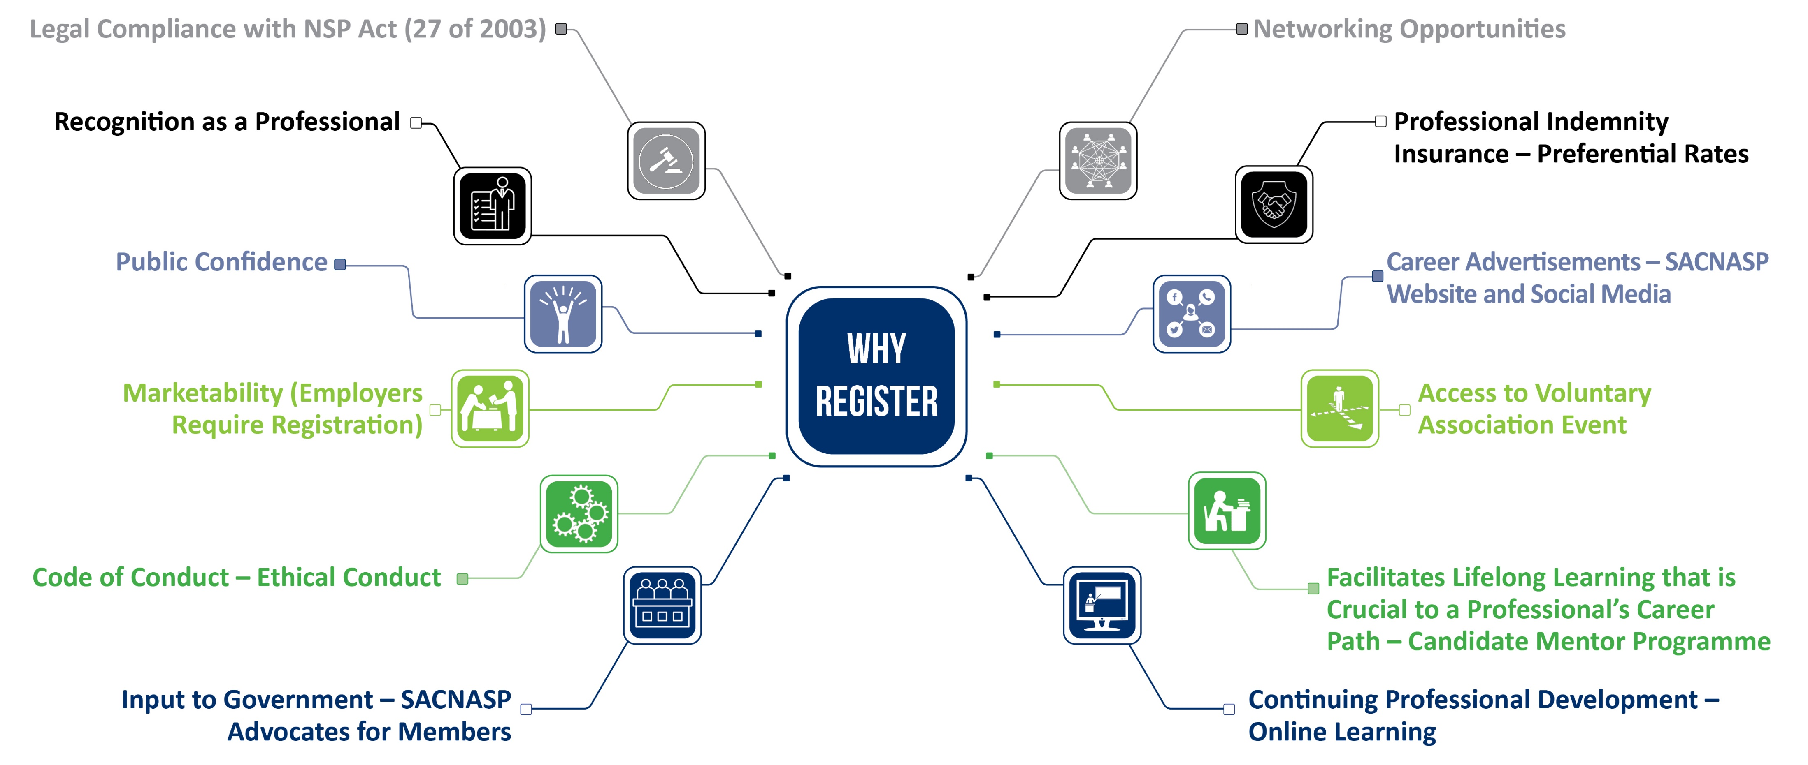
20
Notes:
Public recognition is a mark of excellence as registered scientists are considered as leaders in their field of practice.
The professional recognition provides the public with a sense of confidence, the public is assured that the scientists’ competence has been assessed by experts in the relevant field of practice.
Some employers require professional registration with bodies such as SACNASP as a prerequisite for appointment for certain scientific positions
When a scientist is registered with SACNASP, they need to adhere to a code of conduct. This is to ensure that the registered scientists conduct themselves in such a way that they uphold the dignity, integrity and reputation of the natural scientific professions. It is through the code of conduct that professionals are measured by.

Slide 22
Performance Plan Indicators and Targets
STRATEGIC OBJECTIVE 2: To enforce high professional and ethical standards for the natural scientific workforce.
Outcome | Output Indicator | Actual Performance |  | Estimated Performance | MTEF Targets
 |  | 2020/21 | 2021/22 | 2022/23 | 2023/24 | 2024/25 | 2025/26
Outcome 2 High professional and ethical standards for the Natural Scientific workforce enforced. | Number of new natural scientist applications. | 1 413 | 1 820 | 1 500 | 1 500 | 1 500 | 2 000
 | Percentage of applications processed in the correct timeframes. | N/A | 90% | 93% | 95% | 95% | 95%
 | Percentage of scientists retained. | N/A | 80% | 80% | 80% | 80% | 85%
Notes:
22

Slide 23
STRATEGIC OBJECTIVE 3: To promote the natural science professions and science engagement in South Africa
Our Mandate:
Register
Registration of Natural Scientists
Enable
To enable registered scientists through life-long learning
Regulate
To protect the Public, the Profession and the Environment
Advise
To advise government for policy and decision making
22
Notes:
23

Slide 24
Promoting the natural science professions and
science engagement in South Africa
The Impact of Climate Change on Future Pandemics
Guidelines on Research Ethics and Publication Practices
Promoting ethical and professional conduct for natural science professionals
Reflections on science communication in the age of pandemics
23
Notes:
24

Slide 25
SACNASP & SAASTA jointly submitted a proposal to the Academy of Science of South Africa (ASSAf) to roll out the Young Science Communicator’s Competition.
SACNASP hosted workshops at nine (9) under-resourced schools in the Northern Cape under three different districts. A total of 1 580 learners were reached.
SACNASP hosted a CanDo 4IR workshop at SciFest on 7-13 September 2022.
24
Notes:
25

Slide 26
Performance Plan Indicators and Targets
STRATEGIC OBJECTIVE 3: To promote the natural science professions and science engagement in South Africa.
Outcome | Output Indicator | Actual Performance |  | Estimated Performance | MTEF Targets
 |  | 2020/21 | 2021/22 | 2022/23 | 2023/24 | 2024/25 | 2025/26
Outcome 3 Facilitated public awareness initiatives to address national priorities | Number of public awareness and engagement initiatives conducted to foster the understanding of the contribution of the natural science profession. | 5 | 8 | 8 | 8 | 8 | 10
25
Notes:
26

Slide 27
STRATEGIC OBJECTIVE 4: To promote professional development and transformation of the natural science sector in South Africa.
Our Mandate:
Register
Registration of Natural Scientists
Enable
To enable registered scientists through life-long learning
Regulate
To protect the Public, the Profession and the Environment
Advise
To advise government for policy and decision making
26
Notes:
27

Slide 28
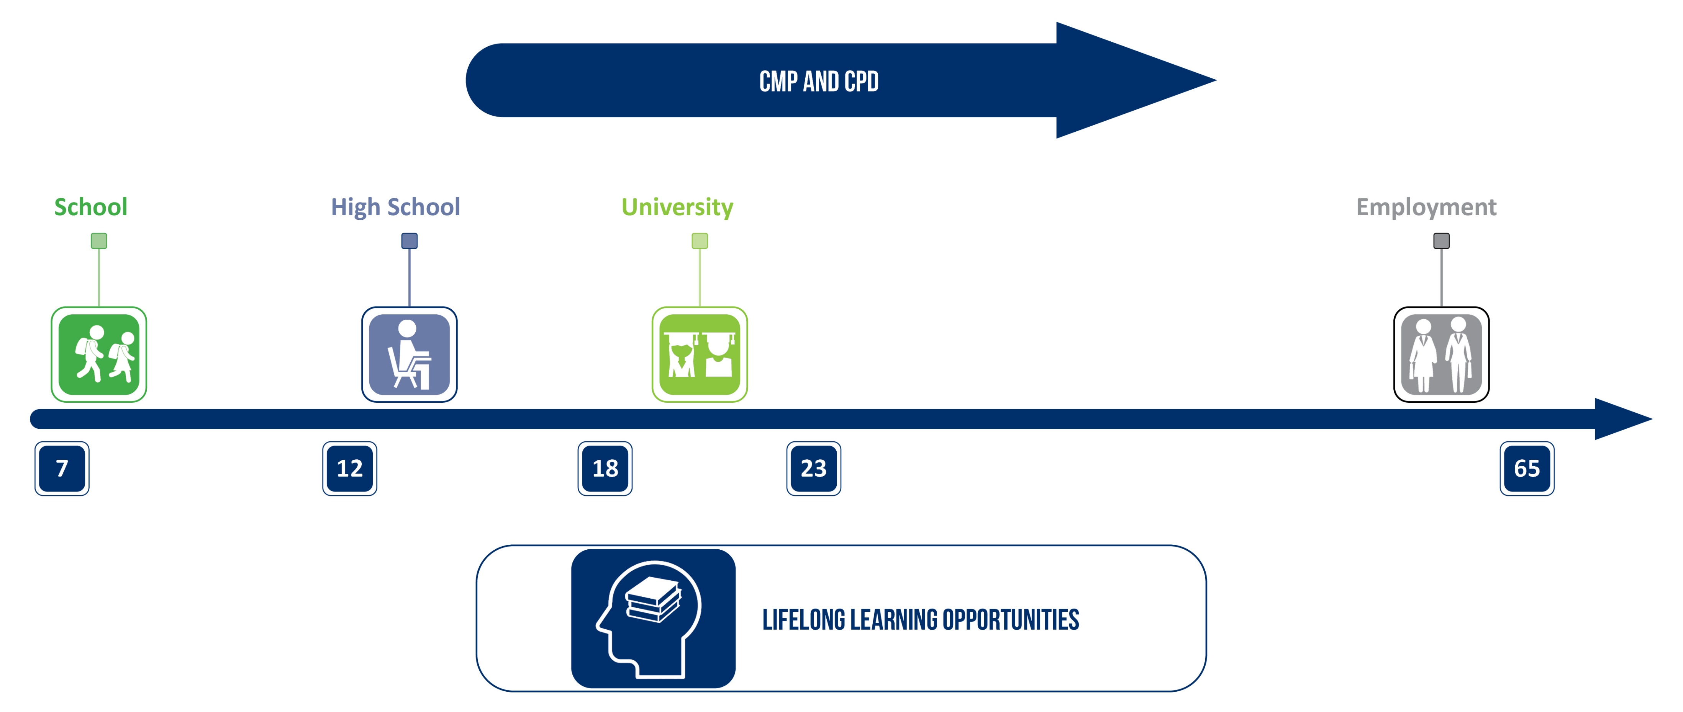
Lifelong learning value chain
27

Slide 29
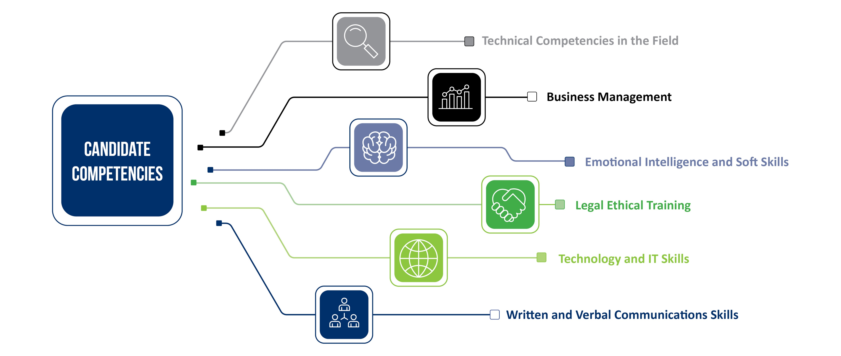
SACNASP value-add: CMP
28
Notes:
Capacity and skills development of scientists through CPD and CMP programmes thus support government initiatives to address unemployment and redress.
29

Slide 30
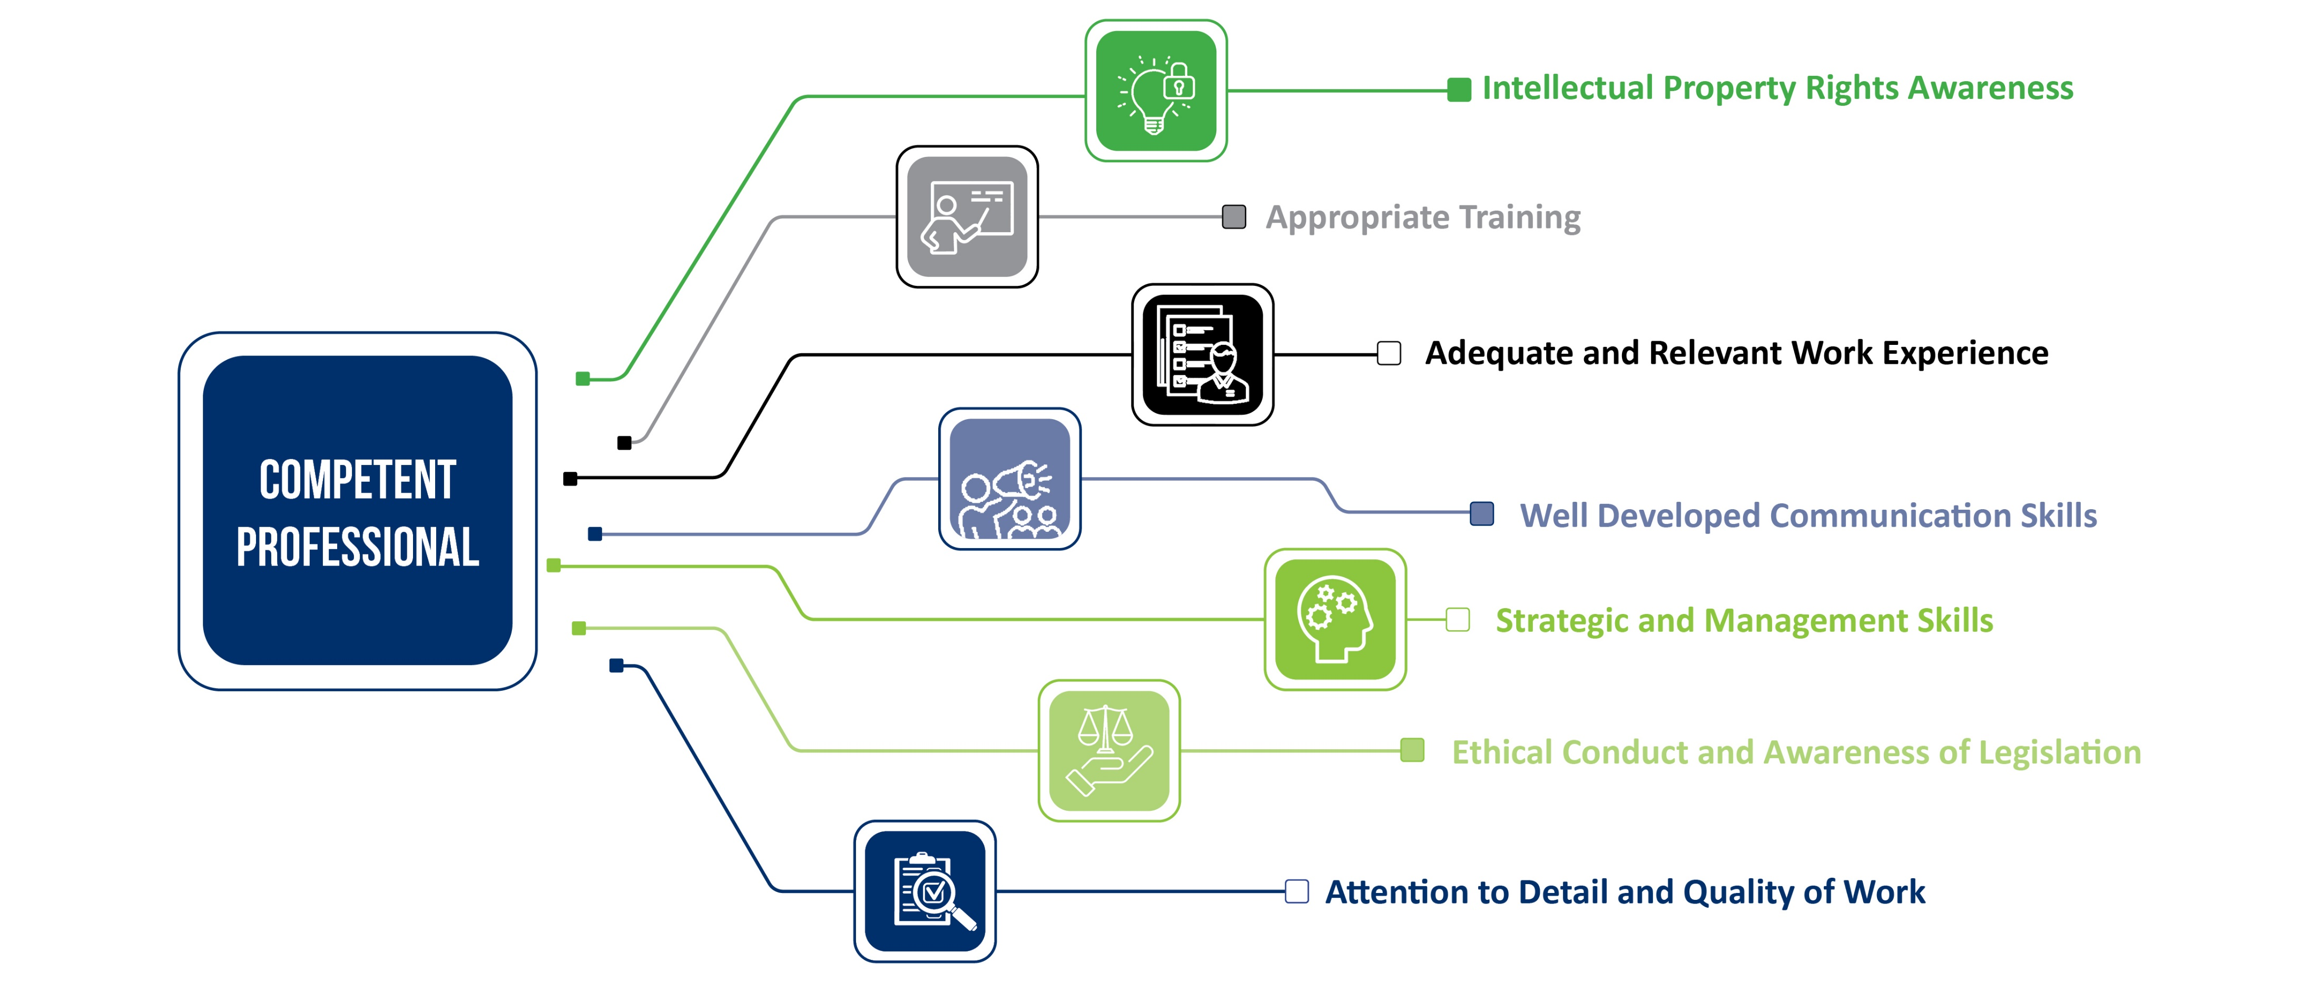
SACNASP value-add: CPD
29
Notes:
30

Slide 31
Continuing Professional Development (CPD)
Scientists who participate in science engagement activities will be awarded continuing professional development points by the Council for Natural Scientific Professions.
2019 White Paper on Science, Technology and Innovation
30

Slide 32
Performance Plan Targets and Indicators
STRATEGIC OBJECTIVE 4: To promote professional development and transformation of the natural science sector in South Africa
Outcome | Output Indicator | Actual Performance |  | Estimated Performance | MTEF Targets
 |  | 2020/21 | 2021/22 | 2022/23 | 2023/24 | 2024/25 | 2025/26
Outcome 4 Created an environment for lifelong learning of professionals. | The proportion of registered natural scientists who participate in the lifelong learning programme. | 29% of scientists on database participated in CPD. | 37% of scientists on database participated in CPD. | 40% of scientists on database participating in CPD. | 50% of scientists on database participating in CPD. | 60% of scientists on database participating in CPD. | 70% of scientists on database participating in CPD.
31
Notes:
32

Slide 33
Performance Plan Targets and Indicators
STRATEGIC OBJECTIVE 4: To promote professional development and transformation of the natural science sector in South Africa
Outcome | Output Indicator | Actual Performance |  | Estimated Performance | MTEF Targets
 |  | 2020/21 | 2021/22 | 2022/23 | 2023/24 | 2024/25 | 2025/26
Outcome 5 Transformation of natural science sector & increased participation of designated groups. | a) Number of women and youth who participate in SACNASP student enrolment programmes. | 60 | 25 (60:40) (women: men) | 700 (60:40) (women: men) | 700 (60:40) (women: men) | 700 (60:40) (women: men) | 800 (60:40) (women: men)
 | b) Number of women and youth who participate in the CMP. | 17 | 17 (60:40) (women: men) | 100 (60:40) (women: men) | 100 (60:40) (women: men) | 100 (60:40) (women: men) | 150
Notes:
33

Slide 34
Performance Plan Targets and Indicators
STRATEGIC OBJECTIVE 4 To promote professional development and transformation of the natural science sector in South Africa
Outcome | Output Indicator |  |  | Estimated Performance | MTEF Targets
 |  | 2020/21 | 2021/22 | 2022/23 | 2023/24 | 2024/25 | 2025/26
Outcome 6 Contributed towards education qualifications and learning pathways for natural scientists. | Number of HEI natural science programmes aligned for endorsement in conjunction with the CHE. | Developed a guideline document informing SACNASP processes. | 2 | 500 | 6 | 6 | 20
33
Notes:
Due to changes in processes the estimated performance has over achieved
34

Slide 35
Performance Plan Targets and Indicators
STRATEGIC OBJECTIVE 5: To foster a culture of good corporate governance.
Outcome | Output Indicator |  |  | Estimated Performance | MTEF Targets
 |  | 2020/21 | 2021/22 | 2022/23 | 2023/24 | 2024/25 | 2025/26
Outcome 7 Compliance with legislative and policy framework. | Unqualified audits achieved. | Unqualified audit report on financial and governance matters issued by 30 September 2021. | Unqualified audit report on financial and governance matters issued by 30 September 2022. | Unqualified audit report on financial and governance matters issued by 30 September 2023. | Unqualified audit report on financial and governance matters issued by 30 September 2024. | Unqualified audit report on financial and governance matters issued by 30 September 2025. | Ensure correct internal controls and policies are in place.
34
Notes:
35

Slide 36
DSI funded projects
SACNASP wishes to thank the Minister of Higher Education, Science and Technology and the Department of Science and Innovation for their continued support.
SACNASP received R10m in total from the DSI to realize some of the objectives of the Strategic Plan (reflected as Deferred income in Annual Report).
Projects focused on:
Project Name | Amount
CMP | 2,386,200
CPD | 3,891,200
Regulations | 1,321,650
IT Platform | 2,650,513
Total | 10,249,563
35
Notes:
36

Slide 37
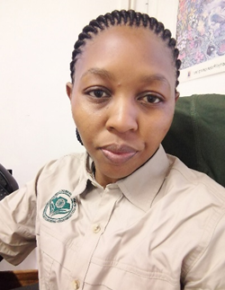
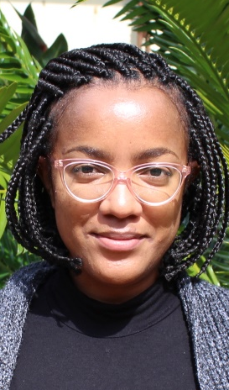

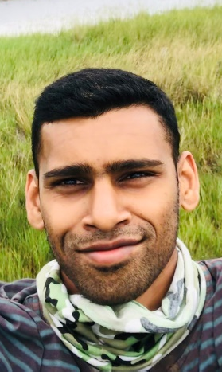
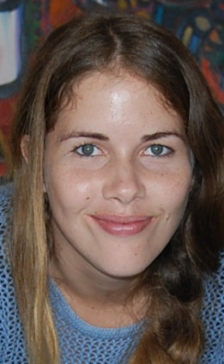
CMP programme
The Candidate Mentoring Phase (CMP) program was initiated in FY2020/21.
The programme is aimed at building a pipeline for the next generation of skilled natural science professionals in South Africa
Ensure transformation in the percentage representation of natural science graduates from designated groups viz. women and marginalized groups.
SACNASP, in collaboration with the VA’s, is assisting graduates to be ready for work by providing them with the skills relevant to their field of practice.
36
Notes:
37

Slide 38
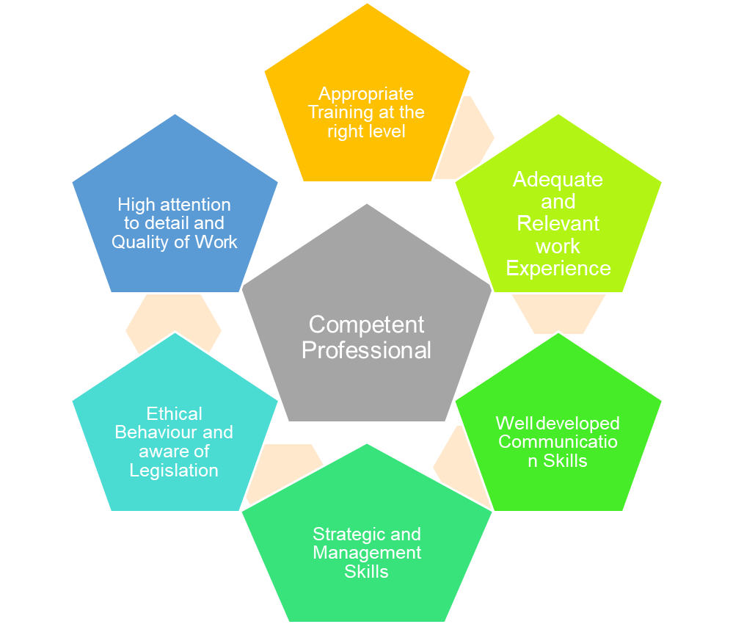
Continuing Professional Development (CPD)
The CPD website was successfully launched on 1 April 2017.
Against the quarterly target of 40% (FY2022/23), 42% of the registered natural scientists have updated their CPD statuses.
To date, 2 413 events have been validated on the CPD portal.
SACNASP is continuously engaging with recognised VAs, higher education institutions and various key stakeholders for CPD validation.
37

Slide 39


Regulation of the natural science profession
Registered Scientists are bound by code of conduct that is reviewed annually
Robust whistleblowing services
38
Notes:
39

Slide 40
Maintenance and support of Information and Technology (IT) Platforms
Streamline registration processes
Database upgrade and data analysis
Maintenance and hosting of IT systems
Improve cybersecurity
39

Slide 41
Finance: Income
40

Slide 42
Budget for FY2023/24
 | 2023/24
1. Administration (Infrastructure, Salaries & Support) | 18,715,439
2. Programme’s
(a) Information Technology support and maintenance | 3,400,000
(b) Human Capital development and Transformation (CPD,CMP) | 2,700,000
(c) Policy advisory | 1,000,000
(d) Regulatory | 1,700,000
(e) Science Engagement | 1,200,000
Total | 28,715,439
41

Slide 43
The DSI has continued to support SACNASP and has committed to a further R30 000 000 as project funding for the period 2022 to 2025.These funds are being used for the projects only.
In the past, the DSI has made allocations for special projects, such as the R14 million allocated in 2021, and the R5 million allocated due to COVID-19 challenges and lockdown.
In order for SACNASP to achieve its objectives, it is clear that, in addition to registration and application fees, SACNASP will require additional funding to overcome the financial challenges resulting from the poor economic situation, and the increase in bad debts.
Negotiation with the DSI is underway, it is intended that SACNASP will ultimately move from project-based funding to a baseline allocation in the future, in order to enable a fit-for-purpose organisation which can effectively deliver on its mandates fully.
42

Slide 44
Bad Debt and membership retention plan 2023/24
In addressing the bad debt and membership retention issues, SACNASP has established a Bad debt and Membership Retention Task Team. The purpose is to:
i. assess the current situation regarding bad debts and recommend interventions.
ii. identify retention and expansion (growth) strategies to increase the pool of registered scientists.
A workplan has been since implemented to look at key areas such as:
Q1 | Q2 | Q3 | Q4
April – June | July Sept | Oct – Dec | Jan - March
Centralise Debt Collection Function and launch workplan | Promote CPD and CPD and CMP programmes as a retention tool | Establish a resource library for registered scientist | Assess impact of annual plan and revise strategies for the next financial year
43

Slide 45
Progress on Minister’s Directives
Directive | SACNASP’s plan | Progress to date
Greater engagement and collaboration between natural sciences, humanities and social sciences. | To establish a platform across all disciplines to tackle grand societal challenges. | SACNASP has collaborated with HSRC on 2 reports. Also participating on DSI- led South African Basic Sciences (SABSplat).
Collaborations with BRICS and Cuba. | To work with the ICR programme at the DSI. | Engagements with the Chinese Embassy and connections made with China Association for Science and Technology (CAST).
Lack of science journalism in SA. | Engage DSI on the country’ strategy to address this. | Meeting with DSI designated directorate facilitated and SACNASP Communication strategy shared with SAASTA.
District Development Model (DDM). | SACNASP to arrange networking sessions, identify the geographical area and deliberate on local problems that would contribute towards DDM. | Consultative workshop on DDM held with the Voluntary Associations.
44
Notes:
45

Slide 46
Progress on Minister’s Directives
Directive | SACNASP’s plan | Progress to date
Indigenous Knowledge Systems (IKS). | Align the programme with the unit of IKS in the DSI. | SACNASP engaging with HEI’s where IKS is a subject. Establish if IKS-based professionals can be registered.
Development of a partnership strategy. | Strengthen relationships and with key stakeholders in the National System of Innovation (NSI). | Key engagements (PPP) initiated locally and internationally with AGRISETA, ETDP, FoodBevSETA, SAQA, National Deans Forum, CHE, CSIR, NRF-SAASTA, HSRC, SASOL Foundations, SARIMA, Nestle, Tiger Brands, Uganda National Council for Science and Technology (UNCST). Royal Society (UK), UK Science Council.
Institutional review | Final interviews completed and report being compiled. | Completed report due end of May 2023.
45
Notes:
46

Slide 47
Key highlights on the 5-year Strategic Plan
Register
Increased number of registrations of scientists from designated groups.
Enable
An embedded system of lifelong learning.
Regulate
Whistle blowing hotline
Professional Conduct Committee addressing malpractice.
Strict governance procedures
Advise
Reports to government
Webinars on topical issues.
46

Slide 48
Contributions to DSI and National Priorities
A capable, ethical and developmental state
A Code of Conduct that is robust and enforceable
Social Cohesion, Safer Communities
Robust regulatory function protecting communities and the environment. Protect and enhance our environmental assets and natural resources.
A Better Africa a better world
Science driven economy for a prosperous African continent.
Economic transformation and job creation
Education, skills and health
Development of briefs on key matters to government
Science engagement and communication activities.
Registration and regulation of natural scientists.
Targeted registration and Life-long learning opportunities provided to designated groups e.g. CMP and CPD
Strategic partnerships with CHE, SAQA, HEI’s and other relevant stakeholders. Skilling, upskilling and reskilling programmes (CMP and CPD).
All procurement evaluations adhere to DSI guidelines on advancing the status of women, youth and people with disabilities.
47
Notes:
48

Slide 49
Challenges & Opportunities
The Council continues to experience challenges in collecting annual fees and bad debts – internal interventions for debt collection (R1.7M recovered so far).
High turnover of staff due to low remuneration and inadequately staffed key departments – OD fit-for-purpose and work study process to align JD and salary benchmarking exercise
Long application processing times for specific fields of practice – AI based systems to improve registration processes.
Progress of the Draft Amendment Bill – recommendation greatly assists the organization deliver on the mandate
Need to adequately resource the mandate of SACNASP – “maximum delivery & leaving no one behind” - the move to baseline funding greatly appreciated.
48
Notes:
49

