Slide 1

SOUTH AFRICAN NATIONAL SPACE AGENCY
2023/2024 ANNUAL PERFORMANCE PLAN
Presentation to the Portfolio Committee on Higher Education, Science and Innovation
By: SANSA Board and Executives
21 April 2023

Slide 2
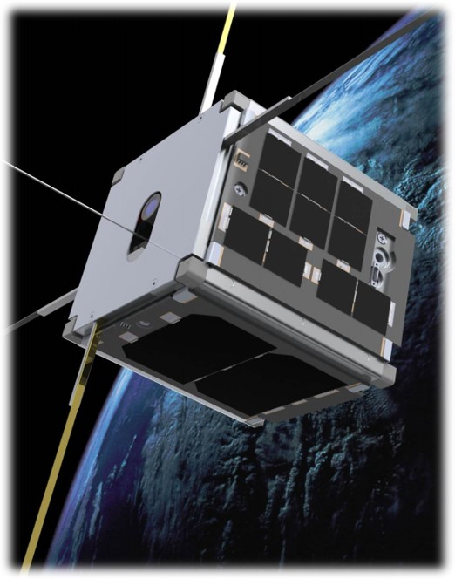
1
OVERVIEW
Vision and Mission
2
Impact Statement
3
Revised Organisational Value
4
2020-2025 Strategic Outcomes
5
Key Strategic Priorities
6
SANSA Programmes
7
2023 / 2024 APP Output Indicators & Targets
8
Operational Information
9
Financial Review
10
Organisation Focus
11
Key Celebrations / The Road Ahead

Slide 3
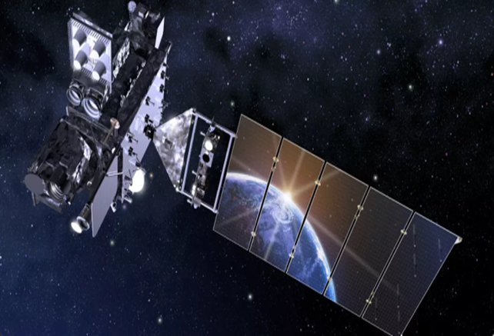
POLICY CONTEXT

Slide 4
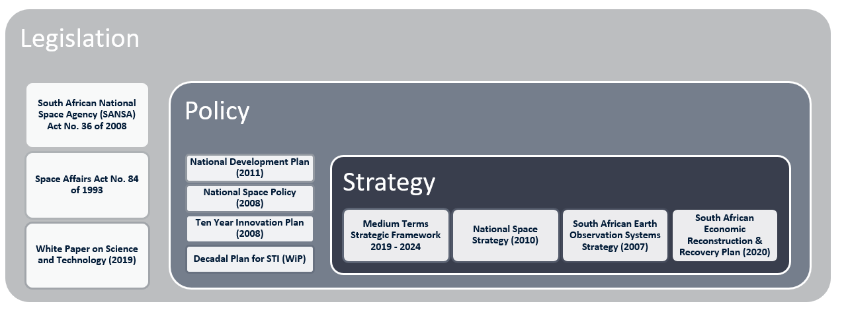
SANSA’s MANDATE
Schedule 3A Public Entity established on 1 April 2011
SANSA’s mandate is informed by several pieces of legislation, policy and strategy …

Slide 5
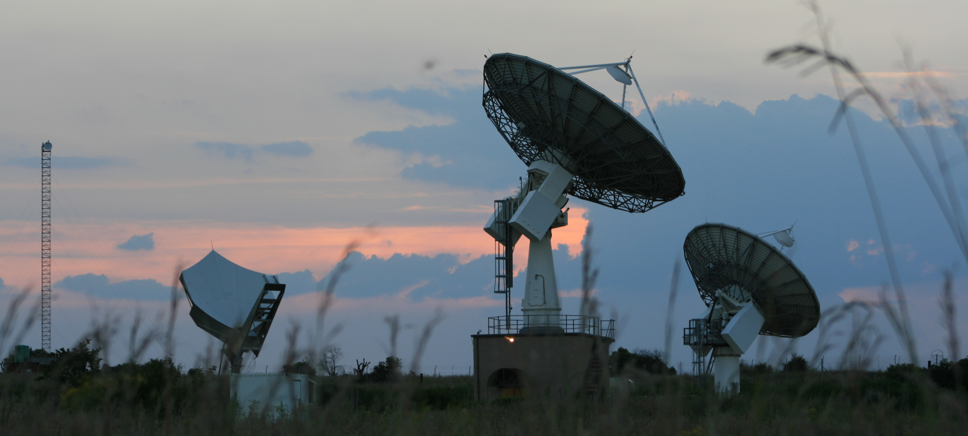
STRATEGIC CONTEXT

Slide 6


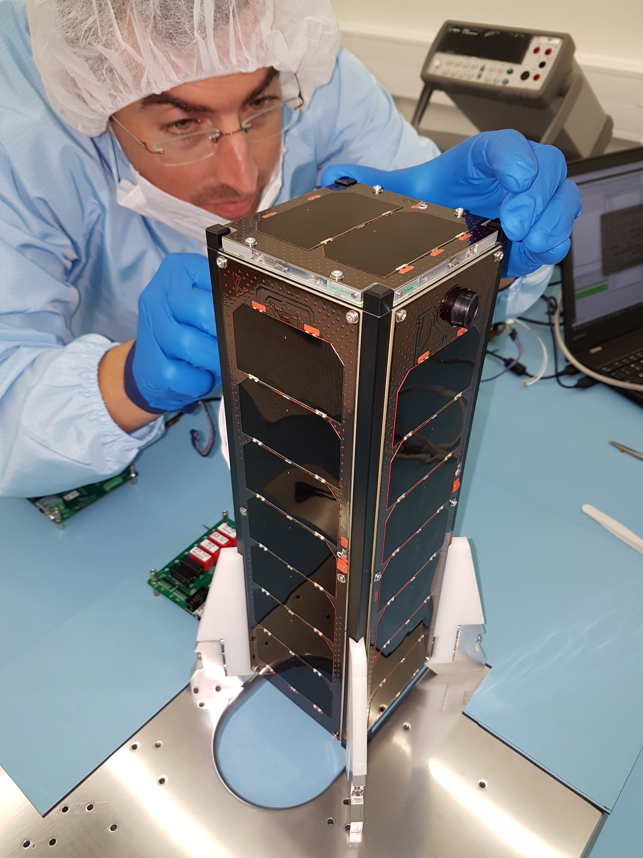

VISION
“An integrated National Space Capability that responds to socio-economic challenges in Africa by 2030”.
MISSION
“To provide leadership in unlocking the potential of Space for the advancement and benefit of humanity”.
6

Slide 7

IMPACT STATEMENT
“A sustainable South African space sector that contributes meaningfully to socio-economic development across the African continent”.
Key enablers:
Development of a fit-for-purpose and performance-driven organisation, and
Leveraging on strategic partnerships to mobilise resources.
The related key initiative:
  Outcome 4: SANSA positioned as a key enabler for the implementation of government's space-related policies.

Slide 8
REVISED ORGANISATIONAL VALUES
Customer - Centric
Everything we do is treated with a sense of urgency and agility
Collaboration and Teamwork
We accomplish so much more working together
Innovation and Solutions driven
No problem is too large for us – we find solutions
Responsive to Opportunities
Every opportunity is treated as a potential for growth for our future
Having fun together
We thoroughly enjoy what we do – it is fun to be at SANSA

Slide 9
2020-2025 STRATEGIC OUTCOMES

Slide 10
KEY STRATEGIC PRIORITIES FOR THE PLANNING PERIOD
Space Industry Development & Transformation
10

Slide 11





SANSA PROGRAMMES
1
Administration
1
2
2
Earth Observation
SANSA Programmes
3
3
Space Science
4
4
Space Operations
5
5
Space Engineering

Slide 12
STRATEGIC PRIORITIES INFORMING PLANNING FOR 2023/24
SANSA’s strategy is underpinned by several key success factors, including:
  Seeking Strategic partnerships and collaborations with national, African and International partners.
  Strategic positioning of SANSA’s programmes to enhance the Agency’s competitiveness within the local, African, and global space sector.
  Resource mobilisation strategies to ensure adequate financial and human resourcing of SANSA’s strategic initiatives to support full delivery against its mandate.
Strategic Projects for 2023/24 include:
  Development of the Space Infrastructure Hub (SIH).
  Progress towards a developed Matjiesfontein deep space facility.
  Progress towards an upgraded Assembly Integration and Testing (AIT) Facility.
12

Slide 13
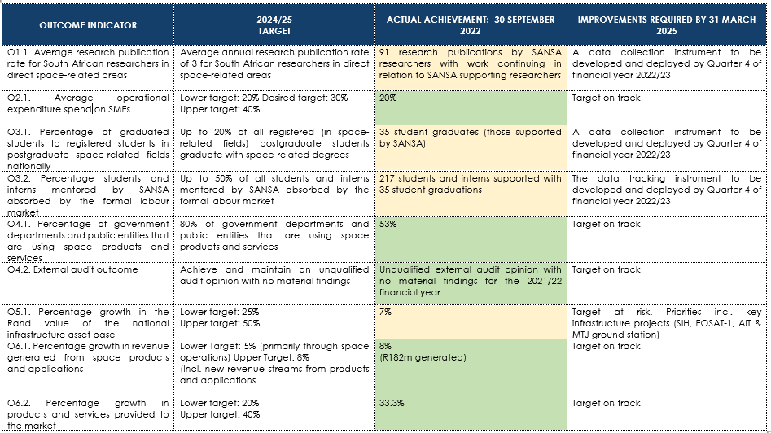
STRATEGIC PLAN 2020-2025 – MID-TERM REVIEW

Slide 14
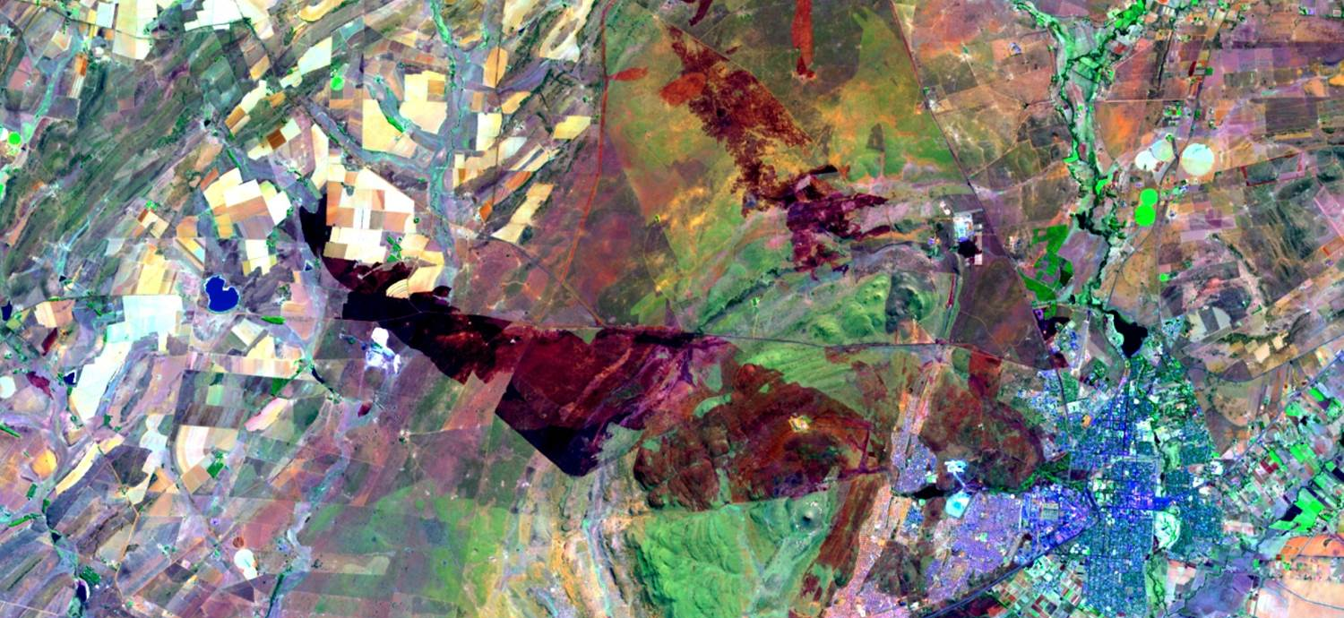
MEASURING PERFORMANCE
2023 / 2024 APP CONSOLIDATED
OUTPUT INDICATORS AND MEDIUM-TERM TARGETS

Slide 15
OUTPUT INDICATORS AND MEDIUM-TERM TARGETS
OUTCOME | OUTPUTS | OUTPUT INDICATORS | ESTIMATED PERFORMANCE | MTEF TARGETS
 |  |  | 2022/23 | 2023/24 | 2024/25 | 2025/26
Outcome 1 Increased space relevant knowledge that supports the developmental agenda | 1.1. National research and development output in space-related sciences | 1.1.1. National research productivity score for supported R&D | 1 445 | 1 500 | 1 600 | 1 700
Outcome 2 Stimulated and growing, inclusive space sector | 2.1. Targeted expenditure | 2.1.1. Percentage operational expenditure spend on SMEs (APP) | 30% | 30% | 32.5% | 35%
 | 2.2. SANSA space-related industry expenditure | 2.2.1. The total contract expenditure to the broad space-related industry for core space projects | R61 million | R647 million | R490 million | R93 million
Outcome 3 Increased human capacity for the implementation of key space initiatives | 3.1. Youth awareness of space-related sciences | 3.1.1. Number of youth directly engaged on space-related sciences | 37 250 | 45 000 | 50 000 | 60 000
 | 3.2. Students and interns supported | 3.2.1. Number of students and interns supported for formalised training | 72 | 72 | 72 | 80

Slide 16
OUTCOME | OUTPUTS | OUTPUT INDICATORS | ESTIMATED PERFORMANCE | MTEF TARGETS
 |  |  | 2022/23 | 2023/24 | 2024/25 | 2025/26
Outcome 4: SANSA positioned as a key enabler for the implementation of government's space-related policies | 4.1. High-performance initiatives | 4.1.1. Number of initiatives to transform SANSA into a high-performing agency | 2 | 3 (i) Implement Culture Improvement Plan (ii) Talent Management Framework; (iii) Development of a Values-Driven Performance Management System | 3 | 4
 | 4.2. Audit actions implemented | 4.2.1. Percentage implementation of External Audit Action Plan | 95% | 95% | 95% | 95%
 | 4.3. Joint space programme initiatives undertaken through partnerships | 4.3.1. Number of joint initiatives undertaken through formal international partnerships | 9 | 12 | 15 | 18
 |  | 4.3.2. Number of joint initiatives undertaken through formal African partnerships | 10 | 12 | 14 | 16
 |  | 4.3.3. Number of joint initiatives undertaken through formal National partnerships | 13 | 15 | 18 | 20
 | 4.4. Awareness and training to key users of space-related products and services | 4.4.1. Number of awareness and training interventions to key users of space-related products and services | 8 | 10 | 12 | 15
 | 4.5. Government departments and public entities using space products and services | 4.5.1. Number of additional government departments and public entities that are using space products and services | 10 | 10 | 10 | 10

Slide 17
OUTCOME | OUTPUTS | OUTPUT INDICATORS | ESTIMATED PERFORMANCE | MTEF TARGETS
 |  |  | 2022/23 | 2023/24 | 2024/25 | 2025/26
Outcome 5 Enabling infrastructure developed and maintained to support the space sector value chain | 5.1. Infrastructure developed or upgraded | 5.1.1. Development of the Space Infrastructure Hub (SIH) | Initiate acquisition of the Phase-1 mission system | 35% of SIH Phase 1 project plan executed | 54% of SIH Phase 1 project plan executed | 55% of SIH Phase 1 project plan executed
 |  | 5.1.2. Percentage progress towards a developed Matjiesfontein deep space facility | Cost benefit and proposal to government and funders Site establishment 20% | 35% of Matjiesfontein deep space facility project plan executed | 85% of Matjiesfontein deep space facility project plan executed | 100% of Matjiesfontein deep space facility project plan executed
 |  | 5.1.3. Percentage progress towards an upgraded AIT facility | 50% | *50% of upgraded AIT facility project plan executed | *100% of upgraded AIT facility project plan executed | Operational AIT facility
Outcome 6 Increased participation of the National Space Programme in the regional and global space market | 6.1. Space products and applications | 6.1.1. Number of products and applications | 7 | 7 | 7 | 8
 | 6.2. Revenue generated from space operations activities | 6.2.1. Rand value of total revenue generated from space applications and services | R70 million | R75 million | R80 million | R85 million

Slide 18
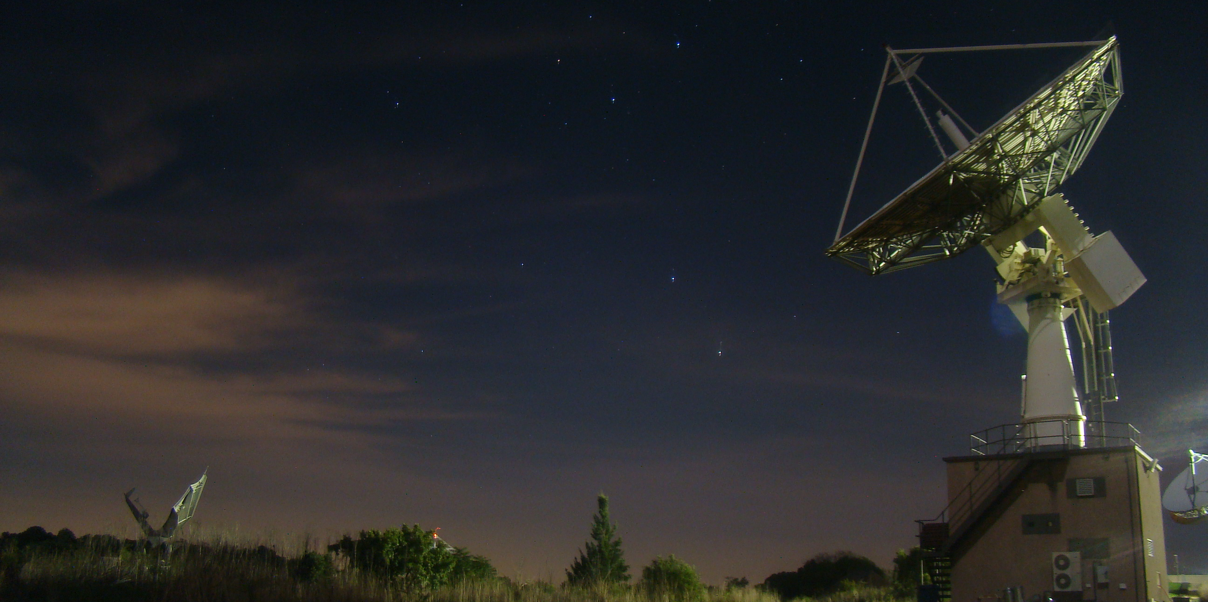
OPERATIONAL INFORMATION

Slide 19
HUMAN CAPITAL INFORMATION
EMPLOYMENT EQUITY PROFILE
EMPLOYMENT EQUITY PROFILE
Female
Male
108
102
108
WOMEN IN SCIENCE
38
(18%)
Female Youth
(<36 years old)
31
(15%)
Male Youth
(<36 years old)
49%
51%
Total Number of Employees : 210
19

Slide 20
EMPLOYMENT AND VACANCIES PER PROGRAMME
Programme | 2021/22 No. of employees | 2022/23 Approved Posts | 2022/23 No. of Employees | 2022/23 Vacancies | % of Vacancies
Administration | 44 | 68 | 63 | 3 | 4%
Earth Observation | 26 | 47 | 26 | 19 | 40%
Space Science | 73 | 74 | 65 | 9 | 12%
Space Operations | 56 | 56 | 46 | 7 | 13%
Space Engineering | 4 | 6 | 10 | 2 | 33%
TOTAL | 203 | 243 | 210 | 40 | 16%
The above table reflects the vacancy rate as a percentage of approved and funded positions. Budget constraints remain a reality in terms of filling vacancies in accordance with programme capacitation plans.

Slide 21
EMPLOYEE INFORMATION

Slide 22
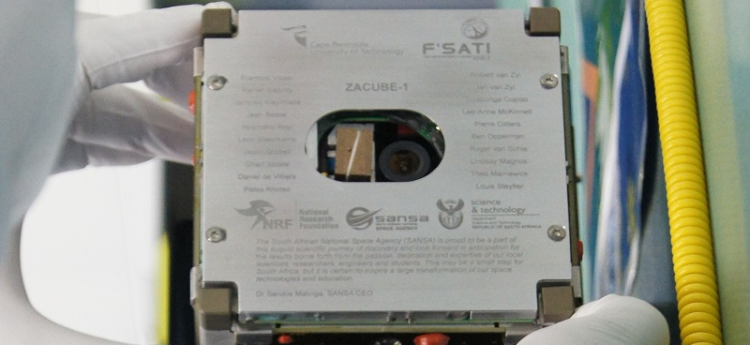
FINANCIAL OVERVIEW

Slide 23
MTEF OVERVIEW
23

Slide 24
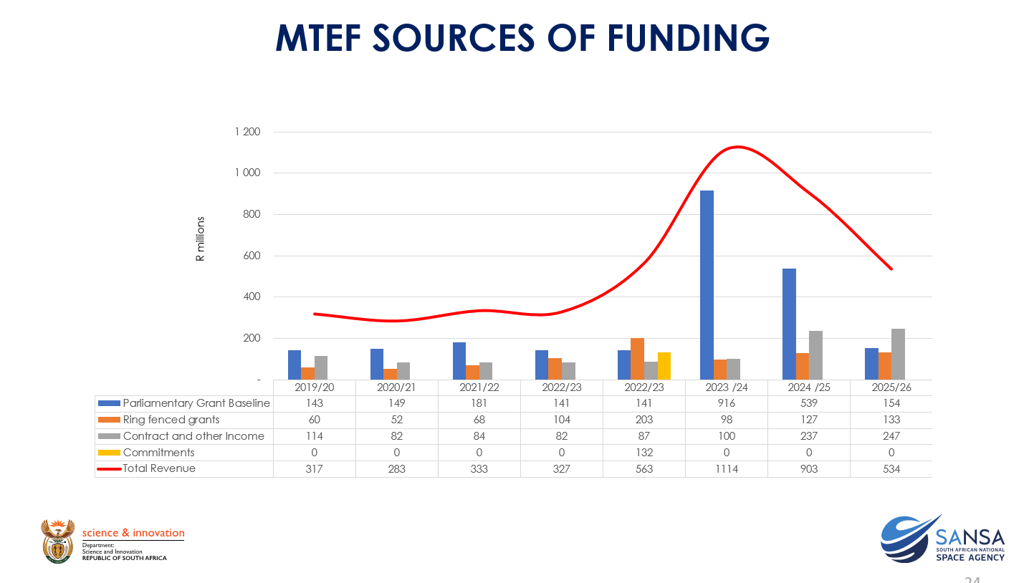
24

Slide 25
MTEF PROGRAMME BUDGET
25

Slide 26
MTEF: EXPENDITURE ESTIMATES
26

Slide 27
FINANCIAL NARRATIVE
MTEF allocation:
  the Parliamentary Grant baseline is expected to increase by 0.4% in 2023/24 and 4% p.a. thereafter;
  in addition, the PG baseline funding will include SIH funding of R775m and R434m in 2023/24 and 2024/25 respectively; and
  ring-fenced allocations totaling R68.3m are indicated over the MTEF period.
Revenue Sources:
  overall, revenue from exchange transactions is expected to increase from R88m in 2022/23 to R247m by 2025/26 owing to the inclusion of SIH revenue;
    the increase is mostly noticeable in Public Sector revenue that increases from R22.7m to R160m due to SIH over the same period;
    private sector income is estimated at R6.5m in 2023/24 and will increase by c. 4.5% p.a. thereafter; and
    foreign income is estimated at R61.8m in 2023/24 and will increase by c. 4.5% p.a. thereafter.
Grant funding:
  ring fenced grant income is expected to decrease from R203m in 2022/23 to R98m in 2023/24 as related projects come to an end;
  the lack of operational funding to sustain infrastructure after the development, remains a perennial challenge.
Expenditure:
  employee costs increase significantly in 2024/25 due to SIH and are expected to average R241m over the MTEF period;
  operating expenditure is expected to average R211m over the MTEF period, including SIH related items; and
  capital expenditure peaks at R758m in 2023/24 and reduces to R406m and R29m in the outer years as SIH construction is completed
27

Slide 28
CELEBRATION AND THE ROAD AHEAD

Slide 29
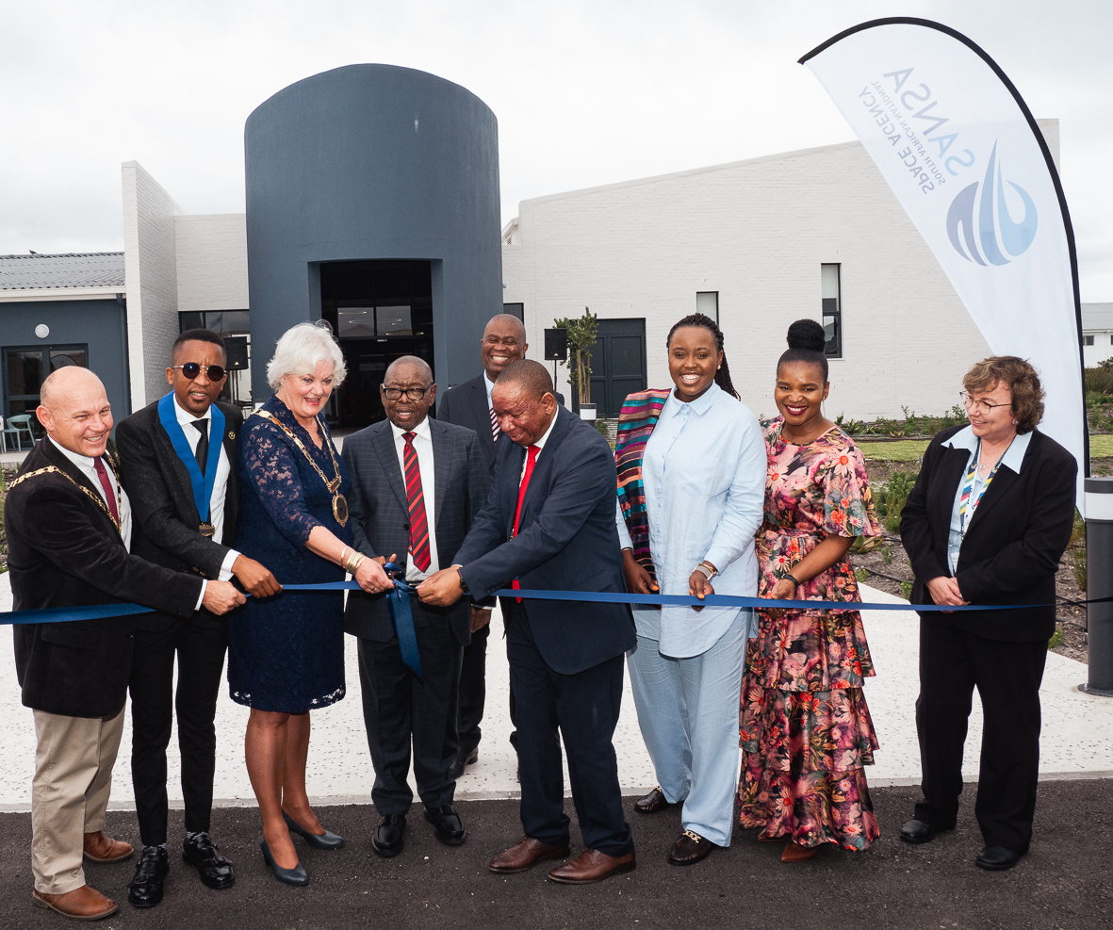
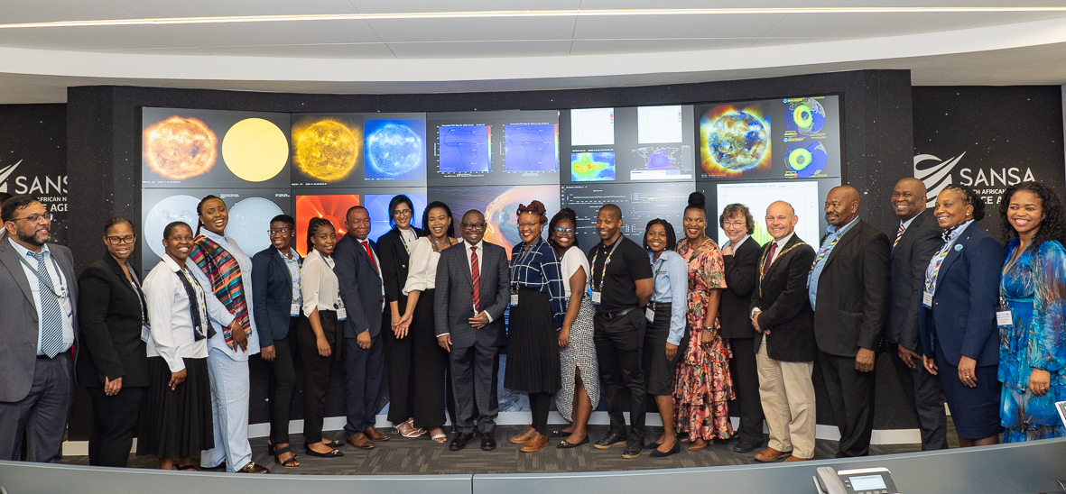
KEY CELEBRATIONS: SPACE WEATHER CAPABILITY LAUNCH
Space Weather Capability was officially launched on 3 November 2022
Extensive media coverage resulting in good visibility for SANSA
4 onsite stakeholder engagement days in November 2022
National and international presentations on the capability
Operational funding commitment received from DSI for 3 years

Slide 30
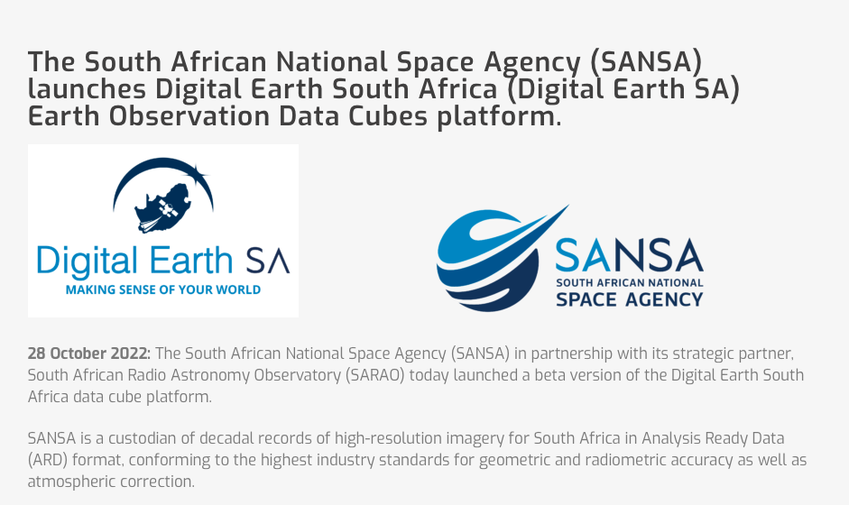
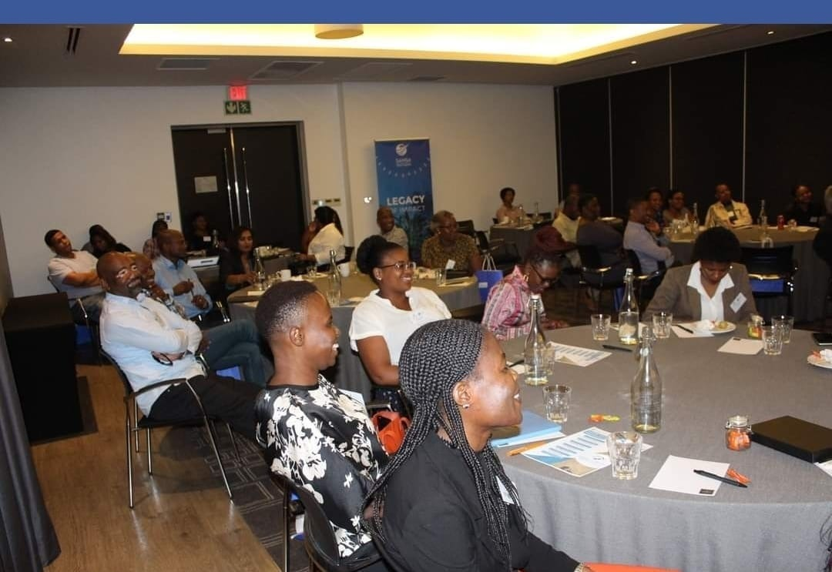
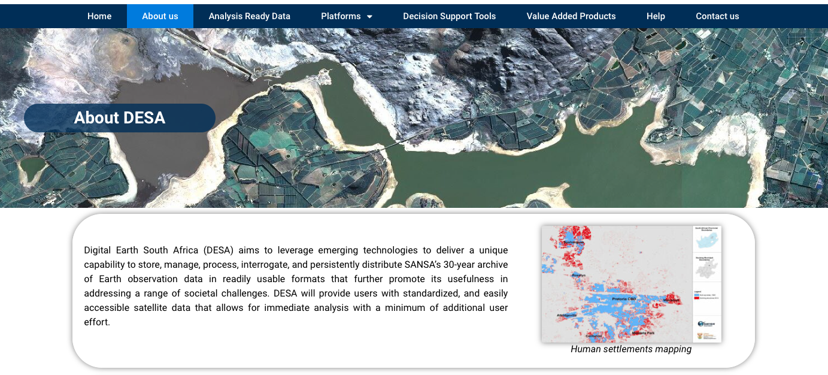
30
https://desa.sansa.org.za

Slide 31
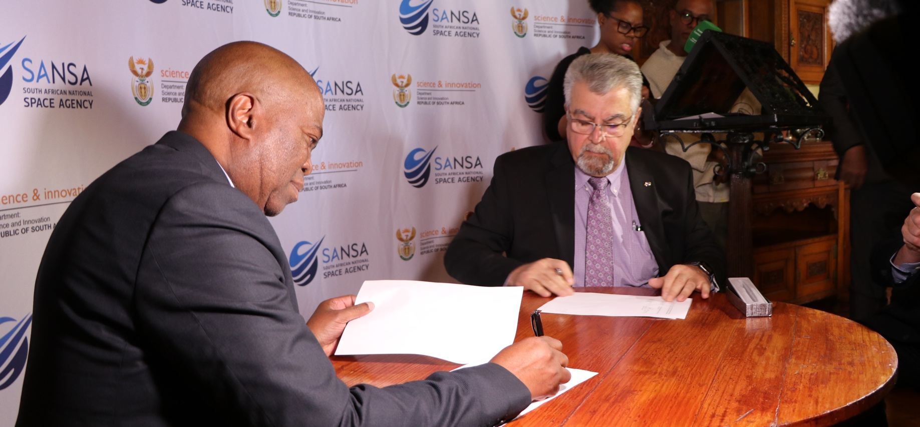
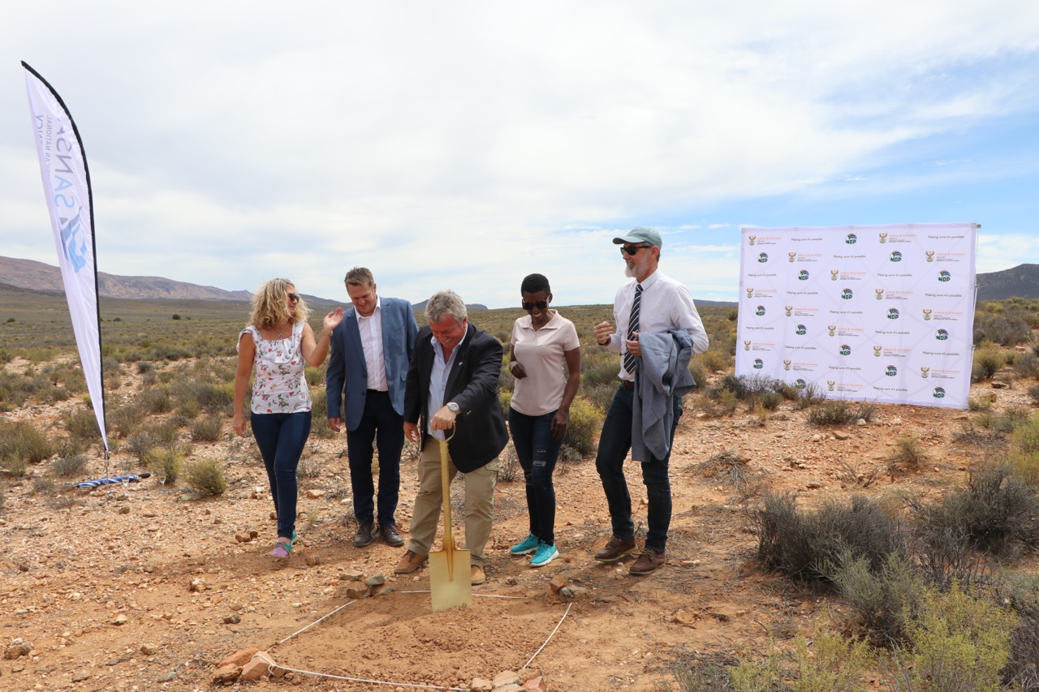
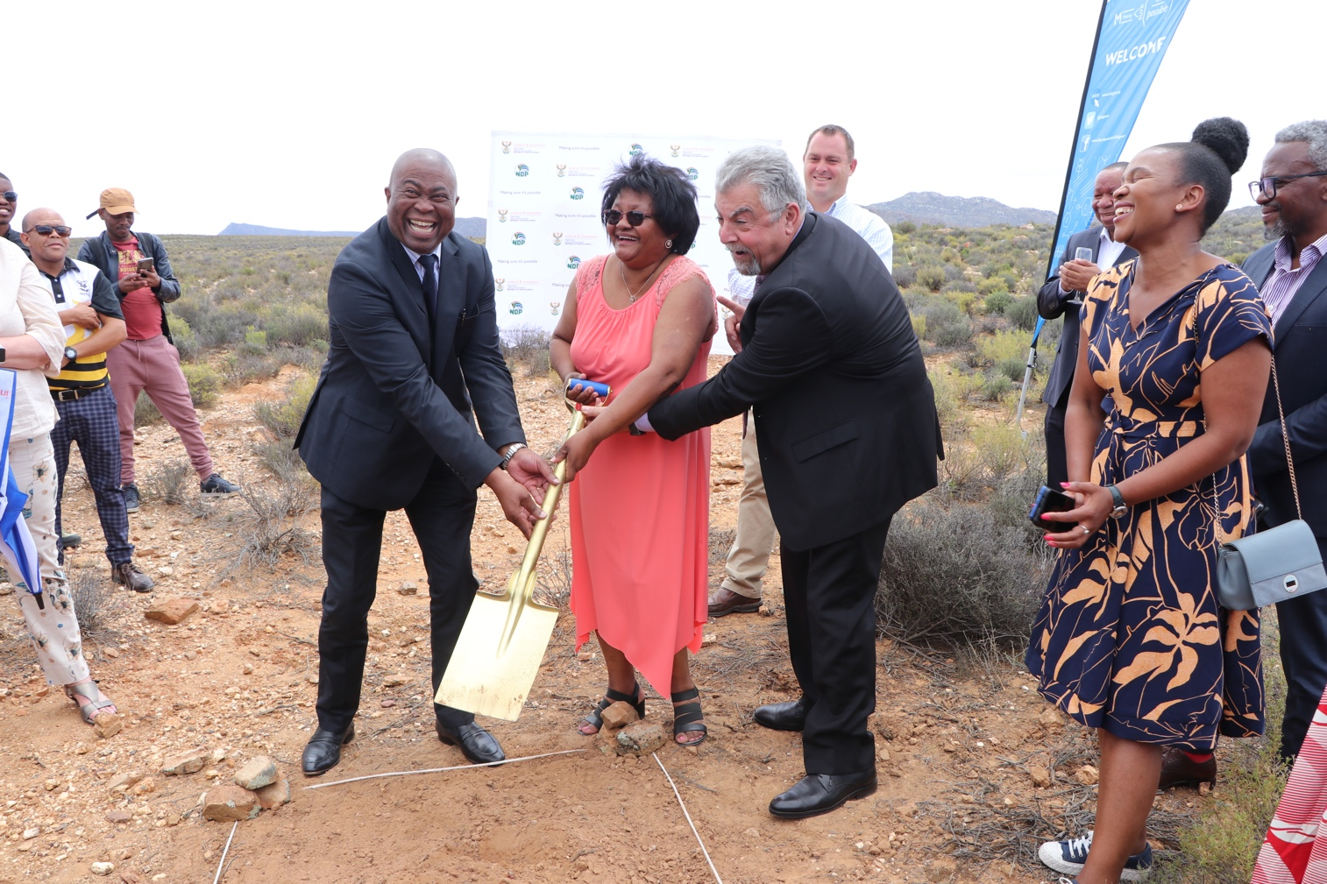
KEY CELEBRATIONS CONT… MATJIESFONTEIN DSN GROUNDBREAKING
A Day to remember
Signing of a historic agreement in a historic Town
DSI & NASA sign a long-awaited Agreement of intent
SANSA will implement the new Deep Space Ground station for SA
The Mayor of Laingsburg is ecstatic with the news
To be completed January 2025
31

Slide 32
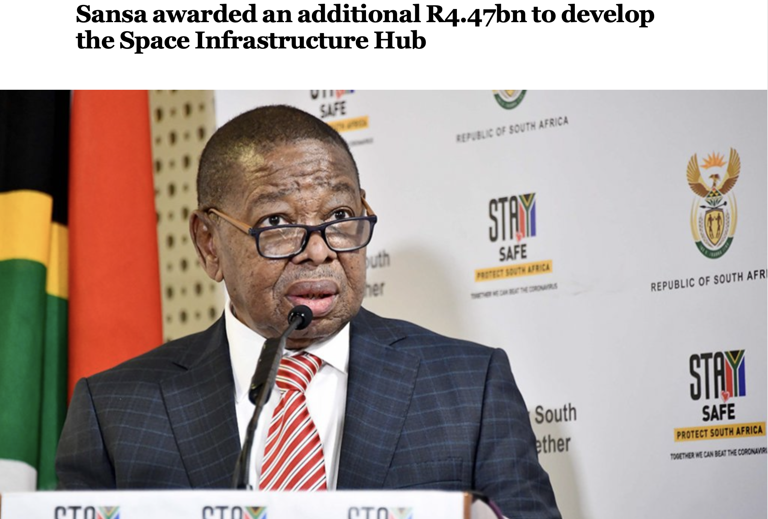
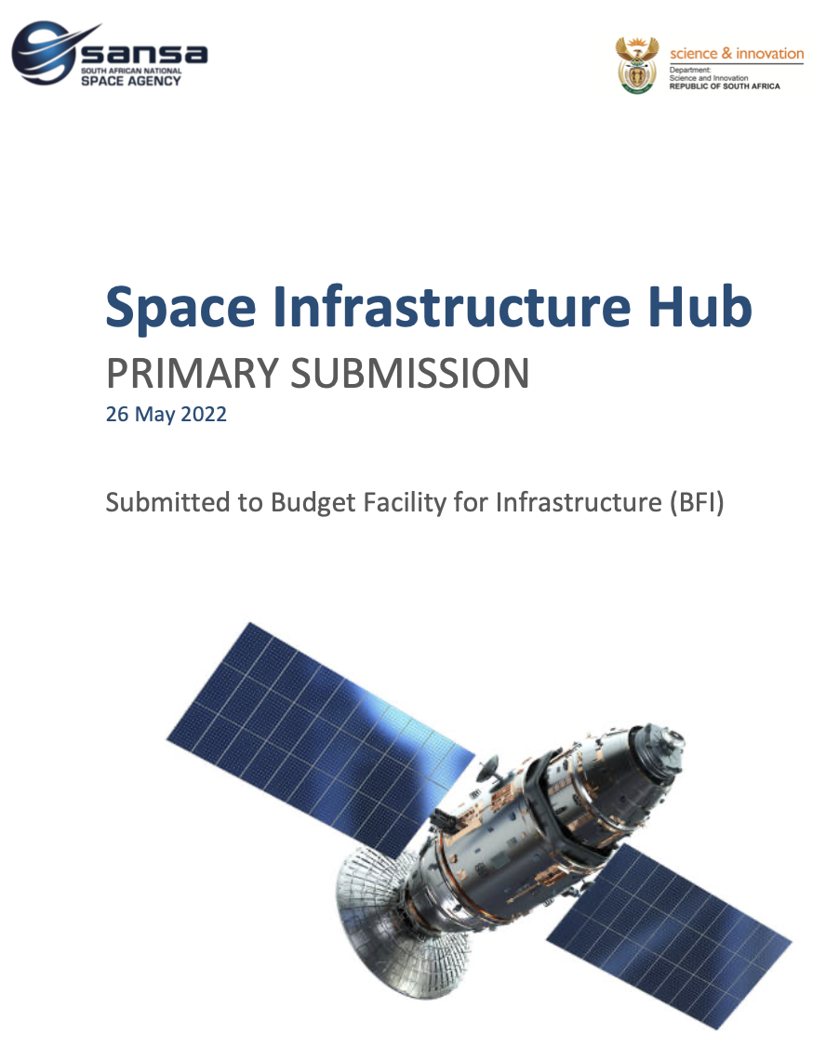
Space infrastructure hub
Received final assessment report
Provisional allocation of funding for Phase-1 (R1.2billion) received
  A supplementary submission addressing business case gaps which mainly related to the Cost Benefit Analysis (CBA) was made to the Budget Facility for Infrastructure (BFI) on 31 March 2023.
  SANSA awaits final approval.
32

Slide 33
SANSA INSTITUTIONAL REVIEW
In terms of the DSI Policy on Governance Standards for Science, Engineering And Technology Institutions (SETIs): Institutional Reviews of SETIs must be conducted every 3 to 5 years.
A retrospective review of SANSA (dating back to its inception) by an external panel of experts
Key considerations to include:
  Strategic positioning of SANSA’s programmes: considering the evolving global space landscape;
  Enhancement of SANSA’s role and capacity in terms of transformation of the sector;
  Utilisation of products / services by users across the space value chain; and
  SANSA’s impact on stakeholders and the community it is intended to serve.
Institutional Review Report submitted by the Review Panel and submitted to the DSI.
SANSA and DSI Management have considered the findings and recommendations.
The SANSA Board is to engage with Minister on the review panel findings and action plans to respond to the recommendations.
33

Slide 34
ORGANISATIONAL FOCUS
Building a SANSA that is relevant & responsive
Stabilisation of the entity: Transformational Leadership
Values – Driven Performance Management System
Increased alignment with priorities of government and the DSI
SANSA to take its rightful place in the Region and Continent
Improved SANSA visibility
SANSA appointed Mr Humbulani Mudau as the CEO: effective April 2023
34

Slide 35
ORGANISATIONAL FOCUS…CONT
Transfer and upgrade of the Assembly, Integration, and Testing (AIT) facility in Houwteq
Implementation of the Space Infrastructure Hub (SIH) Phase-1
Increase Africa-centred focus in accordance with the Agency’s vision for the 2020/25 strategic term
Implementation of SANSA’s organisational culture change initiatives
Provide research & development capability and facilitate the creation of products and applications to address society’s needs and challenges
Support the broader space industry through key infrastructure projects, including seek financing for EOSAT-1
Continued support to students and interns through formalised training to build a pipeline that can be absorbed by the formal labour market
Finalisation of the Institutional Review Action plan
35

Slide 36


Thank You

