Slide 1
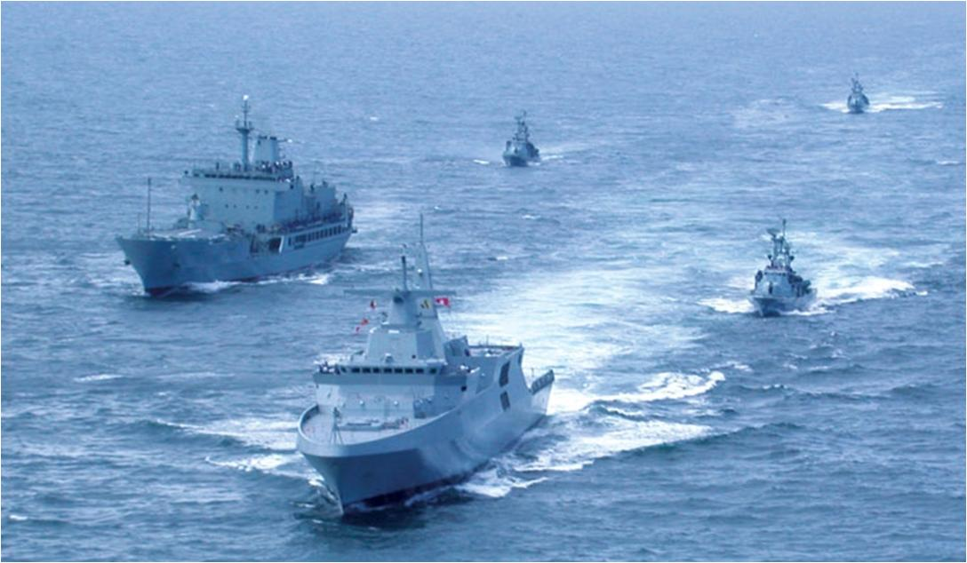
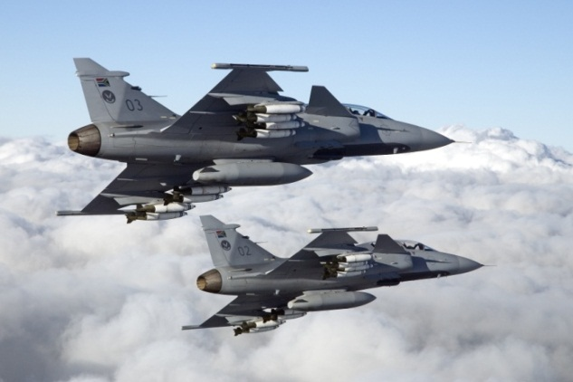
Presentation to the JSCoD&MV on the status of Projects contracted via ARMSCOR and the level of DOD satisfaction

Slide 2
AIM OF THE PRESENTATION
Presentation to the JSCoD&MV on the status of Projects contracted via ARMSCOR and the level of DOD satisfaction

Slide 3
INTRODUCTION
The Special Defence Account provides for the Acquisition of Defence Equipment and Strategic Armaments, the Maintenance of required Defence Capabilities and the financing of Sensitive Defence Activities.
Special Defence Account (SDA)
Strategic Capital Acquisition Master Plan (SCAMP)
Sensitive Projects
1. Army Acquisition
2. Air force Acquisition
3. Naval Acquisition
4. Common Weapons Acquisition:
SF
SAMHS
CMI
5. Technology Development
1. Defence Intelligence
2. Military Police Agency
3. Special Forces
Folio 02 Funding at Services & Divisions
1. SA Army
2. SA Air Force
3. SA Navy
4. SA Mil Health Services
5. CJ Ops

Slide 4
SCOPE
Status and the level of satisfaction of Capital Projects contracted via ARMSCOR
Status and the level of satisfaction of Technology Projects contracted via ARMSCOR
Level of SAN satisfaction with Armscor Dockyard performance
Conclusion
Discussion

Slide 5
STATUS AND LEVEL OF SATISFACTION OF CAPITAL PROJECTS CONTRACTED VIA ARMSCOR (SA ARMY)
Legend:
On Schedule | 1
At Risk | 5
Delayed | 4
10%
50%
40%

Slide 6
STATUS AND LEVEL OF SATISFACTION OF CAPITAL PROJECTS CONTRACTED VIA ARMSCOR (SA AIR FORCE)
Legend:
On Schedule | 10
At Risk | 0
Delayed | 4
71%
0%
29%

Slide 7
STATUS AND LEVEL OF SATISFACTION OF CAPITAL PROJECTS CONTRACTED VIA ARMSCOR (SA NAVY)
Legend:
On Schedule | 7
At Risk | 1
Delayed | 0
89%
11%
0%

Slide 8
STATUS AND LEVEL OF SATISFACTION OF CAPITAL PROJECTS CONTRACTED VIA ARMSCOR (COMMON WEAPONS)
Legend:
On Schedule | 10
At Risk | 0
Delayed | 2
83%
0%
17%

Slide 9
STATUS AND LEVEL OF SATISFACTION OF TECHNOLOGY PROJECTS CONTRACTED VIA ARMSCOR
Programme | Ser No | Proj Name | Description | Status
 |  | a | b | c
Landward | 1 | UBUNTU | SPECIAL FORCES DEFENCE EVALUATION AND RESEARCH INSTITUTE (DERI) | Approved PD (17 Nov 2021)
 | 2 | TANGENT: REPOSE 1 | BALLISTICS MODELLING, PROJECTILE DESIGN, WITH MULTIFUNCTION CAPABILITY, SIMULATION OF ENGAGEMENT SCENARIO | Approved PD (30 Nov 2022): Order In Process
 | 3 | TANGENT: REPOSE 2 | ESTABLISHMENT OF AMMUNITION TECHNOLOGY | Approved PD (30 Nov 2022): Order In Process
 | 4 | TANGENT : ILLUSION 1 | WEAPON SYSTEM LAUNCH RESPONSE (ARTILLERY) | Approved PD (26 Jan 2022)
 | 5 | TEMPLATE: SCIENCE 1 | DEVELOPMENT OF ARMOUR PROTECTION TECHNOLOGY | Approved PD (19 Nov 2021)
 | 6 | TEMPLATE: CRITICAL ANGLES | DEVELOPMENT OF A DATABASE CONTAINING PERFORMANCE OF ARMOUR STEEL AGAINST SMALL ARMS THREATS | Approved PD (19 Nov 2021)
 | 7 | TEMPLATE: REFLEX | SIGNATURE MANAGEMENT | Approved PD (30 Nov 2022): Order In Process
 | 8 | KONYA | LANDWARD DEFENCE EVALUATION AND RESEARCH INSTITUTE (DERI) | Approved PD (17 Nov 2021)
Supp Ops | 9 | ROMULUS: HOLSTER | CHEMICAL AND BIOLOGICAL DEFENCE EVALUATION AND RESEARCH INSTITUTE (DERI) | Approved PD (17 Nov 2021)
 | 10 | STACKED: EMBRACE | ERGONOMICS DEFENCE EVALUATION AND RESEARCH INSTITUTE (DERI) | Approved PD (17 Nov 2021)
Aerospace | 11 | DUCE: STORM | MAINTENANCE OF TEST AND EVALUATION CAPABILITIES TO SUPPORT SANDF (OTR): FUNDED FOR ALL DOD T&FP EXERCISES | Approved PD (29 Sep 2022)
 | 12 | DUCE: PREY | LOW COST TARGET DRONE | Approved PD (29 Sep 2022)
 | 13 | VENTURE: CHEVRON 1 | AEROSPACE DEFENCE EVALUATION AND RESEARCH INSTITUTE (ADERI) | Approved PD (29 Sep 2022)
 | 14 | LOBBY: ARIES II | HOSTILE FIRE INDICATOR FOR HELICOPTERS | Approved PD (2018)
 | 15 | LOBBY: PROXIMA | AIRBORNE EW COMMUNICATIONS | Approved PD (06 Apr 2022)
 | 16 | LOBBY: POLLUX | AIRBORNE ESCORT JAMMER | Approved PD (07 Dec 2021)
 | 17 | PROJECTION: TENOR | GUIDED WEAPON TECHNOLOGY (ROCKET MOTOR AND WARHEAD TECHNOLOGY RESEARCH) | Approved PD (15 Jun 2022)
Maritime | 18 | FLAGG: PIEBALD | MARITIME DEFENCE AND EVALUATION RESEARCH INSTITUTE (MDERI) | Approved PD (09 Dec 2021)
 | 19 | PROSPECTIVE: PRIMROSE | DEVELOPMENT OF BROADBAND UNDERWATER DATA COMMUNNICATION (BUDC) INTO TECHNOLOGY DEMONSTRATOR AND SYNTHETIC APERTURESONAR (SAS) SOFTWARE | Approved PD (09 Dec 2021)
 | 20 | PROSPECTIVE: 30MM RCWS | DEVELOPMENT OF A PEDESTAL FOR 30MM NAVAL APPLICATIONS | Approved PD (16 Oct 2019)
 | 21 | PROSPECTIVE: TESS | TOWER ESCAPE SAFETY SYSTEM (SUBMARINE) | Approved PD (09 Dec 2021)
Electronics | 22 | INDICATE: CHEVRON 3 | ELECTRONIC DEFENCE EVALUATION AND RESEARCH INSTITUTE (E-DERI) | Approved PD (12 Jan 2022)
 | 23 | INDICATE: CNR | ELECTRONIC DEFENCE EVALUATION AND RESEARCH INSTITUTE (E-DERI) | Approved PD (01 Sep 2021)
 | 24 | INDICATE: PERSEVERENCE | COMMUNICATION (COMBAT NET RADIOS) | Approved PD (12 Jan 2022)
 | 25 | INDICATE: CRYPTO | COMMUNICATION INTELLIGENCE AND COMMUNICATION JAMMING (COMINT-COMJAM) | Approved PD (01 Sep 2021)
 | 26 | INDICATE: C2TECH | INFORMATION SYSTEMS SECURITY | Approved PD (27 Jul 2022)
 | 27 | INDICAT: MRSR | JOINT COMMAND AND CONTROL | Approved PD (10 Aug 2022)
 |  | Highly Satisfied: Relating to order placed
 |  | Moderately Satisfied: Relating to order placed longer than 90 days after PD approval
 |  | Unsatisfactory: Relating to order not placed yet

Slide 10
LEVEL OF SAN SATISFACTION WITH ARMSCOR DOCKYARD PERFORMANCE
SAN is not 100% satisfied with the output of Armscor Dockyard
The SAN has resourced the Dockyard as far as possible
Armscor Dockyard was advised and authorised to source partnerships with local Defence Industry to capacitate itself

Slide 11
CONCLUSION
DOD Level of satisfaction with Capital Projects and Technology Projects Allocated to ARMSCOR
DESCRIPTION | CAPITAL PROJECTS | TECHNOLOGY PROJECTS | TOTAL | % | CODE
Satisfied | 28 | 9 | 37 | 52
Unsatisfactory | 6 | 13 | 19 | 27
Dissatisfied | 10 | 5 | 15 | 21
TOTAL | 44 | 27 | 71

Slide 12

Questions/Discussion

Slide 13
STATUS AND LEVEL OF SATISFACTION OF CAPITAL PROJECTS CONTRACTED VIA ARMSCOR
Legend:
On Schedule
At Risk
Delayed

Slide 14
STATUS AND LEVEL OF SATISFACTION OF CAPITAL PROJECTS CONTRACTED VIA ARMSCOR(Cont)
Legend:
On Schedule
At Risk
Delayed

