Slide 1
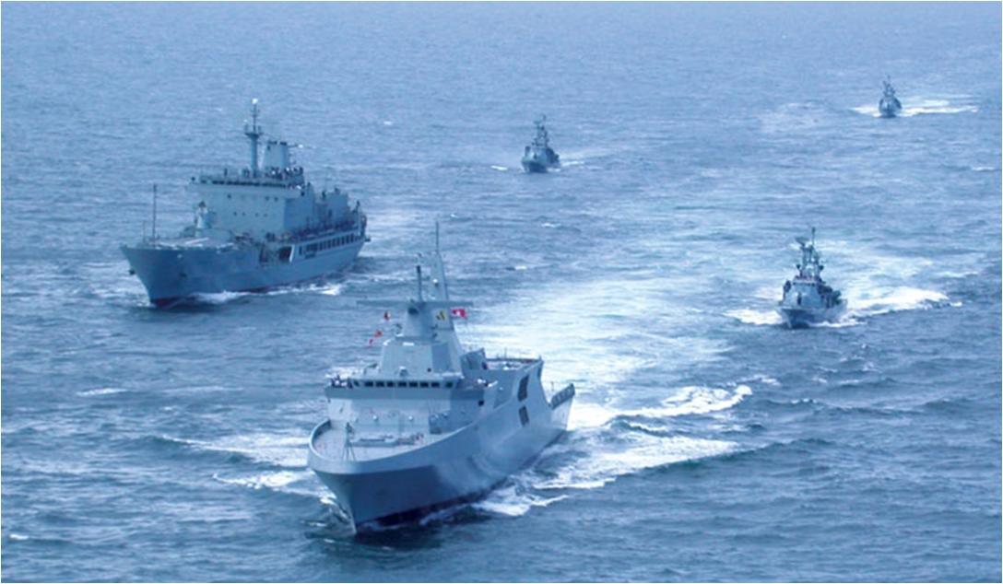
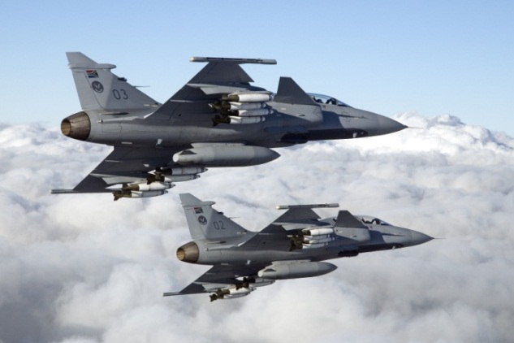
Feedback to the Joint Standing Committee on Defence on the outcomes of the DoD workshop with Armscor on spares and maintenance

Slide 2
INTRODUCTION
ARMSCOR presented Initiatives to Improve Spares Availability for SANDF Prime Mission Equipment to the JSC on Defence (Mar 2023)
It was observed that the above presentation was not aligned with the current realities ito PME serviceability
The JSC on Defence advised that ARMSCOR and the DoD (DMD) had to conduct an workshop, which was initially planned, to find alignment
This workshop was conducted from 2-5 Apr 2023, between ARMSCOR, DMD and the Services
Workshop culminated in the drafting of an agreed Action Plan between ARMSCOR and the DoD.
This presentation focusses on the aspects that are linked to the improvement of spares and maintenance availability (executive summary of the linked outcomes)

Slide 3
AIM OF THE PRESENTATION
To provide feedback to the Joint Standing Committee on Defence regarding the outcome of the DoD/ARMSCOR workshop addressing spares and maintenance

Slide 4
SCOPE
Introduction
Aim of the presentation
DOD/ARMSCOR Workshop Action Plan
ARMSCOR position on the Way Forward
Conclusion
Discussion

Slide 5
DOD/ARMSCOR WORKSHOP ACTION PLAN
S No | Areas of Concern | Agreed Resolutions | Responsible | Timeline
 | a | b | c | d
01 | DOD/ARMSCOR Service Level Agreement: SLA performance measures is based on Averages. SLA performance measures is designed to measure quantities of processes performed | Add Acquisition Performance Measure to SLA not designed on Averages, but on deliverables/output Technology Development Performance Measures are also to be included in the SLA Consultative evaluation of Armscor’s performance, focusing on all aspects of Armscor’s business (Corrective actions and consequence management) | DMD/Armscor | Dec 2023
02 | Armscor Supplier database: Supplier database expansion | The Armscor supplier database to be expanded and constantly updated (Increase Spares and Maintenance and Repair (M&R) availability) - Tool | Armscor | Continuous

Slide 6
DOD/ARMSCOR WORKSHOP ACTION PLAN
S No | Areas of Concern | Agreed Resolutions | Responsible | Timeline
 | a | b | c | d
03 | Contracting Timelines: Protracted timeline for placing orders/contracts for Spares and M&R | Adopt D-Day system for the placing of contacts, until final delivery and payment of Invoices (For spares and M&R) Monitoring of progress through bilaterals, Armscor/DMD forums | Armscor | May 2023
04 | Contract Management: No urgency to solve disputes with contractors affecting operational availability Contracting challenges for Special Forces regarding security, PPPFMA/BBBEE | Include punitive penalties/termination clauses, coupled to timelines in the event of non performance by suppliers in contracts. Implement both procedural and substantive measures in accordance with the contract Sole Suppliers be considered for the Special Forces environment including Security contracts (uniqueness of equipment and security reasons) | DMD/Armscor | Continuous

Slide 7
DOD/ARMSCOR WORKSHOP ACTION PLAN
S No | Areas of Concern | Agreed Resolutions | Responsible | Timeline
 | a | b | c | d
05 | Requirement Processing: Late submission of requirements by End Users Delayed submission of execution plans and dates | End Users to submit their requirements at the beginning of the financial year, or even pre-commit Armscor to submit execution plan in 14 days as per SLA Monitor the implementation of the execution plans through formal and informal engagements Implement corrective actions and provide continues feedback to the End User | Service/ Divisions Armscor/DMD | Immediate Immediate

Slide 8
DOD/ARMSCOR WORKSHOP ACTION PLAN
S No | Areas of Concern | Agreed Resolutions | Responsible | Timeline
 | a | b | c | d
 | Requirement Processing: (Continue) Committed Rollovers generated Poor performance of the Defence Industry Requirement delivery, distribution and processing records management | Committed Roll-overs to be managed with Services and Divisions (Consequence management where applicable) Include strict penalty/termination clauses in contracts (with timelines) Identify alternative suppliers pre-emptively once poor performance is registered Design/develop and implement an electronic tracking system, inclusive of an automated early warning function (visible to all stakeholders in the DoD) | Armscor/DMD Armscor DMD/Armscor/Services and Divisions | Sep 2023 Continuously Oct 2023

Slide 9
DOD/ARMSCOR WORKSHOP ACTION PLAN
S No | Areas of Concern | Agreed Resolutions | Responsible | Timeline
 | a | b | c | d
06 | Time Delays: DMD to Armscor submission processing Long lead times for CJ Ops and Special Forces operational requirements | Requirements to be processed within 72 hours (where possible) Investigate a special process required for CJ Ops and Special Forces requirements | DMD Armscor | Immediate

Slide 10
DOD/ARMSCOR WORKSHOP ACTION PLAN
S No | Areas of Concern | Agreed Resolutions | Responsible | Timeline
 | a | b | c | d
07 | Early Warning with little or no chance for alternative actions: Early warning ito of late delivery (specifically GDA – commodities, spares, consumables) | All efforts should contribute to expedited delivery of spares and M&R requirements Supplier capacity to deliver should be verified prior to order placement Implement contract termination clauses Armscor to expedite the conclusion of new orders (on condition that the URS is received on time) | Armscor/DMD | Annually (Sep)

Slide 11
DOD/ARMSCOR WORKSHOP ACTION PLAN
S No | Areas of Concern | Agreed Resolutions | Responsible | Timeline
 | a | b | c | d
08 | Reliance on OEM and suppliers: Over reliance on OEM Appointment of the same non-performing supplier multiple times | OEM to provide authority to source alternative suppliers (in time) Investigate re-engineering option within the industry (obsolescence management) Keep track of non-performance by suppliers (History) Include in the bid evaluation criteria Pursuit litigation procedures | Armscor/DMD/ Services | Continuous

Slide 12
ARMSCOR POSITION ON THE WAY FORWARD
Procurement of spares should become proactive rather than reactive.
Requirements for spares to be provided early in the financial year – preferably before the start of a financial year.
Phasing of operating funds should be provided to coincide with the lead times of long lead spares – to allow payment for the spares in future financial years if required.
Procurement of spares of equipment for which Denel is the OEM and cannot provide the spares to be contracted to other entities with the requisite engineering and financial abilities (data Packs should be made available to bidding entities, together with sufficient agreements to protect any Denel IP)
Umbrella agreements to be negotiated with OEM's, accompanied by umbrella approval by Armscor BOD, to facilitate quicker turnaround times of spares procurement (similar to umbrella agreements for ammunition)
The key to in-time on-time availability of critical spares, is pro-active identification of spares requirements and early start of associated procurement processes.
Umbrella agreements with local and foreign spares providers to be concluded, based on predicted future requirements and rates of requirements.
SANDF to provide Armscor with multi-year funded requirements for spares.

Slide 13
CONCLUSION
DoD (DMD) and Armscor has reached synergy, and will implement the outcomes to improve the availability spares and M&R contracts that will ultimately lead to the improvement of force readiness levels of the SANDF
Question remains if Armscor is capacitated to comply to its mandate and furthermore if the Industry is in a position to support the sustainment of the SANDF?

Slide 14
Questions/Discussion

