Slide 1

CSIR
SHAREHOLDER’S COMPACT
2023/24

Slide 2
Presentation Outline
  Chairman’s overview
  CSIR mandate and strategic focus
  Key performance indicators (KPIs)
  Key strategic initiatives
  Human capital initiatives
  Key infrastructure projects
  Financial sustainability and good governance

Slide 3
Chairman’s overview
Our strategy to intensify industrialisation in South Africa is aligned with national priorities in the Decadal Plan, Economic Recovery and Reconstruction Plan and the National Development Plan
We are a critical player in the National System of Innovation to commercialise and translate intellectual property (IP) for impact in industry, government and society
The macro and micro economic climate, characterised by geopolitical instability, low domestic economic growth (<1.5% in 2022 and 2023), decline in Parliamentary Grant in real terms, and increasing labour and utility costs pose a significant risk to long-term sustainability
Competition for experienced scientists and engineers remains a challenge to building competitive capabilities in strategic areas of the organisation
An ageing infrastructure base, compounded by lack of capital investment, could derail the organisation’s ability to create impact in the long term
In 2023/24, the organisation aims to implement its new commercialisation model, continue with our focused impact on key strategic sectors of the South African economy, develop and implement solutions for government and grow our position internationally through contract research and development (R&D)

Slide 4
CSIR MANDATE AND STRATEGIC FOCUS

Slide 5

Our mandate
“The objects of the CSIR are, through directed and particularly multidisciplinary research and technological innovation, to foster, in the national interest and in fields which in its opinion should receive preference, industrial and scientific development, either by itself or in co-operation with principals from the private or public sectors, and thereby to contribute to the improvement of the quality of life of the people of the Republic, and to perform any other functions that may be assigned to the CSIR by or under this Act.”
(Scientific Research Council Act, 1988 (Act 46 of 1988, amended by Act 27 of 2014)

Slide 6

Vision and mission
MISSION
Collaboratively innovate and localise technologies, while providing knowledge solutions for the inclusive and sustainable advancement of industry and society.
VISION
We are accelerators of socioeconomic prosperity in South Africa through leading innovation.

Slide 7




Our EPIC values
EXCELLENCE
We strive for excellence and quality in everything that we do. We hold each other accountable to the highest standards and invest in continuous development of our people, processes and ways of doing business.
PEOPLE-CENTRED
Our business is about touching lives. We respect diversity and conduct ourselves in a manner that upholds the dignity of every person. We treat all our stakeholders the way we like to be treated.
INTEGRITY
We act with integrity.
We respect the trust that our colleagues and stakeholders place in us, and commit to ethical decision-making, delivery and governance.
COLLABORATION
We are keen to learn from one another and collaborate across the organisation and with external partners to ensure that our work has the best chance of innovating a better future for South Africans.
7

Slide 8




Our strategic intent
GROWTH
Refers to inclusive and dual
growth for the country and
the CSIR. The CSIR will use its capabilities in, e.g., skilled human capital and infrastructure to assist in growing the economy; but will also grow to become a world-class organisation.
SUSTAINABILITY
Focuses on CSIR-developed
technologies that lead to the advancement and sustainability of South African enterprises and the financial
sustainability of the organisation in a resource-constrained environment.
IMPACT
Focuses on the commercialisation of our technologies and innovations for industrial development, as well as technology and knowledge transfer that enable a capable state.
RELEVANCE
Addresses the CSIR’s role in driving the relevance of innovation in inclusive sustainable industrial development and the creation of a capable state.

Slide 9





Strategic objectives
  SO1
  Conduct R&D of transformative technologies
  and accelerate their diffusion.
  SO2
  Improve the competitiveness of high-impact industries to support South Africa’s re-industrialisation by collaboratively developing, localising and implementing technology.
  SO3
  Drive socioeconomic transformation through research, development and innovation (RDI) that supports the development of a capable state.
  SO4
  Build and transform human capital and infrastructure.
  SO5
  Diversify income and maintain financial sustainability and good governance.

Slide 10





Pillars of the CSIR strategy
  STRATEGIC CLUSTERS
  Delivering the CSIR Strategic Objectives
  HUMAN CAPITAL DEVELOPMENT
  Development of relevant skills to support industrial development
  STRATEGIC INFRASTRUCTURE
  Infrastructure to strengthen scientific and industrial development
  CAPABILITY DEVELOPMENT
  Investing in a relevant, future-facing portfolio of strategic offerings
  ENABLING SUPPORT
  Support that is agile, digitally enabled, efficient, cost-effective and fit for purpose

Slide 11









CSIR STRATEGIC CLUSTERS
Positioned to drive South Africa’s industrialisation
Advanced Agriculture and Food
Improve production through precision agriculture; add value and reduce waste through advanced (agro) processing
Future Production: Chemicals
Strengthen local pharmaceutical, chemical and other industries through advanced product, process and materials development
NextGen Health
Strengthen South Africa’s health security by locally developing vaccines, biologics and precision-medicine based treatments
Advanced Chemistry and Life Sciences
INDUSTRY ADVANCEMENT CLUSTERS
DIVISIONS
Future Production: Manufacturing
Enhance manufacturing industry competitiveness through digital transformation and 4IR technologies
Future Production: Mining
Support the growth and revitalisation of the mining industry
Defence and Security
Build resilient defence and security capabilities in support of national security imperatives
Advanced Production and Security
Smart Places
Enable smarter natural resource use, environmental sustainability and smart infrastructure
Smart Mobility
Enable South Africa to have an efficient, effective, integrated, safe and competitive Transport and Logistics sector
NextGen Enterprises and Institutions
Enable digital transformation in government, public institutions and industry
INDUSTRY AND SOCIETY-ENABLING CLUSTERS
Smart Society
DIVISIONS

Slide 12
KEY PERFORMANCE INDICATORS

Slide 13


SO1: Conduct RDI of transformative technologies and
accelerate their diffusion
KPI | 2021/22 Actual | 2022/23 Target | 2023/24 Target
KPI 1: Publication equivalents | 422.5 | 304.5 | 408
KPI 2: New priority patent applications filed | 7 | 7 | 8
KPI 3: New patents granted | 16 | 6 | 8
KPI 4: New technology demonstrators | 55 | 54 | 56
KPI 5: Number of technology licence agreements signed | 12 | 18 | 18

Slide 14
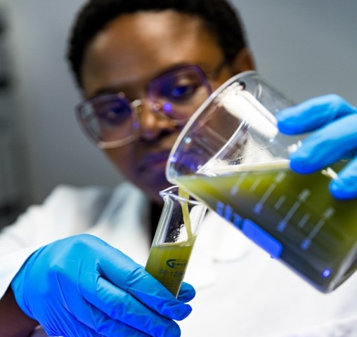
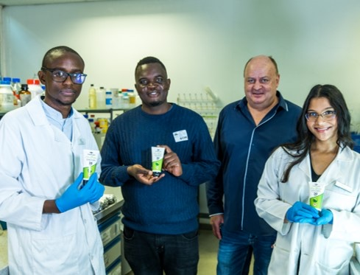
SO2: Collaboratively improve the competitiveness of high-
impact industries to support SA’s re-industrialisation
KPI | 2021/22 Actual | 2022/23 Target | 2023/24 Target
KPI 6: Number of localised technologies | 14 | 11 | 15
KPI 7: Number of joint technology development agreements being implemented for industry | 25 | 27 | 30
KPI 8: Number of SMMEs supported | 99 | 72 | 90

Slide 15
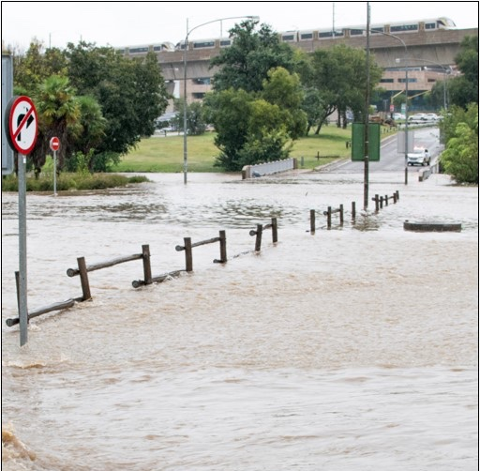
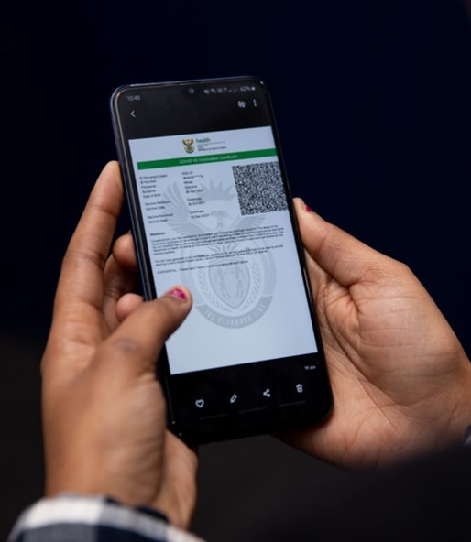
SO3: Drive socioeconomic transformation through RDI that supports the development of a capable state
KPI | 2021/22 Actual | 2022/23 Target | 2023/24 Target
KPI 9: Number of reports contributing to national policy development | 22 | 13 | 22
KPI 10: Number of standards delivered or contributed in support of the state | 8 | 9 | 9
KPI 11: Number of projects implemented to increase the capability of the state | 86 | 45 | 60

Slide 16
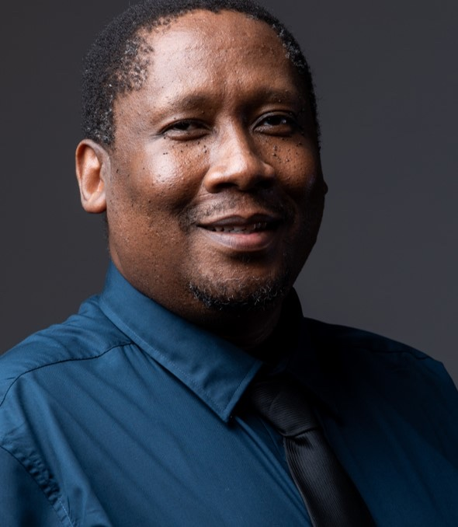
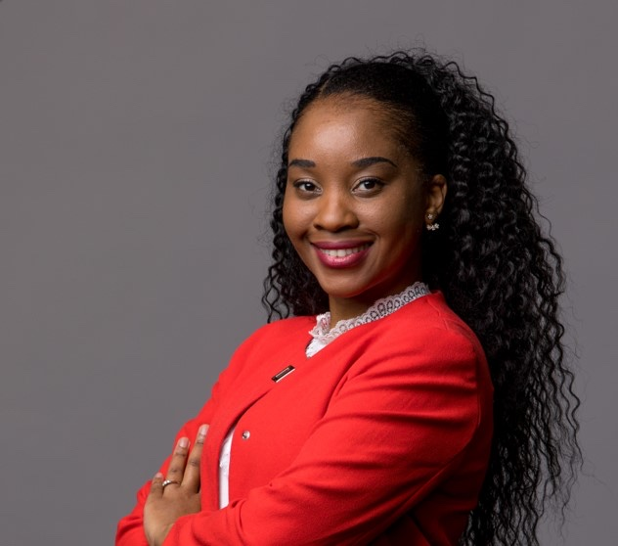
SO4: Build and transform human capital and infrastructure
KPI | 2021/22 Actual | 2022/23 Target | 2023/24 Target
KPI 12: Total SET staff | 1 551 | 1 598 | 1 598
KPI 13: Percentage of black SET staff | 68% | 67% | 67%
KPI 14: Percentage of female SET staff | 39% | 38% | 38%
KPI 15: Percentage of SET staff with PhDs | 21% | 21% | 21%
KPI 16: Total chief researchers | 15 | 16 | 16
KPI 17: Percentage of black chief researchers | 13% | 19% | 19%
KPI 18: Percentage of female chief researchers | 13% | 13% | 13%

Slide 17
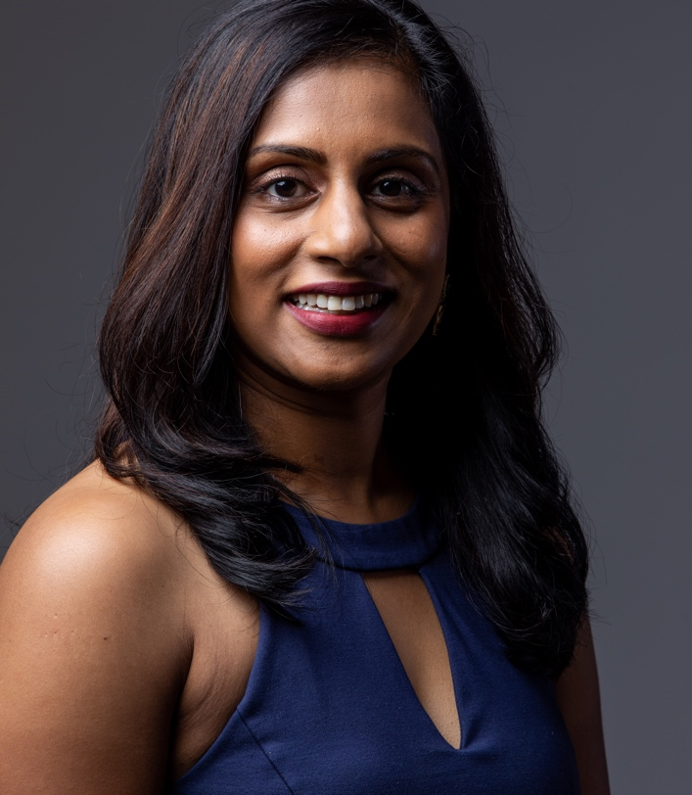
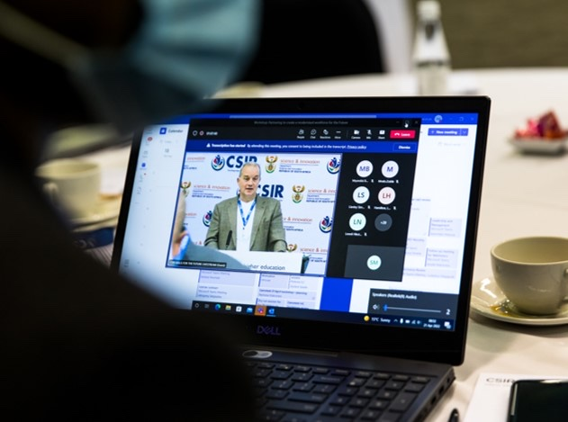
SO4: Build and transform human capital and infrastructure
KPI | 2021/22 Actual | 2022/23 Target | 2023/24 Target
KPI 19: Total principal researchers | 188 | 189 | 189
KPI 20: Percentage of black principal researchers | 34% | 34% | 35%
KPI 21: Percentage of female principal researchers | 19% | 20% | 20%
KPI 22: Number of exchange programmes with industry | 31 | 26 | 31
KPI 23: PPE investment (Rm)* | 104 | 260 | 148

Slide 18


SO5: Diversify income, maintain financial sustainability and
good governance
KPI | 2021/22 Actual | 2022/23 Target | 2023/24 Target
KPI 24: Total income (Rm) | 2 654 | 2 903 | 3 104
KPI 25: Net profit (Rm) | 137 | -5.4 | 11.5
KPI 26: SA public sector income (% Total income) | 56% | 51% | 56%
KPI 27: SA private sector income (% Total income) | 9% | 12% | 11%
KPI 28: International contract income (% Total Income) | 8% | 8% | 9%
KPI 29: B-BBEE rating* | 1 | 1 | 1
KPI 30: Recordable incident rate* | 0.14 | ≤ 1 | ≤ 0.6
KPI 31: Audit opinion | Unqualified audit opinion | Unqualified audit opinion | Unqualified audit opinion

Slide 19
KEY STRATEGIC INITIATIVES

Slide 20

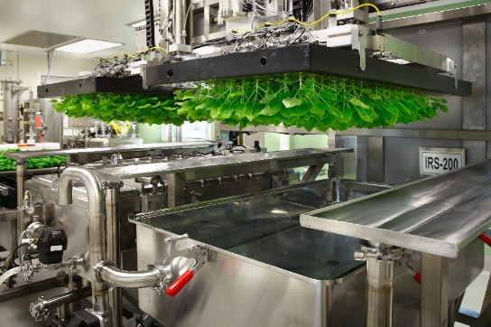
Strategic capabilities for local manufacture of pharmaceuticals
OBJECTIVE
The CSIR is building product prototypes, strategic infrastructure and skills to support the local manufacture of vaccines and therapeutics
MILESTONES FOR 2023/24
Establishment of a virus-like particle vaccine platform to pave the way for future human health vaccine products
Complete construction, commissioning and launch of the FuturePharma pharmaceuticals production facilities, including ISO7 clean rooms for early phase clinical trials, and the first continuous flow chemistry pilot facility in South Africa
Launch of the African Biomanufacturing Workforce Training Program, supported by the Gates Foundation, to drive the production of biopharmaceuticals, vaccines, biologics and reagents on the continent
IMPACT AND BENEFITS FOR SA
Establish and entrench capabilities for local vaccine, therapeutic and drug manufacture for the country and the continent’s health security
NATIONAL PRIORITIES SUPPORTED
Industrialisation through localisation

Slide 21
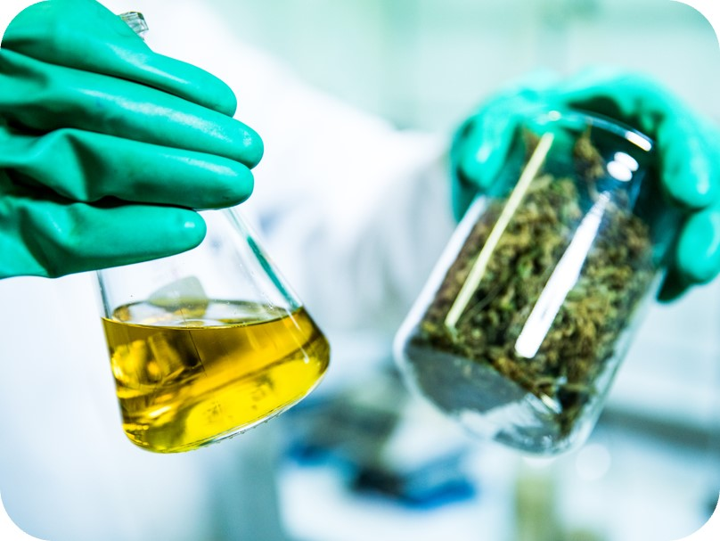

Hemp and medicinal cannabis industries
OBJECTIVE
To develop processes and value-added products from hemp and cannabis for the emerging cannabis industry
MILESTONES FOR 2023/24
Development of high-value pharmaceutical, cosmetic and oil products from cannabis using supercritical carbon dioxide technologies
The CSIR and Coega Special Economic Zone (SEZ) are developing an industrial research facility for commercially viable bio-fibre products and bio-fibre industrial applications through the joint establishment of a special-purpose vehicle in the SEZ
Product and process development support for small, medium and micro enterprises (SMMEs) through the open-access Bioindustry Development Centre to create high-value hemp and cannabis products
IMPACT AND BENEFITS FOR SA
Support the establishment of a thriving, transformed hemp and cannabis industry through the development of high-value products
NATIONAL PRIORITIES SUPPORTED
Industrialisation through localisation
Gender equality and economic inclusion of women and youth

Slide 22
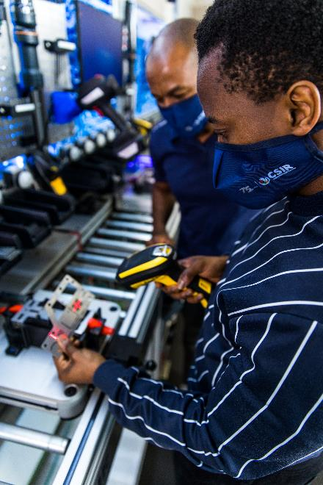
Learning Factory drives 4IR skills development and adoption
OBJECTIVE
Collaborate with industry and entities to develop competency in human-centred automation and enhance uptake of fourth industrial revolution (4IR) technologies
MILESTONES FOR 2023/24
Several collaborations within the manufacturing and mining sectors
Eighteen Learning Factories ( LFs) planned at Technical Vocational Education and Training (TVET) colleges; piloting at Eastcape Midlands TVET College
Establishing a pilot mining LF in Limpopo to support the implementation and operation of modern technologies
Development of mine safety training programmes with virtual reality and augmented reality technologies to simulate emergency situations, including fire and explosions
Decision-support technologies for collision prevention of mine trackless mobile machines
IMPACT AND BENEFITS FOR SA
Skills development in 4IR fields for digitalisation in industry and job creation
Developing entrepreneurs in 4IR-related fields
NATIONAL PRIORITIES
Skills development and digitalisation of industry
CSIR and merSETA established the master ‘Learning Factory’ for 4IR-related skills development, awareness and entrepreneurial innovation.

Slide 23

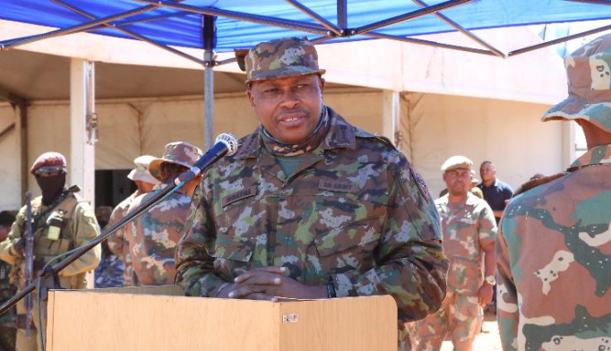
Combat uniform and boots for the SA Army
OBJECTIVE
The CSIR, in partnership with industry, the public sector and the SA Army, is evaluating a new camouflage uniform and improved combat boots for the SA Army
STATUS AND MILESTONES FOR 2023/24
The CSIR supported the SA Army to develop a new uniform and improved combat boots in 2022/23.
The new uniform features a gendered garment design, updated pattern and colours, as well as new fabric suited to a diversity of operational environments
The new boots feature an updated gendered design and new sole technology
Rigorous field evaluations by the SA Army, in internal and external operational environments, have commenced and will continue in 2023/24
Manufacturing of the fabric to be localized, in collaboration with South African industry
IMPACT AND BENEFITS FOR SA
Uniforms with enhanced colour and fastness, and light weight for improved mobility
Tailoring accommodates different genders and body types for soldiers’ comfort
NATIONAL PRIORITIES SUPPORTED
Industrialisation through localisation and operational support to armed forces

Slide 24
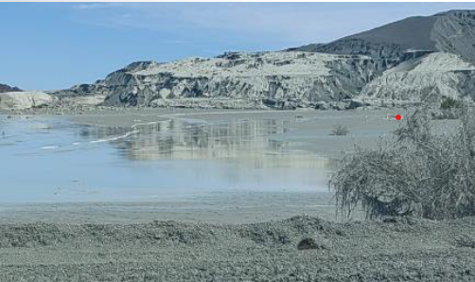
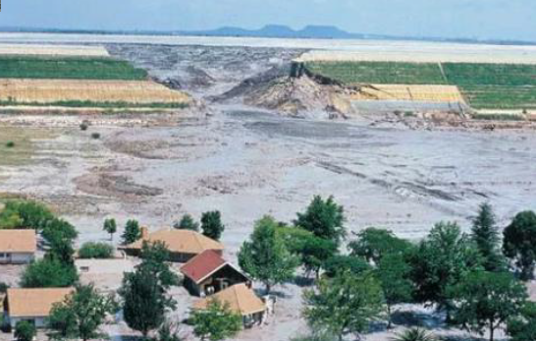
Development of an early warning system for tailings dam wall failures
OBJECTIVE
Proper monitoring, maintenance and management of tailings storage facilities produced from the waste of mining operations remains a concern, following several incidents in South Africa and globally
MILESTONES FOR 2023/24
The CSIR plans to explore the application of electrical resistance tomography to dynamically monitor the movement of the tailings dam wall to develop an early warning system
IMPACT AND BENEFITS FOR SA
To provide industry with a dynamic early warning system for continuous monitoring of geohydrological changes to mitigate disasters caused by sudden mine waste dam failures
This innovation will assist mining companies and government in making smarter safety-related decisions throughout the mine lifecycle
NATIONAL PRIORITIES SUPPORTED
Climate change and environmental sustainability

Slide 25
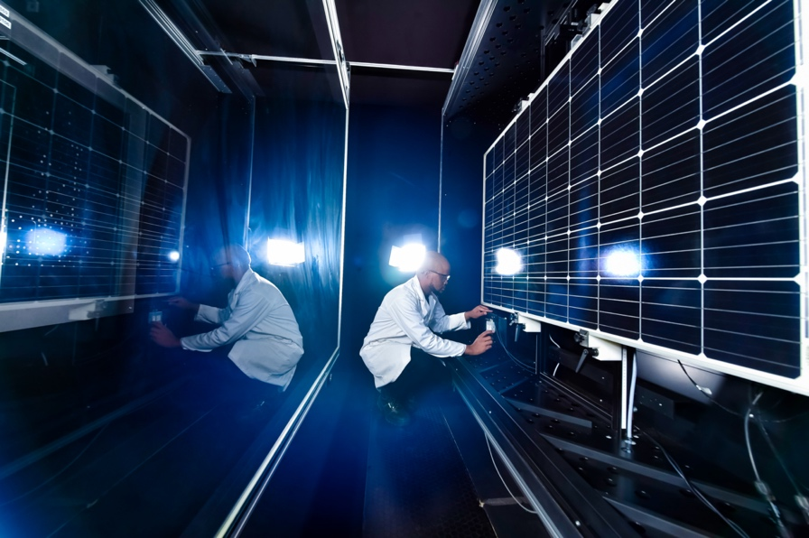

Research in support of a Just Energy Transition
OBJECTIVE
The CSIR is developing a range of capabilities in support of a Just Energy Transition
MILESTONES FOR 2023/24
Provide long-term integrated energy systems modelling to provide independent decision support on policy and investments in renewables
Support government and industry in determining the future role of green energy – solar, wind, hydrogen in the South African energy mix and end-use applications
The CSIR will continue to enable the Just Energy Transition by supporting the development of SMMEs and communities in regions most adversely affected
Energy systems support – photovoltaic and battery quality and reliability testing
IMPACT AND BENEFITS FOR SA
Contribute to addressing current energy challenges
Contribute to the diversification of our national energy mix
NATIONAL PRIORITIES SUPPORTED
Transition to a low-emissions economy
Enable industry competitiveness

Slide 26
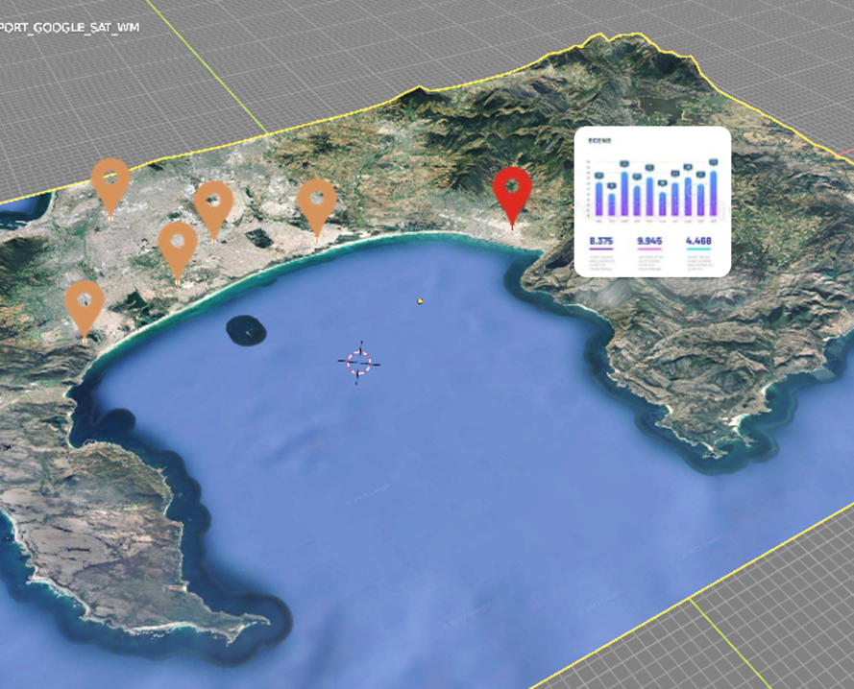
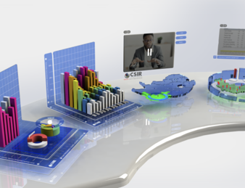
Artificial intelligence for decision support in higher education and training
OBJECTIVE
To enable strategic decision support for the Department of Higher Education and Training (DHET) through the power of artificial intelligence (AI) and augmented reality (AR) for data analytics and visualisation
MILESTONES FOR 2023/24
DHET has several needs with regards to policy, strategy and future planning, which include the prediction of future enrolment, alignment of targets with the NDP and resource requirements
The CSIR has developed a platform to enable a data-driven approach that provides insight to inform policy and decision making, using tertiary institution data
Engaging with DHET to secure additional datasets to scale the platform in 2023/24 and target priority-use cases
Expand application of the platform to other government departments
IMPACT AND BENEFITS FOR SA
Unlocking the power of AR and AI to enhance decision-making in government
NATIONAL PRIORITIES SUPPORTED
Digitisation of government in support of a capable state

Slide 27
BUILDING AND TRANSFORMING HUMAN CAPITAL

Slide 28

Human capital strategic initiatives
RESEARCHER DEVELOPMENT PROGRAMMES
Researcher development through to chief researcher level: Principal Researcher Development Programme (12), Accelerated Researcher Development Programme (10), and Capability Investment Development Programme (6)
LEADERSHIP AND MANAGEMENT DEVELOPMENT PROGRAMMES (LMDP)
Eighty-two employees participated in the LMPD: 76 (93%) black South Africans and 39 (48%) female South Africans
Launching the Executive Development Programme, Executive Coaching and Mentorship-train-the-trainer Programmes
BURSARY AND GRADUATES-IN-TRAINING (GIT) PROGRAMMES
Bursaries: 411 currently offered to undergraduates and postgraduate in science, technology, engineering and mathematics fields
GIT programme: 36 candidates currently supported and 18 planned for absorption in 2023/24

Slide 29
Human capital strategic initiatives
SKILLS DEVELOPMENT STRATEGY
Memorandums of understanding (MoUs) signed with 70% out of 21 SETAs engaged; National Skills Authority engaged and signing of MoU in 2023/24
WORK-BASED LEARNING PROGRAMMES
One hundred and eleven interns are currently supported; CSIR site approved as training provider for Fitter and Turner apprenticeships
Partnership between CSIR, DSI, DHET, NSA, NSF and SETAs: Theme on “skills of the future” through LFs for TVET colleges
INITIATIVES AIMED AT YOUTH, WOMEN AND PEOPLE WITH DISABILITIES
Focus of YES on women and increase of people with disabilities to 2.5%

Slide 30
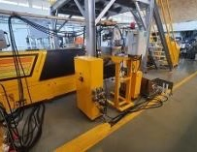
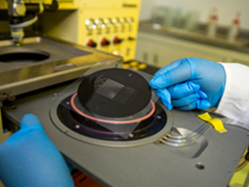
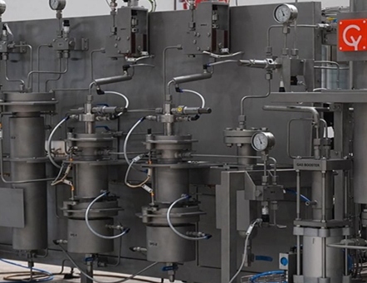
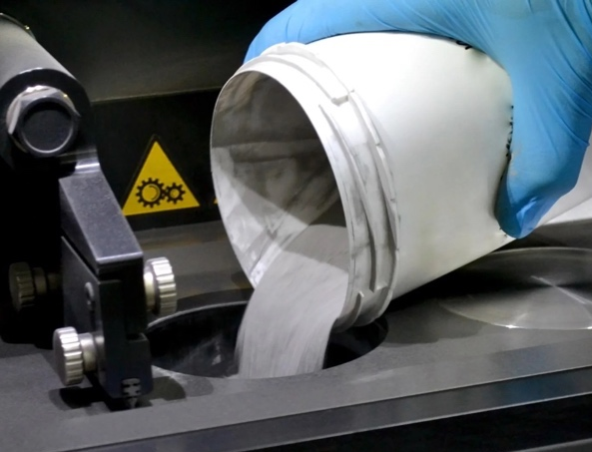
Infrastructure investment plan
Twin-Screw Extrusion Line Extruder
Nano-Micro Manufacturing Facility
Supercritical fluid extraction CO2
Ultrasonic Atomisation Facility
An instrument for the optimisation of production processes of formulated polymer composites materials at a pilot-scale level
Supports research and development in nano-micro manufacturing technologies on a national level, a key capability in diagnostic device manufacture
Intended for cannabis, essential oil and medicinal plant extraction. Increases extraction capacity essential for the CSIR’s ability to support the cannabis and IKS industry
A unique, compact machine for metal powders production,
using a novel ultrasonic automisation technology

Slide 31
FINANCIAL SUSTAINABILITY AND
GOOD GOVERNANCE

Slide 32
Financial sustainability
PARLIAMENTARY GRANT (PG)
PG for 2023/24 to be finalised. According to the 2022/23 MTEF allocation letter, PG increases by R2.9 million (0.4%) In the last three years, there has been negligible, nominal PG growth
With high inflation on input costs and above inflation increases on utilities, the CSIR is under pressure to grow contract R&D income to remain financially sustainable
ECONOMIC CLIMATE
Against the backdrop of a weak economy, South Africa’s gross domestic expenditure on R&D (GERD) has been declining year-on-year, since 2017/18. This impacts the CSIR’s prospects of local income growth
Internationally, the swift post-Covid-19 economic recovery, supply chain constraints, the war in Ukraine and Chinese Covid-19 restrictions have resulted in soaring global inflation, limiting the CSIR’s ability to access new contracts in global markets
Due to persistent inflation, the South African Reserve Bank raised the benchmark rate from 3.25% in 2021 to 7.25% by January 2023. This, however, does not negate the possibility of a recession this year, which will further impact on revenue growth prospects
Energy insecurity and above-inflation increases for utilities remain major themes, impacting directly on productivity and cost

Slide 33
Financial sustainability
ECONOMIC CLIMATE….CONTINUED
Limited funding for R&D infrastructure improvements constrains the ability to improve revenue-generating capabilities
The CSIR’s financial targets are, therefore, considered stretched targets. Combined with the range of uncertainties indicated, this is likely to impact the ability to retain critical skills within the organisation
CONSTRAINTS IMPOSED BY NATIONAL PROCUREMENT LEGISLATION
While there is a strong drive to ensure that procurement by government departments, constitutional institutions and public entities guarantees value for money, as well as open and effective competition and fairness, there are several instances in which direct contracting of the CSIRs strategic capabilities serves the national interest
The CSIR, in pursuit of balancing regulatory requirements, its mandate and Shareholder Compact obligations, has been unsuccessful in its attempts to be designated as the preferred supplier for its core mandate services in support of national efforts
Various requests to National Treasury by the CSIR and various entities to be designated as the preferred service providers of core services and capabilities have been denied
This has inadvertently led to significant constraints in the organisation’s ability to execute its core mandate in the national interest
33

Slide 34
Income statement
KEY INSIGHTS
2023/24 Budget
Net profit of R11.5m due to:
  Total operating revenue of R3.1bn, Investment income of R57.1m and total expenditure of R3.1bn.
  Investment income is estimated to remain relatively unchanged as interest rates are forecast to remain at current levels, together with an estimated lower average cash balance compared to the current year.
Vs Forecast 2022/23:
Growth of R263.5m (9.3%) in total operating revenue driven by contract R&D (12.4% growth) and is split as follows
  R174.9m increase in public sector – R148.3m contract R&D and R26.6m rental income
  R22.8m increase in the private sector driven by contract R&D
  R61.9m increase in international sector income
Minimal increase in Parliamentary Grant of R2.9m (0.4%).
Total expenditure growth of 9.4% driven by:
  Labour cost: R145.3m (8.8%) increase which includes a 6% cost of living adjustment
  Running cost: R91.5m (8.3%) increase
  Depreciation: R34m (29.5%) increase

Slide 35
Balance sheet
KEY INSIGHTS
For assessment of the liquidity position of the CSIR one needs to consider the budgeted cash balance of R1.29 billion with trade and other receivables of R373k (total of R1.67 billion) against the current liabilities of R1.4 billion.
The CSIR maintains a continued strong focus to convert trade receivables into cash and earn revenue on the contracts in progress
PPE is planned to remain relatively stable. Although a CAPEX investment of R148m is planned, the planned depreciation on new, grant and existing assets reduces the PPE balance slightly.
Trade and other payables balance is not expected to increase significantly because CSIR is committed to paying suppliers timely as required by the PFMA.
The current ratio (current assets/current liabilities) is expected to decrease slightly to approximately 1.39 (FC March 2023: 1.4). Industry standards prescribe a healthy current ratio between 1.2 - 2 and the planned current ratio is therefore reflecting healthy maintenance within this industry bracket.
The CSIR has engaged National Treasury on the requirement set out in the approval of the CSIR limit to issue guarantee instruments after some of the large value prospects upon which the approval was granted had not materialized as envisaged and with limited or no probability that those prospects will materialize in the future.
A submission to National Treasury is being prepared and will be submitted to National Treasury before the end of the current financial year after review and approval by CSIR EXCO.

Slide 36
Summary
REVENUE
The secured sales is currently at 45% (41% Public, 132% International and 5% Private).
The target revenue is based on secured sales and pipeline which may not be realized due to various factors such as market conditions, exchange rates, etc.
Tenant income is budgeted at R85m which equates to R26.8m (46.1%) growth compared to the forecast and R28.3m (50%) growth on 2021/22 Actuals.
PG is awarded by National Treasury at their discretion. The macro-economic outlook for South Africa and other more pressing funding needs might impact the allocation awarded to CSIR.
awarded to CSIR.
EXPENSES
Running expenses have been budgeted in line with revenue. This may not be the case when actual work is done and may fluctuate accordingly.
The power crises in South Africa are most likely to lead to extensive costs such as increases in municipal rates, transformer upgrades, solar solution investments, fuel charges etc.
Labour is a function of headcount and approved salary scales adjusted with the increased cost of living. Structures cannot be implemented if the associated sales are not generated and should therefore be monitored closely. Appointment moratoriums will be considered in these cases.
36

Slide 37
Summary
SUPPORT PORTFOLIOS
Most of the costs in support portfolios are fixed per supplier contracts or labour contracts. These costs are likely to increase annually due to inflation. Careful consideration must be taken when contracts are entered into, and cost-saving opportunities and synergies need to be diligently sought after.
Internal factors include approved structure implementation to achieve business plan objectives. Costs should only be incurred if the business operations can afford such services. Appointment moratoriums will be considered in these cases.
External factors include exchange rates, interest rates, and municipal rates to name a few.
Structural changes in ICT and SPU will result in labour cost growth in Support.

Slide 38
Good governance
MAINTAINING GOOD GOVERNANCE
The CSIR recognises that there should be systems of good corporate governance in place and that they should be reviewed continuously
The CSIR ensures that its governance systems are sound and consistent with world-class standards
Maintaining good governance includes compliance with legislation, the relevant provisions of the King IV Code and the Protocol on Corporate Governance in the public sector
Training on ethics and whistleblowing is now targeted at specific potential risk areas identified within the business or tailored to requirements of the area as needed
October is Ethics Awareness Month, in line with international practice featuring a full programme of compliance related training and awareness campaigns
There is a project underway to review affected policies for alignment with the UN Global Compact Principles to meet the requirements of international funders and collaborators
Active pursuit of strategies to improve the CSIR’s carbon footprint against a trajectory of continuous improvement

Slide 39
CSIR technology commercialisation enterprise
THE OBJECTIVE
To drive the development of high-tech industries by accelerating the pace and increasing the scale of commercialisation of CSIR-generated IP
MILESTONES FOR 2023/24
The CSIR will establish a special purpose technology commercialisation enterprise for launch in the first quarter of 2023/24 to house and trade in all CSIR IP, with dedicated capacity to drive all aspects of IP commercialisation
The enterprise will engage suitable entrepreneurs and investment partners to transform CSIR technologies into marketable products and services and will transact on behalf of the CSIR on matters of technology de-risking, business model selection, deal structuring, financing and market entry, among others
The CSIR has established a R100 million seed fund to de-risk technologies into commercially ready prospects through incubation and acceleration support and intends to mobilise further resources in 2023/24
INTENDED IMPACT
  Attracting greater private sector investment (angel investors, VC funds, banks, private individuals, etc.) in the commercialisation of CSIR IP
  Supporting the re-industrialisation of South Africa through a high-impact portfolio of enterprises (existing firms and start-ups) commercialising CSIR IP

Slide 40
Risks and challenges
Security of energy supply: Increased load shedding by Eskom at short notice increases the risk of loss of electrical supply to the CSIR sites across the country
Aging infrastructure: CSIR infrastructure is prone to failures and downtime and increased and costly maintenance requirements; is at risk of becoming irrelevant or obsolete and has a non-competitive real estate offering internally and externally due to inadequate investment in infrastructure renewal and upgrade
Physical and information security risks: Loss of physical CSIR and third-party assets due to theft and endangerment of CSIR staff and visitors due to breaches in security systems. Low maturity levels of information security to meet modern threats
Cost of digital transformation: Lack of resources to implement digital transformation of systems and processes to leverage advances in technology to enhance the agility and efficiency of the organisation

Slide 41
Risks and challenges
Reviewing and re-positioning capabilities at risk
Health Innovation: Limited funding to support CSIR health innovation capabilities and initiatives in support of South Africa’s drive to localize vaccines and critical biological therapies
Defence & Security: Optronic Sensor System capabilities currently under review to re-position for financial sustainability
Energy: Offerings, capabilities and business model of the Energy Centre under review to enhance value proposition to drive relevance, impact and future sustainability
Scarce and critical skills: Driving initiatives to attract, retain and develop skills in ICT, cyber, sensor systems, systems engineering, 4IR as well as transport and logistics in response to high market demand and limited capacity in these high-growth areas

Slide 42
THANK YOU

