Slide 1
2023/24 ANNUAL PERFORMANCE PLAN PRESENTATION TO THE PORTFOLIO COMMITTEE ON AGRICULTURE, LAND REFORM AND RURAL DEVELOPMENT 19 APRIL 2023

Slide 2
TABLE OF CONTENTS
OVG OVERVIEW : MANDATE 3 VISION 6
MISSION 7
VALUES 8
IMPACT STATEMENT 9 OUTCOMES 10
ANNUAL PERFORMANCE PLAN 11-20 BUDGET OVERVIEW 21

Slide 3
OVG OVERVIEW: MANDATE
The OVG derive its mandate from the Property Valuations Act, No. 17 of 2014.
Section 12. 1. (a) of the Property Valuations Act
Whenever a property has been identified for — (a) purposes of land reform that property must be valued by the Office of the Valuer-General for purposes of determining the value of the property having regard to the prescribed criteria procedures and guidelines
Section 12. 1. (b) of the Property Valuations Act
Whenever a property has been identified for acquisition or disposal by a department, for any reason other than that mentioned in paragraph (a), the market value of such property may, at the request of a department, be determined by the Office of the Valuer-General.

Slide 4
OVG OVERVIEW: VALUE IN TERMS OF THE PVA - 5 FACTORS
An authorised valuer shall in terms of Regulation 5(1), value the subject property for land reform purposes in terms of section 12(1)(a) of the PVA and quantify and/or consider the following factors:
Historical value pertaining to Acquisition benefits on the property
Market value of the property
Current use value of the property
The purpose of acquisition
Direct state investment and subsidies on the property
The above factors are prescribed by Section 25 (3) of the South African Constitution. The OVG applies all the above factors to determine just and equitable value of the property

Slide 5
OVG OVERVIEW: KEY CLIENTS
The OVG is currently servicing both section 12 (1) (a) and section 12 (1) (b) clients. Currently the OVG is prioritising Land Reform valuations (section 12 (1) (a))
PVA
Section 12 (1) (a)
Section 12 (1) (b)
CRLR
DFFE
DWS
LTR
LRD
Property Management

Slide 6
STATEGIC PLAN 2020-2025 VISION
To be recognised in the market as the centre of excellence and innovation in respect of all property valuation with primary focus on land reform.

Slide 7
MISSION
Support land reform by providing impartial, efficient, just and equitable valuation services for all land-reform related matters in the country.
Promote accurate professional valuations by informing, communicating and monitoring adherence to the criteria and guidelines applicable to land reform valuations; and
Enhance efficiency and accuracy of valuations through the development of innovative tools and processes, including a database of property value data accessible to the valuation profession as a whole.
Provide impartial, efficient, equitable and accurate general valuation services to / on behalf of government departments.

Slide 8
VALUES
Professionalism and accountability
Respect and integrity (ethics and honesty)
Courtesy and compassion
People centred service standards
Effective communication and transparency
Efficiency
Delivery focus

Slide 9
IMPACT STATEMENT
Impact Statement | Effective land reform enabled by timeous and quality property valuations

Slide 10
OUTCOMES
Outcome | Outcome indicator | Baseline | 5 year target
Just and equitable valuations | Effective application of the Property Valuation Act (PVA) to all valuations | Not Applicable | Just and equitable valuations
Organisational excellence | Improved organisational performance | Approved interim structure | Full Staff Compliment
Good Data Quality | Acceptance Management Reporting | Centralised Data Repository | Centralised Electronic Database with data validation capabilities
Promote ethical conduct | Effective Corruption and Fraud prevention mechanisms implemented | Not Applicable | Full implementation of Corruption and fraud prevention mechanisms

Slide 11
ANNUAL PERFORMANCE PLAN 2023 - 2024

Slide 12
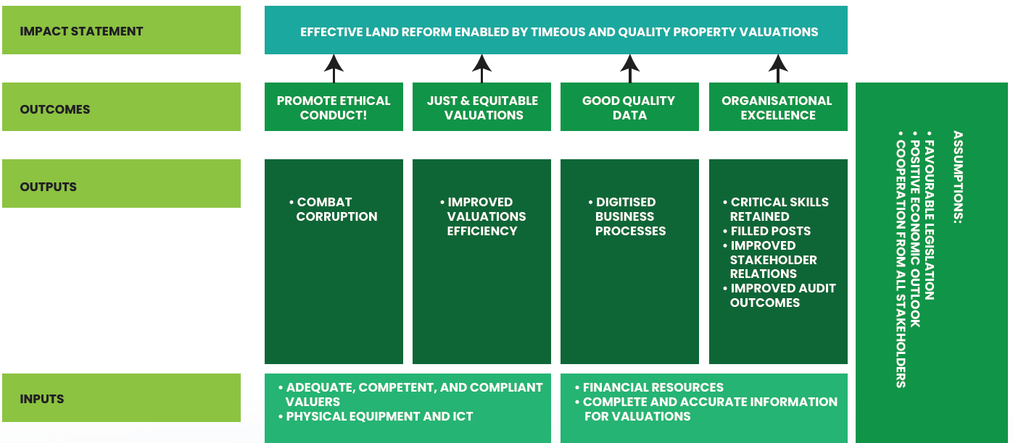
SUMMARISED THEORY OF CHANGE

Slide 13
PROGRAMME 1: ADMINISTRATION
Outcome | Outputs | Output indicators | Audited Performance |  |  | Estimated Performance | MTEF Targets
 |  |  | 2019/20 | 2020/21 | 2021/22 | 2022/23 | 2023/24 | 2024/25 | 2025/26
Promote Ethical conduct | Combat corruption and Fraud | % Implementation of corruption and fraud prevention mechanisms | - | - | - | New indicator | 30% | 60% | 100%

Slide 14
Output Indicators: Annual and Quarterly Targets
Output indicators | Annual Target | Q1 | Q2 | Q3 | Q4
% Implementation of corruption and fraud prevention mechanisms | 30% | - | 10% | 20% | 30%

Slide 15
PROGRAMME 2: VALUATIONS
Outcome | Outputs | Output indicators | Annual Targets
 |  |  | Audited / Actual Performance |  |  | Estimated Performance | MTEF Period
 |  |  | 2019/20 | 2020/21 | 2021/22 | 2022/23 | 2023/24 | 2024/25 | 2025/26
Just, and equitable valuations | Improved valuations efficiency | Average number (#) of working days taken to issue a valuation certificate | 167 | 53 | 34 | 50 | 50 | 50 | 50
 |  | % completion of valuation requests submitted by clients within specified times | - | 93% | 100% | 100% | 100% | 100% | 100%

Slide 16
Output Indicators: Annual and Quarterly Targets
Output Indicators | Annual Target | Quarterly Targets
 |  | Q1 | Q2 | Q3 | Q4
Average number (#) of working days taken to issue a valuation certificate | 50 | 50 | 50 | 50 | 50
% Completion of valuation requests submitted by clients within specified times | 100% | 100% | 100% | 100% | 100%

Slide 17
PROGRAMME 3: OPERATIONS
Outcome | Outputs | Output indicators | Audited Performance |  |  | Estimated Performance | MTEF Targets
 |  |  | 2019/20 | 2020/21 | 2021/22 | 2022/23 | 2023/24 | 2024/25 | 2025/26
Organisational excellence | Critical Skills retained | % of critical skills retained | - | - | - | New Indicator | 70% | 85% | 95%
 | Filled posts | Number (#) of funded posts filled in line with the approved interim structure | 20 | 41 | 64 | 70 | 85 | 95 | 110
 | Improved stakeholder relations | % of valuations queries resolved within 10 days | - | - | - | New Indicator | 100% | 100% | 100%
 | Improved audit outcomes | Unqualified audit opinion | - | - | Unqualified audit opinion | Unqualified audit opinion | Unqualified audit opinion | Unqualified audit opinion | Unqualified audit opinion

Slide 18
PROGRAMME 3: OPERATIONS
Outcome | Outputs | Output indicators | Audited Performance |  |  | Estimated Performance | MTEF Targets
 |  |  | 2019/20 | 2020/21 | 2021/22 | 2022/23 | 2023/24 | 2024/25 | 2025/26
Good Quality Data | Digitised business processes | % of digital maturity roadmap implemented | - | - | - | New Indicator | 30% | 60% | 100%

Slide 19
Output Indicators: Annual and Quarterly Targets
Output indicators | Annual Target | Q1 | Q2 | Q3 | Q4
% of critical skills retained | 70% | 70% | 70% | 70% | 70%
Number (#) of funded posts filled in line with the approved interim structure | 85 | 70 | 70 | 80 | 85
% of valuations queries resolved within 10 days | 100% | 100% | 100% | 100% | 100%
Unqualified audit opinion | 1 |  | Unqualified audit opinion | - | -
% of digital maturity roadmap implemented | 30% | - | - | 10% | 30%

Slide 20
BUDGET OVERVIEW
Financial Period | 2022/23 | 2023/24 | 2024/25 | 2025/26
Programmes | R'000 | R'000 | R'000 | R'000
Administration | 11,148 | 13,572 | 20,914 | 20,914
Valuations | 43,065 | 80,485 | 79,006 | 82,956
Operations | 52,958 | 61,214 | 62,324 | 65,440
 | 107,171 | 155,271 | 162,244 | 169,310

Slide 21
RE A LEBOGA

