Slide 1
Strategic Plan & Annual Performance Plan 2023/24 Financial Year
Presentation to the Portfolio Committee on Agriculture, Land Reform and Rural Development
The National Agricultural Marketing Council:
18 April 2023

Slide 2
NAMC MANDATE AND OBJECTIVES
The NAMC owes its existence to the Marketing of Agricultural Products (MAP) Act (Act No 47) of 1996:
To establish the NAMC
To establish certain regulatory measures in the marketing of agricultural products
The MAP Act of 1996 was amended through the Marketing of Agricultural Products Amendment Acts No 59 of 1997 & No 52 of 2001:
Amendments in terms of the property of Control Boards, Council, levies, finances, liquidation of Boards, consultation in relation to import & export control
Section 9 of the MAP Act: “Functions of the Council” stipulates the mandate of the NAMC:
Advise the Minister regarding statutory measures (1) (a) – (d) & (f)
Undertake investigations and advise the Minister on (1) (e)

Slide 3
NAMC STRATEGIC MANDATE AND OBJECTIVES
Increasing market access to all market participants
MISSION
VISION
The strategic positioning of agriculture in a dynamic global market.
To provide marketing advisory and regulatory services to key stakeholders in support of a vibrant agricultural marketing system in South Africa
More efficient marketing of agricultural products
Optimising export earnings from agricultural products
IMPACT STATEMENT
A viable and inclusive agricultural marketing system contributing to food security, socio-economic growth and sustainable development.
Enhanced viability of the agricultural sector

Slide 4
NAMC MANDATE AND OBJECTIVES

Slide 5
ALIGNMENT TO THE AGRICULTURE AGRO-PROCESSING MASTER PLAN (AAMP)
PILLAR 1
PILLAR 4
Control
Resolving policy ambiguities and creating investment-friendly climate
Success
AAMP PILLARS ALIGNED TO NAMC STRATEGY
Ensuring food security, expanded production and employment creation, decency and inclusivity
PILLAR 5
PILLAR 6
Target
Enabling markets expansion, improving market access and trade facilitation
Developing localized food, import replacement and expanded agro-processing exports
Sales

Slide 6
NAMC STRATEGIC FOCUS
MTSF Priority/ DALRRD Outcome | Improved governance and service excellence Increased Market Access and maintenance of existing market Growth of inclusivity within agricultural value chains
Outcomes | Outcome Indicators | Baseline | Five-year target
The NAMC delivers on its mandate and core functions | Compliant management and good governance of the entity, throughout the current term of governance. | The NAMC achieved three clean audits and two unqualified audit opinions over the past five years. | The NAMC functions at optimal levels deliver on its core-function indicators and receive unqualified audit opinions for each financial year of the 5 years Achievement of ICT services targets in operational plans of each financial year
A viable and efficient agricultural sector generating optimal earnings (domestic and international); | Approved policy advisory that facilitates the marketing of agricultural products, throughout the term of governance. | The NAMC provided 100% policy of scheduled advisory notes to policymaking institutions. | NAMC approved policy advisory and statutory measures of each financial year of the 5 years are adopted by the Minister and implemented by all directly affected stakeholders
 | Approved statutory measures recommendations submitted to the Minister. | The NAMC evaluated statutory measures about 80% of agricultural industries
 | NAMC annual reports reflect the transformation of the sector | An annual average of 20% of statutory levies is spent on transformation activities | Annual average of 20% of levies is spent towards the funding of transformation activities
Enhanced market access for agricultural sector participants | NAMC annual reports reflect increased market access | Smallholder farmers hold a 3% share in the agricultural market | The NAMC will contribute to increasing the smallholder farmers’ market share, by linking 360 farmers to market opportunities by the end of the 5 - year period.
 | NAMC annual reports reflect increased export growth of agricultural products | The agricultural exports growth rate fluctuated between 1.9% and 3.5% over the past five years. | Contribute to the 2% average growth in agricultural exports, through research initiatives.

Slide 7
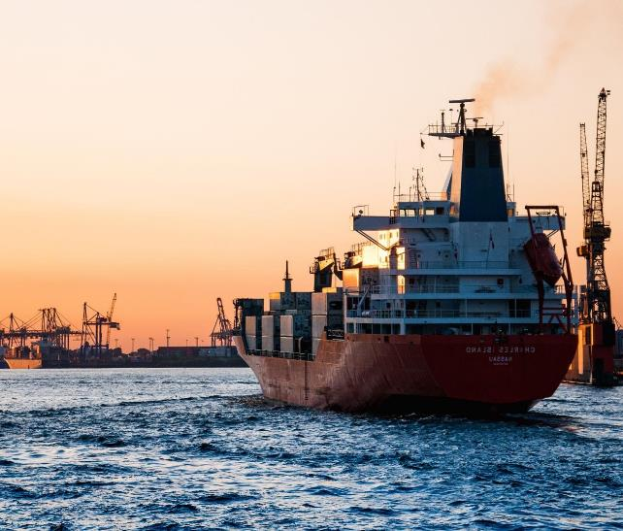
NAMC STRATEGIC OUTS FOR 2023-24

Slide 8
NAMC STRATEGIC OUTCOMES
PROGRAMMES 1: OUTCOME 1: NAMC Delivers on its mandate and core functions
Purpose: This programme aims to ensure that the NAMC functions optimally through effective business processes, corporate governance and resource support services
Outcome | Outputs | Output Indicators
The NAMC delivers on its mandate and core functions | Unqualified Audit Report | Unqualified audit report per financial year
 | 100% Budget spend | Percentage of budget spent each financial year
 | Achievement of Human Capital targets in operational plans of each financial year | Number of Human Capital reports produced each financial year
 | Achievement of Corporate Communications targets in operational plans of each financial year | Number of Corporate Communications reports produced each financial year
 | Achievement of ICT services targets in operational plans of each financial year | Number of ICT reports produced each financial year on the following: ICT Security enhances; ICT Continuity support; WAN/LAN availability monitoring; and Continuous improvement in ICT.

Slide 9
NAMC STRATEGIC OUTCOMES

Slide 10
NAMC STRATEGIC OUTCOMES
PROGRAMMES 2: OUTCOME 2: A viable and efficient agricultural sector generating optimal earnings (Domestic and International).
Purpose: To provide quality research outputs to stakeholders in support of agricultural marketing, trade, policy advisory and statutory measures implementation.
Outcome | Outputs | Output Indicators
A viable and efficient agricultural sector generating optimal earnings (domestic and international); | Statutory Measures Applications | 100% of received Statutory Measures applications are investigated each financial year
 | Status of Statutory Measures Report submitted to the Minister | Number of Status of Statutory Measures Report submitted to the Minister each financial year
 | Approved Trade Remedies, value chain research, advisory reports and Investigations | Number of trade advisory briefs/commentaries produced for each financial year
 |  | Number of value chain analyses produced for each financial year
 | Status report on agricultural industry trusts | Number of status report on agricultural industry trusts submitted to the Minister to the Minister each financial
 | Transformation report on interventions funded through trusts funds and levies | Number of transformation report submitted to the Minister each financial.

Slide 11
Outcome | Outputs | Output Indicators
A viable and efficient agricultural sector generating optimal earnings (domestic and international) | Approved Market intelligence reports to Minister and directly affected stakeholders | Number of Market Intelligence Reports produced each financial year
 | Status of Statutory Measures Report submitted to the Minister | Number of Grain Supply and Demand Estimates Reports produced each financial year
 | Approved Trade Remedies, value chain research, advisory reports and Investigations | Number of Farm to Retail Price Spread Reports produced each financial year
 |  | Number of Food Price Monitor Report produced each financial year
 | Status report on agricultural industry trusts | Number of Trade Fruit Flow reports produced each financial year
 | Transformation report on interventions funded through trusts funds and levies | Number of Food Basket Price Monthly reports produced each financial
 |  | Number of Food Cost Review Reports produced each financial year
 |  | Number of Macro-Digest Labour reports produced each financial year
 |  | Number of Macro-Digest Gross Domestic Product reports produced each financial year

Slide 12
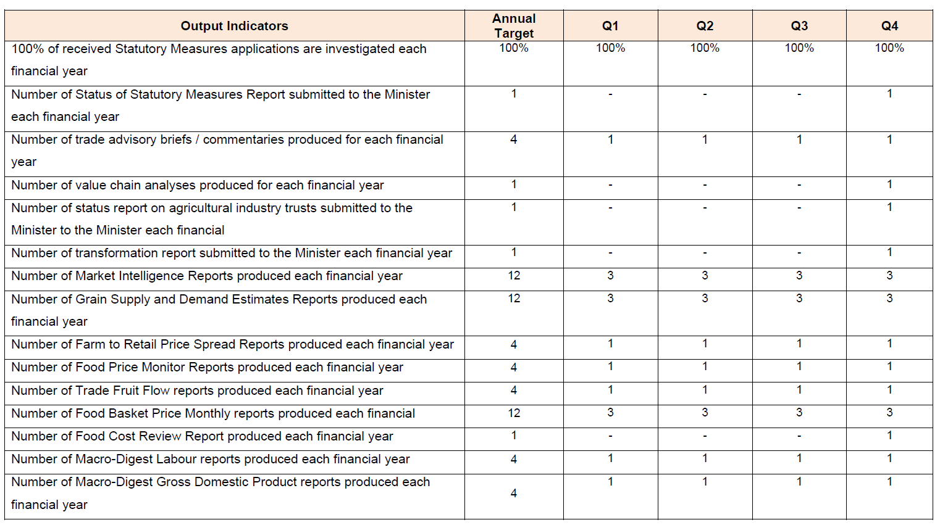

Slide 13
NAMC STRATEGIC OUTCOMES
PROGRAMME 3: Outcome 3: Enhanced market access for the agricultural sector
Purpose: To design market access models that are aimed at increasing market access, encouraging new business development and capacity building for farmers/agri-businesses.
Outcome | Outputs | Output Indicators
Enhanced market access for the agricultural sector participants | Increased number of farmers accessing market opportunities | Number of Smallholder farmers linked to market opportunities
 |  | Number of production scheme/ transformation initiatives designed
 |  | Number of Smallholder Market Access Tracker (SMAT) to Minister and DAGs each financial year.
 | Approved Market Access and Smallholder Farmer Participation reports | Number of Agri-preneur reports produced each financial year
 |  | Number of Smallholder Market Access Estimates reports produced each financial year

Slide 14
NAMC STRATEGIC OUTCOMES

Slide 15
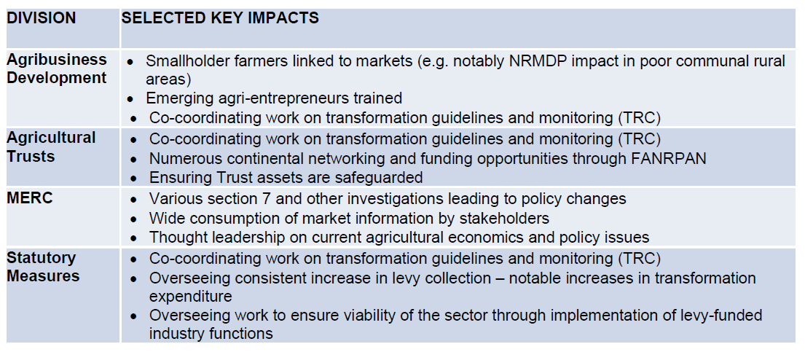
IMPACT OF THE NAMC

Slide 16
STRATEGIC RISKS & MITIGATIONS
Risk Name | Risk Description | Control Improvement Plan
SR1 | Inadequate capacity to support core functions | a) To implement continuous training on the organisational processes; NAMC staff, oversight structures and other stakeholders b) To review and ensure proper capacity (expertise) is sought and maintained; c) To initiate a programme for reskilling officials based on budget availability; d) To continuously ensure a safe working environment for all NAMC employees in line with the OHS Act; e) Review Human Capital policies and procedures as and when required; f) Facilitation of teambuilding sessions; g) Explore models for income generation (resource mobilisation); h) Develop a stakeholder universe (SOP).
SR2 | Possibility of providing incorrect/inadequate advice to the Minister and directly affected stakeholders/ groups | a) Develop an industry data repository; b) Implement the provisions of the Agricultural Trust Policy; c) Review and approve Research Strategy.

Slide 17
STRATEGIC RISKS & MITIGATIONS
Risk Name | Risk Description | Control Improvement Plan
SR3 | The expectation for the NAMC to implement programs or provide support beyond its mandate | a) Facilitate development support for farmers linked with the market. b) Stakeholder engagements (Awareness of NAMC mandate and defining the roles and responsibilities of the NAMCs mandate.
SR4 | Failure to adhere to good governance and poor compliance with relevant prescripts. | a) Review and Approve Ethics and Integrity Policy. b) Awareness of Ethics and other related policies that talk to governance. c) Develop Ethics and Anti-Fraud and Corruption Programmes. d) Implement the approved Ethics and Anti-Fraud and Corruption Programme. e) Engagement sessions with staff on an ethics management programme.
SR5 | Spread of the Coronavirus | a) Review and approve the Business Continuity Management Policy. b) Review and approve the Business Continuity Plan. c) Implementation of the Business Continuity Plan. d) Testing of the Business Continuity Plan.
SR6 | Budget constraints or limitations in financial resources | a) Explore models for income generation - resource mobilization.
SR 7 (New Risk) | Negative Audit Opinion | a) Regular awareness campaigns on NAMC policies and procedures b) Consequence Management c)Implementation of the approved delegation of Authority Framework

Slide 18
MEDIUM-TERM BUDGET ALLOCATION

Slide 19
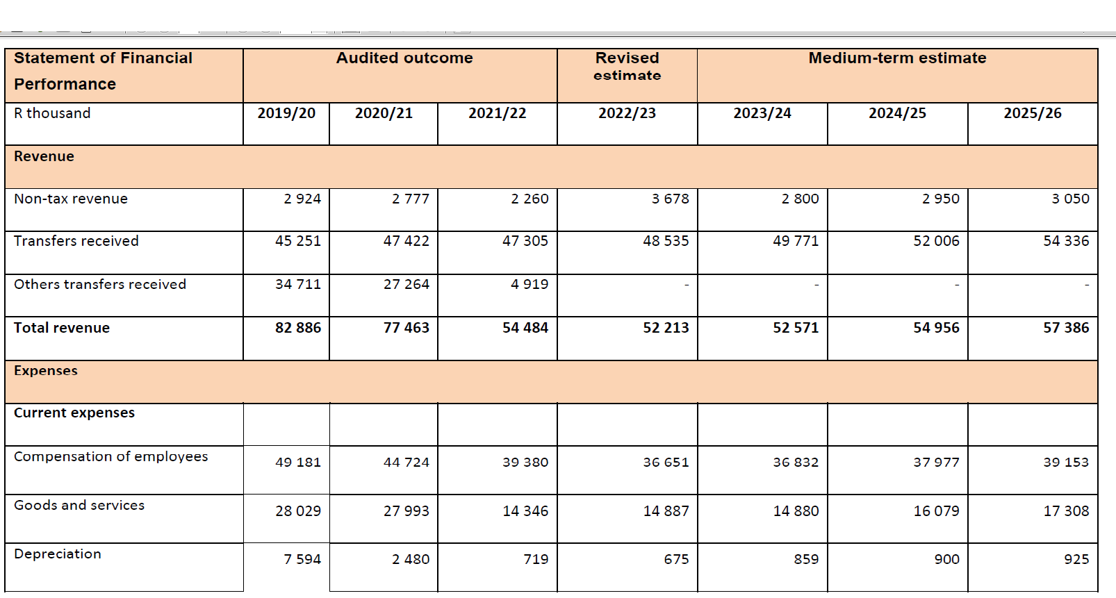
MEDIUM-TERM BUDGET

Slide 20
MEDIUM-TERM BUDGET

Slide 21
Thank you

