Slide 1
Dropping out of learners
Statistics, trends, tracking and tracing
Department of Basic Education
Martin Gustafsson
18 April 2023
1

Slide 2
Contents
Introduction
Definitions and data
Why learners drop out in South Africa
Levels of dropping out without COVID
The impact of COVID
Efforts to normalise enrolments age 15 and below
Current survival to an NSC pass
What do we know about school-college movements?
How our 65% 12-year ‘survival rate’ compares internationally
Dropping out and other challenges in the sector
Conclusion
2

Slide 3

PURPOSE
To present on drop out, throughput and Learner drop-out Prevention

Slide 4
Definitions and data
‘Dropping out’ ideally understood as undesirable departure from schooling system. This should thus exclude, in particular, movement to a TVET college.
Somewhat difficult to measure, a large gap being lack of synergy between DBE and DHET systems, meaning school-college movements not properly tracked. Plans exist to address this.
Despite this, SA has relatively good data to quantify the phenomenon.

Slide 5

Why learners drop out in South Africa
Major 2008 review identified the following key reasons, which remain relevant now:
The closely related problems of (a) academic under-achievement and (b) grade repetition.
Home disadvantage, including parents with a relatively low level of educational achievement.
Males more likely to drop out.

Slide 6
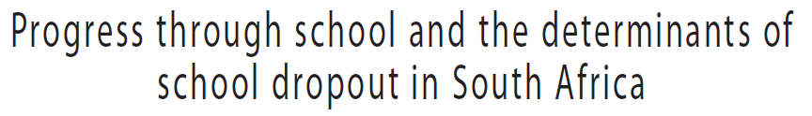
Why learners drop out in South Africa (contd.)
This important study emphasises the problem of falling behind academically.

Slide 7

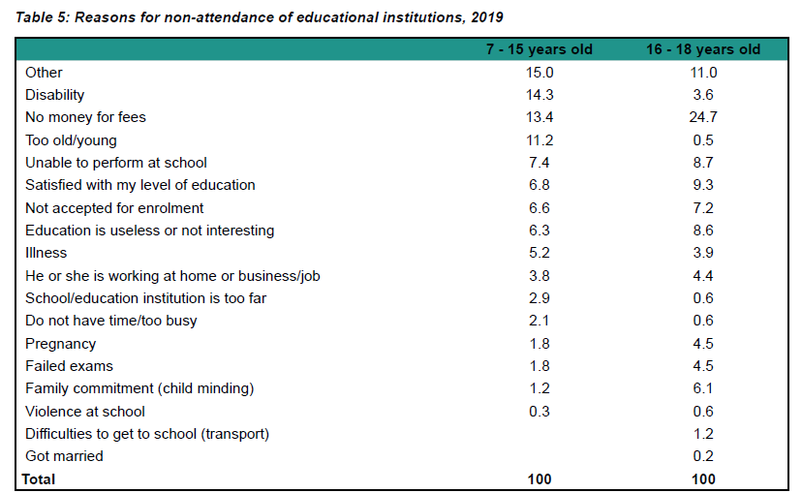
Why learners drop out in South Africa (contd.)
From Stats SA General Household Survey, 2019.
Very few dropouts here.
Fee problem difficult to explain properly in the context of no fee schools.
Add up to 39%, all relate somehow to poor academic achievement.

Slide 8
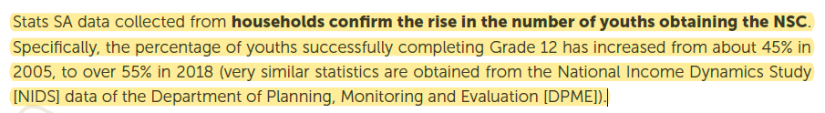
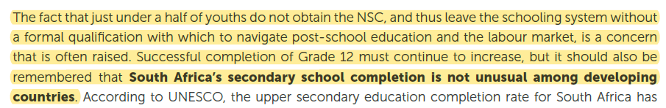
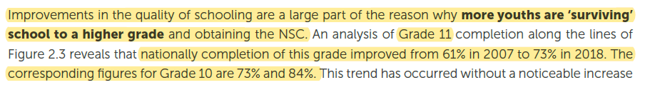
Levels of dropping out without COVID
55% NSC survival before pandemic
From the DBE’s 2019 NSC (‘Matric’) report:
Grades 10 and 11 survival rates

Slide 9
The impact of COVID
Serious attendance and learning losses problems during the pandemic. Dropping out as a result of the crisis a related but separate problem.
Considerable confusion arising out of over-reliance on telephonic surveys (NIDS-CRAM) and delays in the processing and analysis of administrative data on attendance (SA-SAMS).

Slide 10

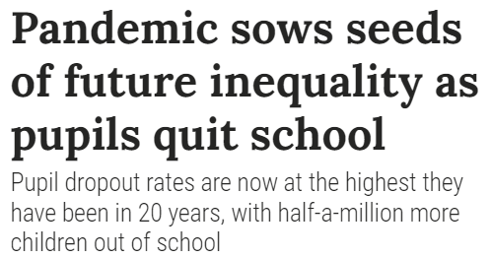

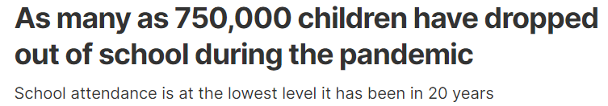
The impact of COVID (contd.)
Concerns in following turned out to be largely unfounded.
8 Jul 2021
9 Jul 2021

Slide 11

The impact of COVID (contd.)
Unsurprising problems that were found at the time:
19,000 children of compulsory school-going age had dropped out when 2020 and 2021 enrolment data compared.
Delayed enrolment for around 27,000 grades R and 1 learners in 2021.
Analysis still to be published suggests the above two problems have been fully or partially resolved.
Available online

Slide 12
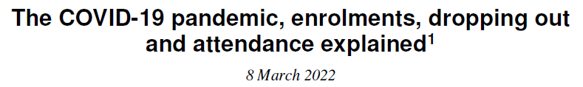
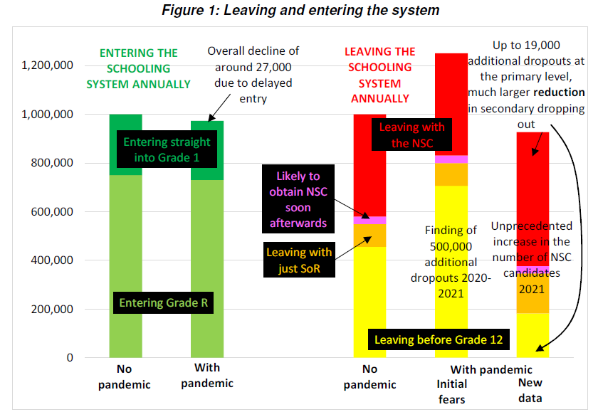
The impact of COVID (contd.)
Surprising phenomenon:
Participation beyond age 15 increased.
Candidates and passes in Grade 12 examinations end of 2021 highest to date. Again in 2022, both previous records broken.
Available online

Slide 13
The impact of COVID (contd.)
Thus, via more flexible grades 10 and 11 promotion rules during the pandemic, the system may have moved abruptly to a new NSC trajectory.
This is not all good. In the current budget climate, educator numbers have remained static, pushing up the learner-educator ratio and class sizes.

Slide 14
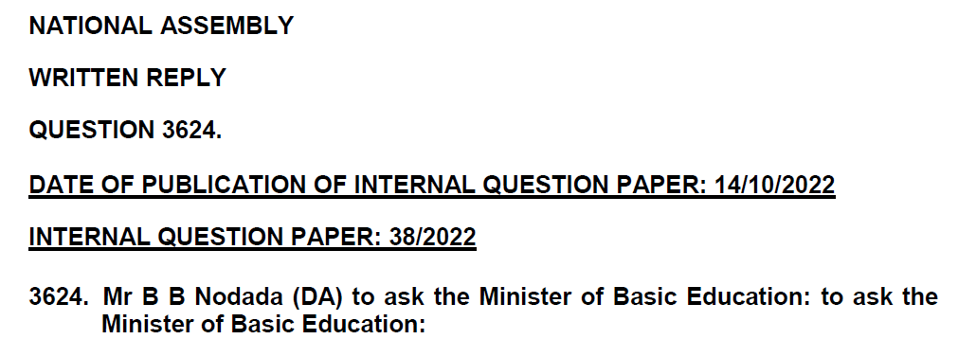
Efforts to normalise enrolments age 15 and below
This is multi-faceted and includes:
School nutrition
Enforcing no fee schools
Implementing and enforcing Government Notice 704 of 2021 regarding protection of pregnant teenagers.
Ongoing strengthening and streamlining of CAPS.
Improving reading in the early grades.
Support to Grade 12 examination candidates.
Expansion of learner-level enrolment and attendance monitoring systems.
Available online

Slide 15
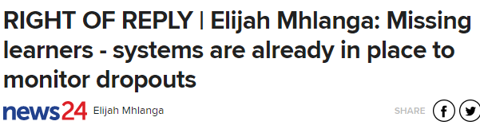

Efforts to normalise enrolments age 15 and below (contd.)
The DBE has engaged with the NGO Zero Dropout and disagrees with much of their analysis, but also their proposals around an Excel-based ‘Early Warning System’.
Available online

Slide 16

Current survival to an NSC pass
2022 NSC report reflects a ‘survival rate’ (in South Africa the term ‘throughput rate’ frequently used) of 62%. Based on Stats SA household data, confirmed via cohort analysis using DBE EMIS data.
What one should not do: divide full-time NSC passes by either earlier Grade 1 enrolment or Stats SA mid-year population estimates.
Africa Check has weighed in on the debate and agrees with the methodology the DBE has used.

Slide 17
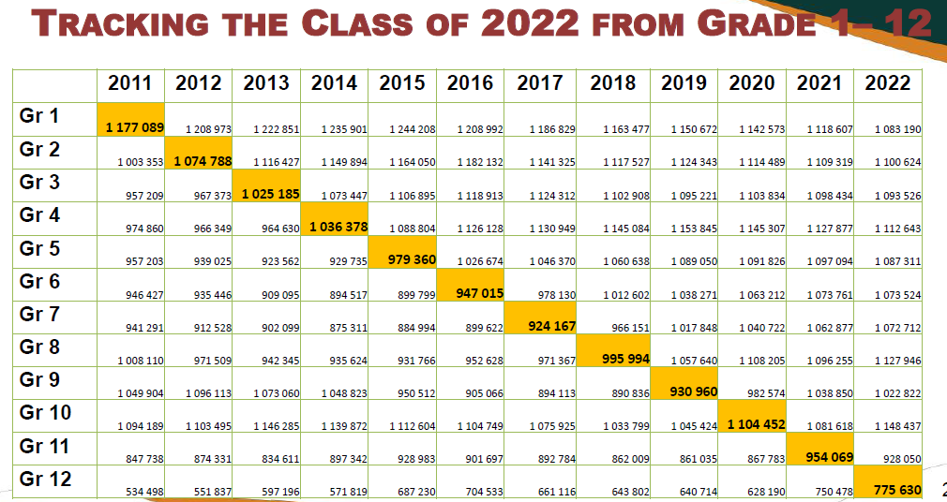
Current survival to an NSC pass (contd.)
Difference of ±100,000.
Difference of ±400,000.
To illustrate the problem: Why can’t we say that e.g. 100,000 learners drop out between grades 1 and 2, or that 400,000 youths did not reach Grade 12? Because repetition, which is especially high in Grade 1, inflates the denominator. Imagine if all Grade 1 learners repeated that grade, and no-one repeated Grade 2. Then Grade 1 enrolment would be twice Grade 2 enrolment, even if no-one was dropping out.

Slide 18
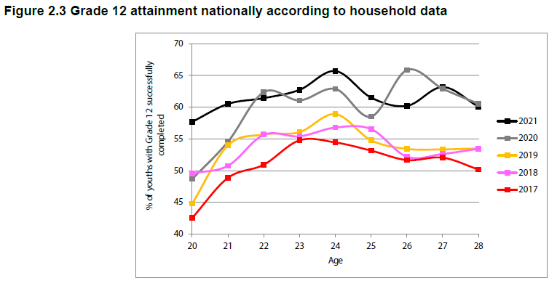
Current survival to an NSC pass (contd.)
How should we then calculate survival (or ‘throughput’)? In using EMIS data, we must take into account e.g. grade repetition. And we should verify using household data, as in the following...

Slide 19

School-college movements
Vital question: if 62% of youths were were obtaining the NSC by 2021, how many were successfully completing 12 years of schooling? This requires looking at TVET colleges, in particular youths who obtain a 12-year TVET certificate without also having the NSC (we should not double-count).
Individual-level analysis of school-university movements exist, but to date nothing similar for school-college movements. Largely a college data problem.

Slide 20
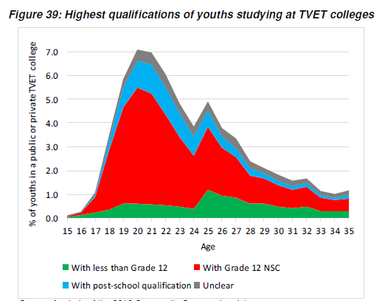
School-college movements (contd.)
What we know about school-college movements is based largely on (a) household survey data and (b) aggregate enrolment numbers.
The question is whether this green segment (‘With less than Grade 12’) has become larger.
From DBE’s ‘Action Plan to 2024’, using 2016 Community Survey

Slide 21
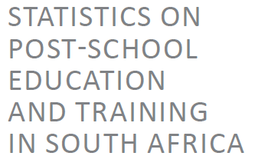


School-college movements (contd.)
What we know about school-college movements is based largely on (a) household survey data and (b) aggregate enrolment numbers.
This would be in line with household evidence that colleges raise the 62% to around 65% only. Ideally, the 71,000 NC(V) Level 2 students would all be here.

Slide 22
School-college movements (contd.)
DHET and colleges acknowledge the under-representation of younger pre-NSC students at TVET colleges and having committed to taking action to bring in younger NC(V) students.
However, it is not easy to change historical admissions patterns, especially if this means replacing older entrants with younger entrants.

Slide 23
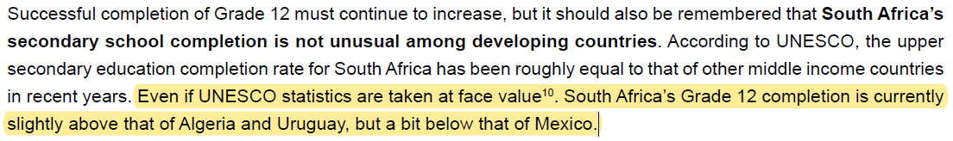
How our 65% compares internationally
From the 2022 NSC report...
Likely reason for South Africa under-estimate in UNESCO source explained in 2022 NSC report.
UNESCO statistics for 2020

Slide 24
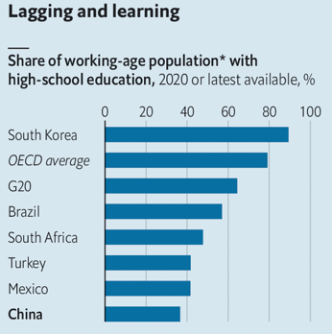

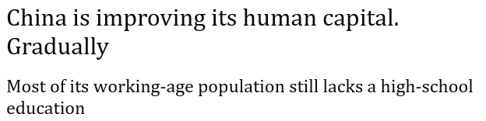
How our 65% compares internationally (contd.)
2022 article in The Economist essentially argues China should be more like South Africa when it comes to secondary completion.

Slide 25
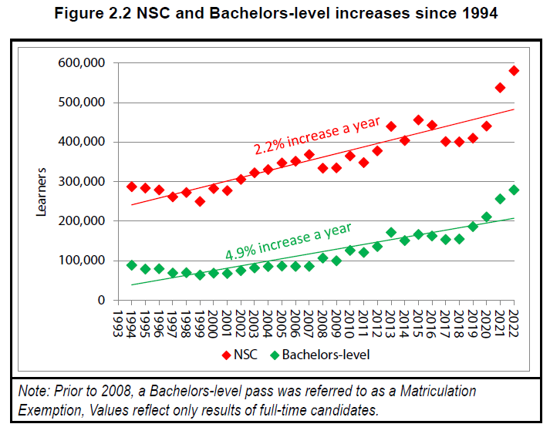
How our 65% compares internationally (contd.)
If we continue at current rates, we would reach a 12-year survival rate for schools alone of 83% by 2050. That’s easily comparable to a rich country such as the United States.
2022 NSC report

Slide 26
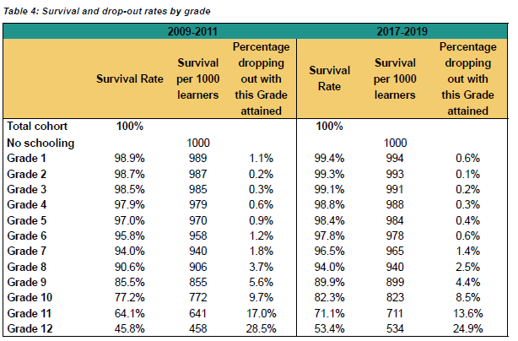
Dropping out and other challenges in the sector
For many years, DBE has monitored school participation, and dropping out, through Stats SA household data.
Dropping out here low but very worrying.

Slide 27
Dropping out and other challenges in the sector (contd.)
The DBE has begun calculating grade-specific dropout rates from using its LURITS system. While dropout rates are low below age 17, these are still worrying as they violate compulsory schooling policy.
SASA cut-off
Unpublished DBE report
Dropping out here low but very worrying.

Slide 28
Dropping out and other challenges in the sector (contd.)
Grades 7 and 8 most recent dropping out ±3%
Grade 9: 5%
Grade 10: 8%
Grade 11: 9%

Slide 29
Dropping out and other challenges in the sector (contd.)
DBE priorities with respect to the monitoring of dropping out:
Continue strengthening LURITS, produce more local-level monitoring of ‘dropout hotspots’, especially age 15 and below.
Closer collaboration with DHET to resolve data issues in the way of monitoring school-college movements.

Slide 30
Dropping out and other challenges in the sector (contd.)
Related work:
Absolute priority must be to improve quality of learning and teaching, which is the main lever to keep more learners in school.
General Education Certificate in Grade 9. From the DBE’s 2023 APP:
A credible GEC would increase the willingness of TVET colleges to take in younger learners and avoid duplication of youths studying for an NSC and then again for another NQF4 qualification at a TVET college.

Slide 31
Learner drop-out Prevention
DBE continues to implement activities that build resilient schools to nurture the wellbeing and build resilience among high-risk learners:
  having just one caring adult (Educator or Learner Support Agent) to support a learner through school dramatically improves their chances of finishing matric
  tracking learner attendance, behaviors and academic performance can signal at-risk learners and trigger the right support at the right time
  ensuring school curricula includes violence prevention, psychosocial support, and emotional learning activities
  Schools remain access points for meals, psychosocial support, and sexual and reproductive health (SRH) services
DBE to develop a National Gender Responsive Learner Dropout Prevention Strategy - Reimagining a schooling culture of care
Piloting a Monitoring process for measuring the impact of PSS interventions towards learner retention - Johannesburg South District starting in Quarter 2 2023/24.
23

Slide 32
Conclusion
The percentage of youths surviving to the NSC – i.e. the NSC ‘throughput rate’ - was 55% in 2019, 62% in 2022.
If attainment of NC(V) Level 4 in a college is counted, the figure rises to 65%. This is what we can call the correct overall ‘throughput rate’ currently.
Grade-specific dropout rates of interest range from 3% in Grade 7 to 9% in Grade 11.
The above figures have improved over 20 years, and can be expected to improve further. They are not unusual by developing country standards.
Contrary to expectations, the pandemic pushed survival to Grade 12 up.
Key initiatives to improve the prospects for youths include: (a) a range of teaching and learning interventions; (b) psycho-social support; (c) the GEC; (d) tighter monitoring of school participation.

Slide 33
RECOMMENDATION
It is recommended that the Portfolio Committee on Basic Education notes and discusses the drop out, throughput and Learner drop-out Prevention.

