Slide 1
SECOND QUARTER PERFORMANCE REPORT TO THE PORTFOLIO COMMITTEE
PRESENTED BY: DIRECTOR-GENERAL:
DATE:18/04/2023

Slide 2
PRESENTATION OUTLINE
Purpose
Introduction
Performance Overview
Departmental performance overview results
Overview of program specific performance
Expenditure Report: Second quarter
2

Slide 3
PURPOSE
The purpose of this presentation is to report the second quarter (2022/23) performance of DSAC with the Portfolio Committee on Sport, Arts and Culture.
For accountability as required by law.
To enable the Committee to provide oversight on the work of the Department and its entities.
3

Slide 4
INTRODUCTION
The Department intends to develop and transform sport, arts, and culture at all levels and harness their socio-economic contribution to creating a better life for all. Our focus is to lead the aspirations of a transformed, active, creative and winning nation, whose pride in being South Africa is inspired by the excellence of the country’s athletes and artists. Moreover our mandate is to lead and create an enabling environment for the social integration of people from different walks of life; make a positive contribution to strengthening sport, arts, and culture; eradicating the divisions and injustices of the past; fostering unity and creating a shared sense of patriotism; and encouraging a nation whose pride is being South African remains critical.
This Second Quarter Performance Report, provides progress made during the period 01 JULY 2022 – 30 SEPTEMBER 2022, including the challenges confronting the Department in its pursuit of the 2022-2023 financial year targets as outlined in the Department's Annual Performance Plan.
4

Slide 5
PERFORMANCE OVERVIEW

Slide 6
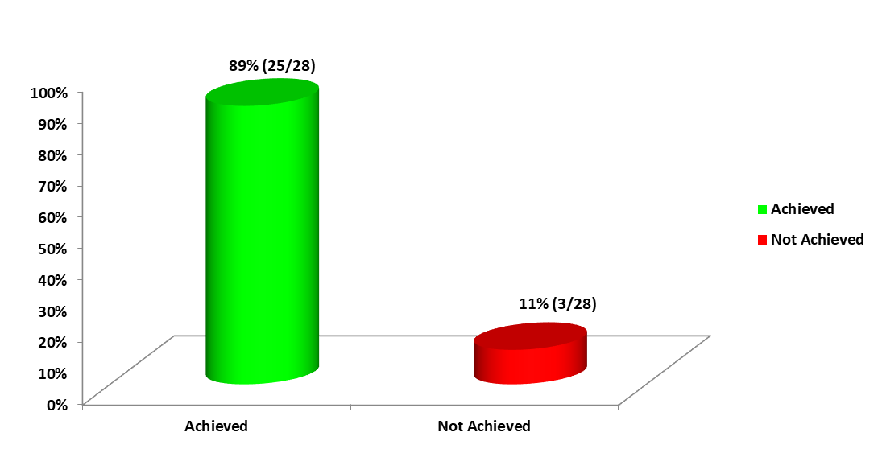
PERFORMANCE OVERVIEW
7

Slide 7
PERFORMANCE OVERVIEW
The Department planned to implement and achieve 28 performance targets during the second quarter reporting period. However, 25/28 (89%) of the aforesaid targets were achieved and 3/28 (11%) were not achieved. The following are the non- achieved targets
LIST OF NOT ACHIEVED TARGETS
ADMIN 1.4 | Number of Izimbizo held
ACPD 3.10 | Number of moral regeneration projects supported by Government
HPP 4.1 | Number of students awarded with heritage bursaries per year
8

Slide 8
OVERVIEW OF PROGRAMME-SPECIFIC PERFORMANCE

Slide 9
PROGRAMME 1
ADMINISTRATION

Slide 10
PROGRAMME 1: ADMINISTRATION
Purpose: Provide strategic leadership, management and support services to the Department.
The programme has the following sub-programmes:
Ministry
Management
Strategic Management and Planning
Corporate Services
Office of the Chief Financial Officer
Office accommodation
11

Slide 11
PROGRAMME 1: ADMINISTRATION….Cont.
Programme one focuses on ensuring effective and efficient administration, and brings together a range of administrative and support functions. These work collectively to help the Department to plan by offering expert knowledge, professional advice and effective internal controls.
12

Slide 12
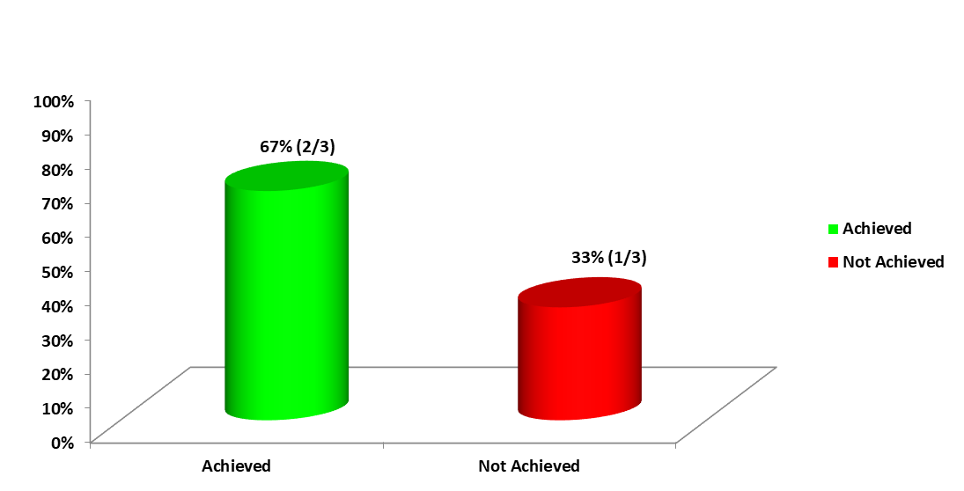
PROGRAMME-SPECIFIC PERFORMANCE
13

Slide 13
PROGRAMME 1: ADMINISTRATION….Cont.
INDICATOR CODE/NO. | PERFORMANCE INDICATOR | 2022/23 ANNUAL TARGET | 2ND QUARTER TARGET | ACTUAL ACHIEVEMENT AS AT SEPTEMBER 2022 | REASON FOR DEVIATION | CORRECTIVE ACTION
ADMIN 1.1 | Percentage of interns enrolled against funded posts. | 5% | - | No reporting required | - | -
ADMIN 1.2 | No. of prioritised manual services mordenised. | 2 | - | No reporting required | - | -
14

Slide 14
PROGRAMME 1: ADMINISTRATION…. Cont.
INDICATOR CODE/NO. | PERFORMANCE INDICATOR | 2022/23 ANNUAL TARGET | 2ND QUARTER TARGET | ACTUAL ACHIEVEMENT AS AT SEPTEMBER 2022 | REASON FOR DEVIATION | CORRECTIVE ACTION
ADMIN 1.3 | Number of SAC awareness campaigns activated to profile the work of the Department. | 4 | - | No reporting required. | - | -
ADMIN 1.4 | Number of Izimbizo held. | 9 | 3 | 4 Izimbizo were held, however the reports received were not adequate to support reported performance. | Inadequate portfolio of evidence | -
15

Slide 15
PROGRAMME 1: ADMINISTRATION…. Cont.
INDICATOR CODE/NO. | PERFORMANCE INDICATOR | 2022/23 ANNUAL TARGET | 2ND QUARTER TARGET | ACTUAL ACHIEVEMENT AS AT SEPTEMBER 2022 | REASON FOR DEVIATION | CORRECTIVE ACTION
ADMIN 1.5 | Percentage of invoices paid within 30 days. | 100% | 100% | 100% of invoices were paid within 30 days. | - | -
ADMIN 1.6 | Percentage of councils/boards that are fully constituted. | 100% | 100% | 100% of councils/boards were fully constituted. | - | -
16

Slide 16
PROGRAMME 2
RECREATION DEVELOPMENT AND SPORT PROMOTION

Slide 17
PROGRAMME 2: RECREATION DEVELOPMENT AND SPORT PROMOTION
Purpose: Support the provision of mass participation opportunities, the development of elite athletes, and the regulation and maintenance of facilities.
The Programme has the following sub-programmes:
Winning Nation
Active Nation
Infrastructure Support
WINNING NATION
The sub-programme has as its key outputs, the support of high-performance athletes to achieve success in international sport, and the development of talented athletes by providing them with opportunities to excel at various sport competitions.
19

Slide 18
PROGRAMME 2: RECREATION DEVELOPMENT AND SPORT PROMOTION…Cont.
ACTIVE NATION
The Active Nation sub-programme is responsible for the promotion of participation in sport and recreation by facilitating opportunities for people to share space and by providing equipment and/or attire to schools, hubs and clubs. It also leads the development of talented athletes by providing them with opportunities to excel at the national school sport championships and by supporting them through the sports academies.
INFRASTRUCTURE SUPPORT
The key outputs of the sub-programme include the provision of technical and management support to municipalities; construction of community gyms and children’s play parks; implementation of heritage legacy projects to transform the national heritage landscape; as well as the development and management of Provincial Resistance and Liberation Heritage Route (RLHR) Sites.
20

Slide 19
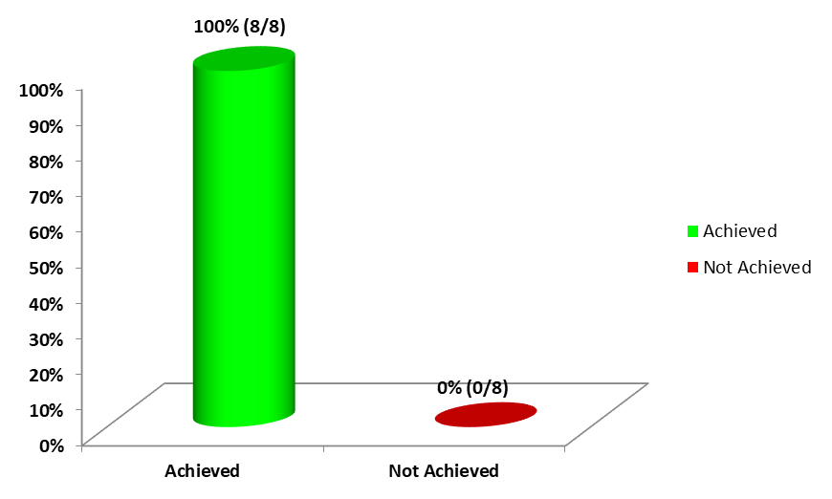
PROGRAMME-SPECIFIC PERFORMANCE
21

Slide 20
PROGRAMME 2: RECREATION DEVELOPMENT AND SPORT PROMOTION…. Cont.
INDICATOR CODE/NO. | PERFORMANCE INDICATOR | 2022/23 ANNUAL TARGET | 2ND QUARTER TARGET | ACTUAL ACHIEVEMENT AS AT SEPTEMBER 2022 | REASON FOR DEVIATION | CORRECTIVE ACTION
RDSP 2.1 | No. of athletes supported through the scientific support programme per year. | 80 | 30 | 31 athletes were supported through the scientific support programme. | Athletes in the programme submit their request for support whenever there is a need, hence the overachievement by 1. | -
RDSP 2.2 | No. of athletes supported by the sports academies. | 3700 | 1000 | 1 629 athletes were supported by sport academies. | The athletes that come through to the district and provincial academies are emerging to high performance. Therefore, when the need arises for athletes to improve their performance, academies will respond as required. As indicated in Q1, the academy programmes in the provinces render support & services to athletes based on their needs and this has also resulted in more athletes being supported in the quarter. | -
22

Slide 21
PROGRAMME 2: RECREATION DEVELOPMENT AND SPORT PROMOTION…. Cont.
INDICATOR CODE/NO. | PERFORMANCE INDICATOR | 2022/23 ANNUAL TARGET | 2ND QUARTER TARGET | ACTUAL ACHIEVEMENT AS AT SEPTEMBER 2022 | REASON FOR DEVIATION | CORRECTIVE ACTION
RDSP 2.3 | % of national federations meeting 50% or more of all prescribed charter transformation targets | 89.5% | - | No reporting required | - | -
RDSP 2.4 | No. of people actively participating in organised sport and active recreation events. | 315 000 | 90 000 | 119 081 people actively participated in organised sport and active recreation events. | Decentralisation of programmes attracts more people to participate in sport and active recreation within their communities. | -
24

Slide 22
PROGRAMME 2: RECREATION DEVELOPMENT AND SPORT PROMOTION…. Cont.
INDICATOR CODE/NO. | PERFORMANCE INDICATOR | 2022/23 ANNUAL TARGET | 2ND QUARTER TARGET | ACTUAL ACHIEVEMENT AS AT SEPTEMBER 2022 | REASON FOR DEVIATION | CORRECTIVE ACTION
RDSP 2.5 | No. of Sport and recreation promotion campaigns and events implemented | 8 | 2 | 2 sport and recreation promotion campaigns and events were implemented. | - | -
RDSP 2.6 | No. of schools, hubs and clubs provided with equipment and/ or attire as per the established norms and standards. | 2500 | 500 | 1 562 schools, hubs and clubs were provided with equipment and/or attire as per established norms and standards. | More people are participating in sport and active recreation events post COVID-19. | -
28

Slide 23
PROGRAMME 2: RECREATION DEVELOPMENT AND SPORT PROMOTION…. Cont.
INDICATOR CODE/NO. | PERFORMANCE INDICATOR | 2022/23 ANNUAL TARGET | 2ND QUARTER TARGET | ACTUAL ACHIEVEMENT AS AT SEPTEMBER 2022 | REASON FOR DEVIATION | CORRECTIVE ACTION
RDSP 2.7 | No. of leaners in the National School sport Championship per year. | 5000 | 2 500 | 3 023 learners participated in the National School Sport Championship. | The return of sport in schools made possible by the relaxation of lockdown restrictions, permitted for more participation in school sport. | -
RDSP 2.8 | No. of learners participating at the district school sport tournaments. | 75 000 | 30 000 | 42 579 learners participated at the district school sport tournaments. | Due to the resumption of sport in schools, more learners participated in the Programme. | -
31

Slide 24
PROGRAMME 2: RECREATION DEVELOPMENT AND SPORT PROMOTION…. Cont.
INDICATOR CODE/NO. | PERFORMANCE INDICATOR | 2022/23 ANNUAL TARGET | 2ND QUARTER TARGET | ACTUAL ACHIEVEMENT AS AT SEPTEMBER 2022 | REASON FOR DEVIATION | CORRECTIVE ACTION
RDSP 2.9 | No. of Municipalities provided with technical and/ or management support during construction. | 50 | 50 | 59 municipalities were provided with technical and/or management support. | The reason for over-achievement was due to sites visits conducted to completed projects to check the status and to confirm usage. | -
RDSP 2.10 | Number of community outdoor gyms and children’s play parks constructed. | 10 | - | No reporting required | - | -
RDSP 2.11 | Number of heritage legacy facilities (including the Resistance and Liberation Heritage Route [RLHR] sites) developed and/or maintained to transform national heritage landscape. | 3 | - | No reporting required | - | -
33

Slide 25
PROGRAMME 3
ARTS AND CULTURE DEVELOPMENT AND PROMOTION

Slide 26
PROGRAMME 3: ARTS CULTURE PROMOTION AND DEVELOPMENT
Purpose: Promote and develop arts, culture and languages, and implement the national social cohesion strategy
The Programme has the following sub-programmes:
National Language Services
Cultural and Creative Industries Development
International Cooperation
Social Cohesion and Nation Building
Mzansi Golden Economy
37

Slide 27
PROGRAMME 3: ARTS CULTURE PROMOTION AND DEVELOPMENT… Cont.
NATIONAL LANGUAGE SERVICES
The key outputs of this sub-programme are the promotion and development of official languages, and the support to efforts to increase qualified language practitioners through language bursaries.
CULTURAL AND CREATIVE INDUSTRIES
The key outputs of this sub-programme are: the development of platforms nationally and internationally to expand market access; capacity building; and the promotion of access to cultural facilities/ community arts centres and participation in arts, culture and heritage programmes.
38

Slide 28
PROGRAMME 3: ARTS CULTURE PROMOTION AND DEVELOPMENT
INTERNATIONAL COOPERATION
The coordination of international engagements involves travelling across international borders and bringing together, a large number of artists, performers, athletes, experts and cultural and creative industry practitioners. The restrictions on international travel and the need for social distancing has therefore negatively impacted on the Department’s International programme.
39

Slide 29
PROGRAMME 3: ARTS CULTURE PROMOTION AND DEVELOPMENT….Cont.
SOCIAL COHESION AND NATION BUILDING
The key outputs of this sub-programme include the provision of support to the Moral Regeneration Movement, implementation of community conversations/dialogue programme; support to the target groups’ projects; implementation of advocacy platforms on social cohesion and nation building by Social Cohesion Advocates; the development of social cohesion and nation building compact to establish partnerships with civil society, private sector and citizens; as well as the promotion of patriotism utilising the flag at National days.
40

Slide 30
PROGRAMME 3: ARTS CULTURE PROMOTION AND DEVELOPMENT….Cont.
MZANSI GOLDEN ECONOMY
Outputs for the Mzansi Golden Economy relate to the increase in support for the creative industry, including the placement of artists in schools to promote and support arts education. In addition, it focuses on research in the sector, through SACO. Projects that are supported through the Mzansi Golden Economy Programme in the creative industry include Flagships Projects, Cultural Events, Public Art, and Touring Ventures productions (incl. Africa Month).
41

Slide 31
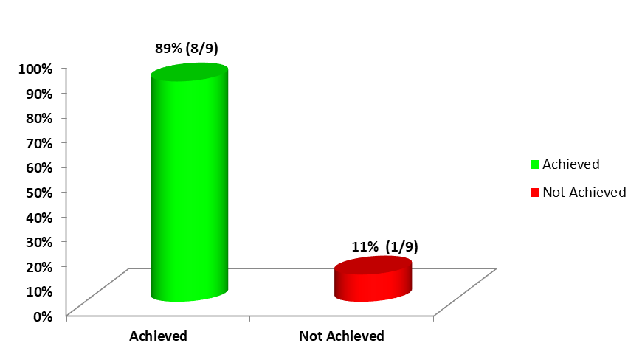
PROGRAMME-SPECIFIC PERFORMANCE
42

Slide 32
PROGRAMME 3: ARTS CULTURE PROMOTION AND DEVELOPMENT….Cont.
INDICATOR CODE/NO | PERFORMANCE INDICATOR | 2022/23 ANNUAL TARGET | 2ND QUARTER TARGET | ACTUAL ACHIEVEMENT AS AT SEPTEMBER 2023 | REASON FOR DEVIATION | CORRECTIVE ACTION
ACPD 3.1 | Number of multi-year human language technology projects supported | 6 | - | No reporting required | - | -
ACPD 3.2 | Percentage of official documents received that are translated and / or edited. | 100% | 100% | 100% of official documents received, were translated and/or edited. | - | -
43

Slide 33
PROGRAMME 3: ARTS CULTURE PROMOTION AND DEVELOPMENT…. Cont.
INDICATOR CODE/NO | PERFORMANCE INDICATOR | 2022/23 ANNUAL TARGET | 2ND QUARTER TARGET | ACTUAL ACHIEVEMENT AS AT SEPTEMBER 2022 | REASON FOR DEVIATION | CORRECTIVE ACTION
ACPD 3.3 | Number of bursaries awarded per year for the development of qualified language practitioners | 250 | - | No reporting required | - | -
ACPD 3.4 | Number of local and international market access platforms supported. | 15 | 2 | 2 Local and international market access platform projects were implemented. | - | -
44

Slide 34
PROGRAMME 3: ARTS CULTURE PROMOTION AND DEVELOPMENT…. Cont.
INDICATOR CODE/NO. | PERFORMANCE INDICATOR | 2022/23 ANNUAL TARGET | 2ND QUARTER TARGET | ACTUAL ACHIEVEMENT AS AT SEPTEMBER 2022 | REASON FOR DEVIATION | CORRECTIVE ACTION
ACPD 3.5 | Number of capacity building projects supported. | 22 | - | No reporting required | - | -
ACPD 3.6 | Number of Provincial Community Arts Development Programmes implemented per year | 9 | - | No reporting required | - | -
45

Slide 35
PROGRAMME 3: ARTS CULTURE PROMOTION AND DEVELOPMENT…. Cont.
INDICATOR CODE/NO | PERFORMANCE INDICATOR | 2022/23 ANNUAL TARGET | 2ND QUARTER TARGET | ACTUAL ACHIEVEMENT AS AT SEPTEMBER 2022 | REASON FOR DEVIATION | CORRECTIVE ACTION
ACPD 3.7 | Number youth focused arts development programmes. | 4 | 1 | 1 (AET) programme was implemented. | - | -
ACPD 3.8 | Number of Gender-Based Violence and Femicide initiatives financially supported. | 3 | - | No reporting required | - | -
46

Slide 36
PROGRAMME 3: ARTS CULTURE PROMOTION AND DEVELOPMENT…. Cont.
INDICATOR CODE/NO. | PERFORMANCE INDICATOR | 2022/23 ANNUAL TARGET | 2ND QUARTER TARGET | ACTUAL ACHIEVEMENT AS AT SEPTEMBER 2022 | REASON FOR DEVIATION | CORRECTIVE ACTION
ACPD 3.9 | Number of international engagements coordinated. | 20 | 5 | 6 International engagements were coordinated. | Due to the Department responding positively to requests received from partner countries. | -
47

Slide 37
PROGRAMME 3: ARTS CULTURE PROMOTION AND DEVELOPMENT…. Cont.
INDICATOR CODE/NO. | PERFORMANCE INDICATOR | 2022/23 ANNUAL TARGET | 2ND QUARTER TARGET | ACTUAL ACHIEVEMENT AS AT SEPTEMBER 2022 | REASON FOR DEVIATION | CORRECTIVE ACTION
ACPD 3.10 | Number of moral regeneration projects supported by Government. | 5 | 4 Ethical Leadership Charter of Positive Values Anti-Femicide and GBV Youth Month Dialogue | 0 | The planned financial support was made outside the reporting period stipulated in the signed MoA (due on the 03/08/2022; but made on 18 October 2022) because of delays in reporting compliance by the MRM. | Further engagement with with MRM to impress upon them the need to submit the reports well in time, to enable the Department to process payments before the end of each quarter.
48

Slide 38
PROGRAMME 3: ARTS CULTURE PROMOTION AND DEVELOPMENT…. Cont.
INDICATOR CODE/NO. | PERFORMANCE INDICATOR | 2022/23 ANNUAL TARGET | 2ND QUARTER TARGET | ACTUAL ACHIEVEMENT AS AT SEPTEMBER 2022 | REASON FOR DEVIATION | CORRECTIVE ACTION
ACPD 3.11 | Number of community conversations/ dialogues implemented by year to foster social interaction | 20 | 5 | 6 Community conversation/dialogues to foster social interaction were implemented. | The over achievement is due the implementation of one dialogue that was postponed from March to July as a result of National Treasury moratorium on procurement amounts. | -
50

Slide 39
PROGRAMME 3: ARTS CULTURE PROMOTION AND DEVELOPMENT…. Cont.
INDICATOR CODE/NO. | PERFORMANCE INDICATOR | 2022/23 ANNUAL TARGET | 2nd QUARTER TARGET | ACTUAL ACHIEVEMENT AS AT SEPTEMBER 2022 | REASON FOR DEVIATION | CORRECTIVE ACTION
ACPD 3.12 | Number of advocacy platforms on social cohesion implemented by social cohesion advocates. | 20 | 5 | 19 Social cohesion advocacy platforms were implemented by Social Cohesion Advocates. | The overachievement is due to the Social Cohesion Advocates intensifying their efforts to respond to a myriad of social ills such as GBVF and xenophobia that threaten social cohesion in our country. The Social Cohesion Advocates are also utilising partnerships to intensify their efforts as part of fostering social cohesion in the country. | -
51

Slide 40
PROGRAMME 3: ARTS CULTURE PROMOTION AND DEVELOPMENT…. Cont.
INDICATOR CODE/NO. | PERFORMANCE INDICATOR | 2022/23 ANNUAL TARGET | 2ND QUARTER TARGET | ACTUAL ACHIEVEMENT AS AT SEPTEMBER 2022 | REASON FOR DEVIATION | CORRECTIVE ACTION
ACPD 3.13 | Number of monitoring reports on the implementation of a social compact for social cohesion and nation building | 2 | - | No reporting required | - | -
ACPD 3.14 | Number of projects through which target groups are supported. | 8 | - | No reporting required | - | -
54

Slide 41
PROGRAMME 3: ARTS CULTURE PROMOTION AND DEVELOPMENT… Cont.
INDICATOR CODE/NO. | PERFORMANCE INDICATOR | 2022/23 ANNUAL TARGET | 2nd QUARTER TARGET | ACTUAL ACHIEVEMENT AS AT SEPTEMBER 2022 | REASON FOR DEVIATION | CORRECTIVE ACTION
ACPD 3.15 | Number of National Days’ celebrations held | 6 | 2 | 2 National Days’ celebrations were implemented. | - | -
55

Slide 42
PROGRAMME 3: ARTS CULTURE PROMOTION AND DEVELOPMENT…. Cont.
INDICATOR CODE/NO. | PERFORMANCE INDICATOR | 2022/23 ANNUAL TARGET | 2nd QUARTER TARGET | ACTUAL ACHIEVEMENT AS AT SEPTEMBER 2022 | REASON FOR DEVIATION | CORRECTIVE ACTION
ACPD 3.16 | Number of projects in the creative industry supported through the Mzansi Golden Economy programme. | 67 | 11 | 22 projects in the creative industry supported through the Mzansi Golden Economy programme. Flagship: 1 Flagship was achieved. MGE “Open Call”: 3 roll-over projects that were partially supported in 2021/22 were fully supported 14 rollover projects that were never supported in 2021/22 implemented. AFRICA MONTH UPDATE: 4 out 10 projects which were partially achieved in Q1, are now fully achieved. | As a result of the high number of applications received and the positive response of the DSAC, a higher number of applications were approved, thus leading to the overachievement. | -
56

Slide 43
PROGRAMME 3: ARTS CULTURE PROMOTION AND DEVELOPMENT…. Cont.
INDICATOR CODE/NO. | PERFORMANCE INDICATOR | 2022/23 ANNUAL TARGET | 2nd QUARTER TARGET | ACTUAL ACHIEVEMENT AS AT SEPTEMBER 2022 | REASON FOR DEVIATION | CORRECTIVE ACTION
ACDP 3.17 | Number of Artists placed in schools per year. | 300 | - | No reporting required. | - | -
ACDP 3.18 | Number of reports produced by SACO. | 16 | - | No reporting required. | - | -
ACDP 3.19 | Number of films and documentaries supported telling stories of the history of liberation, cultural and heritage importance. | 10 | - | No reporting required. | - | -
58

Slide 44
PROGRAMME 4
HERITAGE PROMOTION AND PRESERVATION

Slide 45
PROGRAMME 4: HERITAGE PROMOTION AND PRESERVATION
Purpose: Preserve and promote South African heritage, including archival and heraldic heritage; oversee and transfer funds to libraries.
The Programme has the following sub-programmes:
Heritage Promotion
National Archives Services
Public Library Services
The purpose of the programme is to preserve and promote South African heritage, including archival and heraldic heritage; as well as to oversee and transfer funds to libraries. The budget cuts, together with the lockdown, and accompanying restrictions as well as the likelihood of further increased restrictions, are severely impacting on the implementation of heritage preservation and promotion programmes and the achievement of APP and Operational Plan (OP) targets as detailed in the previous quarterly reports.
61

Slide 46
PROGRAMME 4: HERITAGE PROMOTION AND PRESERVATION…. Cont.
HERITAGE PROMOTION
The sub-programme deals with heritage bursaries; books documenting Living Human Treasures; development of heritage policies, as well as the promotion of national identity utilising the flag at national days, major cultural and sporting events in schools, the Monument Flag Project and “I am the Flag Campaign”.
PUBLIC LIBRARY SERVICES
The key output for this sub-programme is the financial support of newly built and/ or modular libraries.
NATIONAL ARCHIVE SERVICES
The key output of this sub-programme is the upgrading of national archives infrastructure.
SOUTH AFRICAN GEOGRAPHIC NAMES COUNCIL
The key output for this sub-programme, is the transformation and standardisation of geographical names
62

Slide 47
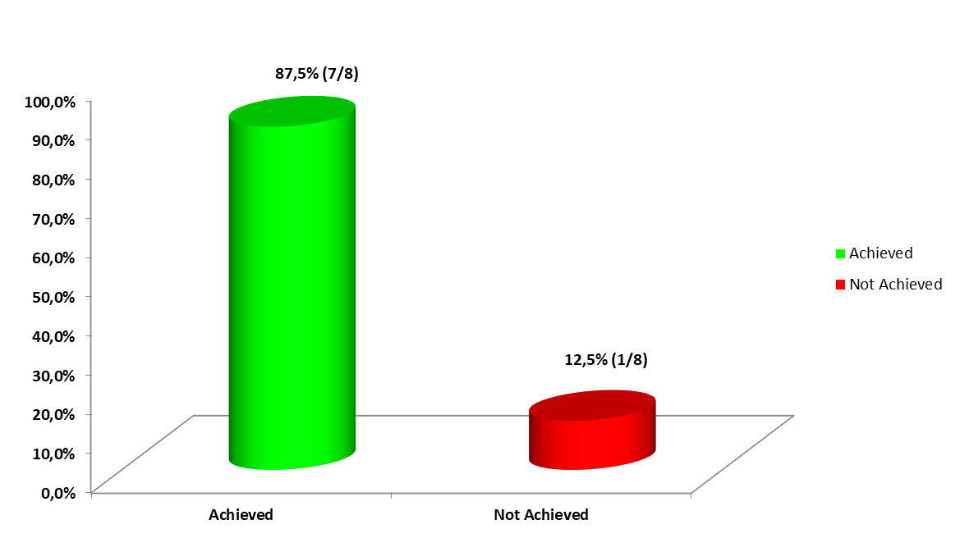
PROGRAMME-SPECIFIC PERFORMANCE
63

Slide 48
PROGRAMME 4: HERITAGE PROMOTION AND PRESERVATION …. Cont.
INDICATOR CODE/NO. | PERFORMANCE INDICATOR | 2022/23 ANNUAL TARGET | 2ND QUARTER TARGET | ACTUAL ACHIEVEMENT AS AT SEPTEMBER 2022 | REASON FOR DEVIATION | CORRECTIVE ACTION
HPP 4.1 | No. of students awarded with heritage bursaries. | 45 | 45 | Zero (0) students awarded with heritage bursaries was implemented. | 2022/23 financial year was the first time the Department implement the Heritage Bursaries through a three (3) Year Memorandum of Agreement (MOA) with universities. There were thus some delays in finalising compliance documentation. | The Department is following up regularly with the universities to expediate the signing of the MOAs. All complying universities would be paid by 30 November 2022.
HPP 4.2 | No. of books documenting living human treasures published. | 5 | - | No reporting required. | - | -
64

Slide 49
PROGRAMME 4: HERITAGE PROMOTION AND PRESERVATION …. Cont.
INDICATOR CODE/NO. | PERFORMANCE INDICATOR | 2022/23 ANNUAL TARGET | 2ND QUARTER TARGET | ACTUAL ACHIEVEMENT AS AT SEPTEMBER 2022 | REASON FOR DEVIATION | CORRECTIVE ACTION
HPP 4.3 | No. of public awareness activations on the “I am the flag” campaign. | 20 | 6 | 7 public awareness activation on the “I am the Flag” campaign were implemented. | The partnership with Kool 2 b South African led to an additional activation. | -
HPP 4.4 | No. of flags provided to schools. | 100 | 30 | 33 flags were provided to schools. | The over-achievement was due to the increased demand from Department of Basic Education. | -
HPP 4.5 | No. of workshops Hosted to advance knowledge of National symbols. | 10 | 3 | 3 Workshops were hosted to advance knowledge of National Symbols. | - | -
69

Slide 50
PROGRAMME 4: HERITAGE PROMOTION AND
PRESERVATION…. Cont.
INDICATOR CODE/NO. | PERFORMANCE INDICATOR | 2022/23 ANNUAL TARGET | 2ND QUARTER TARGET | ACTUAL ACHIEVEMENT AS AT SEPTEMBER 2022 | REASON FOR DEVIATION | CORRECTIVE ACTION
HPP 4.6 | No. of heritage legacy projects where exhibition content is develop. | 3 | - | No reporting required | - | -
HPP 4.7 | No. of progress reports on resistance and liberation heritage route site received and analysed. | 2 | 1 | 1 Progress report on Resistance and Liberation Heritage Route Sites was received and analysed. | - | -
71

Slide 51
PROGRAMME 4: HERITAGE PROMOTION AND PRESERVATION…. Cont.
INDICATOR CODE/NO. | PERFORMANCE INDICATOR | 2022/23 ANNUAL TARGET | 2ND QUARTER TARGET | ACTUAL ACHIEVEMENT AS AT SEPTEMBER 2022 | REASON FOR DEVIATION | CORRECTIVE ACTION
HPP 4.8 | No. of records digitised | 240 (150 treason trial dictabelts & 90 TRC audio tapes) | Treason trial dictabelts 22 TRC Audio Tapes | 660 records digitized. - 198 Treason Trial Dictabelts digitised - 462 TRC Audio Tapes digitised | Increased digitisation capacity through employment of Interns using the Presidential Employment Stimulus Package, enabled the over-achievement. | -
72

Slide 52
PROGRAMME 4: HERITAGE PROMOTION AND PRESERVATION…. Cont.
INDICATOR CODE/NO. | PERFORMANCE INDICATOR | 2022/23 ANNUAL TARGET | 2ND QUARTER TARGET | ACTUAL ACHIEVEMENT AS AT SEPTEMBER 2022 | REASON FOR DEVIATION | CORRECTIVE ACTION
HHP 4.9 | No. of libraries financially supported per year. | 29 | 29 | 29 new librararies were financially supported. | - | -
HHP 4.10 | No. of Gazette notices on standardised geographical names published. | 3 | 1 | 1 Gazette notice on Standardised geographical names was published on 26 August 2022. | - | -
73

Slide 53
FINANCIAL PERFORMANCE REPORT
AS AT SEPTEMBER 2022

Slide 54
PRESENTATION OUTLINE
EXECUTIVE SUMMARY
2. DEPARTMENTAL SUMMARY OF BUDGET VS EXPENDITURE
- per Programme
-Economic Classification
3. BUDGET VS EXPENDITURE
- per Programme and Economic Classification
75

Slide 55
PRESENTATION OUTLINE
1. Executive Summary
2. Departmental Summary of Budget vs Expenditure
- per Programme; and
- per Economic Classification
Budget vs Expenditure Per Programme and Economic
Classification
76

Slide 56
EXECUTIVE SUMMARY
The overall spending is at R2,8 billion (44.2%) against the Adjusted Appropriation of R6,3 billion as at 30 September 2022. The department had projected to spend R3,2 billion (51.0%) of its budget by end of the quarter, which lead to an underspending by R433,5 million (6.9%) against the projections.
  The over and under expenditure against projections are explained as follows:
Compensation of employees (CoE)
The spending is at R169,9 million (45.3%) against the Adjusted Appropriation of R375,4 million. The department had projected to spend R188,3 million (50.1%) of its CoE budget by end of the quarter, which lead to an underspending by R18,3 million (4.9%) against the projections.
    The Department filled number of positions since the commencement of its recruitment drive in January 2022 as an attempt to reduce the vacancy rate, and the remainder are at different stages of the selection process.
    Although a lot of work has been done in the recruitment space, it has not made a huge impact on the vacancy rate. This is due to the reason that most appointments that were made were internal, therefore did not assist in reducing the vacancy rate which according to the Department of Public Service and Administration, must be capped at 10% or less. The Department is in a process of advertising 69 positions.
Goods and services
The spending is at R314,9 million (47.1%) against the Adjusted Appropriation of R668,5 million. There is an underspending of R10,8 million (1.6%) from the projected expenditure of R325,7 million (48.7%).
  The expenditure for goods and services was slow at the beginning of the financial year due to the procurement exemption, however after the uplifting of the exemption the expenditure has started to show the improvement, events for the Department are happening and easing of covid-19 restrictions also makes travelling happening and the expenditure is showing growth.
Projection | Actual | variance
50.1% | 45.3% | 4.9%
Projection | Actual | variance
48.7% | 47.1% | 1.6%
77

Slide 57
EXECUTIVE SUMMARY
Provinces and Municipalities
  An expenditure of R1,1 billion (51.4%) incurred against the Adjusted Appropriation of R2,2 billion relating to transfers of Community Libraries and Mass Participation Conditional Grants. The spending is in line with the projections for the quarter.
    This expenditure item relates to the transfers for the Community Libraries and Mass Participation and Sport Development Conditional grants, which relate to funds that are transferred to various Provinces on a quarterly basis guided by DORA payment schedule/projections.
Departmental Agencies and Accounts (Cur)
  The spending is at R895,7 million (41.1%) against the Adjusted Appropriation of R2,2 billion. The expenditure is below the quarterly projected expenditure of R1,193 million (54.8%) by R297,4 million (13.6%).
  The under expenditure against projections are explained as follows:
    transfers to DSAC entities implementing Phase 3 PESP could not be made because of the conditions set out in the allocation letter that the Department can only apply for National Treasury (NT) approval to increase the transfer to the selected entities once the adjudication and approval process of applications has been finalised at those entities. Transfers were however made to entities as the management fee for the entities to commence with the process upon NT approval to increase its allocations. A request to increase the allocation of the National Museum, BASA and NAC based on the amount adjudicated and approval process of applications finalised, was submitted to National Treasury for its approval;
Projection | Actual | variance
51.4% | 51.4% | 0.0%
Projection | Actual | variance
54.8% | 41.1% | 13.6%
78

Slide 58
EXECUTIVE SUMMARY
    transfers to Entities implementing Phase 3 PESP could not be made as a result of the conditions set out in the allocation letter that the Department can only apply for Treasury approval to increase the transfer to the selected entities once the adjudication and approval process of applications has been finalized at those entities. Approval was however granted by Treasury in June to increase entities allocation for the management fee for the entities to commence with the process.
    2nd quarter tranche to National Library of SA not made, pending confirmation that the entity spent the previous tranche in full and submission of reports; and
    transfers to the State Theatre, PACOFS, Artscape and Northern Cape Theatre for the implementation of incubator programme not done owing to delay in the approval of APP and Operational Plans targets which impacted on the projected dates of first trench payments to cultural institutions.
Departmental Agencies and Accounts (Cap)
  The spending is at R71,1 million (34.3%) against the Adjusted Appropriation of R207,4 million, with an underspending by R33,5 million (16.2%) against the projected expenditure of R104,6 million (50.4%).
    The under expenditure against projections are explained as follows:
    National Heritage Council (Resistance and Liberation Heritage Route): transfer to the NHC will be made as soon as the entity submit the report to account for previously transferred funds;
Projection | Actual | variance
50.4% | 34.3% | 16.2%
79

Slide 59
EXECUTIVE SUMMARY
    Die Afrikaanse Taalmuseum en -monument: the allocated budget was assigned to DPWI to implement the Facilities Management contract for the Entity, DPWI only confirmed registration of the FM contract on the 21st of October 2022. A meeting was also held with DPWI of Western Cape in an effort to fast track the administrative and planning process to implement the FM Contract for the Entity;
    SA Library for the Blind: the processing of invoices from DPWI has been on hold due to delays with finalizing of the SLA between DSAC and DPWI, the SLA is with the Legal Services at the DPWI before submission to the Acting Director-General for approval and signature; and
    uMsunduzi Museum: transfer not made owing to slow spending by the museum on funds DSAC already transferred in the prior financial years.
Higher Education Institutions (Cur)
The expenditure is at R5,2 million (55.1%) against the Adjusted Appropriation of R9,5 million. The department had projected to spend R7,4 million (78.2%) by end of the quarter, which lead to an underspending by R2,2 million (23.1%) against the projections.
    The reason for deviation from the approved projections is owing to virement approval granted towards end of September
    Transfers to Universities implementing HLT projects financially supported made in line with signed MoAs
Projection | Actual | variance
78.2% | 55.1% | 23.1%
80

Slide 60
EXECUTIVE SUMMARY
Foreign Government & International Organisations
  The expenditure is at R3,1 million (52.7%) against the Adjusted Appropriation of R5.9 million. There is an over expenditure of R301 thousand (5.1%) against the projected expenditure of R2,8 million (47.6%) in the quarter.
    Subscription fees to international organizations and operational funds to the African World Heritage Fund were made as projected
Public Corporations & Private Enterprises (Cur)
The expenditure is at R60,7 million (68.3%) against the Adjusted Appropriation of R88,9 million. The department had projected to spend R57,1 million (64.3%) by end of the quarter, which lead to an overspending by R3,6 million (4.0%) against the projections.
    The expenditure has improved mainly due to transfers made to MGE and CCID beneficiaries upon approval of item creation by National Treasury
    Reason for deviation from approved projections is owing to delays in finalisation of projects from the Northern Cape Province regarding the Upgrading of Public Spaces
Projection | Actual | variance
47.6% | 52.7% | (5.1%)
Projection | Actual | variance
64.3% | 68.3% | (4.0%)
81

Slide 61
EXECUTIVE SUMMARY
Households
  The expenditure is at R16.1 million (51.5%) against the Adjusted Appropriation of R31,2 million. There is an under expenditure of R7,4 million (23,7%) against the projected expenditure of R23,5 million (75.2%) in the quarter.
    The under expenditure against projections are explained as follows:
    Transfers to Ministerial bursary support to athletes which are based on claims from schools; and
    delays in vetting the MoAs by Legal Services.
Projection | Actual | variance
75.2% | 51.5% | 23.7%
82

Slide 62
EXECUTIVE SUMMARY
Non-Profit Institutions (Cur)
The expenditure is at R119,4 million (32.1%) against the Adjusted Appropriation of R372,6 million. The department had projected to spend R154,1 million (41,3%) by end of the quarter, which lead to an underspending by R34,6 million (9.3%) against the projections.
Although the expenditure is not in line with the projections, there is a major improvement in expenditure compared to the previous month due to transfers made to MGE and CCID beneficiaries
    The under expenditure against projections are explained as follows:
    The 1st tranche to Lovelife could not be made owing to prior financial year unspent funds and submission of expenditure reports
    South African Sports Confederation and Olympic Committee – the prior financial year’s transfer to SASCOC was made in March with additional funds towards Commonwealth Games and the World Games. Transfer for the current financial year’s allocation will only be made once the organization account for the prior financial year’s transferred funds.
Projection | Actual | variance
41.3% | 32.1% | 9.3%
83

Slide 63
EXECUTIVE SUMMARY
Non-Profit Institutions (Cap)
The expenditure is at R0,00 (0.0%) against the Adjusted Appropriation of R22 million. The department had projected to spend R3,9 million (17.8%) by end of the quarter, which lead to an underspending by R3,9 million (100.0%) against the projections.
    Reason for deviation from approved projections is owing to delays in finalisation of projects from the Northern Cape Province regarding the Upgrading of Public Spaces
    Funds will be reprioritised to one of the needy projects of the Upgrading of Community Arts Centre project
Machinery and equipment
The expenditure is at R5,9 million (46.3%) against the Adjusted Appropriation of R12,8 million. The department had projected to spend R12,4 million (96.1%) by end of the quarter, which lead to an underspending by R6,4 million (49.9%) against the projections.
    The reason for deviation from the approved projections; The service provider for storage equipment has not submitted the invoice as there are still items not yet delivered from overseas. Procurement network infrastructure for NARSSA and film archives will not be done due to insufficient funds, owing to disapproval of roll over request by National Treasury.
Projection | Actual | variance
17.8% | 0.0% | 17.8%
Projection | Actual | variance
96.1% | 46.3% | 49.9%
84

Slide 64
EXECUTIVE SUMMARY
Heritage Assets
The expenditure is at R111 thousands against the Adjusted Appropriation of R144,4 million. The department had projected to spend R23,1 million (11.9%) by end of the quarter, which lead to an underspending by R23,0 million (100.0%) against the projections.
    The reasons for deviation from approved projections is attributed to:
JL Dube Amphitheatre – there are contractual challenges with the project. The contractor left site in June 2022 and interventions by DSAC to get construction to resume is underway. The Implementing agency is currently in the process of quantifying the remaining amount of work;
Sarah Baartman Centre: the service level agreement (SLA) between DSAC and DPWI expired in March 2022. A new SLA and MOU were prepared and sent to DPWI for signature. DSAC has not received any responses and cannot pay any invoices without the signed MOA and SLA;
National Archives New Purpose Building: the appointed service provider to conduct a feasibility study for the project cost lesser than the allocated amount. Approval was granted by NT to apply virement from savings realised from the project to other needy projects during the AENE process; and
Polokwane Performing Arts Centre: the Province has indicated delays in the process of the appointment of the contractor, DSAC awaiting formal communication from the Province with this regards.
Projection | Actual | variance
11.9% | 0.1% | 11.9%
85

Slide 65
DEPARTMENTAL SUMMARY OF BUDGET VS EXPENDITURE PER PROGRAMME

Slide 66
DEPARTMENTAL SUMMARY PER-PROGRAMME
Programme | Adjusted Appropriation | Actual Expenditure 30 SEP 2022 | Variance | Expenditure as % of Adjusted Appropriation |  | Cash-Flow Projections | Actual Expenditure 30 SEP 2022 | Variance | Expenditure as % of Projections
Administration | 453,228 | 276,798 | 176,430 | 61.1% |  | 238,344 | 276,798 | (38,454) | 116.1%
Recreation Development & Sport Promotion | 1,425,786 | 500,012 | 925,774 | 35.1% |  | 593,811 | 500,012 | 93,799 | 84.2%
Arts & Culture Promotion & Development | 1,749,793 | 679,117 | 1,070,676 | 38.8% |  | 1,031,109 | 679,117 | 351,992 | 65.9%
Heritage Promotion & Preservation | 2,666,321 | 1,324,206 | 1,342,115 | 49.7% |  | 1,350,396 | 1,324,206 | 26,190 | 98.1%
TOTAL | 6,295,128 | 2,780,133 | 3,514,995 | 44.2% |  | 3,213,660 | 2,780,133 | 433,527 | 86.5%
87

Slide 67
DEPARTMENTAL SUMMARY PER ECONOMIC CLASSIFICATION….
Economic Classification | Adjusted Appropriation | Actual Expenditure 30 SEP 2022 | Variance | Expenditure as % of Adjusted Appropriation |  | Cash-Flow Projections | Actual Expenditure 30 SEP 2022 | Variance | Expenditure as % of Projections
CURRENT PAYMENTS | 1,043,936 | 484,856 | 559,080 | 46.4% |  | 513,956 | 484,856 | 29,100 | 94.3%
Compensation of Employees | 375,441 | 169,961 | 205,480 | 45.3% |  | 188,279 | 169,961 | 18,318 | 90.3%
Goods and Services | 668,495 | 314,895 | 353,600 | 47.1% |  | 325,677 | 314,895 | 10,782 | 96.7%
TRANSFERS & SUBSIDIES | 5,092,464 | 2,289,182 | 2,803,282 | 45.0% |  | 2,664,282 | 2,289,182 | 375,100 | 85.9%
Provinces & Municipalities | 2,176,061 | 1,117,795 | 1,058,266 | 51.4% |  | 1,117,795 | 1,117,795 | - | 100.0%
Departmental Agencies (Cur) | 2,178,945 | 895,733 | 1,283,212 | 41.1% |  | 1,193,132 | 895,733 | 297,399 | 75.1%
Departmental Agencies (Cap) | 207,390 | 71,078 | 136,312 | 34.3% |  | 104,572 | 71,078 | 33,494 | 68.0%
Higher Education Institutions (Cur) | 9,453 | 5,213 | 4,240 | 55.1% |  | 7,394 | 5,213 | 2,181 | 70.5%
Foreign Governance & International Org | 5,940 | 3,129 | 2,811 | 52.7% |  | 2,828 | 3,129 | (301) | 110.6%
Public corporations and private enterprises (Cur) | 88,883 | 60,721 | 28,162 | 68.3% |  | 57,133 | 60,721 | (3,588) | 106.3%
88

Slide 68
…DEPARTMENTAL SUMMARY PER ECONOMIC CLASSIFICATION
Economic Classification | Adjusted Appropriation | Actual Expenditure 30 SEP 2022 | Variance | Expenditure as % of Adjusted Appropriation |  | Cash-Flow Projections | Actual Expenditure 30 SEP 2022 | Variance | Expenditure as % of Projections
Households | 31,185 | 16,074 | 15,111 | 51.5% |  | 23,453 | 16,074 | 7,379 | 68.5%
Non-Profit Institutions (Cur) | 372,638 | 119,439 | 253,199 | 32.1% |  | 154,074 | 119,439 | 34,635 | 77.5%
Non-Profit Institutions (Cap) | 21,969 | - | 21,969 | 0.0% |  | 3,901 | - | 3,901 | 0.0%
PAYMENTS FOR CAPITAL ASSETS | 158,728 | 6,054 | 152,674 | 3.8% |  | 35,422 | 6,054 | 29,368 | 17.1%
Machinery and equipment | 12,847 | 5,943 | 6,904 | 46.3% |  | 12,350 | 5,943 | 6,407 | 48.1%
Heritage Assets | 144,381 | 111 | 144,270 | 0.1% |  | 23,072 | 111 | 22,961 | 0.5%
Software and other intangible assets | 1,500 | - | 1,500 | 0.0% |  | - | - | - | -
PAYMENTS FOR FINANCIAL ASSETS | - | 41 | (41) | - |  | - | 41 | (41) | -
TOTAL | 6,295,128 | 2,780,133 | 3,514,995 | 44.2% |  | 3,213,660 | 2,780,133 | 433,527 | 86.5%
89

Slide 69
p16
SUMMARY OF BUDGET VS EXPENDITURE PER SUB-PROGRAMME AND ECONOMIC CLASSIFICATION

Slide 70
ADMINISTRATION:
PER SUB-PROGRAMME
Sub-Programme | Adjusted Appropriation | Actual Expenditure 30 SEP 2022 | Variance | Expenditure as % of Adjusted Appropriation |  | Cash-Flow Projections | Actual Expenditure 30 SEP 2022 | Variance | Expenditure as % of Projections
Ministry | 4,515 | 2,331 | 2,184 | 51.6% |  | 2,208 | 2,331 | (123) | 105.6%
Management | 71,881 | 33,747 | 38,134 | 46.9% |  | 35,914 | 33,747 | 2,167 | 94.0%
Strategic Management and Planning | 21,819 | 9,626 | 12,193 | 44.1% |  | 11,096 | 9,626 | 1,470 | 86.8%
Corporate Service | 161,561 | 89,639 | 71,922 | 55.5% |  | 92,019 | 89,639 | 2,380 | 97.4%
Office of the CFO | 68,062 | 30,024 | 38,038 | 44.1% |  | 34,411 | 30,024 | 4,387 | 87.3%
Office Accommodation | 125,390 | 111,431 | 13,959 | 88.9% |  | 62,696 | 111,431 | (48,735) | 177.7%
TOTAL | 453,228 | 276,798 | 176,430 | 61.1% |  | 238,344 | 276,798 | (38,454) | 116.1%
91

Slide 71
ADMINISTRATION:
PER ECONOMIC CLASSIFICATION…
Economic Classification | Adjusted Appropriation | Actual Expenditure 30 SEP 2022 | Variance | Expenditure as % of Adjusted Appropriation |  | Cash-Flow Projections | Actual Expenditure 30 SEP 2022 | Variance | Expenditure as % of Projections
CURRENT PAYMENTS | 439,885 | 270,047 | 169,838 | 61.4% |  | 225,994 | 270,047 | (44,053) | 119.5%
Compensation of Employees | 183,218 | 83,623 | 99,595 | 45.6% |  | 92,280 | 83,623 | 8,657 | 90.6%
Goods and Services | 256,667 | 186,424 | 70,243 | 72.6% |  | 133,714 | 186,424 | (52,710) | 139.4%
TRANSFERS & SUBSIDIES | 496 | 767 | (271) | 154.6% |  | - | 767 | (767) | -
Departmental Agencies (Cur) | 104 | - | 104 | 0.0% |  | - | - | - | -
Households | 392 | 767 | (375) | 195.7% |  | - | 767 | (767) | -
PAYMENTS FOR CAPITAL ASSETS | 12,847 | 5,943 | 6,904 | 46.3% |  | 12,350 | 5,943 | 6,407 | 48.1%
Machinery and equipment | 12,847 | 5,943 | 6,904 | 46.3% |  | 12,350 | 5,943 | 6,407 | 48.1%
PAYMENTS FOR FINANCIAL ASSETS | - | 41 | (41) | #DIV/0! |  | - | 41 | (41) | #DIV/0!
TOTAL | 453,228 | 276,798 | 176,430 | 61.1% |  | 238,344 | 276,798 | (38,454) | 116.1%
92

Slide 72
RECREATION DEVELOPMENT & SPORT PROMOTION: PER SUB-PROGRAMME
Sub-Programme | Adjusted Appropriation | Actual Expenditure 30 SEP 2022 | Variance | Expenditure as % of Adjusted Appropriation |  | Cash-Flow Projections | Actual Expenditure 30 SEP 2022 | Variance | Expenditure as % of Projections
Winning Nation | 278,829 | 83,646 | 195,183 | 30.0% |  | 85,779 | 83,646 | 2,133 | 97.5%
Active Nation | 727,825 | 334,923 | 392,902 | 46.0% |  | 349,960 | 334,923 | 15,037 | 95.7%
Infrastructure Support | 419,132 | 81,443 | 337,689 | 19.4% |  | 158,072 | 81,443 | 76,629 | 51.5%
TOTAL | 1,425,786 | 500,012 | 925,774 | 35.1% |  | 593,811 | 500,012 | 93,799 | 84.2%
93

Slide 73
RECREATION DEVELOPMENT & SPORT PROMOTION: PER ECONOMIC CLASSIFICATION….
Economic Classification | Adjusted Appropriation | Actual Expenditure 30 SEP 2022 | Variance | Expenditure as % of Adjusted Appropriation |  | Cash-Flow Projections | Actual Expenditure 30 SEP 2022 | Variance | Expenditure as % of Projections
CURRENT PAYMENTS | 183,794 | 61,833 | 121,961 | 33.6% |  | 80,171 | 61,833 | 18,338 | 77.1%
Compensation of Employees | 34,956 | 16,562 | 18,394 | 47.4% |  | 17,668 | 16,562 | 1,106 | 93.7%
Goods and Services | 148,838 | 45,271 | 103,567 | 30.4% |  | 62,503 | 45,271 | 17,232 | 72.4%
TRANSFERS & SUBSIDIES | 1,097,611 | 438,068 | 659,543 | 39.9% |  | 490,568 | 438,068 | 52,500 | 89.3%
Provinces & Municipalities | 603,511 | 301,756 | 301,755 | 50.0% |  | 301,756 | 301,756 | - | 100.0%
Departmental Agencies (Cur) | 48,839 | 48,839 | - | 100.0% |  | 48,839 | 48,839 | - | 100.0%
Departmental Agencies (Cap) | 207,390 | 71,078 | 136,312 | 34.3% |  | 104,572 | 71,078 | 33,494 | 68.0%
Higher Education Institutions (Cur) | - | - | - | - |  | - | - | - | -
Foreign Governance & International Org | 139 | 130 | 9 | 93.5% |  | - | 130 | (130) | -
Public corporations and private enterprises (Cap) | 616 | - | 616 | 0.0% |  | 554 | - | 554 | 0.0%
94

Slide 74
….RECREATION DEVELOPMENT & SPORT PROMOTION: PER ECONOMIC CLASSIFICATION
Economic Classification | Adjusted Appropriation | Actual Expenditure 30 SEP 2022 | Variance | Expenditure as % of Adjusted Appropriation |  | Cash-Flow Projections | Actual Expenditure 30 SEP 2022 | Variance | Expenditure as % of Projections
Households | 5,434 | 1,265 | 4,169 | 23.3% |  | 2,502 | 1,265 | 1,237 | 50.6%
Non-Profit Institutions (Cur) | 209,713 | 15,000 | 194,713 | 7.2% |  | 28,444 | 15,000 | 13,444 | 52.7%
Non-Profit Institutions (Cap) | 21,969 | - | 21,969 | 0.0% |  | 3,901 | - | 3,901 | 0.0%
PAYMENTS FOR CAPITAL ASSETS | 144,381 | 111 | 144,270 | 0.1% |  | 23,072 | 111 | 22,961 | 0.5%
Heritage Assets | 144,381 | 111 | 144,270 | 0.1% |  | 23,072 | 111 | 22,961 | 0.5%
PAYMENTS FOR FINANCIAL ASSETS | - | - | - | - |  | - | - | - | -
TOTAL | 1,425,786 | 500,012 | 925,774 | 35.1% |  | 593,811 | 500,012 | 93,799 | 84.2%
95

Slide 75
ARTS & CULTURAL PROMOTION & DEVELOPMENT : PER SUB-PROGRAMME
Sub-Programme | Adjusted Appropriation | Actual Expenditure 30 SEP 2022 | Variance | Expenditure as % of Adjusted Appropriation |  | Cash-Flow Projections | Actual Expenditure 30 SEP 2022 | Variance | Expenditure as % of Projections
National Language Services | 54,844 | 30,313 | 24,531 | 55.3% |  | 34,537 | 30,313 | 4,224 | 87.8%
Pan South African Language Board | 123,124 | 61,562 | 61,562 | 50.0% |  | 61,562 | 61,562 | - | 100.0%
Cultural and Creative Industries Development | 160,155 | 85,440 | 74,715 | 53.3% |  | 87,156 | 85,440 | 1,716 | 98.0%
International Cooperation | 42,533 | 14,337 | 28,196 | 33.7% |  | 20,461 | 14,337 | 6,124 | 70.1%
Social Cohesion and Nation Building | 69,333 | 25,596 | 43,737 | 36.9% |  | 41,215 | 25,596 | 15,619 | 62.1%
Mzansi Golden Economy | 694,343 | 147,300 | 547,043 | 21.2% |  | 490,775 | 147,300 | 343,475 | 30.0%
Performing Arts Institutions | 318,570 | 163,788 | 154,782 | 51.4% |  | 159,288 | 163,788 | (4,500) | 102.8%
National Film and Video Foundation | 155,932 | 81,328 | 74,604 | 52.2% |  | 74,606 | 81,328 | (6,722) | 109.0%
National Arts Council | 130,959 | 69,453 | 61,506 | 53.0% |  | 61,509 | 69,453 | (7,944) | 112.9%
TOTAL | 1,749,793 | 679,117 | 1,070,676 | 38.8% |  | 1,031,109 | 679,117 | 351,992 | 65.9%
96

Slide 76
ARTS & CULTURAL PROMOTION & DEVELOPMENT: PER ECONOMIC CLASSIFICATION….
Economic Classification | Adjusted Appropriation | Actual Expenditure 30 SEP 2022 | Variance | Expenditure as % of Adjusted Appropriation |  | Cash-Flow Projections | Actual Expenditure 30 SEP 2022 | Variance | Expenditure as % of Projections
CURRENT PAYMENTS | 279,511 | 109,334 | 170,177 | 39.1% |  | 149,872 | 109,334 | 40,538 | 73.0%
Compensation of Employees | 86,791 | 40,601 | 46,190 | 46.8% |  | 43,068 | 40,601 | 2,467 | 94.3%
Goods and Services | 192,720 | 68,733 | 123,987 | 35.7% |  | 106,804 | 68,733 | 38,071 | 64.4%
TRANSFERS & SUBSIDIES | 1,470,282 | 569,783 | 900,499 | 38.8% |  | 881,237 | 569,783 | 311,454 | 64.7%
Departmental Agencies (Cur) | 1,199,612 | 390,144 | 809,468 | 32.5% |  | 681,584 | 390,144 | 291,440 | 57.2%
Higher Education Institutions (Cur) | 9,453 | 5,213 | 4,240 | 55.1% |  | 7,394 | 5,213 | 2,181 | 70.5%
Foreign Governance & International Org | 3,319 | 526 | 2,793 | 15.8% |  | 419 | 526 | (107) | 125.5%
Public corporations and private enterprises (Cur) | 88,267 | 60,721 | 27,546 | 68.8% |  | 56,579 | 60,721 | (4,142) | 107.3%
Households | 20,222 | 13,860 | 6,362 | 68.5% |  | 16,451 | 13,860 | 2,591 | 84.3%
Non-Profit Institutions (Cur) | 149,409 | 99,319 | 50,090 | 66.5% |  | 118,810 | 99,319 | 19,491 | 83.6%
TOTAL | 1,749,793 | 679,117 | 1,070,676 | 38.8% |  | 1,031,109 | 679,117 | 351,992 | 65.9%
97

Slide 77
HERITAGE PROMOTION & PRESERVATION :
PER SUB-PROGRAMME
Sub-Programme | Adjusted Appropriation | Actual Expenditure 30 SEP 2022 | Variance | Expenditure as % of Adjusted Appropriation |  | Cash-Flow Projections | Actual Expenditure 30 SEP 2022 | Variance | Expenditure as % of Projections
Heritage Promotion | 65,254 | 19,939 | 45,315 | 30.6% |  | 29,056 | 19,939 | 9,117 | 68.6%
National Archive Services | 79,205 | 22,818 | 56,387 | 28.8% |  | 33,029 | 22,818 | 10,211 | 69.1%
Heritage Institutions | 632,177 | 313,999 | 318,178 | 49.7% |  | 313,599 | 313,999 | (400) | 100.1%
National Library Services | 146,573 | 73,289 | 73,284 | 50.0% |  | 73,289 | 73,289 | - | 100.0%
Public Library Services | 1,601,360 | 822,699 | 778,661 | 51.4% |  | 830,524 | 822,699 | 7,825 | 99.1%
South African Heritage Resource Agency | 62,839 | 31,421 | 31,418 | 50.0% |  | 31,421 | 31,421 | - | 100.0%
South African Geographical Names Council | 5,311 | 3,239 | 2,072 | 61.0% |  | 2,676 | 3,239 | (563) | 121.0%
National Heritage Council | 73,602 | 36,802 | 36,800 | 50.0% |  | 36,802 | 36,802 | - | 100.0%
TOTAL | 2,666,321 | 1,324,206 | 1,342,115 | 49.7% |  | 1,350,396 | 1,324,206 | 26,190 | 98.1%
98

Slide 78
HERITAGE PROMOTION & PRESERVATION:
PER ECONOMIC CLASSIFICATION….
Economic Classification | Adjusted Appropriation | Actual Expenditure 30 SEP 2022 | Variance | Expenditure as % of Adjusted Appropriation |  | Cash-Flow Projections | Actual Expenditure 30 SEP 2022 | Variance | Expenditure as % of Projections
CURRENT PAYMENTS | 140,746 | 43,642 | 97,104 | 31.0% |  | 57,919 | 43,642 | 14,277 | 75.4%
Compensation of Employees | 70,476 | 29,175 | 41,301 | 41.4% |  | 35,263 | 29,175 | 6,088 | 82.7%
Goods and Services | 70,270 | 14,467 | 55,803 | 20.6% |  | 22,656 | 14,467 | 8,189 | 63.9%
TRANSFERS & SUBSIDIES | 2,524,075 | 1,280,564 | 1,243,511 | 50.7% |  | 1,292,477 | 1,280,564 | 11,913 | 99.1%
Provinces & Municipalities | 1,572,550 | 816,039 | 756,511 | 51.9% |  | 816,039 | 816,039 | - | 100.0%
Departmental Agencies (Cur) | 930,390 | 456,750 | 473,640 | 49.1% |  | 462,709 | 456,750 | 5,959 | 98.7%
Foreign Governance & International Org | 2,482 | 2,473 | 9 | 99.6% |  | 2,409 | 2,473 | (64) | 102.7%
Households | 5,137 | 182 | 4,955 | 3.5% |  | 4,500 | 182 | 4,318 | 4.0%
Non-Profit Institutions (Cur) | 13,516 | 5,120 | 8,396 | 37.9% |  | 6,820 | 5,120 | 1,700 | 75.1%
99

Slide 79
THANK YOU

