Slide 1
VOTE 29 DALRRD
DEPARTMENT OF AGRICULTURE LAND REFORM AND RURAL DEVELOPMENT: 2023 ENE
PRESENTATION TO THE PORTFOLIO COMMITTEE ON AGRICULTURE, LAND REFORM AND RURAL DEVELOPMENT
_______(Branch)
2022 MTEF – DEPARTMENTAL CONTROL COMMITEE
DATE: 18 APRIL 2023

Slide 2
TABLE OF CONTENTS
1
Selected Performance Indicators
2
Allocation Letter
3
Human Resource Budget Plan (HRBP)
4
2023 ENE Per Programme and Sub Programme
5
2023 ENE Per Economic Classification
6
2023 ENE Per Province
7
2023 ENE Per Conditional Grant

Slide 3
SELECTED PERFORMANCE INDICATORS
Department selected performance indicator
Nr. | Indicator | Programme | MTSF Priority | MTEF Targets
 |  |  |  | 2022/23 | 2023/24 | 2024/25
1 | Number of plant pest surveillance surveys conducted per year | Agricultural Production, Biosecurity and Natural Resources Management | Priority 2: Economic transformation and job creation | 3 | 3 | 3
2 | Number of animal disease surveillance surveys conducted per year | Agricultural Production, Biosecurity and Natural Resources Management |  | 3 | 3 | 3
3 | Number of hectares acquired for redistribution per year | Food Security, Land Reform and Restitution | Priority 5: Spatial integration, human settlements and local government | 36,628 | 38,459 | 40,380
4 | Number of land claims finalised per year | Food Security, Land Reform and Restitution |  | 459 | 378 | 399
5 | Number of subsistence and smallholder producers supported per year |  | Priority 2: Economic transformation and job creation | 120,000 | 120,000 | 120,000
6 | Number of infrastructure projects completed. | Rural Development | Priority 6: Integrated and inclusive Rural Economy | 83 | 74 | 75
7 | Number of young people trained through the national rural youth service corps programme per year | Food Security, Land Reform and Restitution |  | 819 | 901 | 992

Slide 4
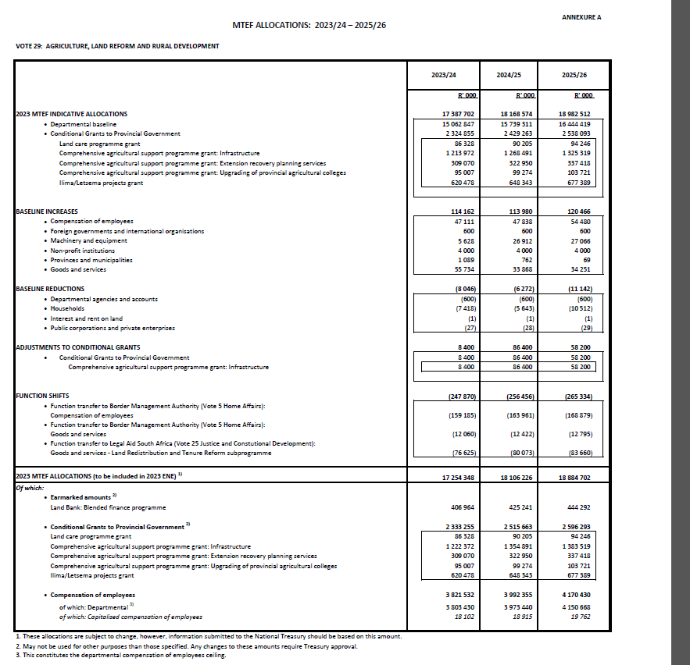
2023 FINAL ALLOCATIONS
4

Slide 5
HUMAN RESOURCE BUDGET PLAN (HRBP)
PROGRAMME | 2023 ENE -2023/24 Initial Headcount R'000 | 2023 ENE 2023/24 Headcount Increase / (Decrease) R'000 | 2023 ENE -2024/25 Initial Headcount R'000 | 2023 ENE 2024/25 Headcount Increase / (Decrease) R'000 | 2023 ENE -2025/26 Initial Headcount R'000 | 2023 ENE 2025/26 Headcount Increase / (Decrease) R'000
Prg 1 Administration | 2,842 | (1,200) | 1,642 | 41 | 1,683 | 129
Prg 2 Agricultural Production, Biosecurity and Natural Resources Management | 1,576 | (174) | 1,402 | (27) | 1,374 | 22
Prg 3 Food Security, Land Reform and Restitution | 1,500 | 346 | 1,846 | (32) | 1,815 | 20
Prg 4 Rural Development | 52 | 29 | 81 | (2) | 79 | 8
Prg 5 Economic Development, Trade and Marketing | 253 | 172 | 425 | (4) | 421 | 8
Prg 6 Land Administration | 726 | 40 | 766 | (15) | 750 | 13
TOTAL | 6,949 | (787) | 6,161 | (39) | 6,122 | 200

Slide 6
HUMAN RESOURCE BUDGET PLAN (HRBP)

Slide 7
HUMAN RESOURCE BUDGET PLAN (HRBP)
PER LEVEL | 2023 ENE -2023/24 Initial Headcount R'000 | 2023 ENE 2023/24 Headcount Increase / (Decrease) R'000 | 2023 ENE -2024/25 Initial Headcount R'000 | 2023 ENE 2024/25 Headcount Increase / (Decrease) R'000 | 2023 ENE -2025/26 Initial Headcount R'000 | 2023 ENE 2025/26 Headcount Increase / (Decrease) R'000
Level 1-6 | 1,754 | (113) | 1,641 | (44) | 1,597 | 24
Level 7-10 | 3,249 | (636) | 2,612 | (38) | 2,574 | 40
Level 11-12 | 817 | (42) | 775 | (35) | 740 | 14
Level 13 to 16 | 1,041 | 4 | 1,045 | (12) | 1,033 | 22
Other | 88 | 0 | 88 | 90 | 178 | 100
TOTAL | 6,949 | (787) | 6,161 | (39) | 6,122 | 200

Slide 8
HUMAN RESOURCE BUDGET PLAN (HRBP)

Slide 9
BUDGET PER PROGRAMME AND PER BRANCH
PROGRAMME / SUB PROGRAMME | 2023 ENE 2023/24 R'000 | % of Total ENE Budget
Prg 1 Administration | 2,962,852 | 17%
Ministry | 46,144 | 0%
Department Management | 125,820 | 1%
Internal Audit | 51,219 | 0%
Financial Management | 262,428 | 2%
Corporate Services | 781,651 | 5%
Provincial Operations | 497,131 | 3%
Office Accommodation | 1,198,459 | 7%
Prg 2 Agricultural Production, Biosecurity and Natural Resources Management | 2,335,874 | 14%
Inspection and Quarantine Services | 321,179 | 2%
Plant Production and Health | 205,006 | 1%
Animal Production and Health | 312,356 | 2%
Natural Resources and Disaster Management | 301,120 | 2%
Biosecurity | 4,657 | 0%
Agricultural Research Council | 1,191,556 | 7%
Onderstepoort Biological Products | 0 | 0%
Perishable Product Export Control Board | 0 | 0%
Prg 3 Food Security, Land Reform and Restitution | 9,425,048 | 55%
Food Security and Agrarian Reform | 2,158,245 | 13%
Land Redistribution and Tenure Reform | 918,220 | 5%
National Extension Support Services and Sector Capacity Development | 598,740 | 3%
Land Development and Post Settlement Support | 620,478 | 4%
Commission on Restitution of Land Rights | 18,307 | 0%
Restitution | 3,947,064 | 23%
Agricultural Land Holdings Account | 984,942 | 6%
Ingonyama Trust Board | 23,781 | 0%
Office of the Valuer General | 155,271 | 1%

Slide 10
BUDGET PER PROGRAMME AND PER BRANCH
PROGRAMME / SUB PROGRAMME | 2023 ENE 2023/24 R'000 | % of Total ENE Budget
Prg 4 Rural Development | 957,470 | 6%
National Rural Youth Service Corps (NARYSEC) | 161,852 | 1%
Rural Infrastructure Development | 763,868 | 4%
Technology Research and Development | 31,750 | 0%
Prg 5 Economic Development, Trade and Marketing | 864,756 | 5%
International Relations and Trade | 157,225 | 1%
Cooperatives Development | 86,271 | 0%
Agro-Processing, Marketing and Rural Industrial Development | 571,489 | 3%
National Agricultural Marketing Council (NAMC) | 49,771 | 0%
Prg 6 Land Administration | 708,348 | 4%
National Geomatics Management Services | 502,946 | 3%
Spatial Plan and Land Use | 190,508 | 1%
Deeds Registration | 1 | 0%
South African Council of Planners | 8,335 | 0%
South African Geomatics Council | 4,055 | 0%
Integrated Land Administration | 2,503 | 0%
TOTAL | 17,254,348 | 100%

Slide 11
BUDGET PER PROGRAMME

Slide 12
ECONOMIC CLASSIFICATION
ECONOMIC CLASSIFICATION | 2023 ENE 2023/24 R'000 | % of Total ENE Budget
Compensation of Employees | 3,803,430 | 22%
Goods and Services | 3,622,711 | 21%
Departmental Agencies & Accounts | 2,411,090 | 14%
Foreign Gov & International Organ | 48,281 | 0%
Households (HH) | 3,961,084 | 23%
Non Profit Institutions (NPI) | 8,335 | 0%
Provincial and Local Governments | 2,429,152 | 14%
Public Corporations & Priv Ent | 456,556 | 3%
Buildings & Other Fix Struct | 446,634 | 3%
Machinery and Equipment | 65,061 | 0%
Software & Intangible Assets | 2,014 | 0%
Grand Total | 17,254,348 | 100%

Slide 13
ECONOMIC CLASSIFICATION

Slide 14
PROVINCE PER PROGRAMME AND BRANCH
PROGRAMME / SUB PROGRAMME | 2022 ENE 2022/23 R'000 | % of Total ENE Budget
Prg 1 Administration | 470,953 | 7%
Provincial Operations | 470,953 | 7%
Prg 3 Food Security, Land Reform and Restitution | 4,919,601 | 69%
Land Development Support | 381,364 | 5%
Tenure Reform and Implementation | 411,557 | 6%
Strategic Land Acquisition | 132,483 | 2%
Property Management | 203,190 | 3%
Land Restitution Support | 3,791,007 | 53%
Prg 4 Rural Development | 857,639 | 12%
National Rural Youth Service Corps (NARYSEC) | 135,982 | 2%
Rural Development | 721,657 | 10%
Prg 5 Economic Development, Trade and Marketing | 541,238 | 8%
D: COOP & ENTRP DEVELOPMENT | 541,238 | 8%
Prg 6 Land Administration | 383,993 | 5%
National Geomatics Management Services | 298,139 | 4%
Spatial Plan and Land Use | 85,854 | 1%
TOTAL | 7,173,424 | 100%

Slide 15
PROVINCE PER ECONOMIC CLASSIFICATION
ECONOMIC CLASSIFICATION | 2022 ENE 2022/23 R'000 | % of Total ENE Budget
Compensation of Employees | 1,720,557 | 24%
Goods and Services | 1,438,002 | 20%
Households (HH) | 3,901,421 | 54%
Provincial and Local Governments | 95,038 | 1%
Machinery and Equipment | 18,406 | 0%
Buildings & Other Fix Struct | 0 | 0%
Grand Total | 7,173,424 | 100%

Slide 16
PER PROVINCE
PROVINCE | 2022 ENE 2022/23 R'000 | % of Total ENE Budget
Eastern Cape | 1,211,420 | 17%
Free State | 315,354 | 4%
Gauteng | 415,695 | 6%
Kwa Zulu Natal | 1,634,644 | 23%
Limpopo | 1,030,656 | 14%
Mpumalanga | 921,288 | 13%
Northwest | 749,958 | 10%
Northern Cape | 360,663 | 5%
Western Cape | 533,746 | 7%
Grand Total | 7,173,424 | 100%

Slide 17
LAND CARE
PROVINCE | 2023 ENE 2023/24 R'000 | % of Total ENE Budget
Eastern Cape | 12,935 | 15%
Free State | 8,616 | 10%
Gauteng | 5,360 | 6%
Kwa Zulu Natal | 13,310 | 15%
Limpopo | 13,480 | 16%
Mpumalanga | 9,830 | 11%
Northwest | 9,101 | 11%
Northern Cape | 8,016 | 9%
Western Cape | 5,680 | 7%
Grand Total | 86,328 | 100%

Slide 18
ILIMA LETSIMA
PROVINCE | 2023 ENE 2023/24 R'000 | % of Total ENE Budget
Eastern Cape | 77,483 | 12%
Free State | 74,402 | 12%
Gauteng | 37,885 | 6%
Kwa Zulu Natal | 76,685 | 12%
Limpopo | 76,592 | 12%
Mpumalanga | 71,678 | 12%
Northwest | 74,099 | 12%
Northern Cape | 71,675 | 12%
Western Cape | 59,979 | 10%
Grand Total | 620,478 | 100%

Slide 19
CASP INFRASTRUCTURE
PROVINCE | 2023 ENE 2023/24 R'000 | % of Total ENE Budget
Eastern Cape | 169,956 | 14%
Free State | 157,816 | 13%
Gauteng | 89,978 | 7%
Kwa Zulu Natal | 166,216 | 14%
Limpopo | 157,816 | 13%
Mpumalanga | 145,677 | 12%
Northwest | 135,677 | 11%
Northern Cape | 102,118 | 8%
Western Cape | 97,118 | 8%
Grand Total | 1,222,372 | 100%

Slide 20
CASP EXTENSION RECOVER PLAN SERVICES
PROVINCE | 2023 ENE 2023/24 R'000 | % of Total ENE Budget
Eastern Cape | 65,437 | 21%
Free State | 24,963 | 8%
Gauteng | 18,036 | 6%
Kwa Zulu Natal | 46,560 | 15%
Limpopo | 63,458 | 21%
Mpumalanga | 22,053 | 7%
Northwest | 24,420 | 8%
Northern Cape | 27,693 | 9%
Western Cape | 16,450 | 5%
Grand Total | 309,070 | 100%

Slide 21
CASP COLLEGES
PROVINCE | 2023 ENE 2023/24 R'000 | % of Total ENE Budget
Eastern Cape | 19,943 | 21%
Free State | 10,704 | 11%
Gauteng | 0 | 0%
Kwa Zulu Natal | 17,798 | 19%
Limpopo | 20,426 | 21%
Mpumalanga | 0 | 0%
Northwest | 18,051 | 19%
Northern Cape | 0 | 0%
Western Cape | 8,085 | 9%
Grand Total | 95,007 | 100%

Slide 22
Questions?
End slide!

