Slide 1
UPDATE ON PROVINCIAL STRATEGY FOR MENTAL HEALTTH
MS C DEAN / DR N FIRFIREY / MS M ROELOFSE
28 FEBRUARY 2023

Slide 2
Outline
Departmental strategy
Strategic Approach
Defining Mental Health
Burden of Disease
Wellness
Make Every Contact Count
Prioritisation of Mental Health in the Province
Summary

Slide 3
DEPARTMENTAL STRATEGY

Slide 4

Our WCG Health & Wellness Strategic Focus
Vision
Access to person-centred quality care
Mission
We undertake to provide equitable access to quality health services in partnership with the relevant stakeholders within a balanced and well-managed health system to the people of the Western Cape and beyond.
Values

Slide 5
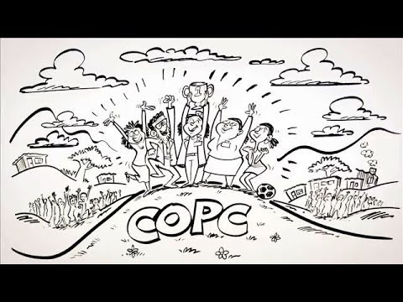
Background and strategy

Slide 6
Vision: Access to person centred quality care
PERSON
CENTRED
APPROACH
LIFE COURSE
APPROACH
INTEGRATED CARE
CONTINUITY OF CARE
HEALTHCARE 2030
Healthcare 2030, the WCGH’s long term strategy, focuses on health and wellness, rather than diseases.
It values quality of life
Healthcare 2030 drives self-management

Slide 7
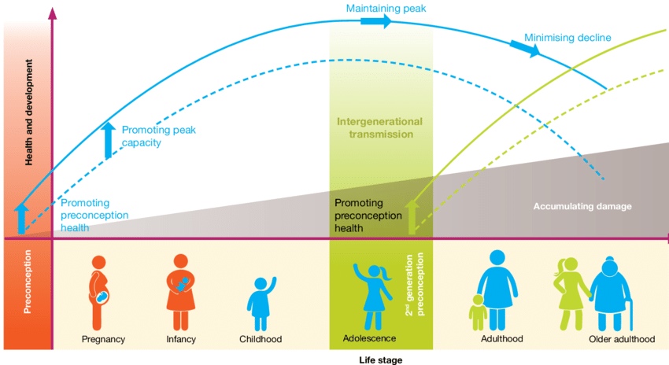
Life course approach
Sense making
Consultation
Prioritization
Service implementation based on context

Slide 8
STRATEGIC APPROACH

Slide 9

Health is Everybody’s Business- Where do we want to go?
We want to support people to live healthy and longer lives and improve health socio-economic outcomes for the population as a whole.
We want the people we serve to know that they matter and with every human contact, make people feel a sense of optimism and worth.
We aspire to become a health system that is people-centric, trusted, and equitable, built on a caring and competent, empowered workforce; clean governance; innovative and accessible service delivery and a health system for YOU.
Our goal is to provide the right care, at the right time, in the right place, at the right price; care that puts people first.
We understand that this requires of us to ‘do’ and ‘be’ differently as individuals and as a Department; and that change starts with us.
We want to work with community members, community structures and partners to become and stay a healthy society.
Notes:
Furthermore, to ensure recovery from the pandemic, “Health is Everybody’s Business – A framework for action over the 2022 MTEF”, has been developed to outline priorities for service re-design and transformation. Action in the area of service delivery reform is focussed on making health services person-centric with greater capability for health promotion and prevention, delivered by interdisciplinary teams*, responsible for a defined geographic area. Placing people at the heart of the health system requires a human-centred service design approach that should drive improvements in effectiveness, quality, efficiency, and equity while optimising care where people live, learn, work, socialise and access services.

Slide 10
Our Reset Agenda
DO - Provides the right care, at the right time, in the right place, at the right price; putting people first.
BE - A resilient system, with connected value-based leaders, acting as stewards for people’s health & well-being; a health system for every person.
BECOME - We aspire to become a health system that is people-centric, trusted, and equitable towards a healthy society.

Slide 11
DEFINING MENTAL HEALTH

Slide 12

DEFINITION OF MENTAL HEALTH (WHO)
Mental health is defined as a state of well-being , individual realizes full potential, cope with the normal stresses of life, can work productively, and is able to contribute to her or his community.
Population-based approach to mental health
Use of knowledge and evidence from research to solve public mental health problems
Engagement with the political, economic and ethical dimensions of the choices underlying MH care
Objective of achieving equity in Mental Health and Mental Health care, including a PHC approach to health systems
Includes promotion, prevention, treatment & rehabilitation
Mental health cannot be separated from physical health – need for integration of mental health into general health care, and appropriate resource allocations to mental health

Slide 13
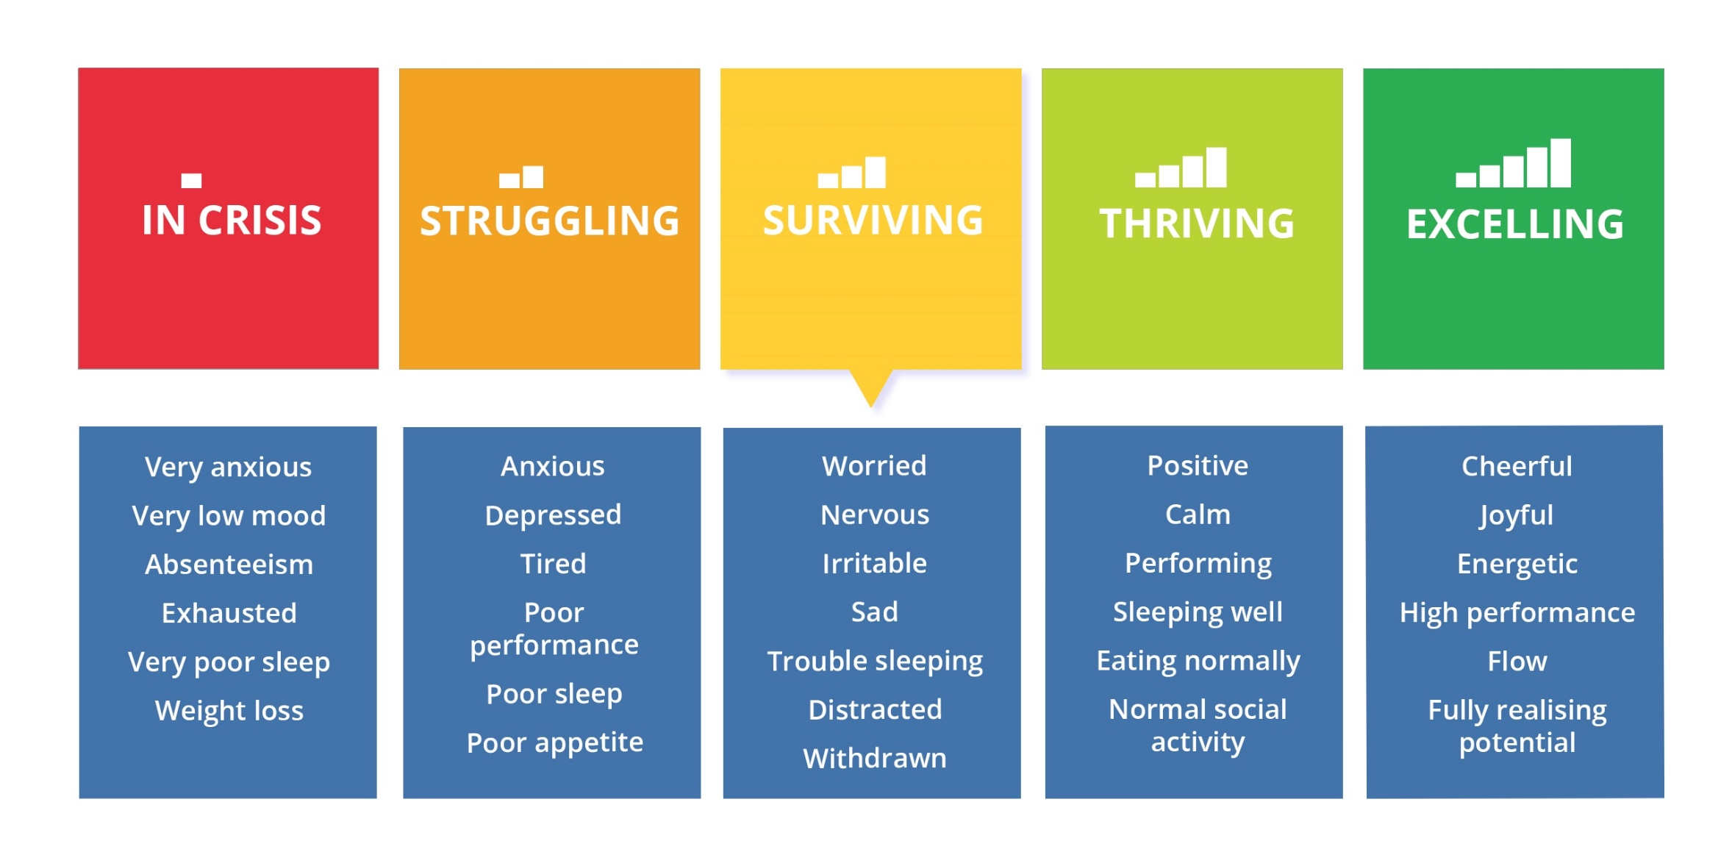
Mental Health Continuum

Slide 14
BURDEN OF DISEASE

Slide 15
The socio-economic impact – NIDSCRAM: Mental Health
  Consistently higher rates of depressive symptoms during the pandemic (24-29% positive screen compared to 21% pre-COVID).
  52% reported ever experienced depressive symptoms since start of pandemic.
  Link with hunger/food insecurity (fewer depressive symptoms when child not reported as hungry).
  Self assessed health indicators:
      More poor individuals reported ill health
      More ‘non-poor’ individuals reported depressive symptoms

Slide 16
Mental Health Data (pre-Covid) – WC Burden of Disease report
Prevalence: The Western Cape had the highest 12-month and lifetime prevalence of mental illness in SA (39%):
    Anxiety disorders was 19%,
    Mood disorders 14%
    Substance use disorders 21%
Suicides :
    Worrying trajectory, increase since April 2020
  Huge unmet need: less than 1 in 4 people with mental illness seek care

Slide 17
Deaths due to suicide from 1 January 2019 to
10 January 2022 in the Western Cape
From 1 January 2019 to 31 December 2021, the Forensic Pathology Services recorded 2 188 deaths due to suicide in the Western Cape
The peak number of deaths each year occur in the month of December.
There was a marked drop in suicides April 2020, at the time of the lockdown.
There has been upward trajectory since April 2020 to date
Data courtesy of FPS

Slide 18
MENTAL HEALTH DATA

Slide 19
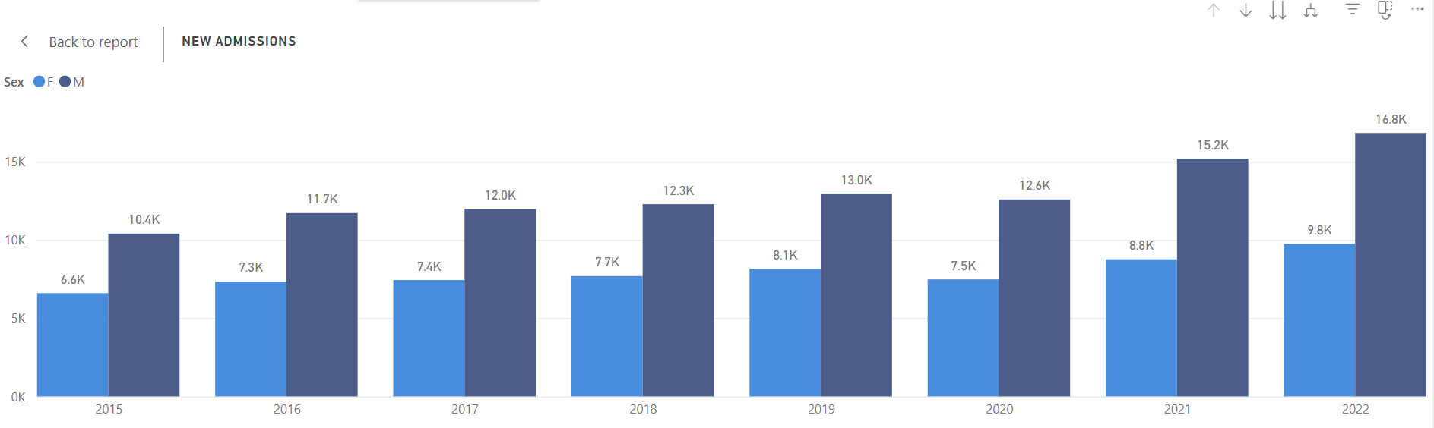
Admissions: Acute Adults
Source: Mental Health Dashboard
Notes:
% drop on slide
Include MH slides 10-11

Slide 20
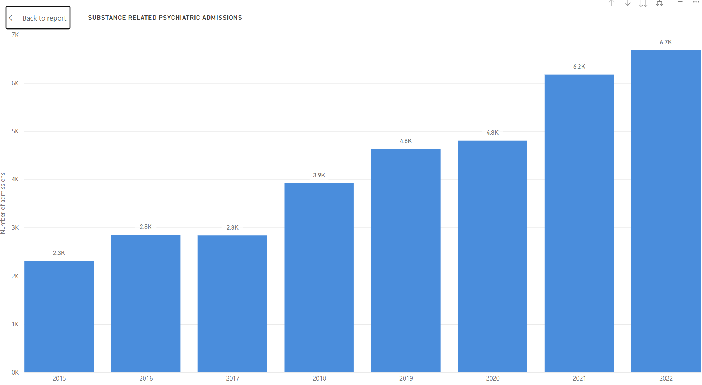
Admissions: Substance
Source: Mental Health Dashboard
Notes:
% drop on slide
Include MH slides 10-11

Slide 21
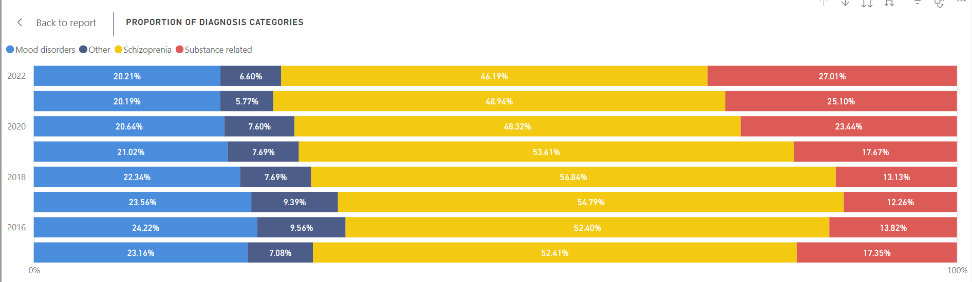
Diagnoses

Slide 22
MENTAL HEALTH SERVICES and Strategies

Slide 23
MENTAL HEALTH SERVICES ARE DELIVERED AT:
PHC , Generalist and Medical Officers, Mental Health Nurse
District and Regional Hospitals (New Somerset Hospitals, Paarl, Worcester and George), provide Acute Services and OPD
Tertiary Hospitals: GSH, TBH and Red Cross
4. Psychiatric Hospitals: Alexandra, Lentegeur, Stikland and Valkenberg
Inpatient Services at Various Hospitals include:
  Child and Adolescent Services (Lentegeur, Red Cross, Tygerberg)
  Services for Persons with Intellectual Disability (Alexandra and Lentegeur)
  Therapeutic Services (all Psych Hospitals)
  Opioid Detox and Alcohol Rehab (Stikland)
  Forensic Observations (Valkenberg Hospital)
  Forensic Services for state patients (Valkenberg, Lentegeur and Alexandra)
  Psychogeriatric Services (Stikland, and a few beds at Alexandra)
Outpatients Services at all psychiatric and Tertiary Hospitals
Above in addition to NPO funding

Slide 24
Influencing Public policy and communities we serve towards increasing Wellness
Two-pronged approach
Address and manage the BOD through disease prevention, health promotion and early detection of disease, treatment and rehabilitation through the provision of comprehensive health services.
Whole of government and whole of society approach to address upstream (incl. midstream and downstream as possible) factors.
Grounded in research and evidence led
Notes:
Impacting policy for the whole system
Integrated the disease prevention and health promotion strategy

Slide 25
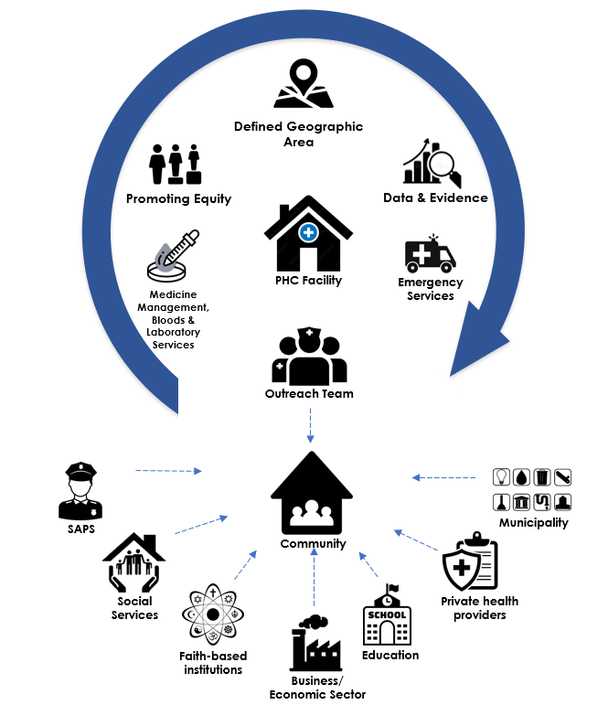
Community Oriented Primary Care (COPC)- a service redesign priority
The COPC approach informs our re-design of primary health care and community-based service.
“COPC is a continuous process by which primary care is provided to a defined community on the basis of its assessed health needs through the planned integration of public health practice with the delivery of primary care services”
Fitzhugh Mullan, Leon Epstein, “Community-Oriented Primary Care: New Relevance in a Changing World”, American Journal of Public Health 92, no. 11 (November 1, 2002): pp. 1748-1755.
For further details on WCGH COPC approach, refer to Circular H11 of 2023_the Western Cape position Statement on COPC towards UHC

Slide 26
Make Every Contact Count (MECC)
What is MECC?
A behaviour change approach that assists all health facilities that are responsible for well-being, care and safety of the public to implement and deliver positive health messages to encourage the population to make better health behaviour choices.
Focus of the approach
Capitalising on the existing opportunities within health facilities, during routine visits, to make a difference to people’s health and wellbeing.
Build a culture and environment that supports and facilitates continuous health improvement through each contact with people entering the health system. MECC needs to be embedded in the current service.
MECC is not intended to be an “add-on” to and already busy environment and does not require staff to be behaviour change specialists or counsellors. It however entails adapting the way in which they engage with patients so that they are not enforcing their opinions onto them.

Slide 27
PRIORITISATION OF MENTAL HEALTH IN THE PROVINCE

Slide 28
Provincial Focus on Mental Health
The WC government initiated an intergovernmental Mental Health Steercom in February 2022
  Mental Health Steercom is chaired by the HOD of Department of Health and Wellness, attended, and/or represented by HODs, in Departments of Social Development, Education, Culture Arts and Sport, Local Government and the Department of the Premier.
  The Focus is to jointly address a response to burden of mental illness by having a Whole of Government Approach/Whole of Society
  Pilot sites (Nyanga and Gugulethu – in the Metro, and Witzenberg – in the Rural), we have completed mapping exercise of all resources available in areas..
  Communication: working towards promotion to prevent Mental Illness ,
  Evidence: working on data base
  Provincial Focus
  Increasing Compliance in accordance with Legislation

Slide 29

Project Description
01
Project 1
Project 2
02
Strengthening mental health capacity
R43.8m
Equitable NPO Funding
R5m
.
Additional project
03
Project 3
04
Child and Adolescent Strengthening
Psychogeriatrics
R7.8m
Provision of additional Mental Health Beds(C&A-George)
R13.8m

Slide 30
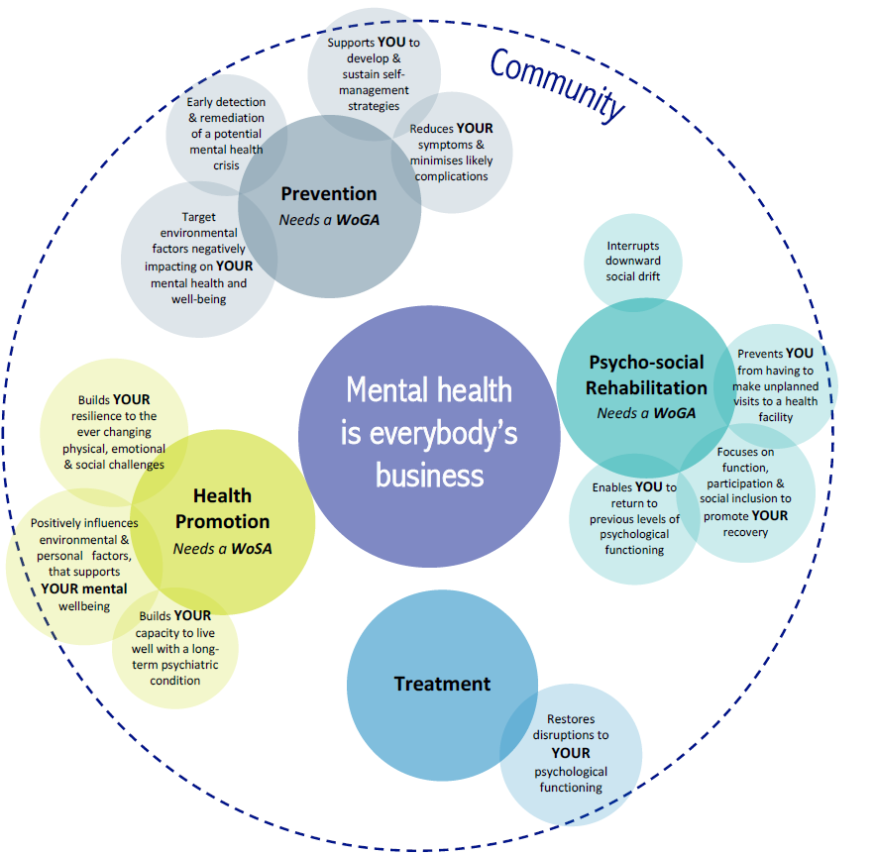
CONCLUSION: Intervention Framework – “Mental Health For You”
Mental Health is everybody’s business
  Poor mental health is not limited to people with a psychosocial disability only, anyone can experience poor mental health when stressors become overwhelming
  The pandemic has exacerbated the existing drivers of poor mental health and is likely to have significant implications particularly for the vulnerable
  Addressing the mental health needs of people requires a WoSA/ WoGA
  It requires a re-design of service provision across all sectors

