Slide 1
VOTE 7: SOCIAL DEVELOPMENT PUBLIC ACCOUNTS COMMITTEE(PAC) REPORT BACK 12 APRIL 2023

Slide 2
ITEM 4 – Page 2: Transversal Departmental resolutions
RESOLUTIONS
BACKGROUND/CONCERNS
Broad-Based Black Economic Empowerment (BBBEE)
While engaging the departments and entities on the status of their BBBEE compliance rate, the Committee became aware that there is a challenge with the certification of the departments and entities, who are of the opinion that they do prescribe to the BBBEE prescripts, but that the annual certification costs are too much just to indicate that they are compliant to the prescript.
RESOLUTIONS
4.1. That the Public Accounts Committee engages the relevant stakeholders to determine the most effective way forward in this manner.
Management Response:
National Treasury is the authority of the BBBEE reporting template that departments use as part of the Annual Reporting Guideline.
The BBBEE Commissioner is the authority of the deadline date relating to the reporting of the BBEE reporting template.
the Regulations are contradictory to the extent that the regulations require organs of state and public entities to be verified in the manner which are suggested. To this end, the DTIC, as custodian of the B-BBEE legislation, has indicated that it has embarked on a process to amend the regulations and align them with the requirements of the Act, which does not require the B-BBEE compliance of organs of state and public entities to be verified by a verification agency/professional.
Thus the status quo remains

Slide 3
11.4, page 18 - List of Information Requested
BACKGROUND / CONCERNS
Compliance Audits versus Performance Audits
The Committee recognizes the constant year-on-year clean audit outcomes of most of the departments and entities of the WCG. The Committee is of the opinion that there should be a move towards performance auditing in order to audit the value for money appropriated to departments and entities in relation to their service delivery mandates.
RESOLUTIONS:
That the Public Accounts Committee engages with the AGSA, Audit Committee and Provincial Treasury to ascertain whether the WCG is at a state of readiness to conduct performance audits.
MANAGEMENT RESPONSE:
Relevant stakeholders to respond.
The Department awaits the guidance from Provincial Treasury.

Slide 4
ITEM 4 – Page 3: Transversal Departmental resolutions
RESOLUTIONS
BACKGROUND/CONCERNS
Transfers of funds from departments to municipalities in the Western Cape.
The Committee engaged the departments on the annual financial statements of departments and entities. The Committee is interested to engage departments on the value for money that were derived from the transfers that were made to the municipalities. The Committee has a keen interest on the transfers that were made to Beaufort West and Cederberg municipalities with the aim to assist these municipalities in rendering a quality service to the residents of the jurisdictions.
RESOLUTIONS
4.3. That the Public Accounts Committee engages with the respective departments and entities and engage them on funds that were transferred to municipalities.
Management Response:
The Department do not transfer funding to Municipalities.

Slide 5
ITEM 4 – Page 3: Transversal Departmental resolutions
RESOLUTIONS
BACKGROUND/CONCERNS
Componentisation of assets
The Committee noted the repeated briefings of the Auditor-General of South Africa regarding the componentisation of assets and that departments are encouraged to componentise assets in their asset registers as it will become a requirement in future. The effective date to componentise assets has not been determined yet.
RESOLUTIONS
That the Public Accounts Committee engages with the Provincial Treasury on the readiness
of the departments and entities of the WCG on this matter.
Management Response:
The department awaits the requirements from National and Provincial Treasury as no Instruction / Policy has been issued to date.

Slide 6
11.4, page 18 - List of Information Requested
BACKGROUND/CONCERNS
11.4.1. A copy of the Disability Court Case as mentioned by the Head of
Department in the meeting and indicated on page 80 of the Annual
Report.
RESOLUTIONS
A copy of the Disability Court Case to be provided to the Committee
DEPARTMENT’S RESPONSE:
A copy of the case was provided.
Case no. 16678-2007 Disability Case Judgement

Slide 7
11.4, page 18 - List of Information Requested
BACKGROUND:
11.4.2. A progress report on the organisational design processed which are highlighted under bullet nr. 4 of the key risks considered and addressed during the year on page 89 of the Annual Report.
RISK:
Inadequate human resources (within DSD) to deliver on the Department’s strategic mandate”. Major contributing factors to this risk is the limiting CoE budget and the non-finalisation of Organisational Design processes. This risk is further exacerbated by the
increased demand for DSD services by the most vulnerable citizens within the province as a result of the COVID-19 pandemic. It was reported during the quarter four ERMCO that an official was allocated to work specifically on the regions Organisational Design investigation, which will include a certain portion of the facilities for the 2022/23 financial year. The committee confirmed that this did not change the severity of the risk at that stage.
DEPARTMENT’S RESPONSE:
The progress made by the Organizational Design unit in respect of this Department’s Organizational Design investigation has been limited, hence the risk referred to remains.

Slide 8
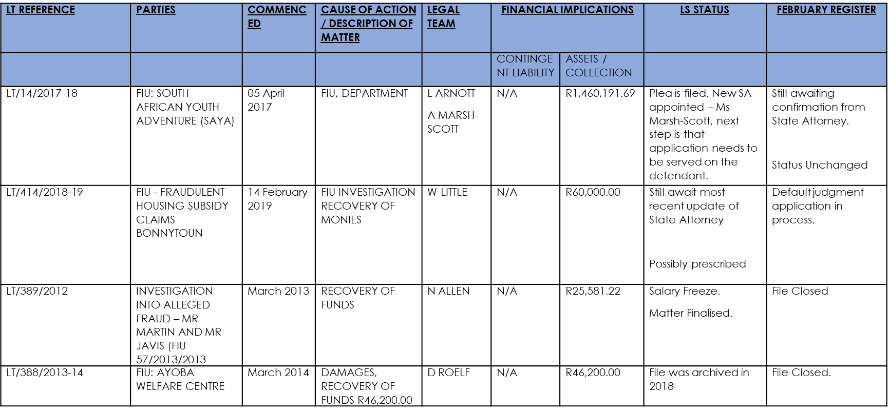
11.4, page 18 List of Information Requested
BACKGROUND:
11.4.3. A report which provides a detailed breakdown and further explanation of the contingent assets as highlighted under note 16.2 on page 195 of the Annual Report.

Slide 9
11.4, page 18 - List of Information Requested
BACKGROUND:
11.4.4. A copy of the Department’s funding policy which applies to all non-governmental organisations who make application to the Department for funding.
RESOLUTION:
Require a copy of the Department’s funding Policy
DEPARTMENT’S RESPONSE:
A copy of the funding policy provided.
DSD Policy on Funding of NGOs for Provision of Social Welfare Community Services (Dec-2017)

Slide 10
11.4, page 18 List of Information Requested
BACKGROUND:
11.4.5. A copy of the Audit Deviation File as mentioned in the meeting by the officials of the
Department.
RESOLUTION:
The specific request for information (Audit Deviation File) has been removed from the SCOPA Report that will be ATC’ed soon within the Western Cape.
DEPARTMENT’S RESPONSE:
Request removed

Slide 11
Thank you

