Slide 1
Contents
DSI PERFORMANCE AND FINANCIAL REPORTS
FOR QUARTERS 2 AND 3 OF THE 2022/23 FINANCIAL YEAR
Presented to the Portfolio Committee on Higher Education, Science and Technology by Dr Phil Mjwara on
31 March 2023
Chapter 01
Chapter 01
Chapter 01
Chapter 01
Chapter 01
Chapter 01
Chapter 01

Slide 2
Presentation outline
Vision and mission
Outcome goals
Key achievements per outcome goal
Performance highlights
Overall performance
Overview of performance per Programme
Financial performance
Conclusion

Slide 3
Vision and mission
Vision
Increased well-being and prosperity through
science, technology and innovation
Mission
To provide leadership, an enabling environment and
resources for science, technology and innovation in
support of South Africa's development

Slide 4
Outcome goals
A transformed, inclusive, responsive, coordinated and efficient national system of innovation (NSI)
Human capabilities and skills for the economy and for development
Increased knowledge generation and innovation outputs
Knowledge utilisation for economic development
Knowledge utilisation for inclusive development
Innovation in support of a capable and developmental state

Slide 5
PERFORMANCE HIGHLIGHTS

Slide 6
A transformed, inclusive, responsive, coordinated and efficient NSI
Cabinet has approved the final version of the STI Decadal Plan and implementation is already under way, focusing mainly on the following:
Societal grand challenges: Climate change and environmental sustainability; future-proof education and skills; and the future of society.
STI priorities: Modernising sectors of the economy (manufacturing, agriculture and mining); new sources of growth (the digital and circular economies); health innovation; energy innovation; sn innovation-enabled capable state; and innovation in support of social progress.
The second meeting of the Interministerial Committee on STI was held in November 2022.
Notes:
NIPMO: National Intellectual Property Management Office
WIPO: World Intellectual Property Organization

Slide 7
Human resources and skills for economic development (1)
The National Development Plan sees human capital development as central in addressing South Africa's unemployment, poverty and inequality challenges.
Postgraduate bursaries and internships awarded through the National Research Foundation and other agencies:
Current transformation interventions: A DSI task team has been established to co-create a robust, evidence-based transformation agenda for the next 10 years, and to identify reforms and actions to be implemented by the DSI and its entities over the 2020-2025 cycle to enhance transformation outcomes.
 | Total beneficiaries | Black | Women | Black women | People with disabilities | South Africans
BTech/honours and master's students | 4 716 | 4 225 | 2 977 | 2 689 | 58 | 4 630
Doctoral students | 2 325 | 1 733 | 1 327 | 989 | 30 | 1 911
Total number of students funded | 933 | 866 | 593 | 580 | 0 | 933
Interns | 933 | 866 | 593 | 580 | 0 | 933
Notes:
Student numbers are cumulative

Slide 8
Human resources and skills for economic development (2)
Intellectual property (IP) and technology transfer skills development
The National Intellectual Property Management Office (NIPMO), in collaboration with the World Intellectual Property Organization (WIPO), the Companies and Intellectual Property Commission (CIPC) and the University of Limpopo hosted the annual WIPO-South Africa Summer School on Intellectual Property and Transfer of Technology in Polokwane from 21 November to 2 December 2022.
The summer school focused on IP and public health in the context of the Covid-19 pandemic, and on future pandemic preparedness.
A total of 114 participants from 14 countries benefited from interactive discussions, group work and practical lectures on various topics by IP experts from academia, the private sector and the government.
Notes:
NIPMO: National Intellectual Property Management Office
WIPO: World Intellectual Property Organization

Slide 9
Human resources and skills for economic development (3)
Green hydrogen technical and vocational education and training study
Minister Nzimande officially launched the South African Green Hydrogen TVET Ecosystem Just Transition Strategic Framework study report on 6 December 2022 in Cape Town.
The TVET study is one of the five subcomponents required to complete the Hydrogen Society Roadmap, which was launched in February 2022.
The development of the TVET study started after the UK's Partnering for Accelerated Climate Transitions (UK PACT) programme launched a €60 million flagship under its international climate finance portfolio, to support green hydrogen job creation from a just transition perspective, which was seen as a benefit for South Africa.

Slide 10
Increased knowledge generation and innovation outputs (1)
Square Kilometre Array
The Minister and the Chairperson of the SKA Council, Dr Catherine Cersasky, launched the onsite construction of the SKA-Mid telescope at the SKA site on 5 December 2022.
The launch took place on the eve of the World Science Forum (WSF) in Cape Town, and this gave the SKA excellent exposure to the WSF delegates. The project received widespread media coverage.
The SKA-Mid will ultimately see 133 antennas added to the existing 64-dish MeerKAT telescope, bringing the number of dishes to nearly 200.
The telescope will be built at a cost of $2,2 billion and completed in 2028.

Slide 11
Increased knowledge generation and innovation outputs (2)
Square Kilometre Array (cont.)
The SKA Organisation (SKAO) has awarded the R889 million contract to build the major civil infrastructure, including power, fibre and roads, to a South African-based company, Power Adenco, which will provide a range of sub-contract opportunities and benefits to local communities.
It is expected that up to R100 million will be spent on local SMMEs, the employment of local people, training and transferring skills to local people, supporting local businesses, and implementing community development initiatives in conjunction with the SKAO and the South African Radio Astronomy Observatory (SARAO).
This contract is in addition to contracts recently awarded to SARAO and South African companies such as Vivo, Zutari and Emcom.

Slide 12
Increased knowledge generation and innovation outputs (3)
Square Kilometre Array (cont.)
SARAO has been awarded a software development contract valued at R150 million.
The total estimated value of the contracts that have now been awarded to South African entities is R1,2 billion, and further contracts are expected.
Furthermore, it is expected that the leasing of buildings to be constructed, and the ongoing technical maintenance and operations of the SKA radio telescope for the next 50 years, will deliver long-term, sustainable foreign investment to South Africa.

Slide 13
Increased knowledge generation and innovation outputs (4)
South African Population Research Infrastructure Network (SAPRIN)
On 14 November 2022, SAPRIN released a working paper, "Measuring rural households and electricity access". The paper is based on a study on access to electricity for rural households, featuring data triangulation with Statistics South Africa national census data.
On 22 and 23 November 2022, the SAPRIN director participated in the National Health Research Summit, where SAPRIN was promoted as an ideal conduit for implementation research to inform the implementation of National Health Insurance to ensure equitable universal health care.
As a result, SAPRIN has been invited to make a presentation to the National Health Research Council at its first 2023 meeting.

Slide 14
Increased knowledge generation and innovation outputs (5)
Completed reviews
The National Equipment Programme: The review report made recommendations on strategic and operational matters to contribute to the transformation of the national system of innovation by ensuring the equitable distribution of research equipment funds.
The South African Research Infrastructure Roadmap (SARIR): The review covered the first five years of the initiative. Its main aim was to assess the effectiveness, progress and rollout of the research infrastructures running since the launch of SARIR in 2016.

Slide 15
Increased knowledge generation and innovation outputs (6)
Indigenous Knowledge Registration System
The Department, in pursuit of protecting, promoting, and developing the indigenous knowledge of South African communities, has established indigenous knowledge systems documentation centres (IKSDCs) across the nine provinces of South Africa.
The Department, in partnership with the Council for Scientific and Industrial Research’s Next Generation Cluster, has also developed a technology tool called the National Indigenous Knowledge Management System to support the process of documenting, recording and safeguarding communities’ knowledge.

Slide 16
Increased knowledge generation and innovation outputs (7)
Indigenous Knowledge Registration System (cont.)
To date, the DSI has trained over 60 unemployed young people in various provinces in qualitative data collection methods and technology usage to document the knowledge at multiple IKSDCs.
To improve the quality and efficiency of processes at various IKSDCs, the CSIR developed a new National Indigenous Knowledge Management System app to be deployed in all the provinces.
On 14-18 October 2022, the DSI and the CSIR facilitated a four-day capability-building workshop in Thohoyandou for the Limpopo IKSDC team.
GENDER (number)
Male | Female
25 | 37
RACE (Number)
Black | White
62 | 0
AGE (Number per age)
<18 | 0
18-35 | 50
>35 | 12

Slide 17
Knowledge utilisation for economic development (1)
Science Diplomacy for Economic Development through Hydrogen round-tables
Minister Nzimande officially launched the Science Diplomacy Green Hydrogen Round-tables on 6 December 2022 on the sidelines of the World Science Forum. The session was hosted with international partner Impact Hydrogen, and Stellenbosch University assisted with the logistics. The initiative is intended to directly support the implementation of both the Hydrogen Society Roadmap, and the Hydrogen Commercialisation Strategy for South Africa, through a series of local and international round-table workshops and follow-up engagements.
South African Green Hydrogen Summit
The Presidency hosted the summit, which gave an indication of progress made in implementing green hydrogen projects as part of infrastructure development. As part of the summit, the DSI coordinated two-panel discussions and held an exhibition on innovations developed under Hydrogen South Africa (HySA). The Department also facilitated site visits to the HySA centres of competence.

Slide 18
Knowledge utilisation for economic development (2)
The Culture-led Smart Village Pilot Project
The Culture-led Smart Village Pilot Project is a collaboration between the DSI, Tshwane University of Technology, the University of Venda, North-West University, the Nyandeni Royal House, Nyandeni communities, the Nyandeni Local Municipality and the OR Tambo District Municipality.
The smart village concept will be based on the particular community’s local conditions, infrastructure, available resources, local demand, and the potential to export goods to urban areas.

Slide 19
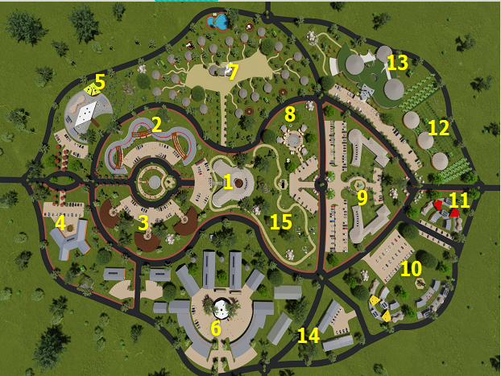
Knowledge utilisation for economic development (3)
1. Community station radio, theatre and museum
2. IKS-led village shopping centre and government offices, etc.
3. Indigenous, cultural and creative industries centre
4. Mini civic square – indigenous and modern architectural forms
5. Village exhibition auction and stock exchange
6. Agriculture hub
7. IKS-led village lodge/hotel
8. Indigenous food restaurant
9. Indigenous and modern arts school
10. Vocational indigenous training centre
11. IKS-led innovation hub (4IR centre)
12. Traditional and modern clinic
13. Indigenous conference centre
14. Village industrial area
15. Park, children's play area and walking trail.
MIXED-USE SMART RURAL VILLAGE
Concept smart village model

Slide 20
Knowledge utilisation for economic development (4)

Slide 21
Knowledge utilisation for economic development (5)
Model indigenous knowledge systems-led smart village

Slide 22
Knowledge utilisation for economic development (6)
The Culture-led Smart Village Pilot Project
The smart village concept holds immense potential as a vehicle for implementing the Protection, Promotion, Development, and Management of Indigenous Knowledge Act to benefit communities and reduce inequality, using biocultural community protocols and introducing smart technologies.
As a rural development model, the concept holds exciting prospects for alleviating the grim levels of spatial and socio-economic equality that plague Nyandeni municipality in particular and South Africa in general.

Slide 23
Innovation in support of a capable and developmental state (1)
Regional Space Weather Centre
Space weather refers to the variable conditions on the sun and in space that can influence the performance of technology use on Earth.
The Regional Space Weather Centre was officially opened in November 2022.
The centre is recognised by the International Civil Aviation Organisation as Africa's only regional space weather information provider.
This facility will enable SANSA to develop 24/7 space weather capability.
The centre is involved in global space weather monitoring and continuously provides space weather forecasting services (bulletins and warnings).

Slide 24
Innovation in support of a capable and developmental state (2)
Deep Space Network
The National Aeronautics and Space Administration (NASA) Deep Space Network is a worldwide network of US spacecraft communication facilities that supports NASA and non-NASA missions that explore the furthest points of our solar system.
It also performs radio and radar astronomy observations to explore the solar system and the universe and supports selected Earth-orbiting missions.
NASA has partnered with the South African National Space Agency (SANSA) to establish a ground station in South Africa.
The new satellite ground station facility will be established for international deep space tracking as well as local use – tracking national satellite missions, scientific research and human capital development programmes.
The Space Weather Centre and Deep Space Network initiatives will contribute significantly to Decadal Plan internationalisation efforts and foreign direct investments.

Slide 25
Innovation in support of a capable and developmental state (3)
The National Biosecurity Hub
The launch of a joint National Biosecurity Hub by the Department of Science and Innovation and the Department of Agriculture, Land Reform and Rural Development in October 2022 is a significant advance in the development of the national system of innovation.
The National Biosecurity Hub is underpinned by a robust science-based regulatory and national response system, international norms and standards on risk assessment and management, and effective coordination of all role players (government, industry and the research community).
The National Biosecurity Hub prioritises plant and animal health matters, as well as food safety, and supports modernising agriculture as part of implementing the Decadal Plan.
The launch was celebrated with the release of an electronic journal entitled "Biosecurity in South Africa: A Renewed Focus", signed by the Minister of Higher Education, Science and Innovation, and the Minister of Agriculture, Land Reform and Rural Development.

Slide 26
International cooperation and resources (1)
The DSI facilitated virtual and physical information dissemination engagements to promote South African participation in South Africa- European Union-funded programmes, extending opportunities to participants in the rest of the continent.
Several other engagement opportunities arose during the quarter, which included the CSIR Biannual Conference in November 2022 at the Durban University of Technology and the Innovation Indaba in October 2022. There were also engagements with multinational private sector partners such as ABB South Africa and Bosch, among others.
The DSI and Department of Higher Education and Training partnered with Schneider Electric to conceptualise a "train the trainer" workshop to build capacity among engineering lecturers at TVET colleges.

Slide 27
International cooperation and resources (2)
The SA-EU Task Force meeting took stock of cooperation in science, technology and innovation, and deliverables for implementation before the 17th SA-EU Joint Science and Technology Cooperation Committee in 2023/24.
The 15th SA-EU Joint Cooperation Council meeting was hosted in South Africa during the quarter, and the DSI undertook extensive engagements on science, technology and innovation with the European Union.
South Africa co-chaired the International Bioeconomy Forum (IBF), and hosted the 5th IBF Plenary meeting, which took place on the sidelines of the World Science Forum.

Slide 28
International cooperation and resources (3)
The DSI presented the results of a study on the nature and scope of trafficking in persons (TIP) in South Africa at a workshop on the review of South Africa's national policy framework on TIP. The research provided critical new insights into the nature and scope of TIP in South Africa. Through the Science Diplomacy Capital for Africa initiative, the DSI hosted a "Science Diplomacy for Social Justice" working group during the World Science Forum.
The DSI coordinated a session on "Making the most of quantum computers, inclusively and openly, to reach the SDGs" and "Technology and social inclusion in the Global South", which focused on the ways climate change is affecting food and the built environment, while considering measures for climate change adaptation, mitigation and resilience-building.
The DSI participated in the Annual Convening of the Water and Energy for Food (WE4F) Grand Challenge, where 175 innovators from six regional innovation hubs in Africa, the Middle East and South-east Asia came together to share and learn about innovation and enterprise in the water, energy, and food nexus.

Slide 29
2022/23 PERFORMANCE OVERVIEW
TARGETS FOR THE QUARTER

Slide 30
Performance of the DSI in Q3

Slide 31
Quarterly analysis 2022/23

Slide 32
Quarter 3 Programme Performance

Slide 33
Programme 1: Administration
The purpose of the Programme is to conduct the overall management and administration of the Department.

Slide 34
Programme 1 performance achievements – Q3
Annual target | Quarter 3 target | Quarter 3 progress | Status
DSI public entities' 2023/24 annual performance plans (or, in the case of the CSIR, shareholder compact) signed by the Minister and chairpersons of the boards by 31 March 2023 | First draft of the DSI public entities' APPs (or, in the case of the CSIR, shareholder compact) submitted to National Treasury and the Department of Planning, Monitoring and Evaluation for concurrence by 30 October 2022 | First drafts of the 2023/24 APPs for public entities (and shareholder's compact for the CSIR) submitted to the DPME and National Treasury on 28 October 2022 | Achieved

Slide 35
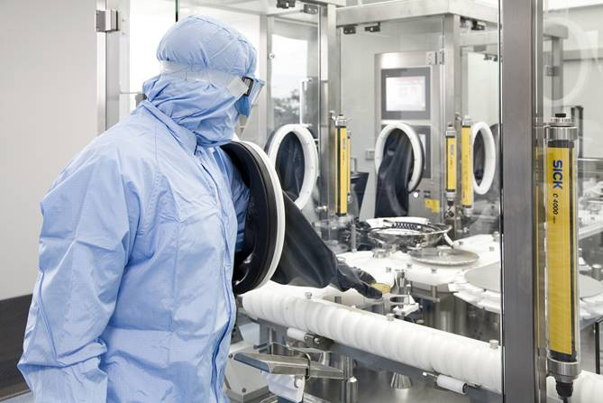
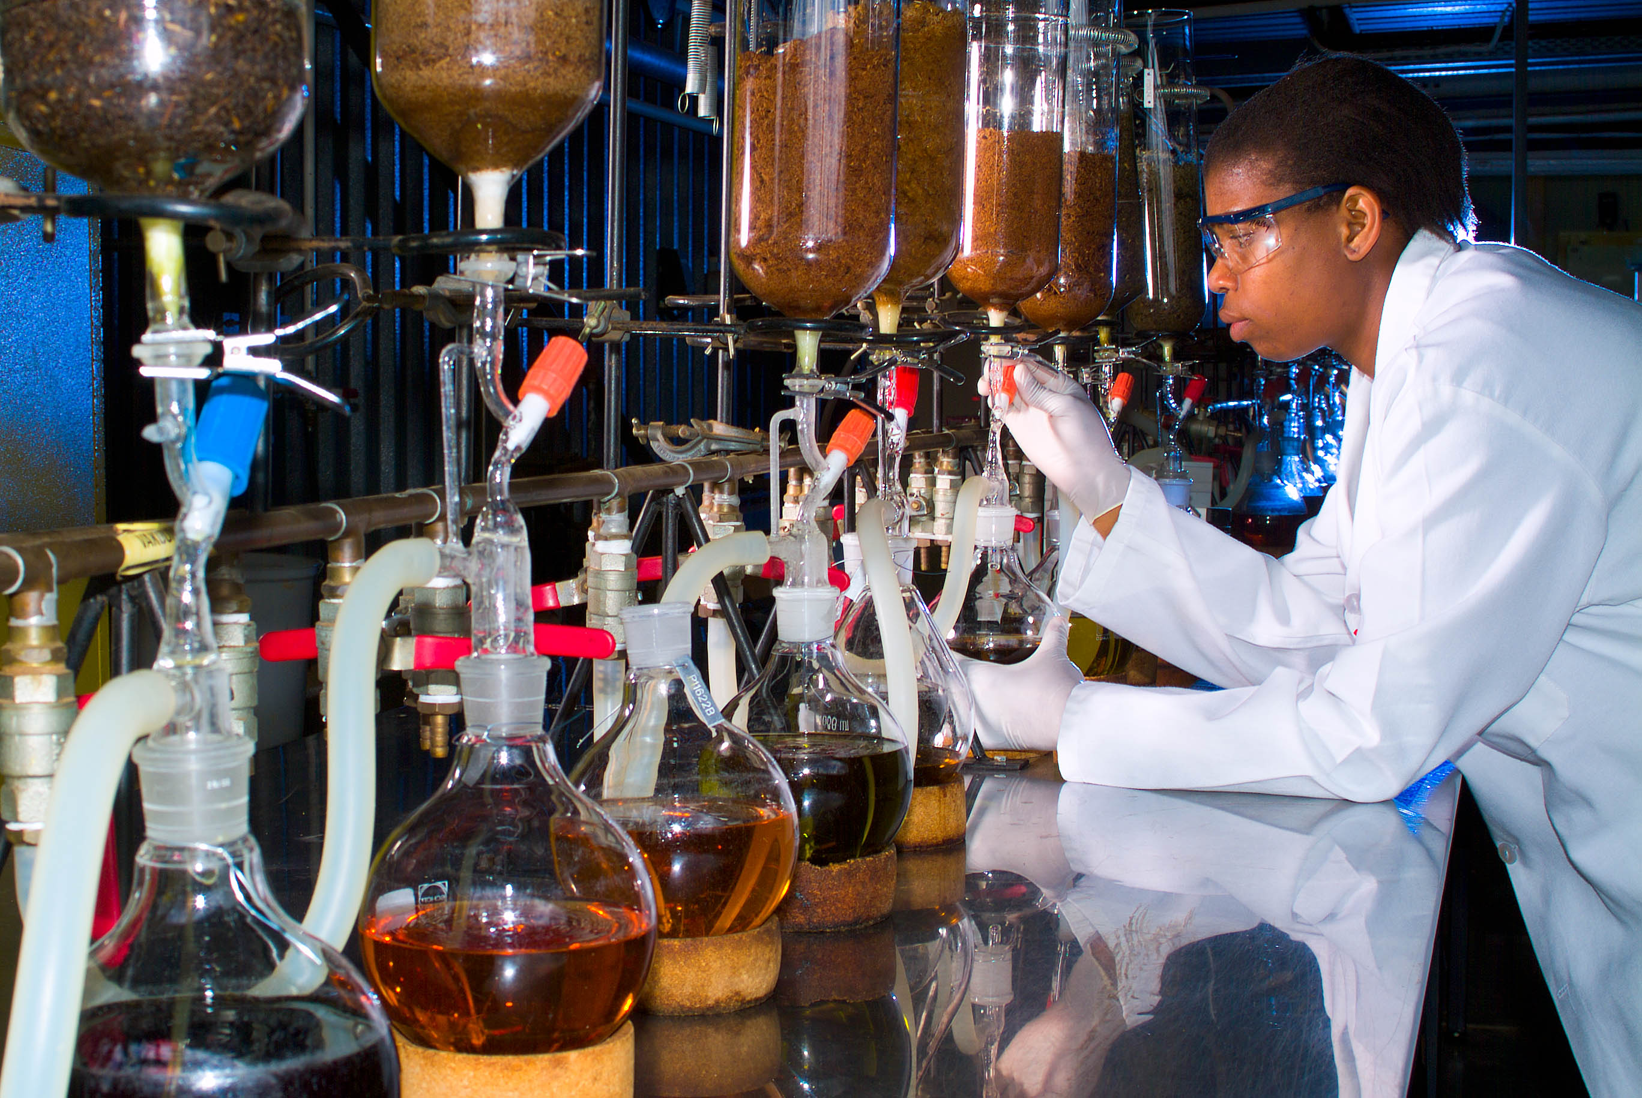
Programme 2: Technology Innovation
The purpose of the Programme is to enable research and development in strategic and emerging focus areas to promote the realisation of commercial products, processes and services from R&D outputs through the implementation of enabling policy instruments.

Slide 36
Programme 2 performance achievements – Q3
Annual target | Quarter 3 target | Quarter 3 progress | Status
8 strategic and technical engagements with SANSA and TIA to ensure alignment with national priorities by 31 March 2023 | 2 strategic and technical engagements with SANSA and TIA to ensure alignment with national priorities by 31 December 2022 | 2 strategic and technical engagements with SANSA and TIA to ensure alignment with national priorities by 31 December 2022 | Achieved
1 000 youth engaged in space science in space science [outreach, awareness and training programmes] by 31 March 2023 | 700 youth engaged | 1 126 youth engaged | Achieved
235 new disclosures received from publicly financed research and development institutions by NIPMO by 31 March 2023 | 115 new disclosures received from publicly financed research and development institutions by NIPMO | 124 new disclosures received from publicly financed research and development institutions by NIPMO | Achieved

Slide 37
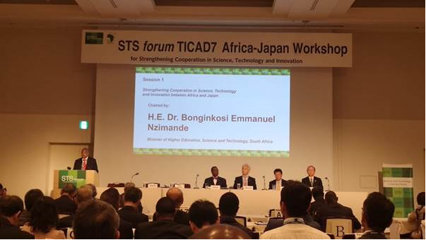
Programme 3: International Cooperation and Resources
The purpose of the Programme is to strategically develop, promote and manage international relationships, opportunities and S&T agreements that strengthen the NSI and enable an exchange of knowledge, capacity and resources between South Africa and its regional and international partners.
Minister Nzimande at the 7th Tokyo International Conference on African Development Science and Technology in Society Forum

Slide 38
Programme 3 performance achievements – Q3
Annual target | Quarter 3 target | Quarter 3 progress | Status
43 dedicated international resource-leveraging engagements undertaken by 31 March 2023 | 10 international resource-leveraging engagements | 12 international resource-leveraging engagements | Achieved
34 international policy dialogues and technical exchanges the policy intents of the White Paper on STI by 31 March 2023 | 11 international policy dialogues and technical exchanges to support the policy intents of the White Paper on STI | 35 international policy dialogues and technical exchanges to support the policy intents of the White Paper on STI | Achieved
15 new STI initiatives supporting Agenda 2063 by 31 March 2023 | 2 STI initiatives supporting Agenda 2063 | 4 STI initiatives supporting Agenda 2063 | Achieved
17 new STI initiatives supported targeting the objectives of the SADC RISPD by 31 March 2023 | 6 STI initiatives supporting the SADC RISDP | 6 STI initiatives supporting the SADC RISDP | Achieved
6 STI plans of action implemented with bilateral African partners by 31 March 2023 | 2 STI plan of action implemented with bilateral African partners | 4 STI plans of action implemented with bilateral African partners | Achieved

Slide 39
Programme 3 performance achievements – Q3 (cont.) (cont.)
Annual target | Quarter 3 target | Quarter 3 progress | Status
12 engagements with global science leaders to advance national priorities in multilateral forums by 31 March 2023 | 3 engagements with a global science leader | 12 engagements with a global science leader | Achieved
8 new international STI initiatives focused on SDGs supported by South Africa by 31 March 2023 | 1 international STI initiative focused on SDGs supported by South Africa | 1 international STI initiative focused on SDGs supported by South Africa | Achieved

Slide 40
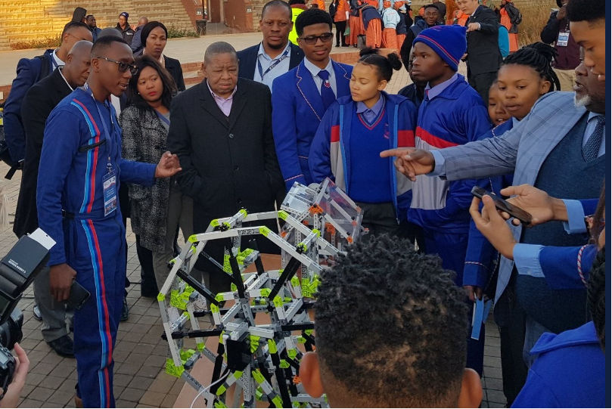
Programme 4: Research Development and Support
The purpose of the Programme is to provide an enabling environment for research and knowledge production that promotes the strategic development of basic sciences and priority science areas, through science promotion, human capital development, the provision of research infrastructure and relevant research support in pursuit of South Africa's transition to a knowledge economy.

Slide 41
Programme 4 performance achievements – Q3
Annual target | Quarter 3 target | Quarter 3 progress | Status
2 200 PhD students awarded bursaries annually as reflected in the reports from the NRF and other relevant entities by 31 March 2023 | 1 800 PhD students awarded an annual bursary as reflected in the reports from the NRF and other relevant entities by 31 December 2022 | 2 325 PhD students awarded an annual bursary as reflected in the reports from the NRF and other relevant entities by 31 December 2022 | Achieved
4 200 pipeline postgraduate students awarded bursaries annually as reflected in the reports from the NRF and other relevant entities by 31 March 2023 | 3 780 pipeline postgraduate students awarded an annual bursary as reflected in the reports from the NRF and other relevant entities by 31 December 2022 | 4 716 pipeline (2 105 BTech/honours + 2 611 master's) students awarded an annual bursary as reflected in the reports from the NRF and other relevant entities by 31 December 2022 | Achieved
300 emerging researchers awarded research grants through NRF-managed programmes as reflected in the NRF project reports by 31 March 2023 | 250 emerging researchers supported in priority science areas | 1 585 emerging researchers awarded research grants through NRF-managed programmes as reflected in the NRF project reports by 31 December 2022 | Achieved

Slide 42
Programme 4 performance achievements – Q3 (cont.)
Annual target | Quarter 3 target | Quarter 3 progress | Status
200 black and female emerging researchers awarded research grants as reflected in the NRF project reports by 31 March 2023 | 150 black and female Emerging researchers awarded research grants as reflected in the NRF project reports | 577 black and female emerging researchers Awarded research grants through NRF managed Programmes as reflected in the NRF project reports by 31 December 2022 | Achieved
750 graduates and students placed in DSI funded work preparation programmes in SETI institutions by 31 March 2023 | 650 graduates and students placed in DSI funded work preparation programmes in SETI institutions | 933 graduates and students placed in DSI funded work preparation programmes in SETI institutions | Achieved
3 000 researchers awarded research grants through NRF-managed programmes as reflected by the NRF project reports by 31 March 2023 | 2 200 researchers awarded research grants through NRF-managed programmes | 3 106 researchers awarded research grants through NRF-managed programmes | Achieved
20 L-band science mode receivers produced for the additional MeerKAT Extension telescope by 31 March 2023 | Progress report submitted by SARAO MD on the progress made in the production of the L-band receivers | SARAO progress report received | Achieved

Slide 43
Programme 4 performance achievements – Q3 (cont.)
Annual target | Quarter 3 target | Quarter 3 progress | Status
12 strategic and technical engagements with the National Research Foundation (NRF), South African Council for Natural Scientific Professions (SACNASP) and the Academy of Science of South Africa (ASSAf) to alignment with national priorities by 31 March 2023 | 3 bilateral engagement reports | 3 bilateral meetings (for NRF, ASSAf and SACNASP) were held in the 3rd quarter | Achieved

Slide 44
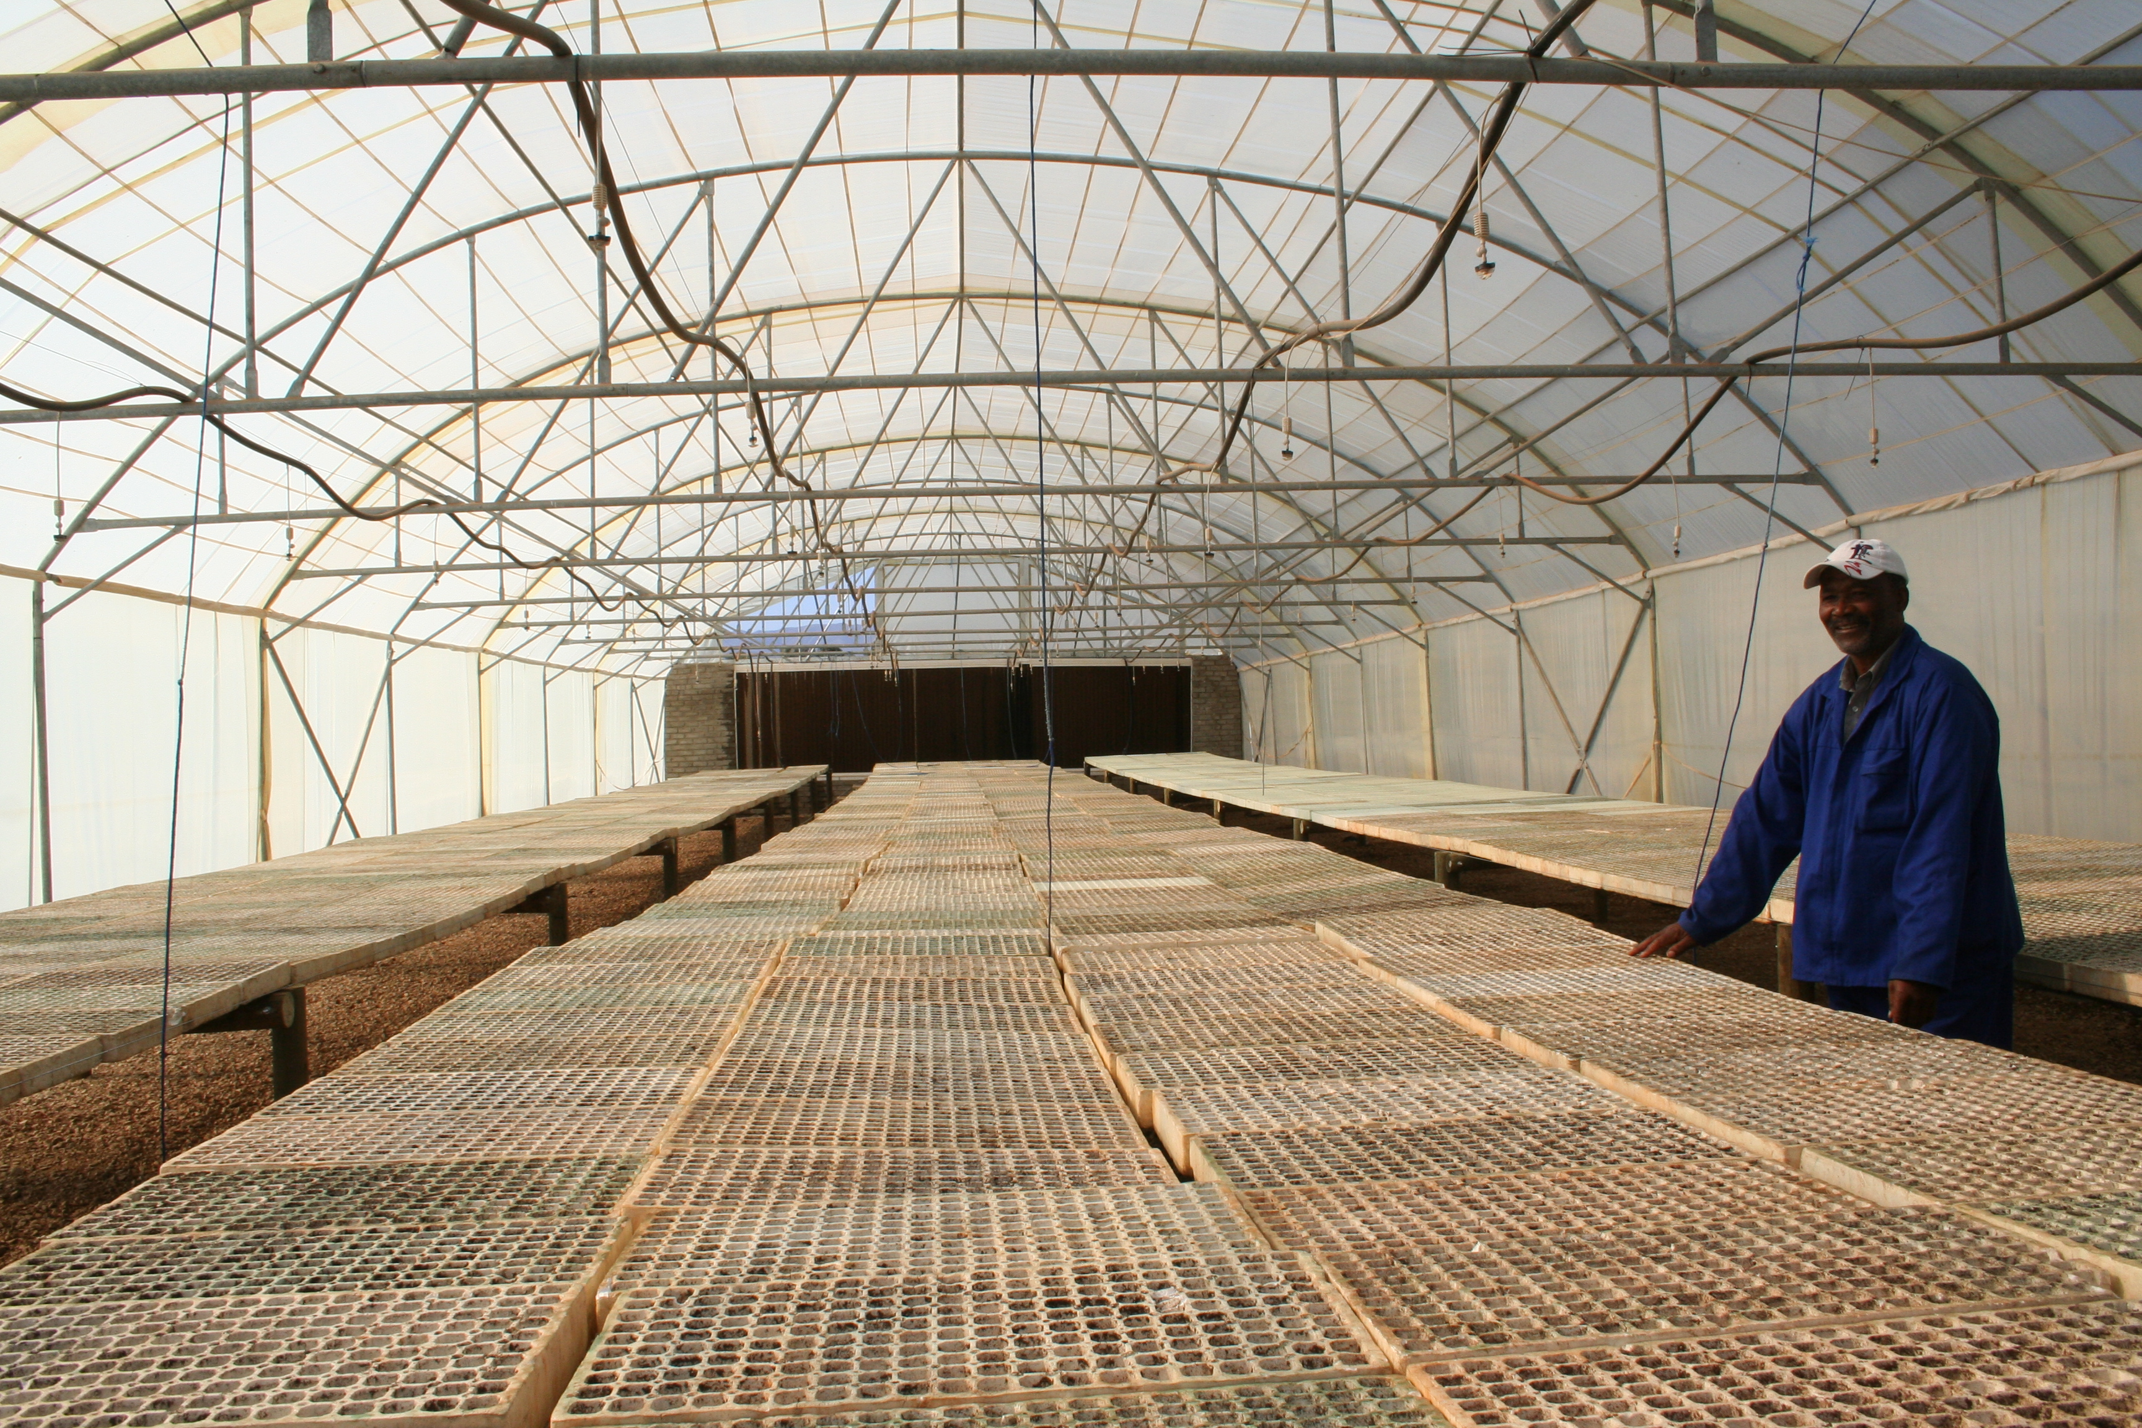
Programme 5: Socio-economic Innovation Partnerships
The purpose of the Programme is to enhance the growth and development priorities of government through targeted S&T-based innovation interventions and the development of strategic partnerships with other government departments, industry, research institutions and communities.

Slide 45
Programme 5 performance achievements – Q3
Annual target | Quarter 3 target | Quarter 3 progress | Status
4 knowledge products on innovation for inclusive development published by between 1 April 2022 and 31 March 2023 | 3 knowledge products on innovation for inclusive development improved between 1 April 2022 and 31 December 2022 | 3 knowledge products on innovation for inclusive development improved between 1 April 2022 and 31 December 2022 | Achieved
Annual target: 6 decision-support systems introduced, maintained and improved by 31 March 2023 | Annual work plan approved for 5 decision-support systems between 1 April 2022 and 31 December 2022 | Annual workplans for 5 decision-support tools/ systems approved between 1 April and 31 December 2022 | Achieved
3 learning intervention hosted between 1 March 2023 | 3 learning interventions hosted between 1 April 2022 and 31 December 2022 | 3 learning interventions hosted between 1 April and 31 December 2022. | Achieved
Knowledge products refer to case studies, policy briefs, technology briefs and research reports.
Decision-support interventions help people think about choices they face; they describe where and why choice exists; and they provide information about options, including, where reasonable, the option of taking no action.

Slide 46
Programme 5 performance achievements – Q3 (cont.)
Annual target | Quarter 3 target | Quarter 3 progress | Status
6 statistical reports or policy briefs approved by Exco for publication and/ submitted to Cabinet and/or disseminated to policy audience by 31 March 2023) | 3 statistical reports approved by Exco for publication and/or submitted to Cabinet and/or disseminated to policy audience between 1 April 2022 and 31 December 2022 | 3 statistical reports approved by Exco for publication and/or submitted to Cabinet and/or disseminated to policy audience between 1 April 2022 and 31 December 2022 | Achieved

Slide 47
TARGETS THAT WERE NOT ACHIEVED – Q3

Slide 48
Classification of reasons for variance due to non or underachievement
Process delays refer to under/non-achievement due to factors outside the Department's control. Therefore, the achievement of such targets depends mainly on outside stakeholders.
Ineffectiveness of implementers refers to non-achievement due to deficiencies during the implementation phase.
Target formulation deficiencies refer to under/non-achievement due to variables not foreseen during the target formulation phase.
The lessons learnt from these reasons for variance can help to address gaps during the strategic planning processes for the following financial year.

Slide 49
Programme 1: Overview of underperformance – Q3 (1)
Quarter 3 target | Quarter 3 progress | Reasons for non-achievement | Status | Variance classification | Likelihood for the Target to be achieved by end of FY
Six platforms (print, broadcast, online, media liaison, stakeholder engagement and social media) to profile the DSI and its entities | Five platforms (print, broadcast, online, media liaison, stakeholder engagement and social media) | The sixth platform source data was rejected as it did not meet the TID prescripts. | Not achieved | Ineffectiveness of implementers | The annual target will be achieved

Slide 50
Programme 2: Overview of underperformance – Q3 (2)
Quarter 3 target | Quarter 3 progress | Reasons for non-achievement | Status | Variance classification | Likelihood for the Target to be achieved by end of FY
Space weather centre issuing bulletins and warnings for aviation industry in South Africa and the African continent | Space weather centre issuing bulletins and warnings for aviation industry in South Africa | In early August 2022, the programmer dedicated to the Operational Space Weather Services project passed away unexpectedly leaving a significant gap in the skills required to complete the project. | Not achieved | Process delays | Target likely to be achieved as plans were made internally to ensure the achievement of this target while a process of appointing a new person is underway.
125 trainees upskilled in intellectual property management and technology transfer skills | 91 trainees upskilled in intellectual property management and technology transfer skills | The Technology and Innovation Support Centre workshop was moved to February 2023. | Not achieved | Process delays | Target likely to be achieved because the training that was deferred to the fourth quarter has already been undertaken.

Slide 51
Programme 2: Overview of underperformance – Q3 (3)
Quarter 3 target | Quarter 3 progress | Reasons for non-achievement | Status | Variance classification | Likelihood for the Target to be achieved by end of FY
7 disclosures licensed for the first time received from publicly financed research and development institutions by National Intellectual Property Management Office (NIPMO) | 6 disclosures licensed for the first time received from publicly financed research and development institutions by NIPMO | This is only the second year that this indicator has been tracked and it is therefore difficult to predict success. However, the annual target of 15 disclosures licensed for the first time has been achieved (and slightly exceeded). | Not achieved | Process delays | Target already achieved for the FY

Slide 52
Programme 3: Overview of underperformance – Q3 (4)
Quarter 3 target | Quarter 3 progress | Reasons for non-achievement | Status | Variance classification | Likelihood for the Target to be achieved by end of FY
82 South African students participating in international training programmes | 50 South African students participating in international training programmes | International partners' reporting time frames differ | Not achieved | Process delays | Target likely to be achieved as most information will be available in the fourth quarter
8 capacity-building initiatives for international cooperation | 6 capacity-building initiatives for international cooperation | The evidence for the achievement of this indicator was inadequate. | Not achieved | Process delays | It is uncertain if the target will be achieved. The evidence from the fourth quarter will determine the likelihood of the achievement of the target

Slide 53
Programme 4: Overview of underperformance – Q3 (5)
Quarter 3 target | Quarter 3 progress | Reasons for non-achievement | Status | Variance classification | Likelihood for the Target to be achieved by end of FY
(3) At least 3 community participatory research projects established at public higher universities by 31 December 2022 (4) Three main STEMI Olympiads and competitions conducted targeting learners in all nine provinces by 31 December 2022 (5) South African Association of Science and Technology Centres Conference held by 31 December 2022 (6) Three talent development camps conducted for selected learners in all nine provinces by 31 December 2022 | (3) Six universities that have been awarded grant funding through the NRF-South African Agency for Science and Technology Advancement are each hosting science shops. (4) Two main STEMI Olympiads and competitions conducted targeting learners in all nine provinces by 31 December 2022 (2022 National Science Olympiad and Eskom Expo for Young Scientists held by 31 December 2022. (5) 2022 Southern African Association for Science and Technology Conference held from 14 to 17 November in Mbombela. (6) Three talent development programmes conducted in four virtual blocks between March and October 2022 | The NRF did not submit all the required progress reports by the submission date of 11 January 2023 (preliminary evidence was submitted). Reports from the NRF are received 20 days after the end of the quarter. | Not achieved | Process delays | Target likely to be achieved due to a synoptic report for all quarters that will be submitted in quarter 4 in line with the Technical Indicator Descriptors.

Slide 54
Programme 5: Overview of underperformance – Q3 (6)
Quarter 3 target | Quarter 3 progress | Reasons for non-achievement | Status | Variance classification | Likelihood for the Target to be achieved by end of FY
At least 20 industrially relevant knowledge or innovation products added to the industrial development IP portfolio between 1 April 2022 and 31 December 2022 | 2 industrially relevant knowledge or innovation products added to the industrial development IP portfolio between 1 April 2022 and 31 December 2022 | The TIA progress reports were received on 21 January 2023 and could not be verified before the cut-off time for reporting. The late submission of evidence by TIA was due to the December / January break | Not achieved | Process delays | The annual target will be achieved

Slide 55
Programme 5: Overview of underperformance – Q3 (7)
Quarter 3 target | Quarter 3 progress | Reasons for non-achievement | Status | Variance classification | Likelihood for the Target to be achieved by end of FY
Annual workplans for 13 innovation support interventions that strengthen provincial or rural innovation systems between 1 April 2022 and 31 December 2022 | Annual workplans for 11 innovation support interventions that strengthen provincial or rural innovation systems between 1 April 2022 and 31 December 2022 | After a due diligence investigation of non-performing interventions, support for interventions in the North-West and Gauteng was terminated by the Directorate: Sector and Local Innovation. The 2 interventions that were terminated contravened the funding agreements, such as not providing reports for activities they were supposed to implement, not holding meetings, etc. | Not achieved | Process delays | Not possible to meet the annual target as it is unlikely that the Regional Innovation Support Programme will be supporting any additional interventions in this financial year

Slide 56
Programme 5: Overview of underperformance – Q3 (8)
Quarter 3 target | Quarter 3 progress | Reasons for non-achievement | Status | Variance classification | Likelihood for the Target to be achieved by end of FY
Preapproval decisions provided within 90 days on 80% of projects received between 27 May 2022 and 25 August 2022 | Preapproval decisions provided within 90 days on 0% (0 out of 13) of projects received between 27 May 2022 and 25 August 2022 | IT failure impacted various aspects of the R&D tax incentive. The R&D tax incentive lost all its data that was saved on the share drive after the malware attack DSI experience on 26 July 2023. R&D tax incentive emails were also non-operational for about 4 weeks | Not achieved | Process delays | It is not possible to meet the annual target (As this is a non-cumulative target, if a target for one quarter is not met, it has already negatively affected the annual target achievement)

Slide 57
Programme 5: Overview of underperformance – Q3 (9)
Quarter 3 target | Quarter 3 progress | Reasons for non-achievement | Status | Variance classification | Likelihood for the Target to be achieved by end of FY
6 strategic and/or technical engagements with the CSIR and/or HSRC between 1 April 2022 and 30 December 2022 | 5 technical engagements held with the CSIR and/or HSRC between 1 April 2022 and 30 December 2022 | Information on the CSIR technical bilateral meeting of June 2022 was only secured on 24 January 2023, after the cut-off date for reporting. Though the 6th engagement took place in the third quarter, the evidence was not submitted timeously by SCIR due to the December / January break | Not achieved | Ineffectiveness of implementers | The annual target will be achieved

Slide 58
2022/23 Q3
FINANCIAL REPORTING

Slide 59
2022/23 Adjustment Budget
Economic classification | Adjusted budget R'000
Compensation of employees | 357 651
Goods and services | 222 231
Transfers and subsidies | 8 554 102
Payments for capital assets | 11 279
Payments for financial assets | --
Total | 9 145 263

Slide 60
Overall financial performance – Q2
The Department planned to spend R5,637 billion by the end of quarter 2.
The actual expenditure for the period amounted to R4,562 billion (50% of the total adjusted budget of R9,145 billion).
This translates to a variance of R1,075 billion or 19% of planned expenditure.

Slide 61
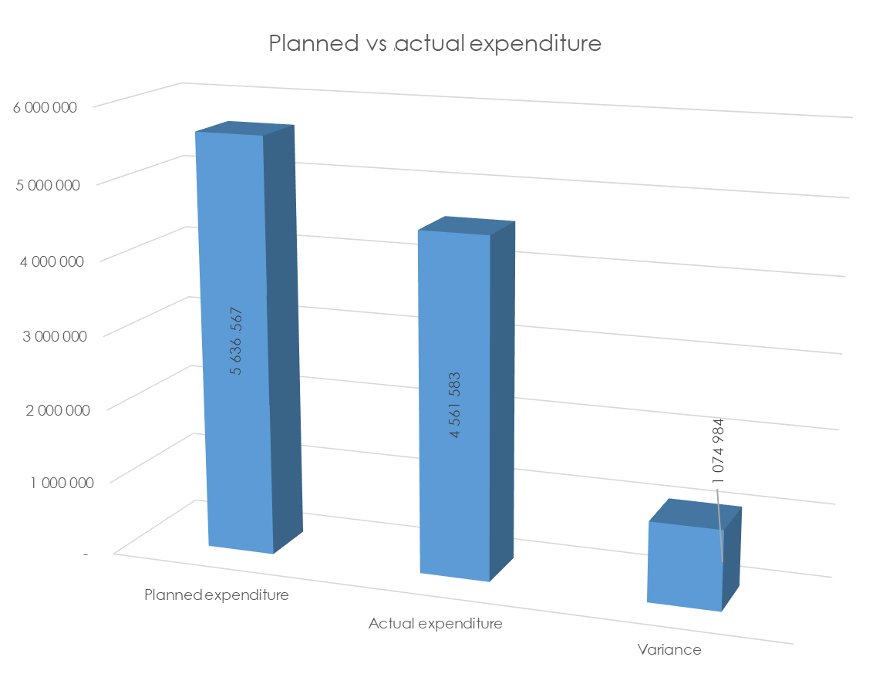
Overall financial performance – Q2

Slide 62
Financial performance per classification – Q2
Item | Planned expenditure R'000 | Actual expenditure R'000 | Variance R'000 | % variance
Compensation of employees | 181 818 | 163 939 | 17 879 | 10%
Goods and services | 115 901 | 105 354 | 10 547 | 9%
Transfer payments | 5 336 857 | 4 289 212 | 1 047 645 | 20%
Payment of capital assets | 1 991 | 3 078 | (1 087) | (55%)
Total | 5 636 567 | 4 561 583 | 1 074 984 | 19%

Slide 63
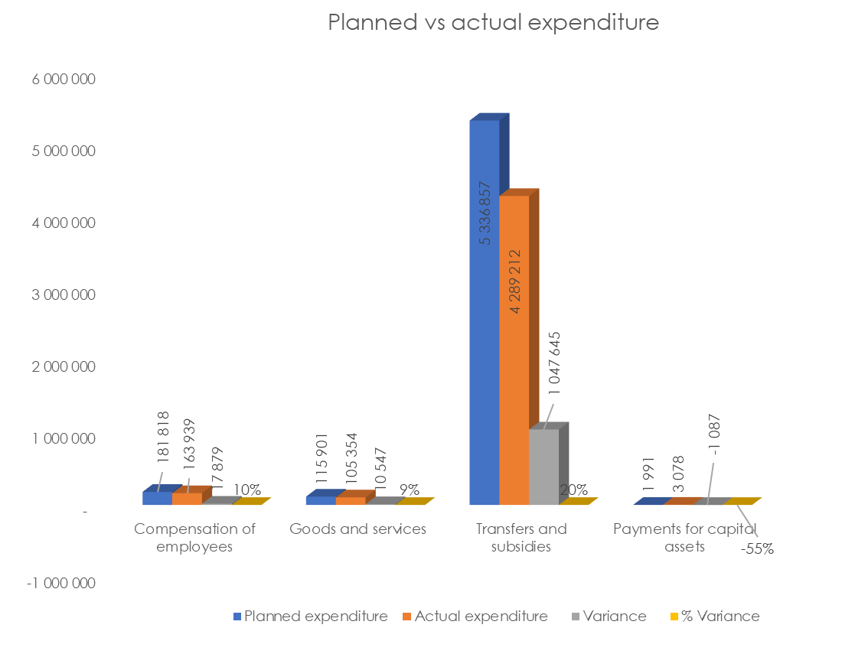
Financial performance per classification – Q2

Slide 64
Financial performance per Programme – Q2
Item | Planned expenditure R'000 | Actual expenditure R'000 | Variance R'000 | % Variance
Administration | 183 153 | 164 077 | 19 076 | 10%
Technology Innovation | 757 110 | 460 621 | 296 489 | 39%
International Cooperation and Resources | 89 546 | 53 068 | 36 489 | 41%
Research Development and Support | 3 412 009 | 3 031 416 | 380 593 | 11%
Socio-economic Innovation Partnerships | 1 194 749 | 852 401 | 342 348 | 29%
Total | 5 636 567 | 4 561 583 | 1 074 984 | 19%

Slide 65
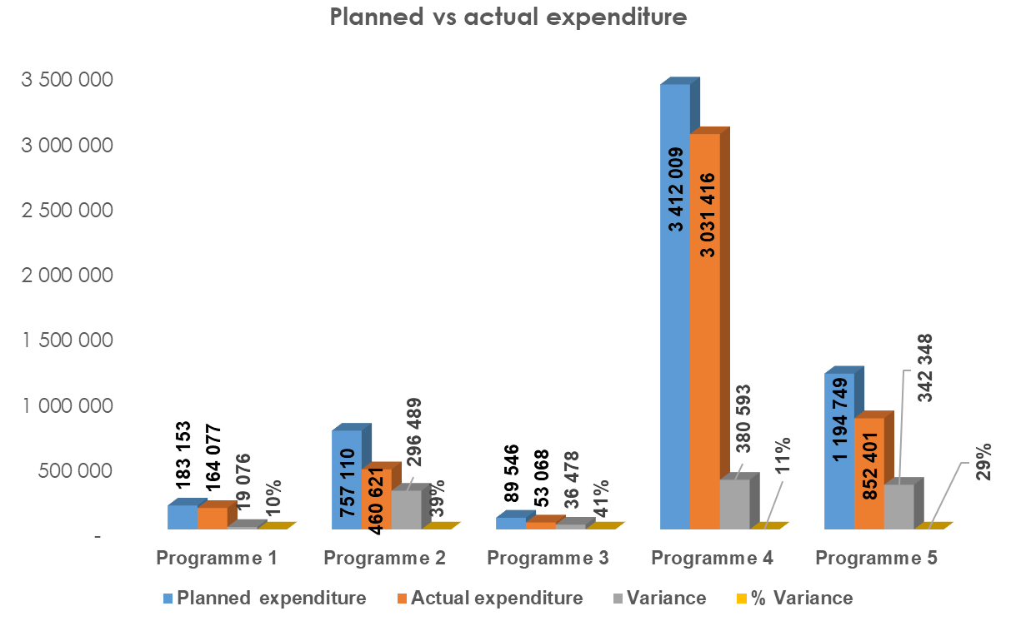
Financial performance per programme – Q2

Slide 66
Overall financial performance – Q3
The Department planned to spend R7,503 billion by the end of quarter 3.
The actual expenditure for the period amounted to R7,048 billion (77,1% of the total adjusted budget of R9,145 billion).
This translates to a variance of R455 million or 6% of planned expenditure.
The DSI has effected virements amounting to R479,557 million from slow spending activities to those that have shortfalls. Parliament approved a R393,553 million virement, National Treasury one of R75,688 million, and the Director-General one of R10,316 million.

Slide 67
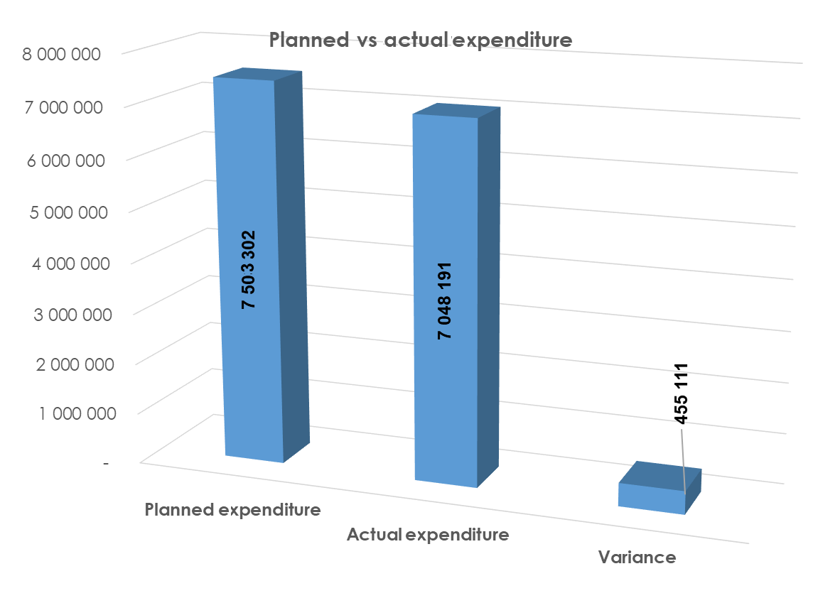
Overall financial performance – Q3

Slide 68
Financial performance per classification – Q3
Item | Planned expenditure R'000 | Actual expenditure R'000 | Variance R'000 | % Variance
Compensation of employees | 266 856 | 255 301 | 11 555 | 4%
Goods and services | 185 908 | 182 156 | 3 752 | 2%
Transfer payments | 7 047 523 | 6 605 887 | 441 636 | 6%
Payment of capital assets | 3 015 | 4 847 | (1 832) | (61%)
Total | 7 503 302 | 7 048 191 | 455 111 | 6%

Slide 69
Financial performance per classification – Q3

Slide 70
Financial performance per Programme
Item | Planned expenditure R'000 | Actual expenditure R'000 | Variance R'000 | % Variance
Administration | 270 466 | 260 314 | 10 152 | 4%
Technology Innovation | 1 250 056 | 1 096 524 | 153 532 | 12%
International Cooperation and Resources | 117 959 | 100 935 | 17 024 | 14%
Research Development and Support | 4 374 295 | 4 268 240 | 106 055 | 2%
Socio-economic Innovation Partnerships | 1 490 526 | 1 322 178 | 168 348 | 11%
Total | 7 503 302 | 7 048 191 | 455 111 | 6%

Slide 71
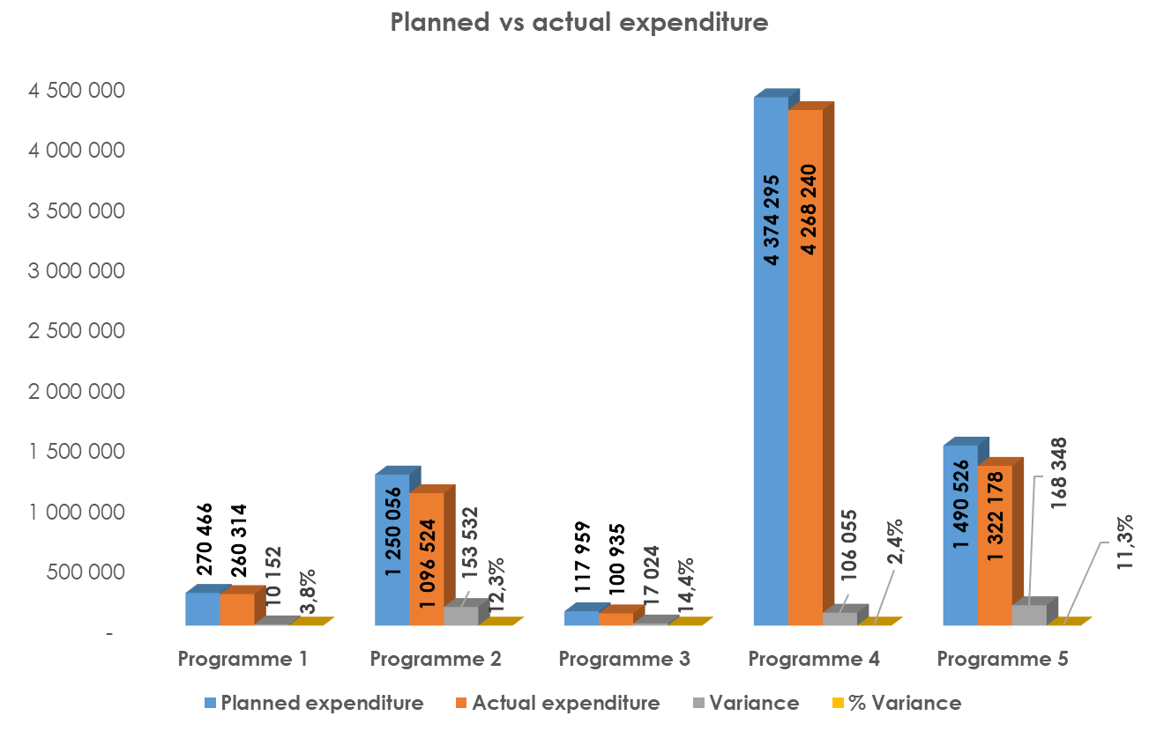
Financial performance per Programme – Q3

Slide 72
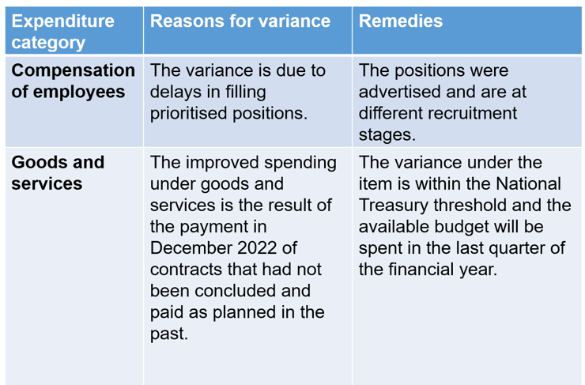
Reasons for variances and proposed remedies

Slide 73
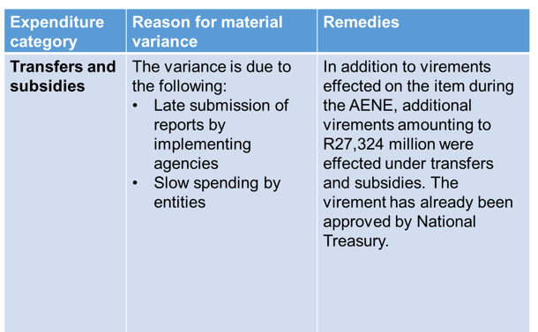
Reasons for variances and proposed remedies

Slide 74
Spending on procurement (Q2)
The total procurement expenditure on goods and services from 1 July to 30 September 2022 amounted to R21 770 418. The procurement expenditure on SMMEs, black, women and youth-owned companies is depicted below as follows:
Total procurement expenditure | Total expenditure on SMMEs | Total expenditure on black-owned companies | Total expenditure on woman-owned companies | Total expenditure on youth-owned companies
R21 770 418 | R11 871 484 | R17 615 850 | R10 106 787 | R3 461 963
% expenditure on SMMEs | % expenditure on black-owned companies | % expenditure on women-owned companies | % expenditure on youth-owned companies
54,5% | 80,9% | 46,4% | 15,9%

Slide 75
Spending on procurement (Q3)
The total procurement expenditure on goods and services from 1 October to 31 December 2022 amounted to R25 675 603. The procurement expenditure on SMMEs, black, women and youth owned companies is as follows:
Total procurement expenditure | Total expenditure on SMMEs | Total expenditure on black-owned companies | Total expenditure on woman-owned companies | Total expenditure on youth-owned companies
R25 675 603 | R11 909 998 | R19 466 176 | R8 257 620 | R3 925 215
% expenditure on SMMEs | % expenditure on black-owned companies | % expenditure on women-owned companies | % expenditure on youth-owned companies
46,4% | 75,8% | 32,2% | 15,3%

Slide 76
Yearly procurement spend to date
The total procurement expenditure on goods and services from 1 April to 31 December 2022 amounted to R57 703 534. The procurement expenditure on SMMEs, and black, women and youth-owned companies is as follows:
Total procurement expenditure | Total expenditure on SMMEs | Total expenditure on black-owned companies | Total expenditure on woman-owned companies | Total expenditure on youth-owned companies
R57 703 534 | R29 593 858 | R45 848 753 | R23 100 295 | R8 199 830
% expenditure on SMMEs | % expenditure on black-owned companies | % expenditure on women-owned companies | % expenditure on youth-owned companies
51,3% | 79,5% | 40,0% | 14,2%

Slide 77
Commodity spend to date on Women, Youth and People with Disabilities
COMMODITY | WOMEN OWNED COMPANIES |  | YOUTH OWNED COMPANIES |  | COMPANIES OWNED BY DISABLED PEOPLE
 | EXPENDITURE AMOUNT | % OF EXPENDITURE | EXPENDITURE AMOUNT | % OF EXPENDITURE | EXPENDITURE AMOUNT | % OF EXPENDITURE
Advertisement | R2 477 595 | 4,29% | R2 482 533 | 4,30% | R0 | 0,00%
Building Repairs | R104 101 | 0,18% | R104 101 | 0,18% | R0 | 0,00%
Catering Services | R391 303 | 0,68% | R14 697 | 0,03% | R0 | 0,00%
Cleaning Services | R2 034 987 | 3,53% | R598 354 | 1,04% | R0 | 0,00%
Computer Equipment | R121 900 | 0,21% | R121 900 | 0,21% | R0 | 0,00%
Computer Software | R441 379 | 0,76% | R0 | 0,00% | R0 | 0,00%
Conferences, Seminars, Venues & Courses | R133 606 | 0,23% | R70 931 | 0,12% | R0 | 0,00%
Consultants | R2 006 002 | 3,48% | R686 645 | 1,19% | R13 540 | 0,02%
Decorating for Event | R54 970 | 0,10% | R331 295 | 0,57% | R0 | 0,00%

Slide 78
Commodity spend to date on Women, Youth and People with Disabilities
COMMODITY | WOMEN OWNED COMPANIES |  | YOUTH OWNED COMPANIES |  | COMPANIES OWNED BY DISABLED PEOPLE
 | EXPENDITURE AMOUNT | % OF EXPENDITURE | EXPENDITURE AMOUNT | % OF EXPENDITURE | EXPENDITURE AMOUNT | % OF EXPENDITURE
Diesel Supply | R717 535 | 1,24% | R516 415 | 0,89% | R0 | 0,00%
Digital Camera | R11 550 | 0,02% | R11 550 | 0,02% | R0 | 0,00%
Fees: Subscription\ License | R4 063 537 | 7,04% | R328 882 | 0,57% | R0 | 0,00%
Fumigation | R42 559 | 0,07% | R85 118 | 0,15% | R0 | 0,00%
Furniture Removal | R161 621 | 0,28% | R38 808 | 0,07% | R0 | 0,00%
Hire & Service Items | R382 413 | 0,66% | R49 600 | 0,09% | R0 | 0,00%
Laptop Bag | R13 755 | 0,02% | R13 829 | 0,02% | R0 | 0,00%
Medical | R3 980 | 0,01% | R0 | 0,00% | R0 | 0,00%
Notebooks | R1 371 951 | 2,38% | R1 371 951 | 2,38% | R0 | 0,00%

Slide 79
Commodity spend to date on Women, Youth and People with Disabilities
COMMODITY | WOMEN OWNED COMPANIES |  | YOUTH OWNED COMPANIES |  | COMPANIES OWNED BY DISABLED PEOPLE
 | EXPENDITURE AMOUNT | % OF EXPENDITURE | EXPENDITURE AMOUNT | % OF EXPENDITURE | EXPENDITURE AMOUNT | % OF EXPENDITURE
Plumbing Services | R5 532 | 0,01% | R134 690 | 0,23% | R0 | 0,00%
Printing | R147 309 | 0,43% | R247 998 | 0,43% | R0 | 0,00%
Recruitment Agencies | R7 281 837 | 12,62% | R559 003 | 0,97% | R549 750 | 0,95%
Security Services | R111 516 | 1,93% | R530 669 | 0,92% | R0 | 0,00%
Stationary | R269 140 | 0,08% | R269 140 | 0,08% | R0 | 0,00%
Training | R523 343 | 0,91% | R659 027 | 1,14% | R0 | 0,00%

Slide 80
Average days before payment of invoices per month for 2021/22 and 2022/23 financial years
Month | Average number of days before payment
 | 2022/23 | 2021/22
April | 8 | 7
May | 7 | 7
June | 7 | 6
July | 6 | 6
August | 7 | 7
September | 7 | 7
October | 6 | 6
November | 10 | 6
December | 7 | 8
Total average number of days | 7 | 7

Slide 81
Percentage of invoices paid within 30 days after receipt in 2021/22 and 2022/23 financial years
Month | Percentage of invoices paid within 30 days of receipt
 | 2022/23 | 2021/22
April | 100% | 100%
May | 100% | 100%
June | 100% | 100%
July | 100% | 100%
August | 100% | 100%
September | 100% | 100%
October | 100% | 99,99%
November | 100% | 100%
December | 100% | 100%
Average | 100% | 99,99%

Slide 82
Siyabonga
Enkosi
Ha khensa
Re a leboga
Dankie
Ro livhuwa
Siyathokoza
Thank you

