Slide 1

GOVERNMENT PRINTING WORKS (GPW)
Progress on 2019 to 2024 Strategic Framework Targets and Plans
and the 2023/24 Annual Performance Plan
Presentation: DHA Portfolio Committee
Date: 29 March 2023
Venue: Pretoria
CEO: Ms Alinah Fosi

Slide 2

Presentation Outline
Background
Apex Government Priorities (2019 to 2024)
Executive Summary
GPW Performance Focusing on the NDP/MTSF Priorities
GPW Priorities for the 2020-2025 MTSF Cycle
Critical Projects
Resolution of Audit Findings
Implementation of MRP Recommendations
ANNUAL PERFORMANCE PLAN (APP): 2023/2024
Performance Targets for the Financial Year
Office of the CEO
Manufacturing & Engineering
Operations Management
Financial Services
Corporate Services
  THE GOVERNMENT PRINTING WORKS 2023-2024 BUDGET
  Alignment of Approved Organisational Structure to Budget Programmes
  Key Considerations
  Summary Budget
  Statement of Financial Position: 2023/2024
  DHA Discount
  Capital Expenditure: 2023/2024
  Capex Projects
  Compensation of Employees: 2023/2024
  Goods & Services Budget

Slide 3
1. Background
The Annual Performance Plan (APP) outlines all outcomes, outcome indicators and performance targets that have been set by the Government Printing Works (GPW) for the financial year 2023/24. These outcomes and targets are in alignment with the Strategic Plan 2020-2025.
The APP was further developed based on the revised Framework for Strategic Plans and Annual Performance Plans with the guidance of the Department of Planning, Monitoring and Evaluation (DPME) for implementation by national and provincial spheres of government.

Slide 4
2. Apex Government Priorities (2019 to 2024)
The GPW contributes to the following MTSF:
1. Building a capable, ethical and developmental State
2. Economic transformation and job creation
3. Education, skills and health
4. Consolidating the social wage through reliable and quality basic services
5. Spatial integration, human settlements and local government
6. Social cohesion and safe communities
7. A better Africa and world

Slide 5
Progress:
2019 to 2024 Strategic Framework Targets

Slide 6
3. Executive Summary
Progress on the 2019 to 2024 Strategic Framework Targets demonstrates that GPW performed well based on the targets it had set for the reporting period
GPW has successfully maintained and achieved the quality measure of producing security printed documents at 100% compliance against client quality and quantity specifications. As at the mid-term reporting period a total number of 432 905 identity documents/cards and 1 432 738 passports were produced.
In contributing to the “economic transformation and job creation” strategic outcome, GPW has been implementing the youth and women through its Artisan and Graduate skills programme. Of the 100 planned for achievement over the MTSF period, a total of 54 have already been taken through this programme.
GPW received a disclaimer audit opinion for the 2019/20 and 2020/21 financial years, as a result of the challenges that emanated from system crash that led to loss of critical finance data. GPW has been implementing a migration plan to stabilise and sustain all operations particularly in ICT and Finance.
GPW’s focus on business continuity, risk management and resolution of audit findings remain a priority in order to strengthen internal controls and ensure clean governance, given challenges experienced in the past financial years.
The next slides focus on GPW’s performance based on the NDP/MTSF priorities.

Slide 7
4. GPW performance focusing on the NDP/MTSF priorities
MTSF Priorities | Outcome | Outcome Indicator | Midterm target | Actual achievement as at 31 December 2022 | Improvements required from the remainder of the planning period
Priority 1: Economic transformation and job creation | Young people and women taken trough artisan and graduate programmes | Number of young people and women taken through artisan and graduate programmes | 20 unemployed young people and women recruited for Artisan and Graduate skills development programmes | 54 unemployed young people and women recruited for Artisan and Graduate skills development programmes Female 30 Male 24 | The target is on track and it is anticipated that GPW will achieve appointment of 100 young people and women at the end of the MTSF.
Priority 5: Social cohesion and safe communities | Security printed material produced | Percentage of identity documents cards distributed that conform to client and quantity specifications | 100% of Identity Documents/ cards delivered that conform to client specifications | 100% of 5 432 905 Identity Documents/ cards delivered that conform to client specifications | This is a quality measure target and it is anticipated that GPW will achieve the target for the duration the MTSF period
Priority 7: A better Africa and world | Security printed material produced | Percentage of passports distributed that conform to client specifications | 100% of Travel documents delivered that conform to client specifications | 100% of 1 432 738 Travel documents delivered that conform to client specifications | This is a quality measure target and it is anticipated that GPW will achieve the target for the duration the MTSF period

Slide 8
4. GPW performance focusing on the NDP/MTSF priorities cont..
MTSF Priorities | Outcome | Outcome Indicator | Midterm target | Actual achievement as at 31 December 2022 | Improvements required from the remainder of the planning period
Priority 6: Building a capable, ethical and developmental State | Workforce trained to improve service delivery and support career path | Percentage of the work force trained as per WSP priorities | 70% of total workforce trained as per critical the WSP identified priorities | 89% of total workforce trained as per critical the WSP identified priorities | -
Priority 6: Building a capable, ethical and developmental State | Effective and efficient internal corporate governance to enable organizational performance | Unqualified audit opinion with no material findings | 90% of approved annual internal audit plan implemented | 94% of approved annual internal audit plan implemented | Facilitate a culture of combined assurance across all lines of defense to improve the adequacy of internal controls
Priority 6: Building a capable, ethical and developmental State | Resilient ,agile and sustainable business in the event of disaster | Percentage implementation of the Business Continuity management activities as subset of enterprise risk management | Business Continuity Management programme implemented | 100 % business continuity management activities implemented | Capacitate ERM unit to ensure that GPW fully implements its BCM programmes

Slide 9
4. GPW performance focusing on the NDP/MTSF priorities cont..
MTSF Priorities | Outcome | Outcome Indicator | Midterm target | Actual achievement as at 31 December 2022 | Improvements required from the remainder of the planning period
Priority 6: Building a capable, ethical and developmental State | Secured management of GPW operations, facilities, information and people | Security model implemented addressing 100% activities as outline in the security plan | 100% of the approved security plan implemented | 100% of approved GPW security model not implemented | Prioritization of the security plan activities to ensure that all the security risks are effectively managed

Slide 10
5.GPW Priorities for the 2020-2025 MTSF Cycle
GPW remains committed to deliver based on the following priorities/strategic pillars:
1. Reposition the GPW’s business processes to ensure stability, sustainability and viability of the organization as a critical national security facility.
2. Improve customer experience through timeous quality and quantity management
3. Ensure return on investment and sound financial management and sustainability.
4. Implement long term vision (Vision 2030), of being a State security printer of choice in the SADC region.
5. Recruit, retain and develop GPW’s workforce to meet market and client demands.
6. Upgrade facilities to ensure effective management of all operations.

Slide 11
6. Critical Projects
GPW repositioning: change management and culture change. GTAC appointed and busy with the development of turn around strategy and provide support on the implementation of HR recommendations based on the MRP Report and change management
Modernisation of GPW- renewed focus on ICT interventions in the wake of 4IR. Migration plan being implemented to ensure stabilisation and sustainability of the ICT environment.
Business continuity of all operations and sustainability of GPW, given the challenges that GPW has been experiencing in ICT and its facilities
Conscious journey towards a clean audit which rests upon the following crucial pillars:
  Quality of oversight processes in GPW- to realise the imperative of achieving a clean audit
  Strengthening and monitoring internal controls to ensure their relevance and effectiveness
  Financial probity and culture that supports probity with our procurement processes being efficient and compliant with legislation, having integrity, equitable and fair
  Overall governance: leadership, management responsibility and effectiveness of governance structures such as EXCO, MANCO, Audit and Risk Committee within the combined assurance framework
Implementation of Ministerial Review Panel Report recommendations: Action plan being implemented based on the short-term, medium-term and long-term activities and milestones.
Security Printing Bill: The Provincial consultative sessions on the Bill are on-going. GPW in partnership with DHA team has already presented to all Provinces, except for North West and Western Cape. Engaging them on dates to finalise consultation.

Slide 12
6. Critical Projects cont..
Appointment of the Ministerial Advisory Board (MAB). Governance structure to advice Minister and EXCO on overall GPW operations.
Strengthening systems of employee wellness and occupational health and safety. Implementation of policies, procedures and plans to create and sustain a caring environment
Critical Infrastructure Projects: New Head Office ( ABSA building refurbishment) and Masterplan (initiation of construction plan): both projects approved for implementation.
DBSA has been appointed as the implementing agent and has begun with administrative processes towards refurbishment and construction of these critical facilities.
Implementation of ISO 9001, ISO 14001, ISO 45001, ISO 27001, ISO 22301, ISO 18788 and ISO 14298: Research and development, including support and service maintenance for 5 years post implementation
Conduct a polycarbonate printing and assembly plant techno-economic study: agile printing facility which is ready for expected future trends in technology and the printing industry

Slide 13
7. Resolution of Audit Findings
Branch / Division | No. of Findings | Resolved | % Resolved | % Not Resolved | Internal Audit Verification
Office of the CEO | 3 | 3 | 100% | 0% | √
ICT | 135 | 114 | 85% | 15% | √
Operations & Production | 18 | 15 | 83% | 17% | √
Marketing | 3 | 3 | 100% | 0% | √
Strategic Support | 12 | 11 | 92% | 8% | √
Risk Management | 15 | 9 | 60% | 40% | √
Security Management | 29 | 19 | 66% | 34% | √
Financial Services | 253 | Audit Review in Progress
SCM | 75 | 37 | 49% | 51% |  | √
Human Resources | 38 | 33 | 87% | 13% |  | √
OHS | 14 | 8 | 57% | 43% |  | √
Total | 595 | 252 | 77.9% | 22.1%

Slide 14
7. Resolution of Audit Findings cont..
As at end of Quarter 3 of 2022/23 Internal Audit confirms that 77,9% of the audit findings raised in prior years by IA and AGSA has been resolved by Management.
This exclude findings raised within the financial services branch, which were deferred for review during quarter 4 as agreed with the CFO to allow finance to address data loss issues experienced as a result of the system crash of 04 February 2021.
An audit is currently underway to verify the effectiveness of management actions plans and/or audit recommendations in addressing the findings raised within finance.
IA is also currently evaluating the remaining 22,1% of the findings that were not addressed by the other branches in the previous quarters.

Slide 15
8. Implementation of MRP recommendations
The GPW management received the MRP report in August 2022
Actions plans, within the SMART principle have been developed and are being implemented.
The Project office has been established and capacitated with a Project Leader, Technical Advisor and Assistant to monitor the implementation of the recommendations.
The project office identifies risks, weaknesses and advise the management towards implementation process.
EXCO acts as the Project steering committee to monitor all the recommendations.
The project office provides feedback to the Project steering committee (i.e. EXCO), at every EXCO meeting.
The implementation model has been developed to technically guide the project and monitor the implementation of the report.
The work streams have been established as a monitoring mechanism and implementation tool.
The work streams have been meeting bimonthly, and are expected to ensure progress, identify risks and attend to all operational challenges.

Slide 16
8. Implementation of MRP recommendations cont..
GTAC has been appointed to advise and assist on the GPW turnaround strategy and serves as an expert leader on human resources at work stream level
As per recommendations of the MRP , a forensic company has been appointed.
The forensic company also serve as a lead expert on investigations at work stream level.
Relevant and critical information has been submitted to the forensic company for further investigation
As per the Report, some cases have already been referred to the Public Service Commission for further investigation.
To date, the GPW management has achieved approximately 26% implementation rate of all the recommendations.
Efforts are in place to attain greater progress from the 01st April 2023.

Slide 17
8. Implementation of MRP Recommendations cont…

Slide 18
ANNUAL PERFORMANCE PLAN (APP): 2023/2024

Slide 19
9. Performance Targets for the Financial Year
The GPW’s APP for 2023/24 has a total of 18 performance targets with critical targets aligned to the Strategic Plan to ensure that all outcomes and desired impacts are achieved. The targets are allocated in alignment with the reviewed structure as follows:
Office of the CEO - 02 Performance Targets
Branch Manufacturing and Engineering - 04 Performance Targets
Branch Operations Management - 01 Performance Target
Branch Financial Services - 02 Performance targets
Branch Corporate Services -09 Performance targets

Slide 20
OFFICE OF THE CEO

Slide 21
10. Office of the CEO
NO. | Outcome | Outputs | Output Indicators | Audited/Actual Performance 2019/20 | Audited/Actual Performance 2020/21 | Estimated Performance 2021/22 | Estimated Performance 2022/23 | Medium Term Targets
 |  |  |  |  |  |  |  | 2023/24 | 2024/25 | 2025/26
Internal Audit
1. | Independent and objective assurance and consulting services provided | Annual internal audit plan implemented | Percentage implementation of the annual internal audit plan | 100% of approved annual internal audit plan implemented | 90% of approved annual internal audit plan implemented | 90% of approved annual internal audit plan implemented | 90% of approved annual internal audit plan implemented | 100% of approved annual internal audit plan implemented | 100% of approved annual internal audit plan implemented | 100% of approved annual internal audit plan implemented
Quarterly Target Information for 2023/24
Output Indicator: Percentage implementation of the annual internal audit plan
Annual Target: 100% of approved annual internal audit plan implemented
Reporting Period: Quarterly
Quarter 1 Target: 20% of approved annual internal audit plan implemented
Quarter 2 Target: 30% of approved annual internal audit plan implemented
Quarter 3 Target: 30% of approved annual internal audit plan implemented
Quarter 4 Target: 20% of approved annual internal audit plan implemented

Slide 22
10. Office of the CEO Continued..
NO. | Outcome | Outputs | Output Indicators | Audited/Actual Performance 2019/20 | Audited/Actual Performance 2020/21 | Estimated Performance 2021/22 | Estimated Performance 2022/23 | Medium Term Targets
 |  |  |  |  |  |  |  | 2023/24 | 2024/25 | 2025/26
Enterprise Risk Management
2. | Resilient, agile and sustainable business in the event of disaster | Business Continuity Management activities implemented | Percentage implementation of the Business Continuity Management activities | Business Continuity Plan submitted for approval and implemented | Business Continuity Management activities 100% implemented | Business Continuity Management programme implemented | 100% of Business Continuity Management programme implemented | 100% of Business Continuity Management activities implemented | 100% of Business Continuity Management activities implemented | 100% of Business Continuity Management activities implemented
Quarterly Target Information for 2023/24
Output Indicator: Percentage implementation of the Business Continuity Management activities
Annual Target: 100% of Business Continuity Management activities implemented
Reporting Period: Quarterly
Quarter 1 Target: 100% BCM activities implemented in line with the Risk Management 3 year rolling plan
Quarter 2 Target: 100% BCM activities implemented in line with the Risk Management 3 year rolling plan
Quarter 3 Target: 100% BCM activities implemented in line with the Risk Management 3 year rolling plan
Quarter 4 Target: 100% BCM activities implemented in line with the Risk Management 3 year rolling plan

Slide 23
BRANCH:
MANUFACTURING AND ENGINEERING

Slide 24
11. Branch: Manufacturing and Engineering
NO. | Outcome | Outputs | Output Indicators | Audited/Actual Performance 2019/20 | Audited/Actual Performance 2020/21 | Estimated Performance 2021/22 | Estimated Performance 2022/23 | Medium Term Targets
 |  |  |  |  |  |  |  | 2023/24 | 2024/25 | 2025/26
1. | Security printed materials produced | Identity Documents/ cards that conform to client specifications produced | Percentage of Identity Documents/ cards produced that conform to client specifications | 100% of 2 822 174 Identity Documents/ cards delivered that conform to client specifications | 100% of 1 267 244 Identity Documents/ cards delivered that conform to client specifications | 100% 2 334 522 of Identity Documents/ cards delivered that conform to client specifications | 100% of Identity Documents/ cards produced that conform to client specifications | 100% of Identity Documents/ cards produced that conform to client specifications | 100% of Identity Documents/ cards produced that conform to client specifications | 100% of Identity Documents/ cards produced that conform to client specifications
Quarterly Target Information for 2023/24
Output Indicator: Percentage of Identity Documents/ cards produced that conform to client specifications
Annual Target: 100% of Identity Documents/ cards produced that conform to the client specifications
Reporting Period: Quarterly
Quarter 1 Target: 100% of Identity Documents/ cards produced that conform to client specifications
Quarter 2 Target: 100% of Identity Documents/ cards produced that conform to client specifications
Quarter 3 Target: 100% of Identity Documents/ cards produced that conform to client specifications
Quarter 4 Target: 100% of Identity Documents/ cards produced that conform to client specifications

Slide 25
11. Branch: Manufacturing and Engineering Continued..
NO. | Outcome | Outputs | Output Indicators | Audited/Actual Performance 2019/20 | Audited/Actual Performance 2020/21 | Estimated Performance 2021/22 | Estimated Performance 2022/23 | Medium Term Targets
 |  |  |  |  |  |  |  | 2023/24 | 2024/25 | 2025/26
2. | Security printed materials produced | Travel documents that conform to client specifications produced | Percentage of Travel documents produced that conform to client specifications | 100% of 917 934 Travel documents delivered that conform to the client specifications | 100% of 553 098 Travel documents delivered that conform to client specifications | 100% of 204 452 Travel documents delivered that conform to client specifications | 100% of Travel documents produced that conform to client specifications | 100% of Travel documents produced that conform to client specifications | 100% of Travel documents produced that conform to client specifications | 100% of Travel documents produced that conform to client specifications
Quarterly Target Information for 2023/24
Output Indicator: Percentage of Travel documents produced that conform to client specifications
Annual Target: 100% of Travel documents produced that conform to client specifications
Reporting Period: Quarterly
Quarter 1 Target: 100% of Travel Documents produced that conform to client specifications
Quarter 2 Target: 100% of Travel Documents produced that conform to client specifications
Quarter 3 Target: 100% of Travel Documents produced that conform to client specifications
Quarter 4 Target: 100% of Travel Documents produced that conform to client specifications

Slide 26
11. Branch: Manufacturing and Engineering Continued..
NO. | Outcome | Outputs | Output Indicators | Audited/Actual Performance 2019/20 | Audited/Actual Performance 2020/21 | Estimated Performance 2021/22 | Estimated Performance 2022/23 | Medium Term Targets
 |  |  |  |  |  |  |  | 2023/24 | 2024/25 | 2025/26
3. | Security printed materials produced | Examination papers that conform to client specifications produced | Percentage of examinations papers produced that conform to client specifications | 100% of 25 217 879 examination papers delivered that conform to client specifications | 100% of 15 005 351 examination papers delivered that conform to client specifications | 100% of 17 150 015 examination papers delivered that conform to the client specifications | 100% of examination papers produced that conform to the client specifications | 100% of examination papers produced that conform to the client specifications | 100% of examination papers produced that conform to client specifications | 100% of examination papers produced that conform to client specifications
Quarterly Target Information for 2023/24
Output Indicator: Percentage of examinations papers produced that conform to client specifications
Annual Target: 100% of examination papers produced that conform to the client specifications
Reporting Period: Quarterly
Quarter 1 Target: 100% of examination papers produced that conform to client specifications
Quarter 2 Target: 100% of examination papers produced that conform to client specifications
Quarter 3 Target: 100% of examination papers produced that conform to client specifications
Quarter 4 Target: 100% of examination papers produced that conform to client specifications

Slide 27
11. Branch: Manufacturing and Engineering Continued..
NO. | Outcome | Outputs | Output Indicators | Audited/Actual Performance 2019/20 | Audited/Actual Performance 2020/21 | Estimated Performance 2021/22 | Estimated Performance 2022/23 | Medium Term Targets
 |  |  |  |  |  |  |  | 2023/24 | 2024/25 | 2025/26
4. | Security printed materials produced | High Security Certificates that conform to client specifications produced | Percentage of High Security Certificates produced that conform to client specifications | 98.6 % of 13 488 576 High Security Certificates delivered that conform to client specifications. | 99% of 6 498 103 High Security Certificates delivered that conform to client specifications | 99% of High Security Certificates delivered that conform to client specifications | 99% of High Security Certificates produced that conform to client specifications | 99% of High Security Certificates produced that conform to client specifications | 99% of High Security Certificates produced that conform to client specifications | 99% of High Security Certificates produced that conform to client specifications
Quarterly Target Information for 2023/24
Output Indicator: Percentage of High Security Certificates produced that conform to client specifications
Annual Target: 99% of High Security Certificates produced that conform to client specifications
Reporting Period: Quarterly
Quarter 1 Target: 99% of High Security Certificates produced that conform to client specifications
Quarter 2 Target: 99% of High Security Certificates produced that conform to client specifications
Quarter 3 Target: 99% of High Security Certificates produced that conform to client specifications
Quarter 4 Target: 99% of High Security Certificates produced that conform to client specifications

Slide 28
BRANCH:
OPERATIONS MANAGEMENT

Slide 29
12. Branch: Operations Management
NO. | Outcome | Outputs | Output Indicators | Audited/Actual Performance 2019/20 | Audited/Actual Performance 2020/21 | Estimated Performance 2021/22 | Estimated Performance 2022/23 | Medium Term Targets
 |  |  |  |  |  |  |  | 2023/24 | 2024/25 | 2025/26
1. | Government information coordinated and distributed | Government Gazettes that conform to client specifications published | Percentage of Government Gazettes published that conform to client specifications | 100% of 2000 Government Gazettes published that conform to client specifications | 100% of 2078 Government Gazettes published that conform to client specifications | 100% of 2130 Government Gazettes published that conform to client specifications | 100% of Government Gazettes published that conform to client specifications | 100% of Government Gazettes published that conform to client specifications | 100% of Government Gazettes published that conform to client specifications | 100% of Government Gazettes published that conform to client specifications
Quarterly Target Information for 2023/24
Output Indicator: Percentage of Government Gazettes published that conform to client specifications
Annual Target: 100% of Government Gazettes published that conform to client specifications
Reporting Period: Quarterly
Quarter 1 Target: 100% of Government Gazettes published that conform the client specifications
Quarter 2 Target: 100% of Government Gazettes published that conform the client specifications
Quarter 3 Target: 100% of Government Gazettes published that conform the client specifications
Quarter 4 Target: 100% of Government Gazettes published that conform the client specifications

Slide 30
BRANCH:FINANCIAL SERVICES

Slide 31
13. Branch: Financial Services
NO. | Outcome | Outputs | Output Indicators | Audited/Actual Performance 2019/20 | Audited/Actual Performance 2020/21 | Estimated Performance 2021/22 | Estimated Performance 2022/23 | Medium Term Targets
 |  |  |  |  |  |  |  | 2023/24 | 2024/25 | 2025/26
1. | Quality financial and supply chain management services compliant with legislation and policies | Clean audit report maintained | Audit outcome | Qualified audit opinion for 2018/19 | Disclaimer for 2019/20 | Disclaimer for 2020/21 | Disclaimer for 2021/22 | Unqualified audit opinion for 2022/23 | Unqualified audit opinion for 2023/24 | Unqualified audit opinion for 2024/25
Annual Target Information for 2023/24
Output Indicator: Audit outcome
Annual Target: Unqualified audit opinion for 2022/23
Reporting Period: Quarterly
Quarter 1 Target: Annual Financial Statements (AFS) for the 2022/23 financial year submitted to AGSA
Quarter 2 Target: Audited AFS included in the Annual Report 2022/23
Quarter 3 Target: Tabling (inclusive of financial statements)
Quarter 4 Target: Unqualified audit opinion for 2022/23

Slide 32
13. Branch: Financial Services Continued..
NO. | Outcome | Outputs | Output Indicators | Audited/Actual Performance 2019/20 | Audited/Actual Performance 2020/21 | Estimated Performance 2021/22 | Estimated Performance 2022/23 | Medium Term Targets
 |  |  |  |  |  |  |  | 2023/24 | 2024/25 | 2025/26
2. | Quality financial and supply chain management services compliant with legislation and policies | Net profit margin maintained | Percentage of net profit margin achieved | 33.87% net profit margin achieved | Non-availability of data due to system failures. | 10% net profit margin achieved | 10% net profit margin achieved | 10% net profit margin achieved | 10% net profit margin achieved | 10% net profit margin achieved
Annual Target Information for 2023/24
Output Indicator: Percentage of net profit margin achieved
Annual Target: 10% net profit margin achieved
Reporting Period: Quarterly
Quarter 1 Target: 10% net profit margin achieved
Quarter 2 Target: 10% net profit margin achieved
Quarter 3 Target: 10% net profit margin achieved
Quarter 4 Target: 10% net profit margin achieved

Slide 33
BRANCH:CORPORATE SERVICES

Slide 34
14. Branch: Corporate Services
NO. | Outcome | Outputs | Output Indicators | Audited/Actual Performance 2019/20 | Audited/Actual Performance 2020/21 | Estimated Performance 2021/22 | Estimated Performance 2022/23 | Medium Term Targets
 |  |  |  |  |  |  |  | 2023/24 | 2024/25 | 2025/26
Human Resources
1. | Young people and women equipped with Artisan and other professional skills | Recruitment plan implemented in relation to the filling of identified positions | Number of young people and women taken through Artisan and Graduate programme(s) | N/a | 31 Unemployed young people and women recruited for artisan and graduate skills development programs | 20 unemployed young people and women recruited for Artisan and Graduate skills development programmes | 20 unemployed young people and women recruited for Artisan and Graduate skills development programmes | 20 unemployed young people recruited for Artisan and Graduate skills development programmes | 20 unemployed young people recruited for Artisan and Graduate skills development programmes | 20 unemployed young people recruited for Artisan and Graduate skills development programmes
Quarterly Target Information for 2023/24
Output Indicator: Number of young people and women taken through Artisan and Graduate programme(s)
Annual Target: 20 unemployed young people recruited for Artisan and Graduate skills development programmes
Reporting Period: Quarterly
Quarter 1 Target: Skills and areas of placement for the 2024/25 intake identified
Quarter 2 Target: Artisan and Graduate skills development programme submitted for approval
Quarter 3 Target: Artisan and graduate skills development programme advertised and shortlisting completed
Quarter 4 Target: 20 unemployed young people recruited for Artisan and Graduate skills development programmes

Slide 35
14. Branch: Corporate Services Continued..
NO. | Outcome | Outputs | Output Indicators | Audited/Actual Performance 2019/20 | Audited/Actual Performance 2020/21 | Estimated Performance 2021/22 | Estimated Performance 2022/23 | Medium Term Targets
 |  |  |  |  |  |  |  | 2023/24 | 2024/25 | 2025/26
2. | Capacity of workforce developed to support service delivery | Workforce trained as per the WSP identified priorities | Percentage of total workforce trained as per WSP identified priorities | 87.6 of total workforce trained. | 46.5% of total workforce trained as per WSP identified priorities | 50% of total workforce trained as per the WSP identified priorities | 60% of total workforce trained as per WSP identified priorities | 70% of total workforce trained as per WSP identified priorities | 70% of total workforce trained as per WSP identified priorities | 70% of total workforce trained as per WSP identified priorities
Quarterly Target Information for 2023/24
Output Indicator: Percentage of total workforce trained as per WSP identified priorities
Annual Target: 70% of total workforce trained as per WSP identified priorities
Reporting Period: Quarterly
Quarter 1 Target: 10% of total workforce trained as per the WSP identified priorities
Quarter 2 Target: 25% of total workforce trained as per the WSP identified priorities
Quarter 3 Target: 25% of total workforce trained as per the WSP identified priorities
Quarter 4 Target: 10% of total workforce trained as per the WSP identified priorities

Slide 36
14. Branch: Corporate Services Continued..
NO. | Outcome | Outputs | Output Indicators | Audited/Actual Performance 2019/20 | Audited/Actual Performance 2020/21 | Estimated Performance 2021/22 | Estimated Performance 2022/23 | Medium Term Targets
 |  |  |  |  |  |  |  | 2023/24 | 2024/25 | 2025/26
3. | GPW capacitated with requisite skills that support its strategy | Recruitment plan implemented in relation to the filling of identified positions | Percentage of identified posts filled in line with the approved structure | 90.6% filled of identified posts filled in accordance with the previous structure | N/A | N/A | N/A | 90% of vacant positions filled in line with the recruitment plan | 90% of vacant positions filled in line with the recruitment plan | 90% of vacant positions filled in line with the recruitment plan
Quarterly Target Information for 2023/24
Output Indicator: Percentage of identified posts filled in line with the approved structure
Annual Target: 90% of identified vacant positions filled in line with the recruitment plan
Reporting Period: Quarterly
Quarter 1 Target: 20% of vacant positions filled in line with the recruitment plan
Quarter 2 Target: 30% of vacant positions filled in line with the recruitment plan
Quarter 3 Target: 30% of vacant positions filled in line with the recruitment plan
Quarter 4 Target: 10% of vacant positions filled in line with the recruitment plan

Slide 37
14. Branch: Corporate Services Continued..
NO. | Outcome | Outputs | Output Indicators | Audited/Actual Performance 2019/20 | Audited/Actual Performance 2020/21 | Estimated Performance 2021/22 | Estimated Performance 2022/23 | Medium Term Targets
 |  |  |  |  |  |  |  | 2023/24 | 2024/25 | 2025/26
4. | Key initiatives and performance areas in line with the Change Management Strategy and Implementation plan outlined | Change management roadmap to guide implementation of change initiatives | Change Management Strategy and Implementation Plan | N/A | N/A | N/A | N/A | Change Management Strategy and Implementation Plan developed | Change Management Strategy and Plan implemented | Change management activities monitored
Quarterly Target Information for 2023/24
Output Indicator: Change Management Strategy and Implementation Plan
Annual Target: Change Management Strategy and Implementation Plan developed
Reporting Period: Quarterly
Quarter 1 Target: Change Management Strategy developed
Quarter 2 Target: Change Management Strategy submitted for approval
Quarter 3 Target: Change Management Implementation Plan developed
Quarter 4 Target: Change Management Implementation Plan submitted for approval

Slide 38
14. Branch: Corporate Services Continued..
NO. | Outcome | Outputs | Output Indicators | Audited/Actual Performance 2019/20 | Audited/Actual Performance 2020/21 | Estimated Performance 2021/22 | Estimated Performance 2022/23 | Medium Term Targets
 |  |  |  |  |  |  |  | 2023/24 | 2024/25 | 2025/26
Information Communication Technology (ICT)
5. | Secured and resilient GPW Information System and Digital Services Ecosystem Platform. | 95,5% availability of GPW Information System and Digital Services Ecosystem Platforming line with Disaster Management Act and good governance. | Percentage of the required capability for the GPW Information System and Digital Services Ecosystem Platform in line with Disaster Management Act and good governance. | N/A | N/A | N/A | N/A | 60% of the required capability for the GPW Information System and Digital Services Ecosystem Platform in line with Disaster Management Act and good governance. | 90% of the required capability for the GPW Information System and Digital Services Ecosystem Platform in line with Disaster Management Act and good governance. | 100% of the required capability for the GPW Information System and Digital Services Ecosystem Platform in line with Disaster Management Act and good governance.
Annual Target Information for 2023/24
Percentage of the required capability for the GPW Information System and Digital Services Ecosystem Platform in line with Disaster Management Act and good governance.
Annual Target: required capability for the GPW Information System and Digital Services Ecosystem Platform in line with Disaster Management Act and good governance.
Reporting Period: Quarterly
Quarter 1 Target: Framework and reference Architecture for the building of GPW Information System and Digital Services Ecosystem Platform in line with Disaster Management Act good governance
Quarter 2 Target: 10% of the required capability for the GPW Information System and Digital Services Ecosystem Platform in line with Disaster Management Act and good governance.
Quarter 3 Target: 20% of the required capability for the GPW Information System and Digital Services Ecosystem Platform in line with Disaster Management Act and good governance.
Quarter 4 Target: 30% of the required capability for the GPW Information System and Digital Services Ecosystem Platform in line with Disaster Management Act and good governance.

Slide 39
14. Branch: Corporate Services Continued..
NO. | Outcome | Outputs | Output Indicators | Audited/Actual Performance 2019/20 | Audited/Actual Performance 2020/21 | Estimated Performance 2021/22 | Estimated Performance 2022/23 | Medium Term Targets
 |  |  |  |  |  |  |  | 2023/24 | 2024/25 | 2025/26
Security Services
6. | Secured GPW Assets, people and information | GPW security model implemented | Percentage implementation of the GPW security plan | GPW security model reviewed and implemented | Reviewed GPW security model implemented | Implementation of the reviewed security model for GPW | 100% implementation of the approved security management plan | 100% implementation of the approved security management plan | 100% implementation of the approved security management plan | 100% implementation of the approved security management plan
Quarterly Target Information for 2023/24
Output Indicator: Percentage implementation of the GPW security plan
Annual Target: 100% implementation of the approved security management plan
Reporting Period: Quarterly
Quarter 1 Target: 100% implementation of the approved security management plan
Quarter 2 Target: 100% implementation of the approved security management plan
Quarter 3 Target: 100% implementation of the approved security management plan
Quarter 4 Target: 100% implementation of the approved security management plan

Slide 40
14. Branch: Corporate Services Continued..
NO. | Outcome | Outputs | Output Indicators | Audited/Actual Performance 2019/20 | Audited/Actual Performance 2020/21 | Estimated Performance 2021/22 | Estimated Performance 2022/23 | Medium Term Targets
 |  |  |  |  |  |  |  | 2023/24 | 2024/25 | 2025/26
Strategic Planning
7. | Customer relationship management maintained | Integrated Marketing and Communication Strategy and Plan implemented | Number of provincial group customers engagement sessions conducted | N/A | N/A | Integrated marketing and communication strategy reviewed and implementation plans developed | 8 provincial group customer engagement sessions conducted | 8 provincial group customer engagement sessions conducted | Review of the Integrated marketing and communication strategy reviewed and implementation plans developed | Review of the Integrated marketing and communication strategy reviewed and implementation plans developed
Quarterly Target Information for 2023/24
Output Indicator: Number of provincial group customer engagement sessions conducted
Annual Target: 8 provincial group customer engagement sessions conducted
Reporting Period: Quarterly
Quarter 1 Target: 2 Provincial group customer engagement sessions conducted
Quarter 2 Target: 3 Provincial group customer engagement sessions conducted
Quarter 3 Target: 3 Provincial group customer engagement sessions conducted
Quarter 4 Target: Customer feedback submitted for consolidation in SDIP

Slide 41
14. Branch: Corporate Services Continued..
NO. | Outcome | Outputs | Output Indicators | Audited/Actual Performance 2019/20 | Audited/Actual Performance 2020/21 | Estimated Performance 2021/22 | Estimated Performance 2022/23 | Medium Term Targets
 |  |  |  |  |  |  |  | 2023/24 | 2024/25 | 2025/26
Facilities Management
8. | Functional and secure facilities | GPW Headquarters building refurbished | Percentage completion of Headquarters building | GPW Headquarters building not completed | N/A | N/A | N/A | 90% refurbishment of the GPW Headquarters building completed | Close-out of Project (Defects Liability Period) 100% Project Completion | -
Quarterly Target Information for 2023/24
Output Indicator: : Percentage completion of Headquarters building
Annual Target: 90% refurbishment of the GPW Headquarters building completed
Reporting Period: Quarterly
Quarter 1 Target: Preparation of Tender Documentation in collaboration with the DBSA as an implementing agent – Prepare and submit for Approval of BOQ & Tender Document
Quarter 2 Target: Project contractor appointed
Quarter 3 Target: Construction project milestones implemented in line with the approved project plan
Quarter 4 Target: Construction project milestones in line with the approved project plan (Practical Completion and handover)

Slide 42
14. Branch: Corporate Services Continued..
NO. | Outcome | Outputs | Output Indicators | Audited/Actual Performance 2019/20 | Audited/Actual Performance 2020/21 | Estimated Performance 2021/22 | Estimated Performance 2022/23 | Medium Term Targets
 |  |  |  |  |  |  |  | 2023/24 | 2024/25 | 2025/26
Legal Services
9. | Legally compliant and informed Business decisions | legal advisory services provided | Percentage of contracts (SLAs/MOU) drafted as per the approved tender document | N/A | N/A | N/A | N/A | 100% Contracts (SLAs/MOU) drafted as per the approved tender document | 100% contracts (SLAs/MOU) drafted as per the approved tender document | 100% contracts (SLAs/MOU) drafted as per the approved tender document
Quarterly Target Information for 2023/24
Output Indicator: Percentage of contracts (SLAs/MOU) drafted as per approved tender document
Annual Target: 100% contracts (SLAs/MOU) drafted as per approved tender document
Reporting Period: Quarterly
Quarter 1 Target: 100% contracts (SLAs/MOU) drafted as per the approved tender document
Quarter 2 Target: 100% contracts (SLAs/MOU) drafted as per the approved tender document
Quarter 3 Target: 100% contracts (SLAs/MOU) drafted as per the approved tender document
Quarter 4 Target: 100% contracts (SLAs/MOU) drafted as per the approved tender document

Slide 43
THE GOVERNMENT PRINTING WORKS’ 2023-2024 BUDGET

Slide 44
15. Alignment of Approved Organisational Structure to Budget
Programmes
GPW reviewed its organizational structure in line with its approved Strategic Plan. The structure was consulted with DPSA, then approved by Minister of the Department of Home Affairs, with concurrence from the Minister of Public Service and Administration.
GPW started with the implementation of the approved organisational structure on the 01st April 2022.
The organization is on a continuous journey of transformation and continues to be run purely on business principles, guided by market forces but operating within the public service milieu.
The continuous improvements of production equipment requires a new set of skills, hence the approval of critical posts, especially within core branches; Manufacturing and Engineering and Operations Management Branches, but also in ICT and Finance, to enable GPW to have agile officials who will assist drive the achievement of strategic and operational objectives.
GPW is currently expanding it’s footprint to provide functional and secure printing services to countries in the SADC region and other African countries. The entity aims to establish itself as the security printer of choice in South Africa, SADC region and the African Continent by effectively assisting its customers with complex challenges of potential identity fraud and security through provision of bespoke security products.
Four hundred and seventeen (417) new positions have been added to the existing structure across the business. The approved structure has a total of 1153 posts.
Implementation of the approved structure will be phased in over a period of five years, and will be funded with the revenue generated through GPW operations.

Slide 45
15. Alignment of Approved Organisational Structure to Budget
Programmes Continued..

Slide 46
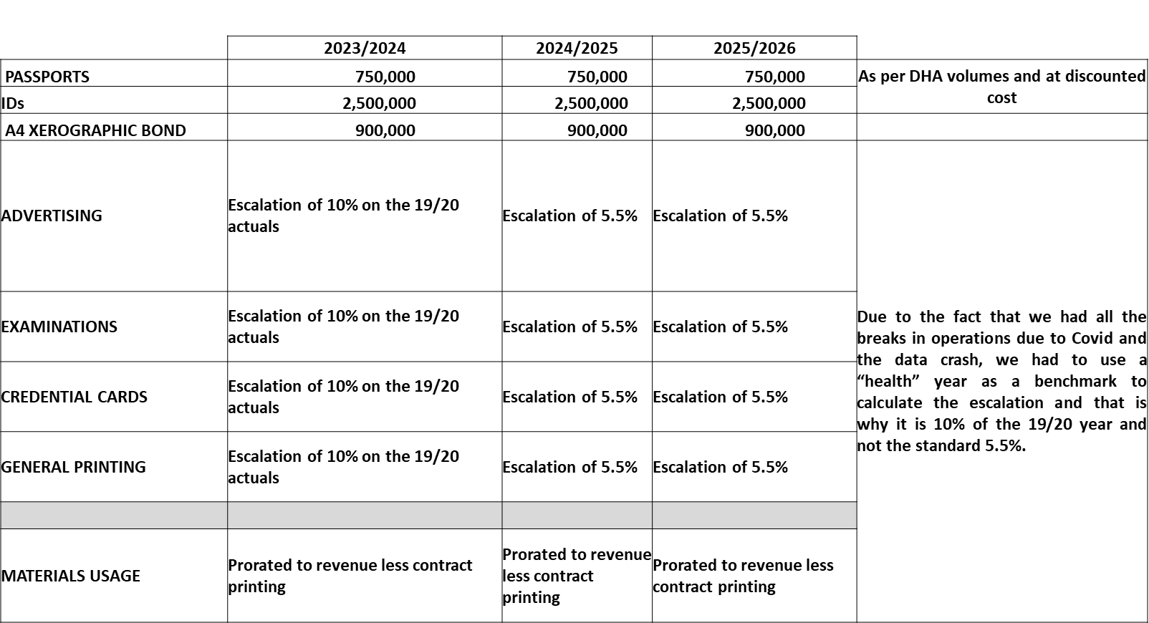
16. Key Considerations

Slide 47
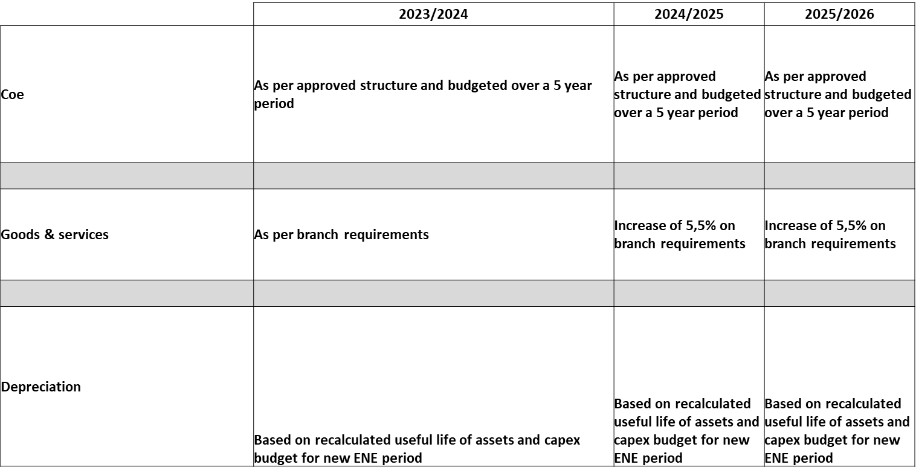
16. Key Considerations Continued..

Slide 48
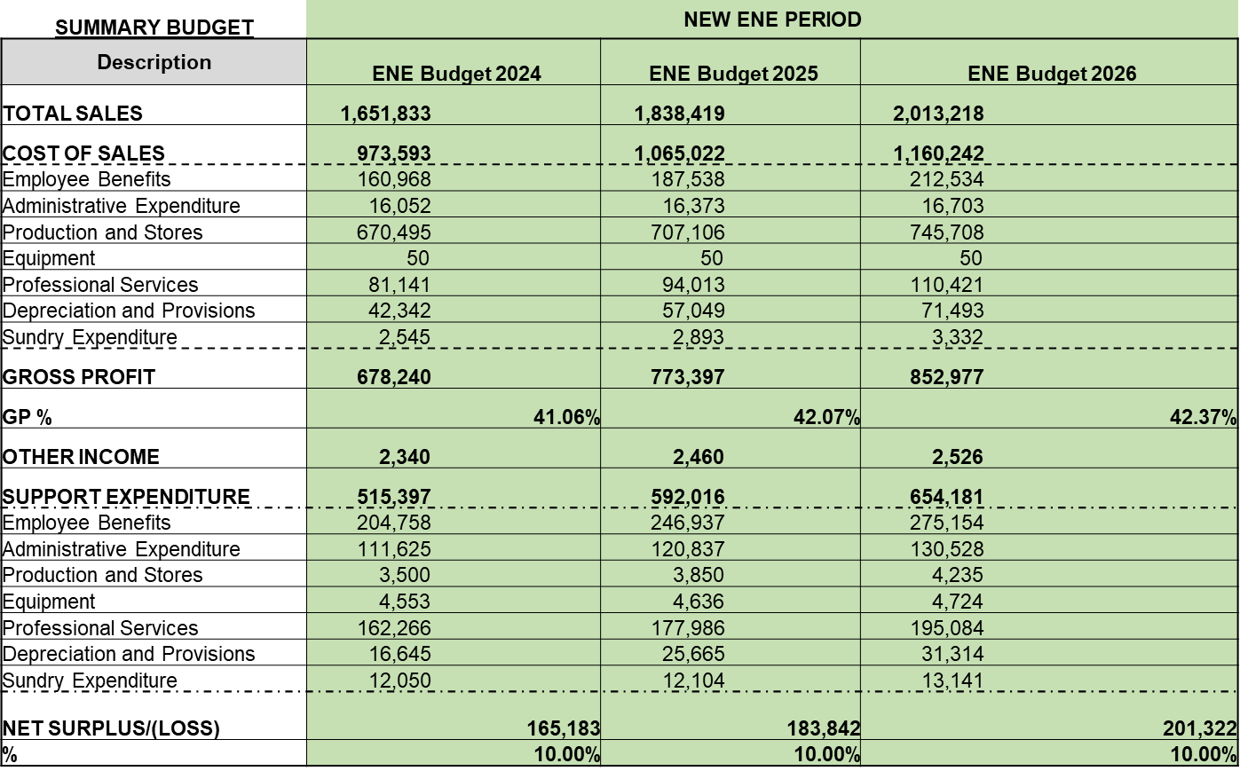
17. Summary Budget 2023-2024

Slide 49
17. Summary Budget 2023-2024 Continued..
Revenue is forecasted to increase at an average annual rate of 15.94%, from R1.426 billion in 2022/23 to 1.654 billion in 2023/24.
GPW is set to generate R5.510 billion of revenue over the medium term through business operations.
Expenditure is forecasted to increase at an average annual rate of 15.54% from R1.288 billion in 2022/23 to R1.488 billion in 2023/24.
Expenditure over the medium term will be R4.960 billion.

Slide 50
18. Statement of Financial Position: 2023/2024

Slide 51
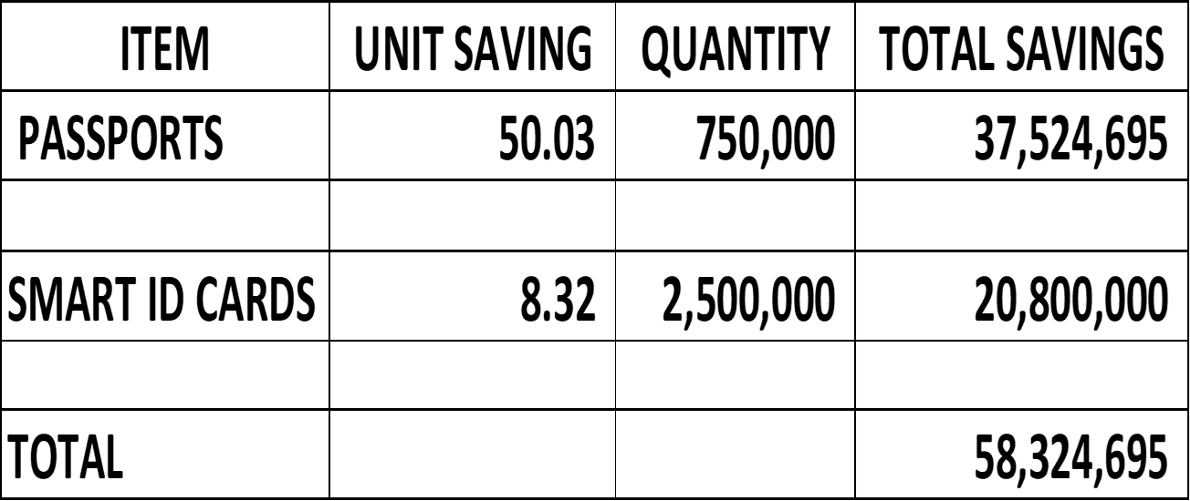
19. DHA Discount

Slide 52
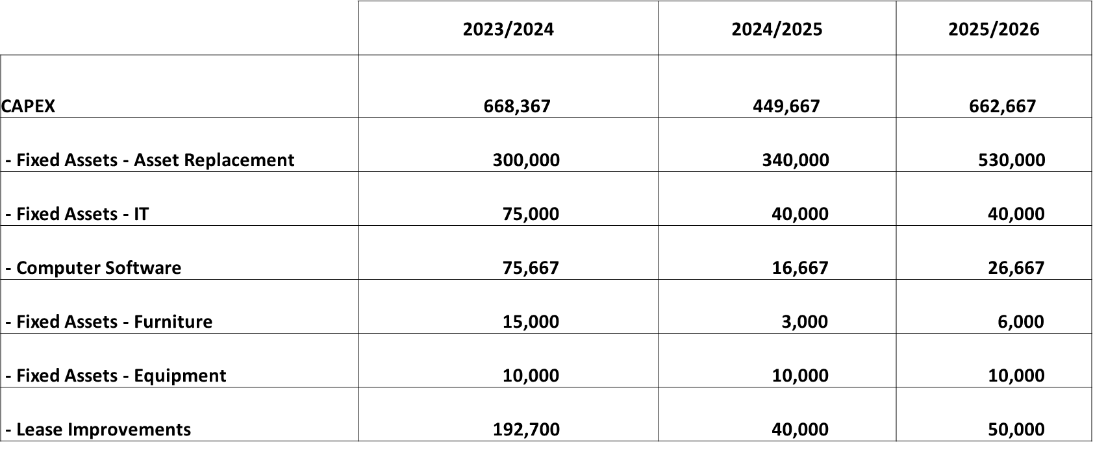
20. Capital Expenditure: 2023/2024

Slide 53
21. Capex Projects
GPW is embarking on process to acquire a new Enterprise Resource Planning (ERP) system and simultaneously resuscitating the eGazette system, which was affected during system outages that were encountered in February 2021.
The ICT environment needs to be revamped to support the overall needs of the organisation, in particular to enable the production capacity.
Development Bank of Southern Africa (DBSA) has been appointed as the preferred bidder to project manage leasehold improvements to the Headquarters Building (that will ensure that staff is moved from the old Bosman facility to Visagie Street within the 2023-2024 financial year) and the implementation of the Master Plan (improvements to the Factory).
The capitalisation program will take place over the MTEF period; these projects will be funded from the accumulated retained surpluses and by future surpluses over the MTEF period.
Proposal are also on the table to enhance regional capacity and revamping the old warehouses in Eastern Cape and Limpopo to enable optimal service delivery.

Slide 54
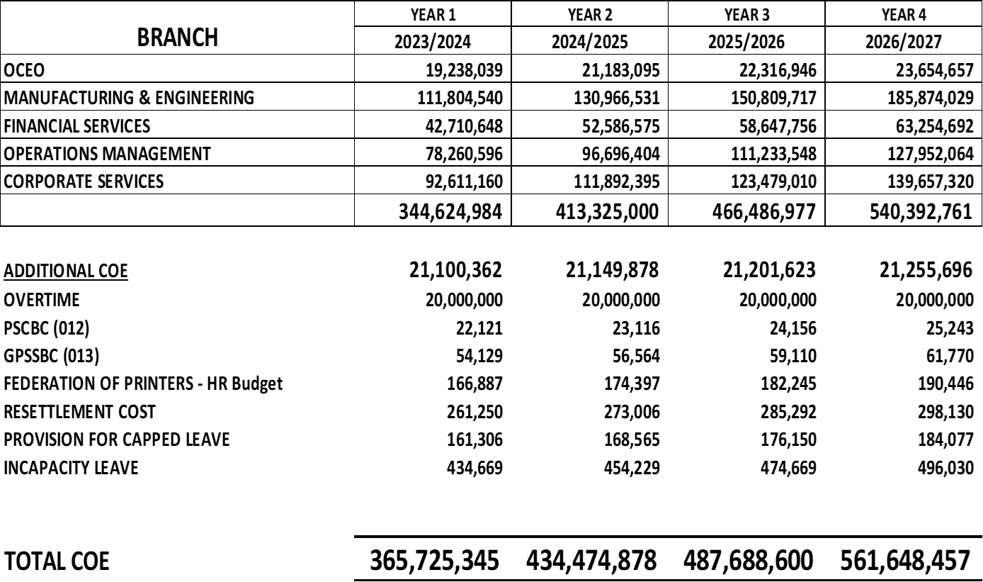
22. Compensation of Employees: 2023/2024

Slide 55
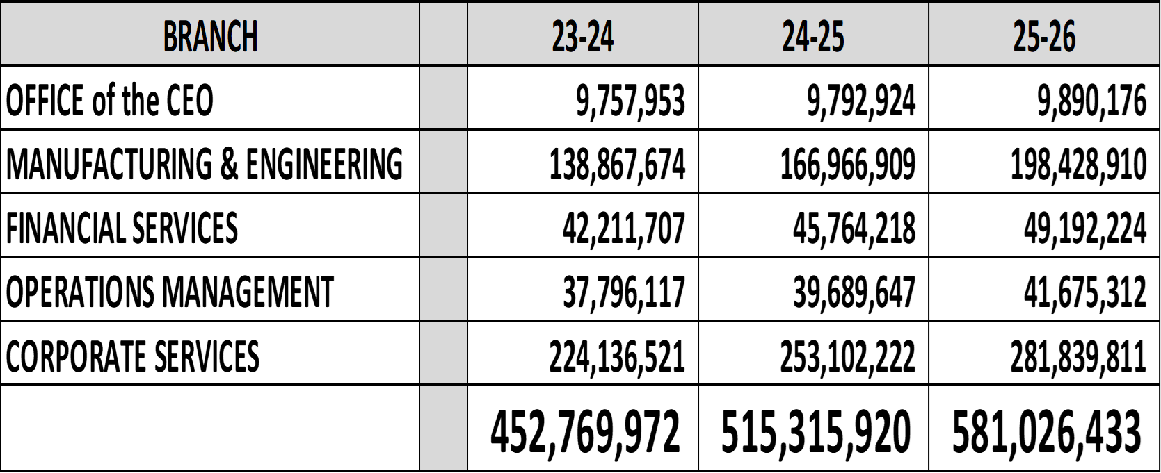
23. Goods & Services Budget

Slide 56

THANK YOU

