Slide 1
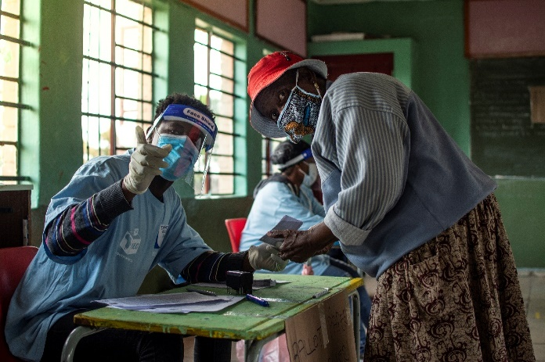
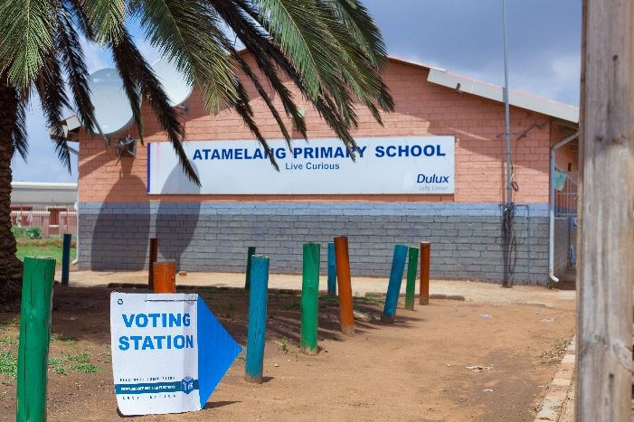
ELECTRONIC VOTING PC HOME AFFAIRS March 2023

Slide 2
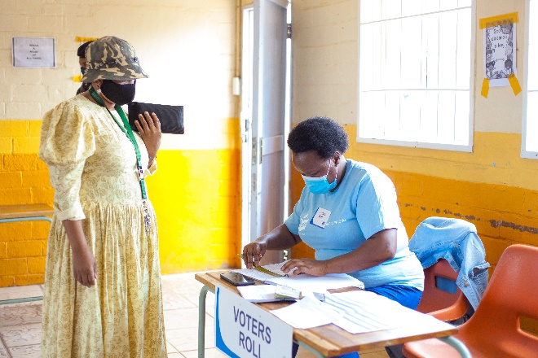
CONTENTS PAGE
Background
Defining e-voting
Types of e-voting
Global status quo
Analysis of e-voting types
Some lessons learnt

Slide 3
INTRODUCTION
In addition to the study visits undertaken over some years, in 2010/11 Electoral Commission commissioned research (desk-top study) into the cross-national experience of electronic voting
In March 2013 the Electoral Commission convened a conference on e-Voting
Members of political parties represented in Parliament were invited to participate, together with interested civil society organisations
Addressed by international experts on e-voting and representatives from EMBs involved in e-voting

Slide 4
DEFINING ELECTRONIC VOTING
An electronic voting system may be defined as an integrated device that utilizes an electronic component for one or more of the following functions: ballot presentation, recording of vote & tabulation of votes cast

Slide 5
DEFINING ELECTRONIC VOTING
E-Voting may be conducted in an environment that is under control of EMB, or an environment that is not controlled by an EMB
E-Voting in controlled environment, such as a polling station, include EVMs (electronic voting machines of India) & DREs (direct recording electronics of Brazil)
E-Voting in uncontrolled environments include internet voting, mobile phone voting, fax & email voting (France, Canada, Japan, Estonia & USA)

Slide 6
TYPES OF ELECTRONIC VOTING
E-Voting in controlled environments
EVMs or DREs: electronic voting machines or direct recording electronic – located inside of polling station & administered by voting staff
Voter directly enters choice into electronic storage using touch-screen, push buttons, key pad or similar device
Votes cast are stored onto memory cartridge, diskette or smart card
Used in India, Brazil, Venezuela, France, Russia, Japan & (parts of) USA

Slide 7
DIRECT RECORDING ELECTRONICS: BRAZIL

Slide 8
ELECTRONIC VOTING MACHINE: INDIA

Slide 9
DIRECT RECORDING ELECTRONICS: Virginia, USA

Slide 10
TYPES OF ELECTRONIC VOTING
E-Voting in controlled environments
Voter Verifiable Paper Audit Trail (VVPAT)
DRE VVPAT: an e-voting machine with added facility of printing piece of paper showing ballot choice of voters which are then placed in physical ballot box
This allows for a manual re-count of ballots (audit trail) if votes are disputed
In effect DRE VVPAT involves use of electronic voting machines in parallel to paper ballot voting method, with latter as a back-up should results be disputed & subject to re-count, which is not possible if only e-voting machine is used

Slide 11
DRE IN CONJUCTION WITH VVPAT

Slide 12
TYPES OF ELECTRONIC VOTING
E-Voting in controlled environments
Optical scans are electronic counting machines
Votes are cast on paper ballots and fed into optical scanner which tabulates votes cast
Used in Philippines in 2010 elections

Slide 13
TYPES OF ELECTRONIC VOTING
E-Voting in un-controlled environments
Internet voting: available at polling stations or any location with access to internet (remote internet voting)
Estonia, Canada & France use remote internet voting
Double envelope encryption used
Voter’s choice encrypted by voting application & placed in inner-envelope
User signs name digitally & places details on outer envelope
Outer envelope received centrally & name crossed off voters’ roll
Inner encrypted envelope, which is anonymous, entered into digital ballot box for counting

Slide 14
SOME SENSE OF COSTS
Manufacturers of e-voting machines mainly located in USA, with some in Canada, India & Brazil
Costs:
EVM without VVPAT: $100 in India to $7 000 in New York
EVM with VVPAT: additional $1 500 to cost of EVM

Slide 15
E-VOTING GLOBAL STATUS QUO
Polling station-based e-voting (e-voting machines) | Remote e-voting (includes internet, fax &/or email) | Abandoned e-voting
Belgium | Austria | Australia
Brazil | Canada | Germany
France | Estonia | United Kingdom
India | France | Ireland
Japan | Japan | Netherlands
Kazakhstan | Switzerland
Paraguay | USA
Philippines
Russia
UAE
USA
Venezuela

Slide 16
ANALYSIS - E-VOTING IN CONTROLLED CONTEXT
ADVANTAGES & STRENGTHS | DISADVANTAGES & WEAKNESSES
Fast & accurate count of votes cast | High costs & limited shelf life (12 years)
Reduces spoilt votes & over-votes | Reduces voting transparency to public
Multi-lingual ballot presentation | Limits vote re-counts, except for EMV with VVPAT machines offering paper trail
`Green’ option, carbon credits | Needs extensive voter education
 | Possible to manipulate machines through `hidden code’ or hardware (Closed code)
 | Lack of consistent standards for certifying hardware & software of machines
 | Most systems are closed to protect IP making auditing difficult
 | Remote manipulation of system possible if system is connected or wireless
 | Success dependent on public trust in the electoral process

Slide 17
ANALYSIS - REMOTE INTERNET E-VOTING
ADVANTAGES & STRENGTHS | DISADVANTAGES & WEAKNESSES
Fast & accurate count of votes | Voters may be unduly influenced or coerced when voting in private
Improves voter access & convenience to the vote | Easier for voter to sell vote when voting in private
Reduces spoilt ballots & over-votes | Hackers may trace vote cast to voter
Longer term cost-savings after initial high costs covered | Security of electronic data – interception & modification of data by hackers
Internet voting is ultimate `green’ election (savings of paper, energy, distribution & storage costs) | Vote re-counts are difficult, without paper ballot trail
May increase voter turnout | High set up costs
 | Reduced public transparency of voting process
 | Lack of consistent & agreed standards for certification

Slide 18
LESSONS LEARNT
General dearth of academic literature on e-voting
The international experience on e-voting is mixed. There is no clear move towards or away from e-voting
Security of e-voting is improving with technologies such as block-chain yet risks may remain
Some countries are willing to accept the risks associated with e-voting (India, Brazil, USA, Canada, Japan), whilst others are not (Netherlands, Germany, UK, Australia, Ireland)

Slide 19
LESSONS LEARNT
Decision to adopt e-voting is context-specific, influenced by size/geography of country, demographics, trust in EMB, political-legal culture, degree of tolerance of risks, etc
When deciding, ensure that e-voting is suitable & most appropriate solution for country – don’t adopt e-voting because `everyone else is doing it & we want to look modern’
Should a decision be made to trial & pilot e-voting, transparency (open source software), inclusivity (buy-in of stakeholders) & trust (in EMB) are critical factors in successful implementation

Slide 20
LESSONS LEARNT
Should e-voting be adopted, critical to ensure independent certification & audit of e-voting system to allow for independent confirmation of election results
Should e-voting be adopted, critical to ensure well-trained voting staff, political parties & voters – open, transparent process for stakeholder buy-in & confidence in system
Process of introducing e-voting (transparency, inclusivity, stakeholder buy-in) is as important as the technicalities of e-voting product

Slide 21
THE END

