Slide 1

Presentation to Portfolio Committee
29 March 2023

Slide 2
Presentation Outline
Purpose of Presentation
DHA Vision, Mission, Mandate, Values and Outcomes
DHA Contribution to the National Development Plan (NDP)
State of the Nation (SONA) 2023 Commitments
Medium Term Strategic Framework (MTSF) 2019 to 2024 Commitments
Key Considerations and Critical Success Factors for 2023/24
Summary of Annual Performance Plan Targets (2023/24)
  Civic Services
  Immigration Services
  Administration
Budget Overview for 2023/24 to 2025/26
Annual Performance Plan Targets per Branch (2023/24 to 2025/26)
  Civic Services
  Immigration Services
  Administration
Recommendation

Slide 3
Purpose of Presentation
To present to the Portfolio Committee on Home Affairs:
Department of Home Affairs Annual Performance Plan (APP) for the 2023/24 financial year; and
Budget for 2023/24 to 2025/26.

Slide 4
Vision, Mission, Mandate, Values and Outcomes
DHA Contribution to MTSF 2014 to 2019
Vision
A South Africa where identity, status and citizenship are key enablers of citizen empowerment and inclusivity, economic development and national security
Mission
The DHA carries out its mission in line with its commitment to citizen empowerment and inclusivity, economic development and national security, by:
- Being an efficient and secure custodian of citizenship and civil registration
- Securely and strategically managing international migration
- Efficiently managing asylum seekers and refugees
- Efficiently determining and safeguarding the official identity and status of persons
Mandate
The DHA’s services are divided into two broad categories: civic services and immigration services.
Mandate 1: Management of citizenship and civil registration
Mandate 2: Management of international migration
Mandate 3: Management of refugee protection
Values
The Department of Home Affairs is committed to being:
- People-centred and caring
- Patriotic
- Professional and showing leadership
- Effective, efficient and innovative
- Ethical and having integrity
- Security conscious
- Development oriented
Outcomes
- Secure management of international migration resulting in South Africa’s interests being served and fulfilling international commitments
- Secure and efficient management of citizenship and civil registration to fulfil constitutional and international obligations
- Efficient asylum seeker and refugee system in compliance with domestic and international obligations
- Secure population register to empower citizens, enable inclusivity, economic development and national security
- DHA positioned to contribute positively to a capable and developmental state

Slide 5
Contribution to National Development Plan (NDP)
DHA Contribution to MTSF 2014 to 2019
A major focus of the NDP is to confront the triple challenge of poverty, inequality and unemployment by achieving higher growth rates.
The DHA has a critical contribution to make to the achievement of the NDP 2030 objectives:
The inclusion of all citizens in democracy and development is enabled by providing them with a status and an identity that gives them access to rights and services. This must be done in an efficient, effective, professional and secure manner.
A further priority for the DHA is to facilitate the acquisition of the critical skills needed for economic growth as determined by the Department of Higher Education and Training (DHET) to build our own skills base.
The DHA must continue to drive integrated and coordinated border management to ensure our borders are effectively protected, secured and well-managed.
The DHA plays a key role in enabling regional development by working with SADC countries through the Department of International Relations and Cooperation (DIRCO) to establish efficient, secure and managed migration.
The DHA is central to harnessing the 4th industrial revolution and building a capable state. The modernisation programme of the DHA can reduce fraud and the cost of doing business by enabling e-government which will attract more investment into the country.

Slide 6
SONA Commitments 2023
DHA Contribution to MTSF 2014 to 2019
SONA COMMITMENT | DHA APP TARGET
More than 340 million paper–based civic records to be digitised by the first cohort of 10 000 unemployed young people appointed by the Department of Home Affairs | Target for 2023/24: 36 million records digitised (birth records) 18 000 Microfilm indexed Target for 2024/25: 152 million records digitised Target for 2025/26: 152 million records digitised
Establish a more flexible points-based system to attract skilled immigration, implementing a trusted employer scheme to make the visa process easier for large investors and streamlining application requirements | Target for 2023/24: White Paper on the Management of Citizenship, International Migration and Refugee Protection submitted to Cabinet for approval Target for 2024/25: Citizenship, Immigration and Refugees Bill submitted to Cabinet for approval Target for 2025/26: Citizenship, Immigration and Refugees Bill tabled in Parliament
Introducing remote worker visa and special dispensation high-growth start-ups | Target for 2023/24: White Paper on the Management of Citizenship, International Migration and Refugee Protection submitted to Cabinet for approval The Immigration Regulations will be amended to incorporate this priority under one of the existing visa categories. Consultations with DTIC are underway on this matter. The Regulations will be presented to the Minister of Home by end of May 2023.

Slide 7
APEX Priority | Revised MTSF Commitment 2024
Economic transformation and job creation | Implementation of a revised visa regime through 95% of visa applications (critical skills) adjudicated within 4 weeks by 2022/23
Social cohesion and safer communities | 100% of selected ports of entry equipped with biometric functionality by March 2024 DHA Automated Biometric Identification System (ABIS) implemented by 2022/23
Notes:
7

Slide 8
Key Developments and Critical Success Factors for 2023/24
The DHA will continue to support the Border Management Authority (BMA) as a public entity through systems, legislation, policies and standard operating procedures that form part of the broader approach to managing migration within the RSA.
The Digitization Programme to modernise civic services as announced by the President in the 2022 SONA has commenced and the 2023/24 financial year will digitise around 36 million birth records.
The Automated Biometric Identification System (ABIS) went live in November 2022. The DHA is in the process of implementing phase 2 which will include additional functionalities such as Iris, infant footprint and palm-print backend recognition capability.
The Biometric Movement Control system (BMCS) rollout to 72 ports of entry will be completed in the 2023/24 financial year.
The DHA has developed an implementation plan to deal with the Vulindlela Task Team policy and process recommendations.
A multi-disciplinary task team has been appointed to deal with the Lubisi Report recommendations.
The implementation of the DHA Repositioning Programme is underway and around 30 projects form part of the Programme Management Office.
To deal with long queues:
  The DHA Menlyn office in the Menlyn Shopping Mall in Pretoria was opened in March 2023 with more malls to follow.
  The Branch Appointment Booking System (BABS) has been rolled out to all 200 modernised offices.
  DHA is in the process of procuring an additional 100 mobile offices to cover the 778 visiting points to augment the DHA access model and strategy.

Slide 9
Key Developments and Critical Success Factors for 2023/24
The procurement process for the Passenger Name Record (PNR) has started. The bid specification process is underway. The PNR system data elements include passenger data from airline reservation systems like payment details, travel itinerary and baggage information. The PNR is a key component of a risk-based approach to immigration.
DHA has made significant progress with the implementation of POPIA.
DHA will continue with the implementation of the DHA Plan to promote gender-based violence and femicide (GBV&F) as well as gender, youth and persons with disability issues. Specific focus to be placed on:
  Increase awareness on issues of harassment through the launch of women’s forums across the DHA.
  Undertake a survey on different issues related to GBV&F.
  Strengthen the DHA Sexual Harassment Policy.
  Host sessions aimed at empowering employees on issues of harassment, especially lower level employees.
  Create a dedicated email for reporting cases of harassment.
Central to the DHA improving its organisational performance and quality of service delivery, is the issue of capacity. The funding received from National Treasury as part of the Capacitation Business Case has already shown a positive impact on target-setting for 2023/24. The DHA will strive to improve its HR capacity from 46% to at least 55% over the medium term in conjunction with National Treasury.
The DHA will continue in its endeavours to find durable solutions for long lasting systemic challenges such as system downtime through working closely with SITA and other service providers.

Slide 10
Key Developments and Critical Success Factors for 2023/24
The Annual Performance Plan for 2023/24 cover the following:
  DHA contribution to the National Development Plan
  Apex Priorities and MTSF related commitments
  DHA contribution to the Economic Reconstruction and Recovery Plan (ERRP)
  State of the Nation (SONA) commitments
  Ministerial priorities
  ICT Modernisation Programme
  Contribution to the National Strategic Plan (NSP) on Gender-based Violence and Femicide
  Contribution to the District Development Model (DDM)
  White Paper on Home Affairs (DHA Repositioning Programme)

Slide 11
Change in Targets – APP 2023/24
BRANCH | AREA | 2022/23 | 2023/24 | Trend | Motivation
CS | Birth registration within 30 calendar days | 750 000 | 800 000 |  | Increase in targets: Based on baseline performance for 2021/22 (798 025) and projected performance for 22/23 Additional human resource capacity (business case) Expansion of mobile fleet (additional 100 mobile offices) Improved connectivity for hospitals and mobiles
 | Smart cards | 2.2m | 2.5 m |  | Based on baseline performance for 21/22 (2 369 245) and projected performance for 2022/23 Additional human resource capacity (business case) Expansion of mobile fleet (additional 100 mobile offices)
IMS | Law enforcement inspections | 540 | 1 296 |  | Increase in head office and provincial targets
 | Business and General Work visas | NA | NA | NA | Business and general work visa categories have been split for the 2023/24 financial year
Notes:
The frontline offices of the Department around the country are totally inadequate to the reach that is needed to address the imbalances of the past. The offices we do have are in many cases badly located, in a poor state of repair, inadequately staffed and equipped.
Our information technology infrastructure is in the main antiquated, inadequately deployed, and in some critical areas has collapsed.
While the Department is committed to the principles of Batho Pele and has made significant progress in setting standards of service delivery, its severe resource constraints and lingering attitude problems mean that we are very far from achieving the world class service our vision demands of us.

Slide 12
Change in Targets – APP 2023/24
BRANCH | AREA | 2022/23 | 2023/24 | Trend | Motivation
CCSS | Business process review | 4 | 16 |  | Increase in target based on urgent need to combat fraud and corruption
 | Investigations | 66% | 75% |  | Additional capacity to be acquired (business case)
 | Threat and Risk Assessments (TRA) | 80 | 40 |  | Majority of 321 offices already covered Emphasis is now on the Annual Operational Plan (AOP) target for TRAs regarding follow-up on recommendations (AOP target has doubled)
 | Vetting | 400 | 450 |  | Baseline performance for 2022/23 is projected at 800 due to BMA project (400 confidential files) Over-achievement was due to additional support from HRM&D staff and working of overtime by CCSS in 2022/23 FY
Notes:
The frontline offices of the Department around the country are totally inadequate to the reach that is needed to address the imbalances of the past. The offices we do have are in many cases badly located, in a poor state of repair, inadequately staffed and equipped.
Our information technology infrastructure is in the main antiquated, inadequately deployed, and in some critical areas has collapsed.
While the Department is committed to the principles of Batho Pele and has made significant progress in setting standards of service delivery, its severe resource constraints and lingering attitude problems mean that we are very far from achieving the world class service our vision demands of us.

Slide 13
Summary of Annual Performance Plan (APP) Targets
for 2023/24

Slide 14
Civic Services
2.5 million smart ID cards issued to citizens 16 years of age and above per year
90% of machine readable adult passports (Live capture system) issued within 13 working days for applications collected and processed within the RSA per year
90% of machine readable child passports (Live capture system) issued within 18 working days for applications collected and processed within the RSA per year
800 000 births registered within 30 calendar days per year
Notes:
14

Slide 15
Immigration Services
85% of permanent residence applications for critical skills (S27b), general work (S26a) and business (S27c) adjudicated within 8 months for applications collected within the RSA per year
90% of business visa applications adjudicated within 8 weeks for applications processed within the RSA per year
95% of critical skills visa applications adjudicated within 4 weeks for applications processed within the RSA per year
1 296 DHA-led law enforcement operations/inspections conducted for targeted areas to ensure compliance with immigration legislation per year
90% of general work visa applications adjudicated within 8 weeks for applications processed within the RSA per year
Notes:
15

Slide 16
NATIONAL APP QUARTER TARGET (HEAD OFFICE & PROVINCES)
SECTORS | ANNUAL TARGET | Q1 | Q2 | Q3 | Q4
Restaurants | 188 | 47 | 47 | 47 | 47
Security Companies | 176 | 44 | 44 | 44 | 44
Manufacturing factories/ Wholesalers | 172 | 43 | 43 | 43 | 43
Transport/ Logistics companies | 144 | 36 | 36 | 36 | 36
Automotive Industry: Car dealership/ towing/scrap yards/ recycling | 148 | 37 | 37 | 37 | 37
Retail outlets | 148 | 37 | 37 | 37 | 37
Farms | 136 | 34 | 34 | 34 | 34
DHA-led operations/ roadblocks | 124 | 31 | 31 | 31 | 31
Mines | 60 | 15 | 15 | 15 | 15
TOTAL | 1296 | 324 | 324 | 324 | 324

Slide 17
Administration
Information Services
Biometric Movement Control System (BMCS) implemented at 38 ports of entry
DGs Office
DHA Bill tabled in Parliament
Institutional Planning & Support
White Paper on the Management of Citizenship, International Migration and Refugee Protection submitted to Cabinet for approval
ABIS Phase 2 operational: Iris, infant footprint and palm-print backend recognition capability deployed into production
National Identification and Registration Bill submitted to Cabinet to obtain approval for tabling in Parliament
Marriage Bill submitted to Cabinet to obtain approval for tabling in Parliament
OSBP Bill submitted to Cabinet to obtain approval for tabling in Parliament
Communication interventions: 20 Media engagements, 6 Outreach engagements and 3 Campaigns
Service Delivery Model (SDM) implementation Framework approved by DG
IMS Case Management System modules for Inspectorate and Deportations piloted in 4 offices (Head office, Epping Refugee Reception Centre, Pretoria Large Office and Lindela Repatriation Centre)
Asylum Seeker Management and Refugee System implemented in 5 refugee reception offices and 2 statutory bodies (RAASA and SCRA)
User Asset Management Plan (U-AMP) 2024/25 submitted to National Treasury and copy to DPW&I
Approved strategic accommodation requirements for 2025/26 submitted to DPW&I
Budget requirements and option analysis for DHA Hybrid Access Model presented to National Treasury to secure funding for Access Model
Digitisation of records: 36 million records digitised (birth records); 18 000 Microfilm indexed

Slide 18
Counter Corruption and Security Services
16 Business processes reviewed to identify vulnerabilities to fraud, corruption and security breaches (per year)
Human Resource Management & Development
DHA Gender-based Violence and Femicide Plan implemented
75% of reported cases of fraud and corruption finalised within 90 working days (per year)
40 Threat and Risk Assessments (TRAs) conducted per year in accordance with the requirements of Minimum Information Security Standards (MISS) and / or Minimum Physical Security Standards (MPSS).
450 vetting files finalised and referred to State Security Agency (SSA) for evaluation
70% of misconduct cases concluded within 90 working days per year

Slide 19
List of 38 Ports for BMCS Rollout 2023/24
Alexander Bay | Waterkloof Military Airbase | Pilansberg International Airport
Makgobistad | Gemsbok | Upington International Airport
Makhaleen Bridge | Onverwacht | Boesmansnek
Pafuri | Derdepoort | Ramatseliso’s Gate
Bothashoop | Peka Bridge | Gqeberha (Port Elizabeth) International Airport
Bray | Middelputs | Mossel Bay
Kruger Mpumalanga International Airport | Twee Rivieren | Saldanha
Rietfontein | Waverley | East London
McCarthy’s Rest | Zanzibar | Ngqura
Platjan | Sendelingsdrift | Ongeluksnek (Legacy)
Pontdrift | Sepapus Gate | Onskeepkans (Legacy)
Josefsdal | Polokwane International Airport
Gqeberha (Port Elizabeth) Harbour Laptop | Makopong
 | Bloemfontein International Airport
Notes:
Completing the logical framework for each Output Indicator in the Annual Performance Plan (APP):
The annual target for 2022/23, quarterly targets as well as monthly targets, needs to be unpacked in the table.
The evidence, that will indicate the achievement of the annual target. ( must comply with auditing prescripts).
Unpack the dependencies and the management thereof.
This slide must be completed for each output indicator identified.
[Refer to section 16.4 of the Strategic Planning Framework for Department Of Home Affairs.]

Slide 20
Review of Business Processes for 2023/24
V-Listing Process Late Registration of Birth (LRB) Asylum Seeker Management (Section 22 Extension) Foreign Office Recruitment
Asylum Seeker Management (Protocols and Legislation focusing on Sections 23 and 24) ID Application (Green Barcoded ID) Marriage Registration Citizenship Application
Passport Application Amendments Loss Control (Recovery of Losses) Birth Registration (Special Circumstances)
Permitting Appeals Implementation of Management Controls at DHA Offices (Efficiency in Controls) Visa Adjudication Unabridged Certificates (Birth, Marriage and Death)

Slide 21
Proposed Annual Coverage Internal Audit Plan for 2023/24
No. | Planned Auditable Area | Reason for inclusion in three year Internal Audit coverage plan for assurance or advisory reviews
Finance and Supply Chain Branch
1 | Revenue Management (Local & Foreign Revenue) | Recurring findings on revenue deterring the department for the past 3 years.
2 | Review of Annual Financial Statement | Material misstatements of disclosure items identified by the auditors in the submitted financial statements
3 | Adequacy Review of Management Action Plans on AG finding | Clean audit outcome.
4 | Validation of Management Action Plans on AG Finding (Effectiveness) | Clean audit outcome.
5 | Transfer Payment | Mandatory audit.
6 | Procurement of goods and services (quotations, bids, deviations and contract management) | Risk related to SCM is inherently high.
 | Civic Services Branch
7 | Birth Registration (NPR data review) | Risk related to birth registration, LRB, death registration, amendments and rectification of records are inherently high leading to fraud and corruption.
8 | Late Registration of Birth (NPR data review)
9 | Amendments and Rectification of records
10 | Death Registration (NPR data review)
 | Immigration Services Branch
11 | Detention and Deportation | Discontinuation of the ZEP.
12 | Port of Entry Compliance Audit | Risk related to porous borders.
13 | Biometrics Movement Control System (BMCS) | Support the completion of the modernisation Programme.
14 | Asylum and Refugee Compliance Audit | Review adequacy and effectiveness of controls of NIIS on efficient processing of Asylum seeker.
15 | E-Visa system review | Support the completion of the modernisation Programme.
Notes:
Completing the logical framework for each Annual Target (Annual Operational Plan (AOP) / Chief Directorate Business Plan (BP) / Directorate (Ops):
The annual target for 2023/24, quarterly targets as well as monthly targets, need to be unpacked in the table.
The evidence, that will indicate the achievement of the target. ( must comply with auditing prescripts)
Unpack the dependencies and the management thereof.
Indicate the available budget and source of funding.
This slide must be completed for each annual target identified.
[Refer to section 16.6 of the Strategic Planning Framework for Department Of Home Affairs.]

Slide 22
Proposed Annual Coverage Internal Audit Plan for 2023/24
No | Planned Auditable Area | Reason for inclusion in three year Internal Audit coverage plan for assurance or advisory reviews
 | Institutional Planning & Support Branch
16 | Audit of Performance Information (AoPI) (Information data review) Q1 | Mandatory audit to review: Effective performance management processes and systems Usefulness of Performance Information Reliability of reported Performance Information Validation of the status on achievement of the operational plans
17 | Audit of Performance Information (AoPI) (Information data review) Q2
18 | Audit of Performance Information (AoPI) (Information data review) Q3
19 | Audit of Performance Information (AoPI) (Information data review) Q4
20 | Strategic Planning and Budgeting
 | Information Services Branch
21 | Network Performance and Availability Review | Review network performance, availability and stability that is challenging the department
22 | Vulnerability Assessment and Network Penetration | Improvement of IS security and monitoring of possible intrusions and detections
23 | Antivirus Management Audit
24 | Patch Management Review
25 | BACM Review | BACM for Visa Adjudication System (VAS)
26 | IT Data and Media Back up | Risk related to loss of data and information
27 | User Account Management on DHA IT Systems | Monitoring of user activities and detections of unauthorized users.
28 | Disaster Recovery Plan | Business continuity
29 | Project Assurance Review | Digitization of records projects
 | Human Resource Management & Development Branch
30 | Recruitment Management | Increased recruitment drive in the department
Notes:
Completing the logical framework for each Annual Target (Annual Operational Plan (AOP) / Chief Directorate Business Plan (BP) / Directorate (Ops):
The annual target for 2023/24, quarterly targets as well as monthly targets, need to be unpacked in the table.
The evidence, that will indicate the achievement of the target. ( must comply with auditing prescripts)
Unpack the dependencies and the management thereof.
Indicate the available budget and source of funding.
This slide must be completed for each annual target identified.
[Refer to section 16.6 of the Strategic Planning Framework for Department Of Home Affairs.]

Slide 23
Budget 2023/24 to 2025/26
Notes:
23

Slide 24
MTEF ALLOCATION – 2023 to 2026

Slide 25
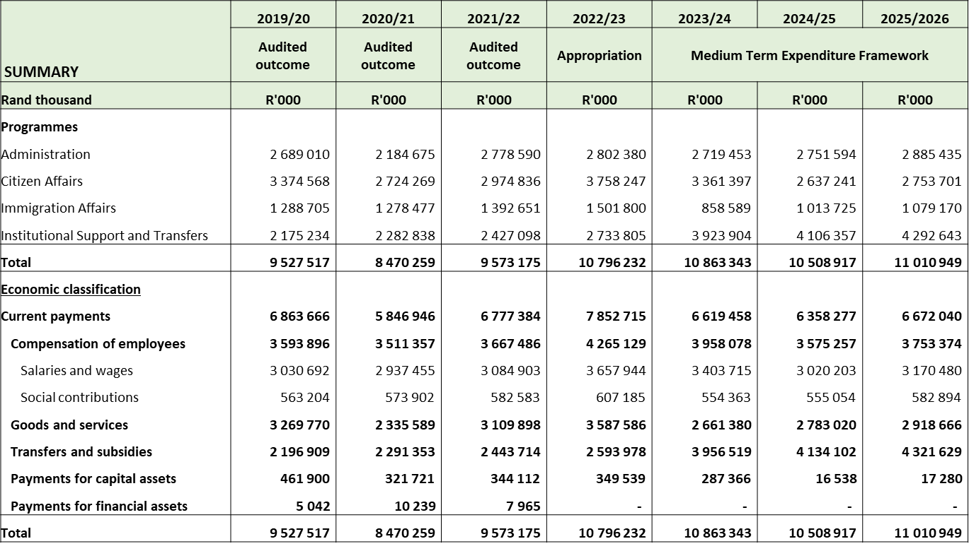
Summary
Notes:
Completing the logical framework for each Output Indicator in the Annual Performance Plan (APP):
The Outcome, Output, Output Indicator and annual target(s), need to be unpacked in the table.
Complete the financial implication information for the 2023/24 annual target.
This slide must be completed for each output indicator identified.
[Refer to section 16.4 of the Strategic Planning Framework for Department Of Home Affairs.]

Slide 26
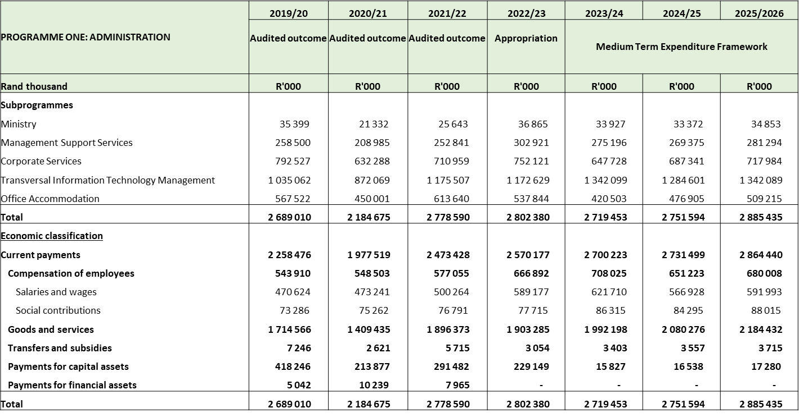
Programme 1: Administration
Notes:
Completing the logical framework for each Output Indicator in the Annual Performance Plan (APP):
The Outcome, Output, Output Indicator and annual target(s), need to be unpacked in the table.
Complete the financial implication information for the 2023/24 annual target.
This slide must be completed for each output indicator identified.
[Refer to section 16.4 of the Strategic Planning Framework for Department Of Home Affairs.]

Slide 27
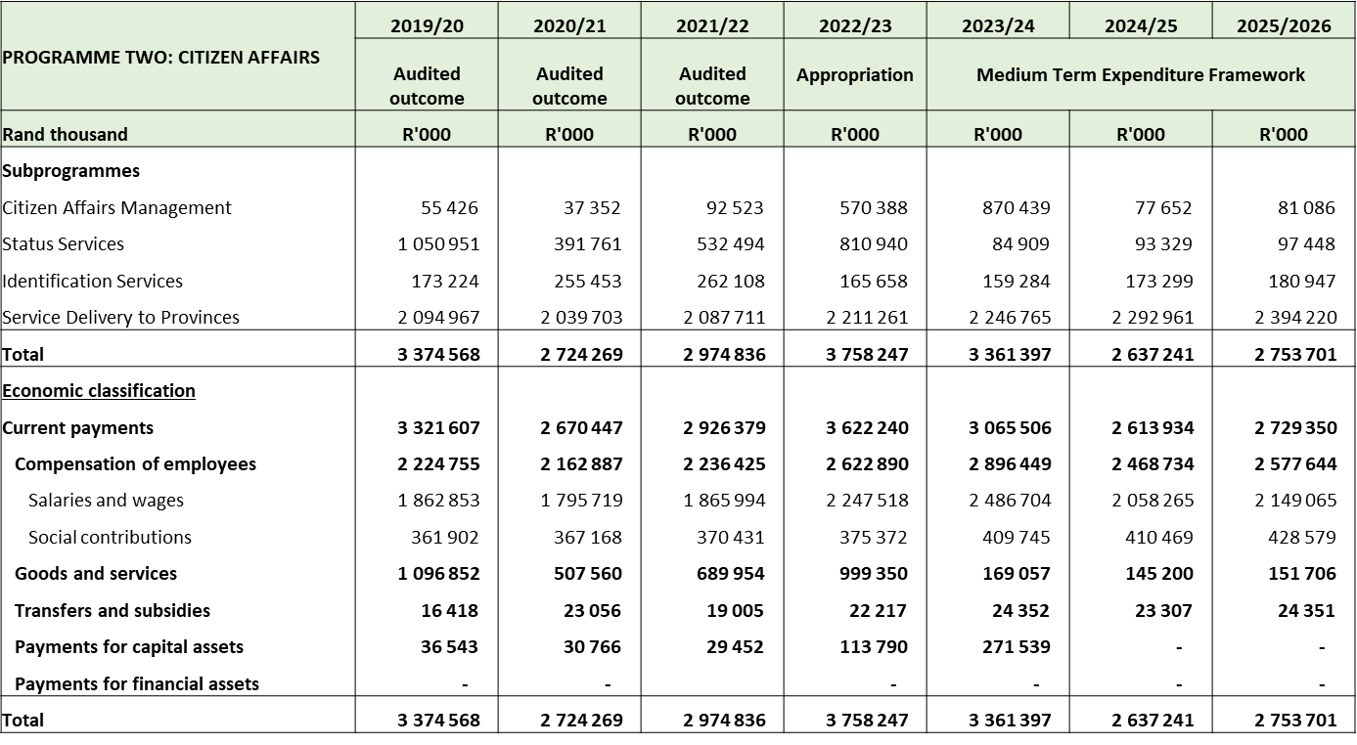
Programme 2: Citizen Affairs
Notes:
Completing the logical framework for each Output Indicator in the Annual Performance Plan (APP):
The Outcome, Output, Output Indicator and annual target(s), need to be unpacked in the table.
Complete the financial implication information for the 2023/24 annual target.
This slide must be completed for each output indicator identified.
[Refer to section 16.4 of the Strategic Planning Framework for Department Of Home Affairs.]

Slide 28
Programme 3: Immigration Affairs
PROGRAMME THREE: IMMIGRATION AFFAIRS | 2019/20 | 2020/21 | 2021/22 | 2022/23 | 2023/24 | 2024/25 | 2025/2026
 | Audited outcome | Audited outcome | Audited outcome | Appropriation | Medium Term Expenditure Framework
Rand thousand | R'000 | R'000 | R'000 | R'000 | R'000 | R'000 | R'000
Subprogrammes
Immigration Affairs Management | 69 818 | 29 239 | 123 588 | 70 388 | 26 479 | 29 419 | 30 735
Admission Services | 832 185 | 787 728 | 823 693 | 1 035 538 | 495 606 | 595 842 | 642 747
Immigration Services | 244 143 | 275 571 | 232 250 | 240 881 | 180 959 | 227 469 | 237 583
Asylum Seekers | 142 559 | 185 939 | 213 120 | 154 993 | 155 545 | 160 995 | 168 105
Total | 1 288 705 | 1 278 477 | 1 392 651 | 1 501 800 | 858 589 | 1 013 725 | 1 079 170
Economic classification
Current payments | 1 278 896 | 1 303 993 | 1 367 575 | 1 492 833 | 853 729 | 1 012 844 | 1 078 250
Compensation of employees | 822 086 | 799 967 | 847 352 | 897 319 | 353 604 | 455 300 | 495 722
Salaries and wages | 694 070 | 668 495 | 712 173 | 761 471 | 295 301 | 395 010 | 429 422
Social contributions | 128 016 | 131 472 | 135 179 | 135 848 | 58 303 | 60 290 | 66 300
Goods and services | 456 810 | 399 013 | 520 223 | 595 514 | 500 125 | 557 544 | 582 528
Transfers and subsidies | 2 736 | 2 419 | 1 927 | 2 840 | 4 860 | 881 | 920
Payments for capital assets | 7 073 | 77 078 | 23 149 | 6 127 | - | - | -
Payments for financial assets | - | - |  | - | - | - | -
Total | 1 288 705 | 1 278 477 | 1 392 651 | 1 501 800 | 858 589 | 1 013 725 | 1 079 170
Notes:
Completing the logical framework for each Output Indicator in the Annual Performance Plan (APP):
The Outcome, Output, Output Indicator and annual target(s), need to be unpacked in the table.
Complete the financial implication information for the 2023/24 annual target.
This slide must be completed for each output indicator identified.
[Refer to section 16.4 of the Strategic Planning Framework for Department Of Home Affairs.]

Slide 29
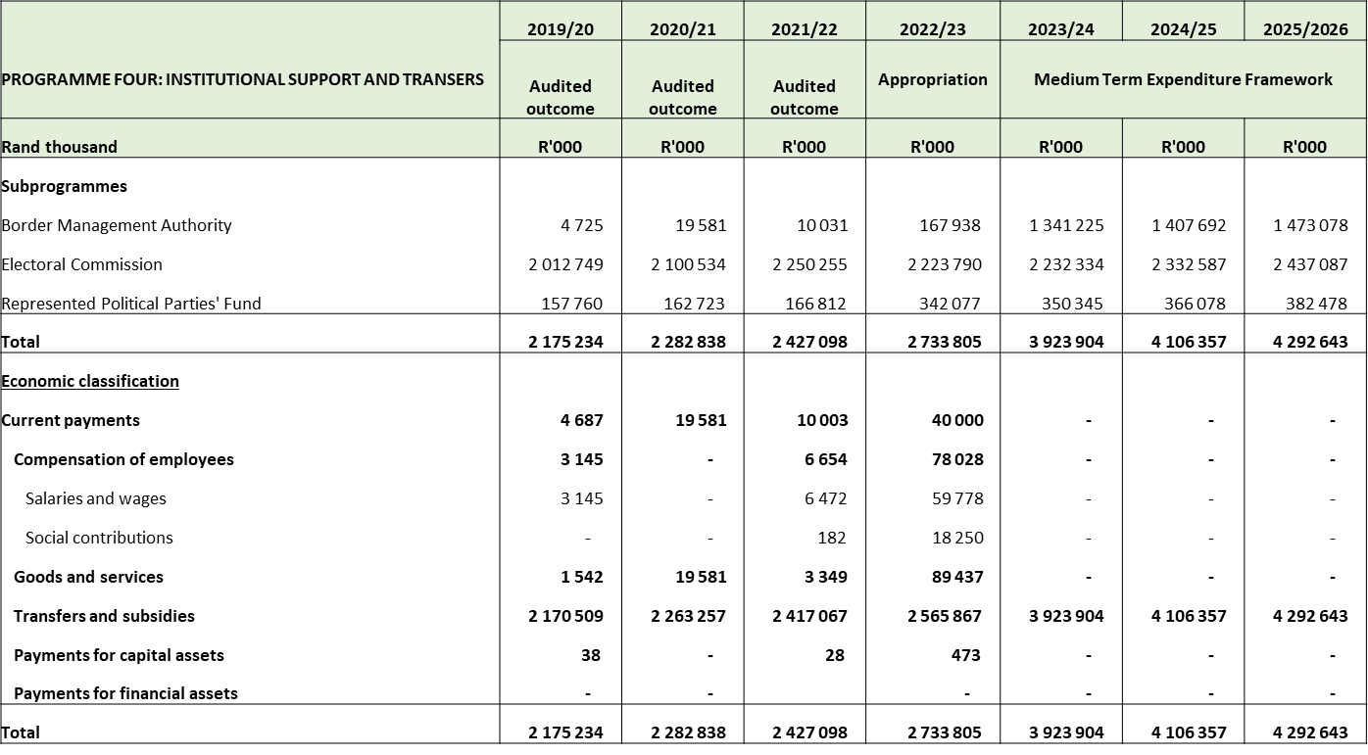
Programme 4: Institutional support and Transfers
Notes:
Completing the logical framework for each Output Indicator in the Annual Performance Plan (APP):
The Outcome, Output, Output Indicator and annual target(s), need to be unpacked in the table.
Complete the financial implication information for the 2023/24 annual target.
This slide must be completed for each output indicator identified.
[Refer to section 16.4 of the Strategic Planning Framework for Department Of Home Affairs.]

Slide 30
BUDGET OUTLOOK
  Financial outlook and guidance provided by National Treasury as per MTEC Guidelines guided the planning process. The DHA must plan with available funding.
Risks to the fiscal framework:
  Slowing global and domestic economic growth;
  Pressure from the public service wage bill; and
  Continued requests for financial support from financially distressed state-owned entities.
Contractual commitments, especially on contracts with a forex component, must be honored. If not, services could be disrupted and litigation ensued.
Payment of suppliers within 30 days becomes difficult towards financial year end in particular.
Maintenance and support are compromised. Vehicles are not repaired as the budget for fleet hardly covers the running costs of fuel.
Tech refreshes are delayed. This contributes to downtime and system instability and ultimately customer frustration.
Security services are underfunded. This has already led to the withdrawal of certain shifts and compromise the asset base of the DHA and the safety of its officials and clients.
Office accommodation – private lease rentals – DHA is not in a position to move to alternative accommodation or open new offices.

Slide 31
FUNDING PRESSURES
To deal with human resource capacity pressures for health facilities and mobile offices, the DHA will:
  Develop a capacitation model
  Reprioritise funding and posts across the DHA
  Develop a 2nd business case for submission to National Treasury
Other funding pressures:
  IT – networks, move away from SITA and ending SARS support (R139 million per annum)
  Ministerial committees (R10 million per annum)
  Buildings and facilities (R180 million per annum)
  Legal costs (R30 million per annum)
  Private security shortfall (R50 million per annum) – Consider alternatives such as installation of alarms and armed reaction.

Slide 32
DETAILED SLIDES PER BRANCH:
CIVIC SERVICES TARGETS – 2023/2026
Notes:
32

Slide 33
APP for 2023/26
APEX Priority: | Social cohesion and safer communities
Output: | Births registered within prescribed period of 30 calendar days
Output Indicator | Estimated Performance 2022/23 | Annual Target 2023/24 | Annual Target 2024/25 | Annual Target 2025/26
Number of births registered within 30 calendar days per year | 750 000 | 800 000 | 800 000 | 810 000
Annual Target 2023/24 | Quarterly Targets
800 000 Births registered within 30 calendar days per year | Q1: 200 000
 | Q2: 200 000
 | Q3: 192 000
 | Q4: 208 000

Slide 34
APP for 2023/26
APEX Priority: | Social cohesion and safer communities
Output: | Smart ID Cards issued to Citizens 16 years of age and above per year
Output Indicator | Estimated Performance 2022/23 | Annual Target 2023/24 | Annual Target 2024/25 | Annual Target 2025/26
Number of Smart ID Cards issued to Citizens 16 years of age and above per year | 2 200 0000 | 2 500 0000 | 2 500 0000 | 2 500 0000
Annual Target 2023/24 | Quarterly Targets
2 500 000 Smart ID Cards issued to Citizens 16 years of age and above per year | Q1: 650 000
 | Q2: 625 000
 | Q3: 575 000
 | Q4: 650 000

Slide 35
APP for 2023/26
APEX Priority: | Economic transformation and job creation A capable, ethical and developmental state
Output: | Adult passports issued as per set standards
Output Indicator | Estimated Performance 2022/23 | Annual Target 2023/24 | Annual Target 2024/25 | Annual Target 2025/26
Percentage (%) of machine readable adult passports (live capture system) issued within 13 working days for applications collected and processed within the RSA per year | 90% | 90% | 90% | 90%
Annual Target 2023/24 | Quarterly Targets
90% of machine readable adult passports (live capture system) issued within 13 working days for applications collected and processed within the RSA per year | Q1: 90%
 | Q2: 90%
 | Q3: 90%
 | Q4: 90%

Slide 36
APP for 2023/26
APEX Priority: | Economic transformation and job creation A capable, ethical and developmental state
Output: | Children passports issued as per set standards
Output Indicator | Estimated Performance 2022/23 | Annual Target 2023/24 | Annual Target 2024/25 | Annual Target 2025/26
Percentage (%) of machine readable passports for children (live capture system) issued within 18 working days for applications collected and processed within the RSA per year | 90% | 90% | 90% | 90%
Annual Target 2023/24 | Quarterly Targets
90% of machine readable passports for children (live capture system) issued within 18 working days for applications collected and processed within the RSA per year | Q1: 90%
 | Q2: 90%
 | Q3: 90%
 | Q4: 90%

Slide 37
IMMIGRATION SERVICES TARGETS – 2023/2026
Notes:
37

Slide 38
APP for 2023/26
APEX Priority: | Social Cohesion and Safer Communities
Output: | Enforcement of compliance of departmental legislation through law enforcement operations/ inspections
Output Indicator | Estimated Performance 2022/23 | Annual Target 2023/24 | Annual Target 2024/25 | Annual Target 2025/26
Number of DHA-led law enforcement operations/ inspections conducted for targeted areas to ensure compliance with immigration legislation per year | 540 | 300 (National) 996 (Provinces) Total = 1296 | 320 (National) 1084 (Provinces) Total = 1404 | 340 (National) 1174 (Provinces) Total = 1514
Annual Target 2023/24 | Quarterly Targets
1 296 of DHA-led law enforcement operations/ inspections conducted for targeted areas to ensure compliance with immigration legislation per year | Q1: 324
 | Q2: 324
 | Q3: 324
 | Q4: 324
Notes:
Completing the logical framework for each Output Indicator in the Annual Performance Plan (APP):
The Outcome, Output, Output Indicator and annual target(s), need to be unpacked in the table.
Complete the financial implication information for the 2023/24 annual target.
This slide must be completed for each output indicator identified.
[Refer to section 16.4 of the Strategic Planning Framework for Department Of Home Affairs.]

Slide 39
APP for 2023/26
APEX Priority: | Social Cohesion and Safer Communities
Output: | Permanent residence permits adjudicated according to set standards
Output Indicator | Estimated Performance 2022/23 | Annual Target 2023/24 | Annual Target 2024/25 | Annual Target 2025/26
Percentage (%) of permanent residence applications for critical skills (S27b), general work (S26a) and business (S27c) adjudicated within 8 months for applications collected within the RSA per year | 39% | 85% | 85% | 85%
Annual Target 2023/24 | Quarterly Targets
85% of permanent residence applications for critical skills (S27b), general work (S26a) and business (S27c) adjudicated within 8 months for applications collected within the RSA per year | Q1: 85%
 | Q2: 85%
 | Q3: 85%
 | Q4: 85%
Notes:
Completing the logical framework for each Output Indicator in the Annual Performance Plan (APP):
The Outcome, Output, Output Indicator and annual target(s), need to be unpacked in the table.
Complete the financial implication information for the 2023/24 annual target.
This slide must be completed for each output indicator identified.
[Refer to section 16.4 of the Strategic Planning Framework for Department Of Home Affairs.]

Slide 40
APP for 2023/26
APEX Priority: | Economic Transformation and Job Creation
Output: | Temporary residence visas (critical skills visas) adjudicated according to set standards
Output Indicator | Estimated Performance 2022/23 | Annual Target 2023/24 | Annual Target 2024/25 | Annual Target 2025/26
Percentage of Critical skills visa applications adjudicated within 4 weeks for applications processed within the RSA per year | 20% | 95% | 95% | 95%
Annual Target 2023/24 | Quarterly Targets
95% of Critical skills visa applications adjudicated within 4 weeks for applications processed within the RSA per year | Q1: 95%
 | Q2: 95%
 | Q3: 95%
 | Q4: 95%
Notes:
Completing the logical framework for each Output Indicator in the Annual Performance Plan (APP):
The Outcome, Output, Output Indicator and annual target(s), need to be unpacked in the table.
Complete the financial implication information for the 2023/24 annual target.
This slide must be completed for each output indicator identified.
[Refer to section 16.4 of the Strategic Planning Framework for Department Of Home Affairs.]

Slide 41
APP for 2023/26
APEX Priority: | Economic Transformation and Job Creation
Output: | Temporary residence visas (business) adjudicated according to set standards
Output Indicator | Estimated Performance 2022/23 | Annual Target 2023/24 | Annual Target 2024/25 | Annual Target 2025/26
Percentage of Business visa applications adjudicated within 8 weeks for applications processed within the RSA per year | 41% | 90% | 90% | 90%
Annual Target 2023/24 | Quarterly Targets
90% of Business visa applications adjudicated within 8 weeks for applications processed within the RSA per year | Q1: 90%
 | Q2: 90%
 | Q3: 90%
 | Q4: 90%
Notes:
Completing the logical framework for each Output Indicator in the Annual Performance Plan (APP):
The Outcome, Output, Output Indicator and annual target(s), need to be unpacked in the table.
Complete the financial implication information for the 2023/24 annual target.
This slide must be completed for each output indicator identified.
[Refer to section 16.4 of the Strategic Planning Framework for Department Of Home Affairs.]

Slide 42
APP for 2023/26
APEX Priority: | Economic Transformation and Job Creation
Output: | Temporary residence visas (general work) adjudicated according to set standards
Output Indicator | Estimated Performance 2022/23 | Annual Target 2023/24 | Annual Target 2024/25 | Annual Target 2025/26
Percentage of General Work visa applications adjudicated within 8 weeks for applications processed within the RSA per year | 60% | 90% | 90% | 90%
Annual Target 2023/24 | Quarterly Targets
90% of General Work visa applications adjudicated within 8 weeks for applications processed within the RSA per year | Q1: 90%
 | Q2: 90%
 | Q3: 90%
 | Q4: 90%
Notes:
Completing the logical framework for each Output Indicator in the Annual Performance Plan (APP):
The Outcome, Output, Output Indicator and annual target(s), need to be unpacked in the table.
Complete the financial implication information for the 2023/24 annual target.
This slide must be completed for each output indicator identified.
[Refer to section 16.4 of the Strategic Planning Framework for Department Of Home Affairs.]

Slide 43
INFORMATION SERVICES TARGETS - 2023/2026
Notes:
43

Slide 44
APEX Priority: | Social Cohesion and Safer Communities
Output: | Biometric functionality implemented at ports of entry equipped with Enhanced Movement Control System (EMCS)
Output Indicator | Estimated Performance 2022/23 | Annual Target 2023/24 | Annual Target 2024/25 | Annual Target 2025/26
Number of selected ports of entry with biometric movement control system (BMCS) implemented | 34 | 38 | NA | NA
Annual Target 2023/24 | Quarterly Targets
38 ports of entry with biometric movement control system (BMCS) implemented | Q1: Network upgrade for 16 ports completed
 | Q2: Network upgrade for 22 ports completed
 | Q3: BMCS rolled out to 19 ports of entry
 | Q4: BMCS rolled out to 19 ports of entry
Notes:
Completing the logical framework for each Output Indicator in the Annual Performance Plan (APP):
The Outcome, Output, Output Indicator and annual target(s), need to be unpacked in the table.
Complete the financial implication information for the 2023/24 annual target.
This slide must be completed for each output indicator identified.
[Refer to section 16.4 of the Strategic Planning Framework for Department Of Home Affairs.]

Slide 45
APEX Priority: | Economic transformation and job creation Social cohesion and safer communities
Output: | Functional Automated Biometric Identification System (ABIS)
Output Indicator | Estimated Performance 2022/23 | Annual Target 2023/24 | Annual Target 2024/25 | Annual Target 2025/26
ABIS Phase 2 completed (Functional Iris, infant footprint and palm-print backend recognition capability) | ABIS Phase 1 operational | ABIS Phase 2 operational: Iris, infant footprint and palm-print backend recognition capability deployed into production | NA | NA
Notes:
Completing the logical framework for each Output Indicator in the Annual Performance Plan (APP):
The Outcome, Output, Output Indicator and annual target(s), need to be unpacked in the table.
Complete the financial implication information for the 2023/24 annual target.
This slide must be completed for each output indicator identified.
[Refer to section 16.4 of the Strategic Planning Framework for Department Of Home Affairs.]

Slide 46
Annual Target 2023/24 | Quarterly Targets
ABIS Phase 2 completed (Functional Iris, infant footprint and palm-print backend recognition capability) | Q1: ABIS Phase 2 system overview design document (SODD) signed off by DDG: CS and DDG: IMS
 | Q2: Front-end and back-end systems developed (source code provided)
 | Q3: Integration testing for front-end and back-end systems conducted (Quality assurance report signed off by DDG: IS) Functional testing for front-end and back-end systems conducted (Quality assurance report signed off by DDG: IS) Regression testing for front-end and back-end systems conducted (Quality assurance report signed off by DDG: IS)
 | Q4: User acceptance testing conducted by CS and IMS against user requirement specifications (signed off by DDG: CS and DDG: IMS) ABIS phase 2 deployed into production
Notes:
Completing the logical framework for each Output Indicator in the Annual Performance Plan (APP):
The annual target for 2022/23, quarterly targets as well as monthly targets, needs to be unpacked in the table.
The evidence, that will indicate the achievement of the annual target. ( must comply with auditing prescripts).
Unpack the dependencies and the management thereof.
This slide must be completed for each output indicator identified.
[Refer to section 16.4 of the Strategic Planning Framework for Department Of Home Affairs.]

Slide 47
APEX Priority: | Social Cohesion and Safer Communities
Output: | Functional integrated case management system
Output Indicator | Estimated Performance 2022/23 | Annual Target 2023/24 | Annual Target 2024/25 | Annual Target 2025/26
Implementation of Integrated Case Management System by 2025/26 | New PI | IMS Case Management System modules (Inspectorate and Deportation) piloted in 4 offices | Counter Corruption and Security Services and Legal Services’ Case Management System modules piloted at head office | Human Resource Management and Development (Labour Relations) Case Management System module piloted at head office
Annual Target | Quarterly Targets
IMS Case Management System modules (Inspectorate and Deportation) piloted in 4 offices | Q1: Business requirement specifications approved by DDG: IMS Functional design specifications approved by DDG: IS
 | Q2: Mid-year progress report presented to Immigration Services
 | Q3: IMS Case Management System modules developed (source code provided) IMS Case Management System modules tested (User Acceptance Testing signed off by DDG: IMS)
 | Q4: IMS Case Management System modules piloted in 4 offices
Notes:
Completing the logical framework for each Output Indicator in the Annual Performance Plan (APP):
The Outcome, Output, Output Indicator and annual target(s), need to be unpacked in the table.
Complete the financial implication information for the 2023/24 annual target.
This slide must be completed for each output indicator identified.
[Refer to section 16.4 of the Strategic Planning Framework for Department Of Home Affairs.]

Slide 48
APEX Priority: | Social Cohesion and Safer Communities
Output: | Asylum Seeker and Refugee System implemented
Output Indicator | Estimated Performance 2022/23 | Annual Target 2023/24 | Annual Target 2024/25 | Annual Target 2025/26
Number of refugee reception centres and statutory bodies with Asylum Seeker Management and Refugee System implemented by 2023/24 | Asylum Seeker Management and Refugee System developed onto live capture platform | Asylum Seeker Management and Refugee System implemented in 5 refugee reception centres and 2 statutory bodies (RAASA and SCRA) | N/A | N/A
Annual Target 2023/24 | Quarterly Targets
Asylum Seeker Management and Refugee System implemented in 5 refugee reception centres and 2 statutory bodies (RAASA and SCRA) | Q1: System deployed in live environment
 | Q2: 50% of data migrated from National Immigration Information System (NIIS) to new system
 | Q3: 100% of data migrated from NIIS to new system System implemented in 5 refugee reception centres and 2 statutory bodies
 | Q4: NA
Notes:
Completing the logical framework for each Output Indicator in the Annual Performance Plan (APP):
The Outcome, Output, Output Indicator and annual target(s), need to be unpacked in the table.
Complete the financial implication information for the 2023/24 annual target.
This slide must be completed for each output indicator identified.
[Refer to section 16.4 of the Strategic Planning Framework for Department Of Home Affairs.]

Slide 49
INSTITUTIONAL PLANNING AND SUPPORT (IPS) TARGETS – 2023/26
Notes:
49

Slide 50
APEX Priority: | A capable, ethical and developmental state Social cohesion and safer communities
Output: | Tabled Citizenship, Immigration and Refugees Bill in Parliament
Output Indicator | Estimated Performance 2022/23 | Annual Target 2023/24 | Annual Target 2024/25 | Annual Target 2025/26
Tabling of the Citizenship, Immigration and Refugees Bill in Parliament for processing | Green Paper on the Management of Citizenship, International Migration and Refugee Protection submitted to Minister for approval | White Paper on the Management of Citizenship, International Migration and Refugee Protection submitted to Cabinet for approval | Citizenship, Immigration and Refugees Bill submitted to Cabinet for approval | Citizenship, Immigration and Refugees Bill tabled in Parliament
Notes:
Completing the logical framework for each Output Indicator in the Annual Performance Plan (APP):
The Outcome, Output, Output Indicator and annual target(s), need to be unpacked in the table.
Complete the financial implication information for the 2023/24 annual target.
This slide must be completed for each output indicator identified.
[Refer to section 16.4 of the Strategic Planning Framework for Department Of Home Affairs.]

Slide 51
Annual Target 2023/24 | Quarterly Targets
White Paper on the Management of Citizenship, International Migration and Refugee Protection submitted to Cabinet for approval | Q1: Green Paper gazetted for public consultation 9 Stakeholder consultations held
 | Q2: National Colloquium held with government and non-governmental representatives. White Paper approved by Minister
 | Q3: Final SEAIS report submitted to Presidency for approval White Paper submitted to the SPCHD, ICTS, ESIEID and JCPS Clusters for approval and recommendation to Cabinet
 | Q4: White Paper submitted to Cabinet for approval
Notes:
Completing the logical framework for each Output Indicator in the Annual Performance Plan (APP):
The annual target for 2022/23, quarterly targets as well as monthly targets, needs to be unpacked in the table.
The evidence, that will indicate the achievement of the annual target. ( must comply with auditing prescripts).
Unpack the dependencies and the management thereof.
This slide must be completed for each output indicator identified.
[Refer to section 16.4 of the Strategic Planning Framework for Department Of Home Affairs.]

Slide 52
APEX Priority: | A capable, ethical and developmental state
Output: | Revised Service Delivery Model implemented in line with a repositioned DHA as per set targets
Output Indicator | Estimated Performance 2022/23 | Annual Target 2023/24 | Annual Target 2024/25 | Annual Target 2025/26
Phased implementation of the revised Service Delivery Model (SDM) | Footprint Development strategy approved by the Minister | Service Delivery Model Implementation Framework approved by the DG | Revised Service Delivery Model implemented (Phased approach) | Revised Service Delivery Model implemented (Phased approach)
Annual Target 2023/24 | Quarterly Targets
Service Delivery Model Implementation Framework approved by the DG | Q1: Draft Service Delivery Model Policy approved by DDG: IPS
 | Q2: Service Delivery Model Policy developed approved by the DG
 | Q3: Draft SDM Implementation Framework approved by DDG: IPS
 | Q4: SDM Implementation Framework approved by the DG
Notes:
Completing the logical framework for each Output Indicator in the Annual Performance Plan (APP):
The Outcome, Output, Output Indicator and annual target(s), need to be unpacked in the table.
Complete the financial implication information for the 2023/24 annual target.
This slide must be completed for each output indicator identified.
[Refer to section 16.4 of the Strategic Planning Framework for Department Of Home Affairs.]

Slide 53
APEX Priority: | A capable, ethical & developmental state
Output: | DHA Hybrid Access Model implemented
Output Indicator | Estimated Performance 2022/23 | Annual Target 2023/24 | Annual Target 2024/25 | Annual Target 2025/26
Compliance with submission of prescribed documents to facilitate the implementation of the DHA Access Model | U-AMP 2023/2024 submitted to National Treasury and copy to DPWI | U-AMP 2024/2025 submitted to National Treasury and copy to DPWI | U-AMP 2025/2026 submitted to National Treasury and copy to DPWI | U-AMP 2026/2027 submitted to National Treasury and copy to DPWI
 | Approved strategic accommodation requirements for 2024/25 FY submitted to DPW&I as part of implementing the DHA Access Model | Approved strategic accommodation requirements for 2025/26 submitted to DPW&I as part of implementing the DHA Access Model | Approved strategic accommodation requirements for 2026/27 FY submitted to DPW&I as part of implementing the DHA Access Model | Approved strategic accommodation requirements for 2027/28 FY submitted to DPW&I as part of implementing the DHA Access Model
 | New PI | Budget requirements and option analysis for DHA Hybrid Access Model presented to National Treasury to secure funding for Access Model | Budget requirements and option analysis for DHA Hybrid Access Model presented to National Treasury to secure funding for Access Model | Budget requirements and option analysis for DHA Hybrid Access Model presented to National Treasury to secure funding for Access Model

Slide 54
Annual Target 2023/24 | Quarterly Targets
U-AMP 2024/25 submitted to National Treasury and copy to DPWI | Q1: Draft U-AMP for 2024/25 submitted to National Treasury for infrastructure budget determination
 | Q2: Final U-AMP for 2024/25 submitted to National Treasury and DPW&I for infrastructure budget determination
Annual Target 2023/24 | Quarterly Targets
Approved strategic accommodation requirements for 2025/26 submitted to DPW&I | Q3: Strategic accommodation requirements for 2025/26 approved by EXCO
 | Q4: Strategic accommodation requirements for 2025/26 approved by DG Strategic accommodation requirements for 2025/26 submitted to DPW&I in order to conduct a feasibility assessment for the 2025/26 U-AMP
Annual Target 2023/24 | Quarterly Targets
Budget requirements and option analysis for DHA Hybrid Access Model presented to National Treasury to secure funding for Access Model | Q1: Budget requirements and option analysis for DHA Hybrid Access Model approved by DDG: IPS
 | Q2:Costing Model for the implementation of DHA Hybrid Access Model approved by the DG
 | Q3: Business case for Infrastructure funding in line with DHA Hybrid Model approved by DG
 | Q4: Infrastructure funding requirements submitted to National Treasury

Slide 55
APEX Priority: | A capable, ethical & developmental state
Output: | Civic records digitised
Output Indicator | Estimated Performance 2022/23 | Annual Target 2023/24 | Annual Target 2024/25 | Annual Target 2025/26
Number of civic records digitised | New PI | 36 million records digitised (birth records) | 152 million records digitised | 152 million records digitised
 | New PI | 18 000 Microfilm indexed | NA | NA
Annual Target 2023/24 | Quarterly Targets
36 million records digitised (birth records) | Q1: Testing phase for digitisation process from a timeline and quality standard point of view at BVR completed (Signed off by DDG: IPS)
 | Q2: Set up of digitisation facility (infrastructure) completed (Signed off as operational by DDG: IPS and service provider)
 | Q3: 18 million records digitised
 | Q4: 18 million records digitised
Notes:
Completing the logical framework for each Output Indicator in the Annual Performance Plan (APP):
The Outcome, Output, Output Indicator and annual target(s), need to be unpacked in the table.
Complete the financial implication information for the 2023/24 annual target.
This slide must be completed for each output indicator identified.
[Refer to section 16.4 of the Strategic Planning Framework for Department Of Home Affairs.]

Slide 56
Annual Target 2023/24 | Quarterly Targets
18 000 Microfilm indexed | Q1: 6 000 Microfilm converted
 | Q2: 12 000 Microfilm converted
 | Q3: 9 000 Microfilm indexed
 | Q4: 9 000 Microfilm indexed
Notes:
Completing the logical framework for each Output Indicator in the Annual Performance Plan (APP):
The Outcome, Output, Output Indicator and annual target(s), need to be unpacked in the table.
Complete the financial implication information for the 2023/24 annual target.
This slide must be completed for each output indicator identified.
[Refer to section 16.4 of the Strategic Planning Framework for Department Of Home Affairs.]

Slide 57
DGs OFFICE TARGETS – 2023/2026
Notes:
57

Slide 58
APEX Priority: | A capable, ethical and developmental state
Output: | Tabled DHA Bill in Parliament
Output Indicator | Estimated Performance 2022/23 | Annual Target 2023/24 | Annual Target 2024/25 | Annual Target 2025/26
Tabling of DHA Bill in Parliament for processing of Bill | DHA Bill revised based on recommendation from Minister | DHA Bill tabled in Parliament | NA | NA
Annual Target 2023/24 | Quarterly Targets
DHA Bill tabled in Parliament | Q1: Revised DHA Bill approved by EXCO Revised DHA Bill approved by Minister
 | Q2: DHA Bill submitted to Cabinet for approval for public consultation
 | Q3: DHA Bill gazetted for public comments
 | Q4: DHA Bill tabled in Parliament

Slide 59
APEX Priority: | A capable, ethical and developmental state
Output: | Tabled National Identification and Registration Bill in Parliament
Output Indicator | Estimated Performance 2022/23 | Annual Target 2023/24 | Annual Target 2024/25 | Annual Target 2025/26
Tabling of the National Identification and Registration Bill in Parliament for processing of Bill | National Identification and Registration Bill submitted to Cabinet for approval for public consultation | National Identification and Registration Bill submitted to Cabinet to obtain approval for tabling in Parliament | National Identification and Registration Bill tabled in Parliament | N/A
Annual Target 2023/24 | Quarterly Targets
National Identification and Registration Bill submitted to Cabinet to obtain approval for tabling in Parliament | Q1: Draft Bill approved by EXCO for submission to Minister
 | Q2: Draft Bill approved by Minister SEIAS Report submitted to Presidency for approval
 | Q3: Draft Bill submitted to the JCPS and GSCID clusters for approval and recommendation to Cabinet
 | Q4: Draft Bill submitted to Cabinet for approval for tabling in Parliament

Slide 60
APEX Priority: | A capable, ethical and developmental state
Output: | Tabled Marriage Bill in Parliament
Output Indicator | Estimated Performance 2022/23 | Annual Target 2023/24 | Annual Target 2024/25 | Annual Target 2025/26
Tabling of the Marriage Bill in Parliament for processing of Bill | Marriage Bill submitted to Cabinet for approval for public consultation | Marriage Bill submitted to Cabinet to obtain approval for tabling in Parliament | Marriage Bill tabled in Parliament | N/A
Annual Target 2023/24 | Quarterly Targets
Marriage Bill submitted to Cabinet to obtain approval for tabling in Parliament | Q1: Draft Bill approved by EXCO for submission to Minister
 | Q2: Draft Bill approved by Minister SEIAS Report submitted to Presidency for approval
 | Q3: Draft Bill submitted to the GSCID, ESIEID and JCPS clusters for approval and recommendation to Cabinet
 | Q4: Draft Bill submitted to Cabinet for approval for tabling in Parliament

Slide 61
APEX Priority: | A capable, ethical and developmental state
Output: | Tabled One Stop Border Post (“OSBP”) Bill in Parliament
Output Indicator | Estimated Performance 2022/23 | Annual Target 2023/24 | Annual Target 2024/25 | Annual Target 2025/26
Tabling of the OSBP Bill in Parliament for processing of Bill | OSBP Bill submitted to Cabinet for approval for public consultation | OSBP Bill submitted to Cabinet to obtain approval for tabling in Parliament | OSBP Bill tabled in Parliament | N/A
Annual Target 2023/24 | Quarterly Targets
One Stop Border Post Bill submitted to Cabinet to obtain approval for tabling in Parliament | Q1: Draft Bill approved by EXCO for submission to Minister
 | Q2: Draft Bill approved by Minister SEIAS Report submitted to Presidency for approval
 | Q3: Draft Bill submitted to the GSCID, ESIEID and JCPS clusters for approval and recommendation to Cabinet
 | Q4: Draft Bill submitted to Cabinet for approval for tabling in Parliament

Slide 62
APEX Priority: | * A capable, ethical and developmental state (A better Africa and world)
Output: | DHA Communication Strategy and Action Plan implemented for media engagements, outreach engagements and campaigns
Output Indicator | Estimated Performance 2022/23 | Annual Target 2023/24 | Annual Target 2024/25 | Annual Target 2025/26
Number of interventions implemented in support of Communication Strategy and Action Plan per year | 20 Media engagements 6 Outreach engagements and 3 Campaigns | 20 Media engagements 6 Outreach engagements and 3 Campaigns | 20 Media engagements 6 Outreach engagements and 3 Campaigns | 20 Media engagements 6 Outreach engagements 3 Campaigns
Annual Target 2023/24 | Quarterly Targets
20 Media engagements, 6 Outreach engagements and 3 Campaigns | Q1: 5 Media engagements, 2 Outreach engagements and 1 Campaign.
 | Q2: 5 Media engagements, 2 Outreach engagements and 1 Campaign.
 | Q3: 5 Media engagements, 1 Outreach engagement and 1 Campaign.
 | Q4: 5 Media engagements, 1 Outreach engagement.

Slide 63
HUMAN RESOURCE MANAGEMENT AND DEVELOPMENT TARGETS – 2023/26
Notes:
63

Slide 64
APEX Priority: | A capable, ethical and developmental state
Output: | DHA Gender-based Violence and Femicide Plan implemented
Output Indicator | Estimated Performance 2022/23 | Annual Target 2023/24 | Annual Target 2024/25 | Annual Target 2025/26
Implementation of DHA Gender-based Violence and Femicide Plan | DHA Gender-based Violence and Femicide Plan implemented | DHA Gender Based Violence and Femicide plan implemented | DHA Gender Based Violence and Femicide plan implemented | DHA Gender Based Violence and Femicide plan implemented
Annual Target 2023/24 | Quarterly Targets
DHA Gender-based Violence and Femicide Plan implemented | Q1 – Q4: DHA Gender-based Violence and Femicide Plan implemented as per identified quarterly deliverables
Notes:
Completing the logical framework for each Output Indicator in the Annual Performance Plan (APP):
The Outcome, Output, Output Indicator and annual target(s), need to be unpacked in the table.
Complete the financial implication information for the 2023/24 annual target.
This slide must be completed for each output indicator identified.
[Refer to section 16.4 of the Strategic Planning Framework for Department Of Home Affairs.]

Slide 65
APEX Priority: | A capable, ethical and developmental state
Output: | Misconduct cases concluded within 90 working days
Output Indicator | Estimated Performance 2022/23 | Annual Target 2023/24 | Annual Target 2024/25 | Annual Target 2025/26
Percentage of Misconduct cases concluded within 90 working days per year | 60% | 70% | 75% | 80%
Annual Target 2023/24 | Quarterly Targets
70% of Misconduct cases concluded within 90 working days | Q1: 70%
 | Q2: 70%
 | Q3: 70%
 | Q4: 70%
Notes:
Completing the logical framework for each Output Indicator in the Annual Performance Plan (APP):
The Outcome, Output, Output Indicator and annual target(s), need to be unpacked in the table.
Complete the financial implication information for the 2023/24 annual target.
This slide must be completed for each output indicator identified.
[Refer to section 16.4 of the Strategic Planning Framework for Department Of Home Affairs.]

Slide 66
COUNTER CORRUPTION AND SECURITY SERVICES TARGETS – 2023/26
Notes:
66

Slide 67
APEX Priority: | A capable, ethical and developmental state
Output: | Business processes reviewed as part of the implementation of the DHA Counter Corruption and Fraud Prevention Strategy
Output Indicator | Estimated Performance 2022/23 | Annual Target 2023/24 | Annual Target 2024/25 | Annual Target 2025/26
Number of DHA business processes reviewed to identify vulnerabilities to fraud, corruption and security breaches | 4 | 16 | 16 | 16

Slide 68
Annual Target 2023/24 | Quarterly Targets
16 business processes reviewed to identify vulnerabilities to fraud, corruption and security breaches | Q1: 4 V-Listing Process Late Registration of Birth (LRB) Asylum Seeker Management / ASM (Sec 22 extension) Foreign Office Recruitment
 | Q2: 4 ASM (Protocols and Legislation focusing on Sections 23 and 24) ID Application (Green Barcoded ID) Marriage Registration Citizenship Application
 | Q3: 4 Passport Application Amendments Loss Control (Recovery of Losses) Birth Registration (Special Circumstances)
 | Q4: 4 Permitting Appeals Implementation of Management Controls at DHA offices (Efficiency in Controls) Visa Adjudication Unabridged Certificates (Birth, Marriage and Death)

Slide 69
APEX Priority: | A capable, ethical and developmental state
Output: | DHA Counter Corruption and Fraud Prevention Strategy Implemented
Output Indicator | Estimated Performance 2022/23 | Annual Target 2023/24 | Annual Target 2024/25 | Annual Target 2025/26
Percentage of reported cases on fraud and corruption finalised within 90 working days per year | 66% | 75% | 80% | 80%
Annual Target 2023/24 | Quarterly Targets
75% of reported cases on fraud and corruption finalised within 90 working days per year | Q1: 75%
 | Q2: 75%
 | Q3: 75%
 | Q4: 75%
Notes:
Completing the logical framework for each Output Indicator in the Annual Performance Plan (APP):
The Outcome, Output, Output Indicator and annual target(s), need to be unpacked in the table.
Complete the financial implication information for the 2023/24 annual target.
This slide must be completed for each output indicator identified.
[Refer to section 16.4 of the Strategic Planning Framework for Department Of Home Affairs.]

Slide 70
APEX Priority: | A capable, ethical and development state
Output: | DHA Counter Corruption Strategy for the DHA implemented
Output Indicato | Estimated Performance 2022/23 | Annual Target 2023/24 | Annual Target 2024/25 | Annual Target 2025/26
Number of Threat and Risk Assessments (TRAs) conducted per year in accordance with the requirements of Minimum Information Security Standards (MISS) and / or Minimum Physical Security Standards (MPSS) | 80 | 40 | 40 | 40
Annual Target 2023/24 | Quarterly Targets
40 Threat and Risk Assessments (TRAs) conducted per year in offices in accordance with the requirements of Minimum Information Security Standards (MISS) and / or Minimum Physical Security Standards (MPSS) | Q1: 10 TRAs conducted
 | Q2: 10 TRAs conducted
 | Q3: 10 TRAs conducted
 | Q4: 10 TRAs conducted
Notes:
Completing the logical framework for each Output Indicator in the Annual Performance Plan (APP):
The Outcome, Output, Output Indicator and annual target(s), need to be unpacked in the table.
Complete the financial implication information for the 2023/24 annual target.
This slide must be completed for each output indicator identified.
[Refer to section 16.4 of the Strategic Planning Framework for Department Of Home Affairs.]

Slide 71
APEX Priority: | A capable, ethical and developmental state
Output: | Counter Corruption Strategy for the DHA implemented
Output Indicator | Estimated Performance 2022/23 | Annual Target 2023/24 | Annual Target 2024/25 | Annual Target 2025/26
Number of completed vetting files referred to SSA for evaluation per year | 800 | 450 | 500 | 550
Annual Target 2023/24 | Quarterly Targets
450 completed vetting files referred to SSA for evaluation per year | Q1: 126
 | Q2: 126
 | Q3: 112
 | Q4: 86
Notes:
Completing the logical framework for each Output Indicator in the Annual Performance Plan (APP):
The Outcome, Output, Output Indicator and annual target(s), need to be unpacked in the table.
Complete the financial implication information for the 2023/24 annual target.
This slide must be completed for each output indicator identified.
[Refer to section 16.4 of the Strategic Planning Framework for Department Of Home Affairs.]

Slide 72
Recommendation
For the Portfolio Committee on Home Affairs to support the DHA Annual Performance Plan for 2023/24

Slide 73
Thank You!
Notes:
73

