Slide 1
UMALUSI 2023/24 APP AND BUDGET
PORTFOLIO COMMITTEE ON BASIC EDUCATION
28 MARCH 2023

Slide 2
Presentation Outline
A. Mandate………..………………………….. 4
B. Strategic Focus…………………………….. 10
C. Measuring Performance……..…………. 15
D. Budget 2023/24-2025/26…..…………….. 29

Slide 3
PART A: MANDATE

Slide 4
Mandate Umalusi’s mandate is determined by:
Chapter 2: Everyone has a right to education
Establishment of Umalusi as a Quality Council
Assigns Umalusi the responsibility for quality assurance of general and further education and training

Slide 5
Mandate cont…
Umalusi is the Quality Council responsible for qualifications registered on the General and Further Education and Training Qualifications Sub-framework (GFETQSF) on the National Qualifications Framework (NQF).
The Council ensures that the providers of education and training have the capacity to deliver and assess qualifications and learning programmes and are doing so to expected standards of quality.

Slide 6
Institutional Policies
The General and Further Education and Training Qualifications Sub-framework: 2014;
Guidelines on Strategy and Priorities for the NQF 2011/2012: Minister of Higher Education and Training;
National policies governing existing qualifications (including their assessment) that are currently certificated by Umalusi;
Standard setting and quality assurance of the General and Further Education and Training Qualifications Sub-framework: Umalusi, 2014;
Council policies and directives on the conduct, administration and management of the assessments for qualifications on the GFETQSF;

Slide 7
Institutional Policies cont…
The regulations pertaining to qualifications on the GFETQSF developed by the Department of Basic Education (DBE) and gazetted by the Minister on assessment and certification, including those promulgated by provincial legislatures and the policy framework that applies to all technical and vocational education and training (TVET) colleges declared or established by the Minister under the Continuing Education and Training Act, Act No. 16 of 2006;
The Policy and Criteria for the development, registration and publication of qualifications on the GFETQSF;
The Policy for the Re-Issue of National Certificates
The Recognition of Prior Learning (RPL) Policy;

Slide 8
Institutional Policies cont…
Policy documents and guidelines pertaining to the National Senior Certificate (NSC), Senior Certificate (amended) (SC(a)), General Education and Training Certificate (GETC), National Certificate (Vocational) (NC(V)), National Education Report 190/191 (NATED) and the national curriculum statements (NCS); and any other qualifications on the General and Further Education and Training Qualifications Sub-framework (GFETQSF), as applicable;
Treasury Regulations; and
Any other appropriate legislation related to the various education and training sectors in which Umalusi is mandated to work.

Slide 9
Strategic Priorities
Reviewing the quality assurance approach
Reviewing, evaluating and appraising qualifications submitted for registration on the GFETQSF;
Providing input to the legislative framework
Intensifying research on educational developments linked to the sub-framework to innovate and to advise the appropriate ministers of education
Intensifying advocacy to communicate accurate and relevant messages to all stakeholders on issues relating to qualifications on our sub-framework.

Slide 10
PART B:
STRATEGIC FOCUS

Slide 11
Performance Environment…
Review of the Quality Assurance approach
The instrument for external moderation of the GETC question papers has been reviewed. The design appropriate for this qualification is at a conceptual stage
Demand for credible qualifications
Umalusi benchmarked the NSC against five other school leaving qualifications (the AS and A levels of the Cambridge International Examination (CIE: AS and A levels), the International Baccalaureate (IB: Diploma), Kenya (Senior Secondary), the New South Wales (Senior Secondary) and Zimbabwe (Senior Secondary). The NSC has been found to be comparable to these qualifications.
Demand for Umalusi qualifications outside South Africa
Use of communication platforms by stakeholders
Based on legal advice, 2022 was the last year that the NSC was offered outside the borders of South Africa. The NATED programmes (N1–N3) will also be phased out in the neighbouring countries where they are offered
The organisation uses MS teams for webinars, YouTube for short videos, Facebook Live for live-streaming, digital banners on Facebook, Twitter and LinkedIn & the GCIS radio facility connecting to all community Radio stations

Slide 12
Performance Environment…
Qualifications, Certification, and Verification
Certification numbers dropped in 2019 and 2020 but have increased again in 2021. Verification numbers dropped in 2020/21 due to the impact of COVID-19 but went back to normal in 2021/22
Quality Assurance of Assessment
Trends in QAA activities, i.e. the moderation of question papers, monitoring of the writing of examinations, monitoring of marking centres, and verification of marking for various subjects reflect an increase in the services provided
Evaluation and Accreditation
Institutions granted “a window period to improve” have reduced from 190 in 2019/20 to 10 in 2022/23 due to a drop in initial site visits
Evaluation and appraisal of new qualifications
Empowerment of women, youth and people with disabilities
GEC qualification: Umalusi is still awaiting the resubmission of the GEC qualification policy for quality assurance processes to be done.
Proposals for 2023/24 under four pillars: Accountability, Social Cohesion, Economic Empowerment, and Research and Information Management

Slide 13
Performance Environment…
Organisational structure and Human resource capacity
The organogram has increased from 138 to 150 posts. Though the vacancy rate has been maintained under 10%, there were up to 23 resignations by the end of quarter 3.
Facilities
The construction of Thuto-Mfundo building has been completed. The building plans for the renovation of Umalusi House have been approved to address OHS deficiencies e.g. accessibility to people with disabilities
Financial Resources
A third clean audit for 2021/22. The increase in fuel prices and the high inflation rate exert financial pressure on the organisation’s budget (the cost drivers for the moderation of question papers, site visits and verification of marking are flights, car rental, and accommodation)
Information and Communication Technology
Communication Management
ICT Network health score maintained at 97%. The implementation of Microsoft Azure cloud addresses the risk of the aging ICT infrastructure. Umalusi has developed an online certification replacement system
Umalusi added a new external communication platform, Wikipedia

Slide 14
Progress on Outcomes
Outcome | Progress made
Efficient and effective administrative systems | Management reviews and adheres to the organisation's policies and regulations Umalusi verifies performance information evidence regularly to avoid the risk of inaccurate reporting Human capital management policies are regularly reviewed and approved by the CEO and Council There is an e-procurement system to enhance SCM processes to manage risks and compliance
Enhanced educational standards | Quality assurance activities are being successfully conducted There is a significant improvement in the quality and standard of question papers, as reflected in the low number of question papers returned to assessment bodies for amendments state of readiness (SOR) was conducted for all assessment bodies Directives for compliance and improvement are issued to the assessment bodies The organisation standardised examination results The number of accredited private education institutions is growing steadily showing adherence to the set standards

Slide 15
PART C:
MEASURING PERFORMANCE

Slide 16
Measuring Performance
Outputs
*Evaluated curricula *Accredited institutions
*Verified qualifications *Standardised results
*Moderated assessments *Printed certificates
Outcome
Enhanced educational standards
Impact
Relevant and credible qualifications

Slide 17
PROGRAMME 1: ADMINISTRATION
Programme Purpose
To provide strategic leadership, management and administrative services to the organisation
Sub-programmes:
Strategy and Governance (S&G)
Public Relations and Communications (PR & Comms)
Information and Communications Technology (ICT)
Human Capital Management (HCM)
Finance and Supply Chain Management (F&SCM)

Slide 18
Programme 1 Indicators & Targets
Outputs | Output Indicators | Annual Target | Q1 | Q2 | Q3 | Q4
1.1: Advocacy initiatives | 1.1.1: Number of advocacy initiatives conducted | 8 | 2 | 2 | 2 | 2
1.2: Achieved ICT network health score | 1.2.1: ICT Network health score maintained at ≥97% | ≥97% | ≥97% | ≥97% | ≥97% | ≥97%
1.3: Minimised vacancy rate | 1.3.1: Average vacancy rate maintained at ≤10% | ≤10% | ≤10% | ≤10% | ≤10% | ≤10%
1.4: Paid invoices | 1.4.1: Average number of days for payment of creditors and suppliers | 30 | 30 | 30 | 30 | 30

Slide 19
Programme 2: Qualifications and Research (Q&R)
Programme Purpose:
The purpose of the programme is to develop and manage an efficient and effective GFETQSF within the NQF and to undertake strategic research in support of that goal.
Sub-Programmes
Sub-Programme 2.1: Qualifications, Curriculum and Certification (QCC)
The purpose of the QCC sub-programme is to manage the GFETQSF qualifications.
Sub-Programme 2.2.: Statistical Information and Research (SIR)
The purpose of the SIR sub-programme is to provide a platform for research, statistical support and the standardisation of learner results to inform Council’s professional work and organisational strategy.

Slide 20
Programme 2 Indicators & Targets
Outputs | Output Indicators | Annual Target | Q1 | Q2 | Q3 | Q4
2.1: Reports on management of qualifications | 2.1.1: Number of reports produced on the management of qualifications in the sub-framework | 1 | - | - | - | 1
2.2: Reports on the certification of learner achievements | 2.2.1: Number of reports produced on the certification of learner achievements for qualifications in the sub-framework | 4 | 1 | 1 | 1 | 1
2.3: Reports on the verification of certificates issued | 2.3.1: Number of reports produced on the verification of qualifications (certificates) in the sub-framework | 4 | 1 | 1 | 1 | 1
2.4: Completed research reports | 2.4.1: Number of research reports completed in various formats | 6 | - | - | - | 6

Slide 21
Programme 3: Quality Assurance and Monitoring (QAM)
Programme Purpose
To ensure that the providers of education and training have the capacity to deliver and assess qualifications registered on the GFETQSF and are doing so to the expected standards and quality.
Sub-Programmes
Sub-Programme 3.1: Quality Assurance of Assessment: School Qualifications
Purpose of this sub-programme is to ensure credibility of assessment and examination results of school qualifications registered on the GFETQSF.
Sub-Programme 3.2: Quality Assurance of Assessment: Post-School Qualifications
Purpose: To ensure credibility of assessment and examination results of post-school qualifications registered on the GFETQSF.
Sub-Programme 3.3: Evaluation and Accreditation
Purpose: To quality assure the delivery of qualifications registered on the GFETQSF at private education institutions and the capacity of private assessment bodies to assess those qualifications.

Slide 22
Programme 3 Indicators & Targets
Outputs | Output indicators | Annual Target | Q1 | Q2 | Q3 | Q4
3.1: Published QAA reports | 3.1.1: Number of quality assurance of assessment reports published for qualifications registered on the GFETQSF | 9 | - | 1 | 1 | 7
3.2: Approved question papers | 3.2.1: Percentage of question papers approved per qualification | 100% | - | - | - | 100%
3.3: Audited Assessment bodies for SOR | 3.3.1: Number of assessment bodies audited for their state of readiness to conduct examinations | 4 | - | - | 4 | -
3.4: Verified marking | 3.4.1: Number of subjects for which verification of marking is conducted | 92 | - | - | - | 92

Slide 23
Programme 3 Indicators & Targets
Outputs | Output Indicators | Annual Target | Q1 | Q2 | Q3 | Q4
3.5: Moderated internal assessment | 3.5.1: Number of subjects for which moderation of internal assessment is conducted | 195 | - | - | - | 195
3.6: Accredited outcomes for private education institutions | 3.6.1: Percentage of accreditation outcomes for private education institutions finalised within 12 months of the site visit | 87% | - | - | - | 87%
3.7: Monitored private education institutions | 3.7.1: Percentage of identified private education institutions monitored after being granted accreditation | 90% | - | - | - | 90%

Slide 24
Priorities
Strategic Plan 2020-2024 | 2020/21 | 2021/22 | 2022/23 | 2023/24
Review the quality assurance of assessment approach so as to accommodate new qualifications and improve the status quo | Review the quality assurance of assessment approach so as to accommodate new qualifications and improve the status quo | Reviewing the quality assurance of assessment approach in view of the budget cuts and the COVID-19 impact | Review the quality assurance of assessment approach so as to accommodate new qualifications and improve the status quo | Reviewing the quality assurance approach;
Evaluate and appraise new and reviewed qualifications | Evaluate and appraise new and reviewed qualifications | Continued evaluation of qualifications on the Umalusi sub-framework and appraising the relevant curricula | Reviewing, evaluating and appraising qualifications submitted for registration on the GFETQSF | Evaluate and appraise new and reviewed qualifications
Amend the founding Acts to accommodate new qualifications and desired extensions in the mandate of quality assurance | Amend the founding Acts to accommodate new qualifications and desired extensions in the mandate of quality assurance | Actively participating in the processes of amending the founding Acts to accommodate new qualifications; | Providing input to the founding acts to accommodate new qualifications and desired extensions to the mandate for quality assurance | Providing input to the legislative framework

Slide 25
Priorities…
Strategic Plan 2020-2024 | 2020/21 | 2021/22 | 2022/23 | 2023/24
Intensify research on educational developments to innovate and advise the Ministers of Education | Intensify research on educational developments to innovate and advise the Ministers of Education | Intensifying research on educational developments to provide evidence-based advice to the Ministers of Education | Intensifying research on educational developments linked to the sub-framework to innovate and to advise the appropriate ministers of education | Intensifying research on educational developments linked to the sub-framework to innovate and to advise the appropriate ministers of education
Intensify advocacy on qualifications within the sub-framework | Intensify advocacy on qualifications within the sub-framework | Intensifying the advocacy to communicate accurate and relevant messages to all stakeholders on issues relating to qualifications on our sub-framework. | Intensifying the advocacy to communicate accurate and relevant messages to all stakeholders on issues relating to qualifications on our sub-framework. | Intensifying advocacy to communicate accurate and relevant messages to all stakeholders on issues relating to qualifications on our sub-framework

Slide 26
Indicator changes
Indicators | 2020/21 | 2021/22 | 2022/23 | 2023/24
1.1.1 | Advocacy exhibitions | Advocacy webinars | Advocacy webinars | Advocacy initiatives
1.4.1 | % of service providers paid in 30 days | % of service providers paid in 30 days | Average no. of days for payment of service providers | Average no. of days for payment of service providers
2.2.1 | % of error-free certificates printed | % of error-free certificates printed | No. of reports produced on certification | No. of reports produced on certification
2.3.1 | % of verifications completed in 2 days | % of verifications completed in 2 days | No. of reports produced on verification of qualifications | No. of reports produced on verification of qualifications

Slide 27
Focus Areas
2020/21 | 2021/22 | 2022/23 | 2023/24
GEC/NASCA Research Moderation Non-certification of learners Phasing out of the NATED programmes | GFETQSF policies NSC benchmark Alignment of qualifications NASCA& GETCA appraisal Articulation of qualifications Reconfiguration of SBA Non-certification of learners | Reviewing of policies Benchmarking of qualifications Alignment of qualifications Appraisal of curricula Conducting research Reconfiguration of SBA Certification of learners Conducting QAA processes | GFETQSF policies & associate policies Offering foreign qualifications e.g. IE Registering the GEC qualification Research on NASCA, GETCA & GEC Appraisal of curricula QAA processes in the centralised GETC: ABET exams Strengthening internal assessment Implementing revised application process for private colleges

Slide 28
Targets that have changed
 | 2020 | 2021 | 2022 | 2023
1.1.1: Number of advocacy webinars | 4 | 4 | 8 | 8
2.4.1: Number of research reports completed in various formats | 4 | 5 | 5 | 6
3.4.1: Number of subjects for which verification of marking is conducted | 84 (70) (85) | 88 93 | 90 | 92
3.5.1: Number of subjects for which moderation of internal assessment is conducted | 125 (85) 180 | 125 198 | 190 | 195
3.6.1: % of accreditation outcomes finalised within 12 months of a site visit | 82% 94.8% | 85% 100% | 86% | 87%

Slide 29
PART D:
BUDGET 2023/24 -2025/26

Slide 30
Overview
Financial Year 2022/2023
The original approved budget amounted to R187,7 million. This budget consists of a DBE R162 million (86%) grant and R25 million (14%) own revenue. As of 28 February 2023, the DBE grant was received in total, and R30 million of own income. Umalusi will therefore exceed its annual revenue budget.
The infrastructure project commenced during the previous financial year, 2021/22, with most of the work performed during the 2022/23 financial year. The total expenditure on this project amounts to R39,5 million, representing 89% of the total contract value, and the final account is still outstanding. The practical completion certificate has been received, and the facility is being used.
The internal financial year-end (2022/23) process has started to ensure the financial year can be closed successfully and reporting requirements can be achieved.

Slide 31
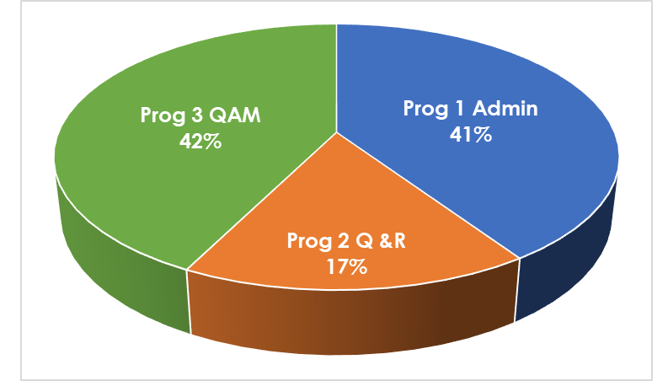
Budget of 2023/24 – R197 Million

Slide 32
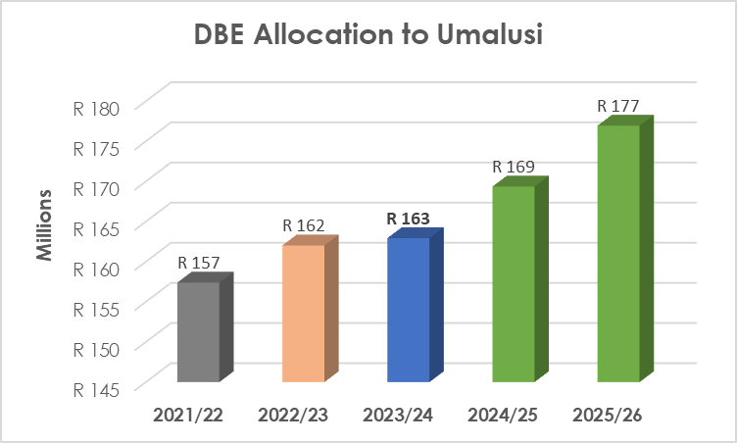
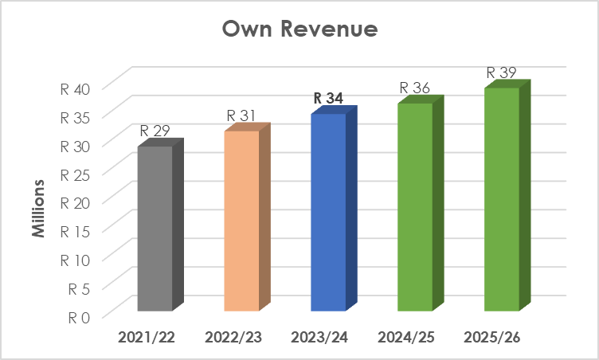
Overview: 2023/24
Financial Year 2023/2024
The total budget amounts to R197 Million.
DBE grant allocation:
2021/22 – R157,4 million
2022/23 – R162,0 million – an increase of 2,94%
2023/24 – R162,9 million – an increase of 0,56%
2024/25 – R169,4 million – an increase of 3,94%
2025/26 – R177,0 million – an increase of 4,48%
Own Revenue:
2021/22 – R28,8 million
2022/23 – R31,5 million – an increase of 9,36%
2023/24 – R34,5 million – an increase of 9,54%
2024/25 – R36,3 million – an increase of 5,35%
2025/26 – R39,0 million – an increase of 7,41%
Future Financial Years Budget Estimates
2024/25 – R205 million
2025/26 – R215 million

Slide 33
Own Revenue
The following are the primary revenue contributors:
Verification
Is the process followed by Umalusi to establish the authenticity of qualifications or certificates. Over the past six years, 250,593 verification were done annually on average.
Accreditation
Umalusi accredit private education institutions to ensure compliance with Section 29(3)(c) of the South African Constitution to ensure that independent educational institutions maintain standards. (Independent schools, private FET colleges and private AET colleges)
Certification
Is the process followed by Umalusi to issue certificates to candidates who have successfully complied with the requirements for a qualification. Over the past six years, 1,124,767 certificates were issued annually on average.
Quality Assurance of Assessment
Charges from Independent Examinations Board (IEB) and the South African Comprehensive Assessment Institute (SACAI)
Interest received
Investment of available funds

Slide 34
Total Revenue
Description | 2021/22 | 2022/23 | 2023/24 | 2024/25 | 2025/26
 | R’000 | R’000 | R’000 | R’000 | R’000
DBE Allocation | R157,400 | 162,031 | R162,945 | R169,365 | R176,953
Verification | R11,934 | R12,452 | R13,249 | R14,097 | R15,061
Accreditation | R5,195 | R4,139 | R10,796 | R11,120 | R11,824
Certification | R5,695 | R2,049 | R2,776 | R2,954 | R3,205
Quality Assurance | R2,534 | R4,696 | R3,782 | R4,024 | R4,343
Interest | R2,403 | R1,269 | R2,068 | R2,212 | R2,368
Rent | R1,023 | R1,087 | R1,812 | R1,921 | R2,220
Total Revenue | R186,184 | R187,723 | R197,428 | R205,693 | R215,974

Slide 35
Expenditure

Slide 36
Comments on the 2023/24 budget:
Compensation of Employees (CoE) aligns with the Department of Public Service and Administration (DPSA). The Umalusi Council has approved twelve additional posts for filling during the 2023/24 year to relieve some of the work pressure.
59% of the total expenditure is allocated to the national operations (programmes 2 and 3) of Umalusi, whereas the administration takes 41% of the total budget.
Programme 1 = 41% - R80,050 million (CoE) = R44,4 million, Other = R35,6 million)
Programme 2 = 17% - R32,853 million (CoE) = R21,7 million, Other = R11,1 million)
Programme 3 = 43% - R84,525 million (CoE) = R33,1 million, Other = R51,4 million)
Goods and services are expected to remain mainly the same because some processes will continue to be performed online as a cost-saving and efficiency measure.
National operations utilise 64% of the budget
A large portion of this funding relates to contract and seasonal workers’ remuneration
Administration utilises the remaining 36 % of the budget for activities such as:
External Audit
Outsourced Internal Audit
Building maintenance
Operational expenditures such as diesel for generators, municipal accounts, copiers etc.
.

Slide 37
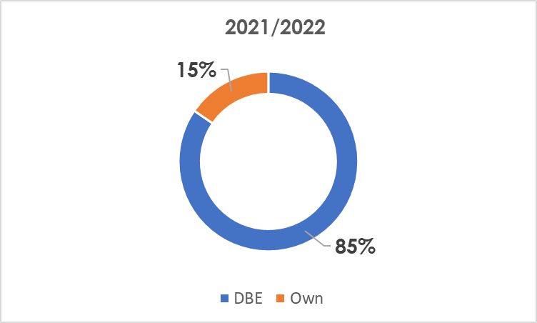
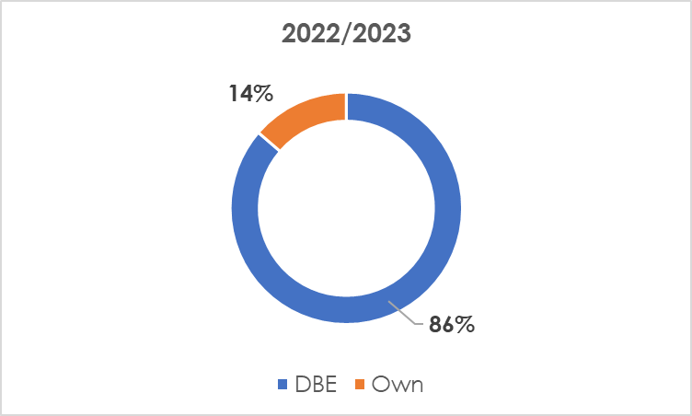
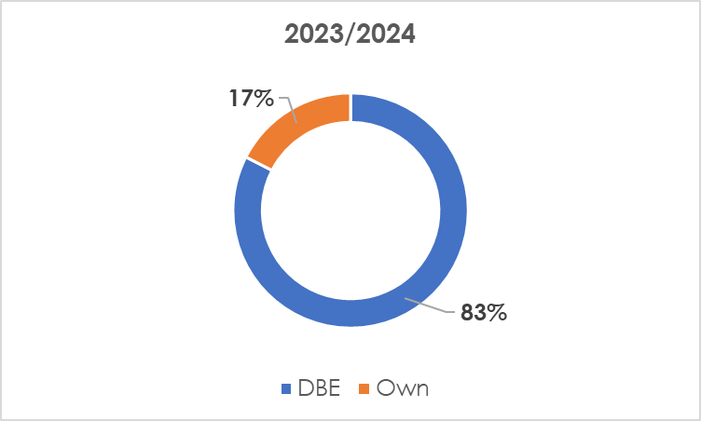
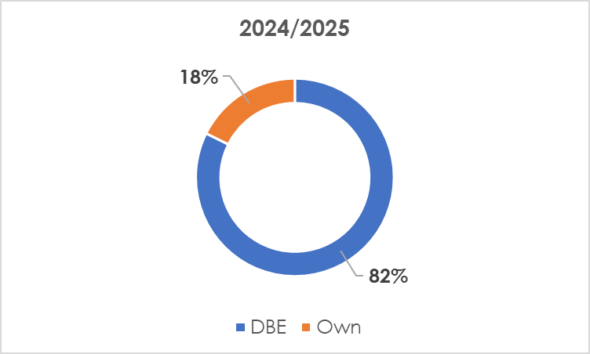
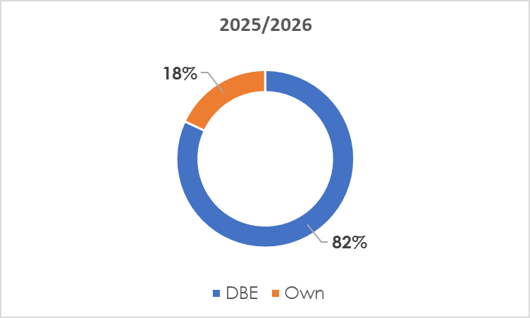
% Split between Own income and DBE grant

Slide 38
Umalusi’s 20th Anniversary Celebration
Umalusi is celebrating its 20th anniversary this year under the theme: Two Decades of Education Guardianship. 2002-2022

Slide 39
THANK YOU
We would like to sincerely thank the Minister of Basic Education, Mrs Angie Motshekga, the Deputy Minister, Dr Makgabo Reginah Mhaule, and our Council for their continued support.
Thank you very much to the Chairperson of the Portfolio Committee on Basic Education, Ms Mbinqo-Gigaba and the Portfolio Committee members for this opportunity to present Umalusi’s 2023/24 Annual Performance Plan and the 2023/24 MTEF Budget.
Dr MS Rakometsi

Slide 40
 012 349 1510
 0800 408 409
 Mafu.Rakometsi@umalusi.org.za
Lesego.Ndala@umalusi.org.za
info@umalusi.org.za
36

