Slide 1
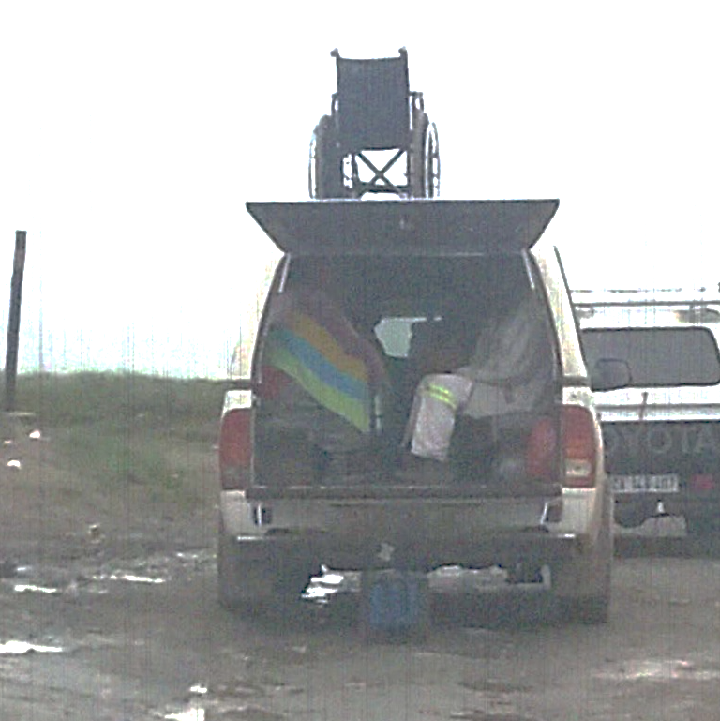
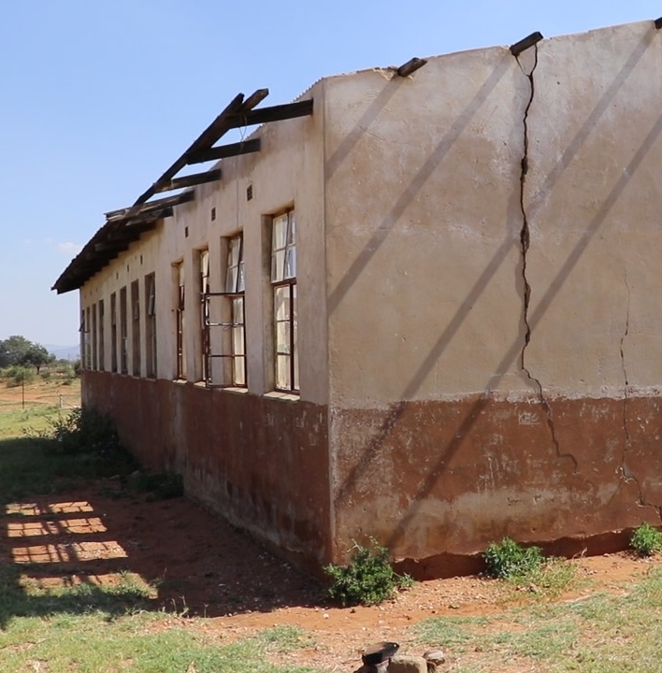
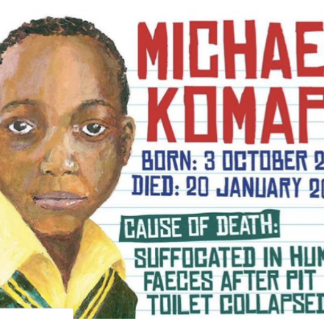
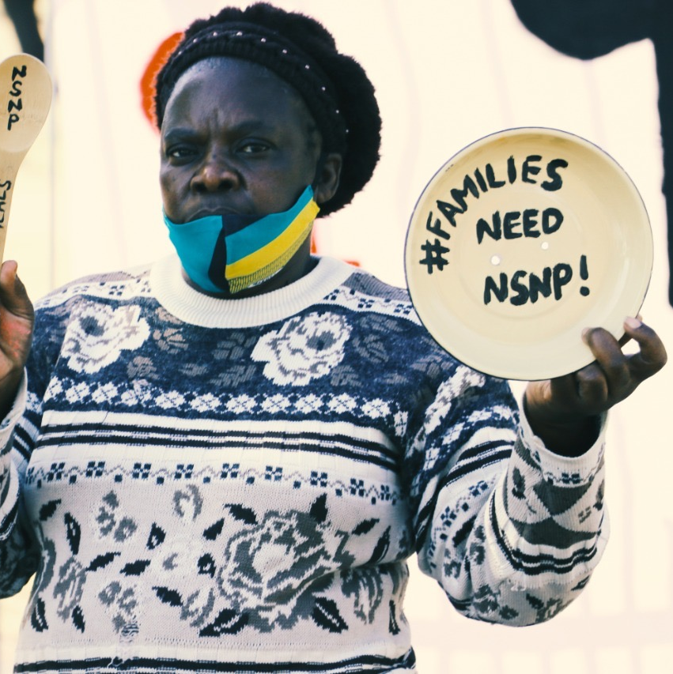
SECTION27 SUBMISSION TO THE SELECT COMMITTEE ON APPROPRIATIONS ON THE DIVISION OF REVENUE AMENDMENT BILL [B 22—2022]
Income Tax Exemption Reference Number: PBO 930022549. Nonprofit Organisation Registration Number: 055-382-NPO SECTION27, Non-Profit Company (2006/021659/08).
Board of Directors: Ms AL Brown (Acting Chairperson) Dr B Brink (Treasurer), Ms U Rugege (Executive Director), Ms N Seme, Mr N Spaull, Mr B Botha, Ms E Kelly, Justice J Froneman, Dr A Skelton, Ms S Kalla.
1st floor, South Point Corner, 87 De Korte Street, Braamfontein, 2001. PO Box 32361, Braamfontein, 2017. T +27 (0)11 356 4100 f +27 (0)11 339 4311 info@section27.org.za www.section27.org.za
By Matshidiso Lencoasa

Slide 2
Introduction
As a public interest law centre that works to advance the rights to basic education and access to healthcare services.
Our submissions centre on the impacts of the adjustments (or lack thereof) to these Constitutional rights, through a gendered lens, particularly in a climate change context.
We submit that:
The DoRAB has the power to advance human rights, but is characterised by real-term cuts to basic education and health care funding that do not keep pace with population growth
Fiscal consolidation path aimed at stabilising debt has been at the expense of social spending areas and the most marginalized shoulder the impact.

Slide 3
Introduction
We recommend:
Parliament consider whether these adjustments will enable the provinces and municipalities to provide basic services, perform the functions allocated to them or strengthen the fiscal capacity and efficiency of the provinces and municipalities.
Human Rights Impact Assessments: Parliament insists that if cuts to social spending must be made, that they must be based on transparent and participatory human rights impact assessments which demonstrate that the reductions will not increase inequality and undermine people's rights to access quality basic education and healthcare services.

Slide 4
Gender Responsive Budgeting (GRB)
Feminisation of poverty: gap between women and men in poverty has widened in the past decade.
In response, President Ramaphosa announced at the G7 Leaders' Summit this year that South Africa would inculcate GRB.
The FFC recommended addressing gender inequality through gender budgeting in the public sector.
Adjustments to the Division of Revenue Bill overlook gender implications, with no mention of gender or GRB.
Adjustments to the provincial equitable share and conditional grants are not made in a gender responsive manner, nor reflected on through a gendered lens.

Slide 5
Gender Responsive Budgeting (GRB)
Recommendations:
Parliament to request National Treasury to provide evidence of how, if at all, considered the FFC’s recommendation for GRB.
Parliament to request a robust plan for the medium term that reflects steps in advancing gender-responsive budgeting moving forward.
Parliament must insist on adequate resource allocation to Provinces to implement the National Strategic Plan on Gender-Based Violence and Femicide to address the scourge of Gender-Based Violence.

Slide 6
Provincial equitable share continues to be reduced in real terms
Minister Godongwana promised in his speech that the MTBPS would “enhance the quality of public services such as education and health”.
Yet no additional funding is provided to the provincial equitable share (PES), which funds the provinces core functions including health care and basic education.
This means that the provincial equitable share increases from R544.8 billion in 2021/22 to R560.8 billion in 2022/23.
Nominal terms: only a 2.9% increase, well below CPI inflation of 6.8% and population growth of 1.4%.

Slide 7
Provincial equitable share continues to be reduced in real terms
This downward spending trend on the PES continues in 2023/24 with a nominal cut to the PES of -0.8%, reducing the PES to R556.4 billion.
This blatant austerity in funding to the provinces should be rejected on the basis that the quality of provincial service delivery will almost certainly decline as a result, and the cuts are in direct contrast to the Minister's rhetoric in his speech.

Slide 8
Some but not all conditional grants keep up with CPI inflation
Spending on conditional grant allocations to provinces, many of which fund critical aspects of basic education and health care, increased by 6.8%, from R116.0 billion in 2021/22 to R123.7 billion in 2022/23.
This is well below combined CPI inflation and population growth of 8.2%.
This downward pressure on conditional grant allocations to provinces also continues.

Slide 9
Some but not all conditional grants keep up with CPI inflation
In 2023/24, proposed 3.5% nominal increase, while combined CPI inflation and population growth are projected to be 6.1%.
We recommend that conditional grants to provinces increase at least in line with CPI inflation and population growth so that their real value is not eroded.

Slide 10
Health Conditional Grants
Health Facility Revitalisation Grant
Earlier this year, SECTION27 made submissions that the DoRB had proposed painful cuts to this grant allocation in seven of nine provinces and that those increases were below inflation.
Unfortunately, the Division of Revenue Amendment Bill proposes no upward adjustments to this grant to remedy this.
In KZN, around 85 health facilities were destroyed by the flood and the KZN DoH received no additional funds from Treasury and were forced to re-prioritise an estimated R200 million of its funds intended for other health priorities.
Neither the MTBPS nor the Division of Revenue Amendment Bill recognises this damage with the Health Facility Revitalisation Grant receiving no adjustment to its funding.

Slide 11
Health Conditional Grants
Health Facility Revitalisation Grant
Recommendation: either ring-fenced relief granted to ensure that health facilities affected by floods can be repaired or the Healthcare Facility Revitalisation grant should be adjusted upwards to account for impact of extreme weather events in KZN and the Eastern Cape.

Slide 12
Health Conditional Grants
District Health Programmes Grant: HIV and TB
We welcome the MTBPS focus on addressing pandemic induced backlogs.
Not reflected in the adjustments: in the 2022/23 budget, the HIV, TB and STI component shows an average annual decline of 3,4% in the MTEF.
No adjustment to the HIV, AIDS and STI sub-programme’s allocation.
Goal set in the Budget Review in February 2022 of retaining 5.7m patients on antiretroviral therapy (ART) by the end of 2022/23.
Instead of adjusting the allocation, the MTBPS adjusts the goal to 5.5m.

Slide 13
Health Conditional Grants
District Health Programmes Grant: HIV and TB
Recommendation: call for upwards adjustments to the District Health Programmes Grant to equip the provinces to achieve HIV/AIDS and TB targets and protect the right to healthcare for people in the country affected by this.

Slide 14
Health Conditional Grants
District Health Programmes Grant: Oncology
While the MTBPS 2022 recognises services backlogs in oncology, funding adjustments to the District Health Programmes Grant do not reflect this.
Commitment to addressing service backlogs such as for oncology is deferred to the 2023 Budget.
Concerned this may be too late for some of the patients who have been on the waiting list to receive radiation oncology services for years.

Slide 15
Education Conditional Grants
Education Infrastructure Grant (EIG)
We welcome the additional funding of the EIG to assist with the repair and maintenance of schools affected by floods in KZN and the Eastern Cape.
While emergency relief is desperately needed at schools in the province, our analysis indicates that this help underestimates the extent of the problem.
EIG additional funding of R116.8 million in 2022/23.

Slide 16
Education Conditional Grants
Education Infrastructure Grant (EIG)
August 2022 progress report by the Auditor General on the implementation of repairs of schools damaged by the floods in KZN alone identified 356 schools needing repairs, and estimated the total cost of these repairs to be R235 375 838,23.
At this average cost, the MTBPS only allocates enough additional funding to support 177 repair projects at flood impacted schools.
Ultimately, this additional expenditure will only meet half of the reported need for school repairs and refurbishments.
We call on increased allocations to the education infrastructure grant (Schedule 4, Part A, page 5) to further support all disaster-struck schools.

Slide 17
Education Conditional Grants
Early Childhood Development Grant
We welcome the MTBPS’s commitment to allocate increased funding to improve and expand early childhood development services in the provinces.
However, the Division of Revenue Amendment Bill does not reflect these upward adjustments to the grant, leaving the provinces in the same position of fewer financial resources to subsidise ECD and construct the low-cost pilot ECD centres.
We call on the Division of Revenue Amendment Bill to reflect the commitment to increased allocation to the ECD grant to equip a successful transition to DBE and to protect and increase the access to ECD services in the country.

Slide 18
Education Conditional Grants
National School Nutrition Programme Grant (NSNP)
We welcome the expansion of the NSNP to learners in some quintiles 4 and 5 in the face of increasingly depressed economic conditions of many families in the country.
The MTBPS, however, lacks clarity on how government plans to continue funding the NSNP sustainably with food price inflation increasing 11.3% year on year, and considering the expected increases of learner enrolments over the medium term, while ensuring that meal quality or quantity is not compromised.
If food prices increase at a similar rate over the next 3 years, the NSNP may not be adequately funded to carry the cost of meals to all qualifying learners.
Recommendation: we call for, at minimum, food inflation linkages to the NSNP Grant.

Slide 19
Contact Details:
e
lencoasa@section27.org.za
w
www.section27.org.za
1st floor, South Point Corner, 87 De Korte Street, Braamfontein, 2001. PO Box 32361, Braamfontein, 2017. T +27 (0)11 356 4100 f +27 (0)11 339 4311 info@section27.org.za www.section27.org.za
Income Tax Exemption Reference Number: PBO 930022549. Nonprofit Organisation Registration Number: 055-382-NPO SECTION27, Non-Profit Company (2006/021659/08).
Board of Directors: Ms AL Brown (Acting Chairperson) Dr B Brink (Treasurer), Ms U Rugege (Executive Director), Ms N Seme, Mr N Spaull, Mr B Botha, Ms E Kelly, Justice J Froneman, Dr A Skelton, Ms S Kalla.

