Slide 1
AI and the Copyright Amendment Bill
Dr. Andrew Rens and Hanani Hlomani

Slide 2
AI: the next general purpose technology
Protein structure prediction for drug discovery
Medical image analysis
Automated translation
Fraud detection
Automated image recognition of defects in manufacturing
Predictive maintenance
Supply chain demand forecasting

Slide 3
Copyright and Outputs:Machine Learning
INPUT DATA
ꜜ
MODEL ←PROMPT
ꜜ
OUTPUT

Slide 4
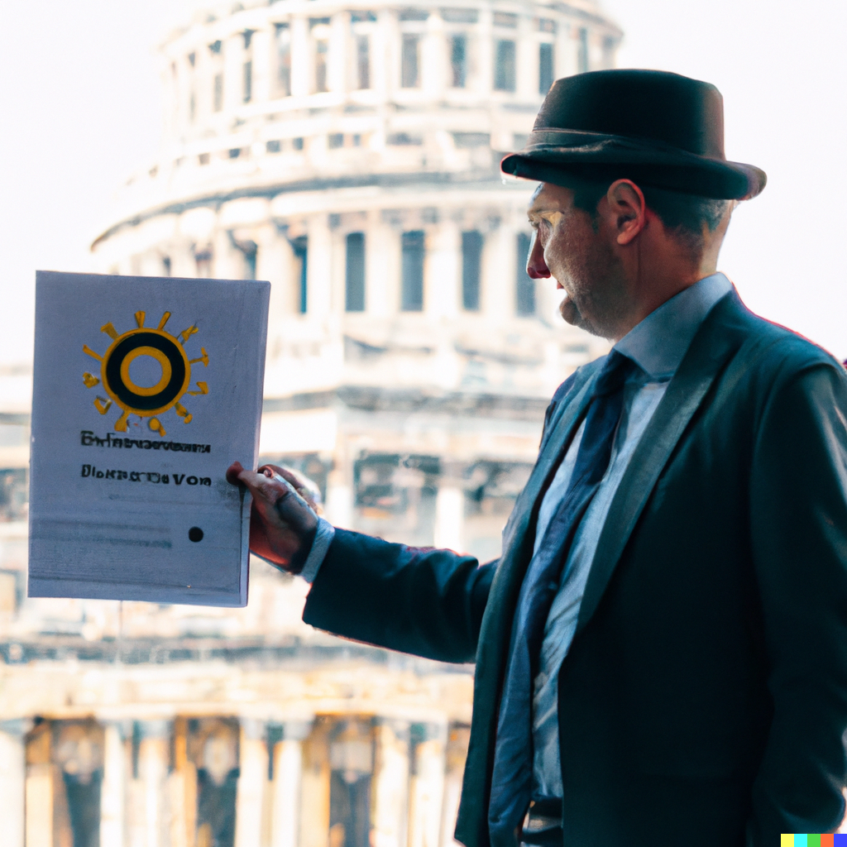
DALL-E2 An expert explains AI copyright to parliament

Slide 5
Large language models
One kind of machine learning is large language models such as ChatGPT that trained using millions of inputs e.g. most of the Internet in English - when the resulting algorithm is fed new data - a text prompt that might be only a few words - it predicts the next word, and the next and the next….

Slide 6
Producing a static ML Model
Corpus Compilation | Reproduction or temporary copy?
Corpus Technical Pre-Processing | Reproduction?
Corpus Annotation | Adaptation or Derivative Work?
Corpus Redaction | Delete reproduction
Train Model | New software work?
Static Model | New software work?

Slide 7
3 copyright questions for AI
Does use in training an algorithm infringe copyright in the individual items in a training corpus?
Do the outputs infringe copyright in individual items in the training corpus?
Does the output have copyright itself?

Slide 8
3 copyright questions for AI
1. Does use in training an algorithm infringe copyright in the individual items in a training corpus?
Maybe. But (most) use for computational analysis should be clearly permitted by an appropriate provision.
2. Do the outputs infringe copyright in individual items in the training corpus?
Very very rarely, and when it does existing law deals with it.
3. Does the output have copyright itself?
Probably not but its important to make it clear that it will not.

Slide 9
No copyright for AI outputs
Copyright is intended as an incentive to humans to create, to produce text, images, video and software.
AI does not need copyright as an incentive to produce. In July 2019 Microsoft invested 1 billion USD in Open AI (producer of ChatGPT) in January 2023 Microsoft invested an additional 10 billion USD.
AI processes do not resemble human creative processes - they are probabilistic.
Most AI systems which are used to generate creative output were trained on very large numbers of creative inputs.
AI systems that produce outputs that mimic their creative inputs risk undercutting the ability of artists to generate earnings.

Slide 10
No Copyright in AI outputs
Amend the 1978 Act to clarify that there is no copyright in AI outputs.
But this technology is developing very rapidly.
Specifying which processes don’t result in copyright creates a trap: legislation that will become rapidly outdated because it is technology specific and technology changes.
Instead make it clear that copyright only attaches to human creativity - the results of a human authors’ skill, effort and creativity.
And for text, images, music, software and audiovisual works make it clear that authors must be human authors.

Slide 11
Insert a new subsection in s2A
2A (3) (a) Copyright extends only to the products of a natural person’s skill, effort and creativity.
(b) In any dispute concerning copyright or authors rights the author or their successor shall bear the onus of proving that a disputed work or aspect of a work is the product of the skill, effort and creativity of the author.
(c) Prompting, selection, filtering and sequencing the products of an automated system or systems is not sufficient to meet the requirements of 2A(3)(a).

Slide 12
Amend S1 definition of “author”
“author”, in relation to -
(a) a literary, musical or artistic work, means the natural person who first makes or creates the work;
(b) a photograph, means the natural person who is responsible for the composition of the photograph;
(c) a sound recording, means the natural person by whom the arrangements for the making of the sound recording were made;
(d) a cinematograph film, means the natural person by whom the arrangements for the making of the film were made;
...
(h) a literary, dramatic, musical or artistic work or computer program which is computer-generated, means the natural person by whom the arrangements necessary for the creation of the work were undertaken;
(i) a computer program, the natural person who exercised control over the making of the computer program;

Slide 13
Enable AI Research
AI is a strategic technology. If South Africa does not develop our own AI we will be reliant on countries that do.
AI is the next big computing technology.
Big tech companies don’t need a copyright exception – they have millions of our images and texts they can use under their terms and conditions.
Big tech doesn’t need copyright they are intent on General Purpose AI.

Slide 14
Enable AI Research
There is a right to research under Section 16(1)(d) of the Bill of Rights.
“Everyone has the right to freedom of expression which includes:
academic freedom and freedom of scientific research”
If copyright is interpreted to restrict the right to use inputs for computational analysis (text mining, data mining and AI research) there could be another Constitutional Court case that the Copyright Act is unconstitutional.
A flexible provision can balance competing interests as technology evolves over time.

Slide 15
Enable AI Research
Insert a clear exception for use in computational analysis - text and data mining and training AI.
But how?
The European Union and the UK have narrow, detailed exceptions but
> they don’t work, and
> the UK is already debating how to change their exception.
Meanwhile the US has fair use that permits most computational analysis and leads the world in AI.
Keep s12A in the CAB but include “computational analysis” as part of research.

Slide 16
Retain S12A but include computational analysis
“In addition to uses specifically authorized, fair use in respect of
a work or the performance of that work, for purposes such as the following,does not infringe copyright in that work:
(i) Research, including informational analysis, private study or personal use, including the use of a lawful copy of the work at a different time or with a different device

Slide 17
Thank you
Research made possible by

