Slide 1
SUBMISSION ON THE 2023 DIVISION OF REVENUE BILL Presented to the Standing Committee on Appropriations 14 March 2023

Slide 2
PRESENTATION OUTLINE
Introduction
Gender Responsive Budgeting
Educational Conditional Grants and PES
Social Protection and Social Grants
Recommendations

Slide 3
ABOUT THE BJC
The Budget Justice Coalition consists of twenty-one civic organisations that aim to collaboratively build people’s understanding of and participation in South Africa’s planning and budgeting processes – placing power in the hands of the people to ensure that the state advances social, economic and environmental justice, to meet people’s needs and wellbeing in accordance with the Constitution.
The organisations who make up the BJC are: Alternative Information and Development Centre (AIDC), the Children’s Institute at UCT (CI), Corruption Watch (CW), Equal Education (EE), Equal Education Law Centre (EELC), the Institute for Economic Justice (IEJ), Oxfam SA, Pietermaritzburg Economic Justice and Dignity Group (PMEJD), the Public Service Accountability Monitor (PSAM), the Rural Health Advocacy Project (RHAP), SECTION27, Ilifa Labantwana, Treatment Action Campaign, Centre for Child Law, 350.org, Open Secrets, Social Policy Institute, Public Affairs Research Institute, Amandla.mobi, Black Sash as well as friends of the coalition.

Slide 4
INTRODUCTION
The BJC is of the view that the State has failed to justify the continuous implementation of budget cuts in efforts to reduce public borrowing.
We call for participatory human rights impact assessments of spending allocations to public services in efforts to protect these services.
We submit that budget cuts disproportionately impact marginalised communities which perpetuates more inequality.
The BJC reiterates its call for gender responsive budgeting and an end to austerity measures by the State.

Slide 5
GENDER-RESPONSIVE BUDGETING
Last year, we made submissions to this committee critiquing the 2022 Division of Revenue Bill for not allocating funding in a manner that reflects the lived experiences of marginalised communities in the country.
We welcome this year’s progress update reported in the Budget Review on gender responsive budgeting in the form of the completion of the development of GRB guidelines, and the intention to workshop these this coming financial year.

Slide 6
GENDER-RESPONSIVE BUDGETING
We call for a gendered budget narrative in the Division of Revenue Bill with an analysis of social spending areas (such as education, health and social development to name a few).
The BJC recommends a public participation workshop or process for the gender responsive budgeting guidelines during and post the 2023/24 financial year for the beneficiaries of GRB to adequately shape the process.

Slide 7
EDUCATION CONDITIONAL GRANTS
Early childhood development (ECD)
BJC welcomes the 51% and 24% increase in the Early Childhood Development (ECD) Conditional Grant for 2024/25 and 2025/26.
In the subsidy component of this grant, after accounting for the unallocated amount, the increase could enable the number of subsidised children to grow by around 20% over the MTEF.
This is a step in the right direction, given that the 2021 ECD Census found only 1.66 million children under 6 years are enrolled in early learning programmes, and less than 630 000 benefit.
BJC is concerned that there is no increase in the value of the per capita subsidy from R17 (centres) and R6 (non-centre based programmes) per day i.e:

Slide 8
EDUCATION CONDITIONAL GRANTS
Early childhood development (ECD) cont.
The value of the subsidy has not been increased since 2019 resulting in its real value being eroded by inflation.
The subsidy has to cover all the programme’s costs such as staff, rent and equipment as well as nutritious food for the children.
Erosion of its real value at a time when food inflation is as high as 13% will likely translate into reduced nutritional support for children under 5 years of age - the group most in need of adequate nutrition to prevent malnutrition and stunting.

Slide 9
EDUCATION CONDITIONAL GRANTS
Early childhood development (ECD)
We are pleased to see that R300 million and R400m in 2024/25 and 2025/26 is put aside within the subsidy component for a nutrition support pilot for early learning programmes (ELPs) and a results based service delivery model.
This is welcomed in a context where 57% of children attending ELPs face barriers to Thriving by Five, these are welcome indications that the Department of Basic Education (DBE) will test approaches to ensuring good nutrition and other improved outcomes for children in ELPs.

Slide 10
EDUCATION CONDITIONAL GRANTS
Early childhood development (ECD)
We call on the DBE to ensure that these initiatives include a focus on unregistered ELPs, recognising that the majority of poor children are accessing programmes which are not able to register and benefit from subsidies without support from government.
We note that this is a pilot and that it will therefore not reach the majority of children in subsidised ECD programmes over the MTEF.
Increasing the per child subsidy to take into account inflation erosion since 2019 therefore remains a core concern for BJC.

Slide 11
EDUCATION CONDITIONAL GRANTS
Early childhood development (ECD)
Gender-responsive budgeting: The ECD conditional grant is one that has great potential in redressing gender inequality in the country.
A report by the University of Stellenbosch found that increased enrolment of children under the age of six at ECD centres is one of the most effective ways of creating new jobs in the “care economy” in addition to equipping children to reach their full potential.
95% of people employed in the sector are women.
Quality ECD investment can therefore contribute substantially to advancing gender equity in the country.
Increasing the per child subsidy would enable programmes to employ more women and improve the wages and precarious conditions of employment for women in the sector.

Slide 12
EDUCATION CONDITIONAL GRANTS
Education Infrastructure Grant (EIG)
This is welcomed in a context of a state of disaster (called in response to the increasing frequency of extreme weather events including the excessive flooding in seven of nine South African countries).
It is imperative that South Africa’s education system is well-resourced to ensure that it can address schools that are still affected by the legacy of apartheid, as well as to be climate resilient.

Slide 13
EDUCATION CONDITIONAL GRANTS
Education Infrastructure Grant (EIG)
One of the elements of access to basic education as provided for in section 29(1)(a) of the Constitution include making education available.
Making education available means that schools should be equipped with adequate infrastructure.
This year, the Education Infrastructure Grant (EIG), which contributes funding for the construction, maintenance, upgrading and rehabilitation of new and existing infrastructure in the provinces, increased by 11% in 2023/24 to R13.8 billion.

Slide 14
EDUCATION CONDITIONAL GRANTS
Education Infrastructure Grant (EIG)
Our concern is that while funding is allocated to eradicating unsafe school infrastructure, the pace at which we are eradicating unsafe school infrastructure is too slow, putting the lives of learners in the provinces at risk
Unfortunately, another young life cut short on 9 March 2023: the lifeless body of a 4-year-old was discovered in a pit latrine toilet in a public school in the Eastern Cape.
On 28 February 2023, it was reported that the Eastern Cape province forfeited R100 million of the Education Infrastructure Grant meant for public school infrastructure.

Slide 15
EDUCATION CONDITIONAL GRANTS
Education Infrastructure Grant (EIG)
On 28 February 2023, it was reported that the Eastern Cape province forfeited R100 million of the Education Infrastructure Grant meant for public school infrastructure.
The money was simply not spent by the end of the last financial year while the state of school infrastructure in the Eastern Cape is devastating.
With over 5000 schools in the Eastern Cape, over 1000 of those schools still use pit latrine toilets, a death trap which continues to swallow the lives of children
The issue of dilapidated and dangerous school infrastructure and inadequate sanitation is not unique to the Eastern Cape.
This requires urgent intervention.

Slide 16
EDUCATION CONDITIONAL GRANTS
National School Nutrition Programme (NSNP)
The National School Nutrition Programme (NSNP) sees a proposed increase of 9.1% this year.
Although this is well above the headline CPI, we recommend that the NSNP considers the rising cost of feeding children nutritious meals, as food price inflation remains higher than headline inflation.
While the Budget 2023 recognises a food inflation rate for this year at 7%, StatsSA recorded a 13.8% year-on-year increase in the most recent month on record
We caution that if food prices rise at a similar rate over the next three years, the NSNP will not be adequately funded to carry the cost of meals to all nine million learners.

Slide 17
SOCIAL RELIEF OF DISTRESS GRANT (SRD)
In January 2023 less than 7,5 million applicants were approved for the grant compared to the 13,5 million applicants.
The BJC notes that the eligibility criteria were drafted in a way whereby the number of approved beneficiaries would not exceed the allocated budget.
The mechanism to apply the means test through direct examination of each applicant’s bank accounts results in errors of exclusion.

Slide 18
SOCIAL RELIEF OF DISTRESS GRANT (SRD)
We submit that the current static means test for social relief, reduces eligibility.
BJC submits that the R350 grant value is being eroded and will require an inflation related increase. The SRD should be increased to R663.
We propose an increase to the FPL, which can be achieved in the current year during the MTBPS.
The BJC notes concerns regarding the implementation and access to the SRD Grant-namely, the bank verification processes, online systems and PostBank processes. BJC reiterates its calls for a UBIG in the long term.

Slide 19
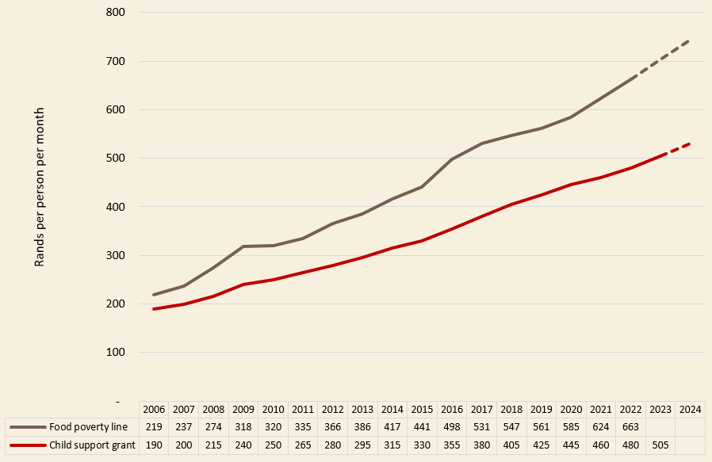
CSG: NOT ENOUGH TO FEED A CHILD
When first implemented, the Child Support Grant was meant to cover the cost of food and clothing for a child.
It no longer covers either – the gap between the CSG and the food poverty line continues to widen.
Treasury uses headline CPI to calculate inflation increases for the CSG and other permanent grants.
This approach fails to acknowledge inequality of inflation. Current inflation is higher for the poor, who spend a substantial portion of their HH budget on food, public transport and energy.
Widening gap: CSG versus food poverty line value

Slide 20
Inflation (April 2022 – January 2023)
CPI headline inflation (average)
4.5%
INFLATION FOR THE POOR
Quintile 1 (poorest 10%) 8.8%
Quintile 2 (next poorest 10%) 8.5%
INFLATION FOR THE RICH
Quintile 10 (richest 10%) 5.0%
Quintile 9 (next richest 10%) 3.7%
PUBLIC TRANSPORT & ENERGY
Public transport 13.4%
Electricity & other fuel for lighting, cooking and heating 8.1%
PRIVATE TRANSPORT
Purchase of vehicles 5.0%
Transport fuel (petrol / diesel) 0.3%
Running costs / maintenance 5.6%
BASIC FOOD
Food inflation (ave) 11.6%
Breads & cereals (e.g. mielie meal) 17.7%
Oils and fats (e.g. margarine) 10.8%
Vegetables 14.7%
SERVICES & LUXURIES
Insurance 1.7%
Financial services 2.2%
Recreational services (e.g. gym) 2.2%
Hotels -1.3%
Domestic worker wages 4.2%
Child support grant (Apr ’23 v Apr ’ 22) 4.2%
Source: Stats SA Consumer Price Index tables, Apr 2022 & Jan 2023. (Calculations by Katharine Hall, Children’s Institute, University of Cape Town.)

Slide 21
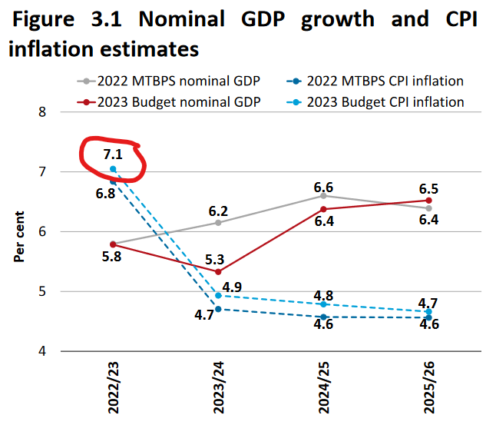
2022/23 INFLATION UNDER-ESTIMATE
Grant increases are calculated according to projected inflation estimates for the coming year.
In 2022, projected CPI (headline) inflation for the 2022/23 year was 4.5%.
This informed grant increases of around 4.5% (e.g. the CSG was increased by exactly 4.5%).
Actual CPI (revised estimate) for 2022/23 is 7.1%. Grants should have received an upward adjustment before the new inflation-linked increases were calculated.
E.g. This would require an additional R15 per month to the CSG, before the 2023/24 increase was applied.
Source: National Treasury Budget Review 2023

Slide 22
RECOMMENDATIONS
GRB related recommendations
A public participation workshop or process for the gender responsive budgeting guidelines during and post the 2023/24 financial year.
SRD related recommendations
Increase the means test threshold to R663 (2022 food poverty line value), to retain real value of income threshold – otherwise people have to be poorer to access the grant. We call for a UBIG.
Increase the SRD to the food poverty line, or as a minimum, apply an inflation-linked increase to correct for the erosion of the grant’s value since 2020.
.

Slide 23
RECOMMENDATIONS (CONT.)
CSG related recommendations
CSG is in special need of protection because it is by far the smallest permanent grant and no longer covers the cost of basic food as originally intended. Failure to invest in children will result in rising hunger and malnutrition, with long-term consequences for children, society and the economy.
An additional increase to the CSG in October, to correct for below-inflation increases last year, and to adjust for food inflation, as food is the primary purpose of the grant.
ECD related recommendations
That the NSNP considers rising cost of feeding children nutritious meals.

Slide 24
Thank You www.budgetjusticesa.org.za https://twitter.com/budgetjusticesa https://www.facebook.com/budgetjusticesa

