Slide 1
SCHOOL SPORT
KARATE SOUTH AFRICA

Slide 2

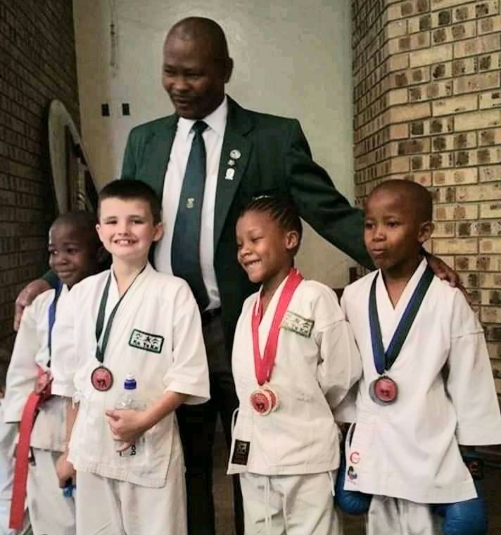
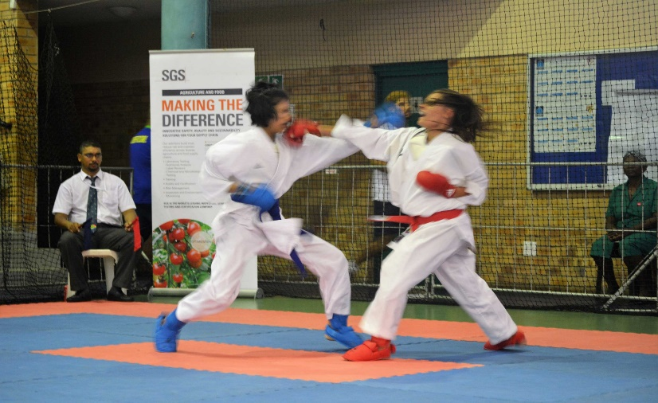
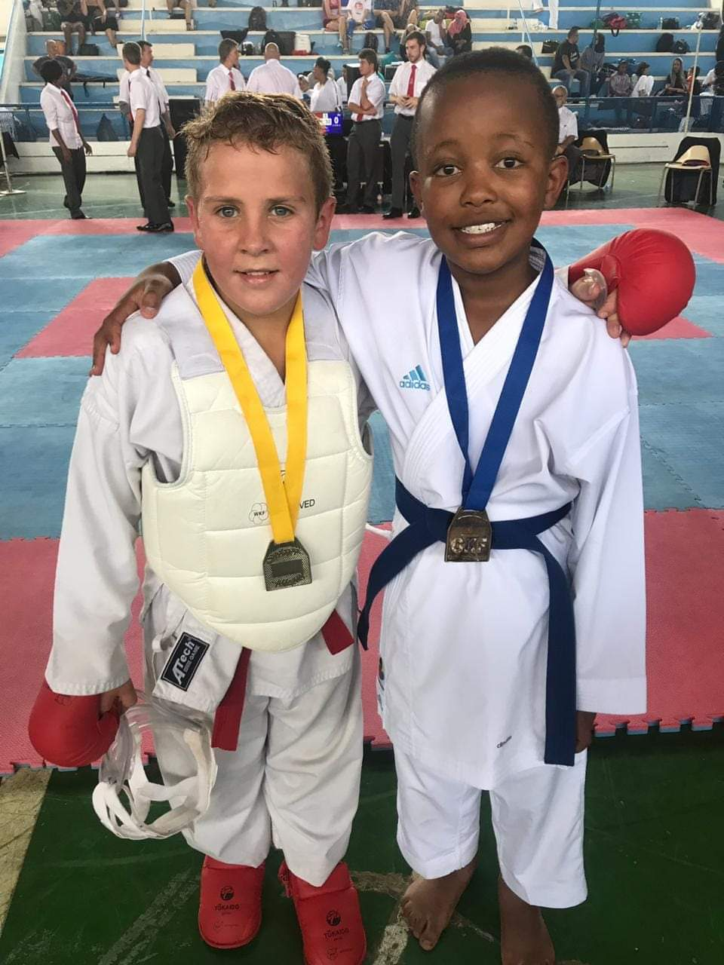
FOCUS OF THE PRESENTATION
KARATE SOUTH AFRICA
PERFORMANCE PLAN 2023/24
DEVELOPMENT OF KARATE IN SCHOOLS

Slide 3
INTRODUCTION TO DELEGATION
KARATE SOUTH AFRICA- OVERVIEW BY PRESIDENT
GLOBAL FOOT PRINT
3rd biggest sport by IF membership
AFFILIATION /MEMBERSHIP
DSAC
SASCOC
UFAK REGION SOUTH
UFAK ALL AFRICA
WKF
COMMONWEALTH
KSA MEMBERSHIP
350 affiliated clubs
14976 affiliated members
10183 non paying development members
All 9 provinces and all 52 districts in SA.
RECOGNITION
By IOC through WORLD Karate Federation
Kumite
Kata

Slide 4
ACHIEVEMENTS OVER THE LAST THREE YEARS
INTERNATIONAL APPOINTMENTS
KSA President
President of CKF
Vice President UFAK
Member : Technical Board WKF
KSA Technical Director
Technical Commission : UFAK Region South
KSA Secretary General
Asst Secretary UFAK Region South
KSA Treasurer
Treasurer CKF
Chair of LOC UFAK Region South
MAJOR TOURNAMENTS
UFAK All Africa Championships December 2022
National events hosted
Hosted Region South (SADAC)
International events attended
DEVELOPMENT
Athlete training and preparation
Coaches and Referees
Table and administration officials
SOCIAL RESPONSIBILITY
Gender focused classes
Senior Citizens Self defence
Karate awareness campaigns in non-urban areas
Youth open days programs

Slide 5
KEY CHALLENGES AND CONSTRAINTS
FUNDING
Employing Coaches/Referees
Equipment
Staging more competition
International participation
Hosting International Events
LOGISTICS
Travel to non-urban areas
Insufficient equipment and apparel
Safe and proper venues
MAIN STREAM VS SCHOOLS
Karate not included in extra curricula activities
Inadequate DSAC/DOE correlation

Slide 6
OPPORTUNITIES TO INCREASE KARATE FOOTPRINT IN SCHOOLS

Slide 7
CONSTITUTIONAL MATTERS
VISION
KSA is committed to developing the character and discipline of today’s members, so that they will become sound leaders of tomorrow who will use the positive values of karate-do, to serve the needs of our rainbow nation with diligence and distinction

Slide 8
CONSTITUTIONAL MATTERS
MISSION
1. to promote, advance, administer, co-ordinate and generally encourage the Development of the sport of Karate in South Africa in accordance with the principles as laid down in the Statutes of KSA and World Karate Federation.
2. In the growth of schools Karate in South Africa, we consider and establish rules to control Karate development in South Africa.
3. We seek to establish and enforce the Laws of the art as promulgated by WKF from time to time and to protect the game against any form of abuse.
4. SASK’s role is to initiate, negotiate, arrange finance and control tours and matches of school teams to and from South Africa.
5. To settle disputes arising between members or bodies or persons connected directly or indirectly with Karate within the jurisdiction of KSASK.
6. Recognize the importance in raising and administering the funds of KSASK in such a manner as KSASK may deem advisable and in particular by means of subscriptions, donations and sponsorship’s.
.
7. To acquire and develop playing equipment.
8. To affiliate to KSA as associate member.
9. To distribute monies to its members for the protection, promotion and advancement of schools Karate.
10. To do all such things as may be incidental or conducive to the attainment of schools Karate.

Slide 9
CONSTITUTIONAL MATTERS
K
S
A
S
T
RUC
TUR
E
CONGRESS (supreme and legislative body)
NATIONAL EXECUTIVE
Committees
PROVINCIAL EXECUTIVE
REGIONS
DOJO’S
MEMBERS/ASSOCIATE MEMBERS

Slide 10
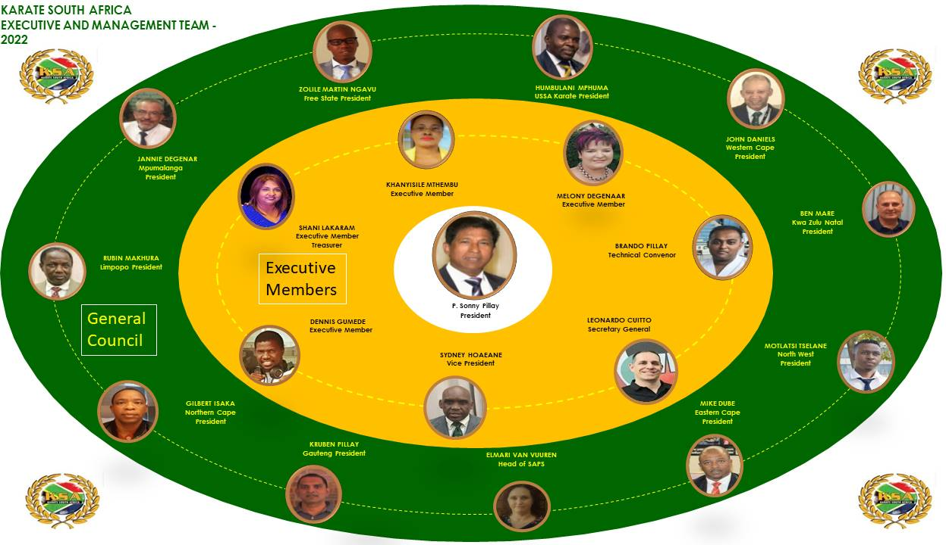
CONSTITUTIONAL MATTERS

Slide 11


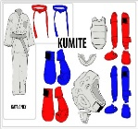
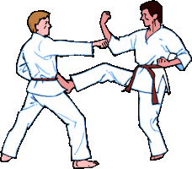




CONSTITUTIONAL MATTERS by Sec-General
AIMS AND OBJECTIVES
EQUIPMENT
Acquire and develop equipment resources
FINANCIAL MANAGEMENT
Financial control and governance
Raise sponsorships and fund activities
MEMBERSHIP
Encourage formation of clubs
Promote & increase membership
SCHOOL SPORTS
Host national schools gathering
Attainment of schools karate
Leagues at primary and secondary schools
TOURNAMENT
Establish school leagues
Host inter district, provincial and national championships
Develop Team SA
COMPLIANCE
Enforce WKF laws
Settle disputes

Slide 12
ROLLOUT by Technical Director and Head Coach
THREE PILLARS OF SCHOOL SPORT
Physical Education
National Championships
Top School League

Slide 13
ROLLOUT by Technical Director and Head Coach
KSA NATIONAL SCHOOLS STRUCTURE
KSA NATIONALEXECUTUVE : TECHNICAL CONVENOR
NATIONAL COORDINATOR SCHOOL KARATE
9 PROVINCIAL COORDINATES
PROVINCIAL DISTRICTS REPRESENTATIVES

Slide 14
ROLLOUT by Technical Director and Head Coach
WEAKNESSES
Karate is privately taught at schools and is not formalised into curriculum
Lack of grass roots co-operation with DOE and sport in general
STRENGHTS
Karate being currently taught privately in approximately 60% of urban schools
KSA have qualified coaches and referees that can be easily deployed should funding be made available
Karate contributes to addressing:
Juvenile delinquency
Drug and alcohol abuse
Family and gender based violence
Human respect and dignity
Self discipline
THREATS
Insufficient public sector funding
Parents are privately funding their kids – impoverished kids continue to be marginalised
Losing qualified coaches to other countries due to lack of local employment
OPPORTUNITIES
High recognition of KSA by WKF – opportunities for hosting world events
International events hosted provides for increased numbers for participation by South Africans
Women and children self defence skills

Slide 15
ROLLOUT by Technical Director and Head Coach
INTERGRATION OF SCHOOLS KARATE INTO KSA : 3 YEAR KEY FOCUS AREAS
YEAR 2
YEAR 3
YEAR 1
9 Provinces, additional 5 schools, additional 50 students
9 Provinces, additional 5 schools, additional 50 students
9 Provinces, additional 5 schools, additional 50 students
3 public schools, 1 rural and 1 IEB
3 public schools, 1 rural and 1 IEB
3 public schools, 1 rural and 1 IEB
Introduce competition formats
Stage ranked competitions – protea colours
Integration will be driven by the regional districts within which each school resides
Multi disciplinary teams of coaches and administrators will be appointed at each district level with oversight by the TD
Full time coaches at schools – free lessons

Slide 16
ROLLOUT by Technical Director and Head Coach
The key constraint to rolling our karate into schools is FUNDING.
Statistics from DOE website

Slide 17
Budget by Treasurer

Slide 18
BUDGET by Treasurer
Start Up Costs
Operating Costs

Slide 19
BUDGET by Treasurer
Start Up Costs
Operating Costs
Competition

Slide 20
BUDGET by Treasurer
Start Up Costs
Operating Costs
Competition

Slide 21
CONCLUDING COMMENTS by President

Slide 22




CONCLUDING COMMENTS by President
1. Karate is globally in the top three sporting codes by IF membership
2. Karate is not just a sport – it is a life skill
3. Executives within the structures of KSA are internationally recognised and occupy positions on international structures
4. KSA has an inclusive and well governed national structure
4. KSA has, within its midst, high ranking world champions and karateka's, highly qualified coaches and referees
5. KSA is poised to increase its footprint across the country both at a high performance, amateur and schools level
KSA PLEA TO DSAC : For the objectives of KSA to be realised and the value of
karate to be unlocked, particular to our youth through the schools, a major
requirements is adequate FUNDING

Slide 23
THANK YOU

