Slide 1
Buffalo City Metropolitan Municipality
BCMM’s BRIEFING PORTFOLIO COMMITTEE OF
HUMAN SETTLEMENTS ON SERVICE DELIVERY MATTERS
DATE: 08 MARCH 2023
VENUE: COMMITTEE ROOM, 1 PLEIN STREET, PARLIAMENT
TIME: 09H00 – 13H00

Slide 2
INDEX
1. USDG FUNDED PROJECT REPSONSE
1.1 2022/23 Status Quo
1.2 USDG Current Allocation
1.3 USDG Status Quo
1.4 USDG Historical Expenditure
2. ISUPG FUNDED PROJECT RESPONSE
2.1 202/23 Status Quo
2.2 ISUPG Current Allocation
2.3 ISUPG Status Quo
2.4 ISUPG Historical Expenditure
2.5 Status Quo – BCMM Serviced Sites (2022/23)
2.6 USDG & ISUPG Prognosis in Picture

Slide 3
INDEX
PRESENTATION 2 : LAND
3.1 Background
3.2 Prevention of Illegal Eviction from and unlawful occupation of Land Act (Pie Act)
3.3 Catalyst of Unlawful land occupations
3.4 Current Hot Spot Areas
3.5 Broad challenges
3.6 Short term intervention on curbing illegal land invasion
3.7 Meduim to Long term intervention on curbing illegal land invasion
PROCURED LAND PARCELS
CHALLENGES & MITIGATING FACTORS
RECOMMENDATIONS
7. THE END

Slide 4
1) USDG FUNDED PROJECTS RESPONSE

Slide 5
1.1) 2022/2023 Satus Quo - USDG (cont)…
2022/2023 DoRA Allocation | R 496 166 000
Transferred to date | R 307 623 000
EXPENDITURE AS AT 31 JANUARY 2023
Expenditure | R 228 604 579
Which is ...... of the transferred funds | 74%
Which is ...... of the DoRA Allocation | 46%

Slide 6
1.2) USDG CURRENT ALLOCATION (cont)….
DEPT NAME | CURRENT USDG BUDGET (Financials) | PLANNED TARGET (Non Financials) | CURRENT EXPENDITURE (Financial) | % EXPENDITURE | COMMENT/ RECCOMENDATION
ELECTRICITY | 10 000 000 |  | 7 956 441 | 71% | 29% Of the current budget will be exhausted by the end of Q3
HUMAN SETTLEMENTS | 113 228 750 |  | 27 23 6915 | 24% | 3 Major projects have been awarded through HDA as part of Recovery Plan 4 Major projects invoices are currently being processed
LOCAL ECONOMIC DEVELOPMENT | 18 760 848 |  | 3 735 697 | 20% | Funding has already been committed to ongoing Projects and will be exhausted by end of Q3
ROADS | 143 010 937 |  | 59 345 | 41% | Contractor on site, with budget committed to be exhausted by end of Q3 As a result of committed funds inter alia our own funding, Roads have requested additional funding to the value of 90 000 000

Slide 7
1.2) USDG CURRENT ALLOCATION (cont)….
SUPPORT SERVICES | 14 884 980 |  | 12 844 851 | 86% | Budget already committed and exhausted to EPMO programmes An additional amount to the value of 16 000 000 is requested
TRANSPORT PLANNING | 60 000 000 |  | 24 393 725 | 41% | The remainder of the budget is already Committed and will be exhausted by the End of the Financial year Additional Funding have been requested To the value of 14 300 000
WASTE MANAGEMENT | 15 800 000 (Transfer Stations 4m Landfill 6.3m Revitalization of Beaches 5.5m |  | 5 5000 000 | 34% | Budget exhausted on Rev of Beaches Part of the 10.3m budget surplus requested To cover the requested additional funding To the value of 5.5m
WASTE WATER | 44 000 000 |  | 39 892 339 | 91% | Budget committed and will be exhausted by the end of Q3
WATER | 66 480 485 |  | 24 031 133 | 36% | Funds already committed and will be Exhausted by the end of the Q3
TOTAL | 496 166 000 |  | 212 678 320 | 46%

Slide 8
1.3) USDG 2022/23 STATUS QUO
The City has spent 43% (R212.68 million) of its 2022/2023 allocated budget of R496.17 million as at 31 December 2022.
In terms of the cash flow projects submitted to NDoHS, the City had projected to spend 40% (R196.12 million). This is as per our submissions to NDoHS on cash flow projections and input to the payment schedule (In April 2022)
The committee needs to also take into account that the funding transferred to the City as at 31 December 2022 is R307.62 million.
As at 31 December 2022, the City has spent 69% of the transferred funds, this in line with the USDG framework that a city should spend at least 60% of the transferred funds.
The City can confirm that it is implementing the projects in line with the cash flow projections and that the total allocated budget will be fully spent by 30 June 2023.

Slide 9
1.4) USDG HISTORICAL EXPENDITURE
Financial Year | Allocation Rand | Roll Over Rand | Expenditure Rand | % | Variance Rand
2012/2013 | 499,474,000 | 267,314,445 | 537,213,242 | 70% | 229,575,203
2013/2014 | 613,305,000 | 176,874,613 | 789,503,174 | 100% | 0
2014/2015 | 673,289,000 | 0 | 666,949,000 | 99% | 6,340,000
2015/2016 | 713 132 000 | 42 404 693 | 755 420 406 | 100% | 116 287
2016/2017 | 731 499 000 | 0 | 731 498 805 | 100% | 195
2017/2018 | 928 128 000 | 0 | 927 836 643 | 100% | 291 357
2018/2019 | 962 992 000 | 0 | 962 985 656 | 100% | 6 259
2019/2020 | 1 157 423 000 | 0 | 934 367 462 | 100% | 223 055 537
2020/2021 | 887 121 000 | 223 055 537 | 1 081 995 471 | 97% | 28 181 065
2021/2022

Slide 10
2) ISUPG FUNDED PROJECTS RESPONSE

Slide 11
2.1) 2022/2023 Status Quo – ISUPG cont…
2022/2023 DoRA Allocation | R 282 122 000
Transferred to date | R 201 592 000
EXPENDITURE AS AT 31 JANUARY 2023
Expenditure | R 103 227 848
Which is ...... of the transferred funds | 51%
Which is ...... of the DoRA Allocation | 37%

Slide 12
2.2) ISUPG CURRENT ALLOCATION cont….
ISUPG BUDGET PER SERVICE | 2022/2023 BUDGET | EXPENDITURE 31 DEC 2022 | VARIANCE | % SPENT | COMMITTED: 31 DEC 2023 | COMMENTS
Amenities | 7 500 000 | 8 311 967 | -811 967 | 111% | 529 777 | Project is completed.
Electricity | 30 000 000 | 0 | 30 000 000 | 0% | 3 694 896 | An annual contract to the value of R18 million for overhead lines to Ziphunzana By-Pass TRA has been appointed. A budget of R12 million is being reallocated to other Engineering performing projects through the mid-year adjustment process which is being tabled at Council on 28 Fbruary 2023.
Human Settlements | 134 600 000 | 45 655 952 | 88 944 048 | 34% | 23 693 025 | More improvement on the expenditure is expected after 28th February Council meeting which will approve the mid-year adjustment budget. This will assist on major infrastructure projects that have contractors on site but with less budget allocations especial those contracts that have been recently appointed in the first & second month of the third quarter (Jan-March 2023).
Local Economic Development | 20 000 000 | 1 832 537 | 18 167 463 | 9% | 348 071 | The budget has been re-directed to performing project, where Contractors are already appointed.

Slide 13
2.2) ISUPG CURRENT ALLOCATION (cont)….
ISUPG BUDGET PER SERVICE | 2022/2023 BUDGET | EXPENDITURE 31 DEC 2022 | VARIANCE | % SPENT | COMMITTED: 31 DEC 2023 | COMMENTS
Roads | 10 000 000 | 6 429 988 | 3 570 012 | 64% | 2 631 110 | The project is progressing very well and variance of the projected will be fully expended by end June 2023.
Spatial Planning | 21 022 000 | 2 205 174 | 18 816 826 | 10% | 450 147 | A deed of Sale has been prepared for a land purchase to the value of R12.5 million. The balance has been adjusted to other performing projects the mid-year adjustment process which is being tabled at Council on 28 Fbruary 2023.
Waste Water | 30 000 000 | 12 927 822 | 17 072 178 | 43% | 7 950 666 | The Project is progressing in line with the cash flow projections. Funding will be fully spent by end June 2023.
Water | 29 000 000 | 17 060 699 | 11 939 301 | 59% | 7 511 583 | The Project is progressing well and funding will be fully spent by end June 2023
TOTAL ISUPG PER SERVICE | 282 122 000 | 94 424 139 | 187 697 861 | 33% | 46 809 275

Slide 14
2.3) ISUPG 2022/23 STATUS QUO (cont)….
The City has spent 33% (R94.42 million) of its 2022/2023 allocated budget of R282.12 million as at 31 December 2022.
The committee is requested to take into account that the funding transferred to the City as at 31 December 2022 is R201.59 million.
As at 31 December 2022, the City has spent 47% of the transferred funds. The City can confirm that the total allocated budget will be fully spent by 30 June 2023.

Slide 15
2.4) ISUPG HISTORICAL EXPENDITURE (THIS INFORMATION IS AS PER WHEN THE ISUPG WAS GRANTED FULL STATUS OF BEING A GRANT)
Financial Year | Allocation Rand | Roll Over Rand | Expenditure Rand | % | Variance Rand
2021/2022 | 258 000 000 | 0 | 234 788 927 | 99% | 3 469 073

Slide 16
2.5) STATUS QUO – BCMM SERVICED SITES (2022/2023)
Item | Quarter 1 | Quarter 2
Serviced Sites | 139 | 179
TOTAL |  | 318

Slide 17
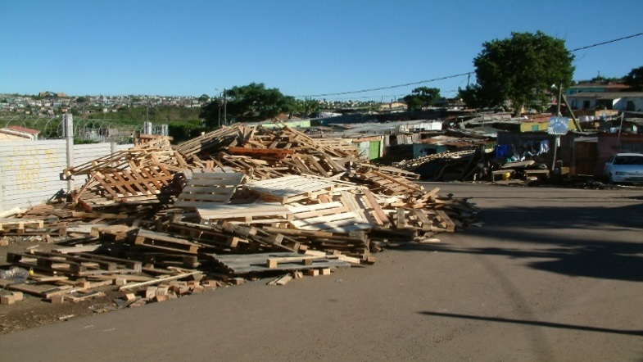
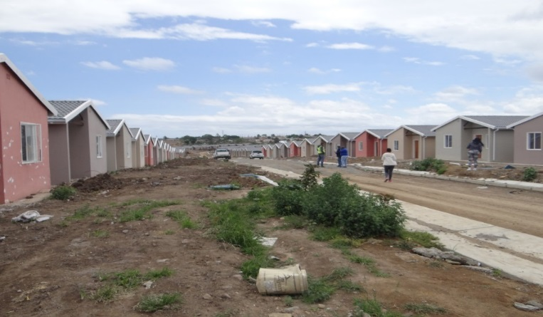
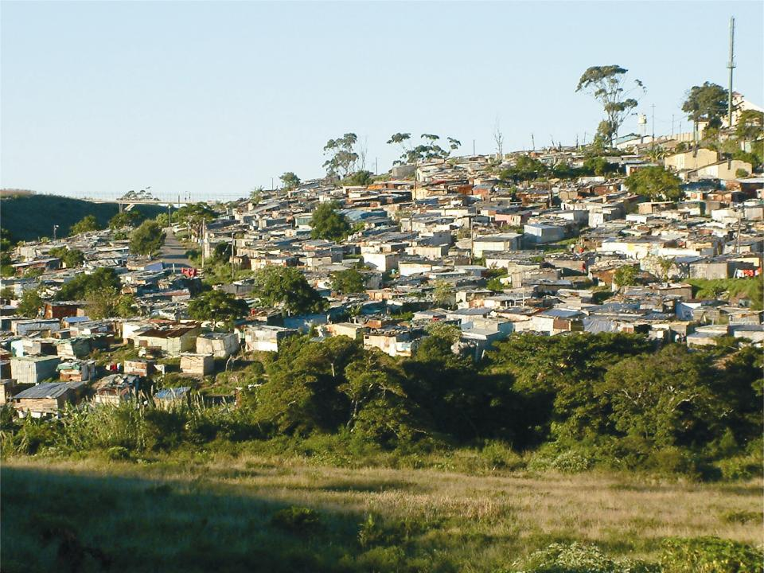
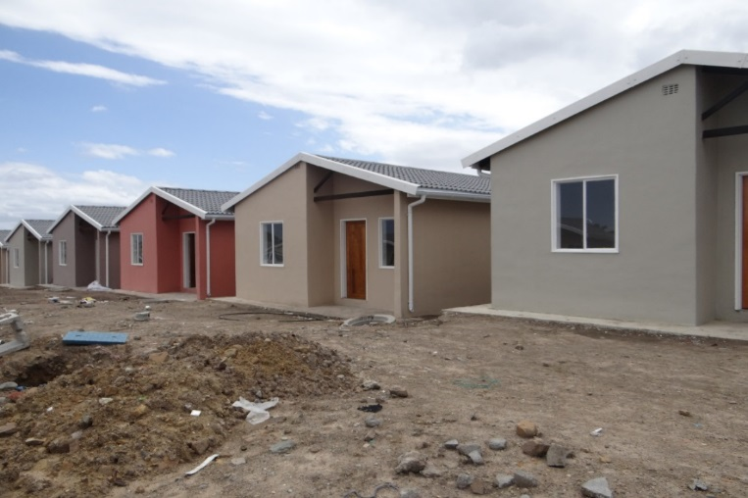
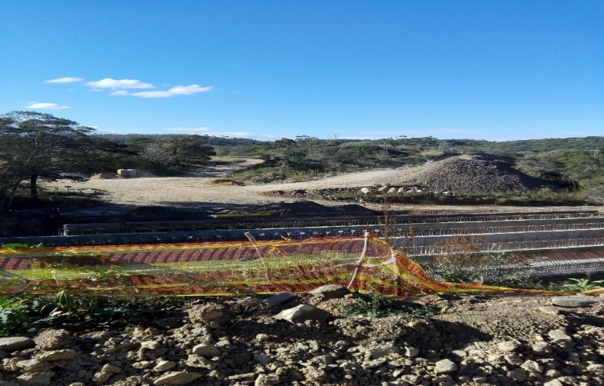
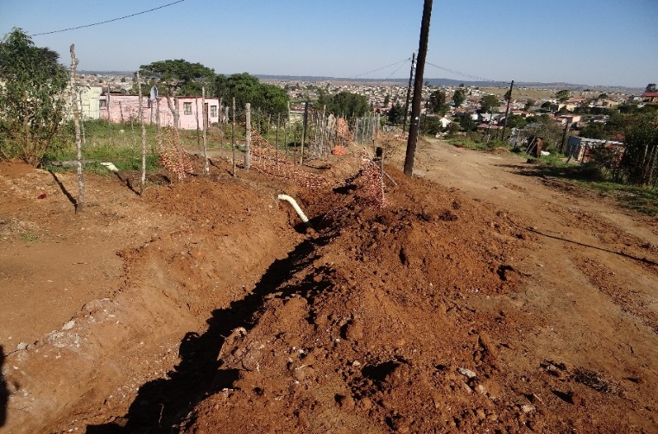
2.6) USDG AND ISUPG PROGNOSIS IN PICTURES
Into Human Settlements
Through USDG
Upgrading Informal Settlements

Slide 18
3.) PRESENTATION 2: LAND

Slide 19
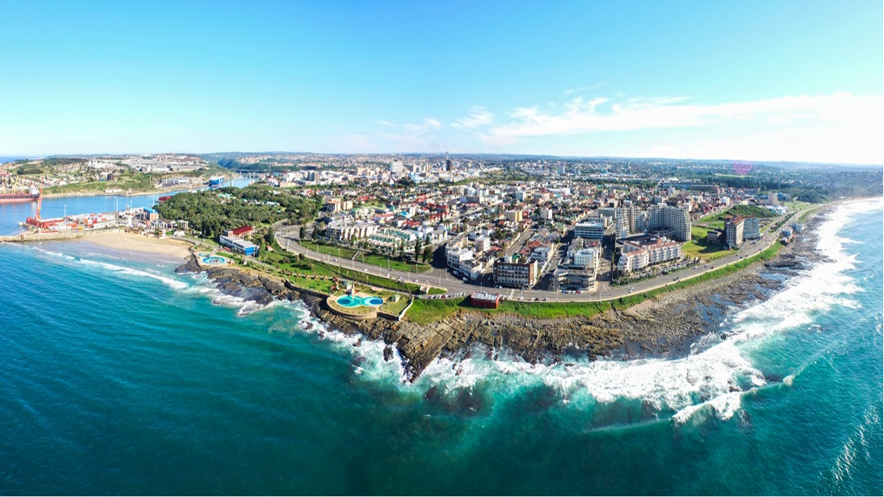
3) MANAGING AND CURBING LAND INVASION AND ILLEGAL OCCUPATIONS OF
LAND WITHIN BUFFALO CITY METROPOLITAN MUNICIPAL AREA OF
JURISDICTION (cont)….

Slide 20
3.1) BACKGROUND
Land Invasion refers, inter alia, to an illegal occupation of land by an individual or groups, whether to establish a settlement, business or both and any other land use which would be deemed illegal within municipal owned land or other privately owned properties without the consent of the owner.
There are large tracks of land which have been invaded and in some areas such an act impact on municipal plans. In response to such illegal activities, steps have been taken by the BCMM to deal with any kind of invasion either proactively or reactively, these included but not limited to application of Land Management Policy, Interdicts and Court Orders, and as such these are documented.

Slide 21
3.2) PREVENTION OF ILLEGAL EVICTION FROM AND UNLAWFUL OCCUPATION OF LAND ACT (PIE ACT) – ACT 19 / 1998
PIE Act
Prevention of Illegal Eviction from and Unlawful Occupation of Land Act (PIE Act) –Act 19 / 1998
Urgent amendment required if municipalities are to succeed in curbing land invasions.
The City and other metros provided a comprehensive amendment bill to National Government on this matter.
Places unnecessary burden on municipalities to provide alternative accommodation.
Lack of a clear time period in which shacks can be demolished without a court order.

Slide 22
3.3) CATALYST OF UNLAWFUL LAND OCCUPATIONS (ULO)
Service delivery protest
Need for space
Opportunistic entrepreneurism
Proximity to alternative services
Political maneuvering
Economic Impacts of COVID 19 (Eviction from backyards)
“Gaming the system” (Awaiting temporary basic services)

Slide 23
3.4) CURRENT HOT SPOTS AREAS
Ward 46:- Farm 924 East London (Near Airport) – BCMM owned land parcel
Erven 65831, 66847, 66051 East London are registered under West Bank Association but under the caretakership of BCMM as the Restitution matter.
Ward 26:- Erf1 Macleantown commonage also a Restitution matter.
Erf 351 Potsdam:- Kanana - BCMM owned land parcel.

Slide 24
3.5) BROAD CHALLENGES
Judiciary systems and outcomes which favors land invaders due to current PIE Act.
Lack of intelligence at a local level that would assist in identifying perpetrators.
Delays in obtaining eviction/ court orders leads to uncontrolled land invasion.
Difficulty in monitoring informal settlements which are not easily accessible.
Mushrooming of shacks after hours or during weekends.
Safety of staff who are confronted by invaders who are often very violent.
Burden on City to provide alternative accommodation as per current legislation when evicting from both Sate and private land.
Unlawful sale of Council land
Lack of intergovernmental intervention between the city and other state land owners within the municipal jurisdiction.

Slide 25
3.6) SHORT TERM INTERVENTION ON CURBING ILLEGAL LAND INVASION
Management is working on an appropriate procurement mechanism to appoint a private security working with National Treasury.
The City consider leasing some if not all vacant portions of land to private developers at a market rate for a period not exceeding five years.
The City should open criminal cases against perpetrators of this illegal act and ensure that there is successful prosecution.
A detailed investigation should be conducted using Private Investigators to check whether organised crime or a syndicates seeking to disrupt the functioning of the City?
Identify serviced sites for those who are willing to buy and build their structure.(So as to promote FLISP)

Slide 26
3.6) SHORT TERM INTERVENTION ON CURBING ILLEGAL LAND INVASION-CONTINUES
Establishment of land invasion JOC and inclusion of the land invasion matter to the already established war rooms at ward level.
To provide feedback on all land invasion attempts and feedback on planned operations attempts now occurring overnight.

Slide 27
HISTORY CONTINUES
3.7) MEDIUM TO LONG-TERM INTERVENTION ON CURBING ILLEGAL LAND INVASION
Establish land protection committees against land invasion in all wards and those committees be chaired by ward councillors
Spatial Planning and Development working together with ward councillors and traditional leaders to roll out awareness campaigns to all BCMM wards against invasion of land.
Fencing of all vacant pieces of land should be considered
Proper and legible signage to warn invaders must be constructed.

Slide 28
4.) PROCURED LAND PARCELS
SIZE | ERF | VALUE | STATUS QUO
5.2682 Ha | ERVEN 1132,1133 AND 1832 HAVEN HILLS | R 12 254 262.80 | Erven 1132 Title Deed Issued. Erven 1133 Title Deed issued . Erven 1832 awaiting on the Deeds office to issue out title deed.
17.1025 Ha | ERVEN 271 SUMMERPRIDE | R 34 195 000.00 | ERVEN 271 Title Deed Issued
21. 4632 Ha | Portion 41 of Farm 807 | R9 121 860.00 | Awaiting on the Deeds office to issue out title deed

Slide 29
4.) PROCURED LAND PARCELS

Slide 30
5.) CHALLENGES & MITIGATING FACTORS
Challenges | Mitigating Factors
Land availability for housing development | Continued engagements between PDoHS, BCMM and HDA to seek ways to resolve this issue.
Vandalism | Continued political intervention/ Consumer Education SAPS is intervening as well.
Force occupation due to “Illegal Beneficiaries” Invasions | Continued political intervention/ Consumer Education
Beneficiary registration | Strengthening of beneficiary allocation committees
Internal services and top structures at different levels of planning (USDG and HSDG not always aligned) | Coordination bi- monthly meetings are sitting between BCMM and PDoHS
Understating of EPWP figures | Improved data collection
Delays on Township Establishment approvals: Land located in the erstwhile Ciskei government: approval is recommended by council and approved by COGTA | Engaging COGTA to devolve this function to the Municipality.

Slide 31
6) RECOMMENDATIONS
It is recommended that:
Human Settlements Portfolio Committee notes the report by Buffalo City
Metropolitan Municipality.

Slide 32
THE END

