Slide 1
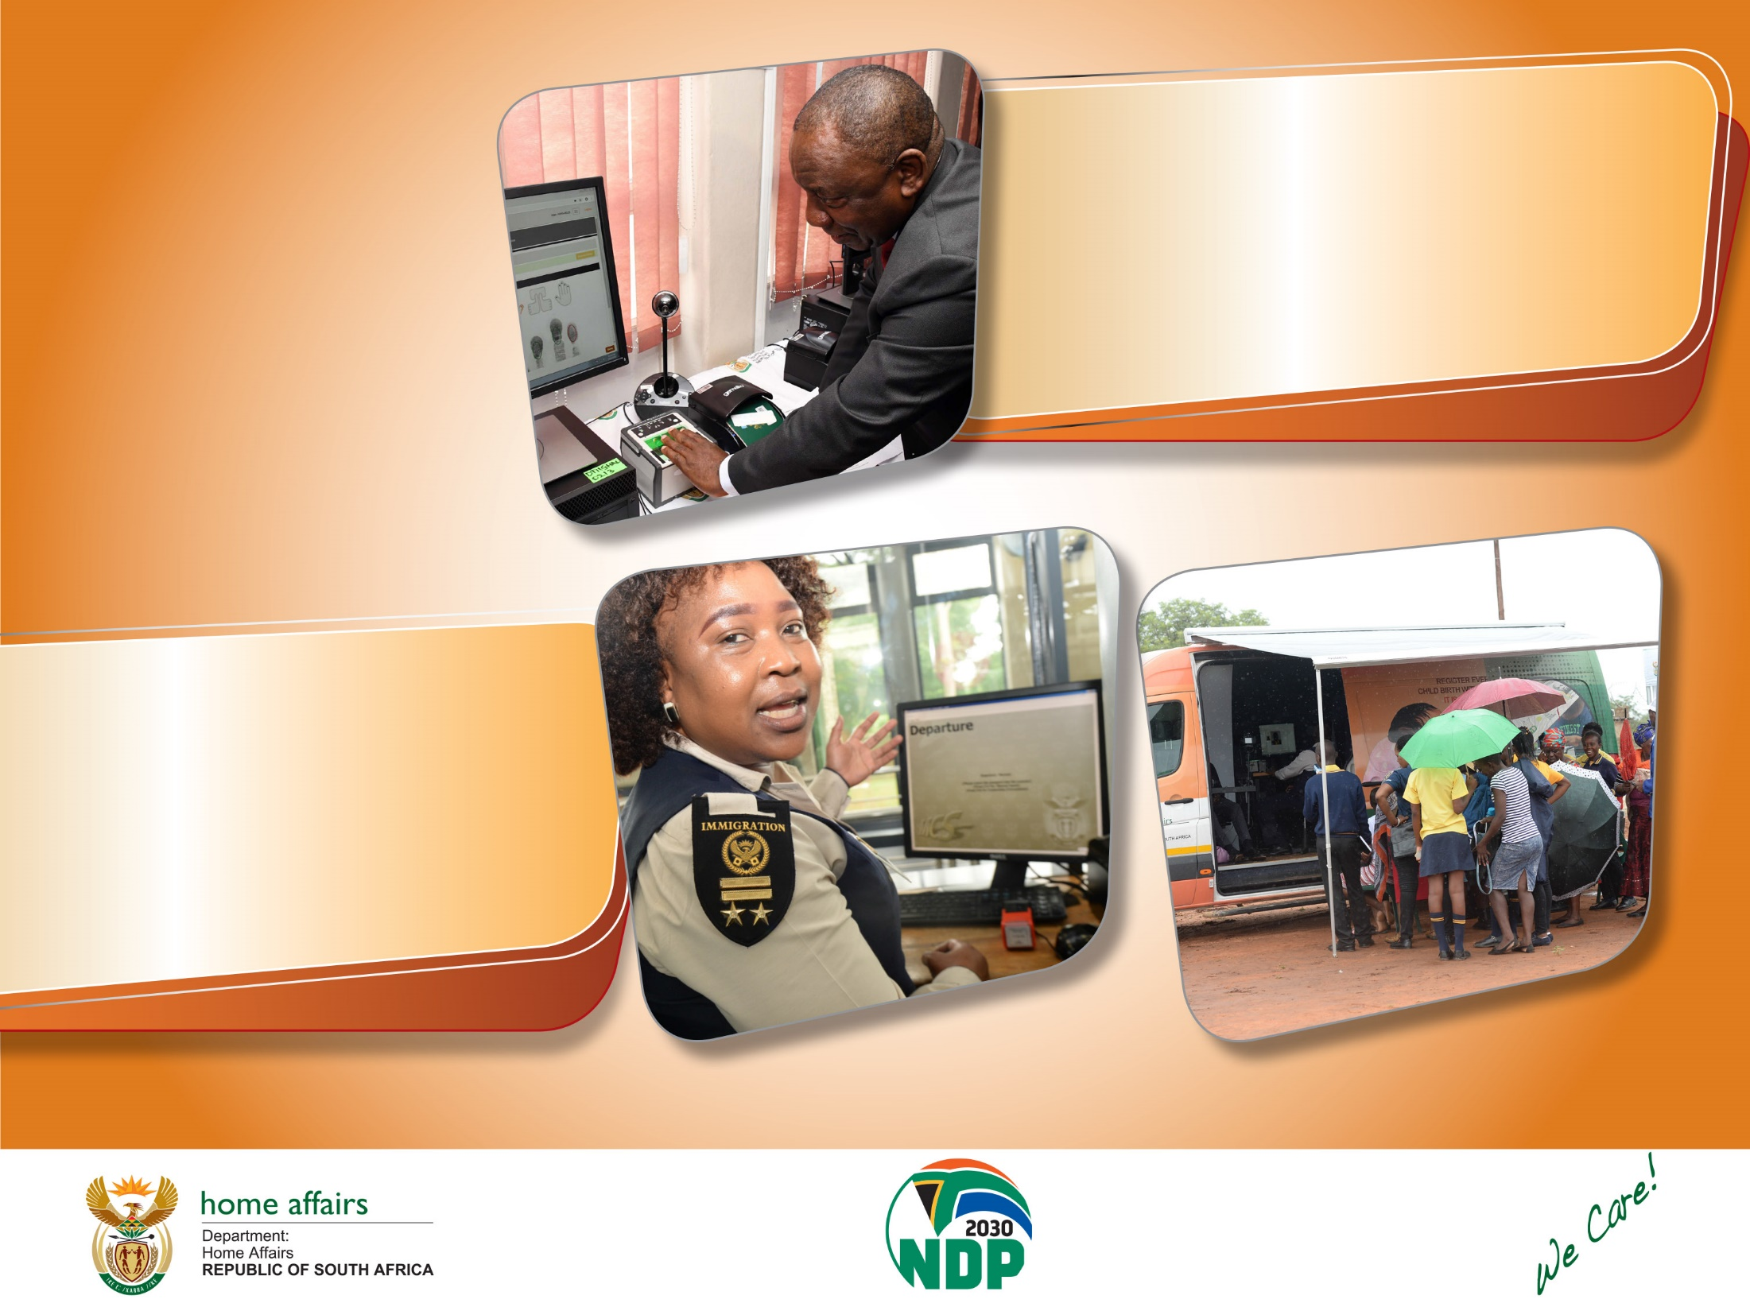
Status of Department Home Affairs:
Western Cape Province
Presented to: WC Parliament
Presented by: A/Provincial Manager: WC Mr. Ricardo Abrams
Date: 3 March 2023

Slide 2
Content
Provincial Overview
Geographical layout of the Province
High level overview of Western Cape Province: access to clients
Governance Structure - Operations Managers Contact details
Alphabetical list of Front Offices and classification
Current developments – footprint expansion
Operating Hours
Mobile Units
War on Queues
1) Basic Appointment Booking System (BABS)
2) Queue Management practices
Service delivery initiatives:
1) Schools Project
2) Assistance to fire victims – Du Noon, Khayelithsa, Masiphumelele, Philippi
3) West Coast High Impact outreach Program 20 – 24 February 2023
Provincial Performance in relation to APP targets Q 3 - 2022/2023
1) Summary DHA WC Provincial Performance Q3 2022/2023
2) Performance Immigration Targets : APP & AOP Level

Slide 3
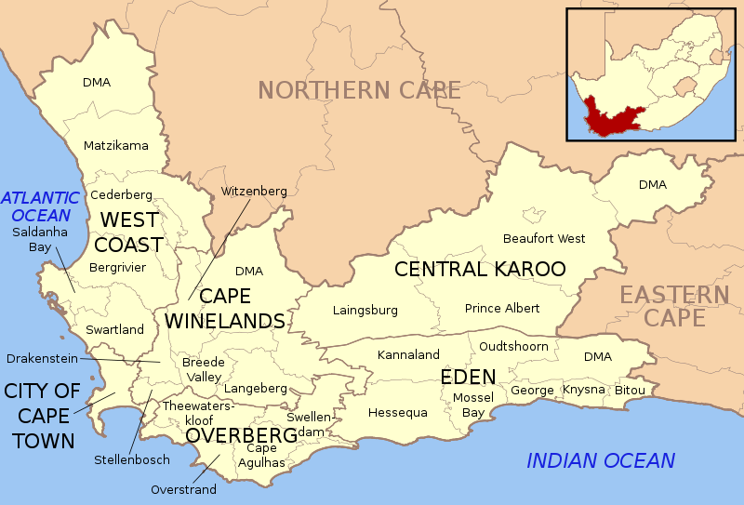
1) GEOGRAPHICAL OUTLAY OF WESTERN CAPE PROVINCE
1x Metro: City of Cape Town, 5 x District Municipalities (West Coast, Cape Winelands, Central Karoo, Overberg, Garden Route) Reporting to Head Office: PoE : 3 x Sea Ports: Cape Town, Saldanha, Mosselbay, 1 x International Airport – Cape Town (National key point), Refugee Centre

Slide 4
2) HIGH LEVEL SUMMARY: FOOTPRINT AND ACCESS TO CLIENTS
Available | Comments
28 x Front Offices within 5 Districts and 1 Metro 1 x permanent contact point – Ladismith 14 x Connected Health Facilities 4 x Banks - Standard Bank Canal Walk, FNB Greenpoint, STD Prominade, Nedbank St Georges Mall. 13 x Mobile Units (1x recoded for disposal, 4x Cape Metro, 2x Cape Winelands, 2x Central Karoo, 2x Garden Route, 1x Overberg, 1x West Coast. 1 x Provincial Office (sharing space with Cape Town Large Office) Provincial Archive Facility established at Bellville Office | 25 x Modernised Front Offices (11 urban, 14 rural) - 89% modernized Citrusdal Offices due for modernization in Q4 2022/2023 Swellendam- and Laingsburg Offices floor space to small for Modernization (Mobile Unit enabled with the Modernization system - stationary next to Laingsburg Office) ABSA Bank – due for activation in May 2023 All Front Offices are equipped with generators – which are adversely affected by continued load shedding

Slide 5
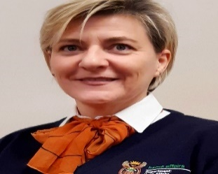
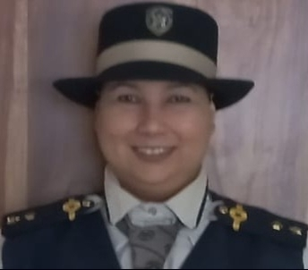
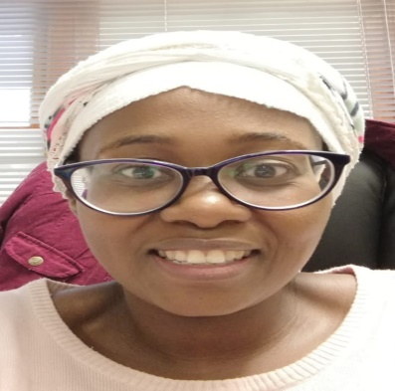
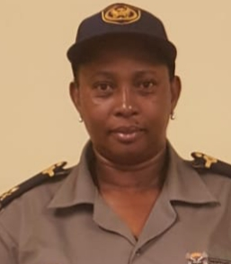
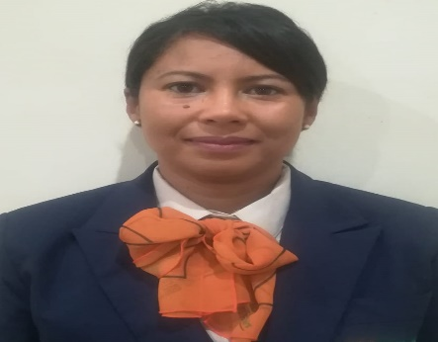
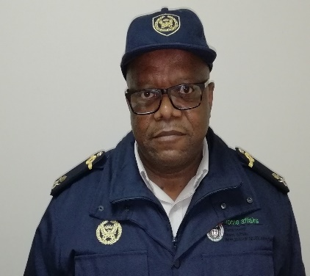
3) Western Cape Management Structure March 2023
A/Provincial Manager: WC Mr. R Abrams
Provincial Coordinator Ms. A van der Berg
Provincial IMS Operations Coordinator (AOP) Ms. R Valentine
Director Finance & Support: Ms. R Tlou
DMO: Cape Metro and Overberg: Ms B Sakawuli
DMO: Cape Winelands & West Coast: Ms. I Michaels
DMO: Central Karoo & Garden Route : Dr M Ngaka

Slide 6
Western Cape Management Structure continued
DMO: Cape Metro and Overberg: Ms B Sakawuli
DMO: Cape Winelands & West Coast: Ms I Michaels
DMO: Central Karoo & Garden Route : Dr M Ngaka
Cape Metro:
Cape Town Large Office
Bellville Medium Office
Wynberg Medium Office
Nyanga Medium Office
Khayelithsa Large Office
3 x Bank: STD Canal Walk, FNB Green point, Nedbank St Georges Mall
Overberg:
Caledon Medium Office
Bredasdorp TSC
Grabouw Small Office
Swellendam TSC
5 x Mobile Units
Cape Winelands:
Paarl Large Office
Somerset West Medium Office
Mitchells Plain Office
Worcester Medium Office
Ceres TSC
Robertson TSC
Stellenbosch Medium Office
1x Bank- Prominade Mitchells Plain
West Coast :
Vredendal Medium Office
Malmesbury Medium Office
Vredenburg Small Office
Citrusdal Small Office
Atlantis TSC
3 x Mobile Units
Garden Route :
George Large Office
Mosselbay TSC
Plettenbergbay TSC
Oudtshoorn Medium Office
Ladismith Service Point
Central Karoo:
Beaufort West TSC
Prince Albert Small Office
Laingsburg Small Office
4 x Mobile Units

Slide 7
Western Cape Operations Management Contact details
Area | Manager | Cell phone number | E-mail Address
A/ Provincial Manager | Mr Ricardo Abrams | 0828082788 | Ricardo.Abrams@dha.gov.za
District Manager Cape Metro & Overberg District | Ms. Bongiwe Sakawuli | 0664784060 | Bongiwe.Sakawuli@dha.gov.za
District Manager: Cape Winelands & West Coast | Ms. Irmgard Michaels | 060 982 1087 | Irmgard.Michaels@dha.gov.za
District Manager Garden Route & Central Karoo | Dr. Mosiuoa Ngaka | 072 6215 047 | Mosiuoa.Ngaka@dha.gov.za
Director Finance and Support | Ms. R Tlou | 0664784046 | Rorisang.Tlou@dha.gov.za
Deputy Director : Counter Corruption | Mr. E Bosch | 0788011094 | Estain.Bosch@dha.gov.za
Provincial Co-ordination & M&E | Ms. Almien van der Berg | 072 6214 102 | Almien.vanderberg@dha.gov.za
IMS Provincial Coordinator APP, OPS, JOINT OPS, Transfers to Lindela | Ms. Rencia Valentine | 0663058826 | Rencia.Valentine@dha.gov.,za
Notes:
7

Slide 8
4) Alphabetical list of WC Offices and classification
SERVICE POINT NAME | CLASIFICATION | CLIENT VOLUME | LOCAL MUNICIPALITY NAME | URBAN / RURAL | OFFICE - STREET ADDRESS
ATLANTIS/ HARTEBEESKRAAL | Small | High | City of Cape Town MM | URBAN | Mpcc Hartebeeskraal, 1 Notthingham Street, Atlantis
BEAUFORT WEST | Medium | Medium | Beaufort West LM | RURAL | 3 De Vries Street, Thusong Centre, Beaufort West, 6970
BELLVILLE | Large | High | City of Cape Town MM | URBAN | Old ABSA Bank Building, Voortrekker Road, Bellville,7530
BREDASDORP | Small | Medium | Cape Agulhas LM | RURAL | 109 Park Street, Bredasdorp
CALEDON | Medium | High | Theewaterskloof LM | RURAL | 11 Haw Street, Caledon
CAPE TOWN | Large | High | City of Cape Town MM | URBAN | Faircape Buiding, 56 Barrack Street, Cape Town
CERES | Small | Medium | Witzenberg LM | RURAL | Panorama Street, Bellavista, Ceres, Erf no: 2628
GEORGE | Large | High | George LM | URBAN | 109 York Street , Telkom Building ,George 6530
GRABOUW | Small | High | Theewaterskloof LM | RURAL | Old Traffic Department, Grabouw 7160
KHAYELITSHA | Large | High | City of Cape Town MM | URBAN | C/O Tsolo And Mzala Street, Khayelitsha, 7793
LAINGSBURG | Small (Legacy Office) | Low | Laingsburg LM | RURAL | Cnr Main & 3Rd Avenue, Goldnerville Laingsburg
MALMESBURY | Medium | High | Swartland LM | URBAN | 4 St Thomas Street, Malmesbury, 7300
MITCHELL'S PLAIN | Medium | High | City of Cape Town MM | URBAN | 1 Alpha Street ,Beacon Valley,Mitchell'S Plain
MOSSEL BAY | Medium | High | Mossel Bay LM | RURAL | Thusong Service Centre, 108 Adriaans Street, KwaNonqaba, Mossel Bay

Slide 9
Alphabetical list of WC Offices and classification continued
SERVICE POINT NAME | CLASIFICATION | CLIENT VOLUME | LOCAL MUNICIPALITY NAME | URBAN / RURAL | OFFICE - STREET ADDRESS
NYANGA (NONTSUMPA) | Medium | High | City of Cape Town | URBAN | C/O New Eisleben & Miller Street, Crossroads, 7755
OUDTSHOORN | Medium | High | Oudtshoorn LM | RURAL | 73 Dassie Road, Bridgton, Oudtshoorn, 6625
PAARL | Large | High | Drakenstein LM | URBAN | 39 Castle Street, Paarl
PRINCE ALBERT | Small | Low | Prince Albert LM | RURAL | Adderley Street 1, Prince Albert, 6930
ROBERTSON | Small | Medium | Breede River/Winelands LM | RURAL | 40 Paddy Street, Robertson Thusong Centre, Robertson
SIMUNYE (PLETTENBERG BAY) | Small | High | Bitou LM | RURAL | Xipula Street,Kwanokuthula,Plettenbergbay
SOMERSET WEST | Medium | High | City of Cape Town MM | URBAN | Department of Labour building, 117 main Road, Somerset West, 7130
STELLENBOSCH | Medium | High | Stellenbosch LM | URBAN | C/O Ryneveld And Jan Cilliers Street. Stellenbosch
SWELLENDAM | Small (Legacy Office) | Low | Swellendam LM | RURAL | 01 Vollenhoven Street, Railton, Swallendam
VICKY ZIMI (CITRUS DAL) | Small | Low | Cederberg LM | RURAL | Vicky Zimri Thusong Centre,Bohemia Street, 7340
VREDENBURG | Small | High | Saldanha Bay LM | RURAL | Main Road, Vredenburg
VREDENDAL | Medium | Medium | Matzikama LM | RURAL | C/o Hoerskool and Bult Street, Vredendal Thusong Centre, 8160
WORCESTER | Medium | High | Breede Valley LM | URBAN | 71-73 Adderley Street Worcester 6850
WYNBERG | Medium | High | City of Cape Town MM | URBAN | Maynard Mall, Level 2, 70 Main Road, Wynberg, 7824

Slide 10
5) CURRENT DEVELOPMENTS 2022/2023 FY
Epping Home Affairs – E-Online Booking Office
Office space was refurbished at Epping site – for the establishment of the E-online Office
100% booking office – no walk ins will be accommodated
100% cashless Office – clients must pay online or with bank cards – no CIT services will be rendered
New concept for taking photos being piloted
Envisaged for the pilot Office will go live by mid March 2023
Official launch of the E-Online Booking Office will co-inside with the launch of the Refugee Reception Centre at the same premises

Slide 11
6) Offices Operating Hours
Working Hours – Staff
Mondays to Fridays from 07h30 – 16h00
Operating Hours:
Mondays to Fridays 08h00 until 15h30
Note: Staff meetings on the last Wednesday of every month –offices opening for clients at 09h00

Slide 12
7) WC Mobile Units: Service Areas
DHA WC has 13 Mobile Units of which 1 were recoded for disposal
10 x New Mobile Units are in the process of being procured for the 2023/2024 FY which will be allocated as per service delivery demand i.e. 1x Worcester, 3 x Malmesbury, 1x Vredendal, 1x Vredenburg, 2x Oudtshoorn, 1x George, 1x Paarl
Mobile Unit Interties are drafted monthly and circulated to stakeholders via the Directorate Mobile Units
No. | DISTRICT | OFFICE STATIONED | REGISTRATION NUMBER | COMMENT | AREA OF SERVICE
1 | Cape Metro | Wynberg | CA 565 113 | Fully operational | Schools Project Special requests – old aged homes etc.
2 | Cape Metro | Cape Town | CA 565 845 | Not operational – electrical issue
3 | Cape Metro | Cape Town | CA 565 969 | Not operational – power supply issue
4 | Cape Metro | Nyanga | HL 04 LS GP | Fully operational | Schools Project Special requests – old aged homes etc.
5 | Cape Metro | Khayelitsha | CA 565 599 | Up for disposal

Slide 13
WC Mobile Units: Service Areas
No | DISTRICT | OFFICE STATIONED | REGISTRATION NUMBER | COMMENTS | AREASOF SERVICE
6 | Overberg | Caledon | CAA413722 | Fully operational | Schools Project Hermanus, Zwelitsha,
7 | Central Karoo | Beaufort West | JB14NYGP | No driver – Acting Capacity Operational | Schools Project Merweville, Leeugamka, Murraysburg, Mantjiesfontein, Nelspoort, Klaarstroom
8 | Central Karoo | Laingsburg | CA565561 | No driver – Acting Capacity | Stationary next to Laingsburg Office
9 | Garden Route | Oudtshoorn | JB14PDGP | Newly appointed driver will assume duty on 1 April 2023 | Schools Project Vanwyksdorp, Ladismit, Calitsdorp, Zoar, Dysselsdoprp, De Rust, Uniondale, Avontuur, Haarlem and Noll.
10 | Garden Route | George | HV64WXGP | No driver - Acting Capacity Operational | Schools Project Riversdale, Hurbertsdale, Slangrivier, Stillbay, Gouwritzmond, Heidelberg, Hoekwil, Karatara, Sedgefield, Rendendal, Albertinia, Grootbrak.
11 | Cape Winelands | Paarl | CAA38739 | Fully operational | Schools Project Saron, Gouda, Bossman Farm
12 | Cape Winelands | Robertson | CA 565152 | Fully operational | Schools Project Bonnievale, Montagu, De Doorns, Ashton, Mcgregor
13 | West Coast | Malmesbury | HV64VXGP | Fully operational | Schools Project Diazville, Hopefield, Clanwilliam

Slide 14
CLIENT CARE & WAR ON QUEUES

Slide 15
1) QUEUE MANAGEMENT PRACTICES: BASIC APPOINTMENT BOOKING SYSTEM (BABS)
BASIC APPOINTMENT BOOKING SYSTEM (BABS)
25 Modernized offices enabled with BABS – pilot phase
Offices currently using a hybrid between BABS clients and walk ins – envisaged to move to 100% booking capacity at high volume offices i.e. Cape Town, Bellville and Wynberg Offices, once the pilot phase concluded
System geared for making appointments for Smart ID Cards and passport applications only
6 x High volume offices issued with tablets to assist walk-in clients with bookings
IMPACT:
Load shedding/ system downtimes – extremely negative impact on Front Offices ability to serve BABS clients and walk ins
Less than 65% of BABS clients turn out for booked appointment slots

Slide 16
2) DHA QUEUE MANAGEMENT PRACTICES: Walk-in clients
Strategies to assist walk-in clients effectively:
Queues categories into:
Smart card and passport applications,
Smart card and passport collections,
Legacy system applications (Birth-, Death- registration, Temporary ID Certificates)
Prioritize client categories: Elderly, physically challenged persons, pregnant mothers, mothers with infants
Scholars with uniform accompanied by parents are prioritized in the morning
Compulsory for office managers to engage clients prior to office opening and visit front office areas every 2 hours to interact with clients
Floorwalkers direct clients and communicate approximate waiting times to clients inside of the office
Managers are required to continuously communicate to clients when high volumes are experienced and redirecting of clients
Plastic chairs provided to clients waiting in queues outside offices

Slide 17
SERVICE DELIVERY INITIATIVES

Slide 18
1) WC Schools Project 2022/2023
During April 2022 – the WC Department of Basic Education was requested to provide the Department with a list of learners without ID documents.
The list comprised of 4552 (including non SACs) Grade 12 learners on CEMIS without ID numbers
The list was circulated amongst the 5 District Managers within the Province on 14 April 2022.
Mobile Unit programs were dedicated to service schools from May – September 2022
In September 2022, during a meeting with Mr Alan Meyer (HOD WC DoBE) a partnership was forged in which the following commitments were made:
WC DoBE to:
assist the DHA with access to Schools/ facilities, mobilising of learners and parents,
marketing/ communicating requirements for ID Smart Card applications (first and re-issues).
Ground level partnerships and collaboration between District Managers
DHA to:
Prioritize learners in uniform reporting to Front Office in the morning

Slide 19
WC Schools Project 2022/2023 - continued
Contact details of Office Managers, District Manager and Coordinators was shared to forge and strengthen working relationships at local front office level.
It should also be noted that some schools i.e. Boys High, Paarl Gym etc. prefer not to disrupt learning with the deployment of Mobile Office to schools, hence arranges was made with Local Offices to receive batches of learners to be serviced prior to official Front Office opening time – arrangements for the 2023 Matric Learners are now in process
Since April 2022 total number of:
4963 First ID Smart Card applications taken in at schools through Mobile Office Programme
and 3448 First ID Smart Card applications were taken in at Front Offices in respect of Learners.

Slide 20
2) ASSISTANCE TO VICTIMS OF DISASTERS
The Department makes provision for the waiving of application fees for enabling documents for persons who lost their enabling documents due to a natural and/ or fire disasters.
Disaster Management Incident Reports are obtained with the details listing of beneficiaries.
The assistance of the DLG are solicited to support the fire victims with free photographs
Once approval for the waving of application fees were granted Mobile Units will plan in collaborating with local ward Cllr for deployment.
Recent fire disasters: Q3 & Q4 2022/2023 FY - the following communities were assisted:
Area | Date of Fire incident | No of informal structures destroyed | Total number of fire victims | No of victims attending venues for assistance
Phola Park, Philippi | 01, 02 January 2023 | 283 | 584 | 452
Du Noon | 30-Dec-22 | 106 | 239 | 86
Khayelithsa | 07-Jan-23 | 81 | 192 | 51
Masiphumelele | 01-Dec-22 | 375 | 1014 | 295
 |  | 845 | 2029 | 884

Slide 21
3) West Coast High Impact Outreach Program: 20 – 25 February 2023
The West Coast District Municipality was identified to host the DHA High Impact Outreach programme for 2022/2023 FY.
The HIOP was executed from 20 – 24 February 2023 with the dry run on Sunday 19 February 2023 in Piketberg where teams were welcomed by the District Speaker Mr. Swartz and DMOs Ms. Michaels
Additional venues were secured to service the Bergrivier Local Municipality where no DHA access points are available to the local community
Fifteen (15) Mobile Units (3x GP, 2x EC, 1x NC, 1x FS and 8x WC) were deployed to service the District for a period of 5 days
27 Venues were attended while Piketberg and Porterville had Mobile Units for 5 consecutive days providing for a total of 41 access points in the West Coast District for the duration of the week.
3 x District IT managers were deployed to support Mobile Units with IT related issues
Central accommodation for 36 Civic Service staff members and 6 Immigration Officers was procured in Lamberts Bay and Citrusdal area
DMO and Office Managers of Malmesbury- and Vredendal Offices were roaming between venues for the delivery of enabling documents and to do Late Registration of Birth interviews.
3 x Immigration law enforcement operations were planned for execution on 22 February and 24 February 2023

Slide 22
West Coast High Impact Outreach Program: 20 – 25 February 2023 - continued
Performance : Civic Services
 | SIDC 1st issue (16 years +) | SIDC re-issue 60 Years + | SIDC re-issues payable | Passport | Birth registration < 30 days | Birth registration 31 to 1 year | Birth registration 1 year to 7 | Birth registration 7 years to 16 | BMD re-print
Day 1 | 138 | 168 | 189 | 10 | 14 | 15 | 3 | 0 | 52
Day 2 | 66 | 93 | 17 | 2 | 11 | 11 | 2 | 0 | 33
Day 3 | 215 | 306 | 144 | 5 | 17 | 16 | 13 | 2 | 47
Day 4 | 282 | 245 | 234 | 17 | 14 | 12 | 5 | 0 | 72
Day 5 | 179 | 208 | 204 | 9 | 26 | 19 | 0 | 0 | 81
Total | 880 | 1020 | 788 | 43 | 82 | 73 | 23 | 2 | 285
In total 2688 ID Smart Card applications were taken in during the Program

Slide 23
West Coast High Impact Outreach Program: 20 – 25 February 2023- continued
Performance : Immigration Services
Two Immigration Law Enforcement Operations executed within the Bergrivier Local Municipality :
1) In loco inspection of the Sandvliet Farm on 22 February 2023 :
18 undocumented foreigners were detained for deportation and
employer charged for contravening Sec 38 of the Immigration Act, Act 13 of 2002.
NOTE: The planned operation at Caladonia Farm could not be executed due to the lack of detention facilities at the Piketberg SAPS
2) In loco law enforcement inspection of spaza shops in the Piketberg township on 24 February 2023
3 undocumented foreigners detained for deportation

Slide 24
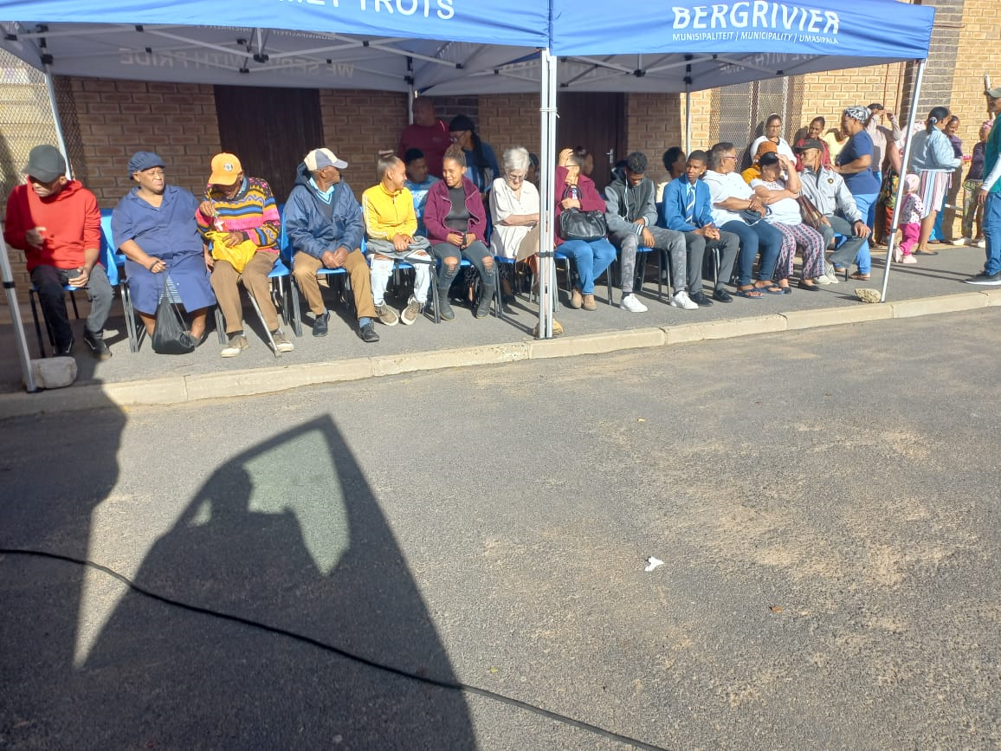
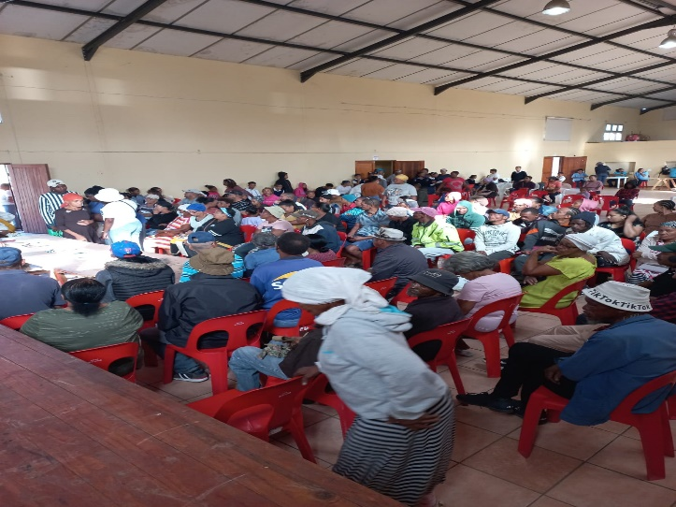
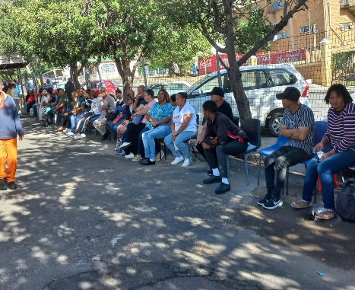
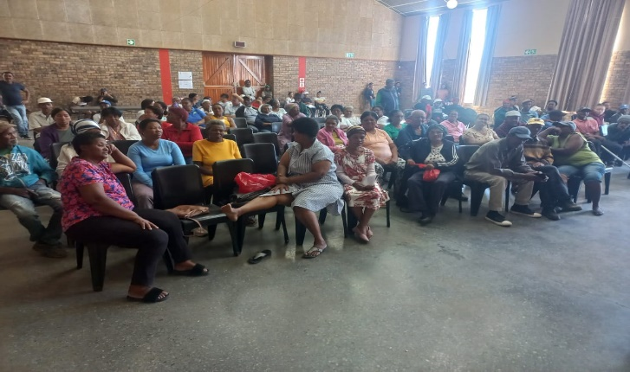
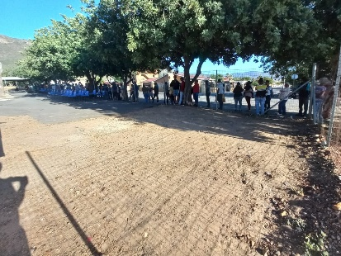
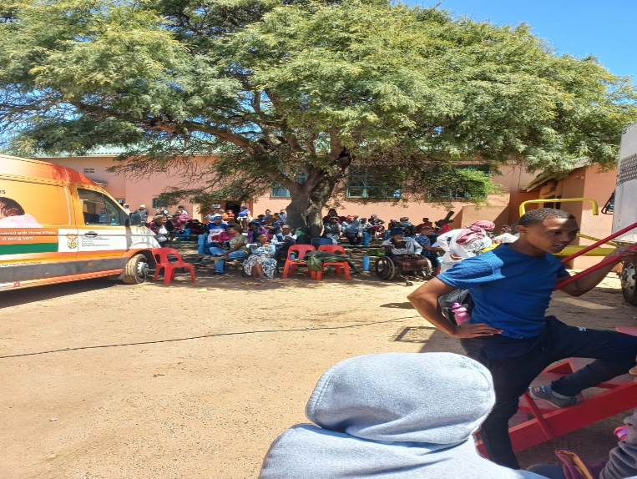
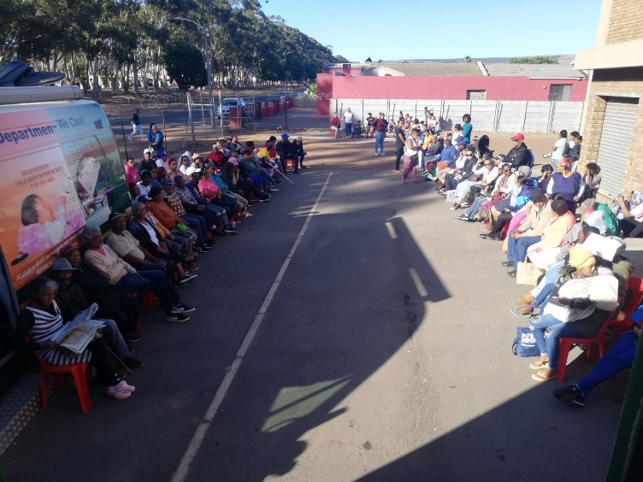
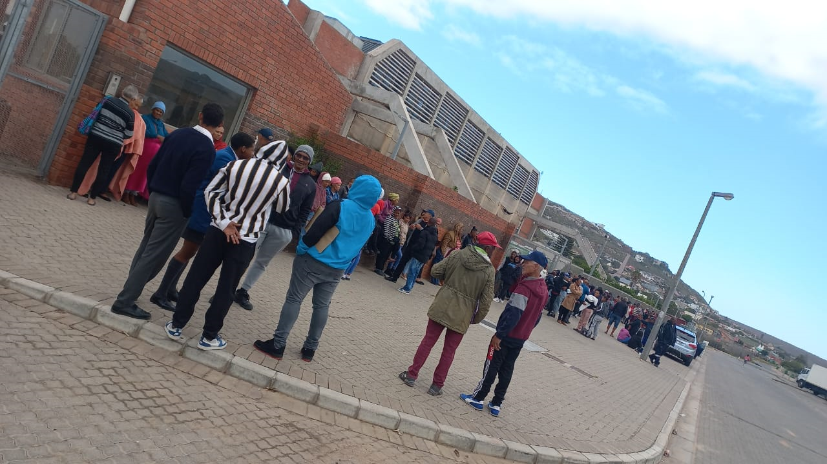
West Coast High Impact Outreach Programme - continued
Piketberg : Allan Boesak Community Hall
Clanwilliam Community Hall
Porterville N Otto Community Hall
Saldanha TSC
Lamberts Bay day 2
Darling Community Hall

Slide 25
West Coast High Impact Outreach Program: 20 – 25 February 2023 – continued
Way forward:
Look at predictable service delivery points in major towns within the West Coast District
Explore the possibility of expanding DHA footprint in the Bergrivier Local Municipality
Increase Mobile Units with 3 additional Mobile Offices in the West Coast in the 2023/2024 FY

Slide 26
4) APP and AOP Performance

Slide 27
1) Summary WC Provincial Performance Targets : Q3
Review Period | Total Quarterly Targets | Achieved | Not Achieved | % Achievement
Q1 | 10 | 8 | 2 | 80%
Q2 | 10 | 8 | 2 | 80%
Q3 | 10 | 9 | 1 | 90%
APP/ AOP | Target | Q1 Performance | Q2 Performance | Q 3 Performance
APP | Birth Registration | Achieved | Not achieved | Achieved
 | Smart ID Cards issued (received at offices) to citizens | Achieved | Achieved | Achieved
 | Payment of Invoices within 30 days | Not achieved | Achieved | Achieved
 | Law enforcement Inspections (NAT 33) | Achieved | Achieved | Achieved
AOP | 70% of Deaths Registered within 72 hours | Not achieved | Not achieved | Not achieved
 | 100% Of detected employers in contravention of the Immigration Act (Act 13 of 2002) charged, | Achieved | Achieved | Achieved
 | 100% Of detected transgressors in contravention of the Immigration Act (Act 13 of 2002) charged, | Achieved | Achieved | Achieved
 | 100% Of direct deportations concluded within 30 calendar days, | Achieved | Achieved | Achieved
 | 100% Of transfers to Lindela concluded within 20 calendar days, | Achieved | Achieved | Achieved
 | 80% of Detected fraudulent marriages & marriage of convenience cases finalized. | Achieved | Achieved | Achieved

Slide 28
2 ) Provincial Performance Immigration Targets : APP & AOP LEVEL
ANNUAL PERFORMANCE PLAN (NAT 33) | AP Q1 | AP Q2 | AP Q3 | TOTAL
33 x Law Enforcement Inspections conducted Business Sectors: Farming = 2 Road blocks = 2 Manufacturers/Wholesalers = 3 Transport/ Logistics = 4 Construction = 2 Hospitability = 17 Mining Industry = 1 General dealers/ supermarkets = 14 Scrap metal/car dealers = 5 | 11 | 23 | 16 | 50

Slide 29
Provincial Performance Immigration Targets : APP & AOP LEVEL
ANNUAL OPERATIONAL PLAN : | AP Q1 | AP Q2 | AP Q3 | TOTAL
Employers charged in contravention of the immigration act (act 13 of 2002) charged | 18 | 18 | 13 | 49
Detected transgressors in contravention of the immigration act (act 13 of 2002) charged | 391 | 459 | 592 | 1442
Direct deportations concluded within 30 calendar days | 39 | 9 | 12 | 60
Transfers to Lindela Holding Facility concluded within 20 calendar days | 97 | 133 | 232 | 462
Detected fraudulent marriages & marriage of convenience cases finalised (investigation and recommendation submitted) within 60 days | 30 | 51 | 13 | 94

Slide 30
Questions

Slide 31
Ndo livhuwa
Ndiyabulela
Ke a leboga
Thank you
Dankie
Inkomu
Ke a leboha
Ngiyabonga

