Slide 1
NETBALL WORLD CUP 2023 STATUS UPDATE

Slide 2
PURPOSE
To highlight the achievements of activities to date.
To provide progress on State of Readiness from October 2022 to date, towards hosting the Netball World 2023.

Slide 3
VNWC2023 LOCAL ORGANIZING COMMITTEE
Tournament Director
Ms. Priscilla Masisi
Executive PA
Ms Akhona Dotwana
Head of Operations
Ms Portia Dimu
Head of Marketing
Mr Bronson Mokabela
Head of Technical
Ms Magriet Bester
Accreditation Manager
Mr. Shiraz Moosa
Safeguard Manager
Ms. Malebo Raditladi
Safety and Security Manager
Mr Yasser Splinters
Team Liaison Manager
Ms. Marchelle Maroun
Legacy Manager
Ms. Annelie Lucas
Head of Finance
Acting Mr. Thabang Moses
Manager Finance, Admin and Procurement
Mr Thabang Moses
Legal Affair Manager
Ms Monique Grimwood
Accommodation and Travel
Ms Natalie Olliefant
Volunteer Manager
Mr Hlalefang Belebesi

Slide 4
ACHIEVEMENTS TO DATE
Launch of Vitality NWC2023 logo
Launch of Telkom VNWC2023 activation campaign
VNWC2023 announcement of umpires (17), UAP’s (6), Technical Officials (12) and Statisticians (14)
200 Days to go
Second phase of tickets sales went live on 10 February 2023
Competition schedule (fixture) is finalized and shared with the teams.
Ticket order form submitted to teams
The following plans forwarded to World Netball:
8.1 Medical plan submitted to World Netball
8.2 Accreditation plan submitted to World
8.3 Congress and candle lighting concept plans.
VNWC2023 Bib launch
Just under 10 000 volunteer applications – closing date 15 February 2023

Slide 5
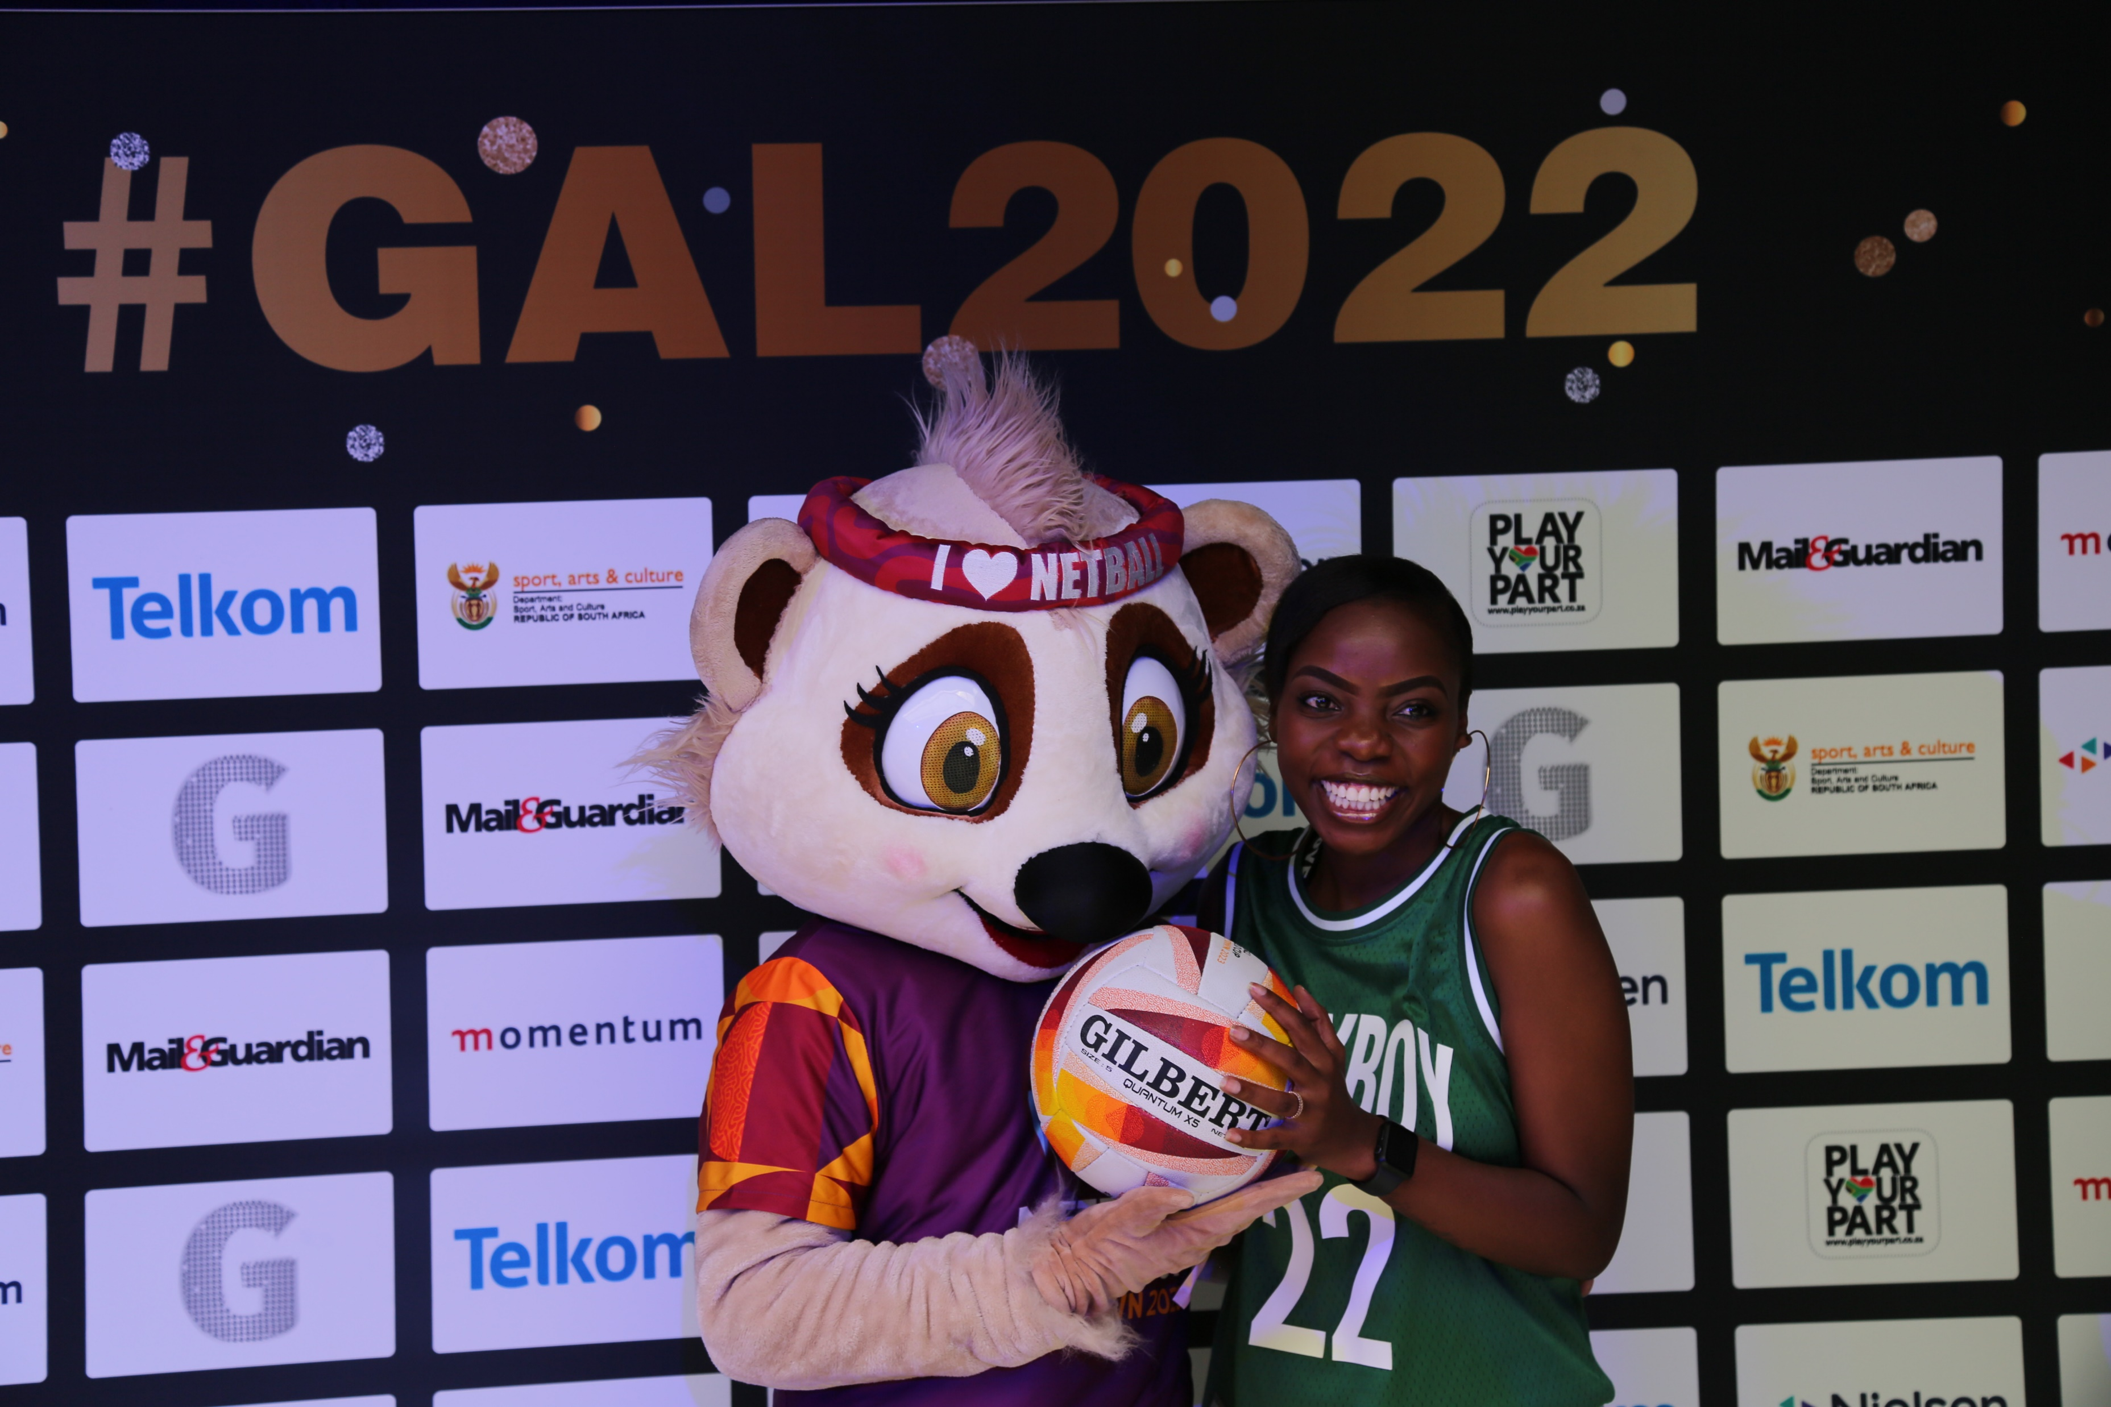
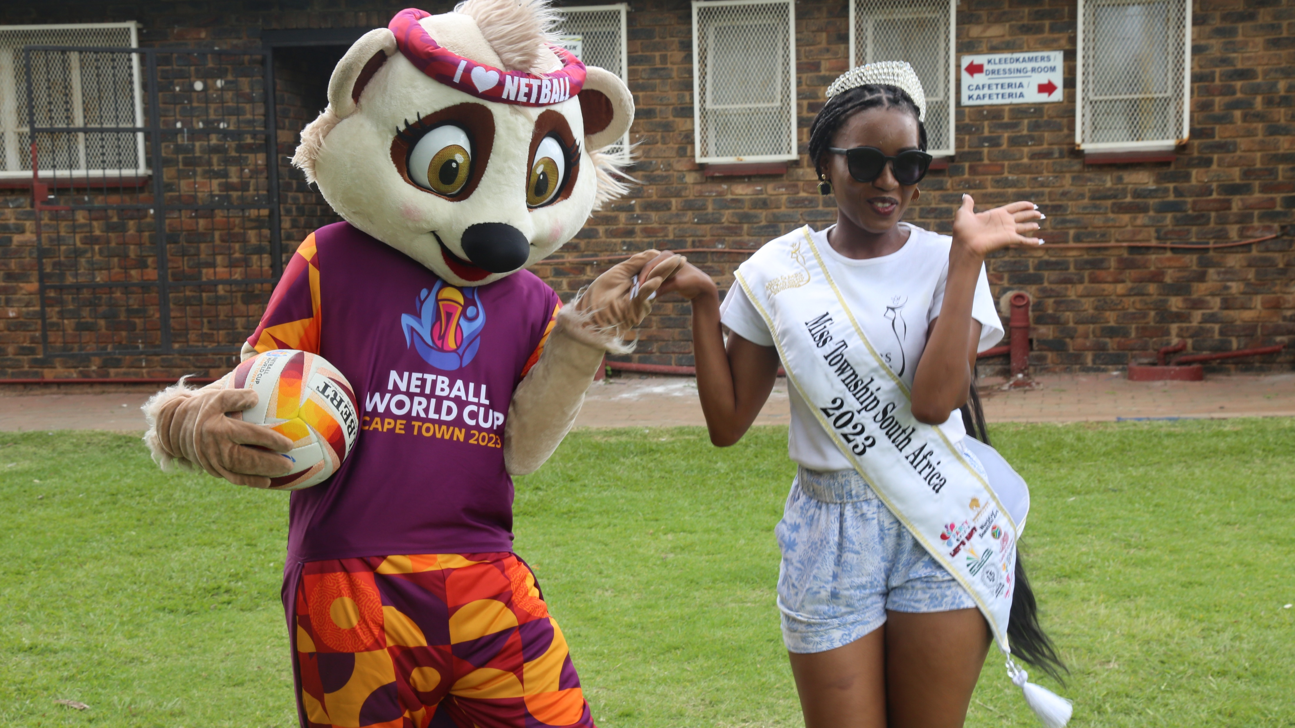
ACHIEVEMENTS TO DATE
Launch of NWC2023 logo
Broadcast partner launch (SuperSport, SABC and Telkom1)
One (1) year to go celebration
Ball Launch (Gilbert)
Count down clocks
Mascot reveal
Sponsorship Launch
Final Draw
Ticket sales & Tour Packages
NWC2023 Teams confirmed
Match Schedule Published
Team Information circulated to participating teams

Slide 6
HASHTAGS

Slide 7
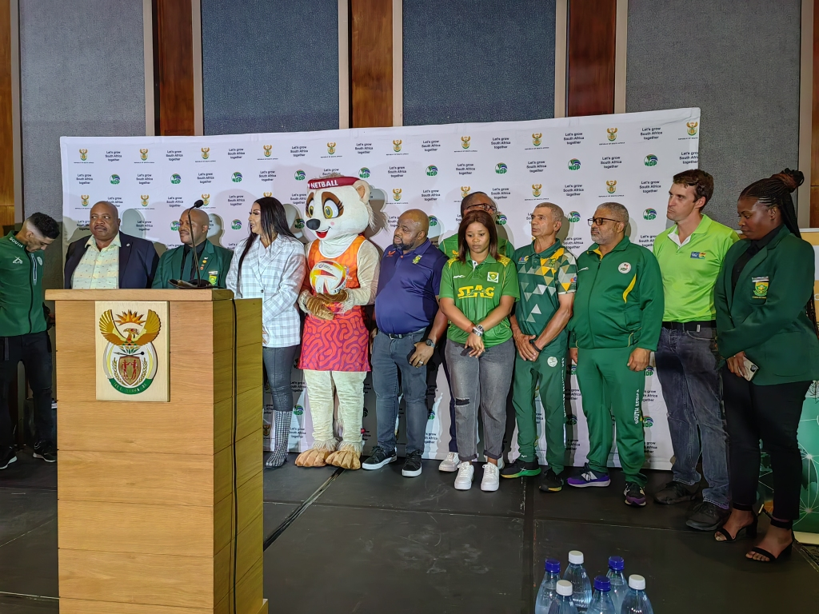
NWC2023 ACTIVATIONS TO DATE
ACTIVATIONS :
Pre Sona function (Cape Town)
Discovery Sponsorship launch (Gauteng)
Telkom VNWC2023 campaign (Gauteng)
Big Walk (Pretoria)
Nelson Mandela Remembrance Walk
School Sport Championships
National Netball Championships
Rugby sevens (Mascot Race)
Gauteng Marathon
Winnie Mandela Museum
Gauteng Community Games ( Holiday Programme)
G-Sport for Girls
Soweto Marathon
Quad Series meet and greet
MEDIA : TV and radio stations activations
Print and online newspapers
Media appearances
Media meet and greet
Social media ads on Facebook, Twitter & Instagram
Content marketing on Facebook, Twitter & Instagram

Slide 8
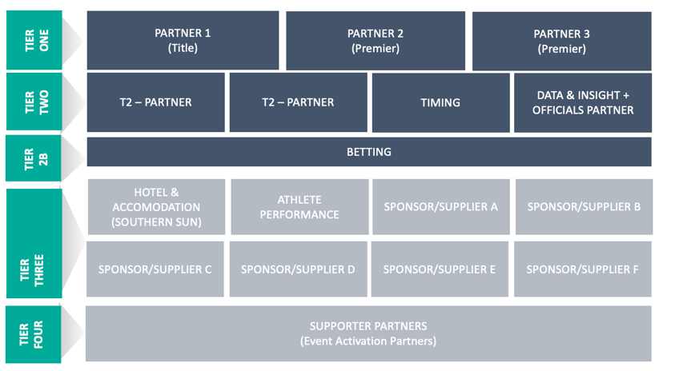
SPONSORSHIP
The commercial agencies have secured the tier one offers as follows:
1 x Global title sponsor ( Vitality)
2 x Premium partners (Telkom and SPAR) sponsor launch was conducted on the 28th November 2022.
Hotel Partner (Southern Sun)
Ball sponsor (Gilbert)

Slide 9
GLOBAL BROADCAST COVERAGE
Expected coverage in over 100 countries
South Africa
Sub-Saharan Africa
UK
Australia
New Zealand
Caribbean
Malaysia
FTA rights granted to qualified African Teams in their own country for own matches.
Available across World Netball’s OTT platform excluding countries where broadcast rights have been sold exclusively

Slide 10
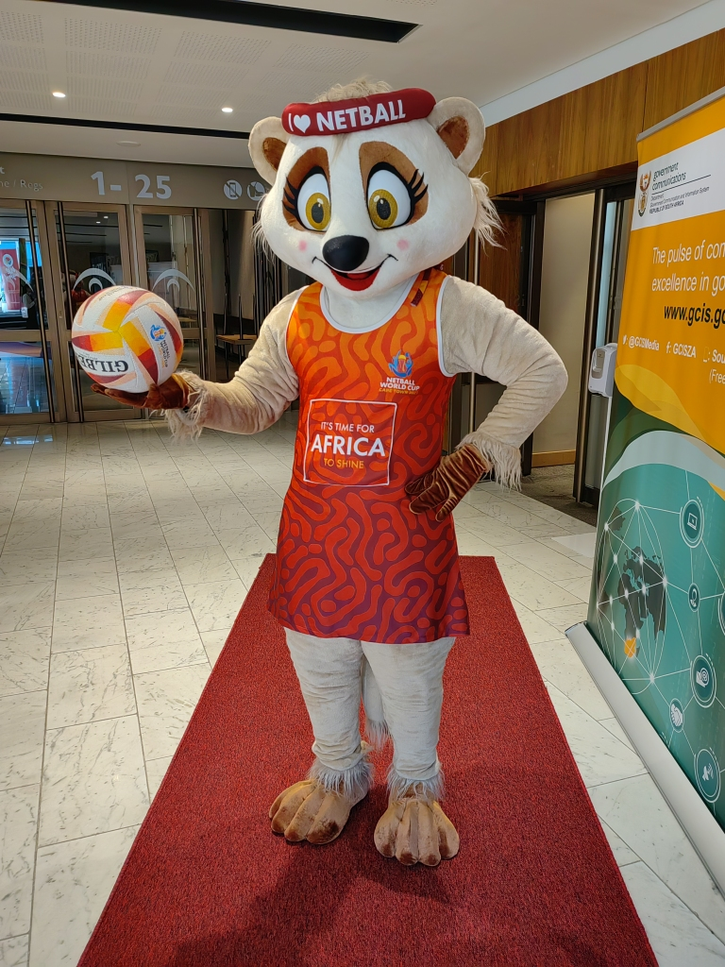
PENDING SPONSORSHIP
The following partnerships are to be concluded:
- ACSA
- Red Bull
- Sage
- Coca cola/PemBev
- Hyundai
- Mercedes
- Hollywoodbets

Slide 11
TRAINING VENUES
Pre-event the following venues will be the primary training facilities;
University of Cape Town ( 2 x indoors)
Cape Town Military Base (1 x indoor)
CTICC2 (2 x Indoor)
CTICC1 (1 x indoor)
All venues meet WN requirements – sprung wooden floors, sunken goal posts
All the teams will be provided with a venue orientation/surface training opportunity on match courts.

Slide 12
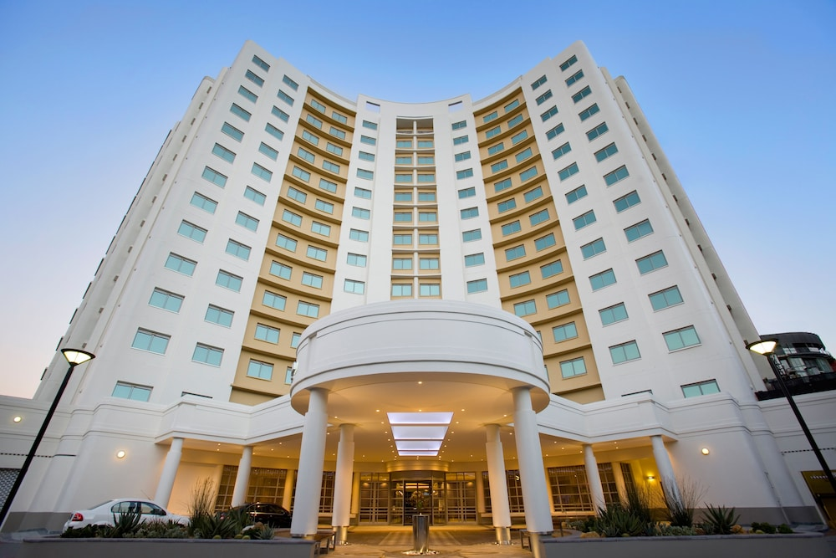
No. | Team | Comments
SOUTHERN SUN WATEFRONT
1. | Australia
2. | England
3. | New Zealand
4. | Scotland
5. | South Africa
6. | Tonga
7. | Wales
SUN SQUARE
1. | Jamaica
2. | Singapore
3. | Trinidad & Tobago
4.
STAY EASY, CITY BOWL
1 | Barbados
2. | Fiji
3. | Malawi
4. | Sri Lanka
TEAMS NOT CONFIRMED
1. | Uganda | No communication as yet
2. | Zimbabwe | No communication as yet
TEAMS ACCOMMODATION CONFIRMED

Slide 13
VNWC2023 UMPIRES APPOINTMENT PANEL (UAP)
Name | Surname | Country
Heather | Gleadall | England
Anne | Anne Abraitis | Scotland
David | Palaamo | New Zealand
Deborah | Lynch | Barbados
Marielouw | Van der Merwe | South Africa
Sharon | Kelly | Australia

Slide 14
VNWC2023 UMPIRES CONFIRMED
Name | Surname | Country
Allison | Harrison | Wales
Angela | Armstrong-Lush | New Zealand
Anso | Kemp | South Africa
Bronwen | Adams | Australia
Elizna | Van den Berg | South Africa
Gareth | Fowler | New Zealand
Gary | Burgess | England
Jemma | Cook | Australia
Joshua | Bowring | Australia
Kate | Mann | England
Kate | Stephenson | England
Ken | Metekingi | New Zealand
Kristie | Simpson | New Zealand
Louise | Travis | England
Tara | Warner | Australia
Terrence | Peart | Jamaica
Tracy-Ann | Griffiths | Jamaica

Slide 15
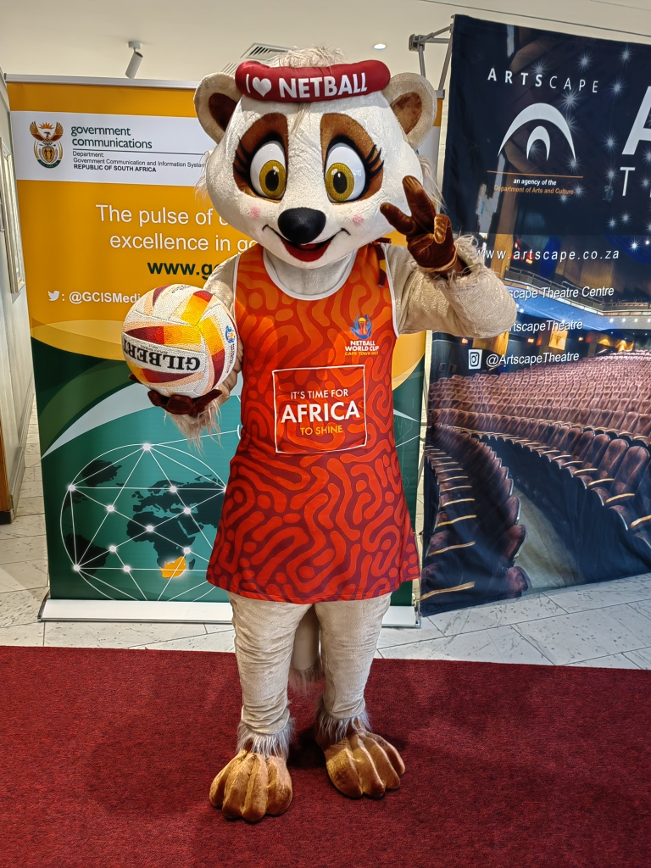
VNWC2023 STATISTICIANS
Name | Country
Lidia Eyssen | South Africa
Joseph Khanye | South Africa
Mario Stuart | South Africa
Anna Makallane | South Africa
Kelebogile Maplanka | Botswana
Pamela Mayangie | South Africa
Chamelle Mc Anda | South Africa
Ziphozonke Mchunu | South Africa
Bongani Mdunjana | South Africa
Nonhle Nkomo | South Africa
Anushka Odendaal | South Africa
Buda Seoli | South Africa
Ambros Sikutu | South Africa
Corona Visser | South Africa

Slide 16
VNWC2023 TECHNICAL BENCH OFFICIALS
Name | Country
Lorraine Boloka | South Africa
Pelonomi Kiti | South Africa
Amanda Kurata | South Africa
Iris Lawrence | South Africa
Devaybri Louw | South Africa
Ivy Masebe | South Africa
Mabel Mogale | South Africa
Faith Mogano | South Africa
Bongi Ningiza | South Africa
Kope Piitso | South Africa
Charlotte Schoeman | South Africa
Puleng Tshabalala | South Africa

Slide 17
PARKING PLAN
CTICC 1
P1 – 1100 bays (500 Hospitality Guest, 500 sold spectator parking
P3 – VVIP, VIP, LOC
Civic Centre parking and Park & Ride to CTICC
Remote Search Park (RSP) situated at CTICC Truck stacking area/parking FW De Klerk Blvd.

Slide 18
MEDICAL: MANADATE
Suitable and Adequate provision of Health & Medical services for the duration of the NWC 2023.
Maintaining optimum safety measures to reduce the possible effects of any untoward incident that may occur.
The Department (NDOH) is working in conjunction with the Western Cape Provincial Department of Health (Lead) ,SA Military Health Services (SAMHS).
Services provided include, primary health care, emergency medical services, hospital preparedness, environmental health, communicable disease and port health services.

Slide 19
OBJECTIVES
Port Health Services at all Ports Of Entry’s.
Emergency Medical Services provided for at HQ Hotels/Venues.
Medical Room established at Event CTICC.
EMS pre-deployed to Staging Area in the event of a mass casualty situation.
Hospitals prepared and placed on-standby.
All accommodations & conference venues at accredited in terms of Environmental Health best practices.
Communicable outbreak response and management systems are placed on standby.

Slide 20
Command and Control
National Health Operations Centre
National Joint Operations Centre
Provincial Health Operations Centre
Provincial Joint Operations Centre
Medical Operations Centre (MOC)
Venue Operations Centre
20

Slide 21
Partnerships
ACSA
Medical Treatment
Room
Emergency Plans
Emergency Routes
Evacuation Plans
Fire & Emergency Service
SAP
Airport
Motorcade
Conference Venue
H/Q Hotels
Staging Area
Parallel Events
JOC
Security Planning
National Health
S.A.P.S
WC.P.G
ACSA
City of Cape
Town
E.M.S
Vehicles
Personnel
Communications
Aero – Medical
Treatment Centre's –
Venue & H/Q Hotels
Hospitals
JOC
Staging Area deployment
CITY OF CAPE TOWN
Disaster Management
Environmental Health
Communicable disease
response team
Fire Safety
PORT HEALTH
Port entry
Immunizations &
Vaccinations
Coordination & Liaison

Slide 22
NWC2023 Security
Cooperation With South African Police Services (SAPS)
Team Security
Security At Team Base Hotel
VIP Security
Spectator Safety
International Cooperation

Slide 23
VNWC2023 Team Security
Team Security is the primary responsibility of the State in line with the Government Guarantee signed by the Minister(s)
Close protection and escort services will be provided by SAPS and Host City Police.
Subject to risk analysis, the Team security contingent will consist of four members of the National Intervention Unit (NIU) of the SAPS.
The role of private security companies will be very limited and regulated by PSIRA, ICASA, SAPS and SSA
Detailed tactical plans for PMA security will have to be developed by SAPS
SAPS will provide two (2) Police Team Liaison Officers

Slide 24
VNWC2023 Airport Security
To prevent exposure to the public and minimise disruptions to airport operations, Teams must not go through the general terminals
The following measures will be applied
Dedicated immigration lanes for NWC2023 Family
General policing and overall security status at airports shall be increased prior to the start of 2023 Netball World Cup. This will include the inner and outer perimeter of airports.
The participating teams are to be met on arrival by their Security and the team Liaison Officers..
Teams, officials, VIPs and certain stakeholders are to travel to their hotels under escort.

Slide 25
VNWC2023 Team Security Liaison Officers (TSLO)
SAPS will provide TSLO during the NWC
The names of the TSLOs must be submitted
A TSLO will be assigned to each Participating Country and will stay with the team throughout their stay
Its the team’s point of contact for all security-related issues
Is in close contact with the local police services and is under the command of the head of police operations at the respective Venue Authority Centre (VOC)
A constant exchange of information between the TSLO, the Team Liaison Officer (TLO) and the Team Transportation Manager (TTM) should be ensured
TSLO to stay in the respective Team Base Hotel accompany the team on all its journeys

Slide 26
VNWC2023 INTERNATIONAL COOPERATION
Participating countries will be requested to send their country’s Police Liaison officers to act as spotters and liaison officers
NATJOINT will in conjunction with the OC will establish an international liaison centre
Focus Areas
Hooliganism
Terrorism / political extremism
Fan support services
Human Trafficking and Forced Prostitution
Prevention and detection of fraud

Slide 27
NWC2023 INTERNATIONAL LIAISON
The Safety and Security Division will do presentation to DIRCO and Embassy representatives of the 16 Participating Nations
It is noted that some PMAs have requested OC and SAPS to address PMA specific accreditation requirements
There is an ongoing one-on-one engagement with some of the PMA security representatives
The Intelligence Coordinating Committee is involved in country and PMA specific risk analysis and corresponding security levels have been agreed to
SAPS is establishing an International Cooperation Centre in which the Intelligence Services of the 16 PMAs will be represented

Slide 28
TICKETING
The ticketing strategy was approved by the Board and WN its primary objective is to achieve revenue projection while considering price points enabling wide accessibility and affordability.
60 games.
Tickets sold in sessions -
2 games x 27 sessions (54)
3 games x 2 sessions (6)
Generating approx. 108,000 seats - less complimentary/entitlement tickets estimated 81,000 tickets AFS.
CTICC 1 (Arena 1) - 5000 seat capacity, and CTICC 2 (Arena 2) - 1200 seat capacity.
Phase two ticket sales will be on sale from the 10 February 2023.

Slide 29
SAFEGUARDING – SAFE & INCLUSIVE
Works to provide a:
A fair and respectful environment for all
Free from all non-accidental violence such as – harassment, abuse, corruption, antidoping, and manipulation of competitions.
Resulting in a fun and enjoyable experience for all.

Slide 30
OBJECTIVES - SAFEGUARDING
The safe sport team provides a wholistic approach to safeguarding all participants, volunteers, LOC at the Games. The emphasis is on:
Minimizing the risks by reviewing existing policies for the games to ensure they deal with safeguarding procedures.
Educating and empowering all participants volunteers, LOC about their rights.
Protecting all stakeholders, through proper systems and procedures.
Providing a 24-hour reporting system
Managing reported incidences
Submitting a final Games report

Slide 31
TRAINING AND PROCEDURES PROGRAM
STAKEHOLDER | TRAINING DATES | ACTIVITY - RESPONSIBLE
CDM/HOD, SECRETARIAT AND LOC | January 2023 January - May | In-person training (Welfare and Safeguarding Manager) & liaise with other experts who can offer to share their knowledge) Training and set up of safeguarding systems with the LOC with guidance and support from Welfare and Safeguarding Manager
Volunteers | May 2023 | Hybrid of in-person and virtual training of volunteers conducted in person by Welfare and Safeguarding Manager and the Local Organizing Committee representatives. Police checks and vetting initiated for all.
Team Management | May 2023 | Hybrid- in person training by Welfare and Safeguarding Manager and the LOC representatives.
All participants in the Games | By June 2023 | All participants signed code of conduct
Volunteers at the Games | MAY 2023 | All volunteers vetted

Slide 32
MATCH SCHEDULE
Phase One ( Preliminary Stage ):
Four round robin groups of four teams from day 1-day 3
There will be two(2) sessions per day.
Phase two ( Cross-over Stage):
Three round robin groups from day 4 – day 7.
Group E: bottom place teams from A,B,C and D
Group F : six teams being the top three from group A and B
Group G : six teams being the top three from group C and D.
Phase 3 ( final classification games):
Day 7-day 8
Play- offs matches
Semi finals and finals

Slide 33
TICKET SALES
SOCIAL MEDIA

Slide 34
NWC2023 TOUR PACKAGES
Tour Operator Interested in reselling our packages:
COUNTRY
Australia | Events Travel
 | Sportsnet Holidays
New Zealand | HOT Events
Europe | One Turn Trading
South Africa | Sports nation
Jamaica | Jamaica Sports
Barbados | Jamaica Sports
Trinidad and Tobago | Jamaica Sports

Slide 35
HOSPITALITY
Further to final confirmation we are looking at the following for our partners
VVIP partners hospitality area which will be used for our partners and Key stakeholders
Based on demand and relative expenses we will offer our partners on first come first serve the opportunity to purchase additional hospitality packages for their various partners and staff and for utilization at their discretion.

Slide 36
NWC2023 Trophy Tour (Proposed route for the trophy tour)
Province | Date | Submission
1. Arrival of the trophy – KZN | 25 – 29 May 2023 | Submitted
2. Gauteng (including the NSA office) | 30 May – 03 June 2023 | Submitted
3. Mpumalanga | 04 -08 June 2023 | Submitted
4. Limpopo | 09-13 June 2023 | No submission as yet
5. Northwest | 14-18 June 2023 | Submitted
6. Free state | 19 – 23 June 2023 | No submission as yet
7. Northern Cape | 24 – 28 June 2023 | No submission as yet
8. Eastern Cape | 29 June – 03 July 2023 | No submission as yet
9. Western Cape(Stops include legacy points) | 04 – 12 July 2023 | No submission as yet

Slide 37
NWC2023 KEY DATES
100 days to go : 19 April 2023
Arrival of Trophy: 23 May 2023
50 days to go : June 2023
NWC2023 Precinct : 21 July 2023( teams and officials arrival)
Meetings and Functions : 21-27 July 2023
WN Board : 25 July 2023
WN Congress : 26-27 July 2023
Candlelight Ceremony: 26 July 2023
Welcome Dinner : 27 July 2023
NWC2023 Competition begins : 28 July 2023( Opening Ceremony)
NWC2023 Competition ends( Medal Ceremony- 06 August 2023)

Slide 38
LEGACY PROGRAMME

Slide 39
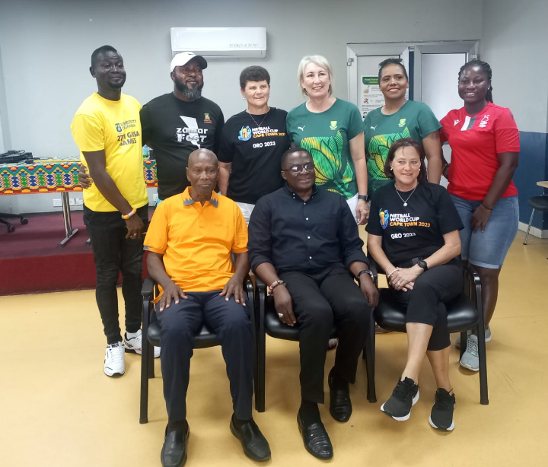
GHANA - LEGACY
The Programme took place from 28 Nov – 02 Dec 2022.
A Total of 30 coaches, umpires and Technical officials participated
2nd Phase scheduled for 2023

Slide 40
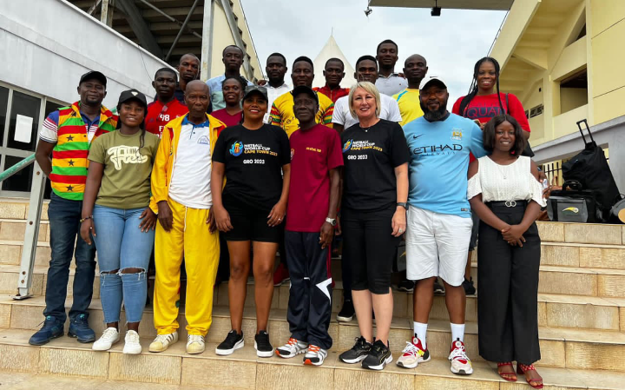
LEGACY KEY DATES
Date | Milestone
05-07 August 2022 | 1st Training of coaches and technical officials in Botswana Training was for 5 days with 24 Candidates.
19-27 August 2022 | Stats training at African Qualifiers 19 and 20 August 2022. Theorical Introduction and online training of the Timing, Scoring and Results System 24 Candidates. 21-27 August 2022 Practical training of the Timing, Scoring and Results System during the live matches- 31 Candidates. Umpire Alerts were tested and approved by ICASA
20-21 August 2022 | Africa Qualifiers High Performance session with African Countries attending Qualifiers
21 Nov-26 Nov 2022 | Diamond Challenge University of Pretoria (Zim, Wales, Spar Proteas and President`s 12)
27th Nov – 3rd Dec 2022 | Training in Ghana (Africa)

Slide 41
TOTAL REVENUE
To guarantee that transactions are categorized in terms of their classifications, the OC has revised the budget presentation.
The baseline against which the current budget is originally assessed is the 2018 budget (included in the Bid Documents and depicted above yellow coded),
The second comparison also illustrates budgetary trends when the current budget is contrasted with the green coded 2019 budget used in the Head of Terms.
The predicted earnings and cash reserves were examined after the 2019 Netball World Cup to make sure they were sufficient to cover costs.
Additionally, real cash received, pledged and earned revenue, as well as projected revenue as forecasted, are all shown in the updated presentation

Slide 42
NETBALL WORLD CUP TOTAL REVENUE
 |  | BID BUDGET-2018 | HEAD OF TERMS BUDGET-2019 | CURRENT BUDGET
DETAILS | NOTES | ORIGINAL | ORIGINAL | ACTUALS | COMMITMENTS | FORECAST | CURRENT BUDGET
REVENUE
Sponsorship | 1 | R 15 000 000 | R 15 000 000 | R - | R - | R 28 000 000 | R 28 000 000
Ticket Sales | 2 | R 12 000 000 | R 12 000 000 | R 4 324 635 | R - | R 60 675 365 | R 65 000 000
Merchandising & Licensing | 3 | R 2 500 000 | R 2 500 000 |  |  | R 2 500 000 | R 2 500 000
Government | 6 | R 47 000 000 | R 47 000 000 | R 60 000 000 | R 30 000 000 | R - | R 90 000 000
Additional Government funding-Western Cape Province - transfer | 6 | R - | R 11 000 000 | R - | R 5 000 000 | R - | R 5 000 000
Additional Government funding-City of Cape Town - transfer | 6 | R - | R - | R 175 000 | R 6 000 000 | R - | R 6 175 000
Accommodation Commission & Travel Rebates & VIK | 3 | R 500 000 | R 500 000 | R - | R - | R 500 000 | R 500 000
Accommodation Charges | 3 | R - | R - | R - | R - | R - | R -
Hospitality Income | 3 | R - | R - | R - | R - | R 1 000 000 | R 1 000 000
Fan Park Income | 3 | R - | R - | R - | R - | R 1 500 000 | R 1 500 000
Broadcasting - Production cost included-Supersport | 4 | R - | R - | R 1 257 090 | R 3 875 535 | R - | R 5 000 000
Broadcasting - Production cost included-SABC | 5 | R - | R - | R 2 400 000 | R 3 600 000 | R - | R 6 000 000
Broadcasting - Production cost included-Supersport | 5 | R - | R - | R 1 500 000 | R 500 000 | R - | R 2 000 000
Interest Income |  | R - | R - | R 307 329 | R - | R 300 000 | R 607 329
Total Revenue |  | R 77 000 000 | R 88 000 000 | R 69 964 054 | R 48 975 535 | R 94 475 365 | R 213 282 329

Slide 43
Revenue trends 2018 – Current
The anticipated revenue shows a pattern of growth since 2018.
The initial public financing secured was R 47 million in 2018, but after evaluation and the sourcing of additional funds, the revenue secured climbed to R 58 million in 2019.
The national government provided additional guaranteed contributions, bringing the total public funding revenue to almost R101 million rands.
The National and Provincial Governments, as well as the City of Cape Town, provide public financial revenue.
Commercial funding is made up of income from ticket sales, sponsorship, broadcasting, licensing, merchandise, and lodging fees, among other sources.
The amount of commercial support secured remained unchanged between 2018 and 2019.
In contrast to 34% in 2019 and 39% in 2018, commercial funding accounts for 52% of the budget currently.
 | Bid Budget 2018 | Head of Terms 2019 | Current Budget
Public Funding | 47 000 000 | 58 000 000 | 101 175 000
Commercial funding | 30 000 000 | 30000000 | 111 500 000

Slide 44
Commercial Funding
Sponsorship - Title Sponsor, Event Partners | R 28 000 000 | 25,11%
Broadcasting - Production cost included | R 13 000 000 | 11,66%
Merchandising & Licencing | R 2 500 000 | 2,24%
Ticket Sales (spectator income) | R 65 000 000 | 58,30%
Accommodation Commission & Travel Rebates & VIK | R 500 000 | 0,45%
Accomodation Charges | R - | 0,00%
Hospitality Income | R 1 000 000 | 0,90%
Fan Park Income | R 1 500 000 | 1,35%

Slide 45
COMMERCIAL FUNDING
Key points to keep in mind
Ticket Sales Revenue
Full ticket sales are anticipated, and they won't be sold as day tickets but as session tickets instead, which will boost revenue.
This kind of income accounts for 58% of all commercial funding.
Even though the initial round of ticket sales only included the first five days of December 2022, there was a significant demand for tickets.
2 Sponsorship
25% of all commercial funding comes from this source of income.
To alleviate the burden of budgetary constraints, several sponsors have already been contacted for proposals on both cash and value in kind. The The title sponsor and other Tier 1 sponsors have already been confirmed.
The LOC will always make sure that they get the most out of the business partnership through their commercial agent.
The Netball World Cup competition's available inventory provides sponsors with a variety of advantages.
3 Other Revenue Sources
Merchandising and licensing, accommodation commission and travel rebates, hospitality and fan park revenues are some additional revenue streams for commercial support.
The majority of the aforementioned revenue streams will be established with the aid of partners like provincial governments, municipalities, and/or sponsors.

Slide 46
TOTAL EXPENDITURE
The World Netball's guidelines and handbook serve as the basis for the costs associated with planning and executing a successful Netball World Cup event.
The following sections comprise the strata of the expenditure budget:
Business Operation costs - 20% of the entire budget is allocated to costs, which include operational and support service expenses.
Tournament Operations costs – comprise 58% of the entire budget and represent the primary activities of planning and delivery.
Personnel Costs – 8% of the total budget is made up of salaries and benefits.
International Hosting Fees - 15% of the budget is made up of the fees for hosting the Netball World Cup.
Business Operating Costs | Tournament Operations Costs | Personnel Costs | International Hosting Fees
Marketing and Sponsorship | Competition Venue
Ticketing | Field of Play
Administration | Back of House Preparation Areas
LOC Office Costs | Seating
Technology Costs | Training Venues
 | Communication
 | Timing ,Scoring and Results System Familiarisation
 | Sports Equipment and Consumables
 | Sports Presentation
 | Medical Services
 | Doping Control
 | Travel,Accomodation and Ground Transport
 | Media and Broadcast
 | Catering
 | Ceremonies,Awards and Trophies
 | Security
 | Accreditation
 | WN Congress
 | Legacy Programme

Slide 47
 | BID BUDGET-2018 | HEAD OF TERMS BUDGET-2019 | CURRENT BUDGET
DETAILS | ORIGINAL | ORIGINAL | ACTUALS | COMMITMENTS | FORECAST | CURRENT BUDGET
Business Operations Costs | R 6 415 600 | R 6 415 600 | R 9 306 250 |  | R 30 661 058 | R 37 755 304
Tournament Operation Costs | R 36 375 100 | R 31 675 100 | R 30 376 453 | R 4 026 527 | R 73 350 942 | R107 853 922
Personnel Costs | R 16 000 000 | R 16 000 000 | R 2 443 224 |  | R13 058 686 | R15 501 910
International Hosting Fees | R 8 780 000 | R 8 780 000 | R 7 980 640 | R - | R 19 942 820 | R 27 923 460
Total Expenditure | R 67 570 700 | R 62 870 700 | R 50 106 567 | R 4 026 527 | R 137 013 506 | R 189 034 596

Slide 48
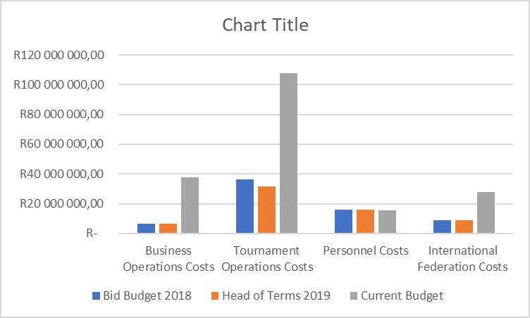
Expenditure trends 2018 – Current
Since 2018, the anticipated costs have progressively risen.
Cost assessments during the bid preparation process, followed by the signature of the hosting agreement in 2019 up to the present, have contributed to an increase in the Tournament's preparation and delivery expenditures over the years.
The advent of Covid 19 also had a detrimental impact on the costs.
Costs for competition locations have significantly increased since 2018
.
To ensure viability after the event, legacy costs are maintained.
 | Bid Budget 2018 | Head of Terms 2019 | Current Budget
Business Operations Costs | R 6 415 600 | R 6 415 600 | R 37 755 303
Tournament Operations Costs | R 36 375 100 | R 31 675 100 | R 107 853 922
Personnel Costs | R 16 000 000 | R 16 000 000 | R 15 501 910
International Federation Costs | R 8 780 000 | R 8 780 000 | R 27 923 460
 | R 67 570 700 | R 62 870 700 | R 189 034 596

Slide 49
PROJECTED SURPLUS/DEFICIT | 2018 | 2019 | 2022
 | BID BUDGET | HEAD OF TERMS BUDGET | CURRENT BUDGET-Commitments and FCST
Public Funding | R 47 000 000 | R 58 000 000 | R 101 175 000
Commercial Funding | R 30 000 000 | R 30 000 000 | R 112 107 329
Total Commercial Funding | R 77 000 000 | R 88 000 000 | R 213 282 329
Business Operations Costs | R 6 415 600 | R 6 415 600 | R 37 755 304
Tournament Operations Costs | R 36 375 100 | R 31 675 100 | R 107 853 922
Personnel Costs | R 16 000 000 | R 16 000 000 | R 15 501 910
International Federation Costs | R 8 780 000 | R 8 780 000 | R 27 923 460,00
Total Expenditure | R 67 570 700 | R 62 870 700 | R 189 034 596
SURPLUS(DEFICIT) | R 9 429 300 | R 25 129 300 | R 24 247 733

Slide 50
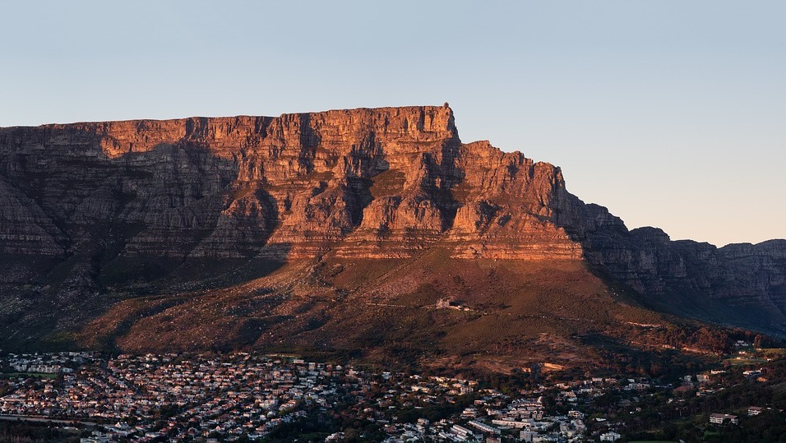
Thank you!
Enkosi!
Dankie!

