Slide 1
INPUTS TO DHET ON THE GBV SECURITY RISK IN THE PSET SECTOR
PORTFOLIO COMMITTEE SUBMISSION
16 FEBRUARY 2023

Slide 2
REMEMBERING THE DHET GBV POLICY FRAMEWORK: STRATEGIC GOALS
Legislation and policies
Norms, standards, guidelines and procedures
Structures, mechanisms
Accountability
Monitoring and evaluation
Budget
Prevention programmes
Awareness programmes
Measures aimed at preventing incidents
Goal 1: Enabling Environment
Enabling Environment
Create an Enabling Environment to inform, prevent, support and monitor GBV in PSET Institutions.
Goal 2: Prevention and Awareness
Prevention & Awareness
Promote the safety of students and staff by putting in place comprehensive awareness and prevention programmes intended to raise awareness of policies and services addressing GBV.
Support & Assistance
Procedures for reporting, investigation and resolution of complaints
Comprehensive, specialized support and other assistance for survivors and where possible perpetrators
Higher Health is the DHET implementing agent of the GBV Framework
Goal 3: Support and Assistance
Put supportive and reparative procedures for complainants/survivors in place.

Slide 3
WORK COMPLETED IN 2021 AND IMPLEMENTATION AND REINFORCMENT ONGOING
Responsible Office
Reporting processes
Informal and formal complaint enquiries
Disciplinary tribunals
Supportive measures
Psychosocial support
Safety and security
Sanctions for non compliance
Responsible Office
After hours reporting
Trained people to take statements
Psychosocial and medical support
SAPS
Complainant centred
Responsible Office
Dignity/respect
Compliance with rules, regulations and policies
Open exchange of ideas
No hate speech
Procedural guidelines
Rape Protocol
Code of Ethics

Slide 4
2022: MINIMUM STANDARDS PROTOCOLS AND FORMS COMPLETED
IN 2022 TO ACCOMPANY GBV GUIDELINES WITH GBV TTT
Staff student relationships
Protocol
on safety and
security
Protocol
on
campus
Accommo-dation
Statement of Complaint
Protocol on
private
accommodation
Notes:
We want our students to be informed, knowledgeable citizens who play an active role in building up their communities.
This course imparts a great deal of knowledge – and students learn best by educating others. That is why peer education is the best mode for this course. Think how many people can be reached and become informed through the peer education model. We know that knowledge saves lives. We saw what misinformation and a lack of knowledge did in the COVID-19 pandemic. We are still grappling with the effects of stigma in terms of HIV prevention and support.

Slide 5
PROTOCOL: SAFETY IN CAMPUS RESIDENCES
Poorly lit residences no visible security = women in danger
Have good lighting in and around res, visible security, and establish community policing forums
Res may be unsafe if overcrowded, mixed ablutions, doors don’t lock
Don’t overfill residences, have separate
ablutions, locks on rooms
Abuse of drugs/alcohol associated with SGBV
Educate students, and develop policies indicating reasonable approved consumption
Res wardens, house mothers, staff and res leadership need to be supportive
Conduct regular training and capacitation on GBV
Priority Areas
Weekend party culture - can be high risk (vulnerable 1st years, too many visitors)
Run education campaigns to promote safe behaviour, no alcohol policy in residences
Encourage reporting of GBV, ensure access to support services such as campus security, psycho-social services etc. Work with Responsible Office to ensure guidelines are followed
Allocation of accommodation can
be problematic
There should be strict allocation policy and
where possible rooms should be allocated
by staff not students
Res students do not always know where to get help
Pamphlets, posters, important numbers displayed – resource pack (policies, protocols)

Slide 6
PROTOCOL: SAFETY IN PRIVATE ACCOMMODATION
Measures that can be taken
Private Accommodation
Owners and managers of PAs must be trained and capacitated on the institution’s GBV guidelines and protocols and comply with same safety and security standards that apply to campus residences. For example –
Not being overcrowded, having locks
Educating residents on alcohol/drug use
Control alcohol/promote safe behaviour
Good lighting and visible security
Support for victims of GBV
Monitoring of minimum standards in PAs must take place annually to check for compliance
PAs must make the same resource packs available and have the same information displayed as at campus residences
Problems in private accommodation establishments (PA)
Don’t fall under control of PSET institution so not monitored or controlled
Some PAs are overcrowded
There’s inadequate security or protective measures, locks on doors, etc
Some are far from campus – have to travel in dark
Same risks as in res- alcohol, weekend party culture

Slide 7
PROTOCOL: STATEMENT OF COMPLAINT
A PSET institution must set up a Hearing Panel/Disciplinary Tribunal to undertake disciplinary proceedings against alleged SGBV perpetrators. The Statement of Complaint is of critical importance in the formal disciplinary process
Written by complainant
Or taken by RO/gender office, campus protection services, campus health, student affairs or other offices on the basis of interview and approved by complainant
Similar to Sworn Statement
Person receiving statement
must be trained and fully capacitated and GBV sensitised
No secondary victimisation
Use victim’s own words
Victim must be calm
Should be taken after psychosocial and medical support
Accompanying
documents
Used in proceedings must be done properly
Details of incident
Where, when, how, nature of incident
Used in formal disciplinary
Reports by health care professionals, J88 form, other relevant forms and info
Reports by witnesses

Slide 8
PROTOCOL: STAFF STUDENT RELATIONSHIPS
Guard against abuse of unequal power relations between staff and students at PSET institutions that can lead to exploitation of vulnerable students for sexual purposes
Boundaries must be set on romantic relationships between staff and students to protect students
Failure to adhere to this protocol must be made a violation that will have disciplinary consequences
H
1
2
3
4
5
Strict standards must be reflected in HR policies and adhered to by staff who hold positions of power over students or other members of staff who are vulnerable such as junior staff, interns and fellows
Staff members in relationships with students or junior staff must disclose this information to HR and their senior line management
Staff members in relationships with students or junior staff must recuse themselves if any conflict of interest might occur. For example if they are supervising work of such students or junior staff
Staff members in relationships with students or junior staff must declare, on an annual basis that there will be no conflict of interest if they continue that relationship
HR must obtain written acceptance and acknowledgement from junior staff or students in relationships with staff members that such relationships are consensual

Slide 9
PROTOCOL: SAFETY AND SECURITY
Institutions must maintain proper standards of safety and
security on campus under their jurisdiction (satellite etc.)
Training should be provided for security personnel whether in-house or accredited private security. Security staff should attend such a course prior to working on campuses and be familiar with the GBV policies and protocols. They should also be trained on implementation of orders in terms of Domestic Violence Act and Harassment Act. Security staff should be vetted for prior GBV convictions.
When incidents take place after hours, the security officer that responds must take action the victim asks for. E.g. Assist them by accompanying them to SAPS/medical facilities, etc. There must be no secondary victimisation and security staff must adhere to a victim centred approach.
Campus must be well lit, security must be visible
Policing forums in partnership with campus security made up of students and staff to enable efficient responses should be formed to respond to after hour incidents.
An annual campus safety audit must be conducted as required by the DHET policy to identify areas of risk which must be addressed. The audit should identify unsafe areas that need lighting, other safety risks and should address these
Extra security should be provided around libraries, sports facilities, other hotspots area where students congregate after hours.
Notes:
The technical task team have met on this on7 Nov – they will revisit all protocols through an in-sitting – to be addressed by DM DHET, SAPs, Justice and TTT on 7 Feb and released to public space for consultation and capcpity- building- consultation community of practice has taken place with student leadership, campus security, residence etc.

Slide 10
HIGHER HEALTH PROTOCOL ROADMAP 2022/2023
H
May to Aug 2022
Oct 2022
Nov 2022
Dec 2022
Feb 2023
5 NEW DRAFT PROTOCOLS DEVELOPED THROUGH consultation with and capacity-building of relevant stakeholders including: Campus security, Student Leadership, SASSOP, Residences, ALCUHO-I, SAVETSA, SAUS, staff, frontline staff etc.
NEW DRAFT PROTOCOLS taken to the HIGHER HEALTH Board of Directors– 17 October 2022
NEW DRAFT PROTOCOLS take to the GBVF TECHNICAL TASK TEAM – 7 November 2022 – incorporating the HH Board of Directors Feedback
NEW DRAFT PROTOCOLS being taken to the HH Board of Directors with consolidated feedback following the engagement with the GBVF TTT – 12 December,2022
7 February 2023 – NEW DRAFT PROTOCOLS to be workshopped and reviewed at the GBVF TTT led by the Deputy Minister of DHET, the Deputy Minister of SAPs and the Deputy Minister of Justice. Thereafter to be released for public consultation, training and capacitation at an identified date

Slide 11
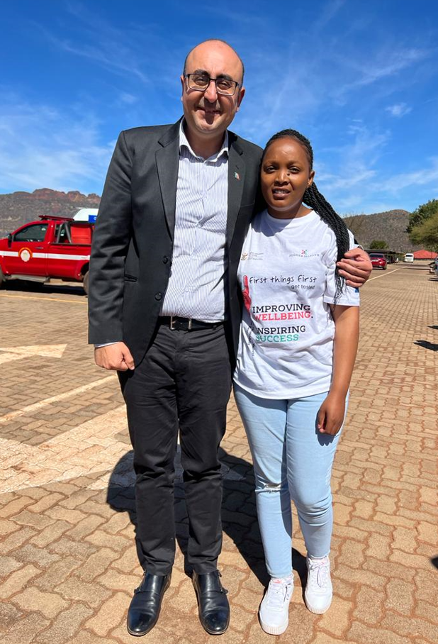
THE IMPACT OF THE GBV WORK JAN TO DEC 2022
Data is being generated through HIGHER HEALTH
Students were capacitated on HIGHER HEALTH GBV Second Curriculum
Jan – Dec 2021: 124 964 / Jan – Dec 2022: 162 909
Students and staff have been assessed using the HIGHER HEALTH GBV risk assessment tool to assess their risk of experiencing GBV
Jan – Dec 2021: 80 500 / Jan – Dec 2022: 85 709
Staff and students have been assisted by HIGHER HEALTH GBV support services
Jan – Dec 2021: 8 676 / Jan – Dec 2022: 6 557

Slide 12
Capacitation and Skills Training JAN – OCT 2022
Capacity building and training
GBV sensitisation
Training on policy and protocols
Checklists and minimum standards
8 748
PSET Staff Capacitated to date
University, TVET and CET management and senior staff
Senior residence staff including wardens and house mothers
Frontline staff including in-house campus security and protection services
Student support services, SRCs, SAUS (one planned this week Thurs/Frida), SATVETSA

Slide 13
THANK YOU

