Slide 1
Sectoral plan in response to loadshedding
Presented by DHET

Slide 2
Public University Survey
18/26 responded
None responses:
DUT, NWU, RU, SMU, Wits, Unizulu , UNISA and VUT

Slide 3
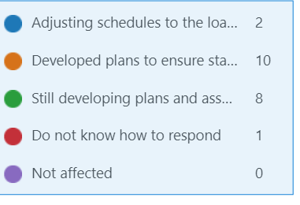
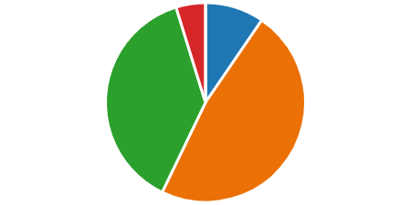
How is your institution responding to loadshedding?

Slide 4
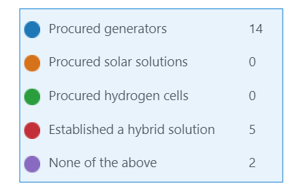
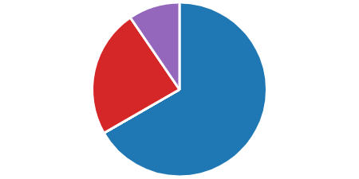
What interventions have you introduced to manage loadshedding?

Slide 5
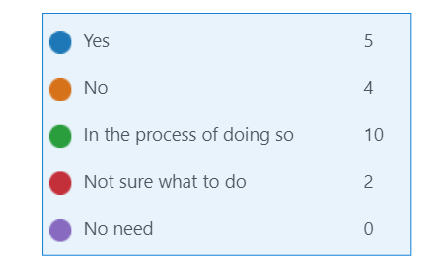
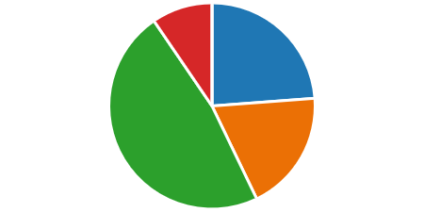
Have you formulated an Energy strategy?

Slide 6
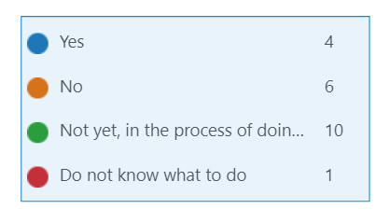
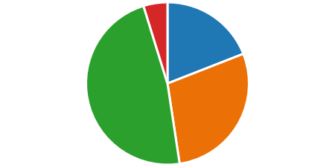
Have you costed your energy strategy?

Slide 7
Way forward
A workshop is planned , to be lead by CSIR
Energy Management Guidelines will be published.
Energy Audits
Energy saving measures
Energy management system
Building for efficient Energy systems
Universities will be required to report annually on progress with developing Energy Management Strategies
Blended learning policy will be pursued to support seamless learning experience

