Slide 1
BRIEFING TO THE PORTFOLIO COMMITTEE ON PUBLIC SERVICE AND ADMINISTRATION
PUBLIC SERVICE COMMISSION
1 -3 QUARTER
PERFORMANCE REPORT
2022/23 FINANCIAL YEAR
15 FEBRUARY 2023

Slide 2
PRESENTATION OUTLINE
2022/23 At a Glance
Strategic Plan & APP Indicators
Increasing PSC Visibility
Organisational Performance
Financial Performance Report
01
Outline
02
03
04
05

Slide 3
2022/23 AT A GLANCE
Total Budget
R295.5 mil
Footprint
1 National
9 Provincial Offices
Establishment
11 Commissioners
Annual vacancy rate at 7,8% below 10%
Clean Audit
Total Complaints finalised 210
Total Grievances 319 finalised 319
National Anti-Corruption Hotline
347 case reports generated
7 Service Delivery Inspections
conducted
A

Slide 4
PSC 5 YEAR STRATEGIC OUTCOMES
The implementation of Priority 1 through the NDP 5-year Implementation Plan and the MTSF has enabled the PSC to identify 4 Outcomes that would contribute towards building “A capable, ethical and development state”.
Repositioning of the PSC to deliver on high-impact catalytic projects
A well coordinated and functioning M&E System (Data Warehouse for the PSC)
Sound leadership practices in the Public Service
An improved service delivery culture
A strong & well-functioning PSC

Slide 5
FY2022/23 APP TARGETS
The PSC has a total of 25 performance indicators in FY 2022/23 APP
Programme 1: Administration
7 Indicators
Programme 2: Leadership and Management Practises
6 Indicators
Programme 3: Monitoring & Evaluation
7 Indicators
Programme 4: Integrity and Anti- Corruption
Performance Indicators
5 Indicators

Slide 7
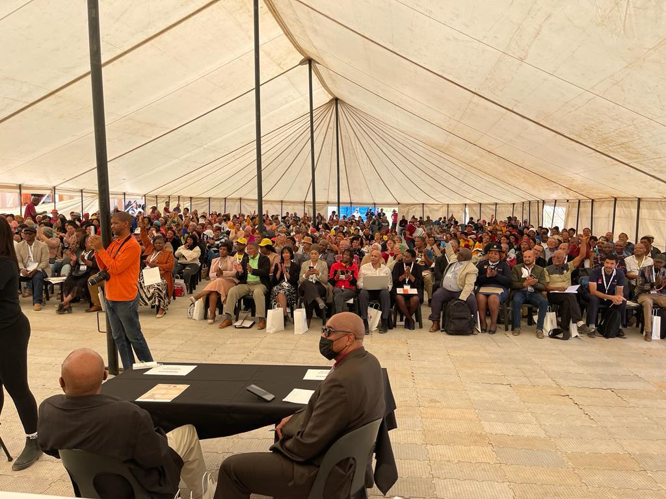
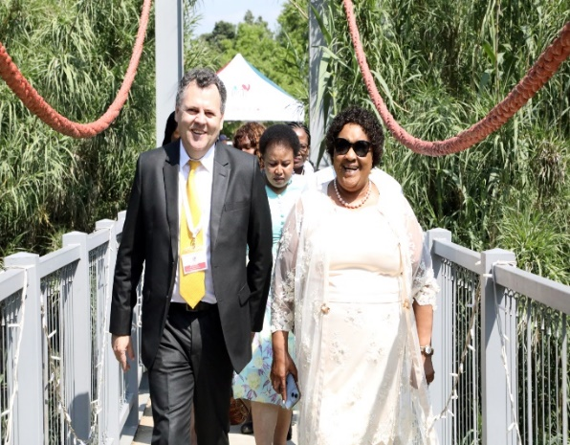
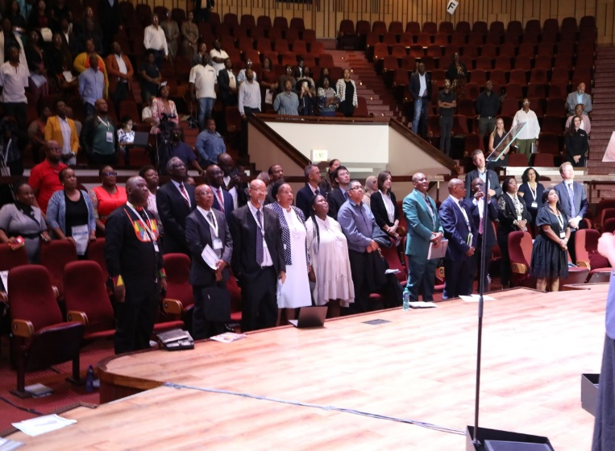
HIGHLIGHTS OF KEY ACHIEVEMENTS
Hosted a successful 2-day conference on Anti-corruption- under the theme “The Cost of Failure of Governance, Ethics and Oversight: A collective response to tackle the scourge of corruption in the Public Sector”. Collaboration with FISD, UN, Anti Corruption Task Team
Presented PSC Bill to the SALGA Executive and received support for the Bill. Preparations are underway to submit Bill
to Cabinet
Coordinated the engagement with the National Planning Commission on Repurposing the Public Service Commission to contribute in the achievement of the National Development Plan (NDP) focusing on Chapter 13 of the NDP.
Produced a report on the National Macro Organisation of Government which was requested by the Portfolio Committee on Public Service and Administration.
Four Citizens forums were successfully conducted in North West, Gauteng, Northern Cape and Free State.
7

Slide 8
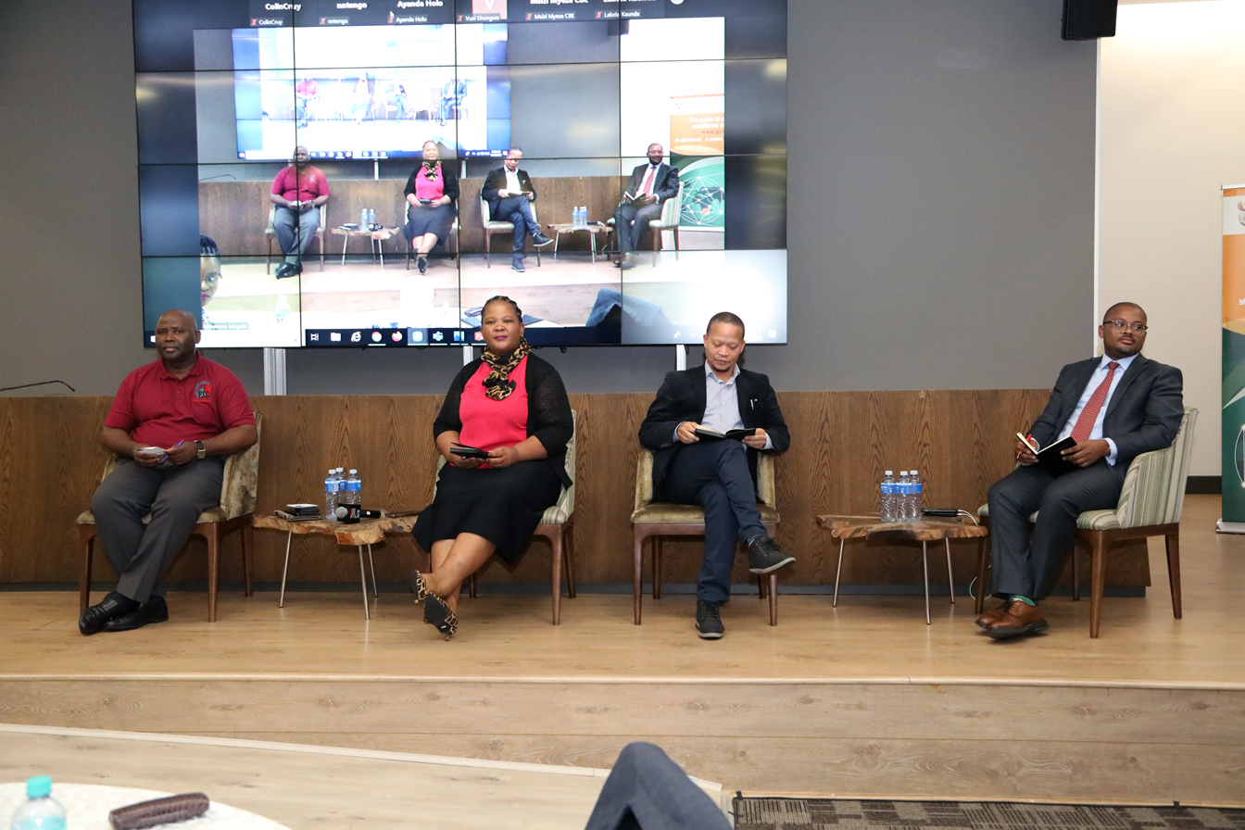
HIGHLIGHTS OF KEY ACHIEVEMENTS
Successfully hosted a seminar titled “Improving Governance, Systems and Processes Post the Commission of Inquiry into State Capture”.
Conducted onsite Inspections at SAPS Forensic Laboratories
Held Round-Table discussions on the Effectiveness of Government Supports Systems in the ICT and Property Management Sector. Final Report to be issued at the end of March 2023
Participated in the Launch of the National Framework on Professionalisation of the Public Service
8

Slide 9
OVERVIEW OF PERFORMANCE INFORMATION

Slide 10
SUMMARY OF PERFORMANCE FOR 2022/23
Programme | Q1 Target |  | Q2 Target |  | Q3 Target
 | Due | Achieved | Due | Achieved | Due | Achieved
Administration | 3 | 3 | 4 | 4 | 3 | 3
Leadership and Management Practice | 4 | 2 | 5 | 3 | 5 | 3
Monitoring and Evaluation | 3 | 2 | 4 | 4 | 4 | 2
Integrity and Anti-Corruption | 2 | 1 | 3 | 3 | 2 | 1
Total | 12 | 8 | 16 | 14 | 14 | 9
74% of APP targets achieved to date
Plans underway to catch up on missed targets e.g Citizens Forum
10

Slide 11
PERFORMANCE PER QUARTER

Slide 12
PROGRAMME 1: ADMINISTRATION
Output Indicator | Target | Actual Performance | Reasons for deviations
Unqualified audit outcome | Unqualified audit outcome | Achieved Q2: Unqualified audit outcome for 2021/22 | None
Number of quarterly bulletins produced | Annual Target: 4 Q1:1 Q2:1 Q3:1 | Achieved Q1:1 Q2:1 Q3:1 | None
Percentage of valid invoices paid within 30 working days of receipt | Annual Target:100% Q1:100% Q2:100% Q3:100% | Achieved: 2745 out of 2745 Q1:100% Q2:100% Q3:100% | None
Percentage of human resources developed | Annual Target: 80% Q1:10% Q2:25% Q3:20% | Achieved Q1:36% Q2:25% Q3:40% | High demand for training interventions resulted in over achievement of the quarterly target.

Slide 13
PROGRAMME 2: LEADERSHIP & MANAGEMENT PRACTICES
Output Indicator | Target | Actual Performance | Reasons for deviations
Percentage of grievances finalised within 30 days (levels 2-12 ) of receipt of all relevant information | Annual Target 85% Q1 : 60% Q2 : 70% Q3 : 80% | Achieved: Q1 76% = 64 out of 84 grievances were resolved | Over achievement is due to improved grievance management and investigators working extended hours.
 |  | Achieved: Q2 79% = 115 out of 146 grievances were resolved
 |  | Achieved: Q3 81% = 236 out of 290 grievances were concluded
Percentage of grievances finalised within 45 days (for SMS) of receipt of all relevant information | Annual Target 85% Q1 : 60% Q2 : 70% Q3 : 80% | Achieved: Q1 86% = 7 out of 8 grievances were finalised
 |  | Achieved: Q2 93% (Q3) = 14 out of 15 grievances were finalised
 |  | Achieved: Q3 83% (Q3) = 24 out of 29 grievances were finalised

Slide 14
PROGRAMME 2: LEADERSHIP & MANAGEMENT PRACTICES
Output Indicator | Target | Actual Performance | Reasons for deviations
Percentage reduction in the number of employees lodging grievances in the Public Service over the MTEF period | Annual Target: 4% Q1 : 1% Q2 : 2% Q3 : 3% | Q1 Not Achieved | Impossible to determine the percentage reduction on quarterly basis. Progress update will be reported at the end of quarter 4.
 |  | Q2 Not Achieved
 |  | Q3 Not Achieved

Slide 15
PROGRAMME 2: LEADERSHIP & MANAGEMENT PRACTICES
Output Indicator | Target | Actual Performance | Reasons for deviations
Number of strategic engagements on PSC recommendations with targeted departments | Annual Target: 10 Q1 : 2 Q2 : 3 Q3 : 4 | Q1 Not Achieved | Due to postponement of planned engagements, the target was not achieved. There are Plans in progress to catch up on missed target.
 |  | Q2 Not Achieved
 |  | Q3: 1 Not Achieved

Slide 16
PROGRAMME 2: LEADERSHIP & MANAGEMENT PRACTICES
Output Indicator | Target | Actual Performance | Reasons for deviations
Number of reports on the grievance management and the efficiency of the grievance procedure produced | Annual Target: 3 Q1: - Q2 : 1 Q3 : 1 | Q2: 1 Achieved | None
 |  | Q3: 1 Achieved | None

Slide 17
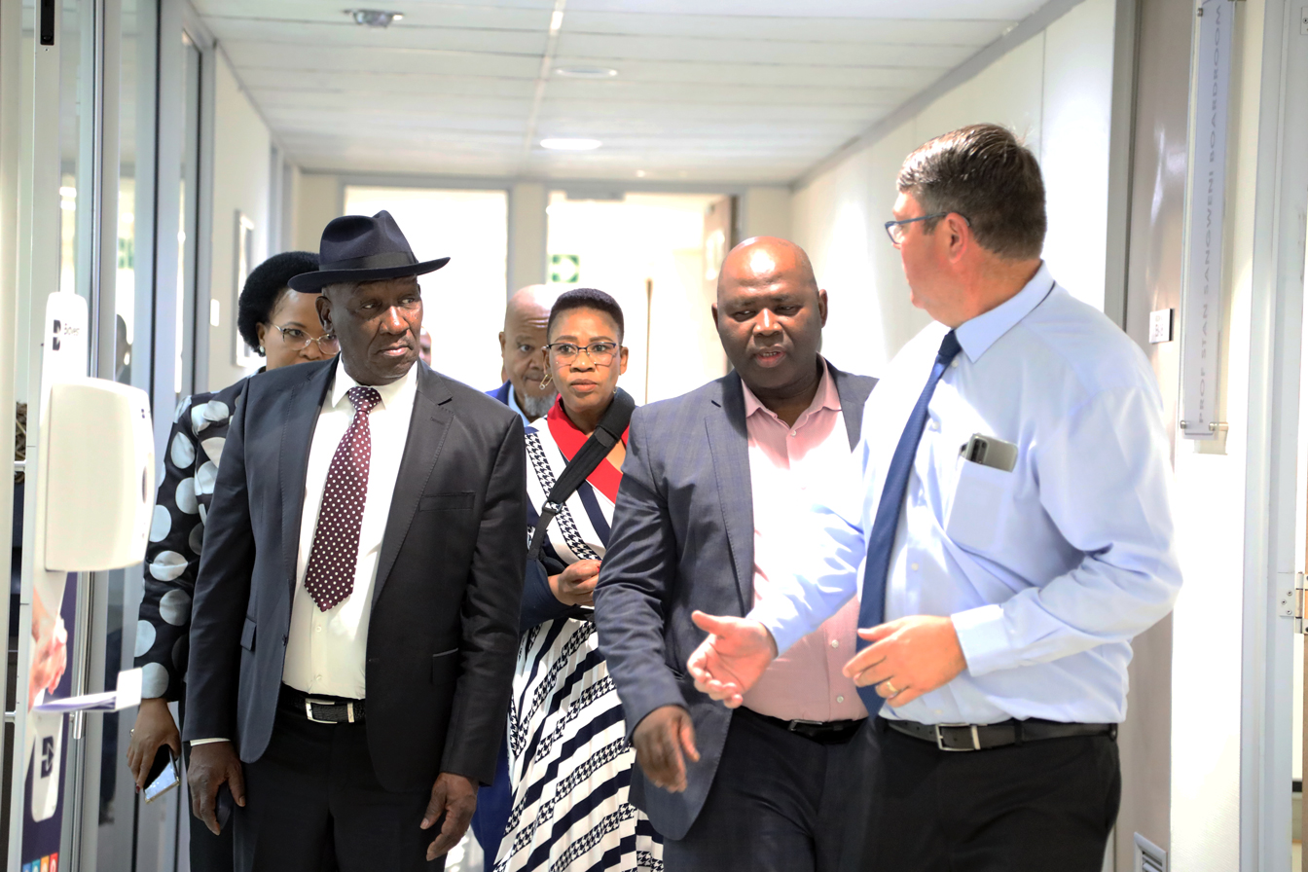
PROGRAMME 3: MONITORING & EVALUATION
Meeting with the Minister of Police

Slide 18
PROGRAMME 3: MONITORING & EVALUATION
Output Indicator | Target | Actual Performance | Reasons for deviations
Number of reports on service delivery inspections approved | Annual Target: 10 Q1: 2 Q2: 4 Q3: 2 | Q1: 2 Achieved | None
 |  | Q2: 2 Achieved | None
 |  | Q3 Not Achieved | There were delays in conducting inspections due to the need to add more inspection sites. Plans are in place to conduct inspections in the WC Magistrates Courts. Mpumalanga inspections are being conducted as well as Limpopo.

Slide 19
PROGRAMME 3: MONITORING & EVALUATION
Output Indicator | Target | Actual Performance | Reasons for deviations
Number of Constitutional Values & Principles (CVP) Engagements held | Annual Target: 20 Q1: 5 Q2: 5 Q3: 5 | Q1: 5 Achieved | None Over-achieved due to high demand during the Public Service Month
 |  | Q2: 14 Achieved
 |  | Q3: 5 Achieved

Slide 20
PROGRAMME 3: MONITORING & EVALUATION
Output Indicator | Target | Actual Performance | Reasons for deviations
Number of citizens forums conducted | Annual Target: 9 Q2: 3 Q3: 3 | Q2: 3 Achieved | None
 |  | Q3: 1 Citizens Forum held in Free State Not Achieved | The quarter target was not achieved due to the unavailability of key stakeholders and the need for further consultations to hold the Citizens Forums in the Eastern Cape and KwaZulu-Natal. A plan has been put in place with the support of the National Task Team to support provinces to conduct all outstanding Citizens Forums in quarter 4.

Slide 21
PROGRAMME 3: MONITORING & EVALUATION
Output Indicator | Target | Actual Performance | Reasons for deviations
Number of reports on the performance of departments produced | Annual Target: 4 Q1: 1 Q2: 1 Q3: 1 | Q1 Not Achieved | Approval of Report was outside the Quarter.
 |  | Q2:1 Achieved | None
 |  | Q3:1 Achieved | None

Slide 22
PROGRAMME 4: INTEGRITY AND ANTI-CORRUPTION

Slide 23
PROGRAMME 4: INTEGRITY AND ANTI-CORRUPTION
Output Indicator | Target | Actual Performance | Reasons for deviations
Percentage of investigations finalised within 90 working days upon receipt of a valid complaint | Annual Target: 75% Q1 : 30% Q2 : 45% Q3 : 60% | Q1:21% 13 out of 63 Not Achieved | The 90 working day as a turnaround time lapsed in Q2, the target to be achieved in Q2.
 |  | Q2: 51% 68 out of 133 Achieved | Over-achievement was due to focusing on reducing the backlog from Q1
 |  | Q3: 50% 97 out 193 Not Achieved | Many of the complaints lodged in Q3 have their lapse date beyond Q3 and are being investigated. Plans are in place to ensure that all valid complaints are finalized within the required timeframes. The focus is to ensure that all valid complaints received in Q3 are finalized in Q4.

Slide 24
PROGRAMME 4: INTEGRITY AND ANTI-CORRUPTION
Output Indicator | Target | Actual Performance | Reasons for deviations
Number of articles on the promotion of professional ethics produced | Annual Target: 4 Q1 : 1 Q2 : 1 Q3 : 1 | Q1: 1 Achieved | None
 |  | Q2: 1 Achieved
 |  | Q3: 1 Achieved
Number of engagements on professional ethics | Annual Target: 3 Q1: - Q2 : 2 Q3: - | Q2: 2 Achieved | None

Slide 25
OVERVIEW OF FINANCIAL PERFORMANCE

Slide 26
FY2022/23 BUDGET OVERVIEW
Total Budget of R295,5m for FY2022/23
76% of the budget is for Compensation of Employees
24% allocated to Goods and Services

Slide 27
EXPENDITURE AGAINST BUDGET
AS AT 31 DECEMBER 2022
 | Pre-Accrual Expenditure | Post-Accrual Expenditure
 | R’000 or % | R’000 or %
Original Budget | 288 449 | 288 449
Additional Funds (COLA) | 7 092 | 7 092
Actual Spending | 205 285 | 213 715
% Spending | 69.5% | 72.3%
Norm | 75.0% | 75.0%
% Variance | 5.5% | 2.7%
Under/ (Over) spending against Norm | 16 371 | 7 941
27

Slide 28
VARIANCE BREAKDOWN
PER ECONOMIC CLASSIFICATION
 | R’000
Compensation of Employees | 14 555
Goods and Services | 2 453
Transfers and Subsidies | (83)
Payment for Capital Assets | (455)
Payments for financial Asset | (98)
Under/ (Over) spending | 16 371
R14.555 million (6,5%) underspending on COE, due to vacant posts including 3 Commissioner posts.
Goods & Services: Expenditure is less due to invoices not yet received or processed where services were rendered. (Accruals to the value of R8.430 million)
28

Slide 29
SPENDING AS AT 31 DECEMBER 2022
PER PROGRAMME
Programmes | Budget | Actual | Actual | Norm | Variance | Variance
 | (R’000) | (R’000) | (%) | (%) | (%) | (R’000)
Administration | 142 316 | 93 612 | 65.8% | 75.00% | 9.2% | 13 125
Leadership & Management Practices | 49 852 | 36 401 | 73.0% | 75.00% | 2.0% | 988
Monitoring & Evaluation | 44 970 | 33 755 | 75.1% | 75.00% | (0.1)% | (27)
Integrity & Anti-Corruption | 58 403 | 41 517 | 71.1% | 75.00% | 3.9% | 2 285
TOTAL | 295 541 | 205 285 | 69.5% | 75.00% | 5.5% | 16 371
29

Slide 30
SPENDING AS AT 31 DECEMBER 2022
PER ECONOMIC CLASSIFICATION
Items | Budget | Actual | Actual | Norm | Variance | Variance
 | (R’000) | (R’000) | (%) | (%) | (%) | (R’000)
Compensation of Employees | 223 834 | 153 321 | 68.5% | 75.00% | 6.5% | 14 555
Goods & Services | 69 658 | 49 791 | 71.5% | 75.00% | 3.5% | 2 453
Transfers & Subsidies | 611 | 542 | 88.7% | 75.00% | (13.7%) | (83)
Payment for Capital Assets | 1 438 | 1 533 | 106.6% | 75.00% | (31.6%) | (455)
Payment for Financial Assets | – | 98 | 0.00% | 75.00% | 0.00% | (98)
TOTAL | 295 541 | 205 285 | 44.9% | 75.00% | 5.5% | 16 371
30

Slide 31
IRREGULAR EXPENDITURE AS AT 31 DECEMBER 2022
IRREGULAR EXPENDITURE AS AT 31 DECEMBER 2022 | 2022/23 | 2021/22 | 2020/21
 | R'000 | R'000 | R'000
Reconciliation of irregular expenditure
Opening balance | 1 218 | 2 534 | 1 666
Prior period error |  |  | -
Add: Irregular expenditure - relating to prior year | - | 772 | 868
Add: Irregular expenditure - relating to current year |  | - | -
Less: Prior year amounts condoned | - | (2 088) | -
Closing balance | 1 218 | 1 218 | 2 534
No procurement irregular expenditure was incurred.
31

