Slide 1
VIOLENCE AND MURDER OF CHILDREN: MANDATE, PROGRAMMATIC INTERVENTIONS AND IMPACT
PRESENTATION TO THE
PORTFOLIO ON SOCIAL DEVELOPMENT
22 FEBRUARY 2023

Slide 2
OUR PRESENTATION AT A GLANCE…
3 GBV Amendment Acts enhancing the protection of children’s rights
Child Justice Courts and Statistics
Femicide Watch, Schools Edu-Campaign, Challenges and TakeAways
Support Services offered to Child Victims of Domestic Violence
Purpose of the presentation
The Child-Centric Sexual Offences Courts and Statistics
Support services offered by Children’s Courts and Challenges

Slide 3
PURPOSE OF THE PRESENTATION
To brief this Committee on ‘violence and murder of children – mandates, programmes and interventions, statistics and impact of interventions and programmes.’
The mandate of DoJ&CD is to safeguard the constitutional rights of all persons living in South Africa, and most importantly, provide an accessible justice system for all, including children.
The Department established the Integrated Case Management System (ICMS), which is a national repository of cases captured from our lower courts, mainly to monitor the life cycle of each case and also determine the effectiveness of the justice system.
The ICMS provides distinct modules of the Criminal Matters, Child Justice, Domestic Violence, Sexual Offences, National Register for Sex Crimes, Children’s Courts, etc. However, the ICMS: Criminal Matters does not capture child murder cases yet, and for this reason, the focus of this presentation will, among other things, be on other violent crimes that predominantly impact on children (i.e. domestic violence and sexual offences).
The Department is currently upgrading the ICMS to incorporate additional data metrics, which will include different age categories of children as victims of murder and other violent crimes.

Slide 4
THE CONSTITUTION OF THE REPUBLIC OF SA
The Most Relevant Legal Framework Protecting the Rights of Children
Children’s Act, 2006
Child Justice Act, 1998
Domestic Violence Act, 1998, as amended
Prevention and Combating of Trafficking in Persons Act, 2013
Criminal Law (Sexual Offences and Related Matters) Amendment Act, 2007
DoJ&CD leads the intersectoral implementation of all these pieces of legislation, except the Children’s Act, 2006;
The DG: Justice and Constitutional Development chairs the DGs Intersectoral Committees for Sexual Offences and Child Justice, which have the representation of the DG: Social Development;
DSD is further represented in other intersectoral committees chaired by DoJ&CD.

Slide 5
3 GBV Amendment Acts Enhancing the Protection of Children

Slide 6
Domestic Violence Amendment Act 14 of 2021
Introduces ‘exposing a child to domestic violence’ as an additional act of domestic violence;
Intermediary services are available to children when testifying in both civil and criminal proceedings;
Safety Monitoring Notice may be issued to police to ensure constant contact with a survivor who shares residence with the respondent;
National Directives must be issued with adequate disciplinary measures against non-compliance. DSD is among Departments that must develop directives.
Legal aid services may be offered in appropriate cases to complainant, respondent or child when applying for PO
Bystandarism in domestic violence perpetrated against a child is prohibited, and failure to do so is a CRIME. No civil or criminal action can be instituted against the reporter or whistle blower if the report of the alleged or suspected abuse was made in good faith. DV is NOT a family matter!
A child may apply for PO, whether assisted or not;
A functionary who believes or reasonably suspects that a child is abused, may report such to a social worker or police officer;
Third Party applicants: Any person may apply for PO on behalf a child without a written consent of such child;
Application for protection order may be made online;
An abused child in need of care: The court considering an application for protection order which involves a child who is in need of care may order a social worker to conduct an investigation in terms of the relevant Act.

Slide 7
Criminal and Related Matters Amendment Act, 2021
(Act No 12 of 2021)
Introduces virtual proceedings. Children may testify in the safety of their homes;
Extends intermediary services to civil and family law proceedings;
No police bail in cases of rape or compelled rape involving, among others, a child victim, a victim with a disability or a victim who is/ was in a domestic relationship with the accused person.
No police bail in cases of assault with intent to do grievious bodily harm against a child under the age of 16 years or a child who is 16 or 17 years old and the accused is 4 years older, and where the victim is or was in a domestic relationship with the accused.
An abused child is often in need of care. The court considering an application for protection order which involves a child who is in need of care may order a social worker to conduct an investigation in terms of the relevant Act.

Slide 8
Tougher Sentences in Cases involving Children
LIFE IMPRISONMENT may be imposed on the accused convicted of:
Murder of children,
Rape of a child,
Rape in a domestic relationship,
Gang rape,
Serial rape,
Femicide,
Domestic homicide,

Slide 9
Criminal Law (Sexual Offences) and Related Matters) Amendment, 2007
The details of the convicted sex offender against a child must be entered in the National Register for Sex Offenders;
A registered sex offender is prohibited from working at environment with direct access to vulnerable persons, including children.
The vetting of all persons who work at spaces that expose them to children and other vulnerable persons is compulsory. These include social workers, probation officers, shelter workers, educators, health care workers, nannies, SAPS officials, intermediaries; etc.
Failure of an employer to vet such employees commits an offence and is liable upon conviction to a fine or to imprisonment for a period not exceeding 7 years or to both a fine and such imprisonment.

Slide 10
FAILURE TO REPORT SEXUAL OFFENCES PERPETRATED AGAINST A CHILD IS A PUNISHABLE CRIME

Slide 11
Programmatic Interventions

Slide 12
CHILDREN’S COURTS
Most Common Services offered by Children’s Courts
When a Child is Abused/ In Need of Care and protection, the Children’s Courts attends to certain applications, which include:
Urgent removal of a child;
Parenting plan;
Foster care applications;
Contribution order;
Adoptions; etc.
Challenges, as Reported by Judiciary
Delayed submission of social work investigation report;
Submission of reports with incomplete information by social workers;
Regulation 56 adverts;
Delayed submission of school letters;
Non-submission/ late submission of foster care extension reports by social workers;
Shortage of intermediary services;
Shortage of social workers,
Poor quality of services offered at Child and Youth Care Centres, etc.

Slide 13
SEXUAL OFFENCES COURTS GIVING SUPPORT TO
CHILD VICTIMS OF SEX CRIMES
Eliminate secondary victimisation often suffered by children from court system
Provide dedicated specialist human capital and matching resources
Improve prosecution and adjudication of cases involving child victims
Agile and effective finalisation of cases
Ultimately prevent peodophilia and repeat sex offending
A child witness may leave the court space without knowing that he/ she was in court testifying

Slide 14
Support Services for Child Victims of Sexual Offences at Sexual Offences Courts: Regulations relating to Sexual Offences Courts
Before Testimony
Information service (including braille and large font material)
Court preparation service, incl Pre-trial Emotional Containment Service
During Testimony
Private testifying service
Intermediary service
After Testimony
Post-trial emotional containment service
Referral to social workers for counselling services;
Private waiting room service
Use of anatomical dolls as testimony assistive tool for children and persons with mental disabilities
Certain disability services, including the reasonable accommodation of a guide dog
Court support services, including court accompaniment service
Other relevant support services
Witness fee service (food and travel allowances)
Language interpretation services, including sign language interpretation service

Slide 15
Sexual Offences Court:
Infrastructural Resources
Private Testifying Room
Intermediary Room (Optional)
Prosecutor’s Consultation room
Court preparation room
Private Witness Kitchenette (Optional)
Private Adult Waiting Room
Private Child Waiting Room
Separate ablution facility for witnesses

Slide 16
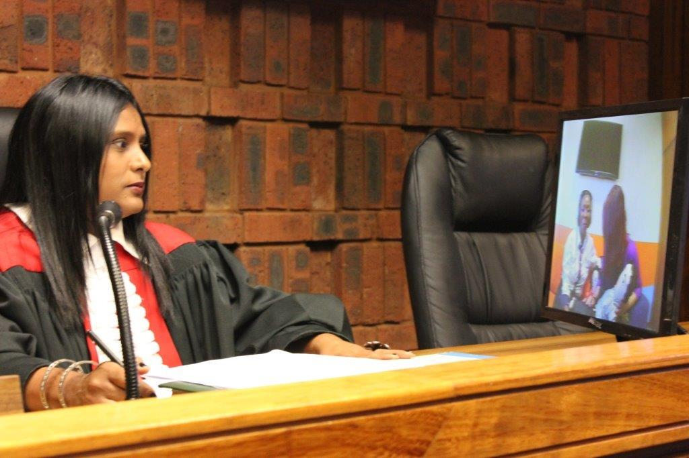
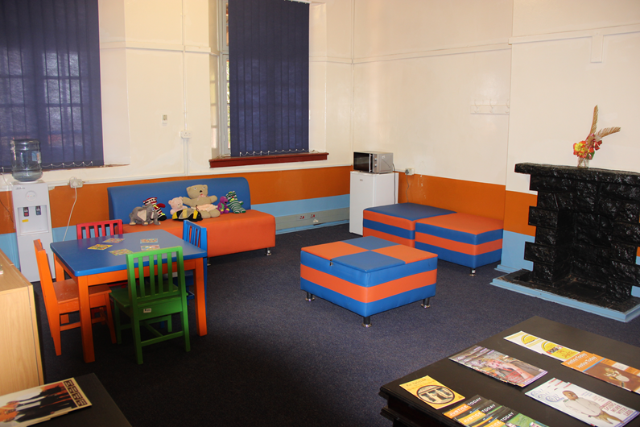
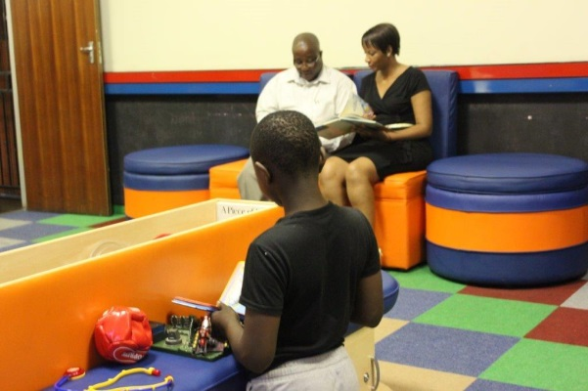
SEXUAL OFFENCES COURTS

Slide 17
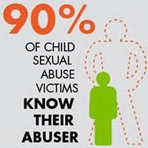
STATISTICS OF SEXUAL OFFENCES AGAINST CHILDREN
STATUTORY RAPE CASES
April to Dec 2022
139 registered cases
3.12% of all registered cases
April to Dec 2021
77 registered cases
2.68% of all registered sexual offences

Slide 18
STATISTICS OF SEXUAL OFFENCES AGAINST CHILDREN
STATUTORY SEXUAL ASSAULT CASES
April to Dec 2022
71 registered cases
1.59% of all registered cases
April to Dec 2021
30 registered cases
1.04% of all registered sexual offences

Slide 19
Apr - Dec 2021 |  |  | Apr - Dec 2022
Charge Name | Total No of Cases | % | Charge Name | Total No of Cases | %
Rape | 2 082 | 72.52 | Rape | 3 318 | 74.41
Sexual Violation of Person | 312 | 10.87 | Sexual Violation of Person | 493 | 11.06
Attempt/induce another person to commit a sexual offence | 111 | 3.87 | Compelled Sexual Assault | 156 | 3.50
Compelled Sexual Assault | 77 | 2.68 | Statutory Rape of a Child | 139 | 3.12
Statutory Rape of a Child | 77 | 2.68 | Attempted Rape | 110 | 2.47
Attempted Rape | 65 | 2.26 | Statutory Sexual Assault | 71 | 1.59
Statutory Sexual Assault | 30 | 1.04 | Compelled Rape | 60 | 1.35
Compelled Rape | 29 | 1.01 | Housebreaking with the Intent to Rape | 26 | 0.58
Housebreaking with the Intent to Rape | 20 | 0.70 | Exposure or displaying pornography to a child | 10 | 0.22
Abduction | 9 | 0.31 | Indecent Assault | 10 | 0.22
Other | 59 | 2.06 | Other | 66 | 1.48
Grand Total | 2 871 | 100.00 | Grand Total | 4 459 | 100.00

Slide 20
Impact: National Court Performance in Sex Crimes
Courts attached to Thuthuzela Care Centres (TCCs)
75.1%
Conviction rate achieved as at 30 June 22
(source: NPA)

Slide 21
CHILD JUSTICE COURTS
CHILD JUSTICE COURTS: TOP 9 CONVICTIONS PER AGES OF CHILDREN: 2021/2022 FY
Charges | AGE |  |  |  |  |  | Total
 | 12 | 13 | 14 | 15 | 16 | 17
Rape | 2 | 3 | 15 | 22 | 17 | 27 | 86
Housebreaking with the Intent to Steal and Theft | - | 2 | 2 | 19 | 27 | 30 | 80
Murder | - | - | 3 | 11 | 16 | 20 | 50
Robbery with Aggravating Circumstances | - | - | 1 | 1 | 8 | 24 | 34
Assault with the intent to do Grievous Bodily Harm | - | - | - | 4 | 12 | 15 | 31
Theft | - | - | 1 | 5 | 8 | 16 | 30
Robbery | - | - |  | 2 | 3 | 20 | 25
Assault | - | - | - | 3 | 3 | 7 | 13
Attempted Murder |  |  |  | 5 | 3 | 5 | 13

Slide 22
CHILD JUSTICE COURTS SENTENCING: 2021/ 2022 FY
Sentencing | 12 | 13 | 14 | 15 | 16 | 17 | Total
Community Service | - | 2 | 1 | 3 | 3 | 1 | 10
Correctional Supervision | 1 | - | 3 | 6 | 16 | 33 | 59
Court Fine | - | - |  | 1 | 1 | 3 | 5
Imprisonment | - | - | 2 | 18 | 30 | 62 | 112
Restorative Justice Sentence | - | - | - | - | - | 1 | 1
Sentence of compulsory residence in child youth centre | - | - | 5 | 12 | 11 | 17 | 45
Sentence Postponed | 1 | - | 8 | 11 | 14 | 18 | 52
Suspended | - | 2 | 11 | 31 | 65 | 117 | 226
Grand Total | 2 | 4 | 30 | 82 | 140 | 252 | 510

Slide 23
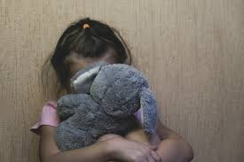
Support Services to Child Victims of Domestic Violence
Child’s rights are explained in the language
of choice and level of understanding;
The Clerk of Court assists child to complete
Order;
Child testifies with the assistance of an
Intermediary
Court accompaniment services permitted
Witness fees (Food and travelling allowance)

Slide 24
Domestic Violence Child Victims
No disaggregated data for child victims of domestic violence.
Integrated Case Management System (ICMS):DV is being upgraded
Child Murders
ICMS: Criminal does NOT capture stats for child homicide cases.
The system is being upgraded
Child Sex Offenders
April to Dec 22
136 children charged with sexual offences
105 children charged with RAPE

Slide 25
The Department is finalizing the development of the Femicide Watch: A National Repository for GBV- Related Femicide Cases, which include CHILD FEMICIDE cases
The Plan is to Publish Femicide Watch in 2023/2024 FY

Slide 27
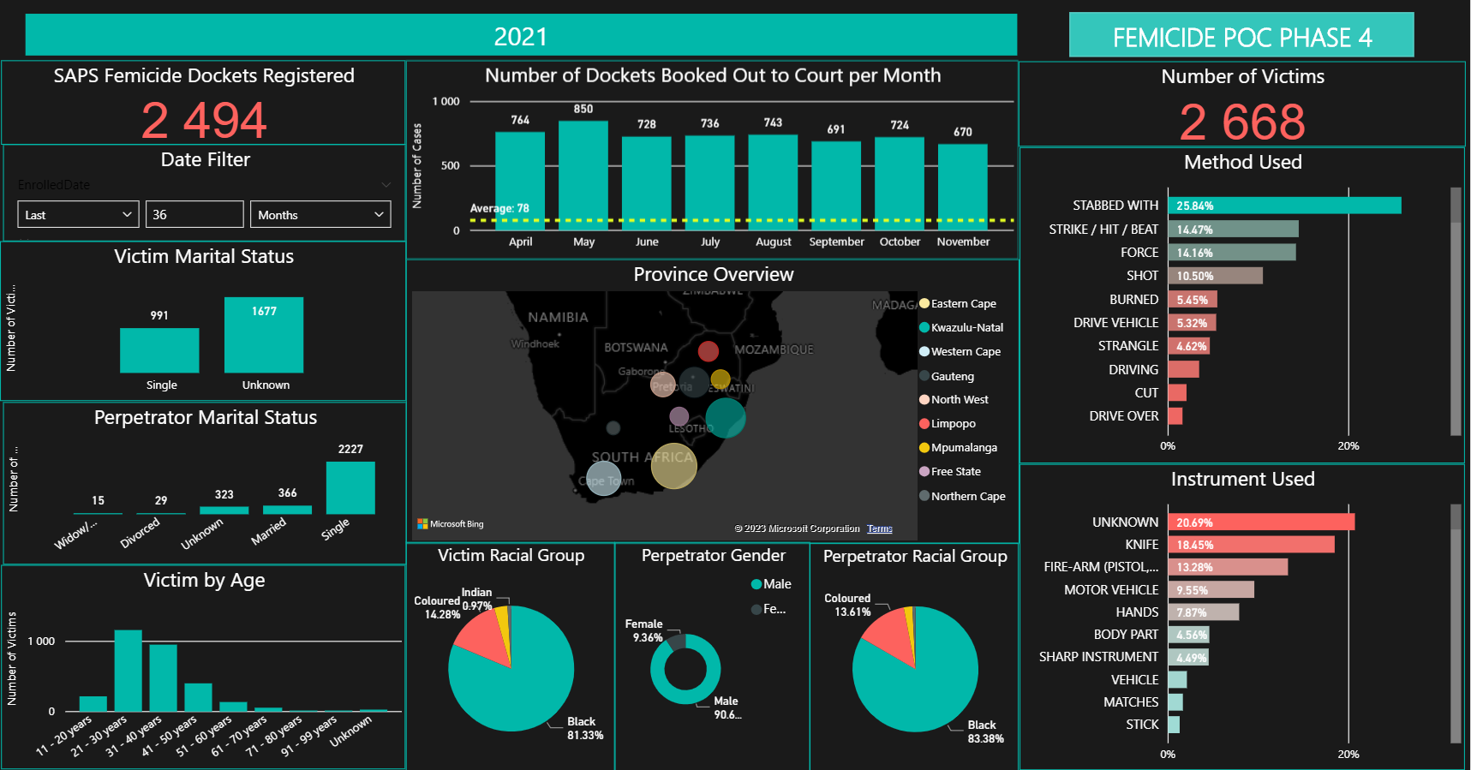

Slide 28
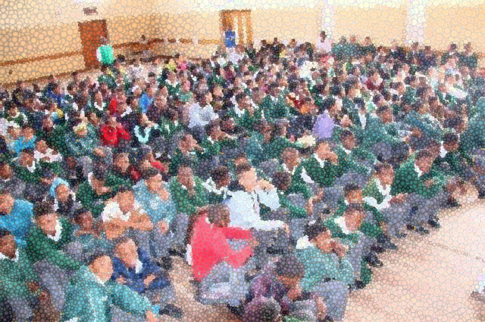
ANNUAL SCHOOLS EDU- CAMPAIGN
2021/2022
100 schools reached
27 841
learners reached
Q1-Q3
2022/2023
54 schools reached
20 281
learners reached

Slide 29
Challenges and Takeaways
The 3 GBV Amendment Acts create a more child-centric criminal justice system;
The ICMS: Criminal does NOT have data metrics for child victims, and this is a lacuna that is being addressed. It is for this reason that the Department cannot provide statistics of child homicide cases. The Criminal Module is being upgraded.
The age of a perpetrator of sex crimes is getting younger in SA. As at 31 Dec 22, out of 136 children charged with sexual offences, 105 were charged with RAPE;
Victim support services often increase the effectiveness of child witnesses in court; hence the conviction rate in sex crimes reported at TCCs linked to Sexual Offences Courts is registered at 75.1%, as reported by NPA
The Femicide Watch dashboard provides data for femicide cases involving child victims;
All social workers, probation officers, shelter workers, and other DSD officials working at service points that give them access to children and other vulnerable persons must be vetted against the National Register for Sex Offenders (NRSO). Failure to do so amounts to a punishable offence;
DSD Social workers are encouraged to provide intermediary services to our courts, particularly in the Children’s Courts.
The Department appreciates the consistent support received from DSD in all intersectoral engagements.

Slide 30
Thank You

