Slide 1

PRESENTATION TO THE PORTFOLIO COMMITTEE
ON SOCIAL DEVELOPMENT:
To brief the Portfolio Committee of Social Development on violence and murder of children in relation to DSD mandate, context, statistics and impact of interventions and programmes.
Wednesday 22 February 2023

Slide 2
Presentation Outline
1. Purpose
2. DSD’s Mandate
3. Contextual Analysis
4. Programmes, interventions and impact
5. Recommendations
1

Slide 3
Purpose
To brief the Portfolio Committee of Social Development on violence and murder of children in relation to DSD mandate, context, statistics and impact of interventions and programmes.
www.dsd.gov.za
2

Slide 4
-A murder of a child in the country is not only a gross violation of the Constitution, but a miscarriage of valuable contribution which this child was going to make to the betterment of our country and the whole world.
Violence against children cannot be tolerated, there is a need for everyone in the country to join forces and stop this brutality.
3

Slide 5
THE DEPARTMENT OF SOCIAL DEVELOPMENT’S MANDATE REGARDING CHILDREN
The Department of Social Development (DSD) is the lead department in the care and protection of children.
Strengthening existing response, care and support services in ways that are victim centred, and survivor focused and trauma informed to facilitate recovery and healing;
The Department derives its mandate on the care and protection of children from Section 28(1) and 28(2) of the South African Constitution (Act 108 of 1996)
The Children’s Act 38 of 2005 gives effect to the rights of children as contained in the Constitution and it sets out principles relating to the care and protection of children
National Strategic Plan on Gender-Based Violence and Femicide (NSP-GBVF 2019-2024) provides a multi-sectoral coherent strategic policy and programming framework to eliminate gender-based violence and femicide against women and children with DSD focusing on Pillar 4 and contributing to other pillars
National Development Plan 2030
However, these Constitutional rights are infringed as the country is confronted with a scourge of violence against children, this include the worst form of violation seen in child murders.
BUILDING A CARING SOCIETY. TOGETHER.
www.dsd.gov.za
4

Slide 6
Contextual Analysis:
Violence against children and gender-based violence issues have been called the country’s second pandemic and have reportedly worsened during and post the COVID-19 hard lockdown.
The scourge of violence against children in South Africa continues to have a negative impact on children and families and the rates of abuse are at an alarming rate, with specific reports of deaths of children allegedly happening at the hands of parents and caregivers.
Violence also harms families across generations, as well as communities and constitutes one of the key drivers of the HIV epidemic in the country.
Substance dependency and abuse as well as unemployment perpetuate violence in families and communities.
Violence undermines social and economic development; it reinforces intergenerational cycles of poverty and inequalities and continues to impede progress towards achievement of the Sustainable Development Goals (SDGs), the National Development Plan 2030 (NDP 2030) and the realization of human rights.
BUILDING A CARING SOCIETY. TOGETHER.
www.dsd.gov.za
5

Slide 7
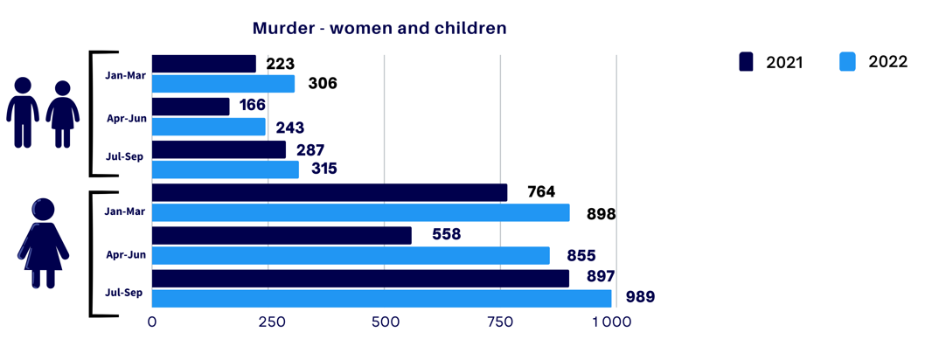
Contextual Analysis Cont.
According to the 2022/23 SAPS Annual Crime Statistics Report
This translates to an average of 9 children per day.
According to the DSD Child Protection Register:
17 488 reported cases of child abuse and neglect with Western Cape leading with 6941 cases followed by Gauteng with 3104 cases and Kwa-Zulu Natal with 3065 cases reported
6

Slide 8
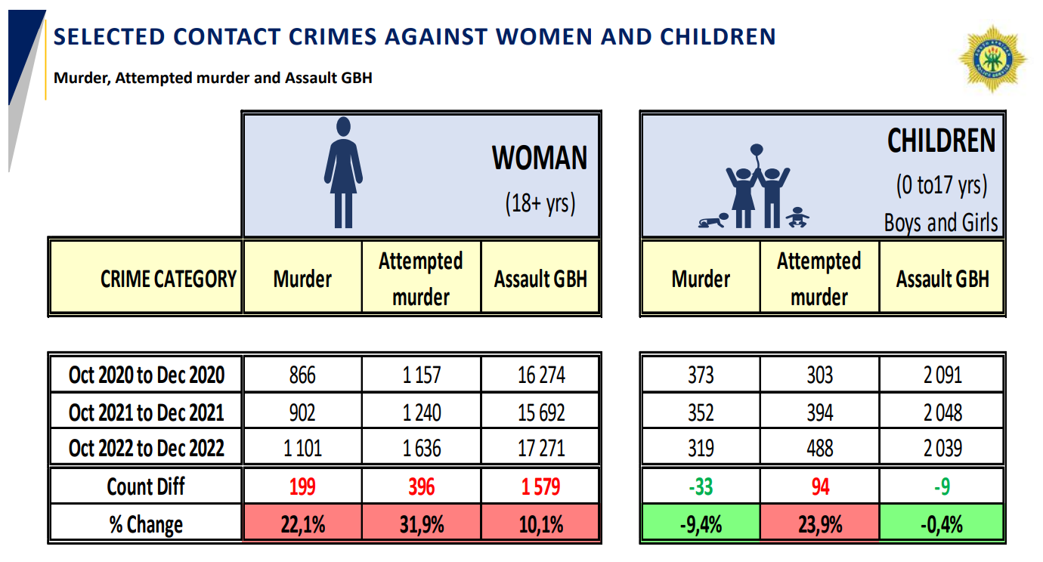
3rd Quarter Crime statistics report
7

Slide 9
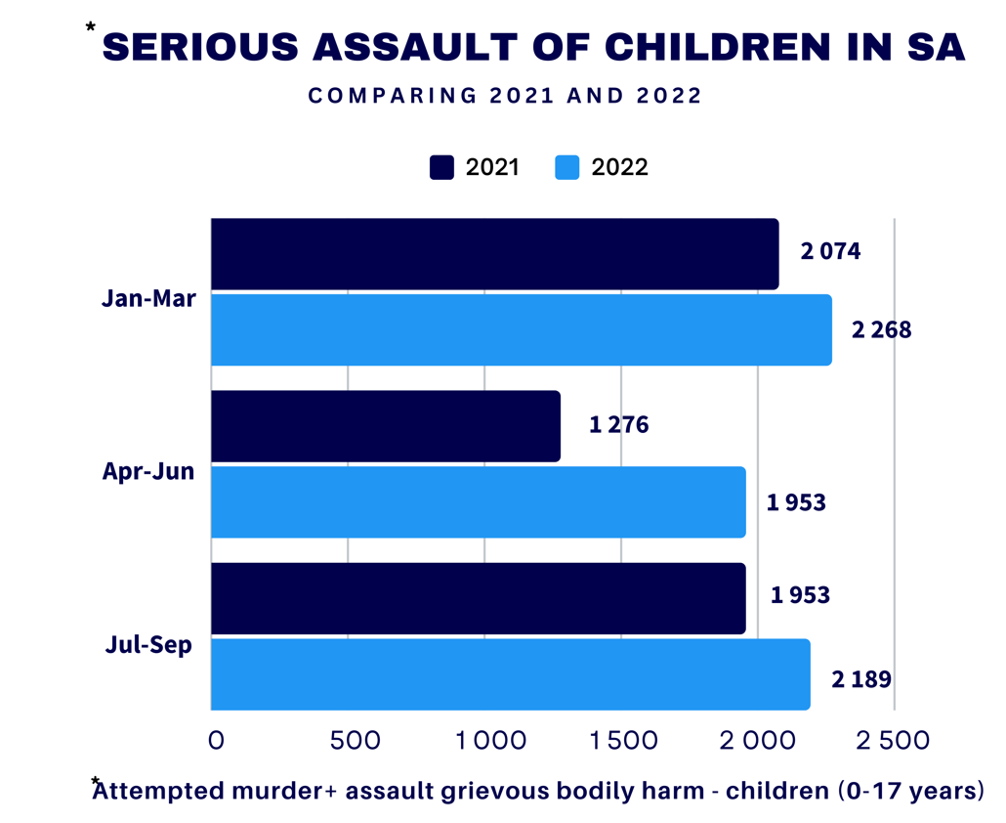
 | SEXUAL ASSULT ON CHILDREN
WP | 2341
KZN | 1418
GP | 1323
EC | 869
MP | 605
FS | 256
LM | 127
NC | 28
NW | 22
RSA | 6989
8

Slide 10

FACTS ON VIOLENCE AND KILLING OF CHILDREN
Violence against children refers to all forms of physical which includes killings, injury or abuse, neglect or negligent treatment, maltreatment or exploitation, including sexual abuse.
Violence against children is mainly caused by the following:
  Rape-Murder i.e. Children are raped and murdered by people that they know
  Traditional/Cultural beliefs and myths e.g. Children with albinism
  Family and relationship breakdown i.e. where one spouse kill the other spouse and the children
  Burden of caring for children due to poverty or mental illness
  Unwanted pregnancies leads to infanticide (killing of new born children)
  bullying and physical fighting among peers (may result in child suicide)
  Gang violence
Children are no longer free to play in the streets even though play is very important for every child’s development.
9

Slide 11
Where violence and murder against children occurs frequently…
Home
Schools
Community
10

Slide 12
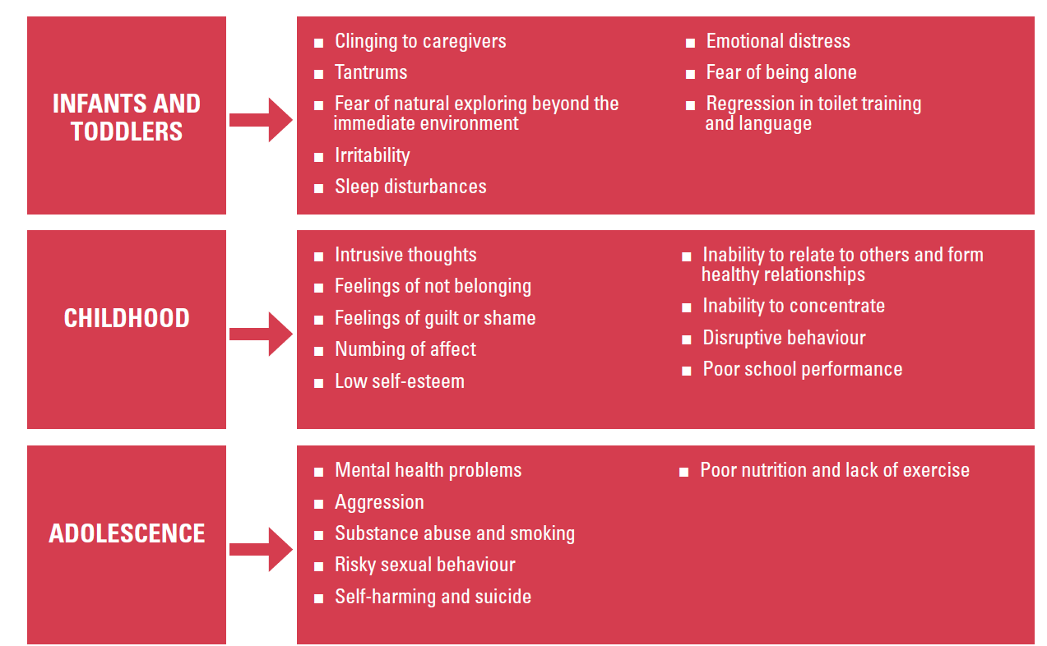
What are the effects of violence against children?
11

Slide 13
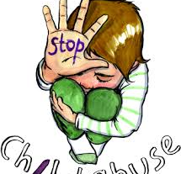
Violence against children is a societal issue and needs a multi-sectoral response …
12

Slide 14
Programmes and Interventions…
The Department of Social Development has different programmes to reduce the levels of VANE in line with strategic policy and legislation National Strategic Plan on Gender-Based Violence and Femicide (NSP-GBVF 2019-2024), and its objectives which amongst which comprise of the following objectives:
Provision of Statutory services within the continuum of care
PILLAR FOUR: Response,
Care, Support
and Healing
4.1 Strengthened existing response, care and support services by the state and civil society in ways that are victim-centred and survivor-focused to facilitate recovery
and healing;
4.2. Secondary victimisation is eliminated through addressing specific individual
and systemic factors that drive it;
4.3. Victims feel supported by the system to access the necessary psychosocial,
material and other support required to assist them with their healing;
4.4. Strengthened community and institutional responses to provide integrated care and support to GBV survivors and their families that takes into account linkages
between substance abuse and HIV and AIDS.
Capacity-Building on the Therapeutic Services for children and families affected by child sexual abuse
Implementation of the Intersectoral Protocol on the management of child abuse, neglect and exploitation
Capacity-building on the guidelines for prevention of and response to Child Exploitation
Provision of crime prevention programmes
Provision of psycho-social support
Provision of Alternative Care services for children who are found to be in need of care and protection
Family preservation programme
(i)Framework of positive values
(ii)Manual on families in crises
(iii)Integrated Parenting Framework
BUILDING A CARING SOCIETY. TOGETHER.
www.dsd.gov.za
13

Slide 15
Programmes and Interventions cont…
The Department of Social Development has different programmes to reduce the levels of VANE in line with strategic policy and legislation National Strategic Plan on Gender-Based Violence and Femicide (NSP-GBVF 2019-2024), and its objectives which amongst which comprise of the following objectives:
PILLAR 1: Prevention and Rebuilding Social Cohesion
2.1. Strengthened delivery capacity in South Africa to roll out evidence-based
prevention programmes;
2.2. Changed behaviour and social norms within key groups as a result of the rollout of evidence-based prevention interventions;
2.4. Optimally harnessed Violence Against Children (VAC) programmes that have
an impact on GBV eradication;
2.5. Increased cross fertilisation and integration of prevention interventions on
violence against LGBTQIA+ persons with broader GBVF prevention and violence
prevention interventions;
2.7. Public spaces are made safe and violent free for all, particularly women and
children.
Education and awareness
365 Days Child Protection Programme of Action against Violence; Child Abuse; Neglect and Exploitation (VCANE). Targeting the 30 GBVF HOTSPOTS
Awareness programme also include Anti-Substance Day
International Day for Families, international and National Children’s Day, Children’s Parliament, Social Crime Prevention Awareness Raising, HIV/AIDS Day
Ezabasha
Sinovuyo
Risiha
Asikhulume…
BUILDING A CARING SOCIETY. TOGETHER.
www.dsd.gov.za
14

Slide 16
Social Behaviour Change programmes …
Risiha
Sinovuyo
What does the programme seek to achieve
Education & Awareness
Policy & Legislation
Psychosocial support
Continuous education and awareness campaigns
Asikhulume
What does the programme seek to achieve
What does the programme seek to achieve
Moving children from vulnerability to resilience
How is it implemented
Children receive services within the social context of their family/household.
Provision of core package of services through the 1200 drop in centres as a method of delivery of services
Services are provided through social service practitioners
This is aimed at addressing the holistic needs of vulnerable children emanating from the high level of poverty, inequality and social exclusion in the country
What is the reach
448 410 children have been reached during 2022/23 financial year
Impact
Protection and safety of children
How is it implemented
What is the reach
Impact
Building strong families that care, protect, support each other and uphold its values
Reached 66 880 parents/caregivers during 2022/23 financial year
Enhancing positive interaction and relationship between parents/caregivers and children.
How is it implemented
What is the reach
Build strong partnership with and mobilize the religious sector to take responsibility and fight violence against women and children in their places of worship
capacitate & empowerment of the religious sector on how to curb the GBVF in their sector
referral of cases to social workers for further services
The programme has been launched in KZN
(365 days campaign which include the national and international education and Awareness days
Has developed the draft Victim Support Services Bill
Policy & legislation
Education & Awareness
Provision of Psychosocial support
15

Slide 17
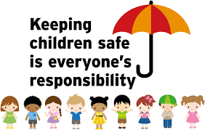


Every child deserves to live in a safe environment, Let’s protect our children…
16

Slide 18
Compendium of Social and Behaviour Change Programmes…
Violence against women and children also results in the increase of new HIV infections.
The Department has developed a Compendium of Social and Behaviour Change (SBC) programmes which places the protection of children and young people between the ages of 10 and 24 at the centre of our interventions.
The Compendium is a basket of 10 different but interrelated SBC programmes which target each individual and groups in the community to bring about positive change in the communities.
The Package of SBC Programmes has been designed as an integrated and holistic interventions with clear linkages between the component parts…implemented as a basket of services delivered together in the same community.
These SBC programmes create awareness and empower the children on issues of safety and protection.
17

Slide 19
Compendium of Social and Behaviour Change Programmes Cont…
The Department funds NPOs through provincial equitable share to implement the programmes. A total number of 42 NPOs are currently funded to implement the programme in 8 provinces, with the exception of Western Cape province.
There has been significant positive impact in communities where the SBC programmes are implemented.
The Department conducted a study to evaluate the effectiveness of the programmes and the findings showed an increase in knowledge post the programme implementation which led to positive behaviour change outcomes.
The following slides depicts the different SBC programmes which are currently being implemented in the country:
18

Slide 20
Compendium of SBC Programmes…
Implemented within same community
Rock Leadership Programme for Traditional Leaders
Families Matter programme
Community Capacity Enhancement (CCE); Social Mobilisation
Men Championing Change Programme
Let’s Talk: Families Programme
Girls and young women(10-24)
Boys Championing Change Programme
ZAZI
ChommY
KeMoja
YOLO
19
Notes:
DSD does a lot
Click
But there is always more to be done…
Other factors that fall within the realm of DSD that could be addressed include:
Click
Building livelihoods of youth – focusing on career building in adolescents and esp young adulthood when grants stop and sexual activity may escalate
Click
Mental health – in RSA depression has been shown to be linked with sex risk behavior. No future – why bother protecting it with a condom?
Click
Family care – building a supportive environment in the home – ongoing protection from abuse and HIV
Click
Help to ensure adherence, among caregivesr and especially children and youth.
Click
Lastly, GBV. A major problem in our communities and something sorely impacting the epidemic.

Slide 21
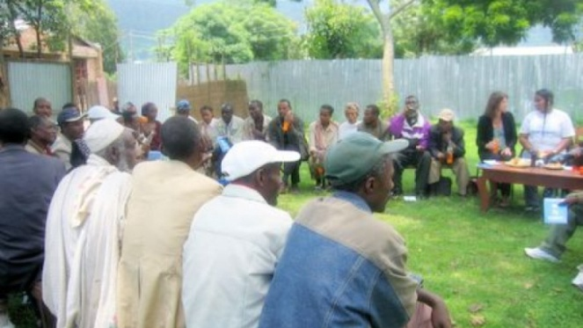

Community Capacity Enhancement (CCE): Social Mobilisation
The CCE methodology premises from the understanding that different communities have different challenges and through dialogues the programme seeks to enhance the communities' capacity to identify and provide solutions to their challenges
Results to a positive shift from risky values, beliefs, actions and behaviours
Build AIDS competent communities
Introduce the package of SBC programmes to the communities
Get buy in of the package of the SBC programmes by the communities
20

Slide 22
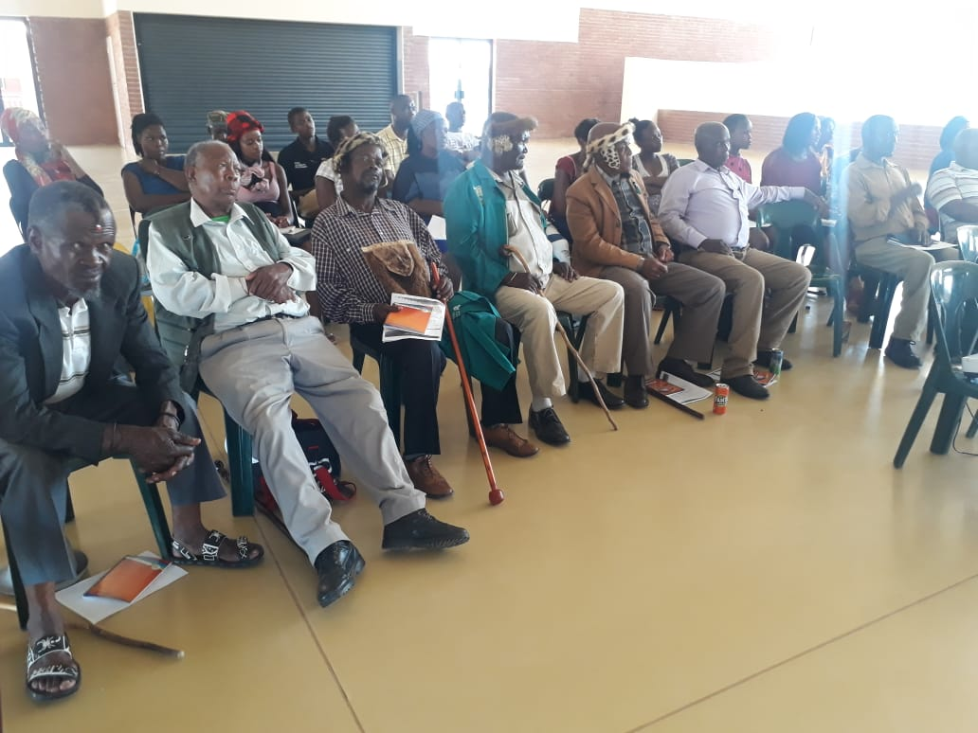
Rock Leadership Programme for Traditional Leaders Programme …
DSD developed the Rock Leadership programme to train Traditional Leaders and foster a partnership with them to address social ills in their communities.
The programme supports and empowers Traditional Leaders with the knowledge and skills to assist their communities to address social issues such as HIV and GBVF through redressing harmful cultural practices, and promoting positive ones, so that they can have a substantial impact in mitigating these twin epidemics.
A total number of 3352 Traditional Leaders, out of 8241 number of Traditional Leaders in the country, were trained on the Rock Leadership Programme
21

Slide 23

Families Matter! Programme (FMP)
Enhancing protective parenting practises associated with reduced sexual risk among adolescents and promoting parent-child communication about sexuality and sexual risk reduction
Gives parents information about the risks their children face
Enhances positive parenting skills to:
  Initiate conversations
  Strengthen relationships
  Protect children from health risks and peer pressure
In the past financial year, 24329 FMP sessions were conducted.
22

Slide 24

Let’s Talk family strengthening programme
Adolescents focus on building skills for better emotional coping, communication, and problem solving. They learn to identify the linkages between their thoughts, emotions, bodily sensations, and behaviours – and to use this knowledge to improve their responses to common stressors in their lives.
Adolescent participants learn about HIV and STI transmission, testing and prevention as well as family planning.
23

Slide 25

The Department developed the Men Championing Change programme to respond to issues of violence against women and children,
Galvanise men to effectively prevent and efficiently respond to issues that adversely affect our communities; and for men to be positive role models in their families (in particular children) and to act as progressive leaders in communities,
Targets men and boys
Men Sector: Men’s Parliaments
Boys Assemblies: Boys Championing Change programme
The Department in partnership with the SANAC’s Men Sector, has conducted 04 National Men’s Parliaments, 22 District Parliaments and 11 Traditional Men’s Parliaments. Each Men’s Parliament was attended by an average of 250 men.
24

Slide 26

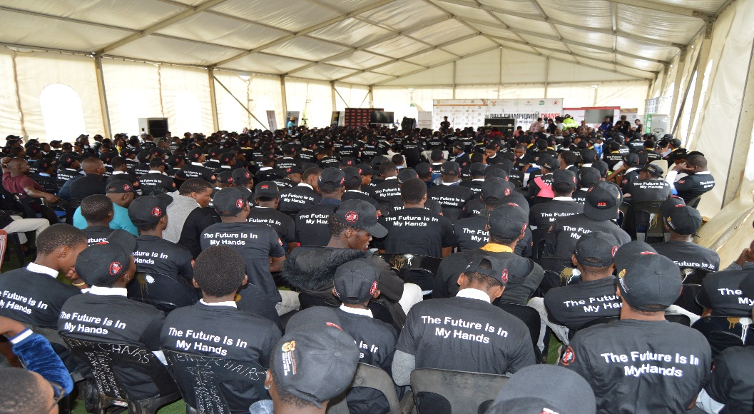
The Boys Championing Change programme targets boys under the age of 18 years old.
The programme aims at developing an increased knowledge and awareness of HIV prevention, gender inequality and harmful gender norms for adolescent Boys.
Adolescent boys are empowered to express more favourable attitudes towards gender equity and an increased value of girls and women in the society.
The Department conducted 10 National and District Boys Assemblies with an average of 500 boys per Boys Assembly.
Further 29814 BCC sessions were conducted in the past financial year by funded NPOs in the country. Each session was attended by an average of 25 boys.
25

Slide 27

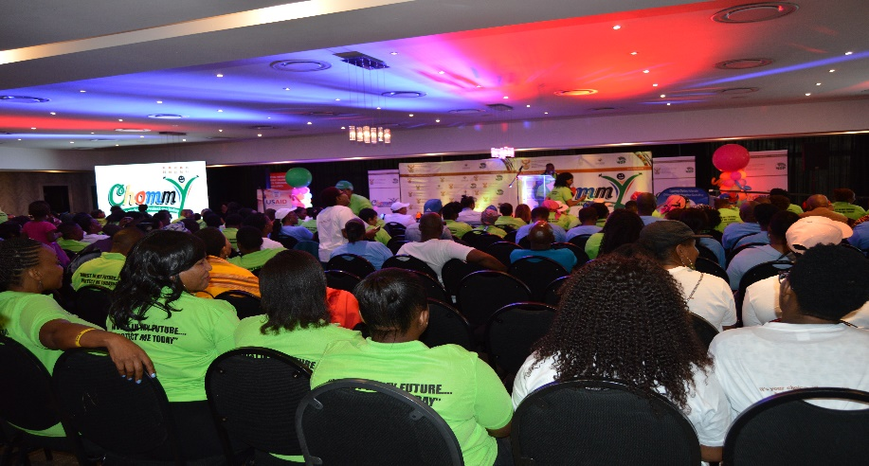
ChommY is an SBC programme that targets children (both genders) between the ages of 10 and 14 under the theme “Invest in my future, Protect me today”.
It instils active citizenry by using indigenous games to stimulate dialogues on issues around child protection, HIV prevention, gender-based violence and substance abuse with a view to reduce HIV infection, teenage pregnancies and child protection.
It equips pre-teens, adolescents and young people with knowledge, skills and values to make responsible choices about their sexual and social relationships.
Funded NPOs conducts interactive sessions with groups of children in schools. Activation events are held in provinces with each activation targeting 200 children.
Recently, webinars for children between 10-14 years old from all provinces were conducted the DSD.
26

Slide 28
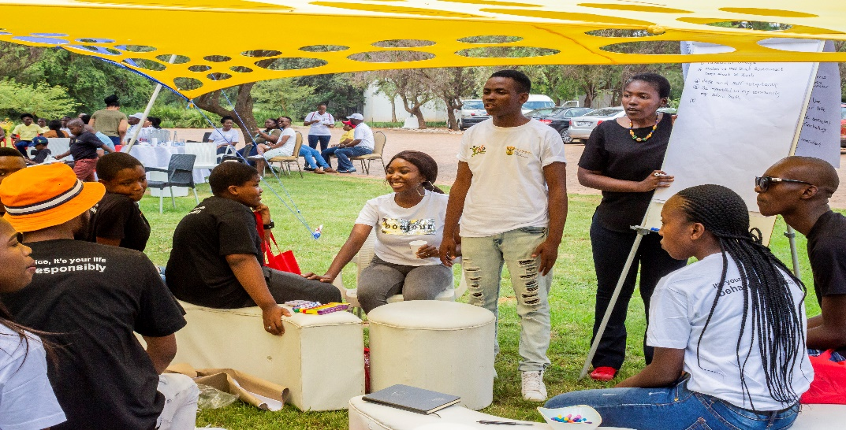

YOLO – “You only live once”
The programme is based on the premise that young people with high levels of self- esteem and self-efficacy are less likely to become victims of violence.
YOLO creates a safe and enabling environment for youth dialogues, where young people can discuss social issues including HIV prevention, teenage pregnancy, gender-based violence, positive values and decision making around sex and sexuality.
Builds resiliency factors, increase their autonomy, self-esteem and self-efficacy to minimise risky behaviours.
A total number of 46204 young people were reached in the past financial year.
27

Slide 29
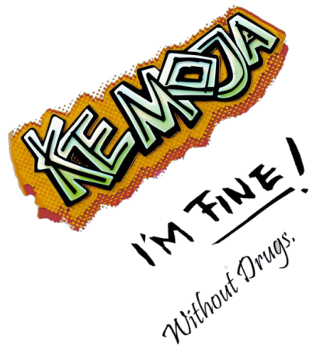
Ke Moja !!!
Creates awareness among young people about harmful effects of substance abuse
Preventing drug dependency, providing information to the young people on drug abuse, educating youth regarding drug abuse
Focuses on healthy lifestyles and alternatives to drugs including alcohol abuse
Promote active citizenry
28

Slide 30
Government to Government Programme (G2G)…
The United State of America Government has entered into a partnership with the Department to scale up the implementation of YOLO and ChommY programme in Free State, Gauteng and KZN.
The G2G programme is being expanded to 2 additional provinces i.e. Western Cape and North West.
The programme is assisting the Department to reach more children and young people to empower them on issues of violence against children and young women.
29

Slide 31
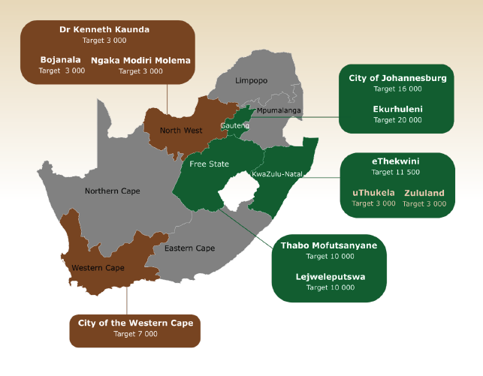
FY 2022/23 (Oct2022-Sep2023)
Targets and NPOs financial allocations summary by District
30

Slide 32
Targets & Financial Allocation – Achieved Annual targets
Indicator | FY 2019/20 |  | FY 2020/21 |  | FY 2021/22 |  | FY22/23
 | Target | Achieved Result | Target | Achieved Result | Planned target | Achieved Result | Planned target
OVC_Serv
 | 25 013 | 35 584 | 30 000 | 37 330 | 24 000 | 42 869 | 74,015
Known HIV Status
 | 23 789 | 1442 | 26 891 | 6 071 | 12 379 | 26 400 | 51,799
FY | Target | Funding
2019-2020 | 25 000 | US$ 1 Million
2020-2021 | 30 000 | US$ 1.2 Million
2021-2022 | 19 500* | US$ 1 33 Million
2022-2023 | 74 015 | US$ 3,6 Million
31

Slide 33
Impact of RISIHA, SBC and G2G Programmes
The Department conducted a study to evaluate the effectiveness of the SBC programmes and the findings showed an increase in knowledge post the programme implementation which led to positive behaviour change outcomes.
There has been significant positive impact in communities where the SBC programmes are implemented namely:
  Created safer spaces for children and reduced vulnerability to violence and murder
  Lead to improved ability to identify and solve the problems children and youth face, skills for coping with difficult emotions, better communication within the children and youth -caregivers, and enhanced knowledge on sexual reproductive health such as the prevention of HIV, other sexually transmitted infections, unintended pregnancy, safe spaces and minimization of exposure to dangerous places.
32

Slide 34
Recommendation(s).
It is recommended that the Portfolio Committee members consider the DSD report on violence and murder of children in relation to DSD mandate, context, statistics and impact of interventions and programmes.
www.dsd.gov.za
33

