Slide 1
ANALYSIS, IMPLICATIONS AND IMPACT OF THE PRESIDENT’S 2023 SONA Presentation to the Portfolio Committee on Basic Education 21 FEBRUARY 2023

Slide 2
PRESENTATION OUTLINE
Purpose
Background: Strategic Priorities
Progress in the sector
Significance of the SONA
and government priorities
5. Analysis of SONA 2023
6. Comparison with Recent SONAs
7. Progress against previous SONAs
8. Recommendations.
2

Slide 3
PURPOSE
To present the Analysis, Implications, and Impact of the President’s SONA and the Budget to the Portfolio Committee on Basic Education.
3

Slide 4
INTRODUCTION
“By 2030, South Africans should have access to education and training of the highest quality, leading to significantly improved learning outcomes. The performance of South African learners in international standardised tests should be comparable to the performance of learners from countries at a similar level of development and with similar levels of access.”
(National Planning Commission: National Development Plan, November 2011)
4

Slide 5
TRACKING IMPLEMENTATION OF SONA COMMITMENTS
Branches are encouraged to make SONA pronouncements part of their deliverables and make sure recourses are availed.
The DG holds quarterly reporting meetings where DBE line functions to report on the progress made on the SONA commitments.
The DBE also submits progress reports to the Presidency.
5

Slide 6
BACKGROUND:
STRATEGIC PRIORITY AREAS IN BASIC EDUCATION
6

Slide 7
STRATEGIC DIRECTION
How the sector plan relates to Sustainable Development Goals and other plans (and reports)
Sector plan
Action Plan to 2024: Towards the realisation of Schooling 2030 (access, redress, equity, inclusivity, quality, & efficiency)
NATIONAL DEVELOPMENT PLAN (NDP)
Independent analysis conducted by DBE
Medium Term Strategic Framework (MTSF)
DBE and PED five-year strategic plans
Periodic reports on progress in the sector (see e.g., 2011 and 2013 reports on DBE website)
Presidency
External evaluations of key programmes;
SONAs
DBE and PED annual performance plans
DBE and PED annual reports
UNESCO 2030 AGENDA & CESA 2016-25 on the AFRICAN AGENDA 2063
PED quarterly sector reports
5

Slide 8
5 GOALS/OUTCOMES FOR GOVERNMENT – MTSF 2019-2024
We must overcome poverty and hunger, joblessness and inequality.
We must overcome a legacy of exclusion and dispossession that continues to impoverish our people.
Our economy will grow at a much faster rate than our population.
Our schools will have better educational outcomes and every 10 year old will be able to read for meaning.
Violent crime will be halved.
8

Slide 9
MEDIUM-TERM STRATEGIC FRAMEWORK (MTSF) 2019-2024 OUTCOMES (EDUCATION)
Outcome 1: Improved school-readiness of children.
Outcome 2: 10-year-old learners enrolled in publicly funded schools read for meaning.
Outcome 3: Youths better prepared for further studies and the world of work beyond Grade 9.
Outcome 4: Youths leaving the schooling system more prepared to contribute towards a prosperous and equitable South Africa.
Outcome 5: School physical infrastructure and environment that inspires learners to learn and teachers to teach.
9

Slide 10
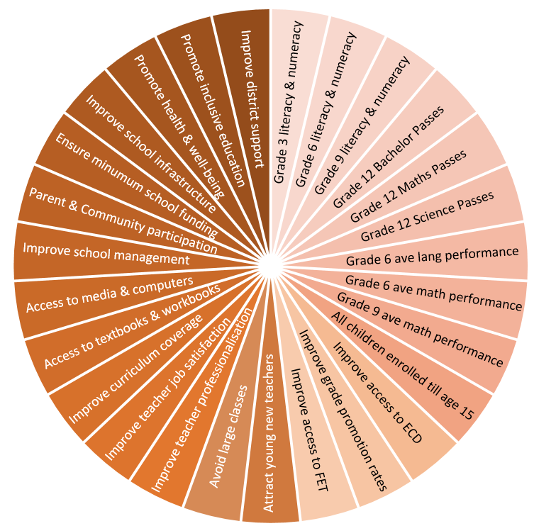
STRATEGIC THRUST
Sector plan
Action Plan to 2024: Towards the realisation of Schooling 2030 (access, redress, equity, inclusivity, quality, & efficiency)
26
27
1
2
25
3
24
4
Goals 1 to 13:
Improvement of Learning Outcomes
Improve learning outcomes in Language, Mathematics and Science as measured in Grades 3, 6, 9 and 12
Ensure full access to compulsory schooling
Decrease grade repetition and retention
Improve access to FET colleges
Improve quality of Grade R
23
5
22
6
21
7
20
8
19
9
18
10
Goals 14 to 27:
Support the improvement of learning outcomes
11
17
16
13
12
15
14
10

Slide 11
Progress in the sector
11

Slide 12
PROGRESS IN THE SCHOOLING SYSTEM
The basic education sector in South Africa has made significant progress towards transformation along six internationally acknowledged dimensions: access, redress, equity, quality, efficiency and inclusivity.
There is now near-universal access to schooling – measured by the attendance rate amongst learners of the compulsory school-going age (7 to 15-year-olds)
this has been above 98% ever since about 2009.
South Africa continues to participate in international assessments of learning (e.g. TIMSS, PIRLS, SACMEQ)
Assessments have collectively revealed significant improvements in the learning since about 2002, albeit from a weak starting point

Slide 13
PROGRESS IN THE SCHOOLING SYSTEM
The TIMSS 2019 result showed a substantive improvement in the Maths and Science performance of Grade 9 learners.
In 2002, merely 10.5% of Grade 9 learners performed at or above a minimum proficiency level in Mathematics
in 2019 this has increased to 41%.
The PIRLS results between 2006 and 2016 similarly showed that South Africa is at a fast rate of improvement by international standards and had the steepest improvement after Morocco and Oman (Gustafsson, 2020).
PIRLS 2021 coming out in May 2023

Slide 14
PROGRESS IN THE SCHOOLING SYSTEM
Impact of the pandemic:
Lost teaching time
Young children most affected
Dropout not yet an issue
Improved efficiency – NSC results
Massive learning losses – reiterates the major long-term challenge

Slide 15
PROGRESS IN THE SCHOOLING SYSTEM
2022 NSC shows resilience of the system:
More candidates, passes and bachelor passes have been recorded than ever before
NSC recipients doubled from 287,500 (1994) to 580,555
Girls make up 56.3% of overall NSC passes.
65.1% of learners qualify for Higher Education (472,171), with 3,235 progressed learners admitted to bachelor studies.
95.9% of Correctional Services learners passed the NSC.
439 learners with special needs admitted to bachelor studies with a 79% pass rate.
Black African Grade 12 learners achieving engineering faculty requirements have tripled in 20 years, while it has remained stable for white learners.

Slide 16
SIGNIFICANCE OF SONA
Presidential pronouncements contribute to setting the key government priorities and deliverables:
In turn, determine the priorities of the DBE and the basic education sector broadly.
The pronouncements commit the DBE, in public, to key activities and outcomes.
It is important to ensure and show alignment to current annual plans for the DBE and for the sector.
16

Slide 17
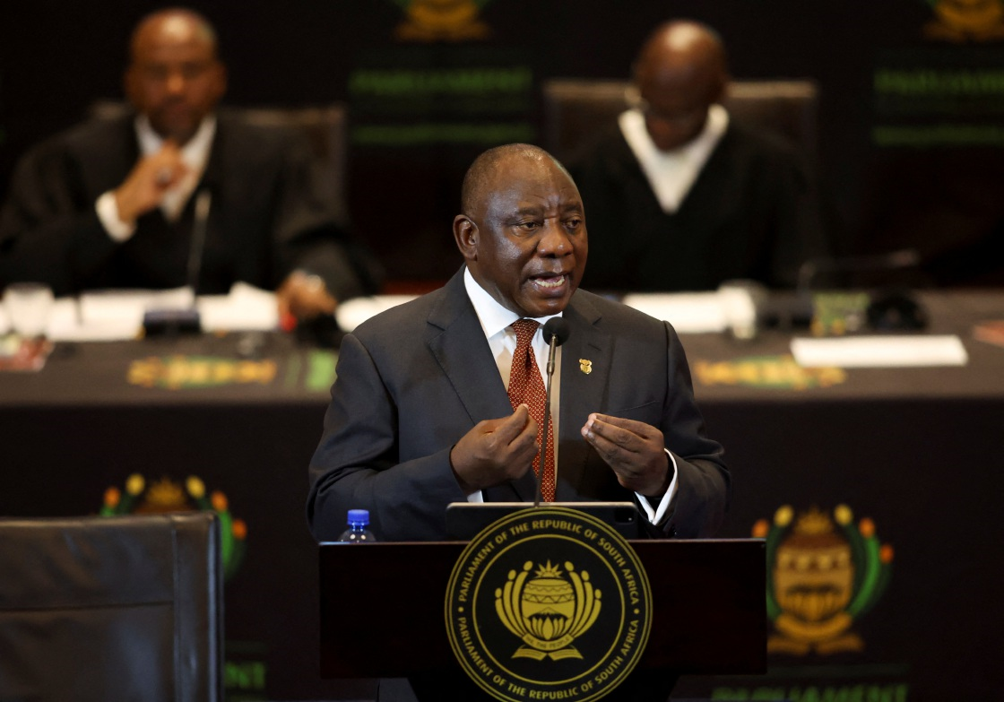
SONA 2023
“Even in these trying times, it is hope that sustains us and fuels our determination to overcome even the greatest of difficulties.”
17

Slide 18
SONA 2023
Early Childhood Development
“We need to start with children who are very young, providing them with the foundation they need to write and read for meaning, to learn and develop.”
“It is, therefore, significant that the number of children who receive the Early Childhood Development (ECD) subsidy has more than doubled between 2019 and 2022, reaching one-and-a-half million children.”
“The Department of Basic Education is streamlining the requirements for ECD centres to access support and enable thousands more to receive subsidies from government.”
18

Slide 19
SONA 2023
Infrastructure
“The Sanitation Appropriate for Education Initiative – known as SAFE – together with government’s Accelerated School Infrastructure Delivery Initiative has built 55 000 appropriate toilets with resources from the public and private sector.”
Three Streams Model
“To produce the skills our country needs, we are expanding vocational education and training systems through the implementation of the approved curriculum of the three stream model.”
19

Slide 20
SONA 2023
Matric Results
“While at the other end of the basic education journey, we must applaud last year’s matric pass rate of 80%, with all provinces showing improved results.” “This was up from 76% the year before.” “The share of bachelor passes in no-fee schools improved from 55% in 2019 to 64% in 2022.” “This means that the performance of learners from poorer schools is steadily improving, confirming the value of the support that government provides to them.” “What these results reveal is that there is a silent revolution taking place in our schools.”
20

Slide 21
COMPARISON TO RECENT SONAs
21

Slide 22
COMPARISON OF PREVIOUS SONA Focus areas
Feb 2020
Feb 2021
Early Learning: Reading & Numeracy
Early Learning: Reading & Numeracy
Lessen Covid-19 related school disruptions
Migration of ECD
Improving educational outcomes
Fourth Industrial Revolution and ICTS/Operation Phakisa
Focus on ECD planning and funding
Competencies and Skills for a Changing World
Coding & Robotics
Improving school readiness and safety
LSEN Support: SASL as HL
22

Slide 23
COMPARISON OF PREVIOUS SONA Focus areas
Feb 2021
Feb 2022
Early Learning: Reading & Numeracy
School infrastructure
Lessen Covid-19 related school disruptions
Improving educational outcomes
Learning Recovery
Focus on ECD planning and funding
Teacher Assistants
Improving school readiness and safety
23

Slide 24
COMPARISON OF PREVIOUS SONA Focus areas
Feb 2022
Feb 2023
Focus on ECD support and expansion
School infrastructure
School infrastructure, SAFE & ASIDI
Expansion of vocational training
Learning Recovery
Teacher Assistants
Matric Results
24

Slide 25
PROGRESS AGAINST PREVIOUS SONAs
25

Slide 26
The Vision for ECD with DBE
The five strategies for improving the quality of ECD in South Africa:
Curriculum-based early learning for all children birth to 5 years – implementing the National Curriculum Framework.
Access to early childhood development programmes for all children from birth to 5 years – a continuum of programmes.
Training and development for all those working in ECD – career paths, with intensive but flexible training opportunities.
Co-ordination of all ECD services.
A flexible funding and provisioning framework.
26

Slide 27
EARLY CHILDHOOD DEVELOPMENT
SONA COMMITMENTS | PROGRESS REPORT | CHALLENGES
2020 COMMITMENTS Government will also ensure that young people are employed in social economy jobs such as ECD & health care. | Investigating the possibility of a Presidential Stimulus Package for ECD. A framework to detail what this package could look like has been developed. | Funding not yet confirmed
27

Slide 28
EARLY CHILDHOOD DEVELOPMENT
SONA COMMITMENTS | PROGRESS REPORT | CHALLENGES
2022 COMMITMENTS Improving school readiness, ECD planning and funding, protection against preventable diseases, policy reform around child welfare and reducing violence against children. | ECD funding: A Public Expenditure and Institutional Review has been conducted in collaboration with the World Bank, National Treasury, the Department of Health and the Department of Social Development. The department is using two methods of payment; the subsidy paid through the Equitable Share and the Conditional Grant (CG). For standardization, the department reviewed the subsidy guidelines to guide provinces on the implementation of the above subsidies. The review of the guidelines have been finalized. | Low expenditure by provinces Delays in appraisal of business plans and signing of service level agreements
28

Slide 29
EARLY CHILDHOOD DEVELOPMENT
SONA COMMITMENTS | PROGRESS REPORT | CHALLENGES
2022 COMMITMENTS Improving school readiness, ECD planning and funding, protection against preventable diseases, policy reform around child welfare and reducing violence against children. | ECD planning: MOU signed with Ilifa Labantwana for the long-term development of an ECD MIS system based on the customization of the WC NPO system; ECD Census data integration is being consolidated by Data Innovators and Nelson Mandela Foundation for the short run use of the Vangasali Registration Management Tool Implementation of the Vangasali Campaign for registration massification. Provinces to capture the information of registered programmes on the system and to process new registrations on the Vangasali Registration Management Tool. | Insufficient resources transferred in provinces for registration processing.
29

Slide 30
EARLY CHILDHOOD DEVELOPMENT
SONA COMMITMENTS | PROGRESS REPORT | CHALLENGES
2022 COMMITMENTS Improving school readiness, ECD planning and funding, protection against preventable diseases, policy reform around child welfare and reducing violence against children. | Improving ECD planning: The DBE is in the process of developing a Quality Assurance and Support System. In November the tools have been alpha tested in the Eastern Cape and the Western Cape. A workshop was also held on developing the business processes for the QASS. The DBE has also drafted Second Children’s Amendment Bill, and is busy reviewing the regulations, norms and standards. The purpose of this is to reduce red tape in the sector. The DBE will be conducting an implementation evaluation of the National Integrated Early Childhood Development Policy (NIECDP). The TOR for a service provider has been drafted. | Tools can only be finalised once the Norms & Standards for ECD is finalised. Processing SCAB through Parliament None
30

Slide 31
READING
SONA COMMITMENTS | PROGRESS REPORT | CHALLENGES
2019/2020 COMMITMENTS We are implementing the Early Grade Reading Programme, which consists of an integrated package of lesson plans, additional reading materials & professional support to Foundation Phase teachers. | EARLY GRADE READING STUDY(EGRS) EGRS: Impact evaluation results at the end of Grade 7 show sustained impact of EGRP intervention. EGRP: Implementation in Dr RSM in 140 schools from 2021-2023 is ongoing. Can DH’s play a coaching role within schools? African Languages Reading Benchmarks: Nguni languages, EFAL, Sesotho-Setswana, Afrikaans benchmarks reports launched The Xitsonga and TshiVenda benchmarks under development Teacher benchmark usage research underway. | Planning and funding for expansion

Slide 32
READING
SONA COMMITMENTS | PROGRESS REPORT | CHALLENGES
2019/2020 COMMITMENTS Improve teaching how to teach reading for meaning in the early grades. | The ETDPSETA has approved funding for PSRIP 5 for implementation from Nov 2022 – Dec 2023. 1500 Foundation teachers (Gr 1 -3) and 70 Subject advisors as well as 1500 teachers (Gr 4- 7) and 70 Subject advisors in the Intersen phase will be trained on PSRIP methodology. Phase 4 of the Reading Champion programme will include quality refinements to use young people to improve reading; Phase 3: 849(97%) of surveyed Reading Champions thought they had made learners in their school more interested in reading. Other campaigns are ongoing to raise awareness across society about the value of reading: Read to Lead National Reading Coalition Virtual Book clubs Book collection boxes | Budgetary constraints

Slide 33
INCLUSIVE EDUCATION
SONA COMMITMENTS | PROGRESS REPORT | CHALLENGES
2019/2020 COMMITMENTS We need to provide skills & create economic opportunities for persons with disabilities. It is therefore a matter of great concern that there are around half a million children of school-going age with disabilities who are not in school. | The Directorate: Inclusive Education has: Focused on implementing inclusive education across the system, including: Mobilizing out-of-school children/learners of school-going age Improving admission processes via the district office Strengthened teacher competencies and qualifications in specialized areas of inclusion, including: Collaboration with British Council, DHET, and HEIs Funza Lushaka funds teachers who take courses in specialized areas of inclusion Q2: 19,093 teachers trained on SASL, Autism, braille, and other areas Implemented SIAS as a mechanism for early identification and addressing of barriers to learning and development. | Insufficient spaces in special schools Slow pace on the placement of learners from special care centres to schools Backlogs in the assessment of the intellectual functioning of learners for appropriate support. Vacancies of inclusive education personnel at district level. Vacancies at district level in some PEDs: Inadequate therapeutic support mechanisms at that level.

Slide 34
THREE STREAM MODEL
SONA COMMITMENTS | PROGRESS REPORT | CHALLENGES
2019 COMMITMENTS Several new technology subjects and specialisations will be introduced. To expand participation in the technical streams, several ordinary public schools will be transformed into technical high schools. 2020 COMMITMENTS We are making progress with the introduction of the three-stream curriculum model, heralding a fundamental shift in focus towards more vocational and technical education. Various technical vocational specialisations have already been introduced in 550 schools and 67 schools are now piloting the occupational stream. | INCREASED ENROLMENTS in technical subjects (2019 -2021) 23% Civil Specialisations (6020 – 7395) 18 % Electrical Specialisations (6057 - 7138) 17 % Mechanical Specialisations (6478 – 7578 ) 15% Engineering Graphics & Design (32 280 - 37 131) 37% Technical Mathematics (9 670-13 295) 34% Technical Science (10 862 – 14 533) PARTNERSHIPS Sasol Foundation to quality assure LTSM and supporting a Skills Competition. DHET Skills Centres for teacher training on practical components (Voc & Occ) National Assoc. of Schools of Technology (NAST) GET BAND Draft CAPS finalised for 37 GET subjects by DBE 105 Public Ordinary Schools piloting 13 Vocational Subjects for Grades 8 & 9 74 Schools of Skills (Years 1-4) offering Occupational Subjects in GET Band. 268 POSs piloting General Education Certificate (GEC) programme LTSM - Vocational 48 books completed LTSM - Occupational 166 books completed 46 Provincial coordinators trained on Occupational and Vocational Curriculum | Lack of suitably qualified subject advisors and teachers for the new Occupational and Vocational subjects (GET) Inadequate funding for teacher training on the practical component for Occupational subjects

Slide 35
SKILLS FOR A CHANGING WORLD
SONA COMMITMENTS | PROGRESS | CHALLENGES
2019 COMMITMENTS In line with our Framework for Skills for a Changing World, we are expanding the training of both educators and learners to respond to emerging technologies including the internet of things, robotics and artificial intelligence. It is why we are emphasising the teaching of science, technology, engineering & maths in schools, why we are introducing subjects like coding & data analytics. Improve the education system and develop the skills that we need now and into the future. 2020 COMMTMENTS This year, we will be introducing Coding and Robotics in Grades R to 3 in 200 schools, with a plan to implement it fully by 2022. | CODING AND ROBOTICS: Draft CAPS finalised 2020 2021 Pilot implementation to Grades R-3 (200 schools) and Grade 7 (1000 schools) 2022 Review and Revision of draft CAPS finalised by DBE. LTSM, devices and kits provided to piloting schools Lesson plans are available for grades R-3 on the MOOC/UNISA platform Teacher training provided to Grade R-3 teachers in all piloting schools Coding Clubs formed PED Project Management Teams established and functional. Teacher training in has been successfully implemented 861 lead teachers & 17 316 teachers trained Evaluation forms indicate that teachers have a clearer understanding of coding and robotics. | PEDs subject specialists are not appointed. No DBE-PED dedicated funding for teacher training for Grades R-3 and Grades 4-6 PEDs expenditure on procurement of equipment still inadequate- though improving. Load shedding disrupts curriculum delivery & teacher training

Slide 36
INFRASTRUCTURE
SONA COMMITMENTS | PROGRESS | CHALLENGES
2019/2020 COMMITMENTS We are determined to eradicate unsafe and inappropriate sanitation facilities within the next three years targeting the nearly 4 000 schools that still have inappropriate sanitation facilities. | Under ASIDI: 306 new schools built, 21 to be completed in 2022/23. 1,251 water supply projects done, 21 to finish in 2022/23. 15,000 toilets built in 1,047 schools, 6 schools to be completed in 2022/23. 373 schools provided with electrical connections. Under SAFE: The SAFE programme was launched to address the eradication of basic pit toilets at 3 395 schools. About 50 000 appropriate toilets were constructed at 2 388 schools. Sanitation projects at the remaining 1 007 schools are scheduled for completion in 2023/24. | Challenges remain, including unreliable water sources, inadequate buildings, and overcrowding.

Slide 37
SOCIAL COHESION
SONA COMMITMENTS | PROGRESS REPORT | CHALLENGES
2019/2020 COMMITMENTS Focus on the first 1 000 days in every child’s life through investment in adequate health care, positive socialisation, good nutrition, social grants, quality childcare, a clean and safe environment and structured early learning. | NSNP provides 9M+ meals/day, crucial during pandemic ECD menus for 2-5 y/o presented to Senior Management Gender Responsive Pedagogy Toolkit for ECE developed and rolled out National School Safety Framework (NSSF): DBE monitoring tool for school safety, sports, gender & social cohesion implemented in 60 districts DBE Policy on the Prevention and Management of Learner Pregnancy in Schools (LPPM): disseminated across provinces | Technical issues hinder EDC practitioners from accessing GRP4ECE digital resources. Inadequate personnel of Social Cohesion and School Safety Coordinators at District Level

Slide 38
RECOMMENDATION
It is recommended that the Portfolio Committee on Basic Education to note the analysis of the education components of the SONA and discusses implications for the sector.
38

