Slide 1
Joint oral presentation on 21 February 2023 to
The Select Committee on Trade, Industry, Economic Development, Small Business Development, Tourism, Employment and Labour
Copyright Amendment Bill
& Performers’ Protection Amendment Bill

Slide 2
The IPO, ASA and IBFC thank you for this opportunity to engage
About the IPO:
The Independent Producers Organisation (IPO) is a national organisation which represents, protects and promotes interests and needs of independent South African film, television and new media producers.
It strives towards creating an empowered, transformed and representative industry, by partnering with key stakeholders towards the advancement of a sustainable and enabling environment for producers and, recognizing their role and responsibilities as the engine drivers of work throughout the industry value chain, to creating opportunities for the full value chain of workers across and suppliers to the sector.
The IPO aims to maximize the industry's potential to contribute to the country's economy, and to preserve and promote South Africa's national identity and stories.
It currently represents over 70% of working producers in South Africa. The majority of its individual members are Black and the majority of it company members are Level 1 or 2 BEE Compliant

Slide 3
The IPO, ASA and IBFC thank you for this opportunity to engage
About ASA:
Animation South Africa is an industry association representing the interests of animation and VFX professionals, which includes performers (motion capture artists and voice-over talents)
Our vision is to create the conditions necessary to foster a globally competitive, sustainable, and inclusive growth for the animation and VFX industry in South Africa. All of our efforts are aimed at growing and supporting our industry

Slide 4
The IPO, ASA and IBFC thank you for this opportunity to engage
About The IBFC:
The Independent Black Filmmakers Collective (IBFC) is a membership-based, non-profit entity supporting collaborative business-to-business networking, advocacy and empowerment of black filmmakers and content producers. The IBFC’s membership is comprised of wholly black-owned South African film and television production companies, independent filmmakers and content creators, and producers, marketers, exhibitors, distributors, media and entertainment facility owners, and entrepreneurs.

Slide 5
Our role in the AV sector
Jointly, the IPO, IBFC and ASA represent almost all those companies and individuals responsible for ALL WORK GENERATED IN THE SOUTH AFRICAN AUDIOVISUAL SECTOR:
creating work opportunities for writers, actors, crew – from highly skilled to unskilled new industry entrants, publicists, location scouts, stunts people, caterers, drivers, seamstresses, construction workers, artisans, editors, special effects, animators, musicians, animal handlers, voice-over artists, distributors…
creating income-generating opportunities for all suppliers to and downstream beneficiaries of the industry – airlines, studios, logistics, equipment and props hiring, costumiers, transport, hospitality/accommodation, armourers, location scouts, location hire, insurance, florists, health & safety companies, tour operators, restaurants … and all the people they employ
attracting billions in Foreign Direct Investment
and taxes paid throughout the direct, indirect and induced value chain
NB: 67% of below-the-line production spend flows to other sectors, rapidly spreading funds throughout the wider economy during the short shooting period of the production

Slide 6
Benefits for the Wider Economy
• On average, 67% of below-the-line production costs are spent in business sectors outside of the film and TV production industry
Film and TV production investment positively impacts other areas of the economy
Proportion of Production Spend in Other Business Sectors by Project Type (%)

Slide 7
The Speed of Impact
• Analysis of several actual film and television budgets show how quickly the economic impact of film and TV production is delivered
• For example, a major $220 million budget film shows that an average of $10 million per week was spent during the 16-week shoot.
Film and TV productions inject huge amounts of capital very rapidly
Major Film Weekly Cashflow ($220 Million Budget)

Slide 8
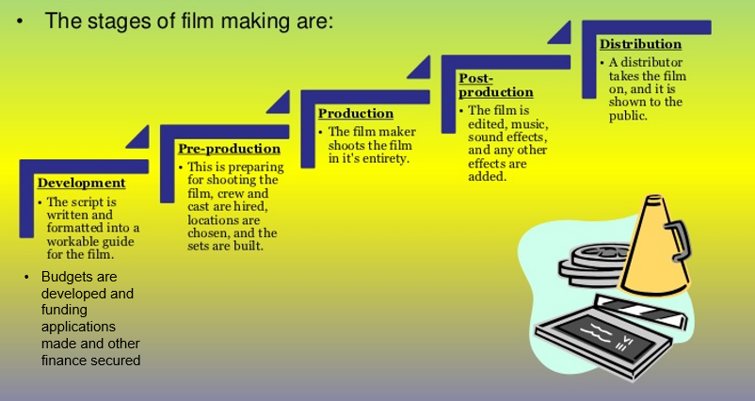
About the South African AV sector - how we work
Most production companies are small/micro businesses, almost all Level 1 or 2 BEE Compliant
Some scripts are producers’ concepts developed by writer, some are scriptwriters’ pitched to producers
Production budgets are secured through combination of grants, rebate incentives and private or institutional investment or loans, sometimes advances from distributors
Some productions eg SABC or Streamers are 100% commissions, some co-productions, some international productions shot in SA
+-9/10 productions don’t make a profit. Any profits generated are used by producer to cover development time on the next production and ongoing office overheads
This is the stage where actors and crew work on a production

Slide 9
About the South African AV Sector - economic overview:
Creative Industries contribute 3% to the GDP. Of that, 30% is the AV sector’s contribution
pre-Covid, valued at R8-10 billion - over R3.4 billion was Foreign Direct Investment
grew @ 5.2% year-on-year – higher than national average
+- 60 000 full time, FTE & freelance jobs (120 000 when including induced jobs)
jobs range from highly-skilled, world-class cast & crew to artisans and unskilled new entrants to the workplace who can go on to build successful careers in the industry
85% of workforce is from PDI population groups
65% of the workforce under the age of 35 - addresses youth unemployment and NDP 2030 goals
employment multiplier (2019/20) 5.65 (SA All Industries 3.10)
economic multiplier (2019/20) 2.82 (SA All Industries 1.75)
contributes meaningfully to direct and indirect taxes throughout value chain
premier international filmmaking destination - great cast, crew, locations, long daylight shooting hours
local content biggest driver of advertising revenues for local broadcasters
incalculable value of contribution to social cohesion, national identity, heritage and culture – telling our stories to compatriots and the world
promotes ‘Brand South Africa’ and drives tourism - some tourism stats here
(Sources: NFF 2017 and 2021 EIA, DTIC 2019 Incentives Report, NAB, SA Cultural Observatory, Olsberg.spi)

Slide 10
About the South African AV Sector - economic overview:
However, the 2021 NFVF Impact study shows it has
shrunk by 59% to R2,89 billion
Lost jobs from 60 000 down to 12 775
38% of business have closed
In Q2 & Q3 2021 we lost at least R2,5 billion in international productions intended for South Africa but moved to other countries
(Sources: NFF 2021 EIA, NAB, Industry Survey, SA Cultural Observatory, Olsberg.spi)

Slide 11
About the Global AV Sector
the film & TV production sector is one of fastest growing sectors in the world at +-25% pa
in 2019/2020 until lockdown, it reached a new global high watermark of $177bn, creating 14 million jobs globally
since reopening in Q3 2020, it exploded to $220 billion, with a seemingly insatiable global appetite for content also fuelled by pandemic, now topping $250 billion
some countries, eg Croatia, Romania, Greece (the new Hollywood of Europe!) and UK are running out of equipment, studios and skills to service their production booms
South Africa is currently not only shrinking its own industry, but also losing out on this share of global growth as work moves to these countries.
It is also rapidly losing key and scarce skills to these countries
Why? Policy uncertainty, challenges with DTIC incentive scheme, electricity crisis, crime = loss of investor confidence – an already high-risk industry has become too high-risk in SA
This will worsen under these Bills - their inherent policy (legal and financial) uncertainty will further elevate South Africa’s international risk profile
Without a conducive, globally attractive, internationally aligned & competitive legislative framework, the country will lose billions in economic activity and FDI and thousands of jobs.
(Sources: Olsberg.spi, The Guardian, tveurope.com)

Slide 12
The AV Sector’s Response to the Bills – Don’t believe the myths!
“The bills controversial”: Almost the entire business end of affected industries are united in opposing the bills because they will reduce work for all.
“These Bills will take South Africa into the 21st Century”: They will not! They will take the entire value chain of all the creative industries into a very bleak future.
“These Bills are pro-poor”. They are not! The poor will get poorer as there will be less work for all.
“The anti-Bills lobby represents foreign interests and big business”. The anti-Bills lobby represents thousands of small businesses, mostly black, and large businesses all trying to create work for all in the creative industries and satellite economies (it could be argued that foreign interests and big business best describes those behind the pro-Bills lobby, those megalithic companies which stand to gain/earn the most from these bills being passed)
“Fair Use exists elsewhere in the world”: But NOT as contained in these Bills! This provision is a hybrid mess which will open the door to wholesale, and undefendable, copyright infringements
“Actors will be better off by getting a share of profits”: They won’t. They’ll get lower upfront payments with no guarantees of future royalties as most productions don’t make a profit, and there will be less work for them under these Bills. Royalties on nothing = nothing.
“These Bills are internationally aligned”: They are not. They do not pass the three-step test, they contain provisions that will render South Africa a global outlier. This will be a serious deterrent to working in or with South Africa

Slide 13
The AV Sector’s Response to the Bills – will undermine other government initiatives
The NDP 2030 ‘recognises that the creative sector should be supported by government …. as a sector that has great potential for growth and job creation over and above its role of facilitating dialogue for nation building’.
The Presidential Masterplan for the sector – one of 17 key sectors identified for their economic potential - seeks to implement plans to optimise such economic recovery, growth and job creation, towards the NDP 2030 goals
Gauteng has listed the Creative Industries, including the AV sector, as a priority sector in its Roadmap to 2030 and other key strategic documents, aiming to position Gauteng as the ‘hub of Africa’s Creative & Cultural Industries… to position this important sector an unlock its dynamic potential role on job creation, social cohesion and nation-building’ and to make the Province globally competitive, with a focus on attracting international productions and stimulating animation and gaming production.
These noble plans will be unachievable under these Bills. Any legislative provisions that threaten foreign and local investment in the sector will undermine the success of any of the above initiatives and cost not just producers, the industry’s transformation and development of small, often Black-owned, businesses, but the country at large, and must be avoided at all costs

Slide 14
AV Sector’s response to the Bills - they will not achieve their stated objectives
We agree that the Bills need to be updated, especially for this digital era, and recognise and support the Bills’ noble objectives of seeking to improve the lot of all in the Creative Industries. However, we assure you that these Bills will have the exact opposite effect. They will:
Drive away investment in local content
Stifle opportunities for international co-productions
See big budget international productions taken to other countries, along with the massive investments of FDI they bring and the thousands of jobs they create
Put a stranglehold on the industry, especially small, emerging production companies
Frustrate transformation efforts in the industry and the ability to build sustainable businesses
Make it nigh-impossible for young, emerging filmmakers to make their first productions which serve as calling cards for future work and growth - impossible to comply with Bills
Hamper efforts to increase film collaborations across Africa and with BRICS countries
Ultimately, work and income-generating opportunities for all working in, suppliers to and downstream beneficiaries of the AV sector will shrivel
The country will lose the many benefits the sector offers and its potential to contribute to economic recovery, growth, jobs, skills transfer, investor confidence and tourism
We urge decision-makers to take the harsh and irrefutable economic realities into account in your deliberations going forward and do the right thing - reject the Bills

Slide 15
The Bills give on the one hand, but take away significant economic and transformative growth potential with the other hand, leaving rights holders with new rights (that may not be enforceable), while at the same time severely limiting those same rights by prejudicing producers’ ability to control and manage their rights. This lack of control and predictability disables producers from giving the necessary guarantees to secure financing for new productions, and will deter investment and international productions and co-productions.
We will not delve into the legal obstacles in the many problematic provisions, but will summarize our key concerns at a high-level and provide more practical information to illustrate that the Bills are not fit for purpose: they will directly and negatively impact government’s own key imperatives for the development of our economy - key among this are Black Economic Empowerment and effective transformation of the sector, Youth empowerment and ensuring the future strength of our country is secured, Women empowerment and Social Cohesion. If businesses in this sector die, we inevitably cannot secure the work of performers and in turn any rights they fight for will become non- existent because productions simply will not take place, further contributing to job loss statistics in our country. No production IP protection equals low investment, which equals less or no work for ALL.
AV Sector’s response to the Bills - why they will not achieve their stated objectives

Slide 16
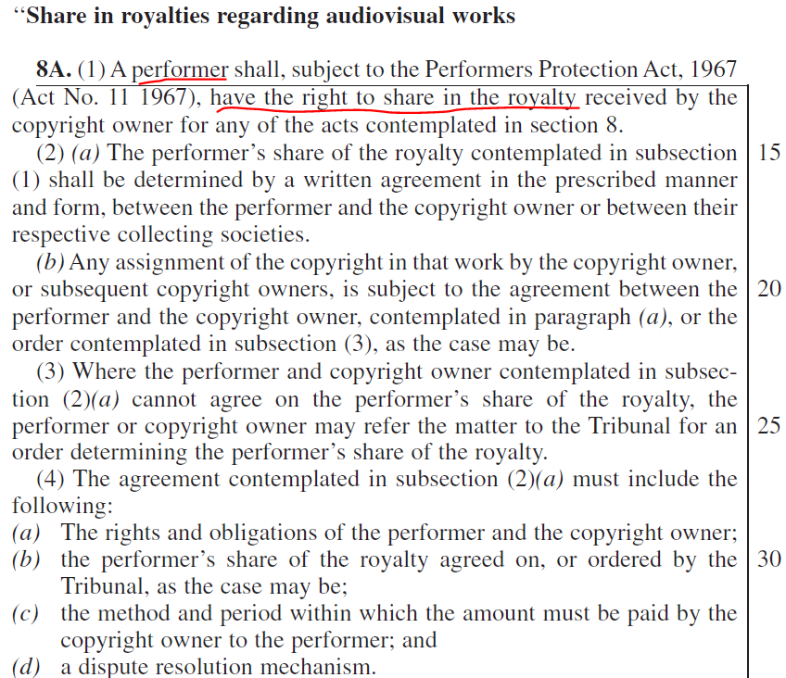
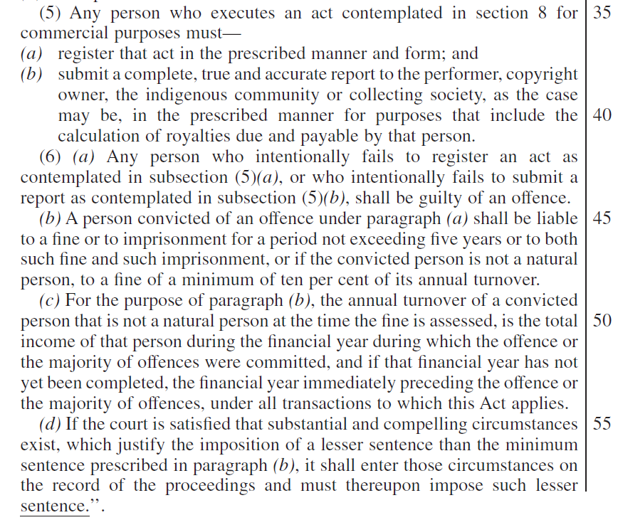
Unwaivable performer royalties - Determined by the Minister

Slide 17
Unwaivable performer royalties - Determined by the Minister
Claims/Intentions
Reality /Consequences
Good for performers. | Bad for performers.
“Contractual exploitation has been the main driver of poverty amongst within the creative and cultural industries.” | Evidence to support this statement? No economic impact study has been conducted. In reality, the main driver of poverty for creatives is the lack of work opportunities, which will be exacerbated and intensified by the bill. FACTS: On international productions filmed here local actor rates are: Lead : between R20,000 and R25,000 per day but would usually do a global at between R60,000 and R100,000 per episode or, for a feature, depending on length of show, between R200,000 and R300,000 global deal. Could be more depending on budget of film. Support Cast : between R12,000 and R20,000 per day Day Player : between R7,500 and R12,000 per day. Rates for actors in TV co-productions range from R1 000 (extras) to R15 000 per day for leads. Local TV daily rates: Extra/background artist: R600-R800. Featured extra: R800-R1500. Guest star: R2500-R4000. Supporting artist: R3000 - R5000. Lead: R4500 - R8000 Is this unfair or exploitative remuneration??

Slide 18
Unwaivable performer royalties - Determined by the Minister
Claims/Intentions
Reality /Consequences
“Will give artists and performers certain protections and will, for the first time, the right to earn fair royalties. It promotes performers' economic rights”. | Mandatory, unwaivable royalties will significantly reduce work opportunities in cases where royalties aren’t possible. It will also reduce and remove the upfront fees they are typically paid. Royalty payments depend on profits. 9/10 films don’t make profits so performers will work on risk and will have to wait years to receive anything, but will most likely receive nothing. It would also be impossible for subscription-based streaming services to pay royalties as their revenue is generated through subscribers paying to access their entire catalogue, not specific titles. It will actively work against the economic interests of performers.
Mandatory, unwaivable royalties will provide better contractual protection. “The bill safeguards the rights of contracting parties” | No contractual freedom. The CAB prevents performers from choosing remuneration packages which work best for them. Royalties are mandatory and unwaivable. Neither party has contractual flexibility. It also prevents the producers from being able to consolidate the rights
Just like musicians are paid needletime, performers should be paid royalties. | Needletime is a remuneration right, not an exclusive right. Users only need to remunerate, they don’t need to ask for permission to use it. It applies only to musicians and not to audiovisual works (different business models entirely)

Slide 19
Unwaivable performer royalties - Determined by the Minister
Claims/Intentions
Reality /Consequences
It is assumed that there is an imbalance of power between performers and producers during negotiations and are, consequently, routinely exploited. It will provide for “opportunities for fairer royalties” | Many performers thrive in the industry. We also want to protect our performers who don’t get good deals, but statutory royalties are unworkable and unprecedented in the global audiovisual sector. It places substantial risk on producers who rely on the ability to work from a fixed budget. The less work opportunities there are, the more likely performers are accept bad deals.
Only considered the main cast and supporting roles when drafting this bill | No definition of “performer”. The current wording means it will include extras or walk-ons (of which there are sometimes thousands), who will enjoy the same rights as leads, which obviously isn’t workable or fair to leads and supporting roles - or producers or investors.

Slide 20
Unwaivable performer royalties - Determined by the Minister
Claims/Intentions
Reality /Consequences
The bill applies only to film & television works. | The bill applies to all audiovisual works, which means performers will receive no corporate work opportunities (which is almost all of the work they get in animation).
Once the bill is passed, investors will just plan to include performers in the profit-share. | If this bill is passed, involving local performers will stifle investment - higher-risk, lower returns for investors.
Compliance and reporting requirements will ensure that performers are paid the right amount in royalties. | Compliance and reporting requirements will be criminally penalised for failure to comply or report, which means producers and broadcasters will drastically reduce their risk by avoiding casting local performers. Significant added financial and impossible administrative burden on producers to ensure compliance or face hefty fines or imprisonment.

Slide 21
Unwaivable performer royalties - Determined by the Minister
Claims/Intentions
Reality /Consequences
If the minister prescribes royalty rates and tariffs, performers will receive equitable remuneration. | Nowhere in the world does the minister prescribe royalty rates or tariffs for various forms of use. It heightens risk and uncertainty for investors and producers, which means they will be far less likely to create opportunities for local performers.
The bill will serve the interests of our local performers. Performers won’t die paupers | More work for foreign performers. Foreign performers performing in South African films might also demand royalties, but, because treaties supercede domestic law, unlike our performers, they will be able to negotiate terms. Less/no work opportunities for local performers. Royalties on nothing are nothing.

Slide 22
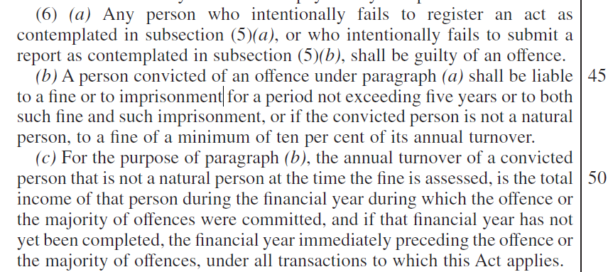
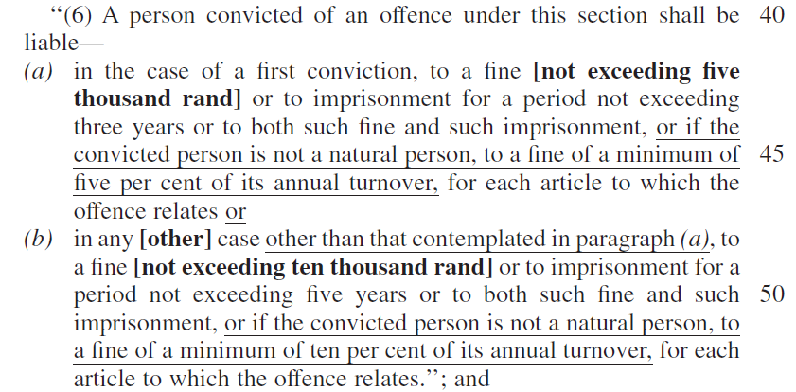
Registration and reporting on royalties
Penalty for non-compliance
POSSIBLY BOTH Up to 5 years in prison
AND A MINIMUM of 10% of annual turnover
Result: Legal risk disincentivizes investment.
Destroys businesses and lives
Penalty for piracy
3-5 years in prison
AND/OR R5,000 - R10,000
AND/OR 5-10% of annual turnover (businesses)
Result: Minor fine - paid from
proceeds of piracy

Slide 23
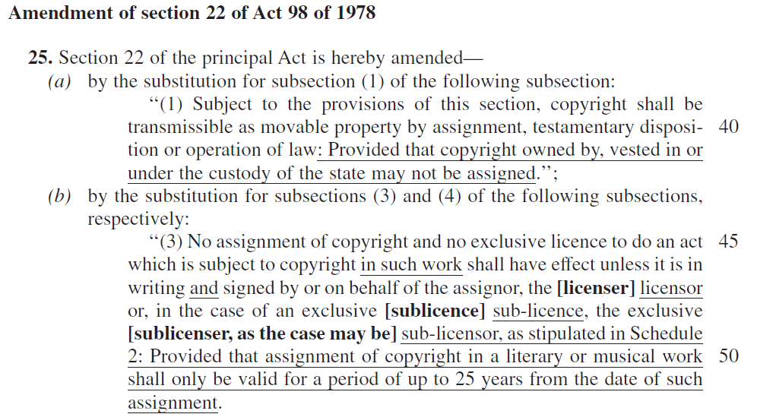
Restricting the assignment of rights to 25 years

Slide 24
Restricting the assignment of rights to 25 years
Claims /Intentions
Reality/Consequences
If a musician signs a bad deal with a record label company on a successful song, they’ll get their rights back to renegotiate terms after 25 years | The way it is currently written, the buyout rights do not revert back to the original owner. The bill is currently missing that relevant section. It only currently functions as a limitation on the license period. When the license period expires, all contributing creators would need to agree to the renegotiated terms. If one party, even an session artist, doesn't agree to the new terms, the production can no longer be commercialised and none of them can continue to benefit from the exploitation of the work. The production will gather dust on a shelf.
It benefits all creative contributors. | The Performers’ Protection Amendment Bill further legislates that performers in audiovisual works would, after 25 years, gain the exclusive right to commercialise their performances. Any one of these performers, including extras, could hamstring further use of a work by refusing to agree to a new 25-year term unless their demands are met. No further income for anyone.

Slide 25
Restricting the assignment of rights to 25 years
Claims /Intentions
Reality/Consequences
Focused on the rights of individual artists. | There are many contributors involved in audiovisual works, ranging from a handful to hundreds sometimes thousands of people.
The rights or artists and performers are always conflicting. | In order to make money, somebody needs to unify the rights in order to commercialize the work. The moment the rights are assigned, a 25 year countdown begins, which would include all the time it takes to make the work, which can take up to 10 years.
“The revised bill extends rights to creative works as well as the duration of those rights. It will allow sustainable revenue generating opportunities within the creative and cultural industries.” | The bill limits the duration of the rights to 25 years. No investor will invest in something they can only get returns on for 25 years - nowhere else in the world is the lifespan of rights so low. How can this possibly be described as “sustainable”? Many old films continue to be monetized for as long as people are willing to pay to see or screen them. I.P is the new gold. It’s what we use to build sustainable businesses.

Slide 26
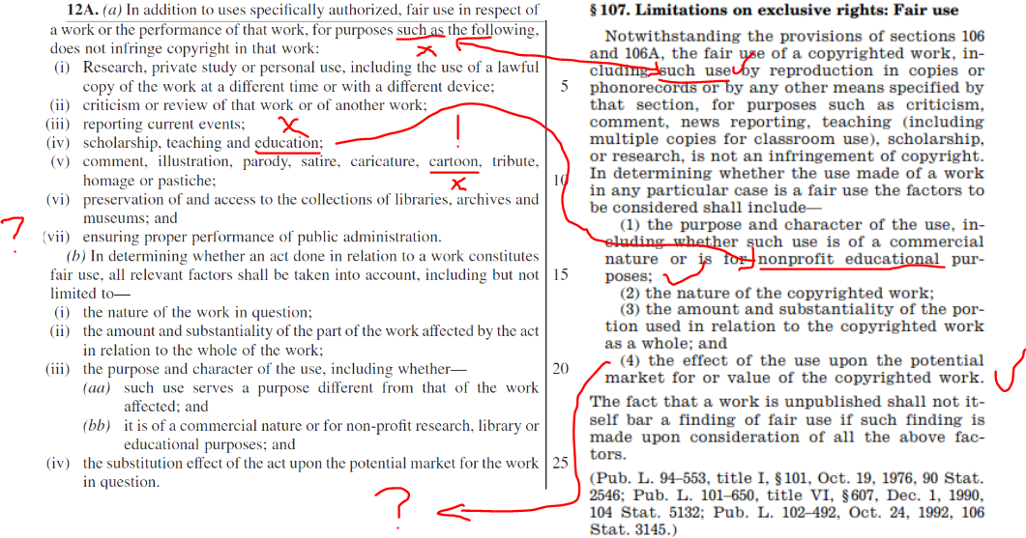
CAB “Fair” use
USA Fair use

Slide 27
CAB “Fair Use” claims/intentions
CAB “Fair Use” Reality/consequences
“Clauses in the bill were adopted from copyright regimes , including the US, UK, Israel, the EU, Singapore. Fair use is tried and tested” | The fair use provision in the bill is fundamentally different from the fair use applied in the U.S and Israel. Countries with which SA has common law (we don’t with US, Singapore, South Korea, Israel - FU countries) have fair dealing and rejected the wholesale incorporation if fair use after extensive consultations, including UK, EU, Australia
“Copyright tribunal will address infringements and other issues”. “The establishment of a copyright tribunal is welcomed as an intervention to drive intellectual property protection for marginalized previously disadvantaged artists.” | No access to attorneys/advocates (and the pro bono legal practitioners provided may not specialize in copyright law). Unlike our current fair dealing system (where you’re able to issue an interdict), infringers will be able to continue to exploit your work until a ruling is made which could take years. Also, there is no statutory damages for the infringer so there is no deterrent. This will prejudice previously disadvantaged artist most. Design tribunals currently have a year-long backlog and many U.S fair use trials have elapsed for over a decade.
Good for the recreation of all content | Doesn’t protect live-action content from being adapted into animation (due to the inclusion of “cartoon”).
The goal is to use content to make more content, especially indigenous works. | Without adequate protection of educational content (80% of the publishing industry), our creatives won’t create and we’ll need to import foreign works.

Slide 28
CAB “Fair Use” claims/intentions
CAB “Fair Use” Reality/consequences
It’s still clear what does/doesn’t constitute fair use and so it will not result in more litigation. | Necessarily leads to legal uncertainty and increased litigation because fair use is a judge-made law. South Africa doesn’t have the 200+ years of jurisprudence to draw from and some fair use cases have dragged on for more than a decade.
The exceptions listed are sufficiently illustrative of what does/does not constitute fair use | These expanded list of exceptions are overbroad and unprecedented. Every new exception is supposed to be subjected to a formal impact assessment.
Open-ended stipulations in the “previous version of the bill”. Fair use is not open-ended | The inclusion of “such as” makes the clause completely open-ended and non-exhaustive and it remains in the latest version of the bill, further undermining investor confidence.
 | Taken together with lax anti-piracy measures, this will open the door to wholesale unauthorised and unpaid for use of others’ content.

Slide 29
CAB “Fair Use” claims/intentions
CAB “Fair Use” Reality/consequences
“Fair use will allow better access to others’ works” | Allows anybody to make use of South African creators without permission and/or remuneration
“The CAB aligns with the constitution and human rights convention and should improve the lives of all stakeholders” | The CAB arbitrary deprives people of property and the freedom to trade, which directly contravenes the bill of rights and constitution. No economic data (SEIAS) to substantiate the claim that it should improve lives.

Slide 30
The state owns what it directs and controls

Slide 31
The state owns what it directs and controls
Claims /Intentions
Reality/Consequences
The state wants to be able to own what it directs and controls | This will mean that creators can never contract out of surrendering their copyright to the State where they do work for them under their direction and control. Creatives and producers currently have little or no ownership in their IP of Commissioned Works rendering possible ongoing commercial exploitation null and void and thus detrimental to the future growth and sustainability of the industry, most of who are small businesses. There will also be legal uncertainty as to whether abidance with state-owned funding body requirements could be construed as under their “direction and control”. It’s ambiguous.

Slide 32
The Minister will decide on contract terms and rates

Slide 33
The Minister will decide on contract terms and rates
Claims /Intentions
Reality/Consequences
Creatives are routinely exploited by those who procure their services and works. The government needs to control rates, contracts and tariffs in order to prevent that from happening. | Producers respond to market drivers and opportunities. If the Minister is able to prescribe the minimum royalty rate, whatever he/she deems fair will supersede whatever agreement would be brokered between parties who would otherwise have been willing to contract with each other. The solution to a few bad deals is to make better deals, not to make it impossible to deals at all.
It is possible to standardize contract terms and rates in the audiovisual industry. | This will primarily prejudice small and emerging production companies who can’t afford to pay the rates established production companies pay. If there is no flexibility on rates, contracts and tariffs, they will be unable to secure the work and provide these opportunities to creatives.

Slide 34
The Minister will decide on contract terms and rates
Claims /Intentions
Reality/Consequences
The regulations are only “likely” to set minimum standards | The bill does not say so. Regulations will be binding to the all affected industries.
The minister is not an industry practitioner and so is an impartial arbiter of disputes. | It is wholly inappropriate to allow someone who may not know the industry (including the legal advisers or politicians) to prescribe rates which cannot apply in every case due to their varying business models and circumstances. A one-size-fits all approach simply cannot work in this sector given the different types of productions and their budgets. It makes no provision for the unique and incredibly diverse nature of productions and their budget, sales potential and business models. Nowhere else in the world does this exist and has sent jitters through the local and international filmmaking community.

Slide 35
Our call
We, the IPO, the IBFC and Animation South Africa, join other industry organisations and sectors in unanimously calling for these Bills to be rejected.
They are fundamentally flawed, fraught with unintended consequences and open to a Constitutional Court challenge, and the immense economic harm they will bring to all in the Creative Industries cannot be addressed by way of some minor amendments.
They need to be redrafted following proper local and international research and real consultation with industry bodies.
The redraft needs to be subjected to a comprehensive Social and Economic Impact Assessment Study, which must be published to enable the legislators and interested and affected parties to engage with and respond to it.
Only thereafter should the redrafted version be Government Gazetted for public comment and next steps of the policymaking process.

Slide 36
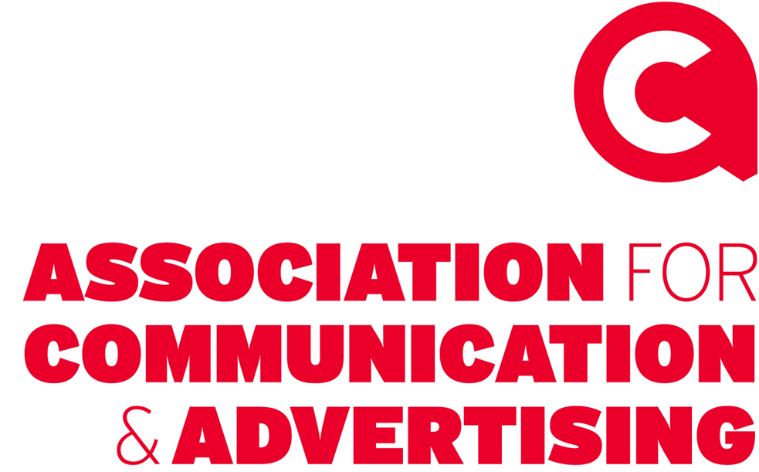
The AV Sector thanks you for this opportunity to present our case
Please note, the following local and international organisations and companies have material concerns about the bills and their impact on the AV sector and its downstream beneficiaries and believe they are not fit for purpose. And as such, the Bills should not be approved in their current form.

Slide 37
The AV Sector thanks you for this opportunity to present our case
THANK YOU

