Slide 1

BRIEFING REPORT
Standing Committee on Appropriations (SCOA)
PRESENTED BY:
MENDOE NTSWAHLANA
CHIEF PROUREMENT OFFICER
15 February 2023
Update on the Q3 Deviations and Contract Modifications Reports
2022/23

Slide 2
Transversal Contracting

Slide 3

Transversal Contracting Mandate
Transversal Contracting is responsible for the facilitation and management of transversal term contracts on behalf of Government;
Mandated by Treasury Regulations (16A6.5)
  “The accounting officer or accounting authority may opt to participate in transversal term contracts facilitated by the relevant treasury. Should the accounting officer or accounting authority opt to participate in a transversal contract facilitated by the relevant treasury, the accounting officer or accounting authority may not solicit bids for the same or similar product or service during the tenure of the transversal term contract”
Optional Provision to be part of Transversal Term Contracts
Relevant Treasuries – National & Provincial

Slide 4

Transversal Contracting Benefits
Standardisation or consolidation of state requirements
  Common products
  Similar specifications and pricing
Benefit from Economies of scale
  High Volumes
Reduce duplication of procurement efforts
  Single centre of procurement

Slide 5
OCPO Functional Structure
The OCPO is set up as a distinctive Division within the National Treasury headed by the Chief Procurement Officer (CPO). The functional structure is organised into six units, each headed by a Chief Director.
Chief Procurement Officer
Divisional Support
SCM Policy, Norms & Standards
SCM Governance, Monitoring & Compliance
SCM Information & Comms Technology (ICT)
Strategic Procurement
Transversal Contracting
SCM Stakeholder & Client Management
Develop and implement SCM norms and standards for all three spheres of Government, Public Entities and SOCs.
Provide support and advice on SCM Legislation and prescripts.
Develop and implement standard contracting frameworks
Design, develop and implement the SCM governance, monitoring, evaluation and compliance framework for all three spheres of Government, Public Entities and SOCs.
Administers Exemptions and Departures from SCM Legislation
Provides advice on deviations, variations and interpretation
To modernise the state supply chain management system.
CSD
E-tender portal
Data analysis and reporting (BI)
E-tendering
To manage the development and provision of strategic procurement services in all three spheres of government.
Develop specific sourcing strategies for specific commodities for client departments
Develop standard technical item specifications, TORs and SCC for client departments
Facilitate and manage Transversal Contracts on behalf of the State
Identify commodities for central facilitation
Negotiate bulk procurement prices
Leverage economies of scale
Supplier management
Ensure and create appropriate platforms to disseminate the work of the OCPO to different types of stakeholders.
Building Communities of SCM Professionals
Capacity Building and training programme initiatives

Slide 6
Commodities Managed: 62

Slide 7
Commodity Value

Slide 8
Top ten Commodities by value

Slide 9
Top 20 Contracts with highest participants

Slide 10
Contract Renewal plans
2022/23 Financial Year | 2023/24 Financial Year
16 Transversal Term Contracts | 10 Transversal Term Contracts

Slide 11
Participation by Provincial Departments

Slide 12
Participation by Provincial Departments

Slide 13
Participation by Provincial Departments

Slide 14
Provincial Organs of State

Slide 15
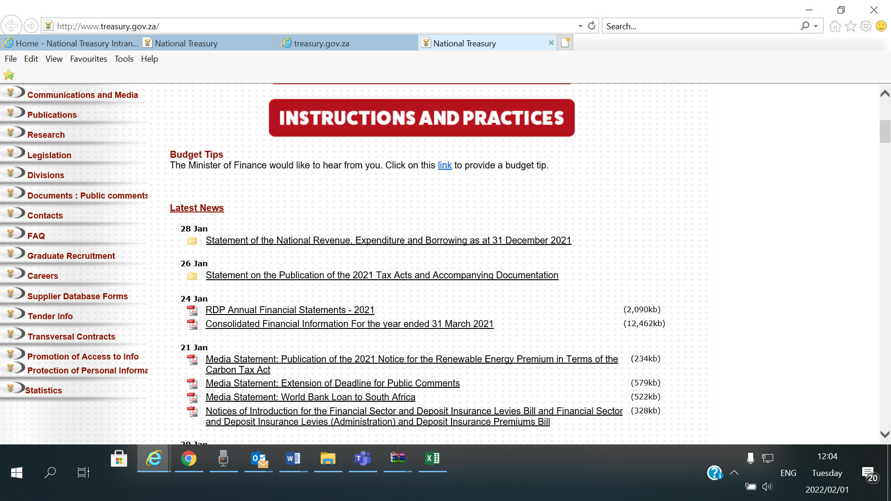
Information on our website
http://www.treasury.gov.za/divisions/ocpo/ostb/contracts/default.aspx

Slide 16
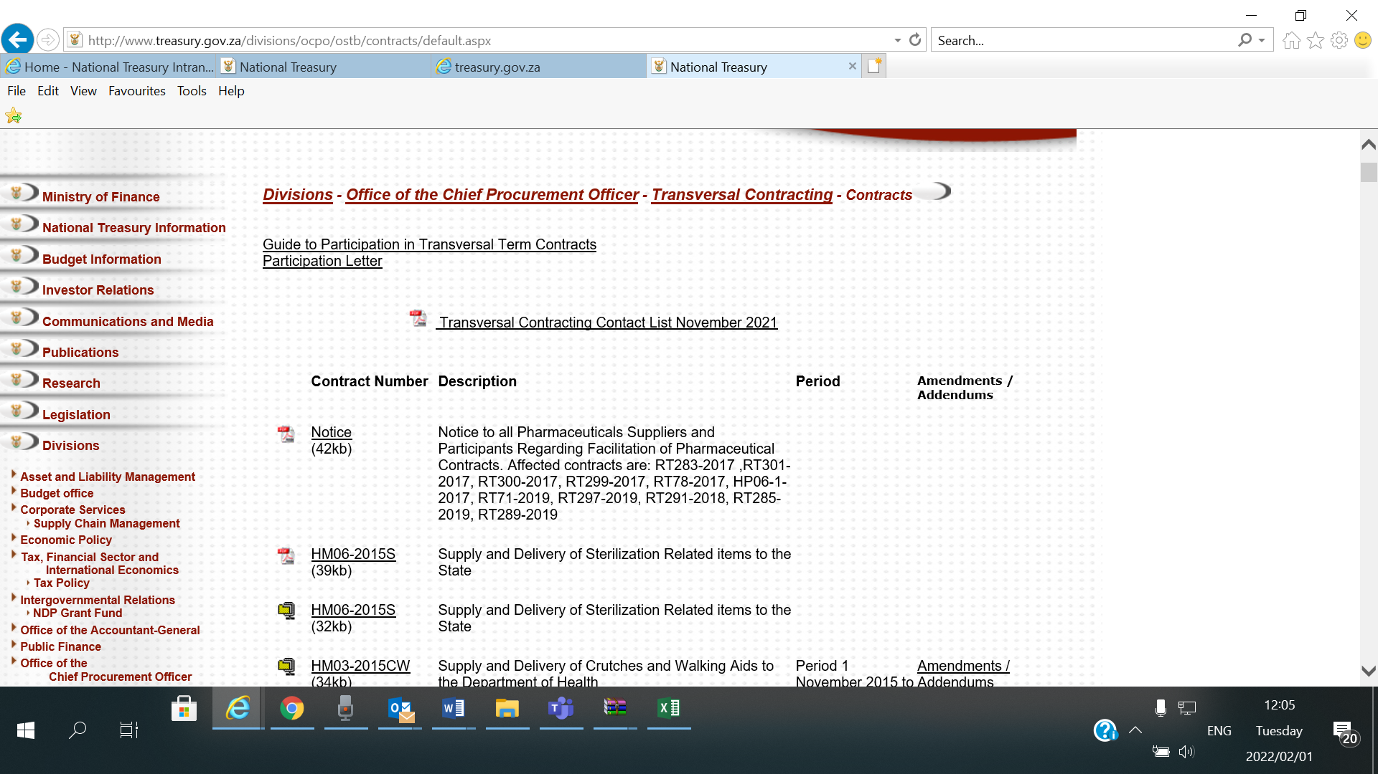
Information on our website

Slide 17
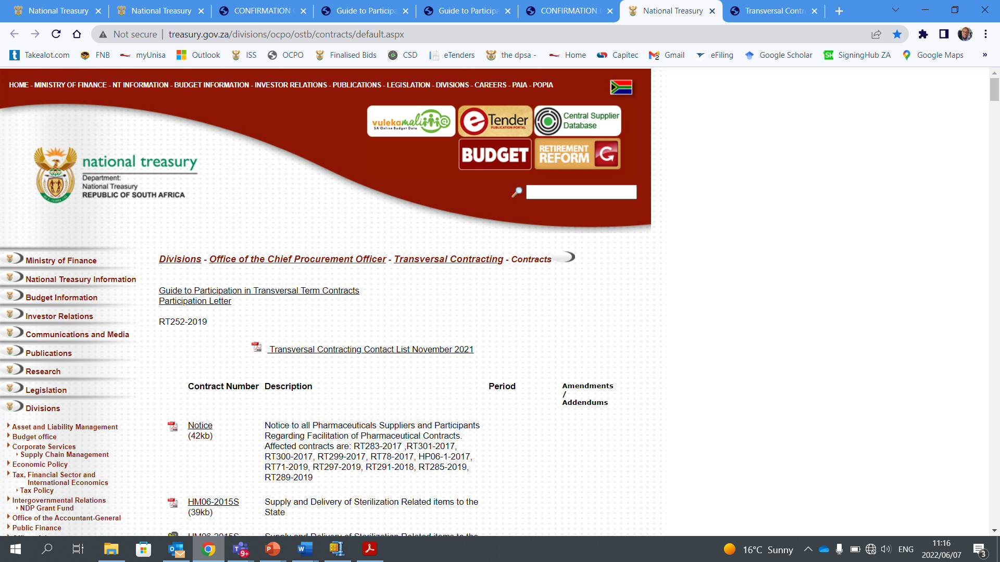
Contact details
Link: http://www.treasury.gov.za/divisions/ocpo/ostb/contracts/Transversal%20Contracting%20Contact%20List%20November%202021.pdf

Slide 18

Challenges & Risks
Late participation requests- Post award
Lack of integrated reporting system
Inconsistent budget commitments – over & under spending
Late payments
Lack of participation support- Education Portfolio

Slide 19
Participation support on LTSM commodities
ORGAN OF STATE | RT7- DISTRIBUTION OF TEXTBOOKS | RT17- SCHOOL STATIONERY
Correctional Services | ✓ | ✓
Limpopo: Education | ✓ | ✗

Slide 20

Opportunities
Expand Current Transversal spending
  New requests for transversal contracts
    Auditing, recalibration and reconfiguration of electricity smart meters
    Air Quality Management System

Slide 21


QUESTIONS AND ANSWERS
Thank you

Slide 22
The role of procurement in the implementation of SA economic reconstruction and recovery plan

Slide 23
Preferential Procurement Regulations, 2022
The Preferential Procurement Regulations, 2022, have been promulgated on 4 November 2022 and became effective on 16 January 2023. There is, however, a concern from some sectors of society that the National Treasury should have prescribed localization as a mandatory requirement in the preferential policies of organs of state. There is a fear that leaving it to the discretion of organs of state may have a serious impact on job creation.
The new regulations empower organs of state to develop their own preferential policies and implement them within the framework prescribed by the Preferential Procurement Policy Framework Act. Organs of state are required to identify specific goals from the Act and RDP Framework of 1994 to be included in their policies and in the invitations to submit tenders. There is a range of specific goals that organs of state can choose from which may include local industrialization, among others.
Section 10 (1)(b) of the B-BBEE Act requires organs of state to implement broad-based economic empowerment when developing their preferential procurement policies. National Treasury has been rollout the regulations to organs of state to ensure that developed policies are in keeping with the regulations.
The National Treasury continues to provide the necessary technical support and clarification of the regulations. It is hoped that the devolvement of powers to organs of state will improve turnaround time in service delivery.

Slide 24
LEVERAGING PUBLIC PROCUREMENT TO SUPPORT BROAD SOCIO-ECONOMIC OBJECTIVES
Preferential Procurement Regulations, 2022
However, it should be noted that the primary legislation informing these regulations has limitations, especially in that, among others, the 80/20 and 90/10 preference systems are prescribed in the Act itself and cannot be changed through Regulations unless the Act itself is amended or repealed.
The public has been raising concerns that this piece of legislation does not adequately address the transformation agenda and black economic empowerment in particular and that there are too many overlapping pieces of legislation on procurement that sometimes contradict one another.
It is against this background that the Public Procurement Bill has been developed to serve as the single national overarching procurement regulatory framework in South Africa.

Slide 25
PROCUREMENT REFORMS AND MODERNISATION
THE PUBLIC PROCUREMENT BILL

Slide 26
The Public Procurement Bill
The aim of the Bill is to:
  Consolidate the various pieces of procurement legislation into a single overarching procurement regulatory framework in South Africa and eliminate fragmentation in the system. Some of the existing pieces of legislation will be amended to give effect to the Bill whereas others will be repealed.
  The Bill provides, among others, for measures to leverage public procurement to advance economic opportunities for historically disadvantaged people, women, youth people with disabilities, small, medium, and micro enterprises, and to support localization for job creation.

Slide 27
The Public Procurement Bill (cont.)
  The Bill has a dedicated chapter providing measures for the implementation of a framework that covers a variety of measures for preferential treatment for categories of preferences, and the protection or advancement of persons, or categories of persons, historically disadvantaged by unfair discrimination, in the allocation of contracts.
  The Bill makes provisions for set-asides to support black economic empowerment, women-owned, youth-owned enterprises, people with disabilities, and localization, among others.
  Measures aimed at advancing small medium and micro enterprises in high-value procurement, among others.

Slide 28
The Public Procurement Bill (cont.)
The Public Procurement Bill (Bill) introduces a differentiated procurement system for a range of strategic goods and services such as capital goods/ projects, and infrastructure. Strategic projects will be procured differently from the conventional normal run-of-the-mill goods and services.
The Bill empowers the Minister to prescribe a framework for preferential treatment for categories of preferences or advancement of persons, historically disadvantaged by unfair discrimination.
  The framework envisaged in the subsection must consider the Broad-Based Black Economic Empowerment Act and includes measures for preference to set aside the allocation of contracts to promote—
  (i) a category or categories of persons or businesses or a sector;
  (ii) goods that are manufactured in the Republic;
  (iii) local technology and its commercialization;
  (iv) services that are provided by a citizen or citizens of the Republic;
  (v) the creation of jobs or intensification of labour absorption;
  (vi) enterprises based in townships, rural or underdeveloped areas;
  measures regarding the participation of a manufacturer of goods in a bid to supply the goods it manufactures;
  measures aimed at advancing industrial development; and
  measures aimed at advancing SMMEs in high-value procurements.

Slide 29
The Public Procurement Bill (cont.)
  Provides for the Minister to make :-
  (3) Regulations—
  (a) must be made regarding the application of subsection (2)(a) and (b)(ii) and (iii); and
  (b) may be made regarding any other provision of this Chapter.
  (4) Without limiting the generality of subsection (1)(b), the policy may include preferences for—
  (a) citizens or permanent residents of the Republic;
  (b) enterprises that are majority owned or controlled by citizens or permanent residents of the Republic, or both citizens and permanent residents;
  enterprises based in townships, rural or underdeveloped areas or in a particular province or
  municipality.
  (5) Persons referred to in subsections (1)(b) and (2)(b)(i) include, but are not limited to—
  (a) black people as defined in section 1 of the Broad-Based Black Economic Empowerment Act, 2003 (Act No. 53 of 2003);
  (b) women, people with disabilities and youth as defined in section 1 of the National Youth Development Agency Act, 2008 (Act No. 54 of 2008) between, and who are citizens of the Republic.
  (6) The Minister must consult with the relevant Minister before making a regulation under this Chapter affecting the powers or functions assigned to that Minister.
  Promotes the Use of technology :- and requires that the Public Procurement Office must develop a electronic public procurement system for all procurement to enhance efficiencies, effectiveness, transparency and integrity and to combat corruption.

Slide 30
Public Procurement Bill - Status
The Bill was consulted with social partners at Nedlac, and the process was completed in October 2022. The Nedlac Secretariat submitted its report to the Minister at the end of October 2022.
The Office of State Law Advisor has been completed legal vetting and issued a preliminary
certification for the Bill to be submitted to Cabinet; and
The Presidency is currently conducting Socio-Economic Impact Assessment. Once finalized the Bill would be ready for submission to Cabinet for consideration and introduction to Parliament in March 2023.

Slide 31
Infrastructure Procurement
National Treasury is currently engaging the metros to identify challenges in infrastructure procurement with a view to unlocking bottlenecks that are caused by the regulatory framework.
At the national level, engagements are taking place with DPWI and its entities to align and streamline the regulatory framework in the construction industry. The above processes would be completed during the new financial year.
Part of the reforms in the Procurement Bill is the development of a dedicated set of regulations to deal with infrastructure procurement including consideration of the use of implementing agents in infrastructure delivery within the ambit of the law. This will ensure that the infrastructure budget is spent and not returned to NRF unnecessarily.

Slide 32
MEASURES TO PROMOTE TRANSPARENCY
AND ACCESS TO PROCUREMENT
OPPORTUNITIES

Slide 33
MEASURES TO PROMOTE TRANSPARENCY IN THE PROCUREMENT SYSTEM
The National Treasury introduced a tool to register potential bidders/ suppliers on the Central Supplier Database (CSD) to promote transparency in the procurement system. The CSD is linked to CIPC and managed by the DTIC, SARS, and the bank details of suppliers.
National Treasury has introduced the e-tender portal to enable organs of state to publish tenders, procurement plans, and results of tender processes making it easier for potential bidders including SMMEs to access government procurement opportunities.
However, payment of suppliers on time or within the terms of the contractual agreements remains a challenge. The OAG is currently seized with this challenge and regular reports are submitted to FOSAD and to government institutions. Parliament could assist in this regard.

Slide 34
Thank you

Slide 35
Update on the Q3 Deviations and Contract Modifications Reports

Slide 36
PURPOSE OF THE PRESENTATION
The purpose of the presentation is to brief the Standing Committee on Appropriations (SCOA) on the number of deviations, expansions and modifications approved as including details on the number that directed to black, women, youth, and persons with disabilities’ companies.

Slide 37
General Responsibilities of Accounting Officers
PFMA Section 38
General responsibilities of accounting officers.—(1) The accounting officer for a department, trading entity, or constitutional institution—
must ensure that that department, trading entity or constitutional institution has and maintains—
(i) effective, efficient and transparent systems of financial and risk management and internal control;
(ii) a system of internal audit under the control and direction of an audit committee complying with and operating in accordance with regulations and instructions prescribed in terms of sections 76 and 77;
(iii) an appropriate procurement and provisioning system which is fair, equitable, transparent,
competitive and cost-effective;
(iv) a system for properly evaluating all major capital projects prior to a final decision on the project;
is responsible for the effective, efficient, economical, and transparent use of the resources of the department, trading entity, or constitutional institution;
must take effective and appropriate steps to—
(i) collect all money due to the department, trading entity or constitutional institution;
(ii) prevent unauthorized, irregular and fruitless, and wasteful expenditure and losses resulting from criminal conduct; and
(iii) manage available working capital efficiently and economically;

Slide 38
General Responsibilities of Accounting Officers
is responsible for the management, including the safeguarding and the maintenance of the assets, and for the management of the liabilities, of the department, trading entity, or constitutional institution;
must comply with any tax, levy, duty, pension, and audit commitments as may be required by legislation;
must settle all contractual obligations and pay all money owing, including intergovernmental claims, within the prescribed or agreed period;
on the discovery of any unauthorized, irregular or fruitless and wasteful expenditure, must immediately report, in writing, particulars of the expenditure to the relevant treasury and in the case of irregular expenditure involving the procurement of goods or services, also to the relevant tender board;
must take effective and appropriate disciplinary steps against any official in the service of the department, trading entity or constitutional institution who—
contravenes or fails to comply with a provision of this Act;
commits an act that undermines the financial management and internal control system of the department, trading entity, or constitutional institution; or
makes or permits an unauthorized expenditure, irregular expenditure or fruitless and wasteful expenditure;
when transferring funds in terms of the annual Division of Revenue Act, must ensure that the provisions of the Act are complied with;

Slide 39
General Responsibilities of Accounting Officers
before transferring any funds (other than grants in terms of the annual Division of Revenue Act or to a constitutional institution) to an entity within or outside government, must obtain a written assurance from the entity that that entity implements effective, efficient and transparent financial management and internal control systems, or, if such written assurance is not or cannot be given, render the transfer of the funds subject to conditions and remedial measures requiring the entity to establish and implement effective, efficient and transparent financial management and internal control systems;
must enforce compliance with any prescribed conditions if the department, trading entity or constitutional institution gives financial assistance to any entity or person;
must take into account all relevant financial considerations, including issues of propriety, regularity and value for money, when policy proposals affecting the accounting officer’s responsibilities are considered, and when necessary, bring those considerations to the attention of the responsible executive authority;
must promptly consult and seek the prior written consent of the National Treasury on any new entity which the department or constitutional institution intends to establish or in the establishment of which it took the initiative; and
must comply, and ensure compliance by the department, trading entity or constitutional institution, with the provisions of this Act.
SIMILAR PROVISIONS FOR ACCOUNTING AUTHORITIES OF PUBLIC ENTITIES IS FOUND IN
SECTION 51 OF THE PFMA

Slide 40
Some of the contributing reasons for replacing Instruction Note No. 3 of 2016/17
Instruction Note 3 of 2016/17 dealing with the Prevention and Combating of the abuse of the SCM system was updated and replaced with SCM Instruction 3 of 2021/22 due to the following reasons:
To enhance transparency and accommodate the recommendations of the Zondo Commission of enquiry into state capture,
  Commission recommends that set standards of transparency consistent with the OECD Principles for integrity in public procurement be formulated by National Treasury for compulsory inclusion in every procurement system adopted by a public procurement entity.
    Introduction of procurement plans, advertising on etender portal, development of an instruction to provide further elaboration on TR16A6.6 which deals with the participation on contracts arranged by other organs of state, publishing of all deviations and contract modifications (variations and expansions) submitted to National Treasury, etc.
To improve turnaround time in decision-making and to expedite service delivery, particularly where the technical comprehension of the required process to be taken in line with the mandate of the institution is best placed with the institution. . During 2020/2021 it was found that there was an increasing number of applications for deviations, extensions and variations. This exacerbated the long turn-around times and stunted institutions in providing the services required, especially in SOCs and institutions with complex capital projects.

Slide 41
Some of the contributing reasons for replacing Instruction Note No. 3 of 2016/17
To provide expanded measures to restrict suppliers from doing business with the state on the basis other than fraudulent claims of preference points. During the review of the previous Instruction Note, it was established that when it comes to the restriction of suppliers for PFMA-related transgressions, the GCCs did not apply to the Schedules 2, 3B and 3D public entities, hence the gap in the case of these entities as Regulation 14 of the PPR, 2017 could ONLY be used to restrict a supplier for a transgression that is related to the fraudulent claims for preference points in terms of the PPPFA.
Hence in the new SCM Instruction 3 of 2021/22 the process to restrict a person or supplier from doing business with the state in terms of the PFMA has been provided for.
To provide measures for restricting and debarring employees of the state from doing business with government.

Slide 42
The approach adopted in developing Instruction 3 of 2021/2022
In developing Instruction note 3, the National Treasury adopted the following approach:
Ensure that, to the extent possible, the revised Instruction does not encroach on the institutional accountability conferred on Accounting Officers and Accounting Authorities in terms of the PFMA.
The Constitutional Court has held that “conduct by an organ of state that has no foundation in some law breaches the principle of legality, which is a subset of the rule of law, a foundational value of the Constitution”
In other words, Accounting officers/ Authorities are accountable for their own decisions, since in terms of the PFMA accountability vests with them.

Slide 43
The approach adopted in developing Instruction 3 of 2021/2022 (cont.)
National Treasury considered all inputs received in an attempt to find legally cognizable means, which in this case was to provide for reporting requirements that would strengthen the transparency of procurement within institutions, thus forcing Accounting Officers/Authorities to account for their decisions, which would serve as a deterrent against abuse of the SCM system.
These reports would be a useful tool for the National Treasury and relevant treasuries to identify areas of possible intervention and support and to strengthen compliance monitoring in the implementation of the PFMA.
To bridge the disparity between government departments, constitutional institutions, and public entities listed to the PFMA in Schedules 3A and 3C on the one hand, and Schedules 2 (SOCs) and 3B and 3D (government business enterprises) on the other hand within public procurement, created by the non-inclusion of SOCs and government business enterprises in Chapter 16A of the SCM Treasury Regulations.

Slide 44
The approach adopted in developing Instruction 3 of 2021/2022 (cont.)
  To this end, the revised instruction differs somewhat from the strict format of being prescriptive, but has, in various areas, short of the narrative to provide context to the SOCs and government business enterprises, who are not governed by the General Conditions of Contract, standard bidding documents, etc.
Considered the inputs by stakeholders, some of which were conflicting, thus the National Treasury had to strike a balance between competing interests while maintaining respective legislative provisions.

Slide 45
Treatment of Disclosures and Declarations
Provides for institutions to identify and manage all potential conflicts of interest and other disclosures made by a person participating in procurement processes to enable the Accounting Officer/Authorities to make informed decisions about the person participating in the SCM process.
During the review process, National Treasury identified a number of inconsistencies in the broader public procurement regulatory framework, and there is an expectation that the procurement prescripts should resolve these inconsistencies.
For instance, the Public Administration Management Act, of 2014 defines what an “employee” and “public service” is and when reading these together, they exclude employees of SOCs. Therefore, to close this gap in the legislation, the new instruction extended the prohibition to do business with the state to employees of SOCs as well.
With regard to the extension of the application, the previous Standard Bidding Documents (SBD) 4, was not applicable to Schedules 2, 3B, and 3D public entities, but in terms of the new SCM Instruction 3 of 2021/2022, the SBD 4 includes these other entities as well.

Slide 46
Deviations from the normal bidding process and expansions/variations
The power to approve procurement by other means, i.e. deviations from inviting competitive bids, which includes limited bidding (sole source, single source), expansions/ variations, and written price quotations that fall outside the competitive bidding thresholds has been devolved to accounting officers/authorities (essentially returned to the AO/AA) and is no longer vested in the relevant treasuries.
The new Instruction provides for monthly reporting on procurement by other means ( deviations) to the relevant treasuries and the AGSA.
Moreover, a provision has been introduced in the Instruction to further provide for reporting in the institution’s annual report where deviations from the competitive process have taken place. It thus elevates transparency and reduces any level of obscurity.
National Treasury is developing the Compliance Reporting Framework that will be issued by the OAG.
It is believed that these reporting interventions will enhance transparency, which is one of the major concerns raised in the Zondo Commission of Inquiry into the state capture report.

Slide 47
Enforcement of compliance to Bid Committee system
In light of several governance lapses which have subsequently been confirmed by the state capture Commissions, it became necessary to extend the bid committee system and enforce its implementation to also SOCs and government business enterprises.
This is an attempt to instil the culture of a bid committee system to avoid instances of abuse where, as articulated in the State Capture Report, it is indicated that certain projects were procured without the participation, knowledge, or approval of the business owners of those projects.

Slide 48
General requirements
The Accounting Officer/Authority—
    may not invite price quotations or bids where no or insufficient provision has been made in the budget;
    must ensure that cash flow is sufficient to meet contractual obligations;
    must pay suppliers within 30 days of receipt of invoice or the period provided for in the contract; and
    may not place orders with suppliers for goods and services to be received in the current financial year and arrange with suppliers to be invoiced and payment to be made in the next financial year, except in the case of a multi-year contract.
Most of these provisions were included in the revised Instruction to emphasise the compliance requirements as these are some of the main areas that are abused, even though these are not necessarily procurement/ SCM provisions, but they play out in the SCM environment. Furthermore, some of these are contained in prescripts that are not applicable to Schedules 2, 3B, and 3D public entities, hence they were included here.

Slide 49
General comments and observations
The revised instruction makes provision for reporting to the relevant treasuries and the Auditor-General of South Africa (AGSA), as well as in the institutions’ annual reports:
  The intention of the monthly reporting to the relevant treasury and AGSA is to ensure that where there are glaring matters of non-compliance, OCPO and those equivalent units in the provincial treasuries can act on it; and the AGSA may, in terms of section 5(1)(d) of the Public Audit Act, consider a special investigation or audit if the AGSA deems it to be in the public interest to do so, based on the report it receives from the institution. In other words, the rationale is to provide for transparency with the belief that early detection can assist with the intervention by National Treasury, the relevant treasury, and the AGSA, and even refer such cases to law enforcement agencies, if so required.
  The purpose of providing for reporting in the annual report is to ensure that the public also has access to this information and it is not hidden away in an obscure report that is difficult to access or even interrogate (and to also provide for ease of reference for the structures to whom AOs/AAs are required to report).
  Most of the remarks from the State Capture report have highlighted the lack of transparency when it comes to procurement processes, and the aim of these reports is to further enhance transparency. It is anticipated that transparency will also help to hold accounting officers / authorities accountable for the decisions that they take.

Slide 50
Repeal and withdrawal of Instructions, Practice Notes and Circulars
The following prescripts were considered in the review and will therefore be repealed by the instruction:
  National Treasury SCM Instruction Note 3 of 2016/17
  Instruction Note No 32 dated 31 May 2011 related to enhancing compliance monitoring and improving transparency and accountability in Supply Chain Management.
  Supply Chain Management Circular postponing implementation of certain paragraphs in Instruction Note No 32 dated 31 May 2011 related to enhancing compliance monitoring and improving transparency and accountability in Supply Chain Management.
  Practice Note Number 7 of 2009/2010 dated 2 October 2009 and the SBD4 document
  Practice Note No SCM 5 OF 2006 on the restriction of suppliers and augmentation of general conditions of contract
  National Treasury Practice Note on the prohibition of restrictive practices: certificate of independent bid determination: standard bidding document.
  Practice Note No SCM 4 of 2006 on Standard Bidding Document: Declaration of bidder's past supply chain management practices.
This reduces the fragmentation in the public procurement / SCM regulatory environment and lessens the burden of complying with conflicting regulatory requirements by SCM practitioners as the issues that were contained in these prescripts are reduced to a single document.

Slide 51
Governance, Monitoring & Compliance
    New Instruction changes the manner in which deviations and variations are now processed and approved.
    DEVIATIONS FROM NORMAL BIDDING PROCESSES
    Did away with National Treasury or relevant treasuries granting approval /support to deviations from due procurement processes,
    Responsibility and accountability has been devolved and now vests with the AO/AA,
    AO/AAs must draft their own SCM policies and include procedures for procurement “by other means”
    Procurement by “other means” to be reported to the relevant treasury and the AGSA within 14 days after the finalization of the procurement;
    Procurement “by other means” (deviations) to be recorded in the institution’s Annual Report.
    EXPANSIONS AND VARIATIONS OF CONTRACTS
    Did away with NT OCPO giving approval / support to expansions or variations
    Responsibility and accountability has been devolved and now vests with the AO/AA
    If construction-related contracts are expanded or varied by more than 20% or R20m; and Goods & Services contracts are expanded or varied by more than 15% or R15m (including all taxes), whichever is the lesser
      The AO/AA must submit monthly reports to the relevant treasury and AGSA
      Expansions and variations must be recorded in the institution’s Annual Report

Slide 52
SOME OF THE DIFFERENCES BETWEEN THE TWO INSTRUCTIONS
SCM INSTRUCTION NOTE 3 OF 2016/2017 | PFMA SCM INSTRUCTION 3 OF 2021/2022
Accounting Officers/Accounting Authorities must obtain prior approval from the relevant treasury for single-source procurement and any other means of procurement | Authority to procure goods, services and or construction works, through other means, is conferred to the Accounting Officer/Accounting Authority (AO/AA)
Sole source and emergency procurement methods are concluded by the AO/AA and reported to the relevant treasury | All procurement through other means, are reported within the stipulated timeframe to the relevant treasury
AO/AA may approve contract modifications below the stipulated thresholds, however, when the thresholds are exceeded the AO/AA must obtain prior approval from the relevant treasury | All delegations are with the Accounting Officer/Authority regardless of the thresholds
The relevant treasury granted approval for deviations and contract variations if they exceeded prescribed thresholds. | Accounting officers/ Authorities and report all procurements through deviations, and contract variations and report to relevant treasuries regardless of the thresholds
T

Slide 53
Relevant treasuries’ role in Instruction 3 of 2021/2022
    Enhance reporting tool (E-Tender Portal or similar) to extract and analyse trends, such as,
      Identify Institutions with a high number of deviations and contract variations,
      Determine the root causes of the deviations and variations (or “other means of procurement”),
      Support institutions where specific trends are apparent,
      Provide advice on SCM procedures and practices, and
      Take immediate corrective action by intervening where there is evidence of persistent abuse of the system.
    Access to the reports will be made available to all Provincial Treasuries, oversight bodies, and to the members of the public.

Slide 54

COMPARISONS BETWEEN
Q3 2021/2022 AND Q3 2022/2023
Old Instruction Note AND New Instruction Note

Slide 55
DEVIATIONS

Slide 56
R2 615 932 844,44
R8 194 123 525,69

Slide 57
Comparisons – Q3 (Old Instruction Note) vs Q3 (New Instruction Note)
    Analysis (Deviations):
    As noted in previous slide, there is a huge overall shift on the transaction total amount from R8,1 billion (Old) to R2,6 billion (New).
    This can be due to institutions not procuring anymore using deviations.
    This can also be due to institutions not reporting deviations as per the new Instruction Note.
    Intervention:
    OCPO will be instituting a process of writing to the institutions that were in the top 20 in the Old Instruction Note but no longer featuring in the New Instruction Note and ask if there were no transactions done through deviation process.
    Upon receipt of a no response, such institutions will be referred to the AGSA for a special audit process to verify if a no answer was indeed true, some have since reported but late.
    Upon a yes response, such transactions will be prioritised for site visits and bid reviews.

Slide 58
CONTRACT MODIFICATIONS

Slide 59
R988 518 471,30
R11 838 781 006,97

Slide 60
Comparisons – Q3 (Old Instruction Note) vs Q3 (New Instruction Note)
    Analysis (Contract Modifications):
    As noted in previous slide, there is a huge overall shift on the transaction total amount from R11,8 billion (Old) to R988 million (New).
    This can be due to institutions not doing contract modifications anymore.
    This can also be due to institutions not reporting contract modifications as per the new Instruction Note.
    Intervention:
    OCPO will be instituting a process of writing to the institutions that were in the top 20 in the Old Instruction Note but no longer featuring in the New Instruction Note and ask if there were no contract modifications done.
    Upon receipt of a no response, such institutions will be referred to the AGSA for a special audit process to verify if a no answer was indeed true, some have since reported but late.
    Upon a yes response, such transactions will be prioritised for site visits and bid reviews.

Slide 61
“Resulting Imperatives”

Slide 62
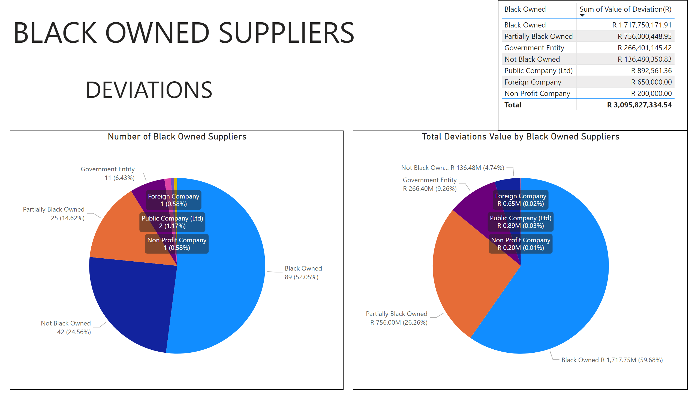

Slide 63
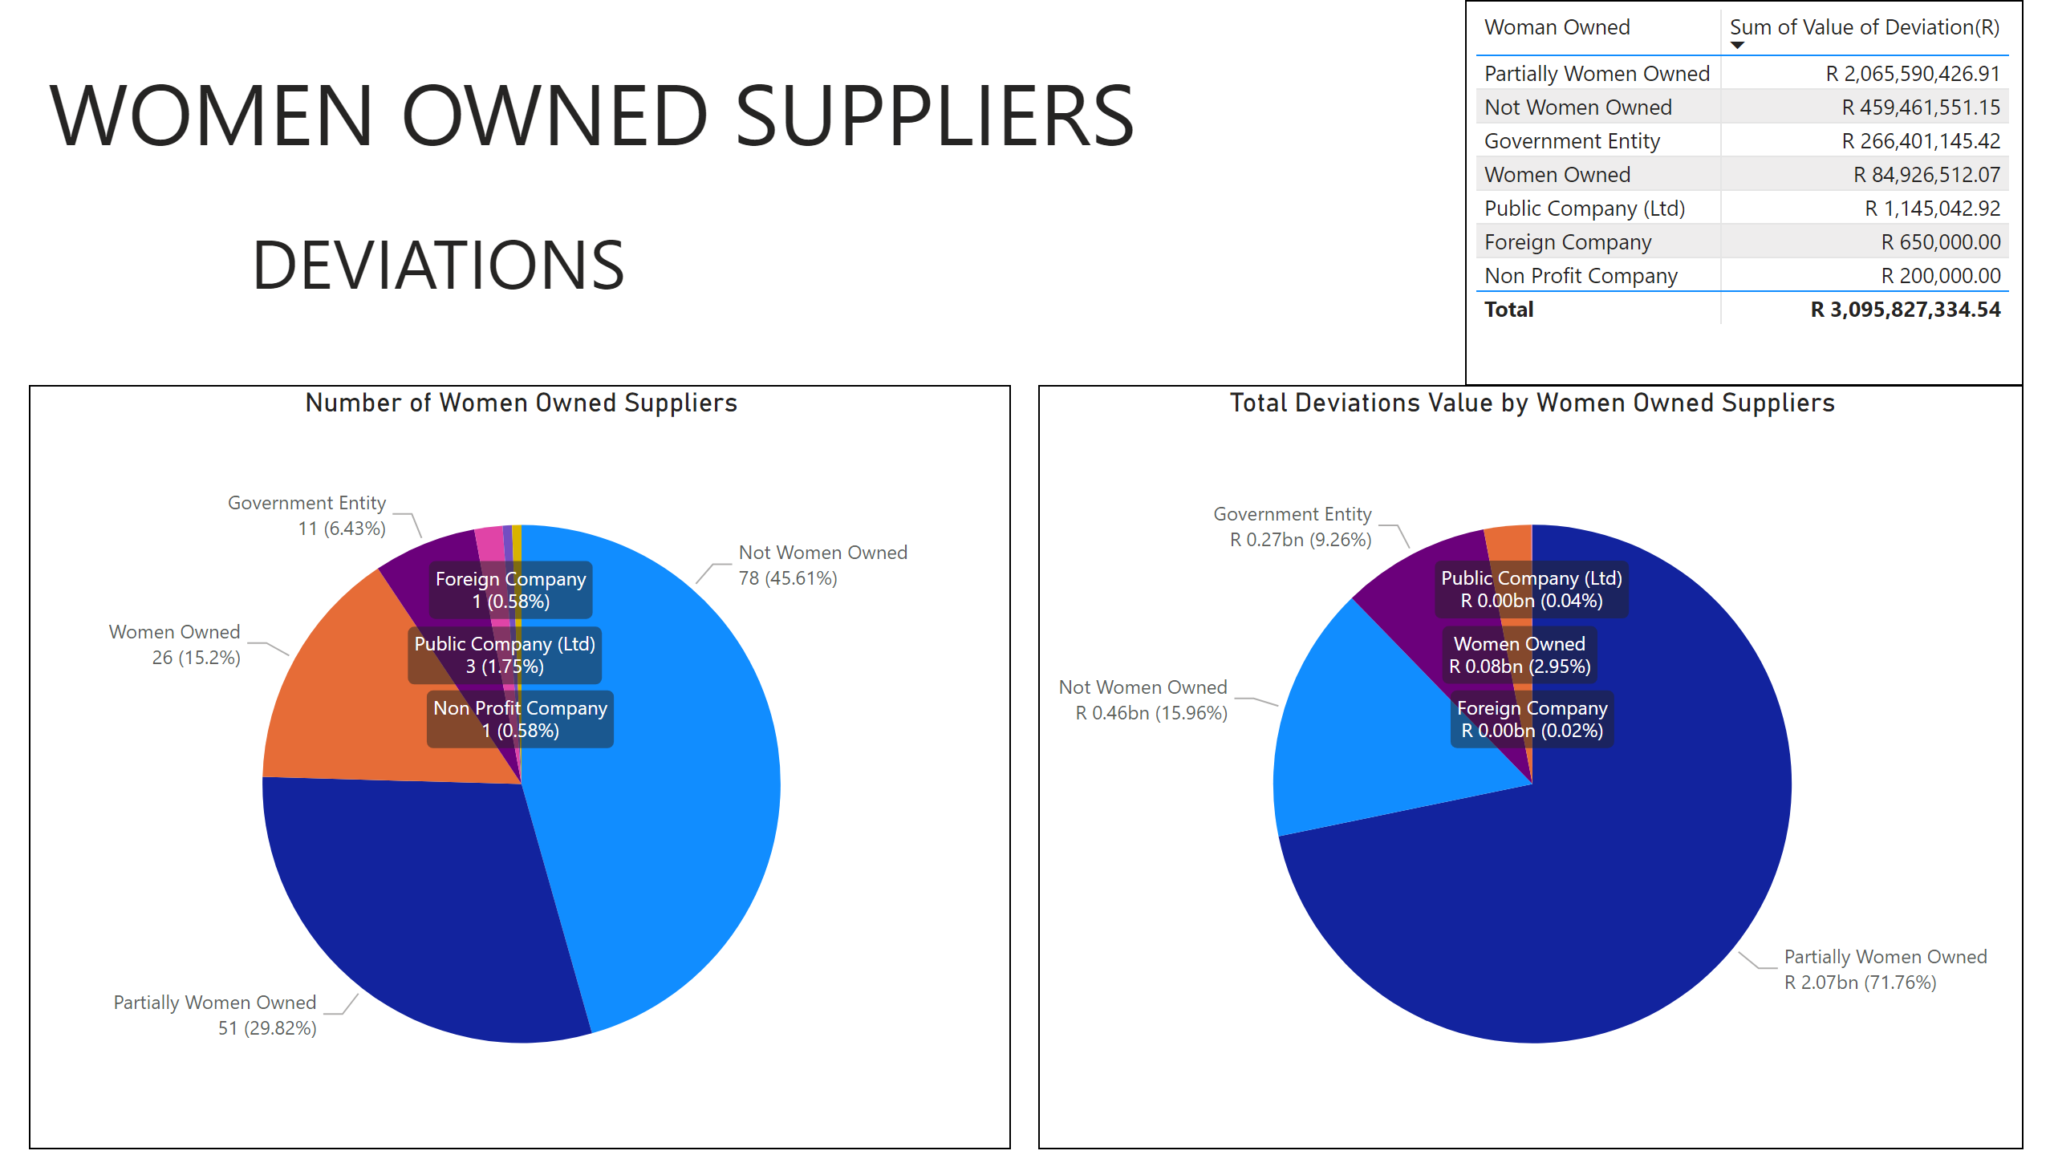

Slide 64
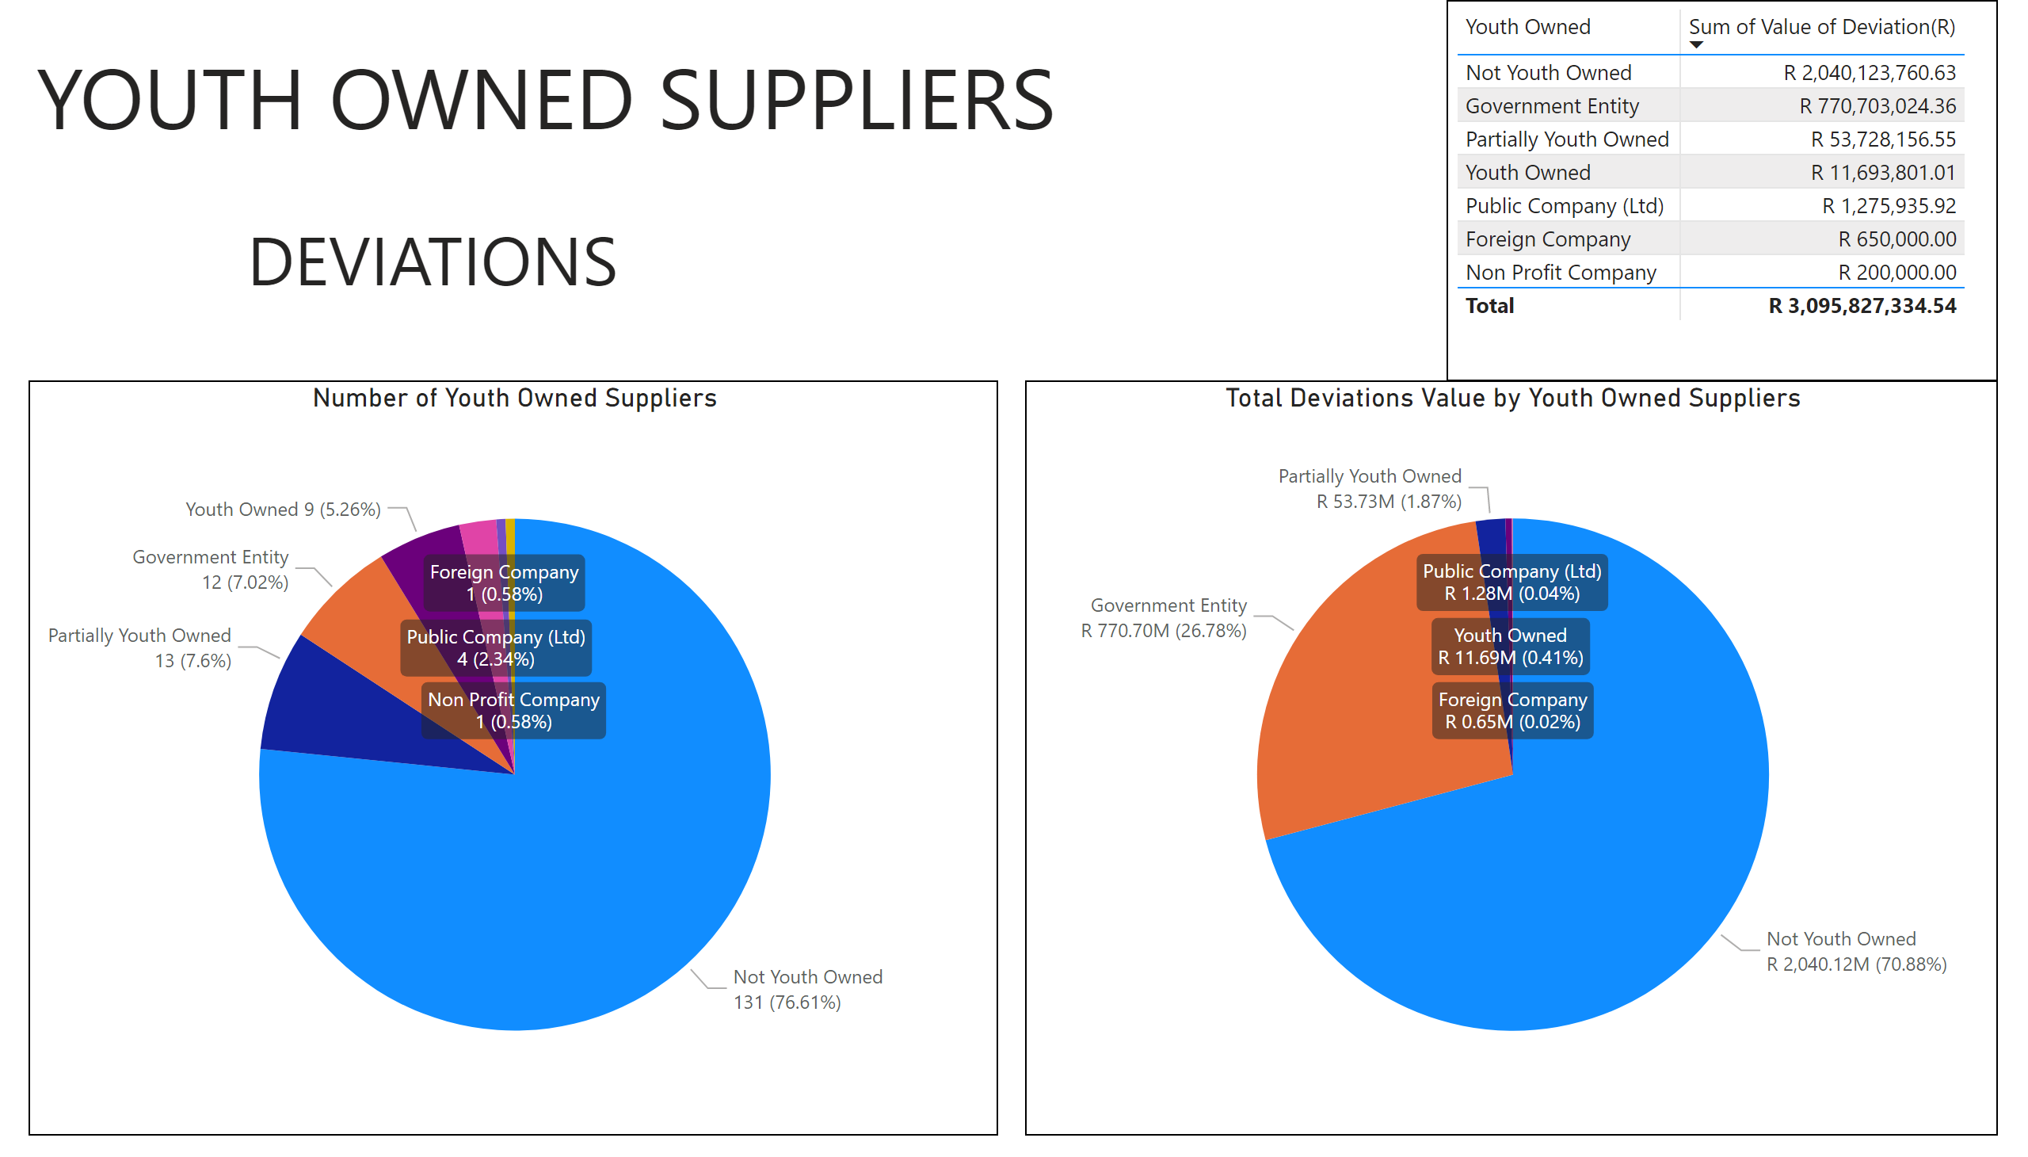

Slide 65
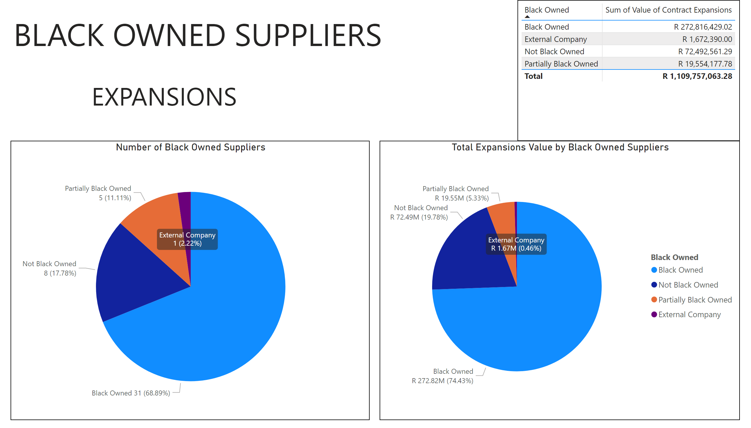

Slide 66
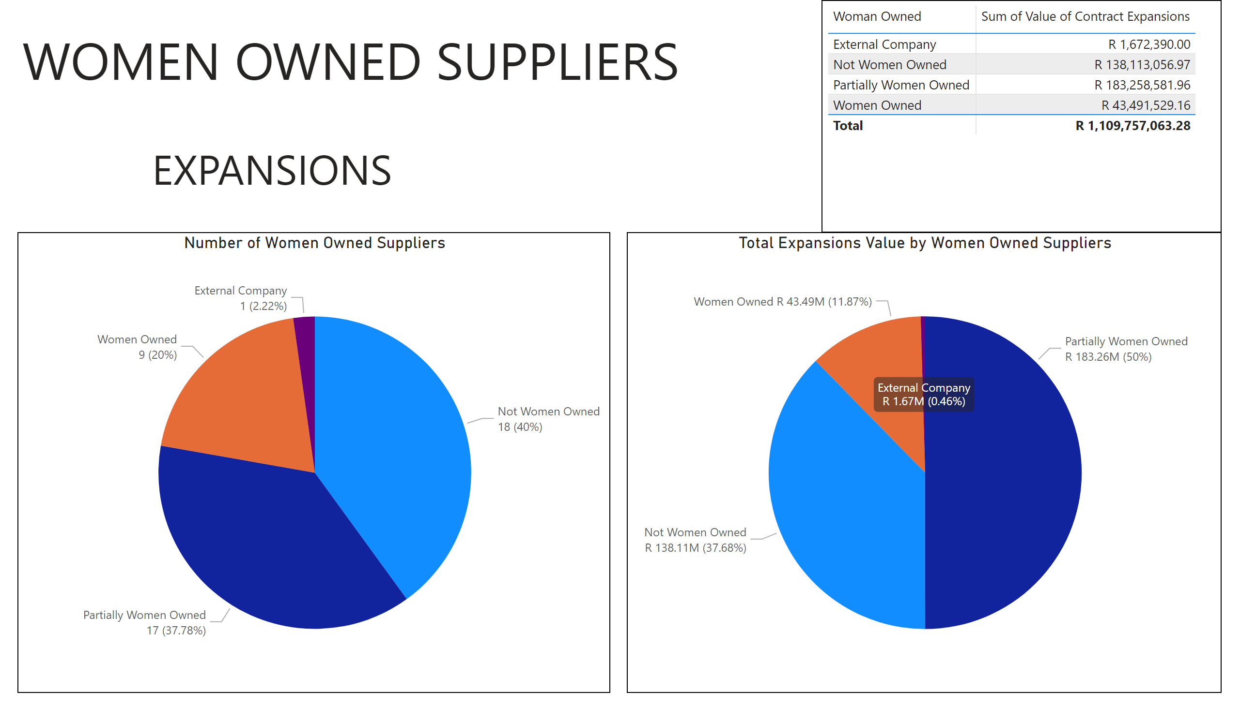

Slide 67
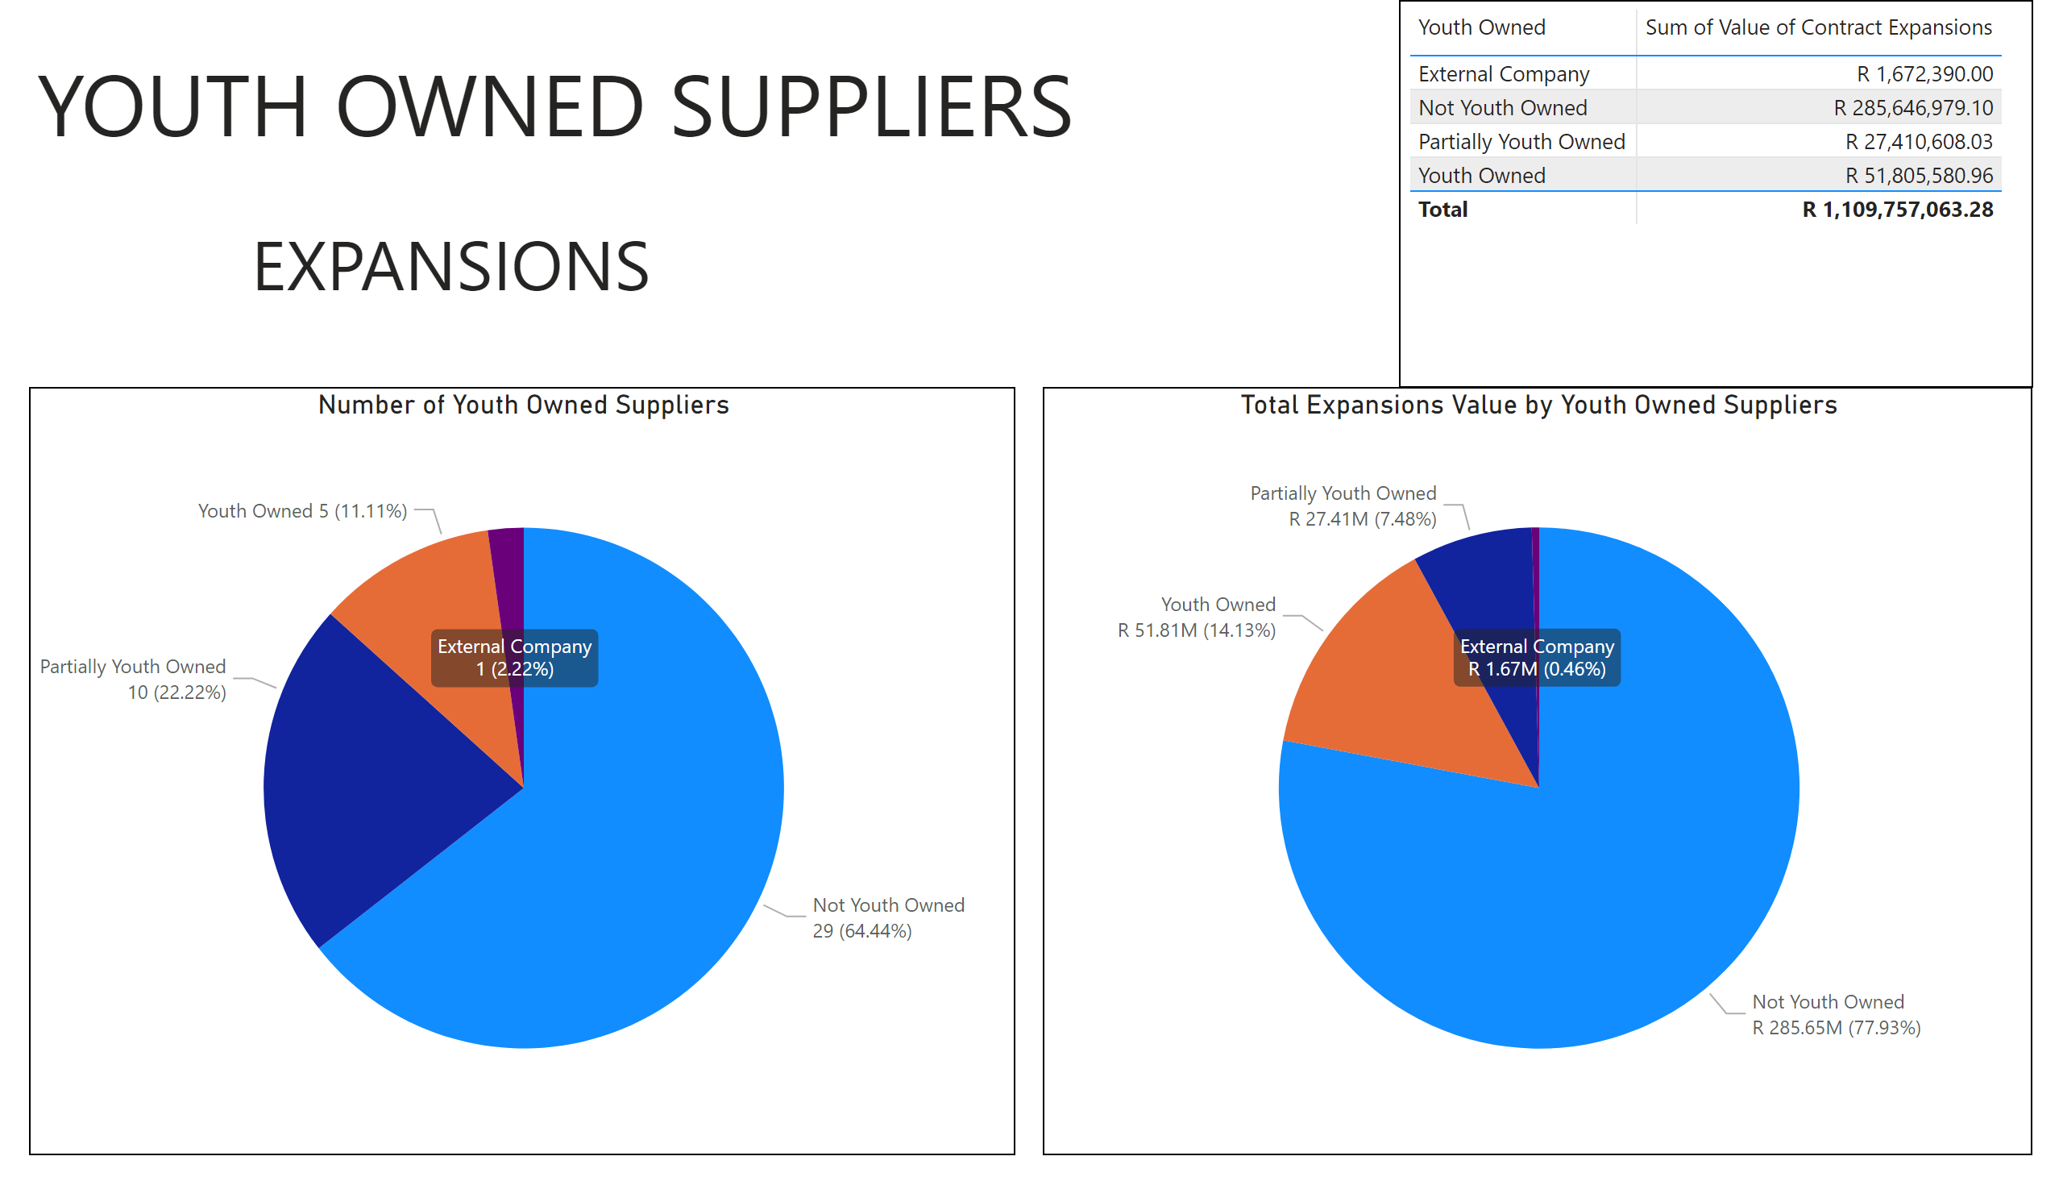

Slide 68
THANK YOU

