Slide 1
Western Cape Education Department
Presentation to Standing Committee on Education
10 February 2023

Slide 2
Quality Education
for every child
in every classroom
in every school
in the province.

Slide 3
Enrolment growth
The WCED system has increased by 17 901 learners on average per year over the period 2018 – 2022
1117080
1100147
Average growth per year:
17 901
16 933
18 314
17 562
18 795
WCED Annual School Survey Data, 2022

Slide 4
2023 admissions process
January 2022 - Advocacy in schools – posters and pamphlets.
March 2022 – Advocacy in media about upcoming admission process.
14 March 2022 –Admissions opened.
15 April 2022– Admissions closed (site remains open for late applications)
16 April 2022 - 27 May 2022 – SGBs apply their admission policies and finalise applications.

Slide 5
2023 admissions process
27 May 2022
Parents informed of outcome of applications.
17 June 2022
Closing date for parents to make a decision on which school they accept.
18 June 2022
System will activate the first successful option where parents have not confirmed.
24 June – 19 July 2022
Schools are closed.
19 July – 31 Aug. 2022
Schools review admission lists and contact parents who applied on the system and still need a place.
1 Sep. – 15 Dec. 2022
The WCED Admission Teams place and resolve outstanding cases.

Slide 6
Successful infrastructure plan delivered
By 31 January 2023, 662 classrooms were completed for the 2023 school year.
A total of 180 classrooms are in the process of completion in line with target dates.
The rate of the build was unprecedented building the equivalent of 1 school every 4 days, or 8 classes per day on average.
The rapid build project saw the completion of 5 new schools.
Saxonsea Junior High School took just 65 working days to build.

Slide 7
Admissions for 2023: Grade 1 and Grade 8 applications - 06 February 2023
2023 | Grade 1 | Grade 8
Received timeously (By 15 April 2022) | 19 861 | 73 742
b) Received late (After 15 April 2022) | 4 993 | 19 974
c) Received extremely late in 2023 | 1 225 | 2 166
Total | 26 079 | 95 882

Slide 8
In process of being placed: Grade 1 and Grade 8 applications - 06 February 2023
2023 | Grade 1 | Grade 8
a) Received timeously (By 15 April 2022) | 4* | 18*
b) Received late (After 15 April 2022) | 35** | 94**
c) Received extremely late in 2023 | 293 | 1032
Total | 332 | 1144
Total % | 1.27% | 1.19%
Note*: Parents are unreachable or have not accepted an offer of placement.
Note**: Placement has been prioritised and/or parents are unreachable.

Slide 9
In process of being placed - Grade 1 and Grade 8 applications
All grade 1 and grade 8 learners that have applied on time, have been placed except for 22 learners who are untraceable or have not accepted an offer of a place.
A further 129 learners who applied late are being prioritized with many parents being unreachable due to contact details being outdated or incorrect, or parents not accepting offers of placement.
A total of 98.8% of grade 1 and grade 8 learners have been placed and we are now focused on the remaining 1.2%, many who are uncontactable, untraceable or applied late.

Slide 10
Grade 1 and Grade 8 extremely late applications – 06 February 2023
2023 | Grade 1 and Grade 8 extremely late applications
Extremely late applications received in 2023 | 3 391
Resolved this year | 2 066
In process of being placed | 1 325

Slide 11
Late applications - challenges
An applicant may therefore require additional classrooms, teachers, transportation or a new subject or language stream.
This requires discussion and agreement with the school’s governing body (SGB)and in some cases, local municipalities.
The 10-day Snap Survey also needs to be finalized in order to determine where the needs lie so that fair distribution of resources can take place in terms of demand.

Slide 12
Late applications - challenges
Areas in which learners apply may be overpopulated. Alternatives in other nearby communities need to be sought, which may require transportation.
There are some schools with grade cohorts bigger than others, making placement in a particular grade within that immediate community difficult, particularly with siblings that require different grades.
A learner could have a specific language preference that is not accommodated at their closest school.
Subject choices also need to be considered as not all schools offer the same subject streams.
Specialised needs of learners also need to be taken into account.

Slide 13
Placement plan
A total of 70 mobiles have been procured for placement in areas of demand based on CEMIS data (10-day Snap Survey) and late applications.
The 70 mobiles are over and above the 842 classrooms we aim to build for the 2023 school year.
An additional 1 143 teaching posts allocated for the 2023 school year.
The 10-day Snap Survey figures are currently being verified and will inform many of the interventions.
Resource packs for learners have been printed and distributed at district offices for learners applying late.
Online support links have been sent to parents for additional reading and at-home learning.

Slide 14
Learning and Teaching Support Materials (LTSM) and learner transport
Learner Materials:
By the end of 2022 in preparation for the 2023 school year, we have delivered:
Textbooks – R62 million
Stationary – R39 million
Furniture – R50 million
Equipment - R1.6 million
Due to the rapid build programme, additional textbooks for the new schools were ordered and are being delivered. Further deliveries by 28 February 2023 of textbooks that are out of print.
Learner Transport:
All learner transport scheme applications received timeously for 2023 were processed and finalised by December 2022.
Late learner transport applications, mainly related to the rapid build programme and the opening of new schools late in November, have since been processed and finalized in January 2023.

Slide 15
Status of vandalism at schools during the holidays
A total of 48 incidents of burglary and/or vandalism affecting 42 schools were reported during the holiday period.
This is an increase from the 41 incidents affecting 34 schools reported during the previous end-of-year holidays.
The WCED provides subsidies for holiday security at 439 schools.
The WCED distributed a budget of R11.7 million for the 2022/23 financial year. This budget is distributed to the 8 education districts who then distribute the funds to schools for additional holiday security.

Slide 16
Admissions 2024
February 2023 - Advocacy in schools – posters and pamphlets.
March 2023 – Advocacy in media about upcoming admission process.
13 March 2023 –Admissions opened.
14 April 2023 – Admissions closed (site remains open for late applications).

Slide 17
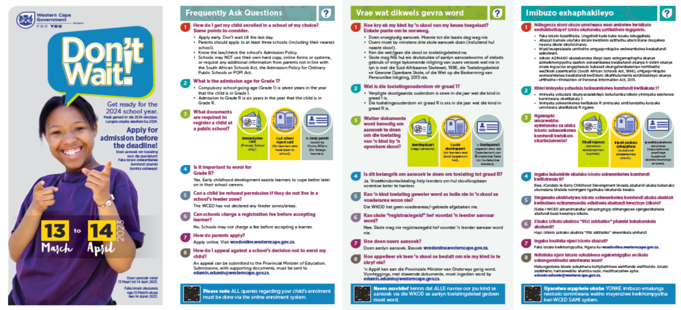
Pamphlet to all primary schools and registered ECD facilities
Pamphlets for all exit grades
Posters for schools with exit grades
Mall activations – Hosting of enrolment days
Radio ads
Print ads – community newspapers
Digital banners
In taxi and back of bus OOH
Mobile and Static Billboards
Loud Hailer services in communities
Social Media – promoted posts

Slide 18
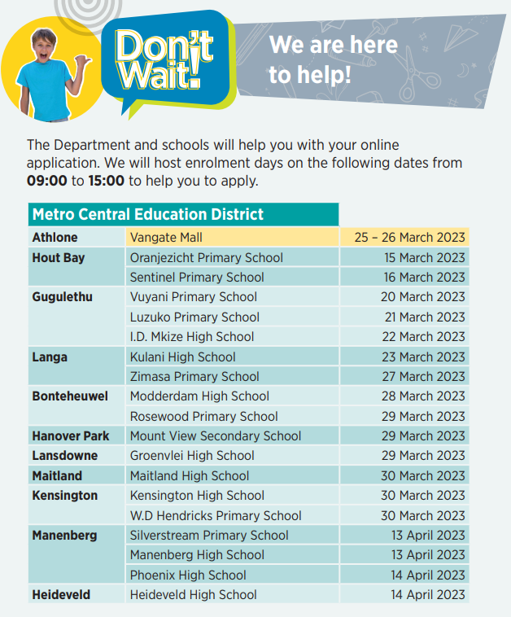
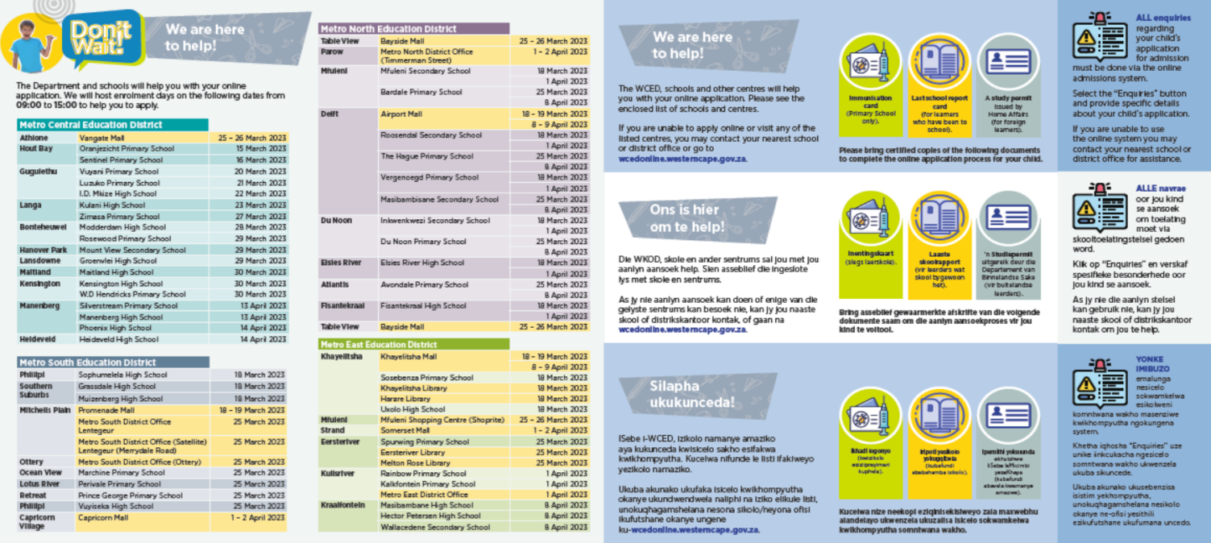
Online admissions assistance
The WCED is opening “pop up” admission sites in each of the 8 education districts.
Each pamphlet contains details of where support can be provided for those that do not have access to IT services for their online application.

Slide 19
Thank You

