Slide 1
Human Settlements Spatial Transformation and Consolidation – priority human settlements and housing development areas
Strategy to Transform the Apartheid Urban Spatial Design

Slide 2
Presentation Outline
Purpose
Background
Problem Statement and Strategic Intent
Spatial Transformation and Consolidation Strategy
PHSHDAs - Instrument towards Spatial Transformation
PHSHDAs Implementation Approach and Progress
Conclusion
Recommendations

Slide 3
1. Purpose of the Presentation
To apprise the Portfolio Committee of the Strategy to transform the Apartheid Urban Spatial Design aimed at Spatial Transformation and Consolidation through PHSHDAs

Slide 4
2. Background
SA’s challenging land and settlement patterns are a result of legacies of colonial domination & apartheid system
Numerous legislations including 1913 Natives Land Act, 1927 Black Administration Act, 1950 Group Areas Act etc. were entrenched dispossession of land to African, Coloured and Indian communities
This resulted in massive forced removals and land dispossession leading to :
  Unequal distribution of wealth coupled with the class division
  Inequalities in spatial patterns
  Poor planning
  Slow provision of infrastructure and services
  Poor land information systems
  Slow and cumbersome land transaction procedures
  Insecure tenure
  Under-regulation of private land development
  Difficulties in the availability of well-located land
A major cause of sprawl may be the failure to properly internalize the costs of infrastructure, specifically the costs of bulk infrastructure. The intentional and unintentional impacts of government policies on spatial development must be given careful consideration.
Despite the massive increase in housing delivery, state investments are still uncoordinated and housing delivery is relegated to the periphery of towns and cities

Slide 5
3. Problem Statement and Strategic Intent
Problem Statement:
  Human settlement patterns remain inequitable and dysfunctional with the form and location of land developments;
  Human settlement projects and informal settlement upgrades rarely responding directly to government’s intent of spatial integration and spatial justice
  Provision of shelter and security, tenure insecurity and poor response in addressing asset poverty persists
  Disasters and effects of climate change
Strategic Intent
  National Development Plan (NDP) 2030 clearly expresses the need to redress and ‘address the challenge of apartheid geography.
  Ensure spatial integration through the accelerated provision of well-located housing and land to poor South Africans
  Human settlements addresses poverty, create employment, improve socio-economic conditions and creating sustainable future
  An increasing housing demand, household size reduced and accelerated leading to a proliferation of informal settlements
  South Africa is urbanising rapidly with 63% of South Africans already living in urban areas; will rise to 71% by 2030.
MTSF 2019-2024 has overarching goals:
  To improve integrated settlement development and linking job opportunities and housing opportunities to support spatial transformation
  Spatial transformation through multi-programme integration in Priority Development Areas (PDAs) and ensure priority investment opportunities through an area-based approach
  Improved living conditions and environment through provision of adequate housing
  Provision of security of tenure - the eradication of title deeds backlogs

Slide 6
4. Spatial Transformation and Consolidation Strategy
In order to address the problem of building settlements in peripheries and away from amenities, the department in collaboration with provinces and municipalities developed a strategy on spatial transformation, in line with the proposals made in the National Development Plan (2012).
Human Settlements Framework for Spatial Transformation and Consolidation aims to:
  Create opportunities for liveable, inclusive and resilient towns and cities through integrated settlement development;
  Reverse the unjust and dysfunctional spatial legacy of apartheid;
  Improve participation of the disadvantaged in the residential property market; and
  Increase the asset creation potential of the state’s investments in human settlements
Aligns to the principles of the NDP, NSDF and to the objectives of the IUDF and SPLUMA which includes:
  Spatial justice: reversing segregated development and creation of poverty pockets in the peripheral areas, to integrate previously excluded groups, resuscitate declining areas;
  Spatial Efficiency: consolidating spaces and promoting densification, efficient commuting patterns;
  Access to Connectivity, Economic and Social Infrastructure: Intended to ensure the attainment of basic services, job opportunities, transport networks, education, recreation, health and welfare etc. to facilitate and catalyze increased investment and productivity;
  Access to Adequate Accommodation: Emphasis is on provision of affordable and fiscally sustainable shelter in areas of high needs; and
  Provision of Quality Housing Options: Ensure that different housing typologies are delivered to attract different market segments at appropriate quality and innovation
  Human Settlements is a concurrent function, therefore planning for human settlements development involves multiple stakeholders

Slide 7
5. PHSHDAs - Instrument towards Spatial Transformation
The PHSHDAs are intended to realize opportunities within specific areas for mixed use, high density and multiple typology housing and human settlements development
These priority areas require specific programmatic intervention interventions with transformation objectives and which allocations are progressively prioritized through the existing grants:
  Forward-looking land assembly and township establishment
  Upgrading of Informal Settlements
  Declared Social (Rental) Housing Restructuring Zones
  Opportunities for Greenfield Development (new places)
  Distressed/ dilapidated/ degenerating communities/ precincts
The commitment to invest in the declared PHSHDA’s by all stakeholders, would result into well planned, budgeted settlements with the required infrastructure, social services such as schools, health care facilities as well as social amenities
Mixed use development would be facilitated.
Densification would be enabled by policies of ‘infill’ and redevelopment of well-located land,
Accommodating mixed residential and mixed income developments.
Townships would be redeveloped to improve services and urban amenities there, but also to promote economic development.
Former white areas and city centres would become more mixed in function, income and race, to make these areas more accessible to those who had been excluded,
Spatial planning would move away from its traditional focus on ‘control’ to a more facilitative function, attempting to redress the spatial legacy of the past.

Slide 8
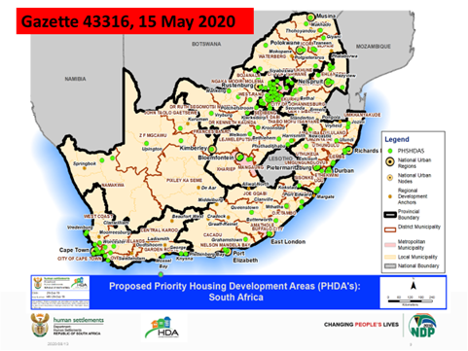
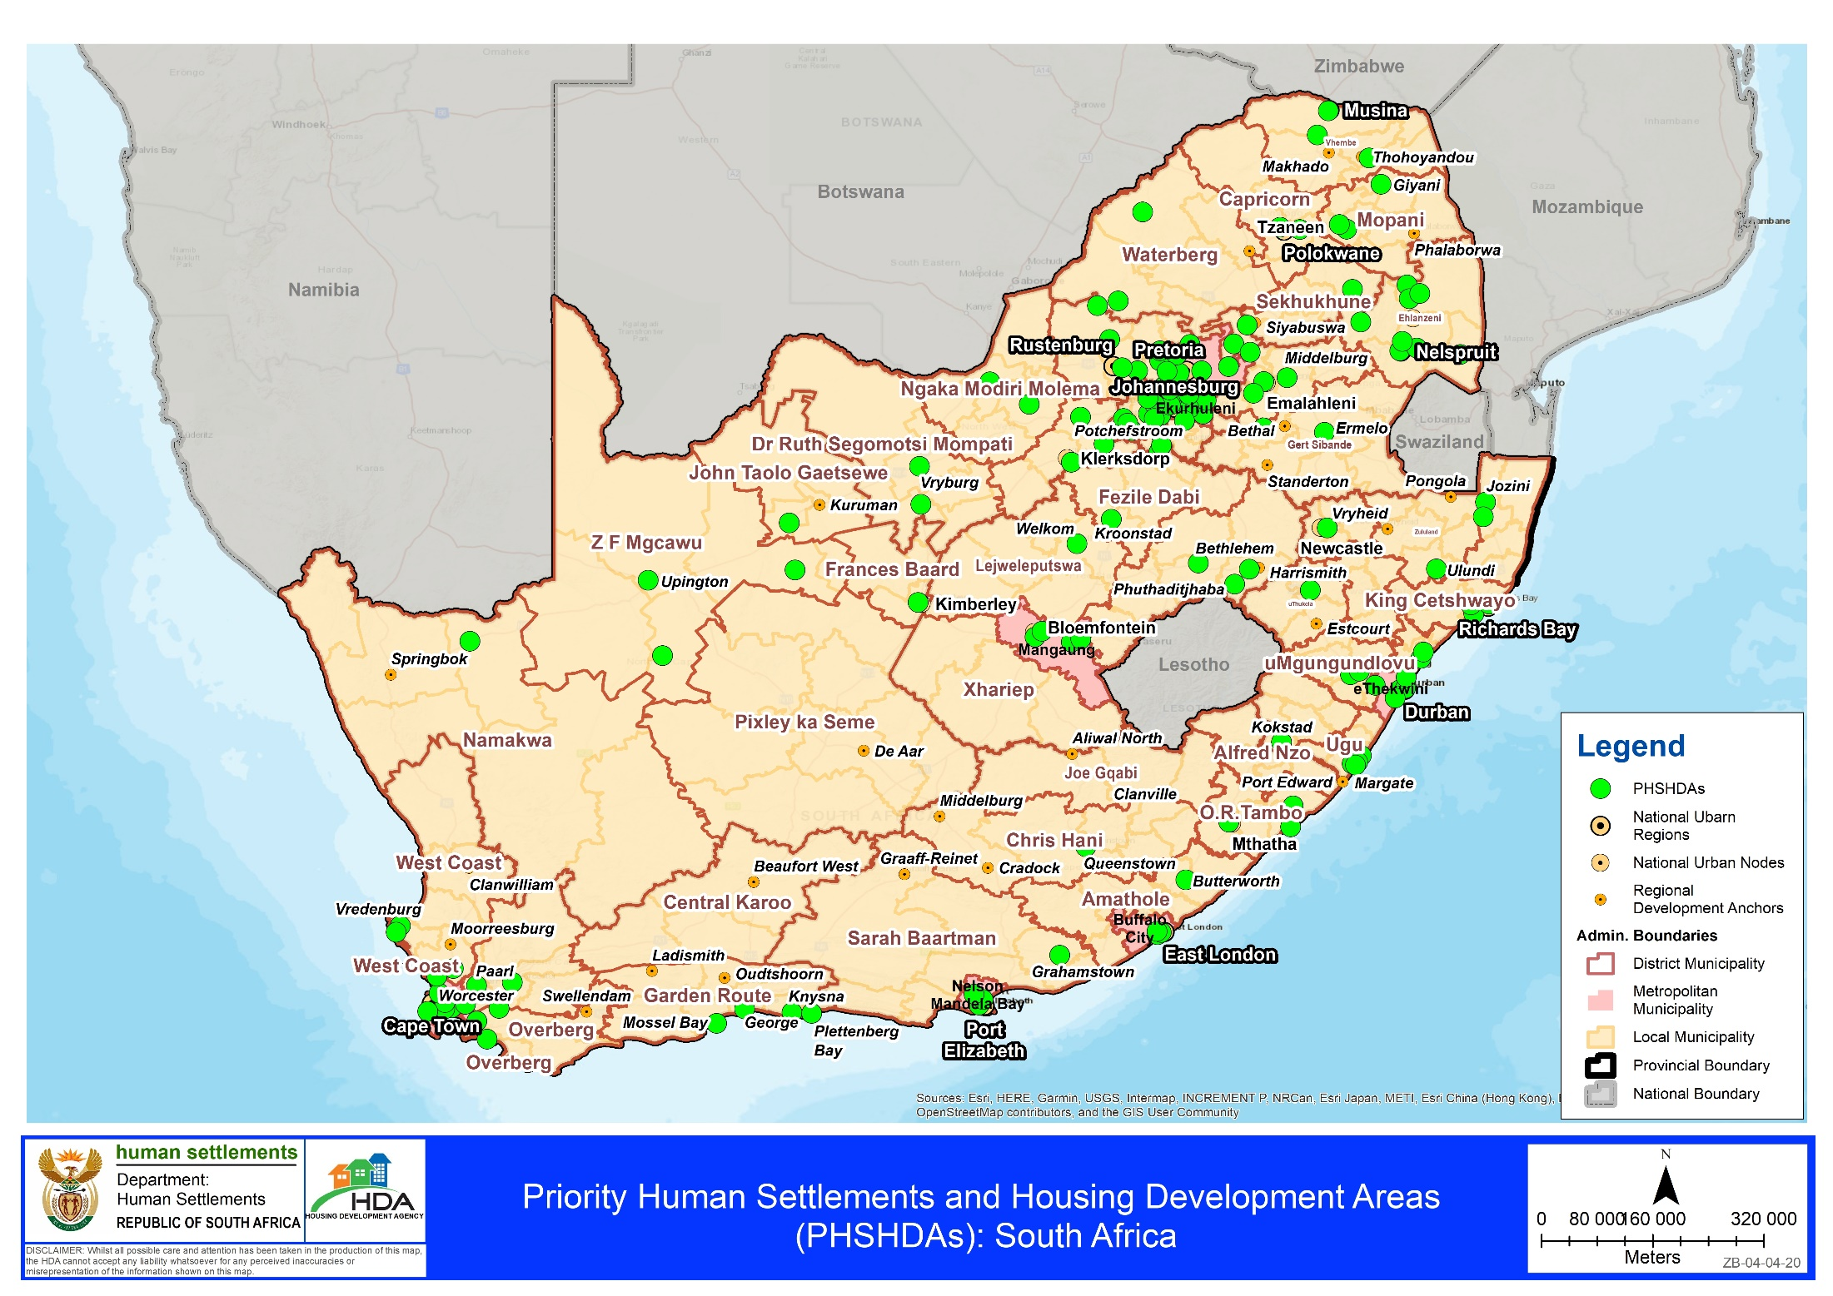

Slide 9
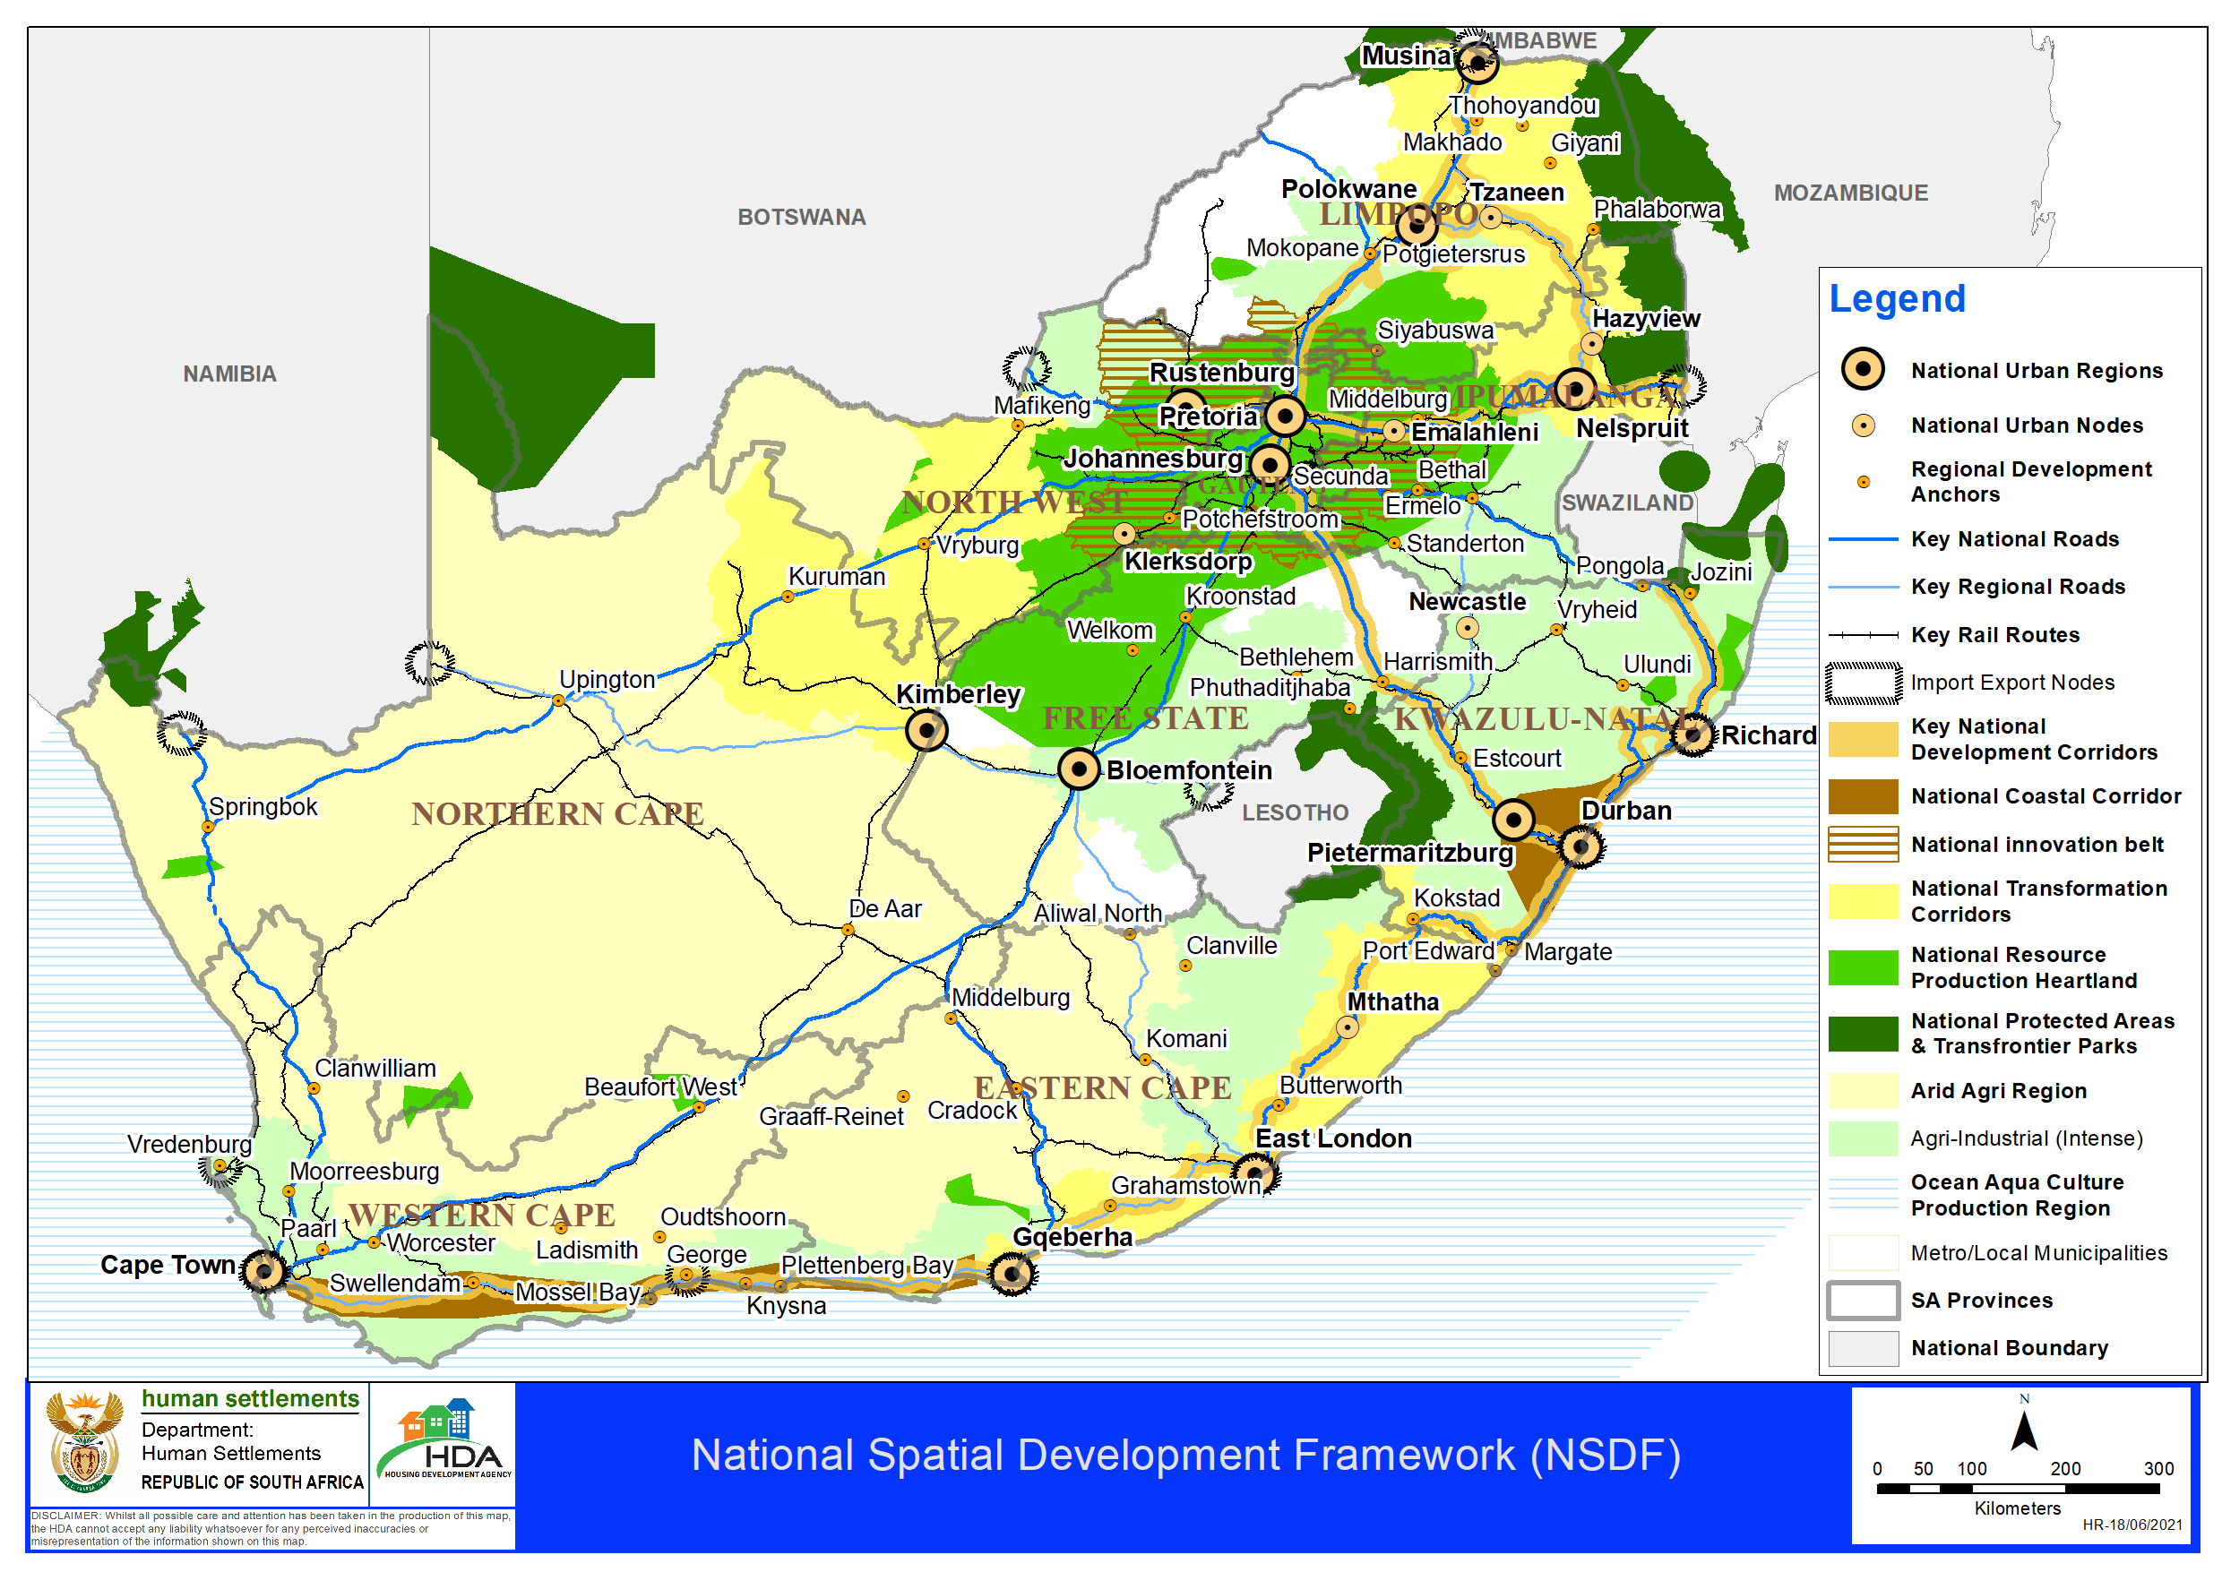

Slide 10
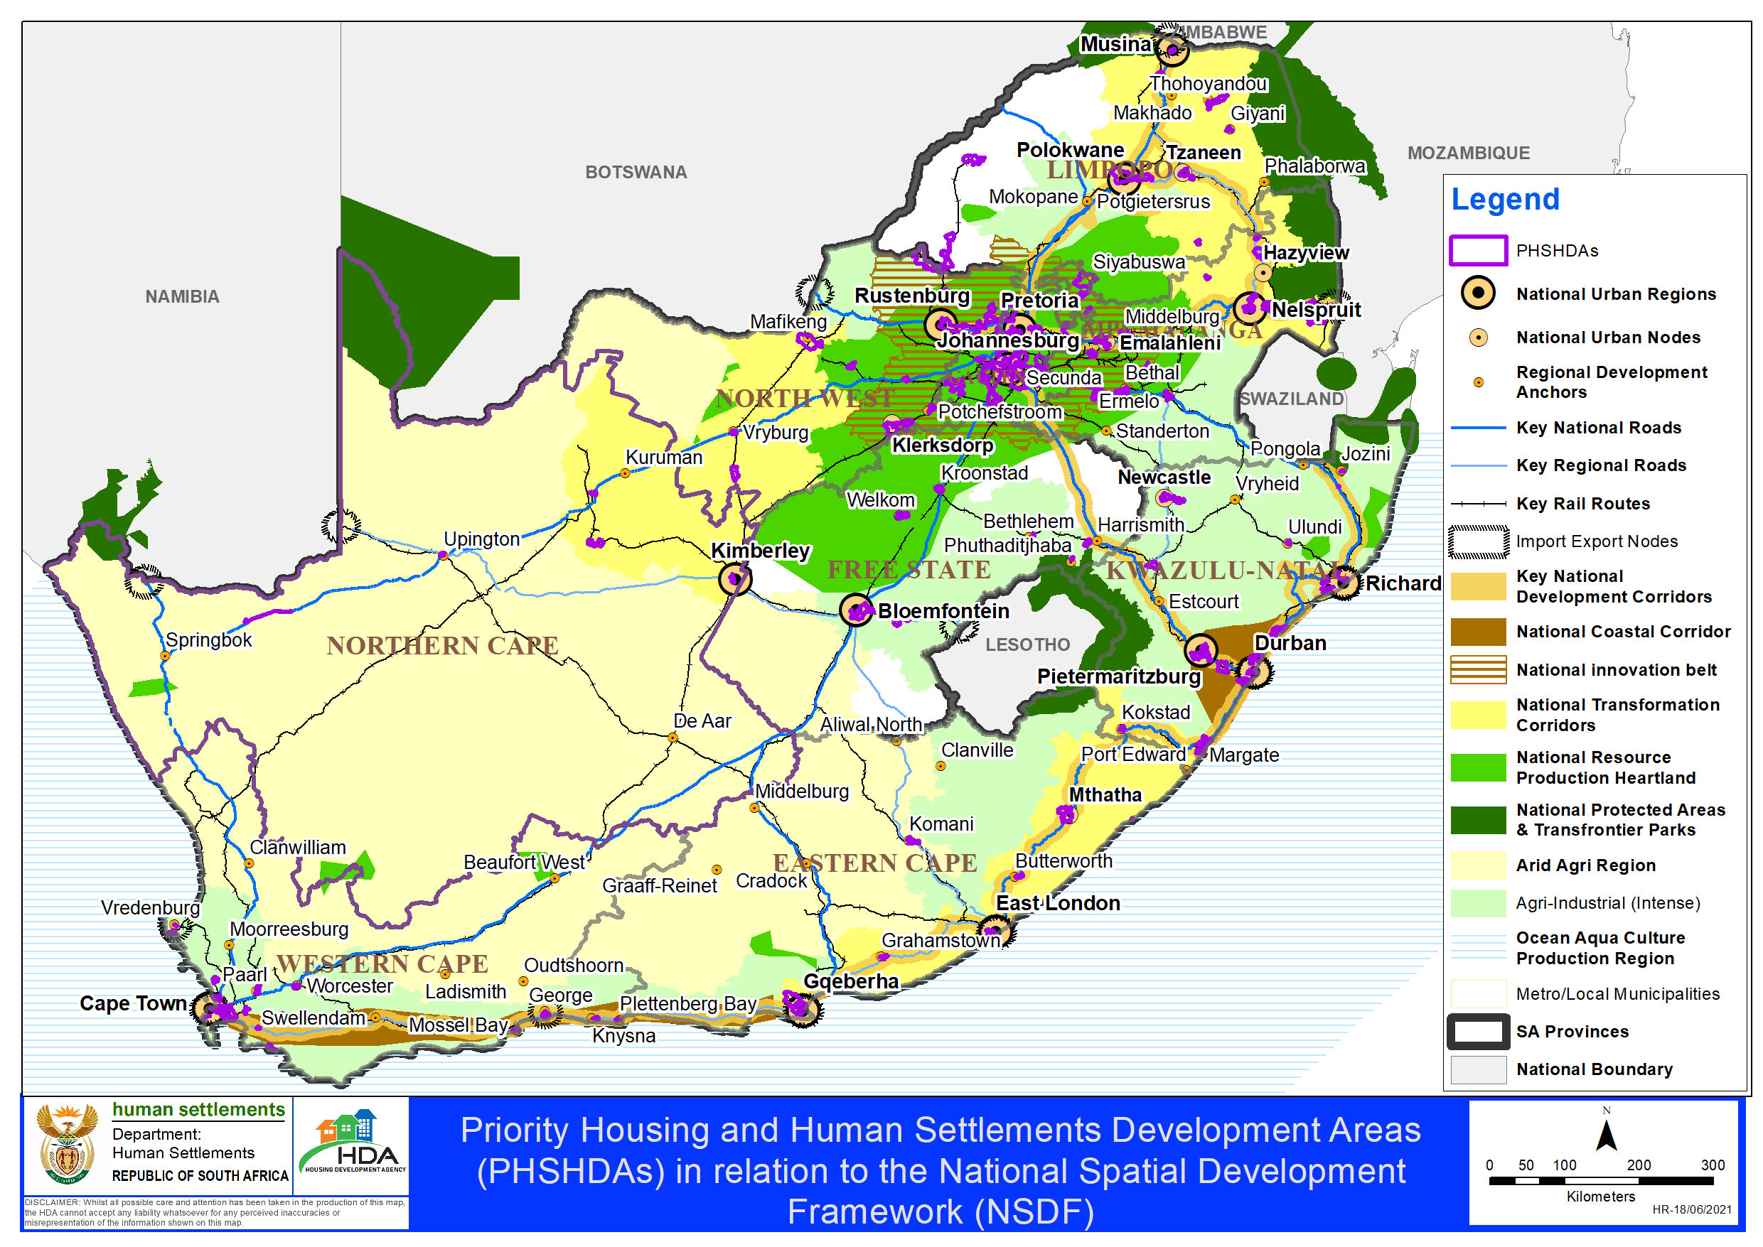

Slide 11
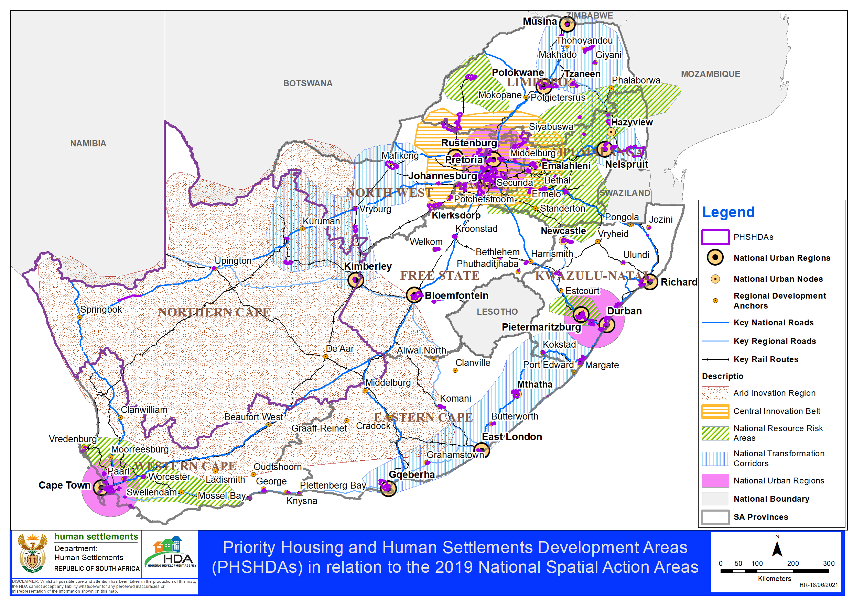

Slide 12
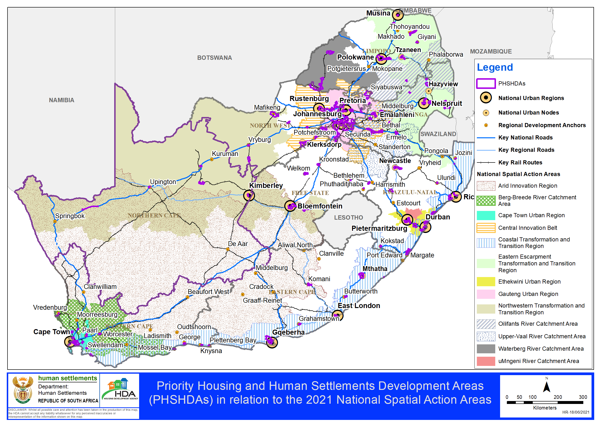
Human Settlements Spatial Transformation and Consolidation

Slide 13
6. Priority Human Settlements and Housing Development Areas
Implementation Approach
Programme Management & Governance
Declare and Plan Priority Development Areas
Legislation (Housing Act, HDA Act, SPLUMA
Land Assembly in PHDAs
Transport & Mobility
Bulk Infrastructure
Implementation Institutional Arrangements
Public sector Project Manager
(HDA et al.)
Public sector funds manager (HSDB et al)
Infrastructure
development
Release
of state-owned land
Acquire privately owned land (equity, expropriation
Communication & Connectivity
Private sector developers & Investors
Priority Area Dev. SPV
Multiple Projects (IRDP, UISP, SH, PHP,
Title Deeds, Basic service
Ecological Infrastructure
Air quality Management
Ecological Governance
Climate Change
Renewables
Local Economy
Small Business investment promotion
Transaction Support Services
Economic Hubs, Industrial Parks, SEZs
Economic Development
Spatially targeted Public Funding
HS Grants
Built Environment Grants
Community Development grants
Economic Dev. Incentives
Incentives
Development Plans (Red Book)
Social Facilities
Energy
Community participation and Stakeholder mobilization
Monitoring and evaluation

Slide 14
6.a Implementation Progress
68 Integrated implementation programmes prepared with 5 adopted by municipal councils
In terms of the state land release programme to date, 2557 hectares has been released for human settlements development by DPWI. An additional thirty-two (32) land parcels measuring 10 350 hectares to undertake preliminary human settlements planning. In excess of 64 000 housing opportunities are planned from the released land parcels.
Three building buildings acquired in inner cities (Sea Point Cape Town and two ESKOM buildings located in Braamfontein, Johannesburg and Kimberly ) for social housing purposes. Development potential of 1200 units for Braamfontein and Kimberly.
Human Settlements grants allocations to PDA (next slide). Engagements with other sectors on alignment of funding to PDAs. Estimated MIG Allocations is R17billion in PDAs for the purposes of providing internal bulk infrastructure to settlements.
Bulk infrastructure requirements assessment underway to inform prioritization of projects

Slide 15
Investment in Priority Human Settlements Housing Development Areas: HSDG
Details per PDA is available

Slide 16
Investment in Priority Human Settlements Housing Development Areas: ISUPG

Slide 17
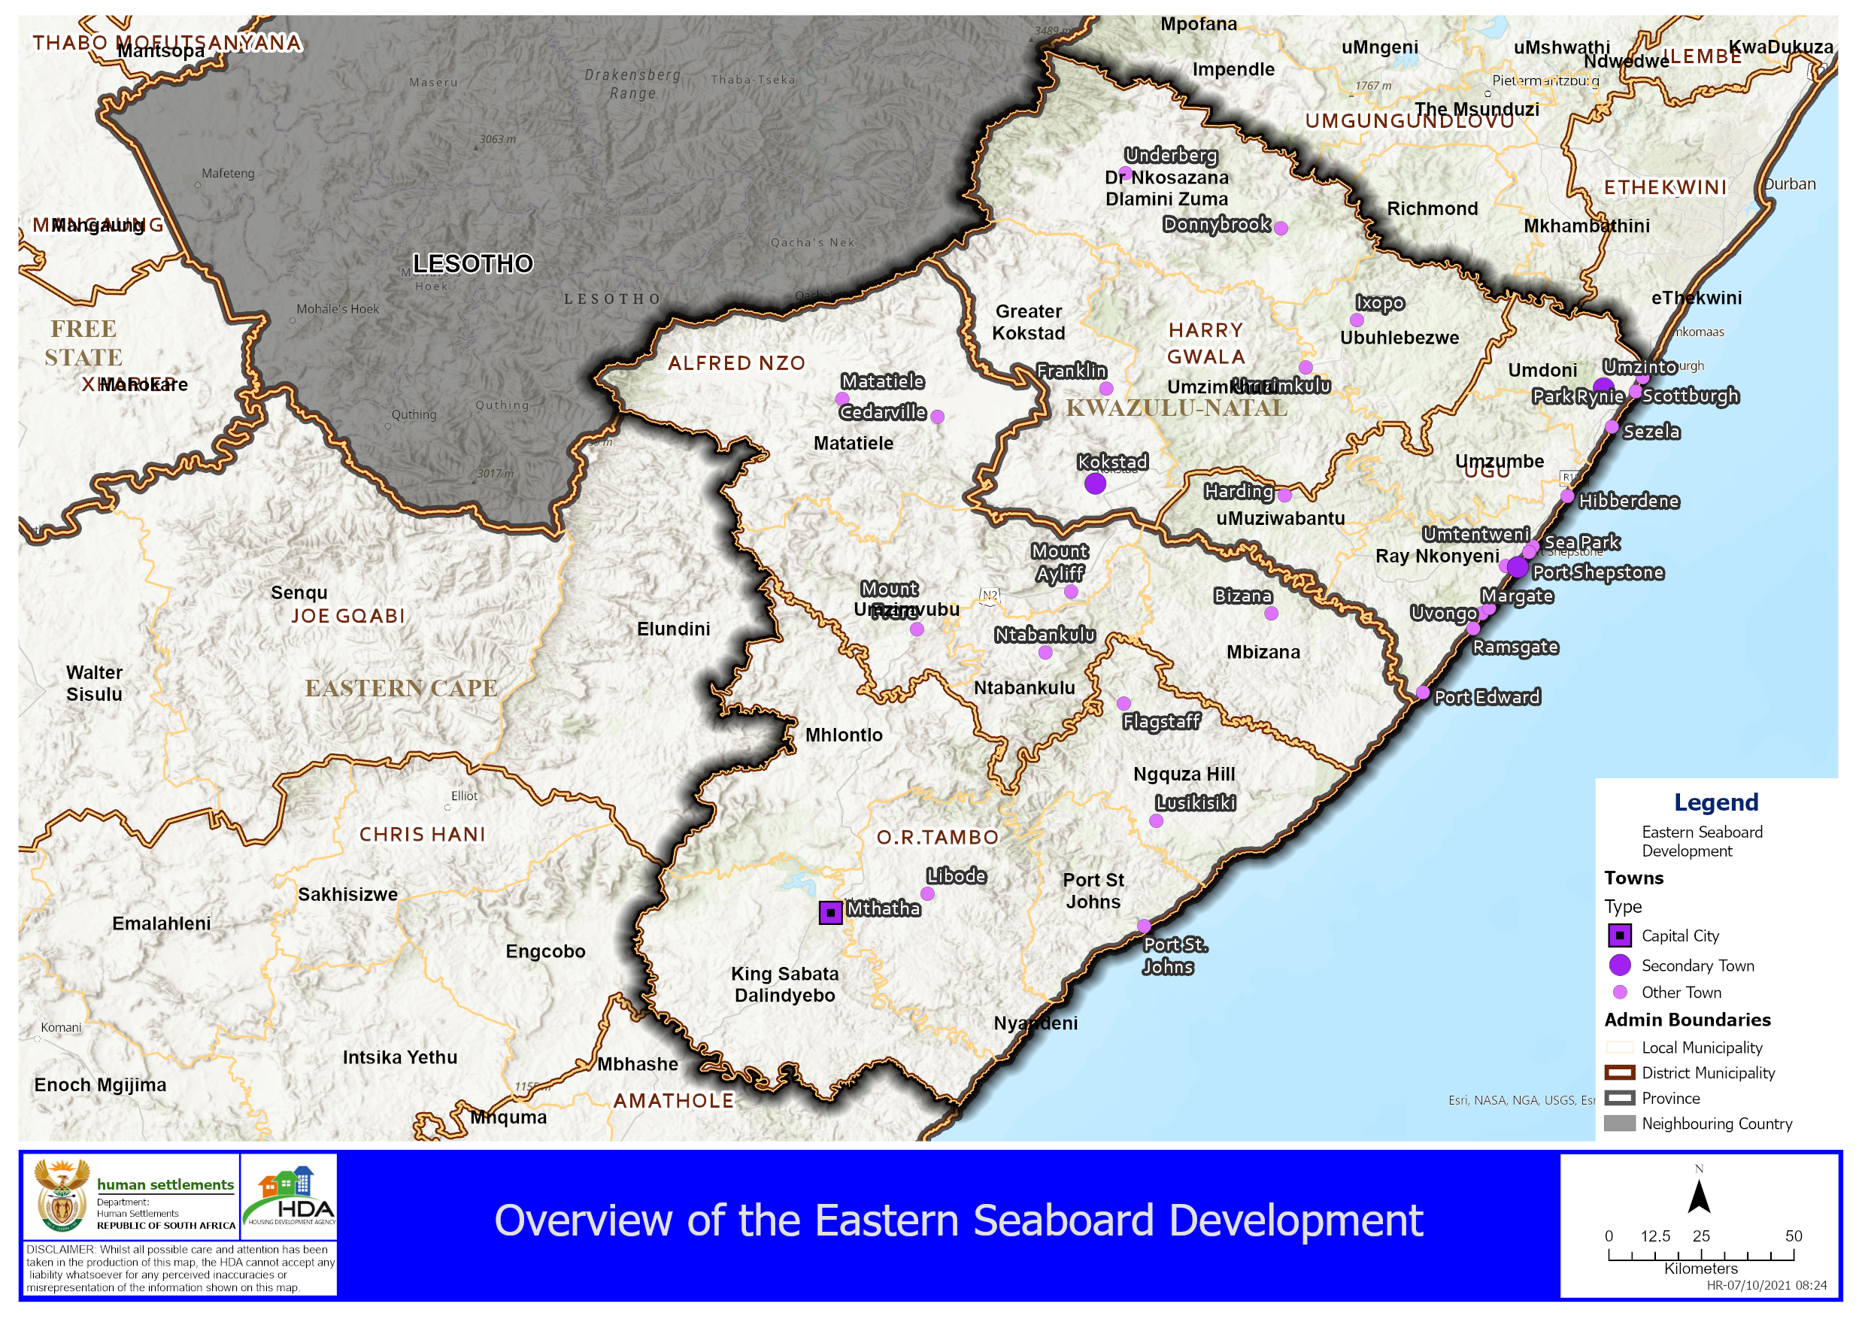
Alignment to DDM
Example: Eastern Seaboard
District Municipality | Local Municipality | PHSHDA Name
O.R.Tambo District Municipality | King Sabata Dalindyebo Local Municipality | Mthatha CBD and surrounds
 | Port St Johns Local Municipality | Port St. Johns Urban Centre
 | Ingquza Hill Local Municipality | Lusikisiki Urban Development Node
Ugu District Municipality | Ray Nkonyeni Local Municipality | Shelly Beach, Uvongo-Margate, Gamalakhe Nositha, Greater Port Shepstone
Harry Gwala DM | Greater Kokstad Local Municipality | Koskstad Town
Source: DHS (HSDG &ISUPG, 2022/23)

Slide 18
Municipal Infrastructure Grant Allocations in PHSHDAs
(2021/22-2022/23)
Source: COGTA (2022)

Slide 19
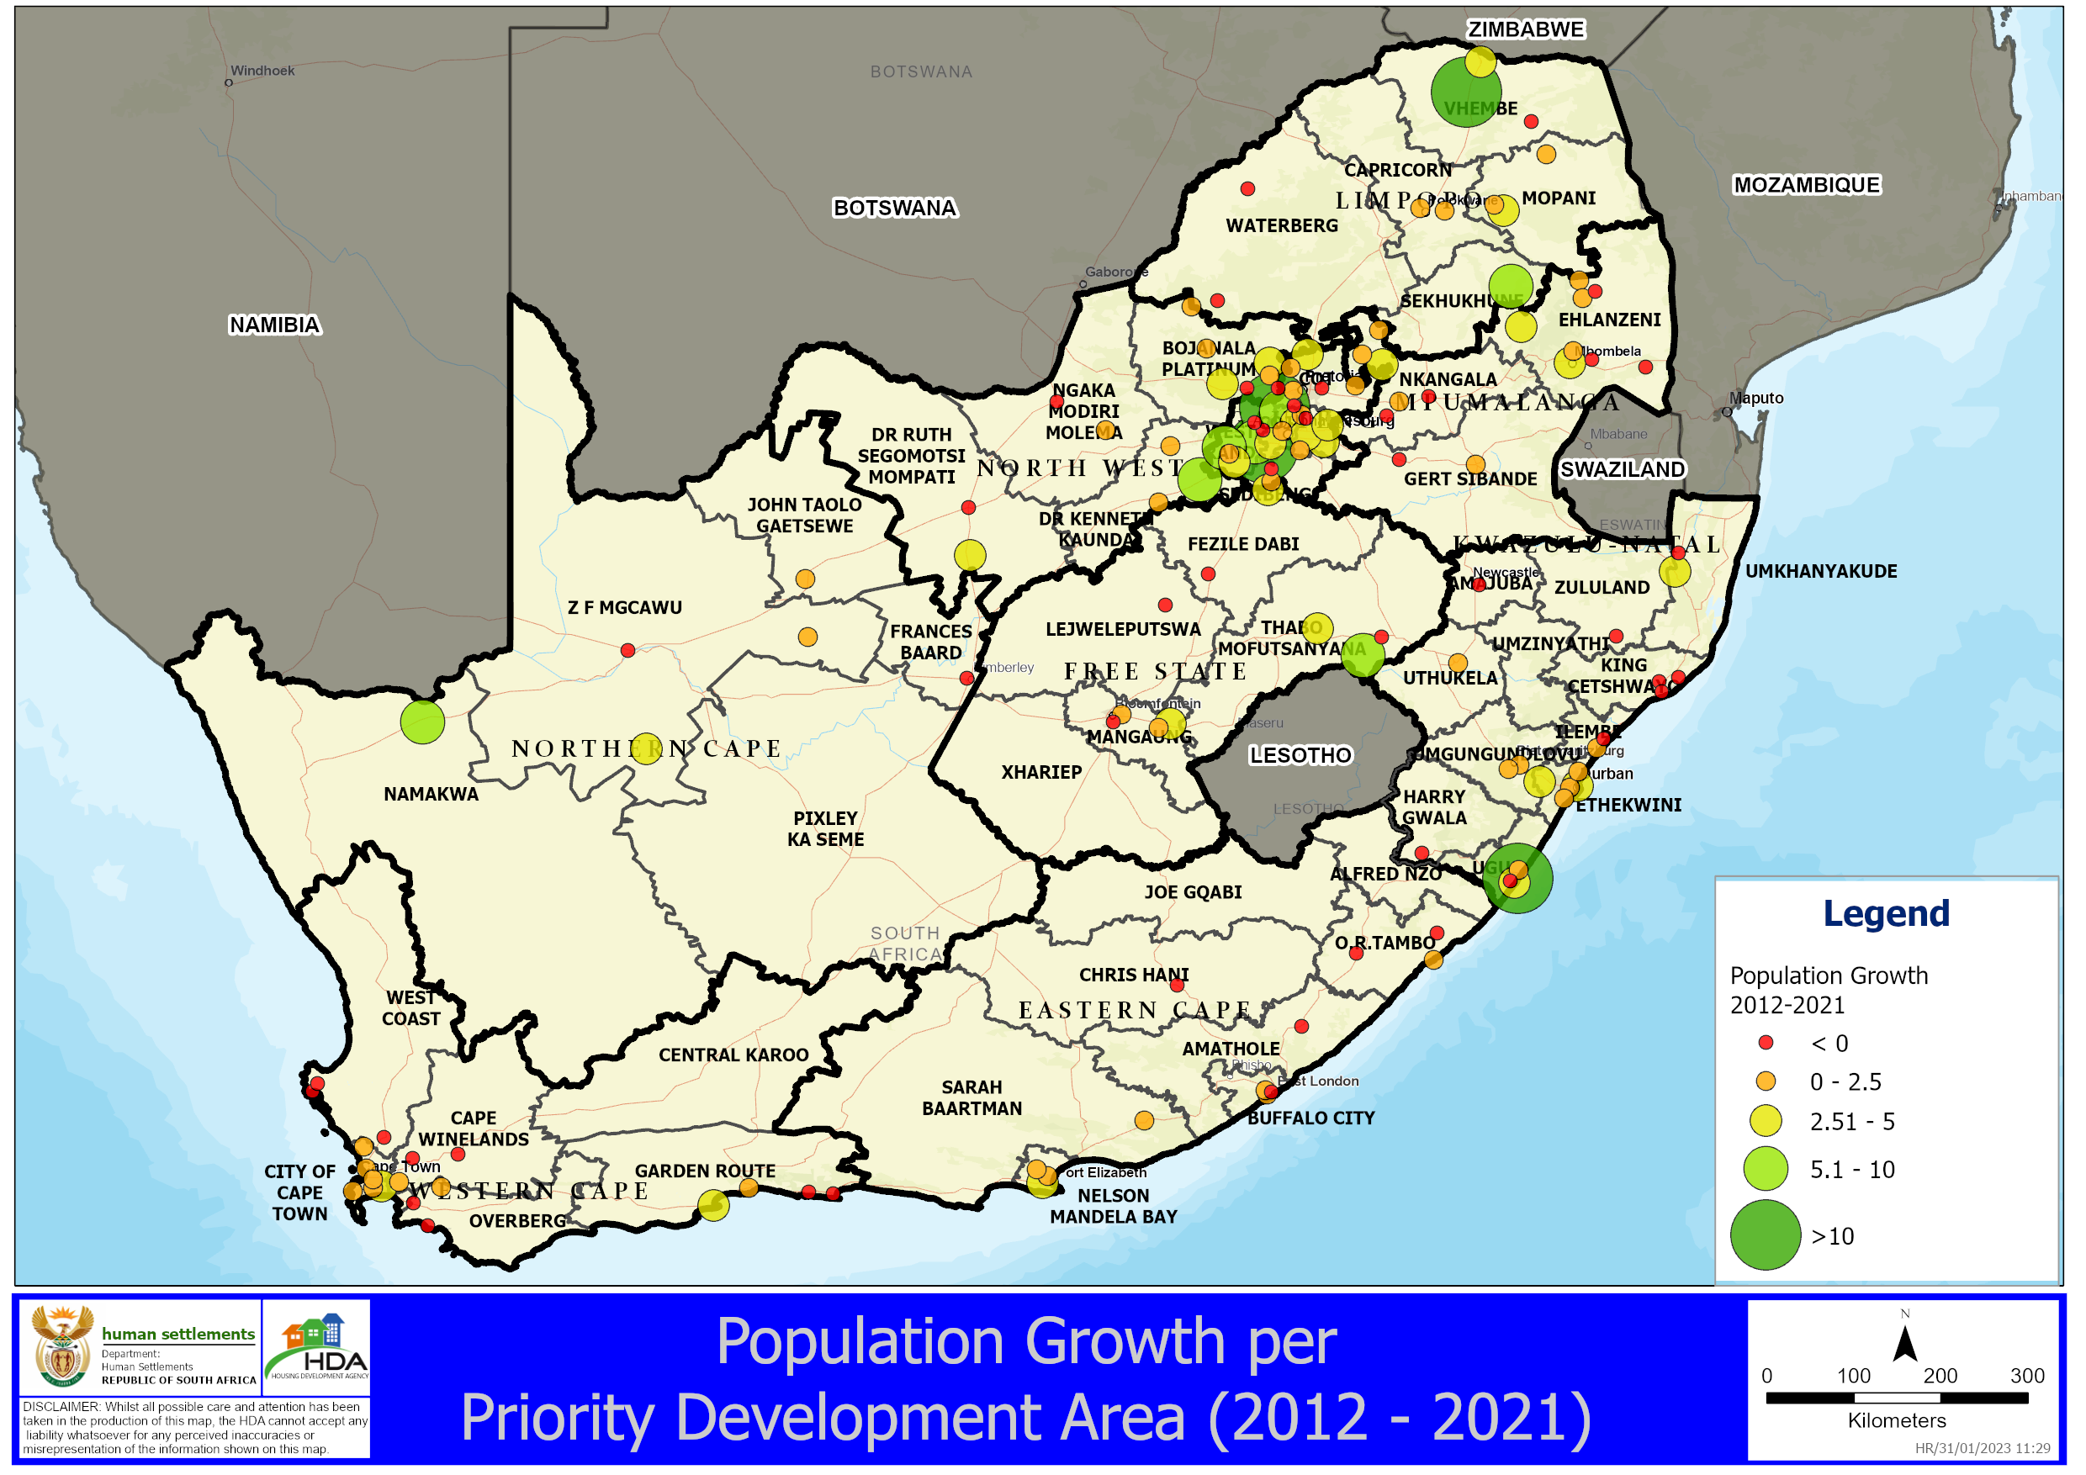

Slide 20
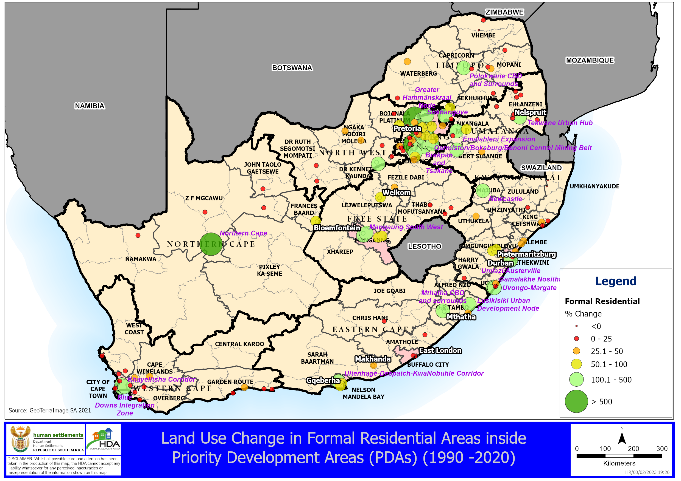

Slide 21
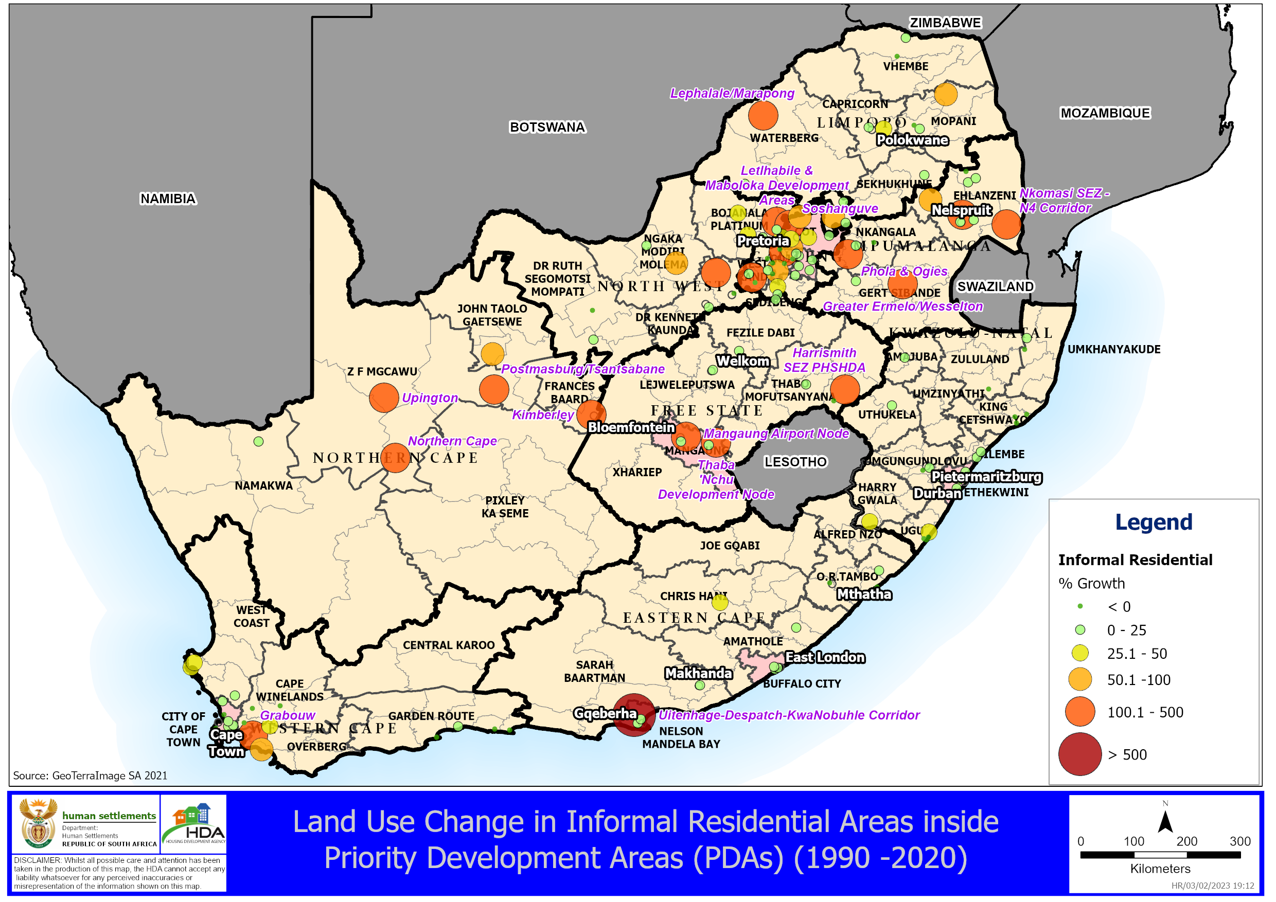

Slide 22
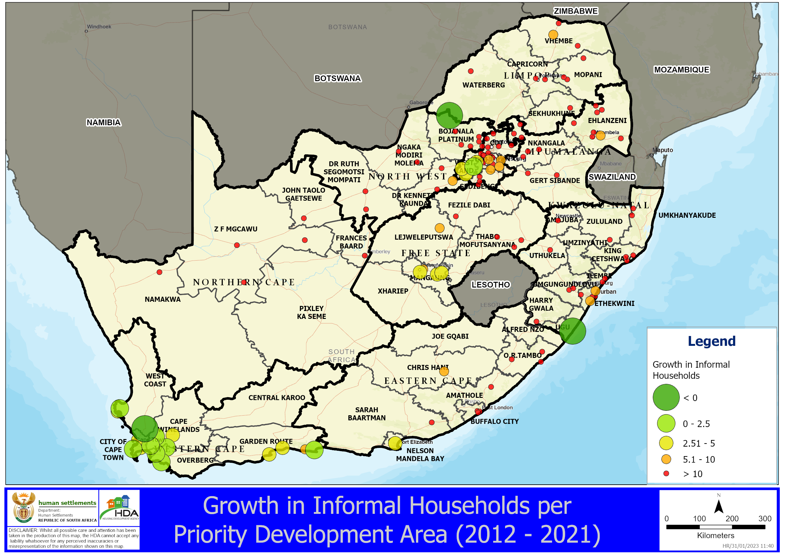

Slide 23
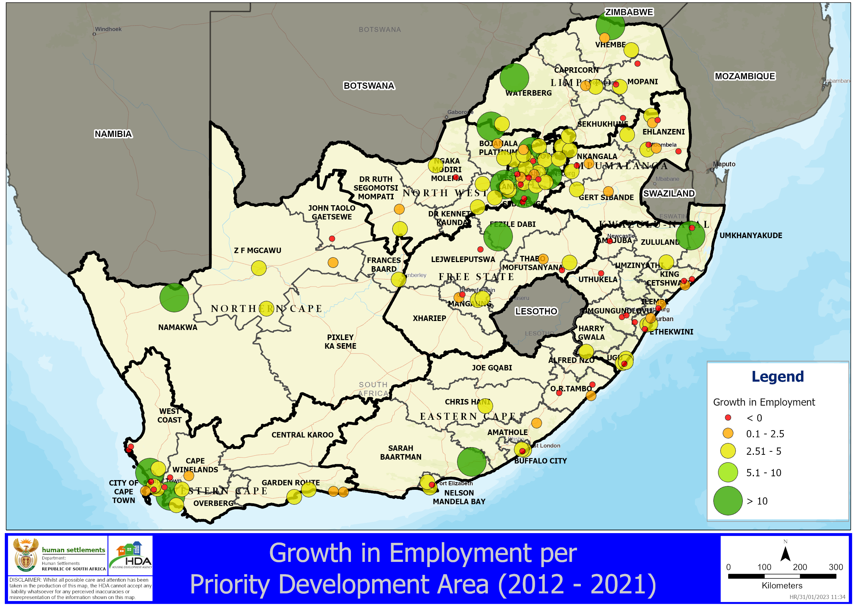

Slide 24
7. Conclusion
Factors contributing to slow spatial transformation: Slow transformation of the land use management system; powerfully entrenched spatial interests (e.g. represented through resistance to densification and new development by the middle class or urban edge type commercial and office development by large developers); inadequate use of new or existing fiscal and other instruments to incentivize or regulate spatial behaviors.
Main Activities:
  Maintain momentum with sector engagements to achieve coordination and alignment of progressive public sector investments in PDAs – in line with the District Development Model
  Coordinated the development of infrastructure and ensuring sequencing of budgets and implementation plans with other sector departments and other stakeholders.
  Implementing a multi-sector response on public –private partnerships to improve social, economic integration
Key Priorities:
  Explicit attention must be given to infrastructure within PDAs
  Innovative local responses to the promulgation and implementation of the SPLUMA + Accelerating measures on the approvals Development Planning applications
  Structured and systematic implementation agreements, and monitoring & reporting system;
  Complete township establishment processes before undertaking housing development;
  Align land acquisition to priority development areas;
  Undertake land zoning/rezoning processes as prescribed in SPLUMA and municipal schemes;
  Use of Government Land and Buildings in Urban and Rural areas as a Catalyst for Integration for Spatial Transformation and Spatial Justice by allocating Government Land / Buildings

Slide 25
Recommendation
For the Portfolio Committee:
Note of the Strategy to transform the Apartheid Urban Spatial Design aimed at Spatial Transformation and Consolidation through PHSHDAs

