Slide 1

PRESENTATION TO THE PORTFOLIO COMMITTEE
ON THE READINESS FOR 2023 ACADEMIC YEAR
Department of Basic Education
07 FEBRUARY 2023

Slide 2
Contents of the Presentation
Introduction
Learner admissions and registration
Provision of teachers
Provision of LTSM
Provision of infrastructure with emphasis on safe water, sanitation and learner transport
Curriculum Management
Early Childhood Development
Information Communication Technology
National School Nutrition Programme
School Safety
Social Cohesion and Equity
Role of School Governing Bodies
Learner drop out
Support for underperforming schools
Support for teachers
Quality Learning and Teaching Campaign
Portfolio Committee oversight
DBE Monitoring
Conclusion

Slide 3
Introduction
The Department has over the years been conducting School Readiness Monitoring (SRM) to provide support to schools and identify any challenges that may impact on effective teaching and learning on the first day of each academic year and ensure that they are addressed promptly at the appropriate level of the system.
The 2023 SRM was conducted between 11 – 20 January for Inland Provinces (Free State, Gauteng, Limpopo, Mpumalanga and North West) and 18 – 27 January for Coastal Provinces (Eastern Cape, KwaZulu-Natal, Northern Cape and Western Cape). Twenty six (26) Districts across all provinces were randomly selected for this exercise.
This presentation reports on some of the critical elements that informs the readiness of the system to commence with the 2023 academic year which includes amongst others, learner admissions, the availability of teachers, LTSM, infrastructure, curriculum coverage, access to ICT, ECD and others.

Slide 4
LEARNER ADMISSIONS AND REGISTRATION

Slide 5
2023 Learner Admission and Registration Status
PROVINCE | CHALLENGES | MITIGATIONS | RECORD OF GRADE 1 AND 8 PLACEMENT
KWAZULU- NATAL | Relocation of people from rural areas to the Metro Areas People moving after 30 September when Admission period is closed A lot of parents still do not apply on time despite the province’ massive advocacy Death of guardians especially during November/December Rapid physical growth of Richards Bay (King Cetshwayo) outpaces the schools provision | Parents are requested to provide proof of relocation documents to discourage them of leaving underperforming schools to better performing schools, the PED sets intervention strategies to on underperforming schools to discourage depopulation In addressing rapid growth, the PED opens Learner Admission process from 1 March – 30 September, and is monitored monthly Verification Visits are conducted to ascertain the capacity in schools that claims to be full | Grade 1 : 124 Grade 8 : 144
4

Slide 6
2023 Learner Admission and Registration Status…
PROVINCE | CHALLENGES | MITIGATIONS | UNPLACED LEARNERS as at 24/01/2023
EASTERN CAPE | Schools of choice insistent by a lot of parents. Common across all provinces. | Neighbouring schools requested to share the load. Mobile classrooms provided. | Grade 1 : 130 Grade 8 : 836
NORTHERN CAPE | Schools of choice insistent by a lot of parents. | Neighbouring schools requested to share the load. Mobile classrooms provided. | Grade 1 : 79 Grade 8 : 69
NORTH WEST | Challenges of unavailability of water caused a community protest that affected learner attendance during school reopening period in Zeerust. | Community meetings held | Grade 1 : 8 Grade 8 : 84
6

Slide 7
2023 Learner Admission and Registration Status…
PROVINCE | CHALLENGES | MITIGATIONS | UNPLACED LEARNERS as at 24/01/2023
LIMPOPO | Oversubscribed schools in the Polokwane and Ellisras areas. Lack of spaces. | Neighbouring schools requested to share the load. | Grade 1 : 250 Grade 8 : 170
MPUMALANGA | In Witbank, some members of a political party prevented learners from getting into some schools until all learners were admitted. | Police intervened. Meetings held to resolve matters. 40 brick and mortar classes in Mbombela were built in 2022 | Grade 1 : 74 Grade 8 : 178
FREE STATE | In Edenville, some parents prevented learners from getting into schools until all learners were admitted. | Mobile classes provided Community meeting to resolve differences | Grade 1 : 0 Grade 8 : 317
7

Slide 8
WC Learner placement as at 02/01/2023
1579 placement cases (0,13%) are still being resolved compared to 1 163 179 learners successfully enrolled.
 | GR1 |  |  |  | GR8
DIST | ON TIME 15 /4/22 | DEADLINE to YEAR END 16/4 – 31/12 ‘22 | IN 2023 1/1 – 2/2 ’23 | TOT | ON TIME 15 /4/22 | DEADLINE to YEAR END 16/4 – 31/12 ‘22 | IN 2023 1/1 – 2/2 ’23 | TOT | GR TOT GR 1 & 8
CWED | 1 | 1 | 2 | 4 | 1 | 0 | 3 | 4 | 8
ECK | 0 | 0 | 6 | 6 | 1 | 0 | 25 | 26 | 32
MCED | 0 | 10 | 48 | 58 | 8 | 24 | 182 | 214 | 272
MEED | 3 | 34 | 78 | 115 | 6 | 66 | 200 | 272 | 387
MNED | 0 | 12 | 70 | 82 | 3 | 31 | 143 | 177 | 259
MSED | 1 | 6 | 71 | 78 | 15 | 26 | 454 | 495 | 573
OED | 0 | 0 | 0 | 0 | 0 | 0 | 13 | 13 | 13
WC.ED | 0 | 0 | 17 | 17 | 0 | 0 | 18 | 18 | 35
TOT | 5 | 63 | 292 | 360 | 34 | 147 | 1038 | 1219 | 1579
% COMPARED TO SUCCESSFULLY ENROLLED GRADE 1 LEARNERS |  |  |  | 0,36% | % COMPARED TO SUCCESSFULLY ENROLLED GRADE 8 LEARNERS |  |  | 1.2% | 0.79%
8

Slide 9
Gauteng placement as of 3 Feb 2023
GRADE | TOTAL APPLICATIONS | TOTAL PLACED | TOTAL UNPLACED
1 | 173 218 | 170824 | 2394
8 | 182 115 | 179827 | 2288
Grand Total | 355 333 | 350651 | 4682
A total of 332 447 unique applications were received for the 2023 Academic Year. Of these: 292 145 submitted Complete Applications (with valid Proof of residence); And 40 332 submitted Incomplete Applications (with no valid proof of residence), 22856 were late applications

Slide 10
Challenges in GP and WC
Increased applications by parents from independent schools due to financial distress , parents not able to pay fees in Independent School
Parental choice where parents declined offers of placement the previous year who opted for independent schools are now returning to public schools due unaffordability
Increased number of families becoming guardians of their siblings’ children who either passed away of lost jobs
Incomplete applications
Submission of fraudulent proof of residence
Delays in accepting placement and unnecessary appeals to MECs
Parents coming from other provinces
Non South Africans who mostly reside in high pressure areas
Schools in high pressure areas over- subscribed
Limited infrastructure and unavailability of land
10

Slide 11
Mitigation
  Allocation of funds to identified schools to build 878 additional brick and mortar classrooms in Gauteng and 842 in the Western Cape
  Provision of mobile units are to over-subscribed schools that are not in the classroom building initiative
  Establishment of 8 satellite schools to accommodate unplaced applicants
  Increased school capacities to include the use of specialist rooms
  Gauteng might in some areas consider platooning as an interim measure to alleviate over-crowding
11

Slide 12
Example of mitigation
EKURHULENI NORTH | JHNB WEST | TSHWANE WEST
At the beginning of the 2023 Academic Year, Ekurhuleni North had a total of 232 unplaced Grade 1 learners All these learners were placed at in Olifantsfontein Primary School Olifantsfontein Primary School received 3 mobile units and had 2 existing mobiles renovated 501 Grade 8 learners in the Kempton Park area were unplaced in Ekurhuleni North 106 of the 501 learners were placed across schools where capacities were increased, while the remaining 395 were placed at a satellite school, registered as New Kempton Park SS, at 17 Pienaar street, Kempton Park | At the start of the 2023 Academic Year, 434 Grade 8 learners were unplaced in Johannesburg West Roodepoort, 38 of the 434 learners are accommodated across schools where capacity was increased accordingly 396 of the 434 learners are accommodated in a satellite school managed by Die Burger High School accommodated at Robinhood College at 17 6th Street, Maraisburg Revamping of the premises is complete and relevant resources ( educators; LTSM) were provided Parents were advised to send learners to report to school on 30 January 2023 to commence with learning and teaching | At the start of the 2023 Academic Year, a total of 223 Grade 8 applicants were unplaced around Akasia/Theresa Park in Pretoria North, Tshwane West 47 of the 223 learners in Pretoria North are placed at Amandasig Secondary and are currently attend classes on a rotation basis while awaiting completion of Theresa Park satellite school 176 Grade 8 applicants mostly residing in Pretoria West are placed at Theresa Park satellite School

Slide 13
TEACHER PROVISIONING
12

Slide 14
2023 Post Provisioning Process
There are three critical processes that need to be completed timeously to ensure that there is a teacher in every class at the beginning of the school year.
  Schools must receive their final post establishment letters for the new year by 30 September
  Schools that declare vacancies must immediately profile such vacancies and prepare for the filling at the beginning of the year, prioritising educators declared in addition; bursary graduates; and other self-funded and NSFAS graduates.
  Schools that have to declare posts in addition, and the identification of educators declared in addition should commence with the process as soon as they receive the final establishment. This is to ensure that educators declared in addition are immediately redeployed to schools with matching vacancies as each.
In addition to the School Readiness Monitoring, the Department undertakes an annual monitoring (January to March) of post provisioning focussing on compliance with the norms, processes and timeframes.

Slide 15
Educators Additional to Staff Establishment

Slide 16
Teacher Provisioning
  All PEDs declared post establishments for 2023 and distributed allocation letters to schools accordingly
  Only two PEDs, EC and KZN, experienced delays in declaration of post establishments and distribution of letter to schools and this is expected to impact on the readiness for 2023 affecting key processes related to ensuring that there is a teacher in front of every class.
Province | Date of Distribution of Post establishment
Eastern Cape | 11 November 2022.
Free State | 21 September 2022
Gauteng | 27 September 2022
KwaZulu-Natal | 29 November 2022.
Mpumalanga | 04/05 October 2022
Limpopo | 28 September 2022
North West | 03 October 2022
Northern Cape | 28 September 2022
Western Cape | 20 September 2022
Source: PED Reporting
14

Slide 17
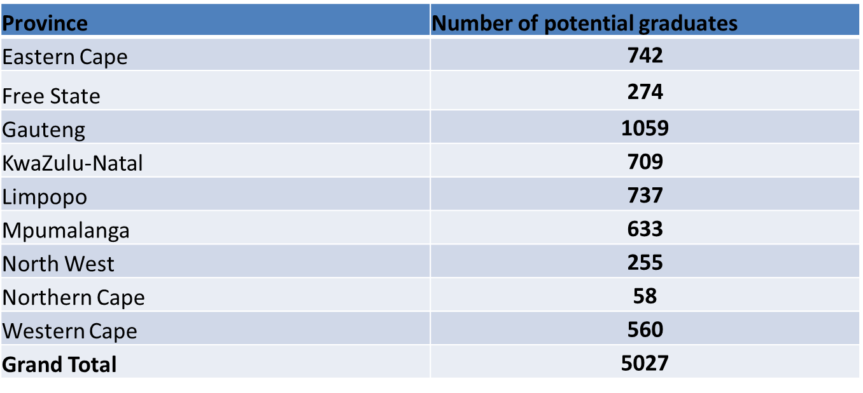
Supply of Educators: Provisional list of Funza Lushaka Graduates
As part of preparation for 2023, a provisional list of a total of 5027 potential Funza Lushaka graduates was distributed to PED in October 2022.
PEDs are expected to start with the provisional placement of graduates in identified vacant posts for 2023.

Slide 18
LEARNER AND TEACHER SUPPORT MATERIAL

Slide 19
Background and context
The provisioning of LTSM is one of the integral components of ensuring successful teaching and learning in schools.
Each year, the Department of Basic Education (DBE) develops and distributes the LTSM Sector Plan that guides the sector regarding the provisioning of LTSM.
Milestone deliverables and timeframes are clearly articulated in the DBE LTSM Sector plan.
PEDs develop provincial LTSM Management Plans guided by the DBE LTSM Sector Plan.
LTSM Forum meetings are held and Provincial Monitoring visits are conducted as part of planning, monitoring and support activities.
Where necessary, targeted support, informed by the monitoring process, is provided to the province/s.

Slide 20
Introduction
HEDCOM of 22 November 2022 noted that majority of provinces had already completed the process of ordering and delivery of LTSM to schools was at an advanced stage.
The weekly one-on-one meetings continued as part of monitoring process.
To date, most provinces have delivered almost 100% of LTSM (both top-up textbooks and stationery).
Provinces are currently conducting mop-ups in order to ensure that all outstanding and emerging deliveries are completed.
The summary of the progress report is included in the table below:

Slide 21
Progress on procurement and delivery
Province | Progress on procurement and delivery
 | Top-up Textbooks | Stationery
EC | Delivery of Textbooks to schools is at 100%. | Delivery of Stationery to schools is at 100%.
FS | Delivery of Textbooks to schools is at 100%. | Delivery of Stationery to schools is at 85%.
GP | Delivery of Textbooks to schools is at 100%. | Delivery of Stationery to schools is at 100%.
KZN | Delivery of Textbooks to schools is at 99.5% (central procurement), 100% compliance with Section 21 C Schools. | Delivery of stationery to schools is at 100%, with 100% compliance by section 21 C schools
LP | Delivery of Textbooks to schools is at 99%. | Delivery of Stationery to schools is at 100%.
MP | 100% delivery for the 649 schools (new grades, new schools and e-books). | Delivery of Stationery to schools is at 100%.
NC | Delivery of Textbooks to schools is at 93.58%. | Delivery of Stationery to schools is at 90.6%.
NW | Delivery of Textbooks to schools is at 96%. | Delivery of Stationery to schools is at 96%.
WC | Delivery of Textbooks to schools is at 100%. | Delivery of Stationery to schools is at 100%.

Slide 22
Summary of LTSM progress report
It should be noted that the national retention and retrieval rate is at
+- 90% and therefore procurement for top-up textbooks equates to +- 10 percent.
As indicated in the table above, significant progress regarding LTSM procurement for 2023 academic year is notable in all provinces.
Mop-up deliveries for both textbooks and stationery underway and expected to be completed by January 2023.
In addition, the delivery of Volume 1 Workbooks is complete.
The DBE will continue to monitor the mop-up deliveries for both top-up textbooks and stationery and compile a report.
Therefore, the report on the delivery of LTSM for the 2023 is not static and will change until all deliveries are completed.

Slide 23
INFRASTRUCTURE AND SCHOOL MAINTENANCE, WATER AND SANITATION AND LEARNER TRANSPORT

Slide 24
Infrastructure and Maintenance
Performance Indicator (SECTOR) | Targets 2022/23 | Progress
Number of public ordinary schools provided with water supply. | 572 | 268
Number of public ordinary schools supplied with electricity | 167 | 37
Number of public ordinary schools supplied with sanitation facilities. | 530 | 301
Number of additional classrooms built in, or provided for, existing public ordinary schools (includes replacement schools) | 1094 | 653
Number of specialist rooms built in public ordinary schools including replacement schools. | 134 | 43
Number of new schools that have reached completion and ready for occupation (includes replacement schools) | 38 | 12
Number of new schools under construction (includes replacement schools) | 84 | 68
Number of Grade R classrooms built (including those in replacement schools) | 154 | 35
Number of schools provided with new or additional boarding facilities | 11 | 3
Number of schools where scheduled maintenance projects were completed | 1542 | 656
Number of schools provided with high security perimeter fencing | 201 | 40
Number of classrooms refurbished as smart classrooms. | 1000 | 210

Slide 25
Infrastructure and Maintenance
To improve the of maintenance of facilities, a condition has been stipulated and currently under implementation, that 60% of the total Education Infrastructure Grant (EIG) per province must be allocated to maintenance projects.
An incentive allocation on the EIG is being implemented to incentivize qualifying provincial departments to address immediate challenges such as the norms and standards and maintenance.

Slide 26
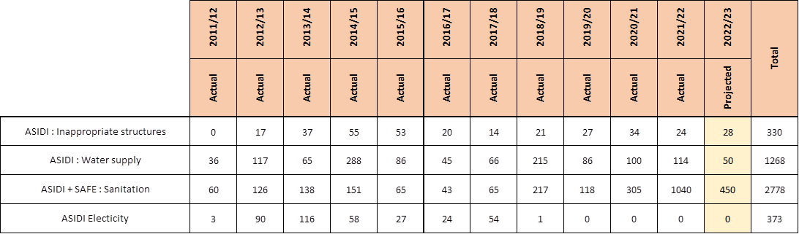
ASIDI and SAFE Progress

Slide 27
Learner Transport
Availability of learner transport: There were plans in place to ensure that learner transport is available on reopening of schools
These are continuing efforts to mainstream road safety programmes, focusing on learner transport operators, parents and learners in order to raise awareness about road safety and law enforcement. This is particularly prevalent in privately arranged learner transport, where there is minimal involvement of government as contracts are entered into by parents and operators.
There was an instances in EC where providers complained of lack of payment. This was resolved and did not affect the transportation of learners.
Some cases of late arrival of transport and overcrowding in buses in several provinces were reported. These were reported to the relevant officials and amicably resolved.

Slide 28
Learners Transported (ordinary schools)
PROVINCE | NEEDS |  | TARGET |  | Progress
 | No. of Learners in Need | No. of Schools in Need | No. of Learners Targeted | No. of Schools Targeted | No. of Learners Transported in Q 1 | No. of Learners Transported in Q 2 | Target for Q3 | No. of schools | % Learners transported to date Against the Target | % Learners transported to date Against the Need
Eastern Cape | 139823 | 1595 | 102998 | 1039 | 125423 | 125071 | 102998 | 1,009 | 121% | 89%
Free State | 9933 | 178 | 9933 | 178 | 9458 | 9524 | 9933 | 178 | 96% | 96%
Gauteng | 191021 | 628 | 185023 | 593 | 188685 | 190857 | 185023 | 645 | 103% | 100%
KwaZulu Natal | 231188 | 1550 | 61000 | 402 | 73933 | 73933 | 61000 | 402 | 121% | 32%
Limpopo | 69005 | 580 | 56062 | 483 | 69005 | 57636 | 56062 | 499 | 103% | 84%
Mpumalanga | 64500 | 351 | 64500 | 351 | 64500 | 69725 | 64500 | 351 | 108% | 108%
North West | 82050 | 530 | 71347 | 438 | 64450 | 64450 | 71347 | 314 | 90% | 79%
Northern Cape | 25799 | 267 | 25754 | 270 | 25754 | 25878 | 25754 | 268 | 100% | 100%
Western Cape | 62666 | 472 | 62666 | 472 | 64301 | 64843 | 62666 | 475 | 103% | 103%
TOTAL | 875985 | 6151 | 639283 | 4226 | 685,509 | 681,917 | 639283 | 4,141 | 107% | 78%

Slide 29
Learners Transported (LSEN)
PROVINCE | NEEDS |  | TARGET |  | Progress
 | No. of Learners in Need | No. of Schools in Need | No. of Learners Targeted | No. of Schools Targeted | No. of Learners Transported in Q1 | No. of Learners Transported in Q2 | Target for Q3 | No. of Schools
Eastern Cape | 3696 | 23 | 1531 | 10 | 2695 | 2808 | 1531 | 13
Free State | 1220 | 4 | 1220 | 4 | 1322 | 1322 | 1220 | 4
Gauteng | 11784 | 39 | 8455 | 33 | 5870 | 5541 | 8455 | 30
KwaZulu Natal | 15326 | 75 | 15278 | 75 | 7887 | 7919 | 15278 | 75
Limpopo | 314 | 3 | 245 | 2 | 245 | 257 | 245 | 2
Mpumalanga | 1004 | 5 | 1004 | 5 | 1004 | 1004 | 1004 | 5
North West | 9 | 1 | 9 | 1 | 9 | 9 | 9 | 1
Northern Cape | 86 | 3 | 86 | 3 | 41 | 41 | 86 | 1
Western Cape | 9244 | 52 | 9244 | 52 | 9244 | 9244 | 9244 | 52
TOTAL | 42683 | 205 | 37072 | 185 | 28317 | 28145 | 37072 | 183

Slide 30
CURRICULUM COVERAGE

Slide 31
Introduction
The pandemic brought about unprecedented teaching time losses which forced the hand of the sector to develop and implement various strategies to ensure continuation of teaching.
ATPs were trimmed and implemented in the remainder of 2020 to deal with the time loss and the associated impacts.
2021 ATPs were reviewed to ensure the recovery of learning in the interim period ( 2021 – 2024);
Implementation of the Recovery ATPs started in 2021;
Grade 12 curriculum remained untouched during the trimming, but additional content were included as part of the recovery ATPs for grade 12 in some subjects.

Slide 32
Preparations for the Academic Year
Summary of 2023 academic year preparations - Curriculum
  Online teacher survey conducted, to obtain feedback on the gaps in the 2022 ATPs and the Programme of Assessment
  Analysis of feedback from the teacher surveys
  Establishment of Review teams (per phase per subject) to revise the ATPs
  Centralised, Revision, and Finalization of RATPS – some feedback from teachers’ survey was incorporated into the revised 23-24 ATPs.
  Quality Assurance of the ATPs by Teacher Union representatives and DBE and PED Curriculum Managers
  Editing, design and layout of the ATPs
  Adjustment to the Programme of Assessment
  Approval of the revised ATPs by CEM
  The ATPs were released via a Circular (S33 of 2022) and they have been uploaded on the DBE website. The Circular and links for the ATPs were shared with stakeholders.

Slide 33
Plans to Support Provinces
Grades R-9:
  Mediation of Languages study guides in selected under-performing districts
  Monitoring curriculum coverage and SBA implementation
  Revise/Strengthen the Early Grade Reading Assessment Toolkit for all the languages
  Grades 10-12
    Mediation of study guides for new poetry and short stories texts
    Mediation of study guides for Mathematics, Science (Life Sciences, Physical Sciences) and Technology
    Monitor and support curriculum coverage in underperforming districts
    Monitor and support extra classes in all provinces

Slide 34
Learning Resources
The following study guides have been developed for Grade 12 learners will be distributed to Provincial Education Departments:
  Study guides for new poetry texts for all home languages
  Study guides for new poetry texts for all first additional languages
  Study guides for short stories for all first additional languages
  Study guides for Technical subjects including Technical Mathematics and Technical Sciences and Marine Sciences
  Finalise, distribute and mediate the drama study guide for SASL
  Finalise, distribute and mediate diagnostic reports for subjects with high enrolment

Slide 35
EARLY CHILDHOOD DEVELOPMENT

Slide 36
Readiness of the ECD Sector
ECD programmes follow a less rigid academic year than primary schools.
Continuous support of these programmes throughout the year is therefore critical.
The 2023 academic year has started without any unexpected challenges with the reopening of ECD programmes.
The DBE, in collaboration with PEDs, are continuing with the implementation of the Vangasali registration project to ensure that all ECD programmes which are currently providing early learning services to children are regulated by the state.
PEDs are also being supported to ensure that the 4th tranche of subsidy payments will be paid to eligible ECD programmes during the first quarter of the academic year.
Furthermore, provinces are also in the process of training ECD practitioners on the implementation of the National Curriculum Framework, as well as on NQF level 4 and 5 qualifications.

Slide 37
ACCESS TO ICT AND VIRTUAL PLATFORMS FOR LEARNERS

Slide 38
Plans to Support Learners through Provision of Digital Materials and ICT
DBE and PEDs have also developed, packaged and distributed Digital Materials to learners.
Pupils learning without direct guidance of teachers require support to facilitate self study that would include utilisation of digital platforms and materials that support remote learning.
The call to governments across the world to explore the use of distance learning programmes, open educational applications and platforms that schools and teachers can use to reach learners remotely and limit the disruption of the pandemic on education was made by UNESCO and supported by many educationists and EdTech organisations.
The DBE and PEDs have made strides in pushing for the use of technology to provide support to learners through virtual classrooms, broadcasting, video streaming and online content resources.

Slide 39
Intervention Strategies
Strategic areas | Identified intervention plans
Connectivity and ICT devices | Implementation of the: SA Connect Policy; and Social Obligations as part of the auctioning of the high demand spectrum to provide schools with connectivity
Digital Content distribution | Procurement of offline servers to all districts Broadcasting solutions Woza matric Tswelopele EDIFY APP (STEM) Siyavula MTN, Telkom and Vodacom online solution
ICT Teacher Professional Development | Establishment of the Provincial and district teams

Slide 40
ICT-enabled Learner Support Initiatives
  The learner support ranges from:
  Virtual Classrooms
  Broadcast (TV and Radio);
  Online Content & Support Resources (Educational portals and websites);
  The use of social media platforms;
  Roll-out of connectivity to teachers and learners as part of the Social Obligations;
  Engaging tutor support in critical subjects through partnerships;
  Providing learners with access to e-learning packages;
  Platforms to provide learner access to on-line textbooks;
  Collaborative partnerships with private sector organisations and sister provinces on content resources and, communication platforms.

Slide 41
Challenges and Recommendations
CHALLENGES
PEDS are at different levels of ICT-enabled learner support;
The support is mostly on MST and high enrolled subjects;
Some learners have no access to ICT devices;
Radio, television and you-tube broadcasts have limited engagement;
Inadequate and costly connectivity to support remote learning;
Lack of learner devices and data to access online content resources;
Lack of network coverage in some rural areas.
RECOMENDATIONS
DCDT to expedite the rollout of SA connect;
More educational websites to be zero-rated by all network providers;
Allocation of additional budget towards ICT;
Engage DCDT on ensuring availability of network in all rural areas.

Slide 42
NATIONAL SCHOOL NUTRITION PROGRAMME

Slide 43
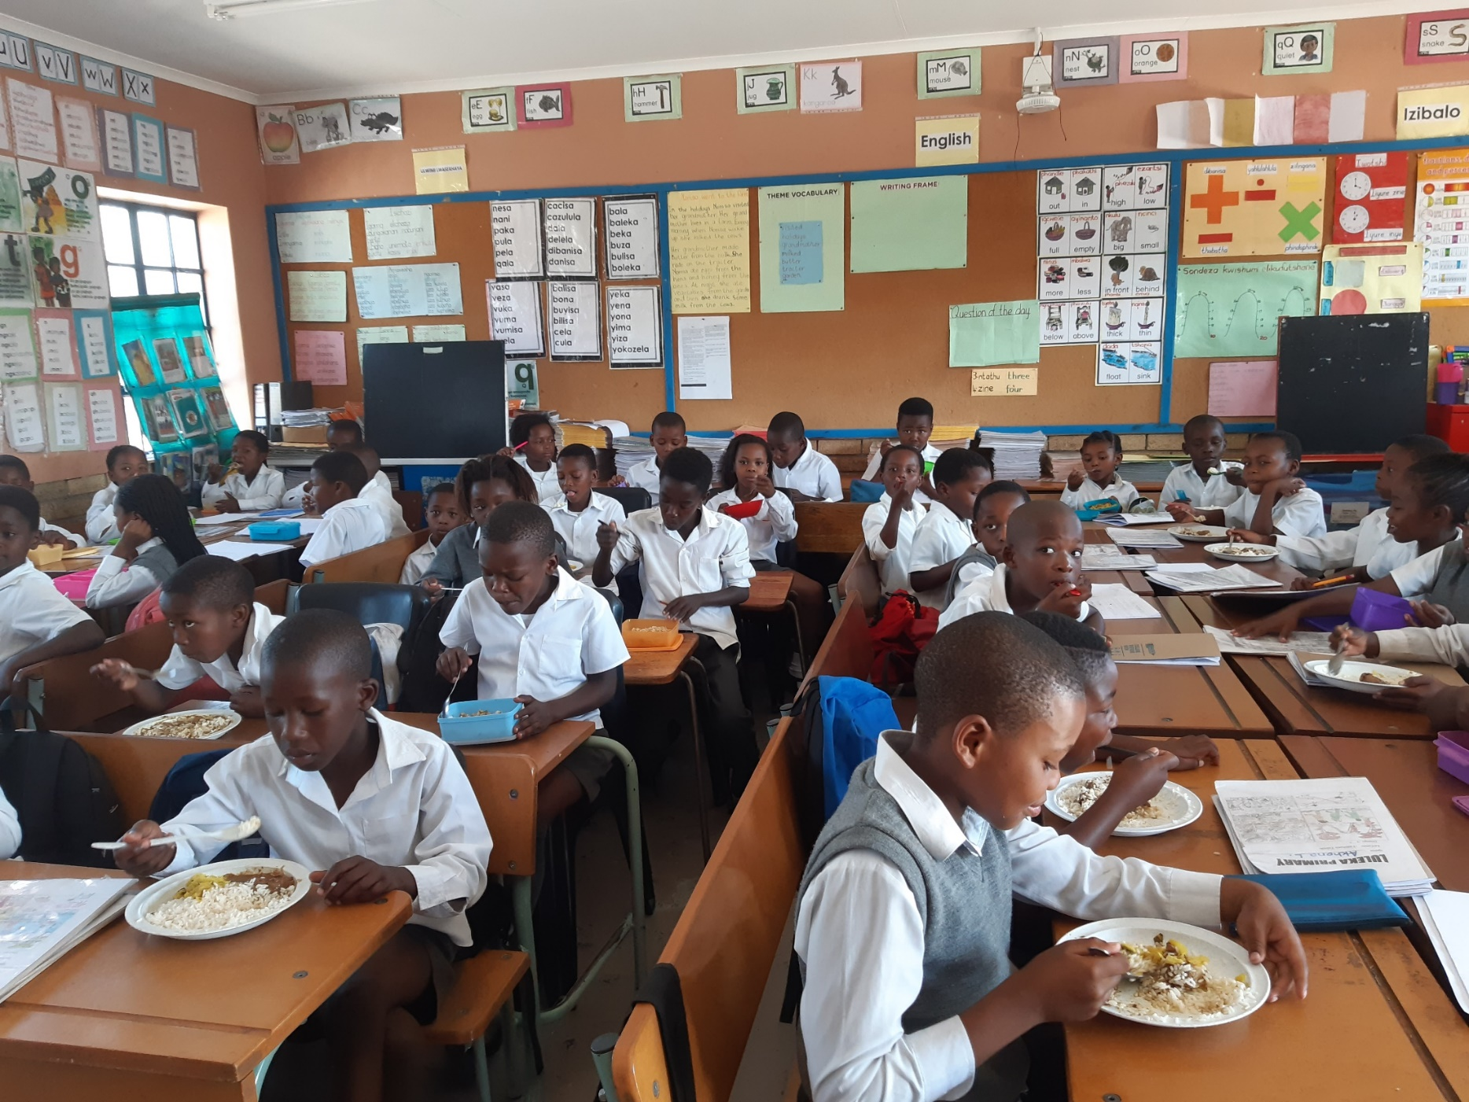
National School Nutrition Programme

Slide 44
Expenditure as at 31 December 2022

Slide 45
Procurement Model
Decentralised Model
Eastern Cape, Free State, Northern Cape and North West have all received their allocation from the Department of Basic Education on 08 December 2023, for the procurement of food items for January to March 2023
Centralised Model –Currently all provinces have contracts in place for the delivery of food items for this quarter
Gauteng-the new service providers will start in June 2023.
KZN- the province is busy with appointment of new service providers for April 2023.
Limpopo-Service providers are contracted till 2024.
Mpumalanga- the service providers are on a month to month contract after their contracts expired.
Western Cape- New service providers have been appointed to start in April 2023.

Slide 46
Budget and AG findings
Budget Increase
The NSNP applied for a budget increase for menu improvement R1.5 billion was granted in November 2022, over a three year cycle of 2023-2025
The budget is for breakfast and processed chicken livers’ pilot and the phasing in thereof
Auditor General findings
Each province reported on the progress of how they are dealing with the Auditor General findings during the Inter-Provincial meeting of 21-22 October 2022
DBE will continue to support the provinces and monitor progress

Slide 47
SCHOOL SAFETY

Slide 48
National School Safety Framework
The digital training was developed in 2020.
The online NSSF Training is now SACE Accredited - 15 PDP points.
Circular released in September 2022 encouraging School Safety Committees to enrol in Digital Training.
The NSSF online Training will also be used in the fourth phase of the PYEI in 2023.

Slide 49
Inter-departmental Campaign on the Prevention of Violence, Bullying, Corporal Punishment, Drugs and Substance abuse in Schools
Championed by the Deputy Minister and supported by other Deputy Ministers-Partner Departments.
Raise awareness on Social Ills impacting negatively on schooling.
Target SMT, Leaners, SGBs, Parents & Community at large.
Rolled out in Four Provinces:
  Gauteng (Gauteng West)
  Limpopo (Sekhukhune East)
  Mpumalanga (Nkangala)
  North West (Dr Kenneth Kaunda District: 10-19 August 2022)
Campaign accompanied by pre-cursor events and the main events.
Next Campaign will be hosted in the Eastern Cape in Feb 2023.

Slide 50
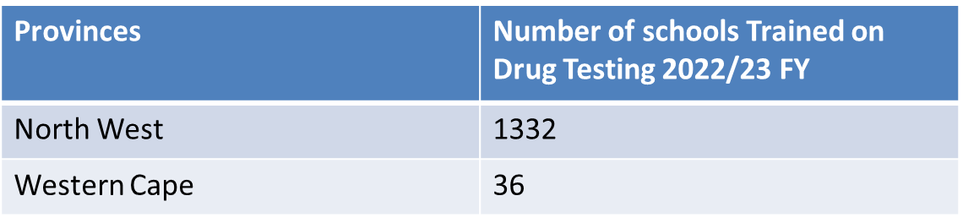
National Strategy for the Prevention and Management of Alcohol and Drug use amongst Learners in Schools
Informed by The Policy Framework for the Management of Drug Abuse by Learners in Schools and Public Further Training Institutions.
Reiterates that schools are Alcohol and Drug-free Zones.
Increasing knowledge, life skills, and confidence amongst learners so that they are less likely to engage in problematic alcohol and drug use.
Encourages drug testing, with intentions to rehabilitate.

Slide 51
Prevention and Management of Corporal Punishment in Schools
Developed and printed the Protocol to deal with incidents of Corporal Punishment in all Provinces.
Released a circular on the banning of corporal punishment in schools, in April 2022.
Participated at an International Online Conference convened by End Violence Against Children on Corporal Punishment in Schools in April 2022.

Slide 52
Disaster Risk Management
The DBE has a partnership with SANTAM & NDMC- developed the Disaster Risk Management Tool.
Disaster Risk Management: Assessment Training in Provinces.
Training takes place over 2 days:
  Day one specific for the district and provincial officials: Inclusive Education; Infrastructure; School Safety; Provincial Disaster Management; Fire Chiefs form Municipalities.
  Day two Schools Assessment Tool training (special Schools)
Training conducted in Mpumalanga: October 2022
The Ethiopian delegation was hosted in 2022 and the feedback was very positive, especially the draft lesson sets in the LO textbooks which support disaster risk reduction know-how in the classroom.

Slide 53
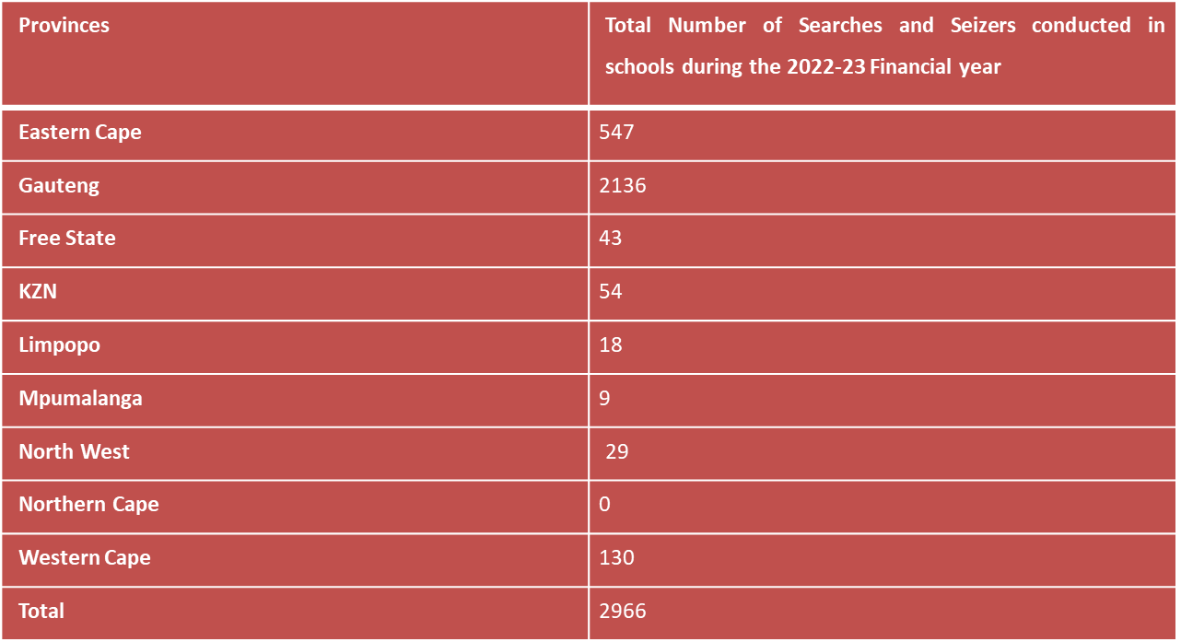
DBE & SAPS Protocol
Continuous Implementation of the Protocol for curbing violence through re-linking of schools to local police stations, searches and seizers, crime awareness campaigns in schools and closure of taverns nearby schools
Number of Searches and Seizers conducted in 2022-23 FY

Slide 54
School Safety Plans for 2023
Monitor the remaining 15 districts in three Provinces (GP, KZN, and NC);
Organise the Inter-Departmental Campaign on Violence Prevention: Eastern Cape, Buffalo City (Enyobeni Tavern Area), Feb 2023;
Continue with Training Workshops on the Disaster Risk Assessment Tool;
Release a circular on the banning of corporal punishment in schools;
Develop Digital Training on the Protocol to deal with incidents of Corporal Punishment in Schools;
Facilitate Research on Harmful Religious Practices in Schools, in partnership with UNICEF;
Strengthen School Safety programmes in Special Schools;
Facilitate discussions with the Department of Labour on schools that received contravention notices for lack of compliance with the Occupational Health & Safety Act;
Release a Circular to remind schools of the regulations of Safety Measures about school exactions and water activities; and
Release another Circular on the banning of Corporal Punishment.

Slide 55
SOCIAL COHESION PROGRAMMES

Slide 56
Social Cohesion Programmes
In terms of the MTSF Priority 6 on Social Cohesion and Nation Building (to promote national identity and patriotism), a communique to schools is distributed for:
  Recital of the Preamble of the Constitution on the first day of each school term and all school events
  Protocols around hoisting of the National Flag and African Union (AU) Flag
  Promotion of the National Anthem and AU Anthem
In terms of the National Development Plan Vision 2030 (towards building safer communities)
  Distribute tips for parents and learners for ensuring the safety of children from exposure to harmful content found in the online and cyber community when utilising eLearning and Digital Learning Devices
  Tips for younger learners inserted in learner workbooks on what a learner must do to report and reduce the risk of sexual assault
In terms of the National Strategic Plan to end Gender-based Violence and Femicide
  Circular to schools for convening School Assemblies to end School-related Gender-based Violence (SRGBV) and Bullying using the Connect with Respect guidance of the United Nations
  An at-a-glance summary of the Protocol for the Management and Reporting of Sexual Abuse and Harassment in Schools

Slide 57
District Monitoring
District monitoring on the implementation of the National School Safety Framework (NSSF), social cohesion, sport, and enrichment programmes are annually conducted in 75 districts.
60 districts have been monitored in the 2022-23 financial year across 8 provinces. This excludes Northern Cape.
In quarter four 15 Districts will be monitored.

Slide 58
ROLE OF SCHOOL GOVERNING BODIES

Slide 59
The role of SGBs
Set the tone of the school in establishing, culture, values and ethos of the school in collaboration with stakeholders
Develop policies that respond to the need of the school in line with departmental policies
Allocate and utilise school funds to respond to the needs of the school in a consultative and transparent manner
Recommend for the appointment of relevant, qualified and competent staff members
Develop a Code of Conduct for learners and instil discipline in the school
Maintain the school property to bring about a conducive learning environment
SGBs play a monitoring oversight role on all aspects of the school and hold the SMT accountable for the delivery of quality education in the school

Slide 60
LEARNER DROPOUT AND EFFORTS TO IMPROVE RETENTION

Slide 61
Definitions and Data
‘Dropping out’ is ideally understood as undesirable departure from schooling system. This should thus exclude, in particular, movement to a TVET college.
‘Dropping out’ is difficult to measure because of lack synergy between DBE and DHET systems, meaning school-college movements are not properly tracked.
Despite this, South Africa has a relatively good data to quantify the phenomenon.

Slide 62
Matric Completion Rates Measured using Household Survey Data
Analysis of household survey data indicates that in recent years at least 50% of youths complete grade 12
An alternative method of comparing the number of matric passes for a particular year to the 18-year-old population of the same year suggests that the figure could be as high as 56%
But whichever method one uses there has been a consistent improvement over time
Females are also considerably more likely to complete Grade 12 than males.

Slide 63

Impact of the Pandemic on Dropout
Huge disruptions to school attendance in 2020 and 2021
The overall effect of school closures and rotational timetabling meant that in some grades up to 60% of the 2020 school year was lost.
A DBE analysis of 2021 Term 3 administrative data on attendance suggested that approximately 22% of contact time was lost nationally, but that in schools where rotational timetabling was still being implemented the amount of lost contact time was as much as 50%.
Initial household surveys (NIDS CRAM) suggested about half a million children did not return to school leading to lots of media coverage in 2021 – this turned out to be wrong.
More recent evidence based on administrative enrolments data points to no massive worsening of the dropout patterns, compared to what we saw before the pandemic.
There have been some problems, such as grades R to 1 enrolment being around 25 000 lower than expected in 2021 due to parents delaying first enrolment. But compared to the initial half a million estimate, this is a relatively small and manageable problem.
In fact, participation in schooling rose during the pandemic. Between 2019 and 2021, enrolments increased by half a million. This was mainly due to less dropping out.
More NSC candidates, NSC passes and Bachelor passes in 2020, 2021 and 2022 than ever before.
While in many ways this is a good thing, more learners in the system when budgets are tight makes delivering quality services particularly difficult.
Despite much initial worry about the possible impacts of the pandemic on dropping out, the main negative effect has in fact not been dropping out, but that learners are behind in their learning. This presents a possible risk of future dropout when those children affected by learning losses in the early grades reach the latter parts of secondary school.

Slide 64
SUPPORT FOR UNDERPERFORMING SCHOOLS

Slide 65
Underperforming Secondary Schools
1711 secondary schools were identified as underperforming.
These are schools that obtained less than 65% in the 2021 NSC examinations
A monitoring tool was administered to 819 underperforming secondary schools to check if they were supported by the PEDs.
The main focus was on the following:
  the number of support visits, (expectation is that at least two
  support visits should be conducted per annum)
  the support by Subject Advisors on the subjects whose
  average was below 30%;
  the support by Circuit Managers on leadership and management
  how the SMTs manage the curriculum

Slide 66
Number of schools visited per Province
PROVINCE | TOTAL NUMBER OF Underperforming schools per province | SCHOOLS VISITED ONCE | SCHOOLS VISITED TWICE (evidence collected from schools) | % as at 25 January 2023 | Annual Target | % of Annual target
EASTERN CAPE | 308 | 100 | 88 | 29%
FREE STATE | 18 | 9 | 7 | 39%
GAUTENG | 51 | 49 | 46 | 90%
KWAZULU-NATAL | 387 | 143 | 128 | 33%
LIMPOPO | 625 | 344 | 226 | 36%
MPUMALANGA | 143 | 110 | 96 | 67%
NORTH WEST | 75 | 14 | 10 | 13%
NORTHERN CAPE | 39 | 32 | 24 | 62%
WESTERN CAPE | 65 | 18 | 12 | 18%
TOTAL | 1711 | 819 | 637 | 37% | 1000 | 64%

Slide 67
Observations
There is an increase in the number of support visits by district officials to underperforming schools;
Support by CMs and SAs translates to the improvement in curriculum management by SMTs;
Accountability by subject teachers is strengthened;
Data utilization by SMTs has improved;
The number of underperforming secondary schools continues to decline in all the provinces, e.g. it dropped from 2018 in 2020 to 1711 in 2022
There is a decrease in chronically underperforming schools (from 573 in 2020 to 500 in 2022)

Slide 68
Support on Data Utilization to Improve Performance
School Improvement Support Coordinators (SISCOs) support SMTs of underperforming schools in:
  developing data-driven Academic Performance Improvement Plans (APIPs);
  developing interventions that are informed by data; and
  strengthening curriculum management.

Slide 69
SUPPORT SPECTRUM FOR TEACHERS

Slide 70
Support for Mathematics
Ten (10) districts that under-performed in Mathematics in 2022 were identified as follows:
  EC : three districts
  KZN: two districts
  LP : three districts
  NC : one district
  MP : one district
A programme for support has been designed
Study guides have been developed through Second Chance and NECT will be utilized.
Programme will be implemented in July / Aug 2023

Slide 71
Support for Grade 8 & 9 Mathematics and Natural Science
Senior Phase has been identified as the cause for poor performance in NSC Maths and Physical Science
A support programme for Grades 8 & 9 was designed and implemented in 14 districts in 2021, 2022 and 2023
Training Manuals have been developed through the subject specialists and are available to other schools

Slide 72
Mathematics Teacher Audit
Information about personnel handling Mathematics in schools is critical
A Mathematics teacher audit will be developed this year
The Audit will show the disaggregated number of teachers, their qualification and age, etc
This information will guide the differentiated forms of support needed to improve Mathematics

Slide 73
Support for
Grade 8 & 9 Economic and Management Sciences
Senior Phase has been identified as the cause for poor performance in Accounting and Economics
A support programme for Grades 8 & 9 was designed and will be implemented in 2023 & 2024
The programme will be implemented in collaboration with the E-Cubed project that is currently running
Training Manuals will be developed through the subject specialists and will be made available to other districts

Slide 74
QUALITY LEARNING AND TEACHING CAMPAIGN

Slide 75
Governance and Management
ACTIVITY | CURRENT STATUS | INTERVENTION
Establishment of School Governing Bodies (SGB) structures | Most schools have established structures, however some members might have resigned for various reasons | The school planning should include the election of new members to fill in the vacant post
Community participation in the SGB | Some members of the community participate in the SGBs to either advance their business interest or political careers | School were advised to conduct training and induction for new and old members on the roles and responsibility of the SGB
Inclusivity | A number of schools have established SGB, however some components are not included in the structure | The schools were advised to consider the inclusion of all components
Curriculum and Assessment Planning | Most schools have indicated that, they have either completed planning or in the process of completing | Schools are advised to finalised planning a year before and to consider integrated planning The school have been advised to consider synergy in planning for example, school improvement plan, School Development, Program of Assessment AND Assessment Plans
Quality Learning and Teaching Campaign (QLTC) placement Development of QLTC program | The current situation in schools, is that the SGB have been established , however the QLTC is not part of the SGB | The Guideline document has been submitted to the schools and training on the QLTC has been proposed Schools have been advised to develop programs that will encourage community participation (e.g. donate a uniform , Adopt a cop)
.

Slide 76
Governance and Management
ACTIVITY | CURRENT STATUS | INTERVENTION
Management of rape cases and vetting of teachers | Some schools have reported cases of rape in their schools involving teacher | The schools have been advised to implementing the protocol on Gender Based Violence (GBV) and the vetting procedures of teachers
Inclusivity/ Special school | Some special schools are unable to accommodate the needs of learners with special needs or learning disabilities | The matter will be referred to the directorate Inclusive Education
Vacant Post | Some schools have reported vacancy in the critical post such as principal and deputies | Schools have been advised to plan ahead , they should not wait for teachers to retire before the post is advertised.
Late registration of learners | Some schools are still busy with registration of learners and some of those learners are being referred by districts officials to the schools. | Schools through the QLTC Have been advised to conduct campaigns and awareness on the early registration of learners and the implications thereof
Time – Tabling | Most school reported adherence of teachers and learners to class attendance, what is of a challenge is that there's no uniformity in the management of the attendance registers for both teachers and learners | The schools have been advised to strengthen the management of both registers
Dysfunctional school | Some schools were in a state of near collapse and leaners under performed in Grade 12 | Training was conducted for teachers, curriculum managers at the districts and provinces, SGB , SMT
Support to the systems | Some schools are struggling with gate way subjects | Partnership have established with universities to support schools mostly in curriculum matters
.

Slide 77
Governance and Management
ACTIVITY | CURRENT STATUS | INTERVENTION
Infrastructure | The condition in some schools is bad , classrooms are not in good state | The matter has been noted and would be referred to the directorate responsible
Overcrowding | Some schools have unreasonable overcrowded classroom with more than sixty learners in the classroom | The matter will be referred to the responsible directorate
Water and sanitation | Some schools reported continues disruption of water supply and none functionally of boreholes | Some disruptions are caused by electricity supply and this would be reported to the directorate responsible. The school will use their funds to address the boreholes challenges
Sanitations | The number of learners in schools is continuously increasing and this has had a bearing in resources such as toilets | The schools has been advised to compile a data on learner enrolment and the number of toilets for both teachers and learners. Secondly the school should submit information on the types of toilets used.
ICT Distribution | The ICT has not been distributed equitable in schools | The matter will be referred to the ICT directorate for intervention
Capturing and management of information | Most schools do not capture discipline information on SASMS. In some schools such information is captured on adhoc basis | SASAMS would be requested to assist schools in capturing the information
Access to documents | The majority of schools have reported not receiving document on Protocols for management of GBV, Policy on Management of learner pregnancies and 50 Points document | Some of the documents have already been forwarded to schools. The matter would be reported to the directorates responsible and training could be conducted for affected schools
.

Slide 78
Governance and Management
Monitoring findings | CURRENT STATUS | INTERVENTION
Learner Admission | Gauteng is experiencing overcrowded classrooms in the following Grades, 1,8,9,10 and 11. in the following schools, Seshegong Secondary school,Olieven Secondary school and Steve Tswete Secondary school | Work Stream established to attend to classrooms, LTSM , Human Resources, NSNP and infrastructure Churches and libraries have been identified to assist in alleviating the pressure from the overcrowded school Service Providers have been approached Meetings have been held with SGB’s , Unions , councillors, Faith Based Organisation to try and in the situation . More meetings are planned with the district, province and communities to put proper systems in place for 2024.
Special School | Some schools in the Western Cape have a challenge with learners severe learning disabilities and some of them are not being catered for No district support on learners identified to have special needs, school not clear on the processes to follow for referral.( Chris Hani district Eastern Cape province) | The matters has been captured and will be referred to Inclusive Education directorate for attention.
Presidential Youth Employment Initiative (PYE) Project | Some schools in Western Cape have not employed youth for the Phase 4 of the project. | The matter has been escalated to the Provincial Task Team as well as the DBE project Management Team (PMT).
Sanitations and ablution facilities | Shortage of toilets for Grade 8 for boys and girl learners in Free State Lejweleputswa district Shortage of r toilets for Grade R learners in the I Free State Xhariep district No proper toilets for learners in Grade The service provider could not complete the building of toilets since August 2022 in the Eastern Cape Joe Gcabi district | The matters has been noted and will be referred to infrastructure directorate for intervention
Infrastructure (classrooms ) | The service provider that was building new classes has abandoned the project, Building materials are lying all over the place causing hazardous situation at the school. Grade some R classes in Zululand districts the children are learning under appalling conditions | The matter will be referred to the infrastructure directorate for intervention
Learner Transport | There are learners who travel between 6km and 35 km to and from school and no transport is provided in the Chris Hani District , Eastern Cape Province The are learners travelling between 6km to 35 Km attending Technical College that offers Technical Subjects ((isikhoba Nombewu Technical) in Chris Hani District in the Eastern Cape | The matter will be referred to the MST directorate.
School Sports | In most schools monitored sports is not being taken serious , the focus is mostly on academic performance and less in sports | The matter will be raised with the directorate School Sports
.

Slide 79
Part 2

Slide 80
PORTFOLIO COMMITTEE
KWAZULU-NATAL
OVERSIGHT
SCHOOLS REACHED AND ISSUES PICKED UP

Slide 81
DISTRICTS AND SCHOOLS VISITED
Districts | SCHOOLS VISITED
Zululand (4 Schools) | KwaMame Full-Service School, Manzezulu ECD Centre, Zamimpilo Special School and Phumanyova Technical High School
King Cetshwayo (4 Schools) | Dover Farm School, Thuthukani Special School, Ilembe Primary School and Tisand Technical High School
Harry Gwala (5 Schools) | Nombewu Full-Service School, Mhlaba Combined School, Vulekani Special School, Kromhoek Primary School, Dingeka Comprehensive Technical

Slide 82
ISSUES RAISED
 | KEY AREAS | CHALLENGE | PC RECOMMENDATION | KZN PROGRESS UPDATE
1. | Learner Transport (Dedicated Learner Transport | Unavailability of learner transport because of financial constraint | KZN DoE must make means to assist learners in spite of financial constraints and ensure that the learners’ right to basic education is protected. | 1. The provision of learner transport is the joint responsibility between the Department of Education and the Department of Transport. In terms of the provincial learner transport policy, it is provided to learners traveling three (3) kilometers to their school of need.
 |  |  |  | 2.Learner transport is provided to learners attending schools in quintile 1 to 3.
 |  |  |  | 3. Learners attending full-service schools are entitled to dedicated learner transport. To this end, the Department is engaged in a process of identifying funds to provide transport to full service schools
2. | KZN Transport (Buses) for Special Schools | 1. The first one was a request for additional buses |  | Last year a needs analyses were conducted and established that 30 new buses were needed for 75 special schools in the province. These are mainly replacements. Due to financial constraints only 15 buses will be procured during the new financial year.
 |  | 2. The second issue was that it takes the Department very long to repair or fix broken buses. It can take more than three (3) months to replace the tyres or to get new license discs. |  | With respect to special schoolsThe Department is aware of the delays in repairs to buses. The service provider responsible for servicing and repairing the fleet is sourced through the Department of Transport. This contract also provides for the servicing of the entire fleet of the Department, including buses for special schools. Upon being alerted to the challenge of a prolonged time it takes for the repairs and service, two meetings were held with the service provider and the Department of Transport. The last meeting was in November 2022. The service provider has undertaken to improve its turnaround time. A follow up meeting will be held before end of February 2023.

Slide 83
ISSUES RAISED…
3. | Infrastructure | There was a dire need for infrastructural intervention in the schools visited. Dover Farm School in King Cetshwayo was in a serious need for intervention. The school had very limited ablution facilities. | More proper classrooms should be built since the school has a lot of mobile classrooms which were in a very bad state.
 |  | Mhlaba Combined School in Harry Gwala had a block which had the roof blown away by the freak storm couple of years ago. | The same school in February 2021 was visited and specific resolutions were crafted on issues to be attended to urgently. During the 2023 oversight visit to the same school, it was discovered that the 2021 resolutions had not been attended to. For example, the structure with the roof that was blown away in 2020 was still standing, posing a serious danger to learners. Consequently, the Portfolio Committee wanted to get a proper explanation as to why the resolutions had not been implemented after two years. | The department has taken a decision to demolish the block that was damaged by storm at Mhlaba Primary School.
 |  | The lack of sanitation and ablution facilities in some schools. Those schools include Dover Farm School in King Cetshwayo, Nombewu Full-Service School and Mhlaba Combined School in Harry Gwala District. |  | With respect to the ablution facilities, the appointment of the contractor will be finalized by 15 March 2023 and will be on site for a 3-month period of which will be complete on the 14 June 23.
 |  |  |  | On the upgrades and additions project, an appointment of PSP will be made on 30 March 2023. The appointment of the contractor will then be appointed on 10 January 2024.
 |  |  |  | It is worth noting that considerations have been made on procurement process including utilization of open tender and appeals period

Slide 84
ISSUES RAISED…
4. | Post Provision Norms | There was a challenge of weighting of learners at Special schools and a technical school | In all special schools the shortage of support staff was identified as one of the biggest challenges. With correct weighting the schools could qualify for more teachers. | PPN certificates were issued to all the schools at the end of 2022. All schools that have experienced an increase in learner enrolment are allowed to submit such increases for adjustments in their PPNs and new posts to be allocated. This is done after the 10th day after the start of each year. The allocation of PPN takes into account subjects weighting, this includes technical subjects and special schools. It should be noted that due to budget cuts during the current MTEF the department may struggle to fill all substitute posts.
5. | Filling of posts | The non-filling of vacant posts for support staff. Special schools are the most affected, they have a shortage of professional staff such as nurses and physiotherapists. |  | The department is able to fill all the vacant education posts in special schools. However, due to austerity measures implemented in the province the department has been unable to fill posts for support personnel.
 |  |  |  | Two requests to fill 600 identified critical posts in special schools were disapproved by Treasury. The reasons given were that the department could not afford the recurring costs associated with filling those posts
6. | National School Nutrition Programme | Thuthukani Special School had three (3) challenges with the provision of NSNP. |  | 1. All learners will be catered for from 1st April 2023.
 |  | 1.100 learners were not catered for in 2022. |  | 2. The secondary school per learner allocation will commence on 1st April 2023.
 |  | 2. The school has 19 year olds whereas per learner allocation was for primary schools. |  | 3. The school will be provided with two (2) volunteer food handlers from 1st April 2023.
 |  | 3. The school is not a boarding school and did not have volunteer food handlers.

Slide 85
ISSUES RAISED…
7. | Safety and Security in schools | In all three districts that were visited schools complained about the lack of safety and security. The Committee pleaded with the department to find some innovative ways to come up with some security measures in schools especially because the Department was providing resources and equipment that may attract criminals. | The department to help ensure that school principals identify police stations or police personnel with whom they are going to work in ensuring the safety of their schools. (Adopt a cop initiative). | All schools have established the committees. Weakness has been identified in this area. This will be rectified by ensuring that Districts attend to the relaunching of the QLTCs and also ensuring that safety committees are operational and effectively implemented. This will be rectfied by ensuring that Districts attend the relaunching of the QLTCs and also ensuring that safety committees are operational and effectively implemented
 |  |  | In terms of the QLTC each school is required to establish a school safety committee
8. | Shortage of water | Many schools have shortage of water | The department must consider installing boreholes in schools and the budget must be put aside to deal with this issue. | The Department will engage the Department of Water for guidance and try to address this challenge (acidic water) before the end of February 2023.
 |  | At Vulekani Special School the Department installed a borehole but the quality of water is such that it cannot be consumed by people. It has a lot of acid. | The department to find ways to reduce acid in the water.
9. | Quintile Ranking of schools | Some schools had higher quintile rankings but located in impoverished areas | The department was requested to look at this issue. | Each affected school will contest the quintile ranking following the normal process and the Department will attend to the matter.

Slide 86
PART 3

Slide 87
DBE
2023 School Readiness Monitoring

Slide 88
Districts Visited
Province | Districts
Eastern Cape | Amothole West, Chris Hani East, Joe Gqabi and OR Tambo Coastal
Free State | Motheo and Lejweleputswa
Gauteng | JHB South, Ekurhuleni South, Tshwane South and Sedibeng West
KwaZulu-Natal | King Cetshwayo, Pine Town, Uthukela and Umzinyathi
Limpopo | Capricorn North, Sekhukhune East, Sekhukhune South and Mopani East
Mpumalanga | Bohlabela and Nkangala
North West | Bojanala and Dr Ruth Mompati
Northern Cape | Francis Baard and John Taolo Gaetswe
Western Cape | Cape Winelands and Metro East
6

Slide 89
Number of Schools Reached
Province | Number of schools Monitored
Eastern Cape | 54
Free State | 50
Gauteng | 56
KwaZulu-Natal | 116
Limpopo | 201
Mpumalanga | 60
North West | 7
Northern Cape | 27
Western Cape | 51
Total | 622
6

Slide 90
General Findings

Slide 91
General findings : Eastern Cape
  Inappropriate toilets
  Storm damaged schools
  Late coming of the principal and teachers
  Shortage of teachers
  Shortage of toilets
  Schools not fenced
  Shortage of classrooms

Slide 92
General findings: Free State
  Inappropriate toilets.
  Dysfunctional SGBs.
  No water supply.
  Dilapidated buildings and fenced.
  No QLTC structure or QLTC is not functional.
  Toilets were vandalised.
  Toilets and plumbing equipment were stolen during festive season.
General findings: Gauteng
  Shortage of classrooms.
  Uncontrolled access to schools.
  QLTC not functional.

Slide 93
General findings: KwaZulu-Natal
  Pit latrines.
  Shortage of toilets.
  Vacant posts.
  Storm damaged schools.
  Non-viable schools.
  Shortage of computer rooms and administration support staff.
  School with asbestos roof.
  Multigrade teaching.

Slide 94
  General findings: Mpumalanga
  Classroom overcrowding.
  Dysfunctional toilets.
  Shortage of classrooms.
  Collapsing school building structure.
  Unpaid temporary educators (6 months)
General findings: Northern Cape
  Insufficient toilets.

Slide 95
General findings North West
  Classroom overcrowding.
  Dysfunctional toilets.
General findings: Western Cape
Undocumented learners
Inadequate fencing of some schools

Slide 96
CONCLUSION
All school specific challenges have been brought to the attention of provincial heads of department. They have been requested to provide plans to deal with these within a month.
Some of the challenges require a sector sharper focus. These include rationalisation of schools and quintile ranking.

Slide 97

89

