Slide 1
Presentation to Portfolio Committee on Environment, Forestry & Fisheries
27 January 2023

Slide 2
Introduction
PCC was mooted in the Presidential Job Summit Framework Agreement in October 2018.
Commission appointed by President in December 2020 based on Cabinet decision
Purpose is to independently advise on the country’s climate change response and pathways to a low-carbon, climate-resilient economy and society
Commission consists of 12 Ministers and 26 Commissioners appointed on the basis of nominations from social partners.
Climate Change Bill to be considered by Parliament includes provisions for Commission as permanent statutory body

Slide 3
What we do - PCC’s main functions
Research & information
Ensure scientific evidence base for recommendations and better decision making by social partners
Build consensus
Forge consensus between diverse stakeholders to build support for policy and action required for a just transition
Enable action
Influence policy, promote sustainable economic change, and provide advice where action falls short.

Slide 4
Just transition is overarching focus
Shift towards low carbon, climate resilient and ecologically sustainable economy and society which contributes to the goals of decent work for all, social inclusion, and the eradication of poverty
Three different elements of justice to consider:
Procedural – inclusivity in decision-making
Distributive – distribution of resources in society
Restorative – compensation for impacted groups
PCC developed a JT framework as a practical guide for stakeholders in implementing the Just Transition and it indicates the short to medium term policy interventions.
The PCC is now working towards the development of the implementation plan, which will be done in consultation with implementers.

Slide 5
PCC work complements key government processes
The PCC exists to provide independent advice which may complement work of line agencies
DFFE
DMRE
Mitigation Potential Analysis
Updated NDC (to 2030 and 2030 to 2035)
Updated LEDS
Carbon Budgeting (SETS)
Enhanced Ambition Ministerial Round Table
SRJP
IRP update
IEP update
Gas Master Plan Support
DoT and DPME
Green Transport Strategy
National, Provincial and Local Strategic Planning
The Just Transition Transaction
DMRE JT Framework
NT
Carbon Tax
Green and Transition Taxonomy
Sustainable Finance Technical Paper
Net-zero Economic Modelling.
DTIC
COGTA
Industry Master Plans
Local and provincial government panning and capacity building
As well as specifically impacted local government, for example in Mpumalanga

Slide 6
PCC at COP 27 - Egypt
2023 SCHEDULE OF EVENTS
Day 3: Wednesday, 9 November 2022 (Finance Day) Title: Financing the Just Transition in South Africa: A COP Dialogue – Session 1 | Host: Presidential Climate Commission (PCC) Time: 09:00 to 10:30
Day 6: Saturday, 12 November 2022 (Adaptation & Agriculture Day) Title: Adaptation as a Key Driver of the Just Urban Transition – Session 1 | Host: Presidential Climate Commission (PCC) Time: 09:00 to 10:30
Day 9: Tuesday, 15 November 2022 (Energy Day) Title: Competing Narratives in SA’s Energy Transitions – Session 5 | Host: Presidential Climate Commission (PCC) Time: 14:30 to 16:00
Day 11: Thursday, 17 November 2022 (Solution Day) Title: Developing M&E for a Just Transition – Session 1 | Host: Presidential Climate Commission (PCC) Time: 09:00 to 10:00

Slide 7
Mitigation event discussed in depth the future of energy globally and locally
Key Points:
Future competitive economies are zero-carbon
Even accounting for short term demand fluctuations resulting from the war in Ukraine medium term demand for fossil fuels is flat or down under existing policy measures
If countries met their commitments this demand is significantly down
Energy systems need to rapidly transition to least cost renewable based systems
Participant | Topic
Facilitator, Steve Nicholls, PCC | Welcome and introduction
Erwin de Nys, World Bank global | The South African CCDR in the context of global CCDR efforts
Mr Tim Gould, Chief Energy Economist, International Energy Agency | Global narratives on energy transition and insights from WEO 2022
James McKay, CEO SA Energy Council Andre de Ruyter, CEO Eskom Joanne Yawitch, NBI, NPC and JET-P Secretariat Hlengiwe Radebe, WWF South Africa | Facilitated Panel Discussion followed by audience Q&A
Crispian Olver, PCC | Summary and Closure

Slide 8
The PCC Mitigation work is therefore focused on
Understanding least-cost, secure energy transitions and their impact on economic competitiveness
We have hosted 7 events in the last quarter building critical knowledge on energy systems in transition (available on our website)
We will be hosting 10 stakeholder sessions during February and March focussing on our energy recommendations and the JET-IP
We will collate the feedback from these event into a recommendations paper on behalf of commissioners to the President and Cabinet
Understanding the impact of net-zero transitions on each sector of the South African economy and the steps we need to take to remain competitive
Building the capacity of the modelling community to generate relevant supporting data and information, including at a provincial scale, and building the capacity of economic planers to use this data
Developing alternate employment opportunities in Mpumalanga and other regions most impacted by climate transitions

Slide 9
Energy transitions are the critical first step
Pro-climate, pro-renewable pathways are pro-poor
Concerns centered on energy security of renewables and therefore the need for baseload are unfounded
Study after study determine the long-term energy mix to be comprised of renewables, storage and peaking support
There is an energy crisis, and we need to implement urgent short-term interventions, but that optimal short-term solutions are also renewable based
The short-term plan is grid constrained and therefore needs to be location based, maximizing the existing grid connections
This short-term planning also then gives direction to the JET-IP
But we need to focus on every possible means of improving security
We need to simultaneously:
Base all work in the Just Transition
Develop a short-term (2028) spatial based electricity plan, aligned with the JET-IP. This will get renewables on the grid as quickly as possible. The only technologies we get on quickly enough are renewables, storage and peaking gas support.
Improve EAF as much as possible
Set up independent transmission company and invest in grid expansion
Work with public and private stakeholders to drive Energy Efficiency
Get us much new generation on the grid as possible

Slide 10
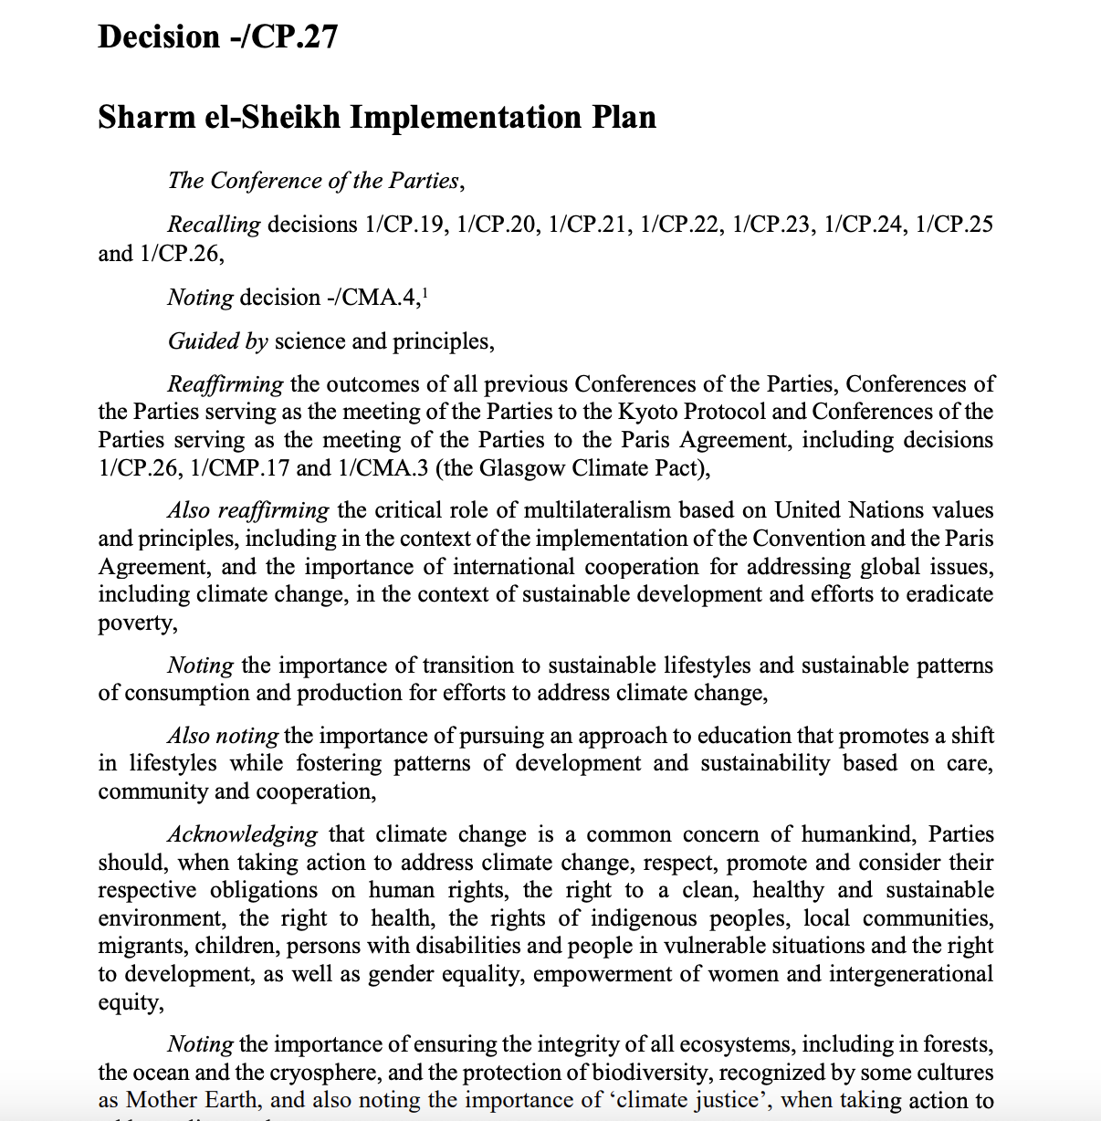
Reflections on COP 27 - Adaptation
Agreement on the setting up of a Loss and Damage Fund
Most parties were positive on the discussions on the Global Goal on Adaptation, but little movement by way of formal agreements and new funding.
The discussions outside the negotiations were vibrant, including the SA-led Adaptation dialogues in both the SA Pavilion and the China Pavilion

Slide 11
Strategic Approach for PCC on Adaptation
Knowledge Support – Climate RDI Roadmap
Building agency in Social Partners
Institutional Agency eg. Cities Support Project
Climate Resilience Development Pathways
Catalytic and co-ordinating Partner
Climate
Resilient
Development
Agency,
jobs and
Enterprises
Facilitate local and international partnerships
New CC empowering Protocols for Disaster Management
Accelerate implementation of NCCAS

Slide 12
Focus for 2023 – Adaptation
Launch of the PCC papers on the KZN Floods and the Gqeberha Drought focusing on Climate emergencies and preparedness.
Sectoral Climate Resilience -> Gap Analysis projects in 3 pivotal sectors : Agriculture, Water & Built Environment
Empowering the Just Urban Transition with a combination of the next phase of the Cities Support Programme
A special focus on Climate Resilience in Mpumalanga
Foundations work on Climate Adaptation resourcing
Developing International Adaptation Partnerships with ICCN Adaptation Working Group and the global Locally Led Adaptation Action Coalition

Slide 13
The PCC’s climate and transition finance role is built on addressing this challenge
Monitoring & evaluating capital flows
Mobilising climate finance
Enabling the flow of funds
Notes:
Monitoring
The PCC aims to strengthen climate finance monitoring efforts, aligning reporting with a transition taxonomy, expanding coverage across the private sector, and supporting climate budgeting and tagging to improve planning and decision making across the economy. This addresses all barriers to scaling up finance for transition, through informing gap analysis, solution design and evaluation of the efficacy of solutions.
Mobilising
The PCC aims to increase climate finance mobilization indirectly through the development of a Just Transition Fund (JTF); engagement with entities that can access climate finance from bilateral and multilateral sources; and creating awareness on best practice that could enable positive just transition outcomes. This addresses barriers created by market gaps.
Enabling
The PCC will use its consensus building approach and platform to create momentum within the financial sector to enable the just transition. Enabling greater climate finance flows that deliver a just transition may occur through support for policy, regulation, and legal processes; direct engagement with financial actors; and improvements in methodologies, frameworks, and policy documents. This addresses gaps in policy and regulation and misalignment in capital allocation to mobilise capital at scale through aligning policy objectives with returns to capital.

Slide 14
PCC Climate Finance Strategy and Plan
1. A coherent understanding and approach to Climate Finance: A PCC internal concept note to guide advice and endeavors to mobilize and scale up climate finance for mitigation and adaptation
2. A strategic plan to implement the PCC’s role in mobilizing and scaling up climate finance

Slide 15
Designing a Just Transition Financing Mechanism
1. The social and justice components of the just transition require special means to finance them
2. The existing financial ecosystem is not geared to provide resources to pure just transition programmes and projects
3. Adaptation finance is a challenge
4. Creative approaches are required to ensure that negative impacts of mitigation are ameliorated
for different options and trade-offs to meet both decarbonisation outcomes and economic development objectives

Slide 16
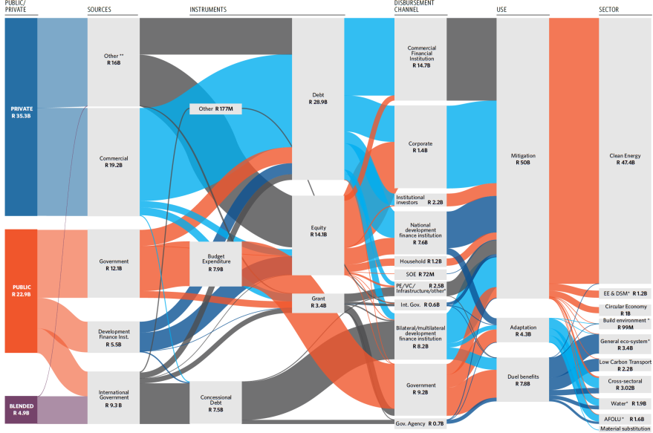
Climate finance Landscape and Tracking Flows
Approximately $2.4bn per year, mainly towards mitigation and clean energy (81%)
Adaptation makes up only 7% of funds, with a further 13% dual benefit.
Very limited contribution to just transition
Primarily debt, equity and concessional debt – limited grants
Historic scale of access inadequate for the scale of climate response
A biennial analysis of macro climate-related financial flows in South Africa tom inform future policy and climate-related interventions
Chart source: CPI, Green Cape et al, Climate-Finance-Landscape-2020

Slide 17
Outreach and Communications
SECTORAL CAMPAIGNS AND STAKEHOLDER RELATIONS
Development of Q1 Stakeholder Engagement Plan - Energy Plan, JET-IP and JTF Implementation
Mobilisation Campaign through Arts, Essays and Youth Engagement
Increased consultation of affected and impacted communities
WORKING WITH THE MEDIA
Media Engagement and Capacity Building Q1 of 2023
Capacity Building for Community Radio including targeted programmes co-funded with donors
DIGITAL MEDIA AND CONTENT DEVELOPMENT
Website and Digital Platforms Development ( FB, Twitter, Web, LinkIn .
Zero-Rating ( Data Free) content on platform to increase access to online engagements
Accessibility of PCC reports-local language translation
Raise awareness on the science of climate change; its impacts and the opportunities of a just transition .
Educate, inform and mobilize through outreach campaigns to ignite collective action .
Seek platforms to strengthen collaboration, in pursuit of building a national brand for climate action .
Share climate stories, produce credible science-based reports and promote climate initiatives.

Slide 18
Monitoring, Reporting & Accountability
Climate Change Bill will formalise legal status of PCC and institutionalise reporting and accountability
For time being, PCC reports to Presidency and Ministers for DFFE and DPME
PCC will report to Parliament on an annual basis via Minister DFFE, and PCC plans to be included in Minister’s budget speech
PCC annual report – April 2023
PCC is building systems to enable critical evaluation of progress with climate transition, and is collaborating with DFFE and DPME to avoid duplication of effort

Slide 19
Thank you
Email: thuli@climatecommission.org.za
For further information www.climatecommission.org.za

